Slide 1
Volume Rendering
Lecture 21

Slide 2
Acknowledgements
These slides are collected from many sources.
A particularly valuable source is the IEEE Visualization conference tutorials.
Sources from:
  Roger Crawfis, Klaus Engel, Markus Hadwiger, Joe Kniss, Aaron Lefohn, Daniel Weiskopf, Torsten Moeller, Raghu Machiraju, Han-Wei Shen and Ross Whitaker

Slide 3
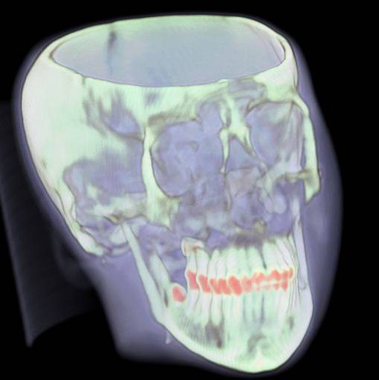
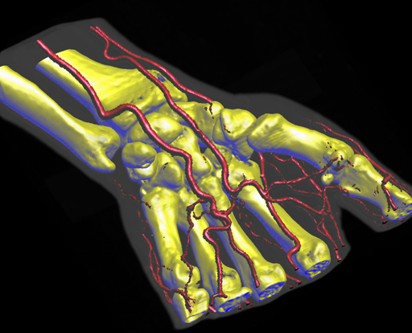
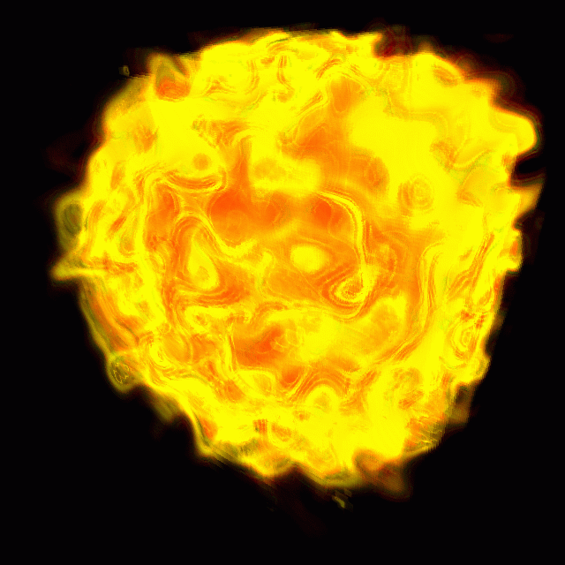
Visualization of Volumetric Data

Slide 4
Overview
Volume rendering refresher
  Rectilinear scalar fields
  Direct volume rendering and optical models
  Volume rendering integral
  Ray casting and alpha blending
Volume resampling on graphics hardware (part 1)
  Texture-based volume rendering
  Proxy geometry
  2D textured slices

Slide 5
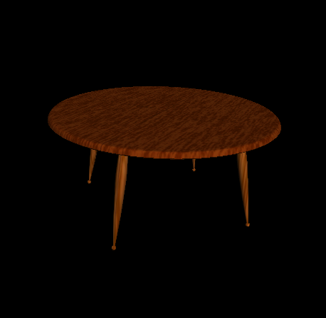
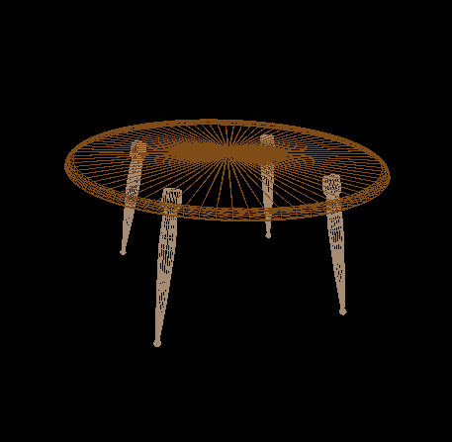
Surface Graphics
Traditionally, graphics objects are modeled with surface primitives (surface graphics).
Continuous in object space

Slide 6
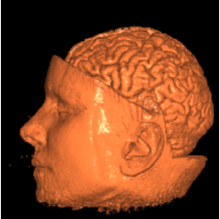
Difficulty with Surface Graphics
Volumetric object handling
  gases, fire, smoke, clouds (amorphous data)
  sampled data sets (MRI, CT, scientific)
Peeling, cutting, sculpting
  any operation that exposes
  the interior

Slide 7
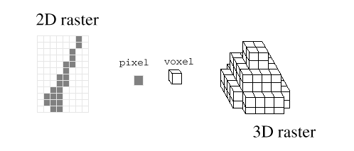
Volume Graphics
Typically defines objects on a 3D raster, or discrete grid in object space
Raster grids: structured or unstructured
Data sets: sampled, computed, or voxelized
Peeling, cutting … are easy with a volume model

Slide 8
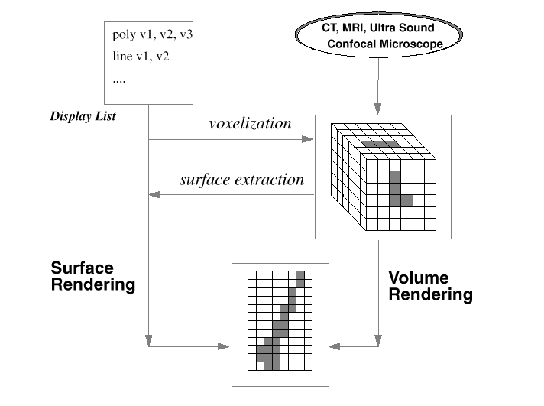
Volume Graphics & Surface Graphics

Slide 9
Volume Graphics - Cons
Disadvantages:
  Large memory and processing power
  Object- space aliasing
  Discrete transformations
  Notion of objects is different

Slide 10
Volume Graphics - Pros
Advantages:
  Required for sampled data and amorphous phenomena
  Insensitive to scene complexity
  Insensitive to surface type
  Allows block operations

Slide 11
Volume Graphics Applications (simulation data set)
Scientific data set visualization

Slide 12
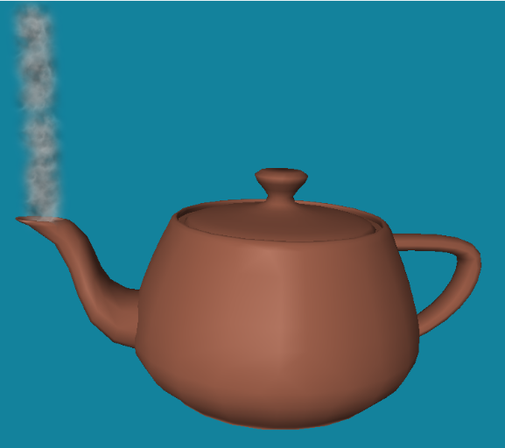
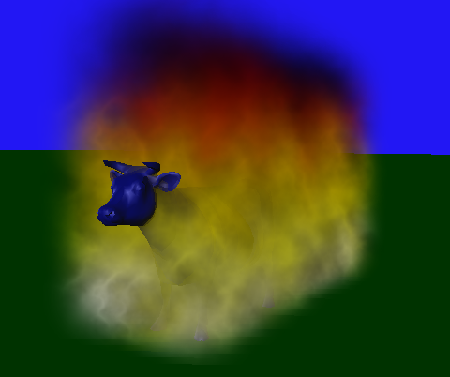
More Volume Graphics Applications (artistic data set)
Amorphous entity visualization
  smoke, steam, fire

Slide 13
Volume Rendering Algorithms
Intermediate geometry based (marching cube)
Direct volume rendering
  Splatting (forward projection)
  Ray Casting (backward projection) or resampling
  Cell Projection / scan-conversion
  Image warping

Slide 14
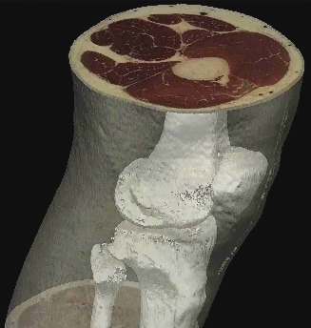
How to visualize?
slice
Slicing: display the volume data, mapped to colors, along a slice plane
Iso-surfacing: generate opaque and semi-opaque surfaces on the fly
Transparency effects: volume material attenuates reflected or emitted light
Semi-transparent
material
Iso-surface

Slide 15
Overview
Volume rendering refresher
  Rectilinear scalar fields
  Direct volume rendering and optical models
  Volume rendering integral
  Ray casting and alpha blending
Volume resampling on graphics hardware (part 1)
  Texture-based volume rendering
  Proxy geometry
  2D textured slices

Slide 16
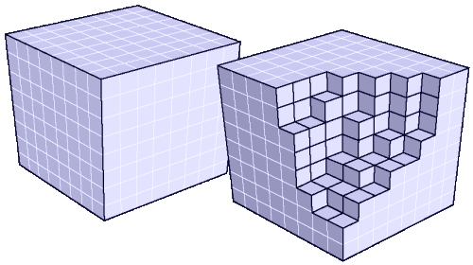
Volume Data
Continuous scalar field in 3D
Discrete volume:
voxels
Sampling
Reconstruction

Slide 17
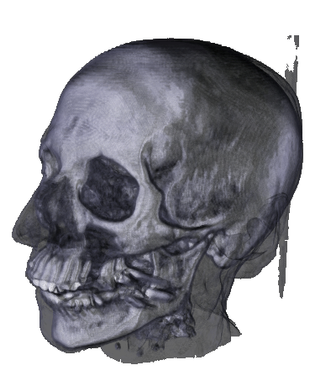
Direct Volume Rendering
Render volume without extracting any surfaces (DVR)
Map scalar values to optical properties
(color, opacity)
Need optical model
Solve volume rendering
integral for viewing rays
into the volume

Slide 18
Direct Rendering Pipeline I
Detection of Structures
Shading
Reconstruct (interpolate/filter) color/opacity
Composite
Final Image Validation (change parameters)

Slide 19
Direct Rendering Pipeline
Classify
Shade
Reconstruct
Visibility
order
Composite
Validate

Slide 20
Early Methods
Before 1988
Did not consider transparency
did not consider sophisticated light transportation theory
were concerned with quick solutions
hence more or less applied to binary data

Slide 21
Back-To-Front - Frieder et al 1985
A viewing algorithm that traverses and renders the scene objects in order of decreasing distance from the observer.
Maybe derived from a standard -
“Painters Algorithm”
1.
2.
3.

Slide 22
Back-To-Front - Frieder et al 1985
2D
  Start traversal at point farthest from the observer,
  2 orders
  Either x or y can be innermost loop
  If x is innermost, display order will be A, C, B, D
  If y is innermost, display order will be C, A, D, B
  Both result in the correct image!
  If voxel (x,y) is (partially) obscured by voxel (x’,y’), then x <= x’ and y <= y’. So project (x,y) before (x’,y’) and the image will be correct

Slide 23
Back-To-Front - Frieder et al 1985
3D
  Axis traversal can still be done arbitrarily, 8 orders
  Data can be read and rendered as slices
  Note: voxel projection is NOT in order of strictly decreasing distance, so this is not the painter’s algorithm.
  Perspective?

Slide 24
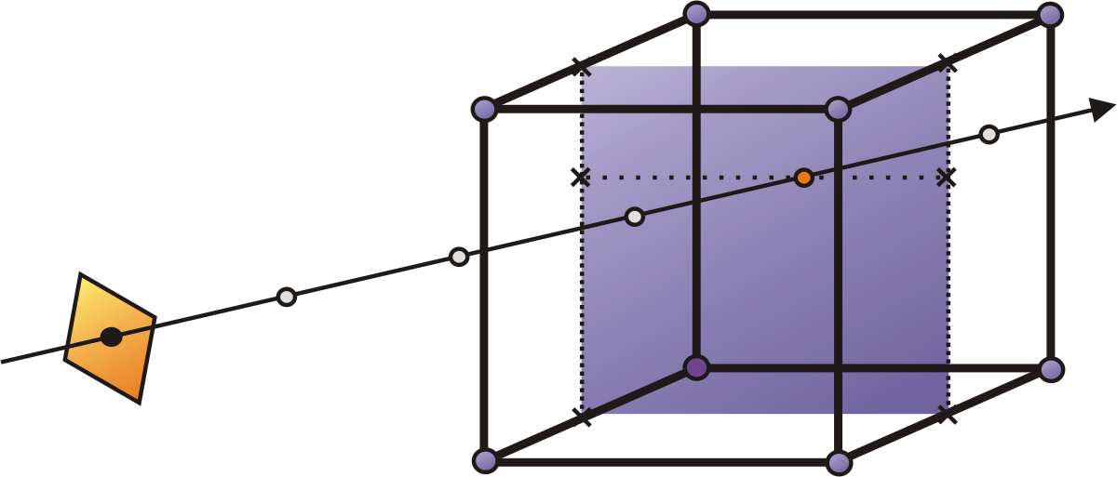
Ray Casting
Goal: numerical approximation of the volume rendering integral
Resample volume at equispaced locations along the ray
Reconstruct at continuous
location via tri-linear
interpolation
Approximate integral

Slide 25
Ray Tracing
“another” typical method from traditional graphics
Typically we only deal with primary rays -
hence: ray-casting
a natural image-order technique
as opposed to surface graphics - how do we calculate the ray/surface intersection???
Since we have no surfaces - we need to carefully step through the volume

Slide 26
Ray Casting
Since we have no surfaces - we need to carefully step through the volume: a ray is cast into the volume, sampling the volume at certain intervals
The sampling intervals are usually equi-distant, but don’t have to be (e.g. importance sampling)
At each sampling location, a sample is interpolated / reconstructed from the grid voxels
popular filters are: nearest neighbor (box), trilinear (tent), Gaussian, cubic spline
Along the ray - what are we looking for?

Slide 27
Basic Idea of Ray-casting Pipeline
Data are defined at the corners
of each cell (voxel)
The data value inside the
voxel is determined using
interpolation (e.g. tri-linear)
Composite colors and opacities
along the ray path
Can use other ray-traversal schemes as well
c1
c2
c3

Slide 28
Evaluation = Compositing
“over” operator - Porter & Duff 1984

Slide 29
Compositing: Over Operator
cf = (0,1,0)
af = 0.4
c = af*cf + (1 - af)*ab*cb
a = af + (1 - af)*ab
cb = (1,0,0)
ab = 0.9
c = (0.54,0.4,0)
a = 0.94

Slide 30
Volumetric Ray Integration
color
opacity
1.0
object (color, opacity)

Slide 31
Interpolation
Closest value
Weighted average

Slide 32
Tri-Linear Interpolation

Slide 33
Interpolation Kernels
volumetric compositing
color
opacity
1.0
object (color, opacity)

Slide 34
Interpolation Kernels
interpolation kernel
volumetric compositing
color
opacity
color c = c _{s} α_{s}(1 - α) + c
opacity α = α _{s} (1 - α) + α
1.0
object (color, opacity)

Slide 35
Interpolation Kernels
interpolation kernel
volumetric compositing
color
opacity
1.0
object (color, opacity)

Slide 36
Interpolation Kernels
volumetric compositing
color
opacity
1.0
object (color, opacity)

Slide 37
Interpolation Kernels
volumetric compositing
color
opacity
1.0
object (color, opacity)

Slide 38
Interpolation Kernels
volumetric compositing
color
opacity
1.0
object (color, opacity)

Slide 39
Interpolation Kernels
volumetric compositing
color
opacity
1.0
object (color, opacity)

Slide 40
Interpolation Kernels
volumetric compositing
color
opacity
object (color, opacity)

Slide 41
Levoy - Pipeline
Acquired values
Data preparation
Prepared values
shading
classification
Voxel colors
Voxel opacities
Ray-tracing / resampling
Ray-tracing / resampling
Sample colors
Sample opacities
compositing
Image Pixels

Slide 42
Ray Marching
Use a 3D DDA algorithm to step through regular or rectilinear grids.

Slide 43
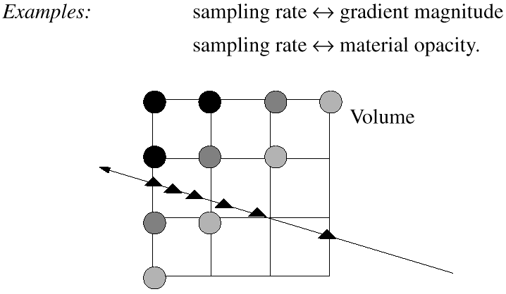
Adaptive Ray Sampling
[Hanrahan et al 92]
Sampling rate is adjusted to the significance of the traversed data

Slide 44
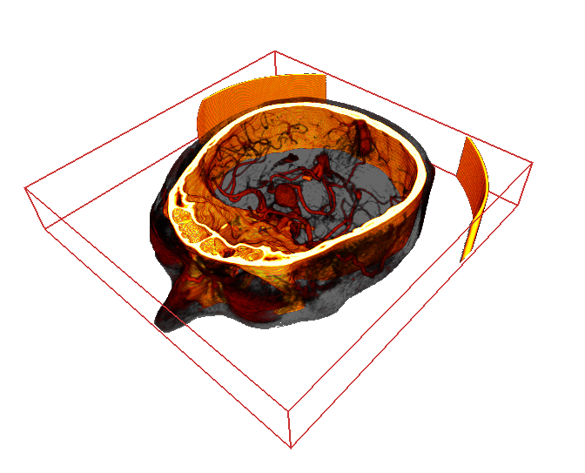
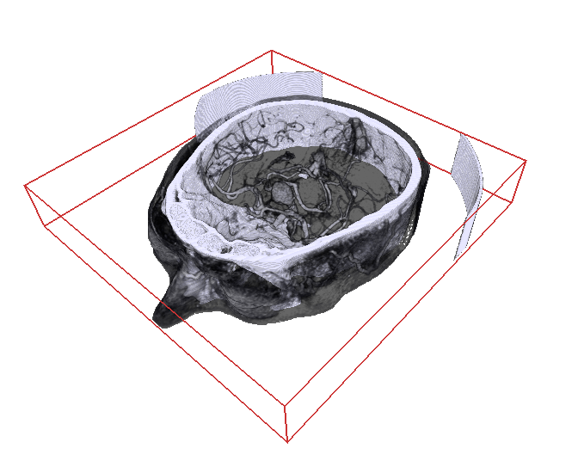
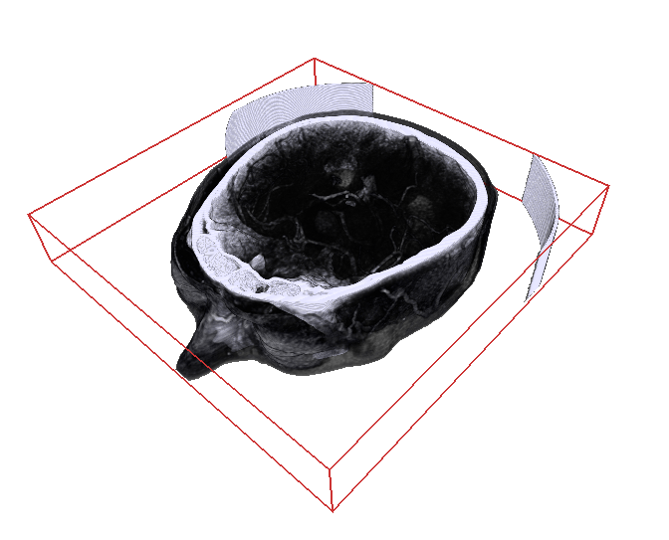
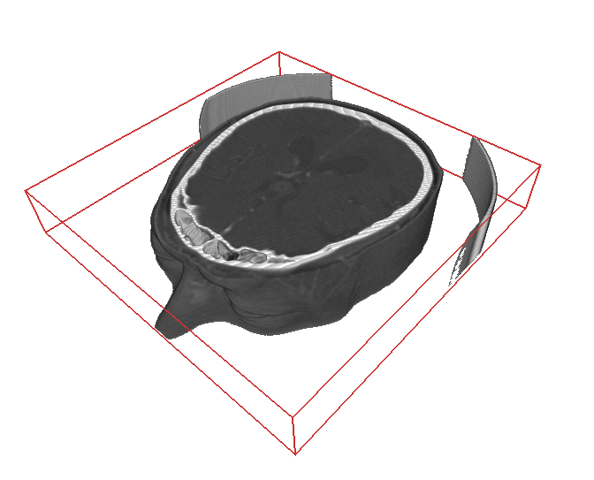
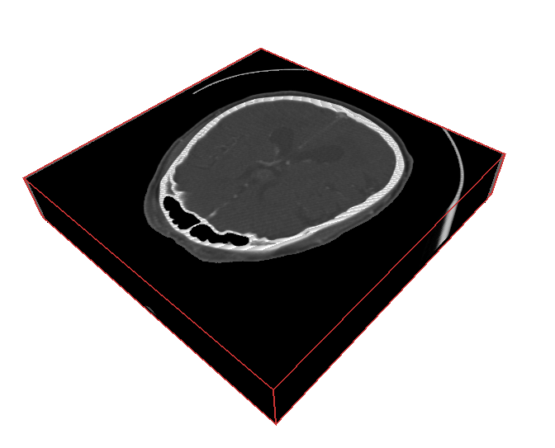
Classification
How do we obtain the emission and absorption values?
scalar value s
T(s)
emission RGB
absorption A

Slide 45
Ray Traversal Schemes
Intensity
Max
Average
Accumulate
First
Depth

Slide 46
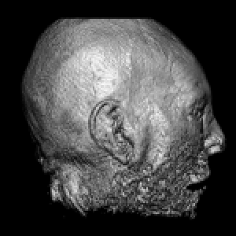
Ray Traversal - First
Intensity
First
Depth
First: extracts iso-surfaces (again!)
done by Tuy&Tuy ’84

Slide 47
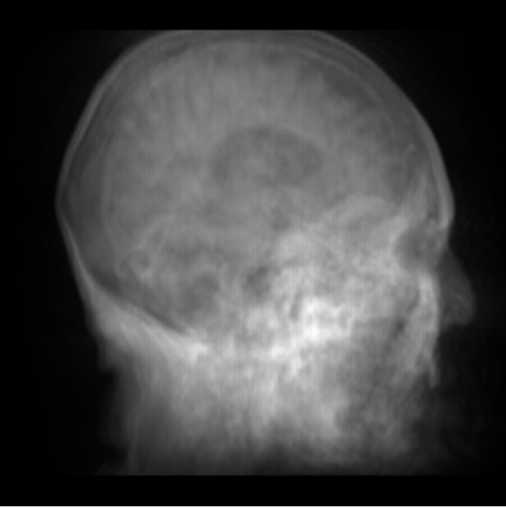
Ray Traversal - Average
Intensity
Average
Depth
Average: produces basically an X-ray picture

Slide 48
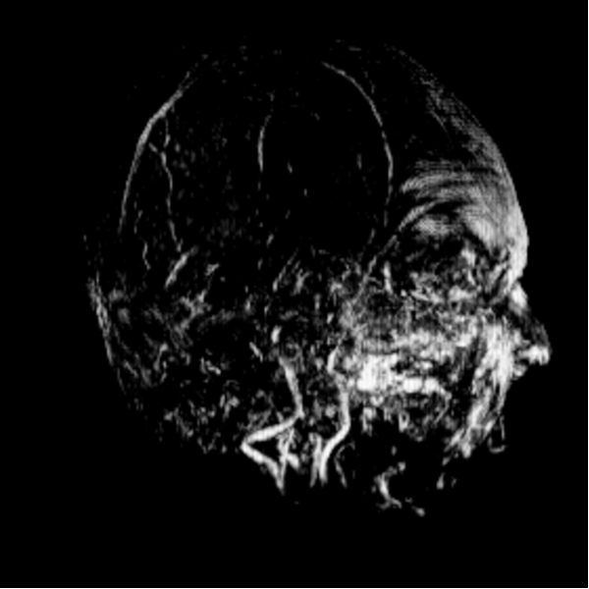
Ray Traversal - MIP
Intensity
Max
Depth
Max: Maximum Intensity Projection
used for Magnetic Resonance Angiogram

Slide 49
Maximum Intensity Projection (1)
No emission or absorption
Pixel value is maximum scalar value along the viewing ray
Advantage: no transfer function required
Drawback: misleading depth information
Works well for MRI data (esp. angiography)
Maximum S_{max}
Scalar value S
s₀
s
ray

Slide 50
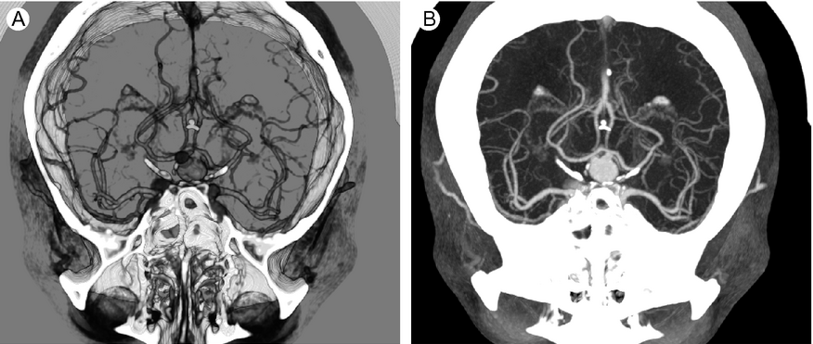
Maximum Intensity Projection (2)
Emission/Absorption
MIP

Slide 51
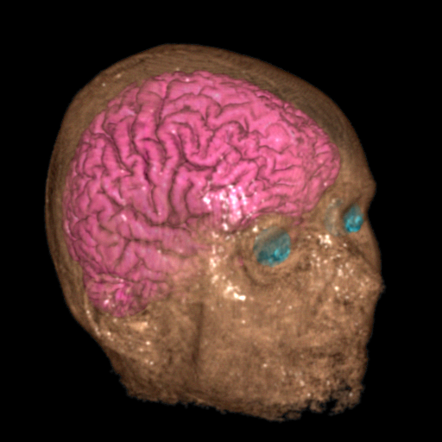
Ray Traversal - Accumulate
Intensity
Accumulate
Depth
Accumulate: make transparent layers visible!
Levoy ‘88

Slide 52

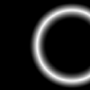
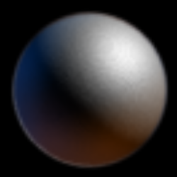
Transfer function
v = f (x)
“ here’s
the edge ”
v
0
x
α
v
v
0

