Slide 1
Procedural Content Tiling
CSE 788
Prof. Roger Crawfis

Slide 2
Seamless Tiling

Slide 3
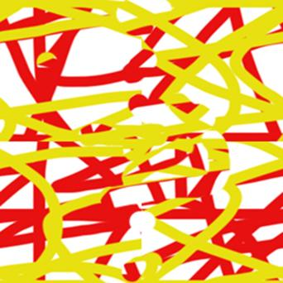
Seamless Tiling
Where is the seam?
http://homepages.rpi.edu/~mcdanm2/RPI_MediaStudioImaging/MSI_Lecture4_Graffiti.html

Slide 4
Rotations and Edges

Slide 5
Simple patterns
16 tiles from Li-Yi Wei (SIGGRAPH 2004)
Two choices, either
Solid yellow edge
Blue in middle
2⁴ Tiles

Slide 6
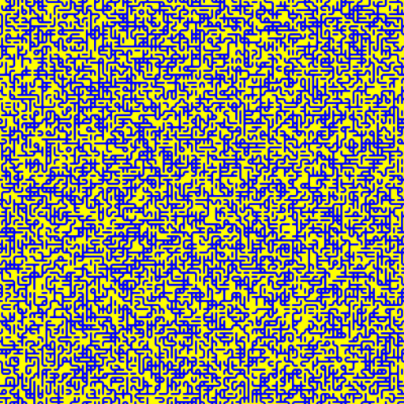
Simple Tiles
Randomly selecting tiles.

Slide 7
What is a tessellation?
If many copies of a shape can be used to cover a surface, without leaving any gaps between them, then we say that the shape will tessellate.
The pattern that is formed is called a tessellation.
Simply put: A tessellation is like a puzzle that repeats a particular pattern.
For example:
Notes:
Read…. To students….
Click anywhere when finished...

Slide 8
They appear in nature
Honeycombs...
Mud flats?
Notes:
Read headings…
Click when slide finishes...

Slide 9
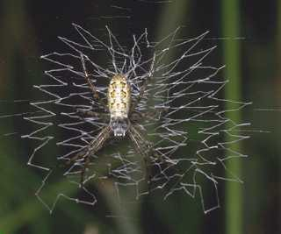
Tessellations in Nature
snake skin
spider web
armadillo armor

Slide 10
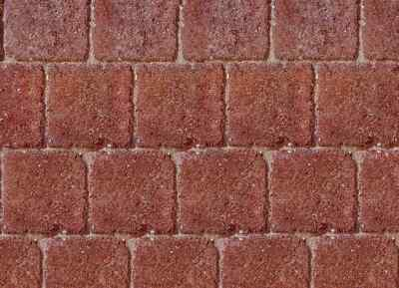
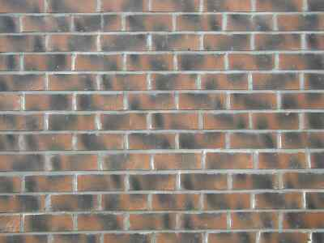
Human Tessellations
Look for tessellations in walls, patios and pavements.

Slide 11
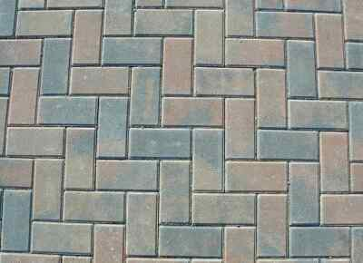
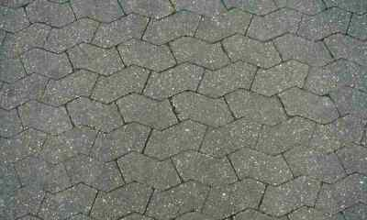
Human Tessellations
Common shapes can be arranged in unusual ways
Sometimes an unusual shape will tessellate

Slide 12
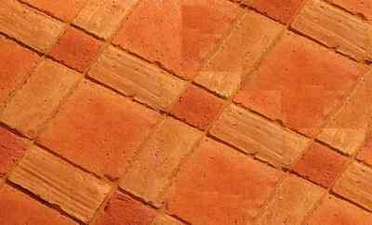
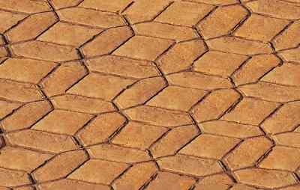
Human Tesselations
Sometimes 2 or more different shapes will tessellate.

Slide 13
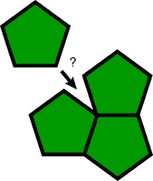
Regular Tessellations
A regular polygon tessellation is constructed from regular polygons.
Regular polygons have equal sides and equal angles.
The regular polygons must fill the plane at each vertex, with repeating patterns and no overlapping pieces.
Note: this pentagon does not fit into the vertex… therefore it is not a regular tessellation.
Notes:
Read to students…
Note... links for student presentation..
Two links take you to internet...
Polygon examples and Regular polygon examples
Important concept… filling the vertex...
click when completed...

Slide 14
Regular tiling
Which other regular polygons do you think can tile the plane?

Slide 15
Triangles
A Regular triangle would be an equilateral.
How many triangles to make 1 complete rotation?
The interior angle of every equilateral triangle is 60º. If we sum the angles around a vertex, we get 60º + 60º + 60º + 60º + 60º + 60º = 360º

Slide 16
Pentagons
The interior angle of a pentagon is 108º, and 108º + 108º + 108º = 324º.
Can not get to 360º.

Slide 17
Hexagons
The interior angle is 120º
120º + 120º + 120º = 360º.

Slide 18
Heptagons and Octagons
Not without getting overlaps.
In fact, all polygons with more than six sides will overlap.

Slide 19
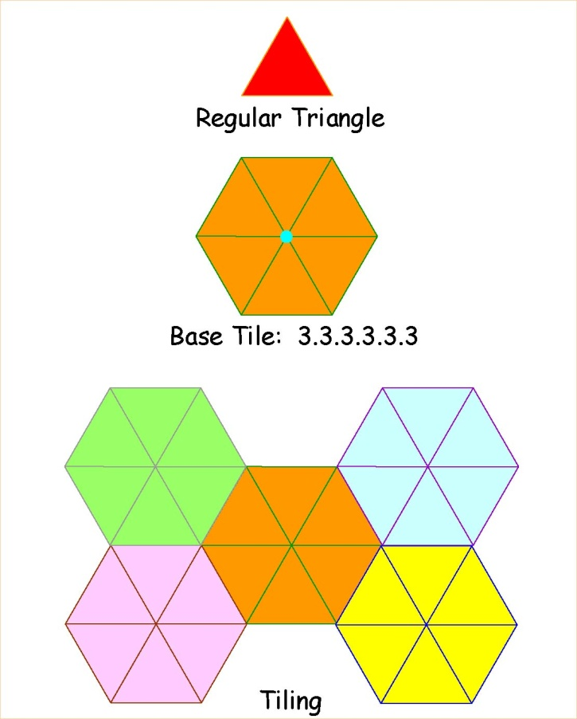
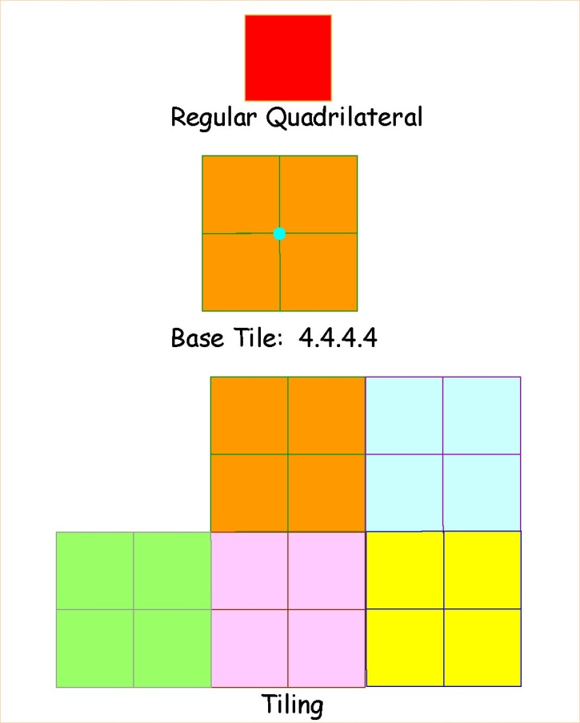
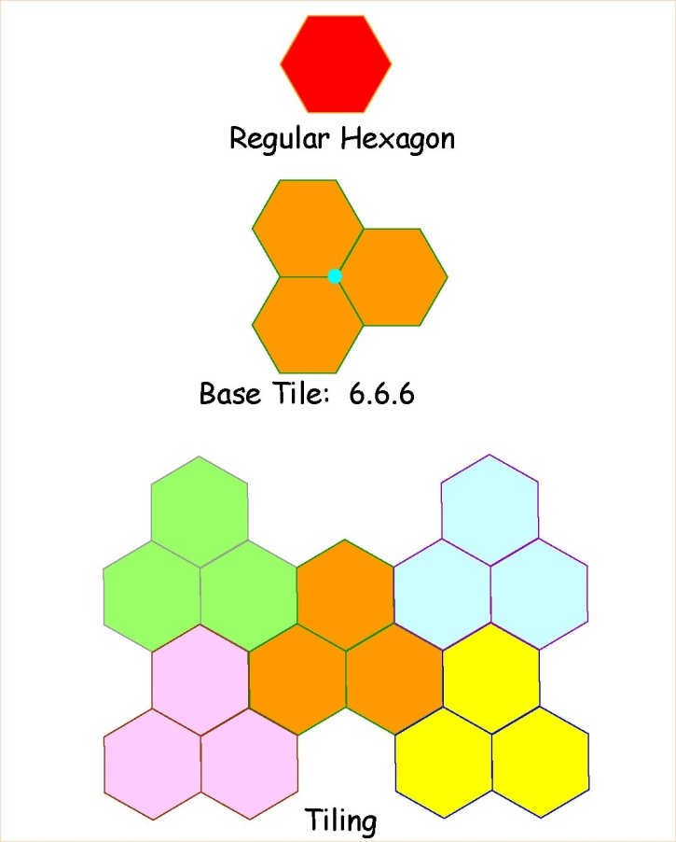
Regular tilings
The only regular polygons that tessellate the plane are triangles, squares and hexagons.

Slide 20
Other Tessellations
vertex
The plane is not filled at the vertex, because there is space left over.
space
Notes:
Read slide…
Space at vertex should be noted.
click when completed...

Slide 21
Tesselation modifications
Once we have a regular polygon tessellation, we can change / deform it using “alterations” to the sides of the polygon.
These alterations are called transformations.
Translation
Reflection
Rotation

Slide 22
Translations - a slide
Translation is a slide of one side of the polygon.
this side
the alteration
moves here
Notes:
Translations…..
click when completed...

Slide 23
Reflections - mirror images
Reflection is a flip or mirror image of one side of the polygon.
the alteration
flips
here
Notes:
Reflections…..
Go through with audience….
Demo on board… check audience for correctness.

Slide 24
Rotations - turns
Rotation is a turn of a side around one vertex of the polygon
the alteration
here
rotates around
this vertex

Slide 25
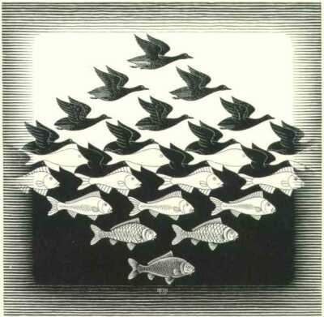
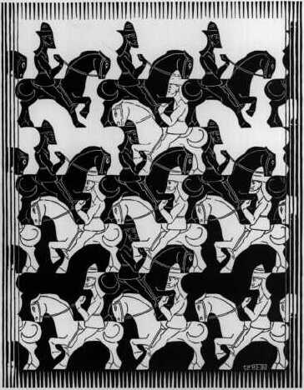
Tessellations by M.C. Escher

Slide 26
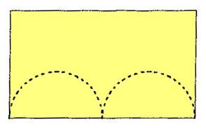
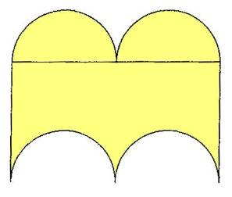
Make Your Own Escher Tessellations
Step 1: Start with a simple shape that will tessellate e.g. a rectangle.
Step 2: Remove a shape or shapes from one side of the rectangle and fix them to the opposite side.

Slide 27
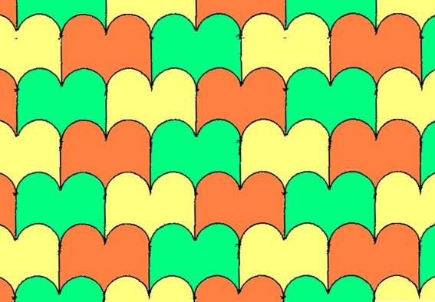
Make Your Own Escher Tessellations
Use this as a template to create your tessellation.

Slide 28
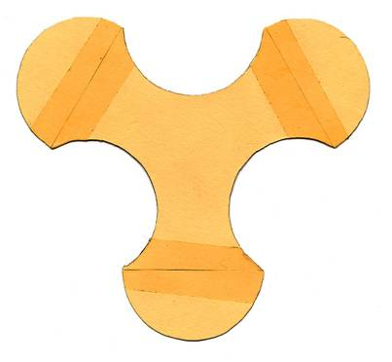
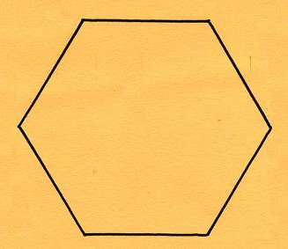
Make Your Own Tessellations
You could start with a hexagon and cut semi-circles from three of the sides and fix them to the opposite sides like this.

Slide 29
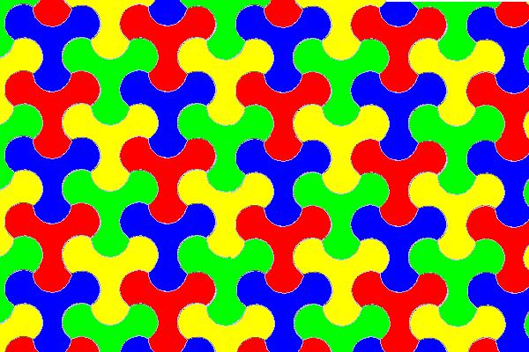
Make Your Own Tessellations

Slide 30
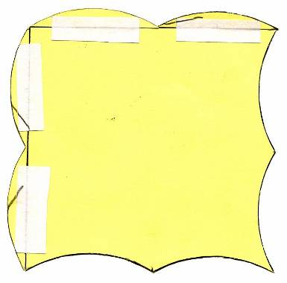
Making Tessellations
Start with a square and cut segments from two sides and fix them to the opposite sides like this.

Slide 31
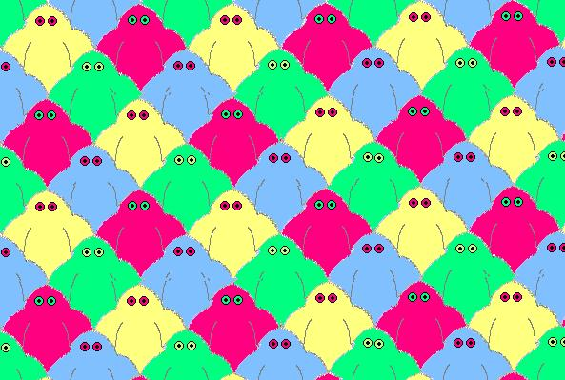
Making Tessellations

Slide 32
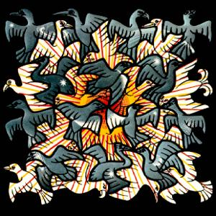
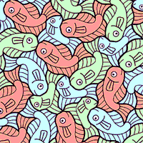
Professional Tessellations
Sun and Moon
M.C. Escher
Fish
Robert Ingalls
Many artists have created master works of art using the simple rules of tessellations.
M.C. Escher and Robert Ingalls are among many tessellation artists.

Slide 33
Having Fun
First create a tessellating template.
Step 1: using grid paper cut out a perfect square.
Step 2: with a pencil make a line on two adjacent sides of the square. Be sure not to draw through a corner.
Step 3: cut out the pieces and attach them with tape to the opposite sides from where they came.
You have now created your tessellation template.

Slide 34
Seeing a Figure
Looking at your tessellation template, study the sides and the shape to decide what sort of figure you might see.
The person who designed this form saw an elephant and an elf.
Are there any other different forms that you might see?
When looking for the shape be sure not to see too much detail as it can make the art work too crowded.

Slide 35
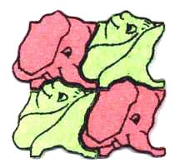
Putting It All Together
Take your tessellation template and trace it on to a piece of paper.
When tracing you can use different types of symmetry to change your picture.
Be sure that your whole page is filled with a repeating pattern.
Color in your picture creatively.
Elephants
Translation symmetry
Elves and Elephants
Combinations of symmetry

Slide 36
Seamless Textures
Rather than deforming the edges, let’s use a regular grid and ensure (or deform) the colors to keep them consistent.

Slide 37
Translate
Shift the texture over by half of its width.
This pushes the middle to the right edge.
Wrap the texels that went off the edge around.
Clean up the middle.

Slide 38
Mirror
Flip about the y axis and merge.
Flip the merged about the x axis and merge again.
Repaint the interior if needed.

Slide 39
Texture Replacement
A huge & important literature
but I can only briefly touch it here

Slide 40
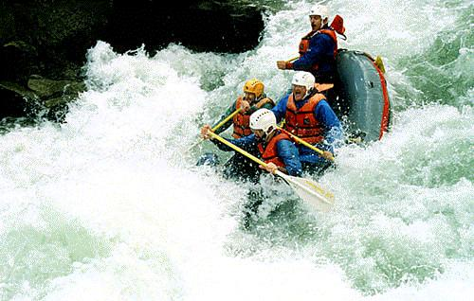
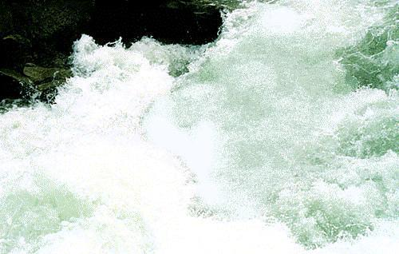
Image Editing

Slide 41
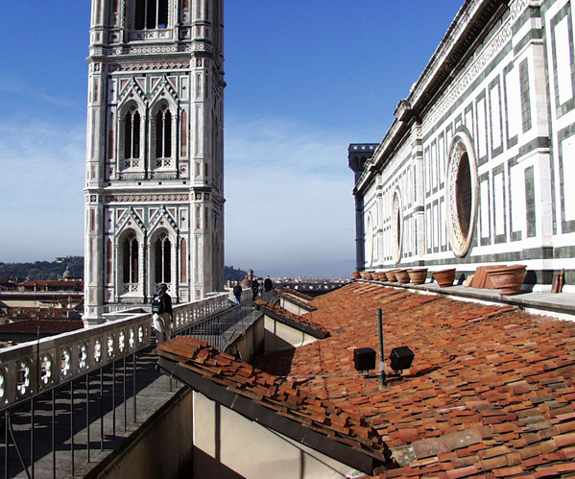
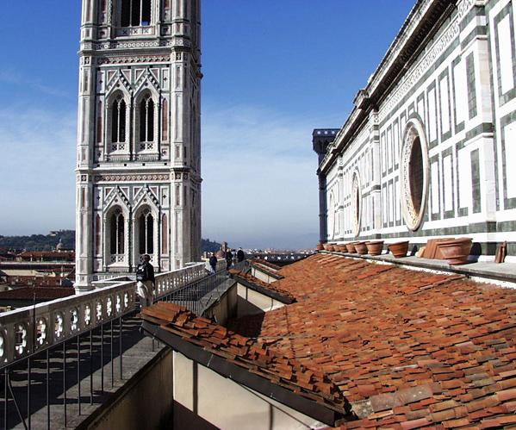
Artifact Removal

Slide 42
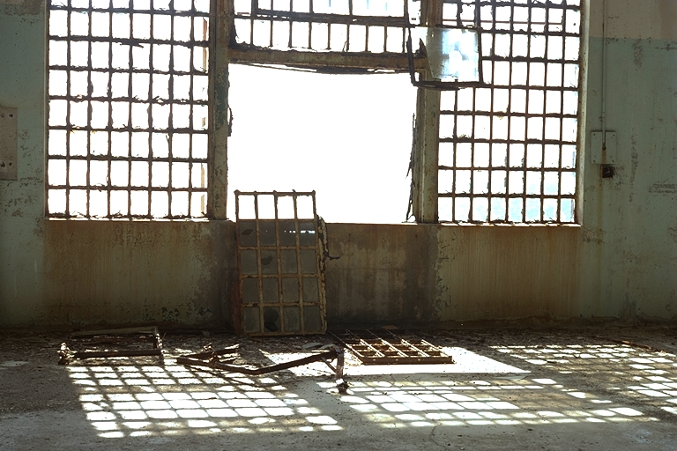
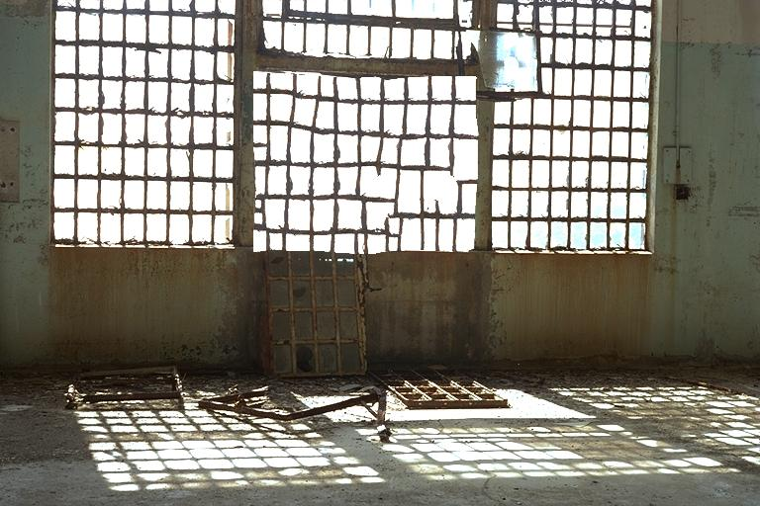
Detail Hallucination
Alcatraz

Slide 43
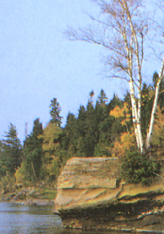
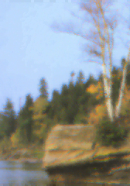
Image analogies [Hertzmann et al 2001] Control Map from Input Images
Simple Blur
?
:
::
:
A
Control map
A’
B
Control map
B’

Slide 44
Image analogies
Artistic Styles
?
:
::
:
A
Control map
A’
B
Control map
B’

Slide 45
Image analogies
Goal: Match conditional image statistics
:
::
A
A’
:
B
B’

Slide 46
Synthesis
:
::
A
A’
:
B
B’

Slide 47
Texture-by-numbers
:
A
control map
A’

Slide 48
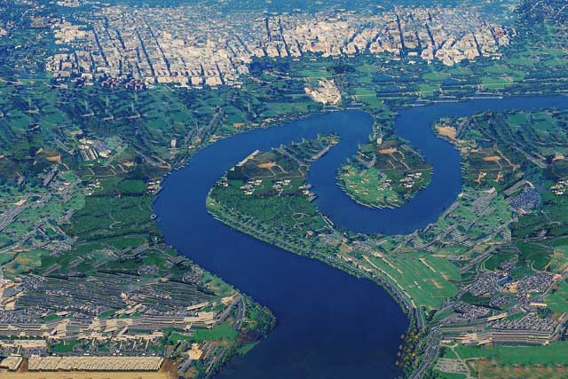
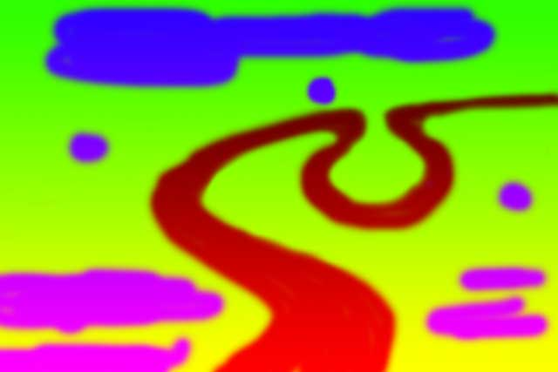
Texture-by-numbers
::
:
B
Control map
B’

Slide 49
Efros & Freeman 2001 Control Map from Target Color
+
=
parmesan
rice
+
=

Slide 50
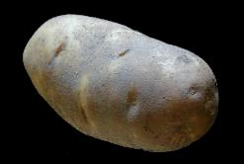
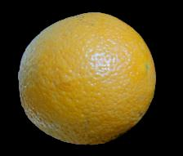
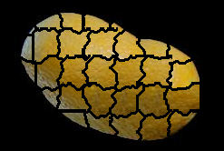
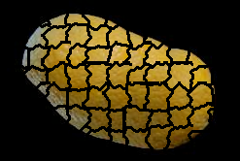
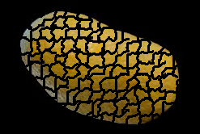
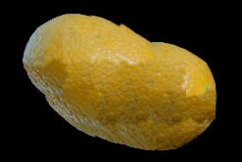
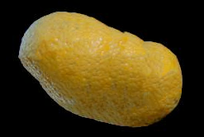
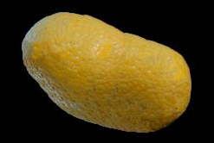
+
=

Slide 51
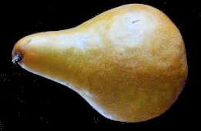
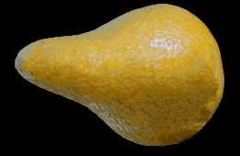
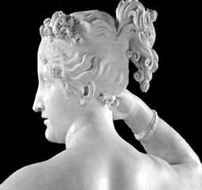
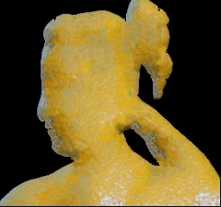
+
=

Slide 52
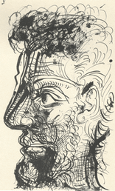
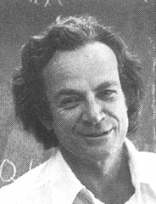
Source
texture
Target image
Source
correspondence
image
Target
correspondence image

Slide 53
+
=

