Slide 1
Volume Rendering
Lecture 21

Slide 2
Acknowledgements
These slides are collected from many sources.
A particularly valuable source is the IEEE Visualization conference tutorials.
Sources from:
Roger Crawfis, Klaus Engel, Markus Hadwiger, Joe Kniss, Aaron Lefohn, Daniel Weiskopf, Torsten Moeller, Raghu Machiraju, Han-Wei Shen and Ross Whitaker

Slide 3
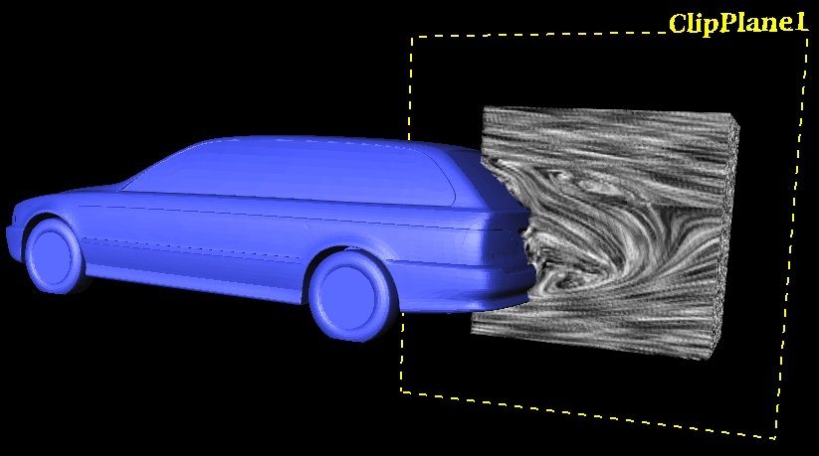
Visualization of Volumetric Data
Direct volume rendering of scalar fields
Flow visualization in 3D
Focus on regular grids

Slide 4
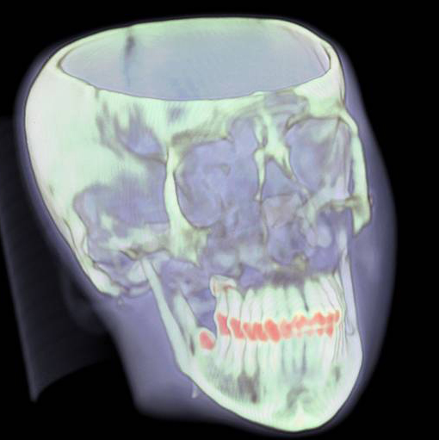
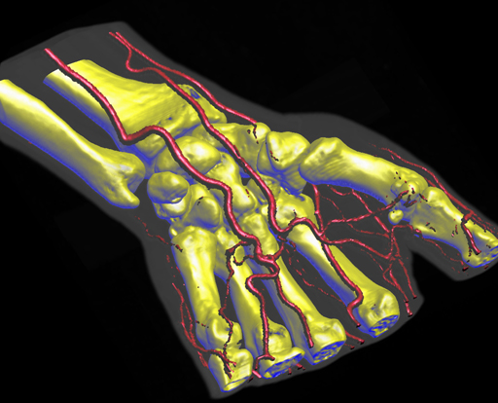
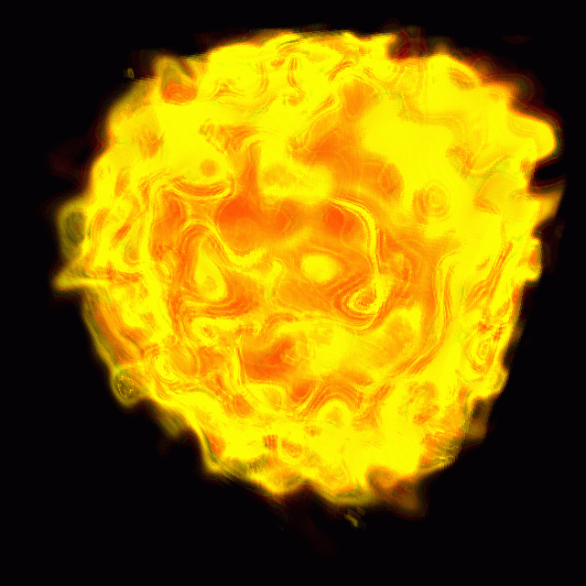
Visualization of Volumetric Data

Slide 5
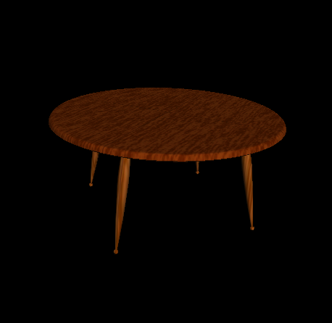
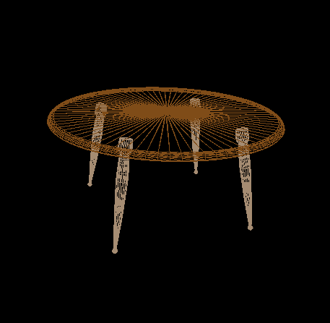
Surface Graphics
Traditionally, graphics objects are modeled with surface primitives (surface graphics).
Continuous in object space

Slide 6
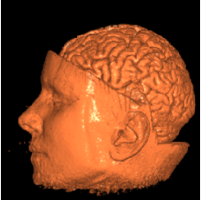
Difficulty with Surface Graphics
Volumetric object handling
gases, fire, smoke, clouds (amorphous data)
sampled data sets (MRI, CT, scientific)
Peeling, cutting, sculpting
any operation that exposes the interior

Slide 7
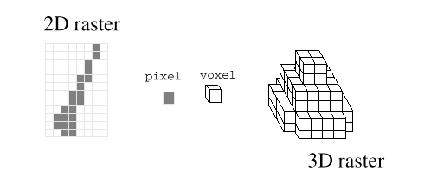
Volume Graphics
Defines objects on a 3D raster, or discrete grid in object space
Raster grids: structured or unstructured
Data sets: sampled, computed, or voxelized
Peeling,cutting … are easy with a volume model

Slide 8
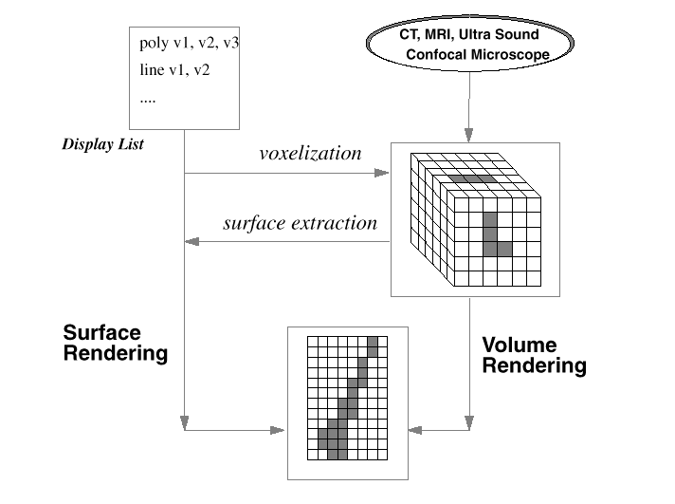
Volume Graphics & Surface Graphics

Slide 9
Volume Graphics - Cons
Disadvantages:
Large memory and processing power
Object- space aliasing
Discrete transformations
Notion of objects is different

Slide 10
Volume Graphics - Pros
Advantages:
Required for sampled data and amorphous phenomena
Insensitive to scene complexity
Insensitive to surface type
Allows block operations

Slide 11
Volume Graphics Applications (simulation data set)
Scientific data set visualization

Slide 12
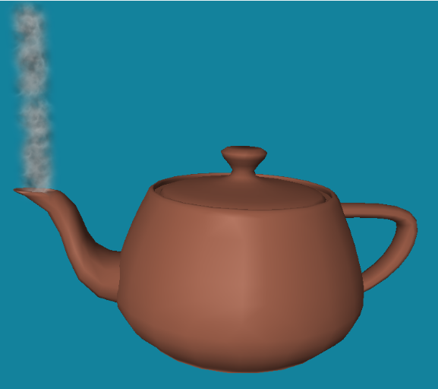
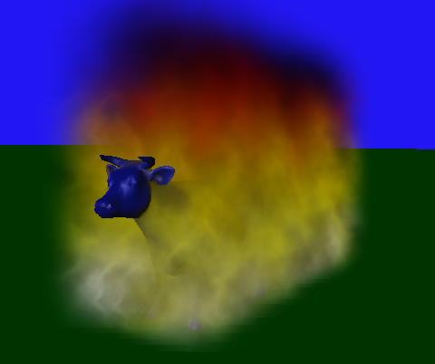
More Volume Graphics Applications (artistic data set)
Amorphous entity visualization
smoke, steam, fire

Slide 13
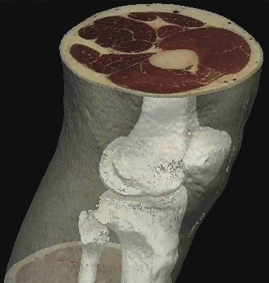
How to visualize?
slice
Slicing: display the volume data, mapped to colors, along a slice plane
Iso-surfacing: generate opaque and semi-opaque surfaces on the fly
Transparency effects: volume material attenuates reflected or emitted light
Semi-transparent material
Iso-surface

Slide 14
Volume Data
Continuous scalar field in 3D
Discrete volume: voxels
Sampling
Reconstruction

Slide 15
Direct Volume Rendering
Render volume without extracting any surfaces (DVR)
Map scalar values to optical properties (color, opacity)
Need optical model
Solve volume rendering integral for viewing rays into the volume

Slide 16
Direct Rendering Pipeline I
Detection of Structures
Shading
Reconstruct (interpolate/filter) color/opacity
Composite
Final Image Validation (change parameters)

Slide 17
Direct Rendering Pipeline
Classify Shade
Reconstruct
Visibility order
Composite
Validate

Slide 18
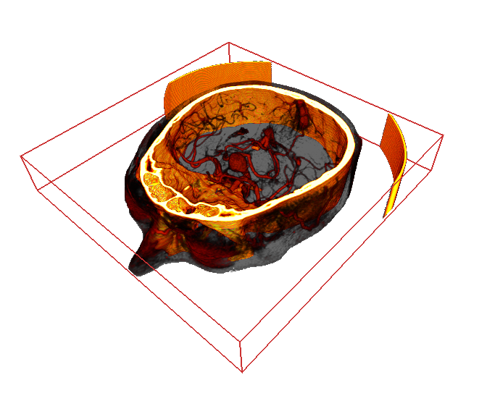
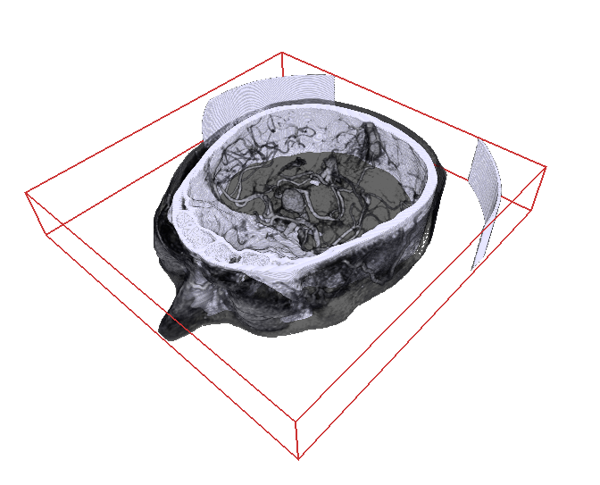
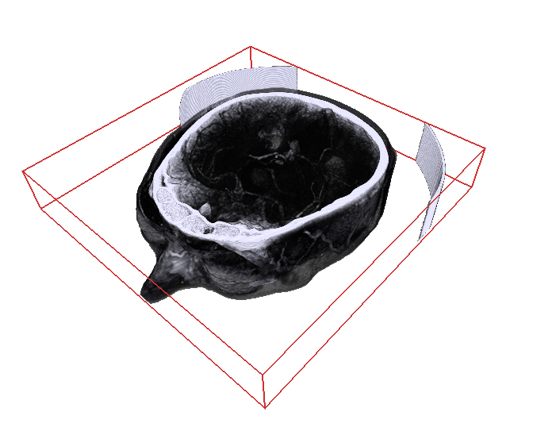
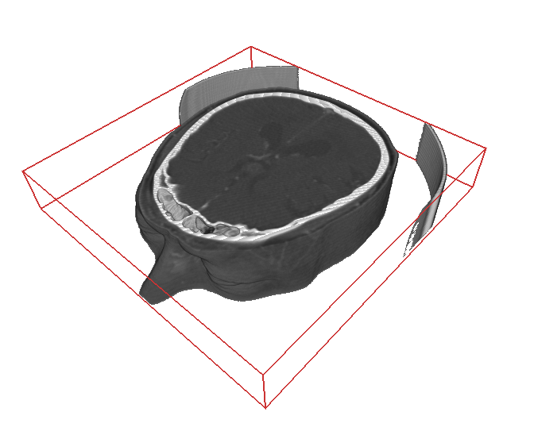
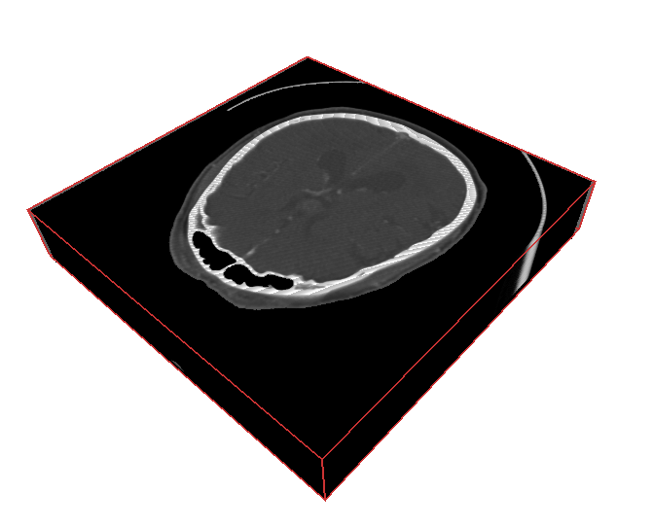
Classification
How do we obtain the emission and absorption values?
scalar value s
T(s)
emission RGB
absorption A

Slide 19
Ray Traversal Schemes
Intensity
Max
Average
Accumulate
First
Depth

Slide 20
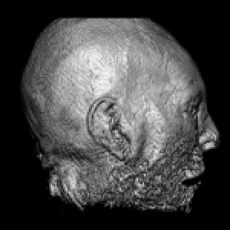
Ray Traversal - First
Intensity
First
Depth
First: extracts iso-surfaces (again!) done by Tuy&Tuy ’84

Slide 21
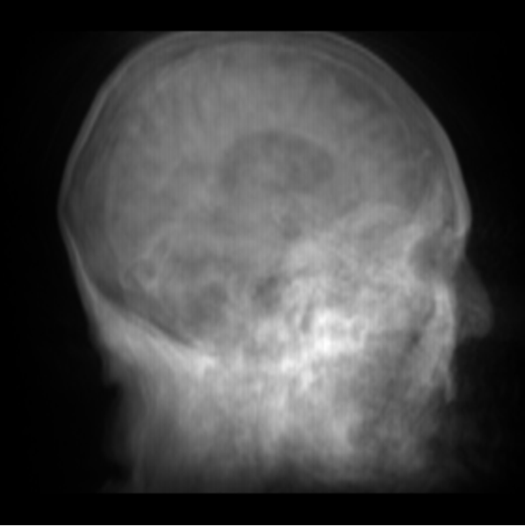
Ray Traversal - Average
Intensity
Average
Depth
Average: produces basically an X-ray picture

Slide 22
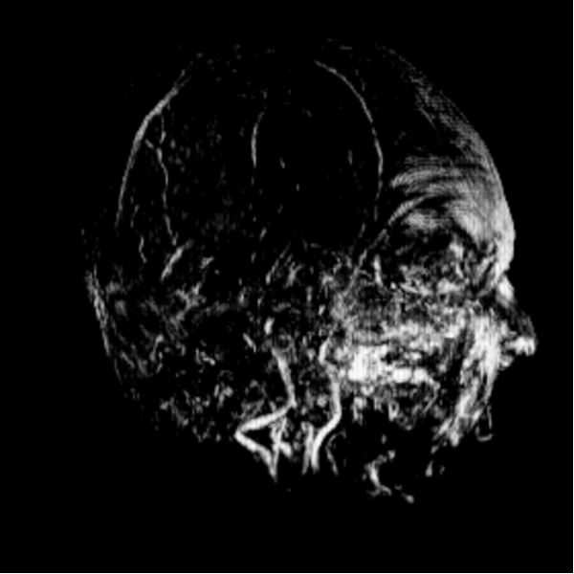
Ray Traversal - MIP
Intensity
Max
Depth
Max: Maximum Intensity Projection used for Magnetic Resonance Angiogram

Slide 23
Maximum Intensity Projection (1)
No emission or absorption
Pixel value is maximum scalar value along the viewing ray
Advantage: no transfer function required
Drawback: misleading depth information
Works well for MRI data (esp. angiography)
Maximum S_{max}
Scalar value S
s₀
s
ray

Slide 24
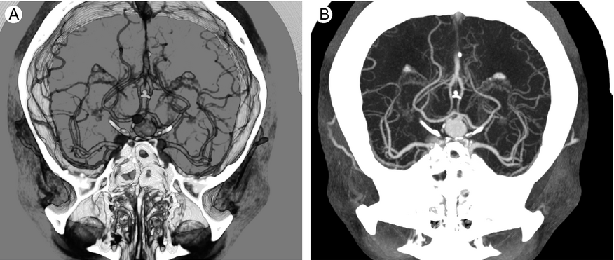
Maximum Intensity Projection (2)
Emission/Absorption
MIP

Slide 25
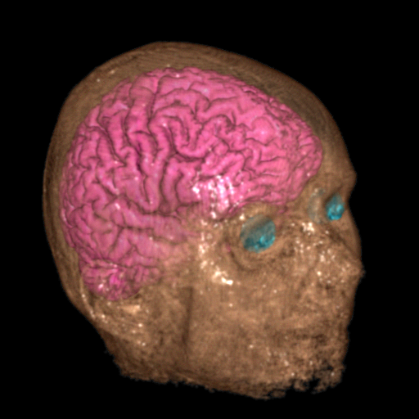
Ray Traversal - Accumulate
Intensity
Accumulate
Depth
Accumulate: make transparent layers visible! Levoy ‘88

Slide 26
Texture-Based Volume Rendering
Roger Crawfis

Slide 27
Texture-based Volume Rendering
Volume rendering by ray casting is time-consuming
one ray per pixel
each ray involves tracking through volume calculating samples, and then compositing
different for each viewpoint
Alternative approach - using texture maps - can exploit graphics hardware

Slide 28
Texture Mapping
Modern graphics hardware includes facility to draw a textured polygon
The texture is an image with red, green, blue and alpha components…
… so several overlapping polygons can be composited

Slide 29
Texture-based Volume Rendering
Draw from back-to-front a set of rectangles
first rectangle drawn as an area of coloured pixels, with associated opacity, as determined by transfer function and interpolation - and merged with background in a compositing operation (supported by hardware)
successive rectangles drawn on top

Slide 30
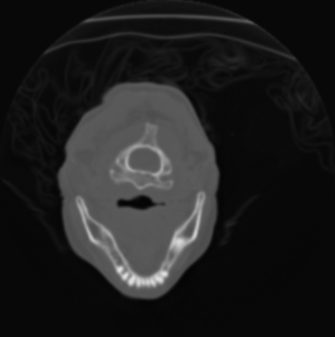
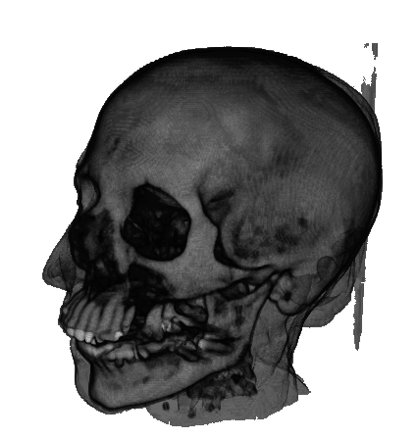
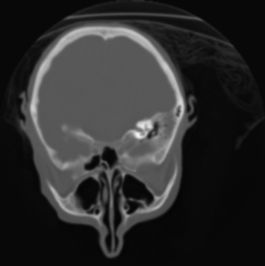
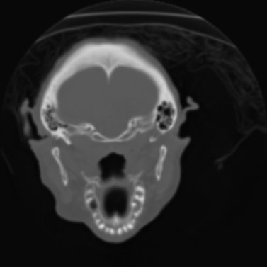
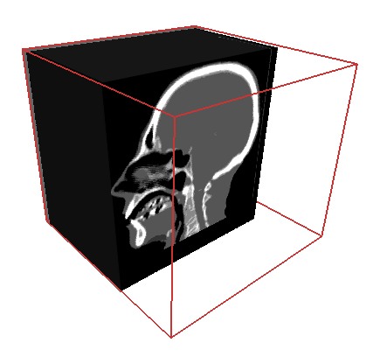
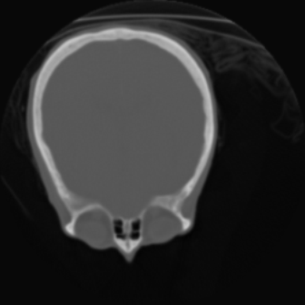
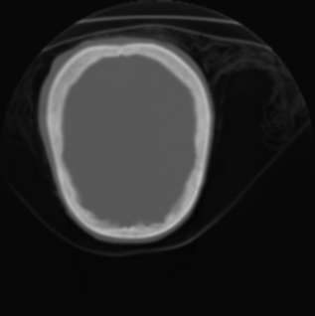
Texture-Based Volume Rendering
Data Set
Proxy Geometry
Image

Slide 31
Texture-based Volume Rendering
For a given viewing direction, we would like to select slices perpendicular to this direction
This requires interpolation to get the values on the slices
3D texture hardware supports tri-linear interpolation.
volume
image
plane
3D texture mapping

Slide 32
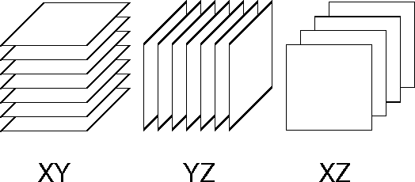
Texture-based Volume Rendering
Less-GPU intensive solution - 2D texture mapping:
view volume as set of slices parallel to co-ordinate planes
choose the orientation best suited to viewing direction

Slide 33
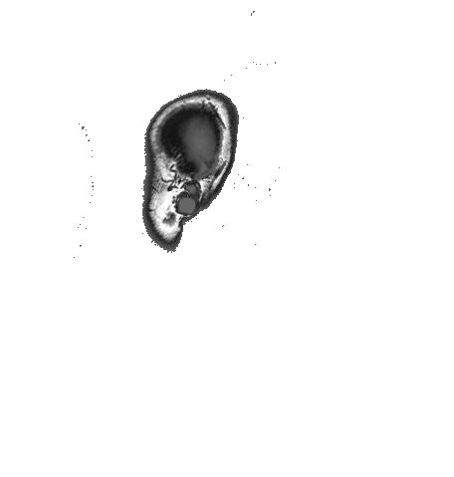
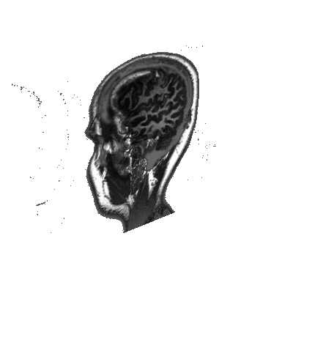
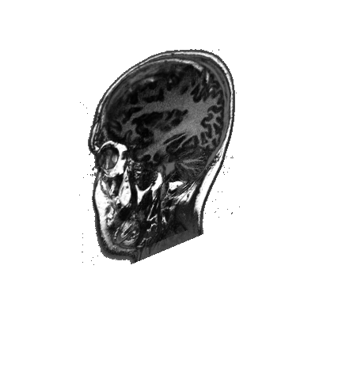
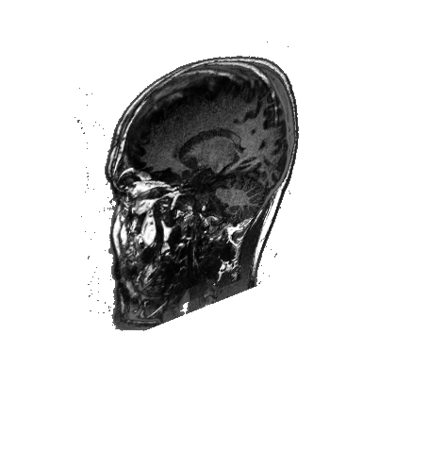
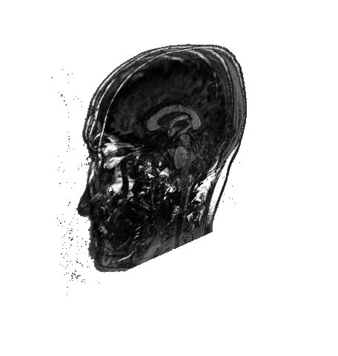
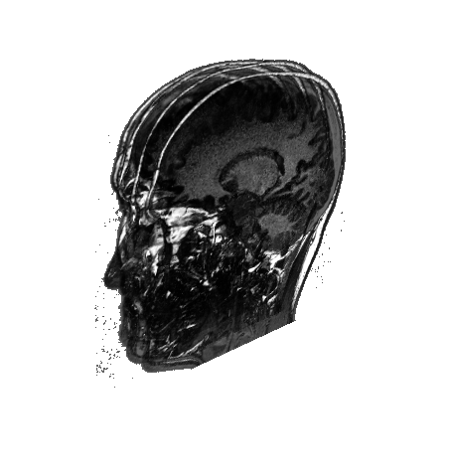
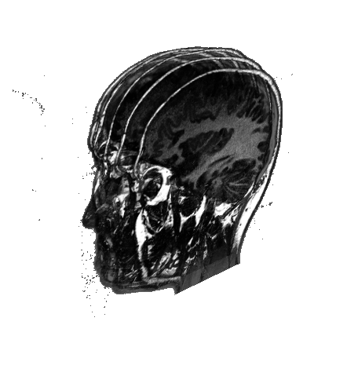
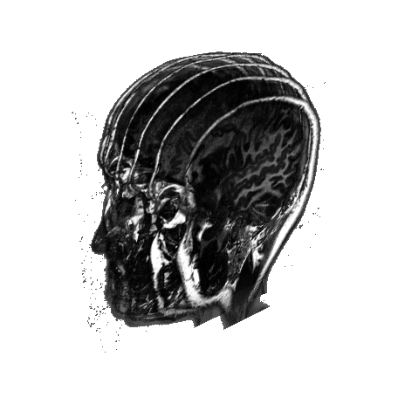
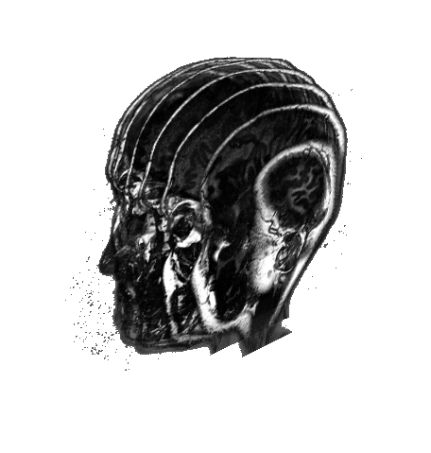
Render Proxy Geometry
No volumetric hardware primitives...
Stack of texture-mapped slices
Generate fragments: resample volume!

Slide 34
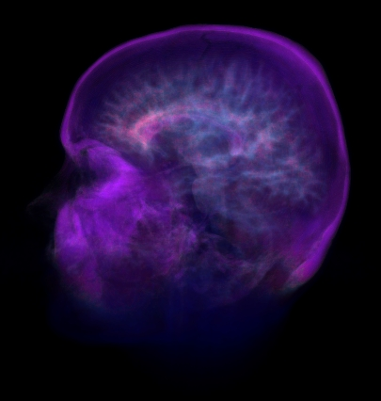
Texture Mapping
+
2D image
2D polygon
Textured-mapped
polygon

Slide 35
Texture Mapping (2)
(0,1)
(1,1)
(0,0.5)
(0.5,0.5)
(0,0)
(0.5,0)
(0,0)
(1,0)
assign the texture coordinates
to each polygon to establish
the mapping
Each texel has 2D
coordinates assigned
to it.

Slide 36
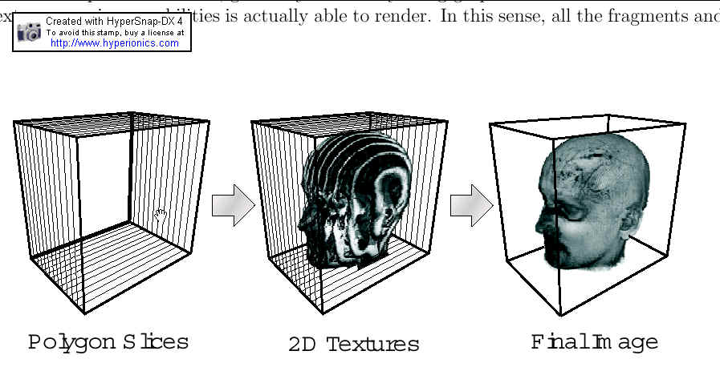
Texture based volume rendering

Slide 37
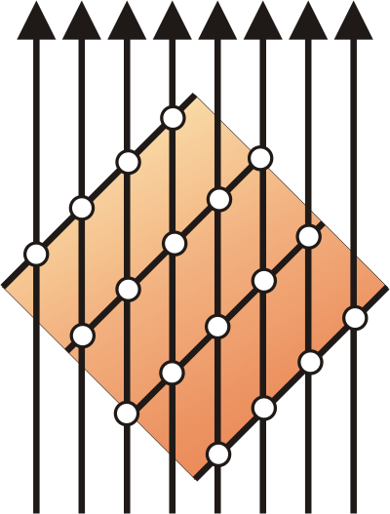
2D Textured Slices (1)
Object-aligned slices
Three stacks of 2D textures
Bi-linear interpolation
Fast and simple, but consumes lots of memory

Slide 38
Three copies of data needed
Different input textures are needed for different view directions.
Reorganizing the textures on the fly is too costly.
Prepare the texture sets beforehand
z
y
x
xz slices
yz slices
xy slices

Slide 39
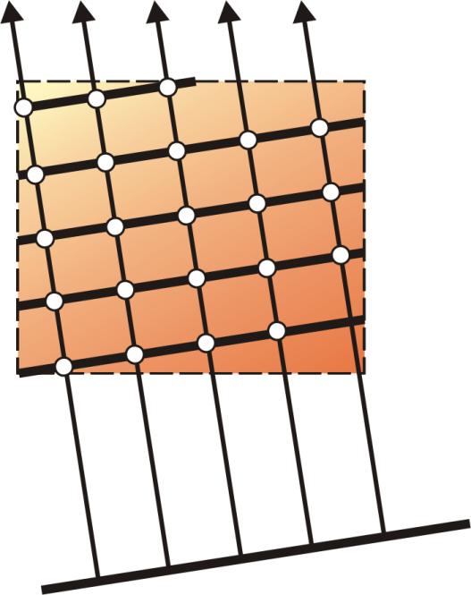
3D Texture Based Volume Rendering
View-aligned slices; clip slice geometry
Single 3D texture
Tri-linear interpolation

Slide 40
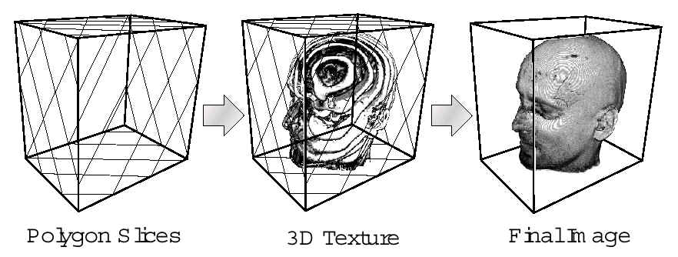
3D Texture Based Volume Rendering
Texture Interpolation

Slide 41
3D Texture Mapping
Arbitrary slicing through the volume and texture
mapping capabilities are needed
- Arbitrary slicing polygon: this can be computed
using software in real time
This is basically polygon-volume
clipping

Slide 42
3D Texture Mapping
Texture mapping to the arbitrary slices
This requires 3D texture mapping hardware
Input texture: volume (pre-classified and shaded)
essentially an (R,G,B,α) volume
Depending on the position of the polygon,
appropriate textures are re-sampled, constructed and
mapped to the polygon.

Slide 43
Solid (3D) Texture Mapping
Now the input texture space is 3D
Texture coordinates: (r,s,t)
(0,1,1)
(1,1,1)
(0,1,0)
(1,1,0)
(r2,s2,t2)
(r3,s3,t3)
(0,0,0)
(1,0,0)
(r0,s0,t0)
(r1,s1,t1)

Slide 44
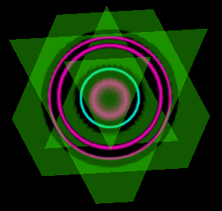
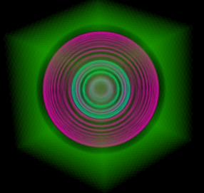
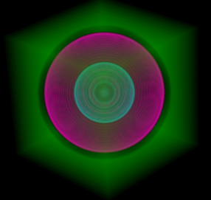
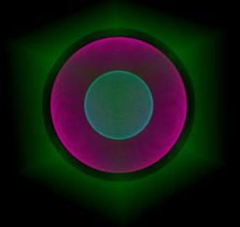
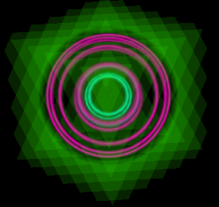
Slice Based Rendering
View direction
1 slice
Slices
5 slices
20 slices
45 slices
85 slices
170 slices
Notes:
This is what it looks like if we compute the integral with a varying number of slices, or sample points.

Slide 45
Lighting and Shading
3D texture mapping with hardware tricks to achieve lighting is now feasible.
C. Lao, OSU

Slide 46
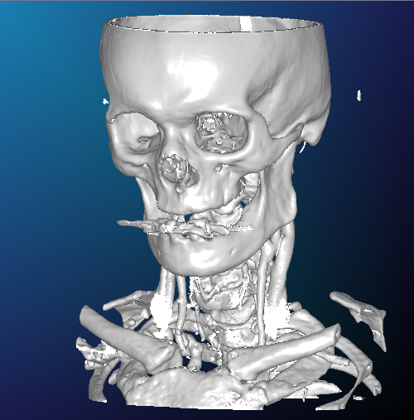
Lighting and Shading
Gradient estimation
Pre-computed gradients
On-the-fly gradients
Per-pixel illumination
Non-polygonal shaded isosurfaces
Volume shading
Pre-computed illumination

