Slide 1
Real-time Rendering Lab 4
CSE 781
Prof. Roger Crawfis

Slide 2
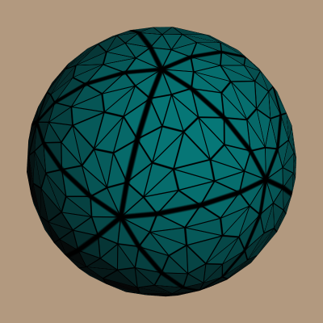
Tessellation Shaders
Anything with tessellation shaders.
http://prideout.net/blog/?p=48

Slide 3
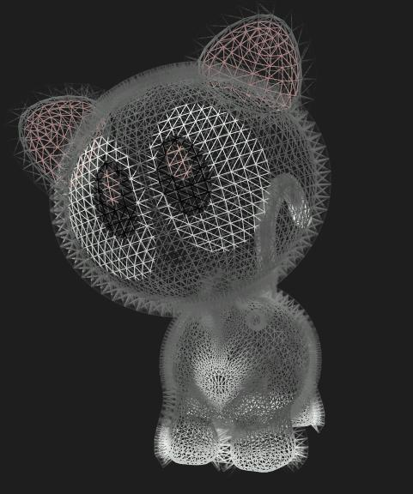
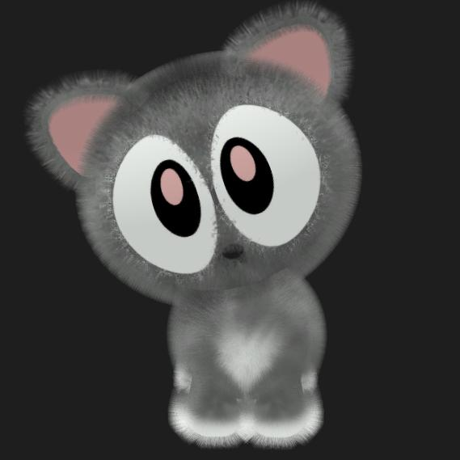
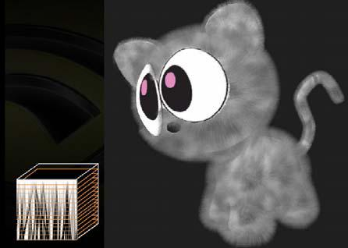
Shells and Fins
http://www.uweb.ucsb.edu/~ygong/2007/04/rendering-fur-with-shells-and-fins.html

Slide 4
Environment Mapping
Use Texture Layers.
Use Mip-mapping to control the Blue or glossiness.

Slide 5
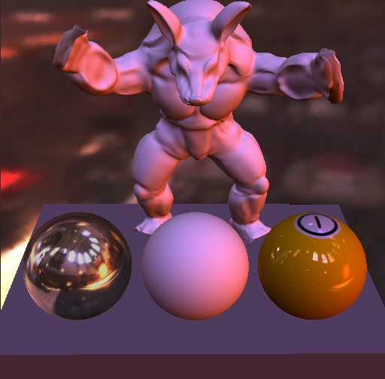
Spherical Harmonics
Combine everything with Spherical Harmonics Environment Mapping to produce something similar to:

Slide 6
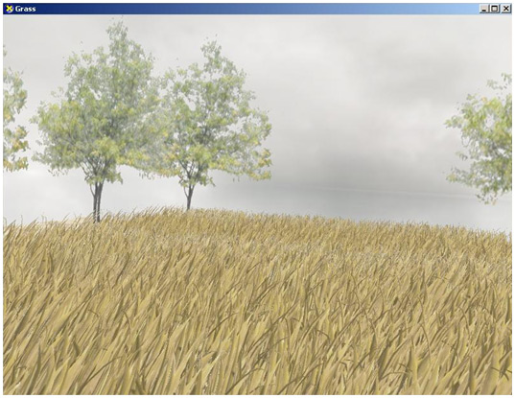
Instancing
1000’s ->10,000’s of complex objects.
Different transformations
Different colors / shaders?
Different …
Use with people / trees / …
http://software.intel.com/en-us/articles/rendering-grass-with-instancing-in-directx-10/

Slide 7
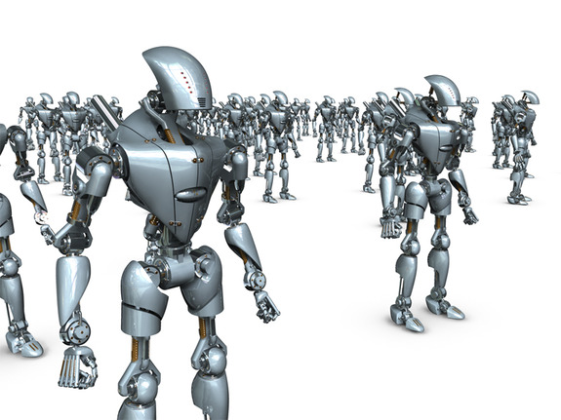
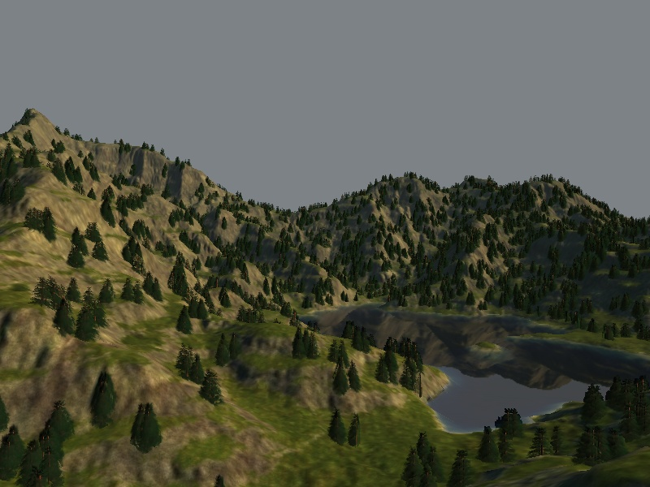

Slide 8
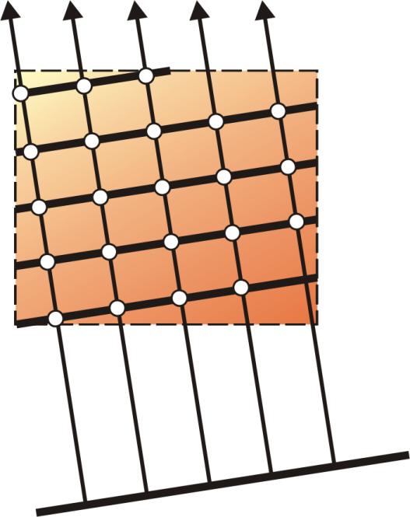
3D Texture Based Volume Rendering
View-aligned slices; clip slice geometry
Single 3D texture
Tri-linear interpolation

Slide 9
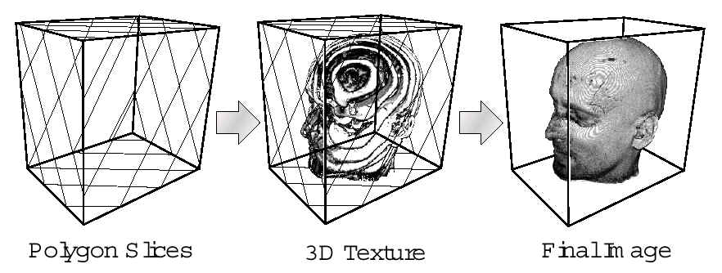
3D Texture Based Volume Rendering
Texture Interpolation and Transfer Function (Pseudo-coloring)

Slide 10
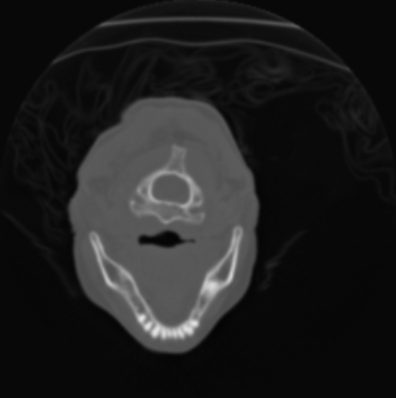
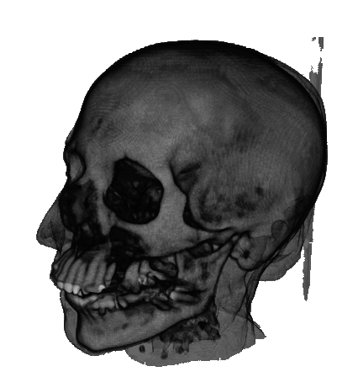
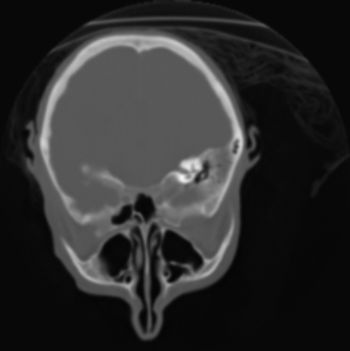
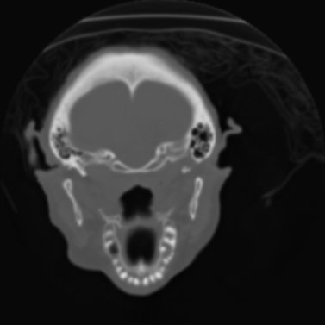
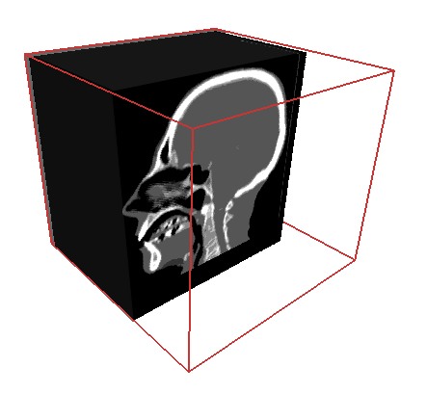
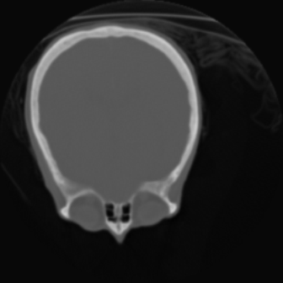
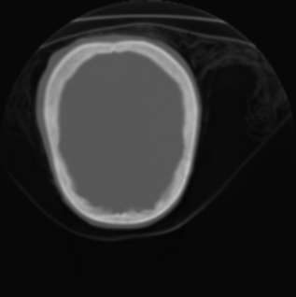
Texture-Based Volume Rendering
Data Set
Proxy Geometry
Image

Slide 11
3D Texture Based Volume Rendering
View-aligned slices; clip slice geometry
Single 3D texture
Tri-linear interpolation

Slide 12
3D Texture Based Volume Rendering
Texture Interpolation

Slide 13
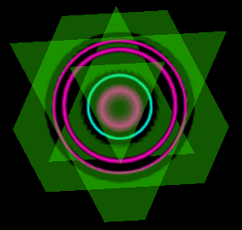
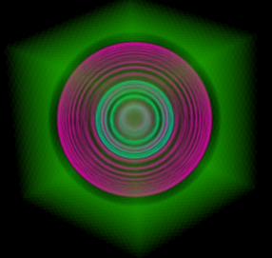
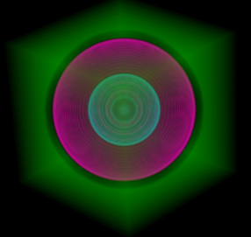
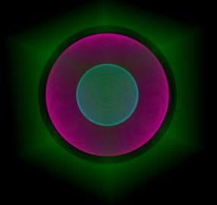
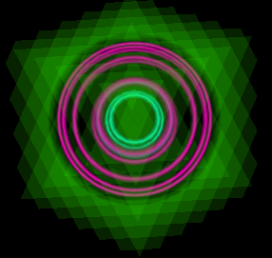
Slice Based Rendering
View direction
1 slice
Slices
5 slices
20 slices
45 slices
85 slices
170 slices
Notes:
This is what it looks like if we compute the integral with a varying number of slices, or sample points.

Slide 14
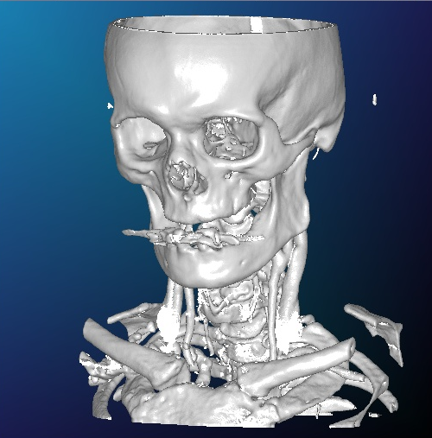
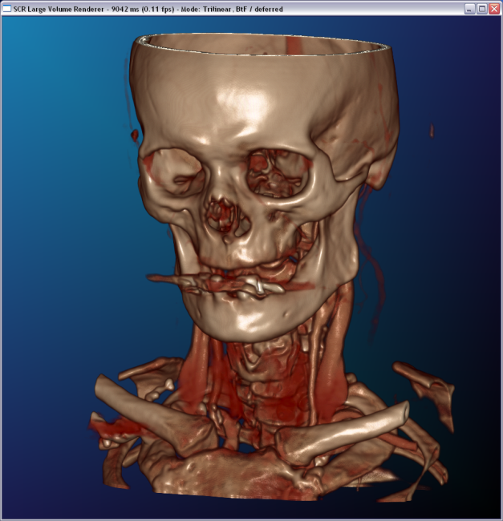
Lighting and Shading
Gradient estimation
Pre-computed gradients
On-the-fly gradients
Per-pixel illumination
Non-polygonal shaded isosurfaces
Volume shading
Pre-computed illumination

Slide 15
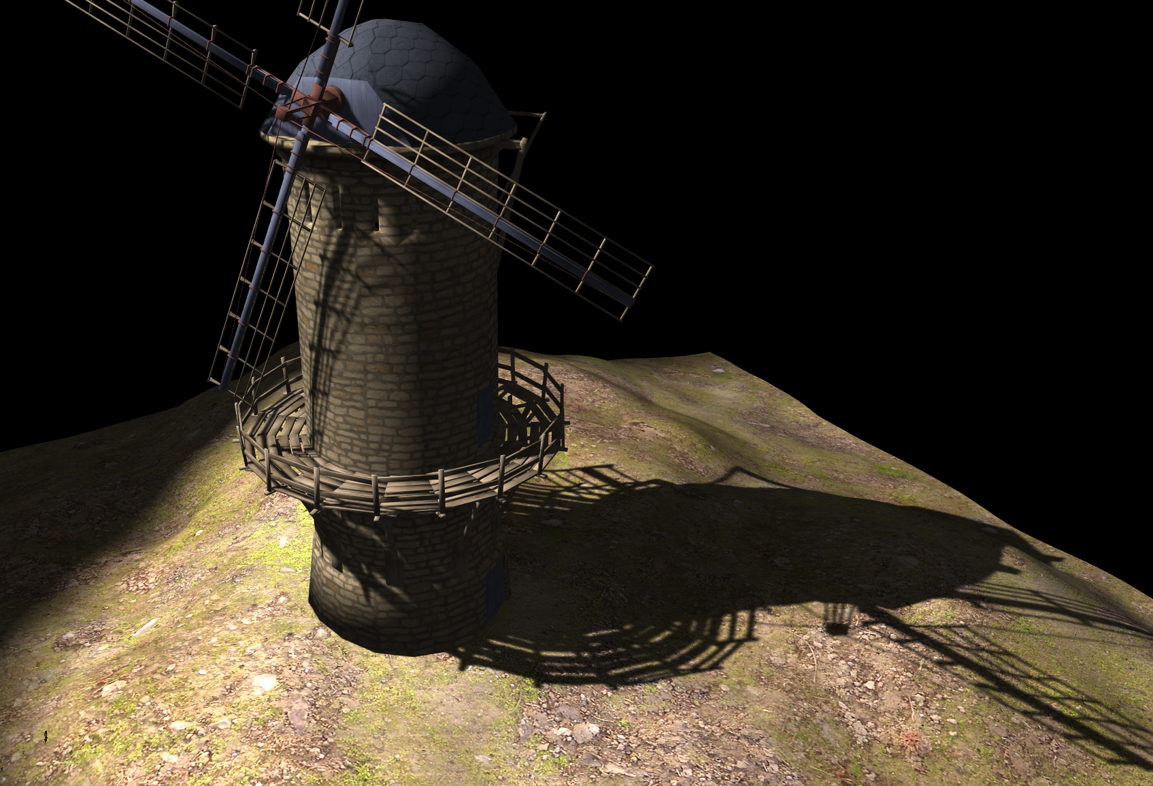
Variance Shadow Mapping
http://www.punkuser.net/lvsm/images/windmill_evsm.png

Slide 16
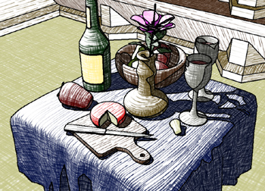
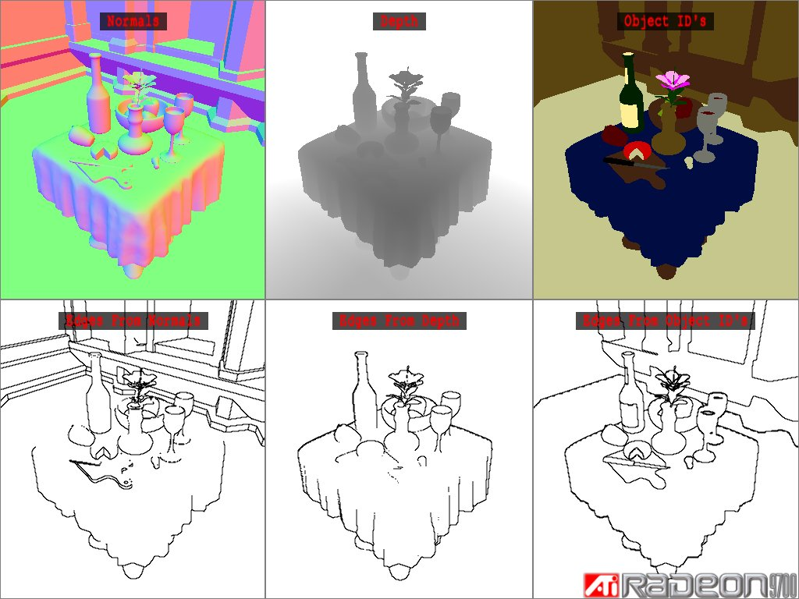
Non-Photorealistic Rendering
http://ati.amd.com/developer/demos/r9700.html

Slide 17
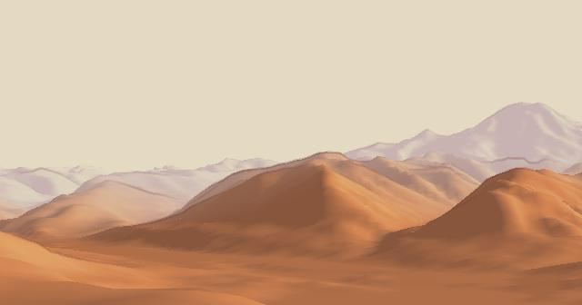
Non-Photorealistic Rendering
http://artis.imag.fr/Publications/2006/BTM06a/
http://exibeo.net/bin/shader_code/celshader.html

Slide 18
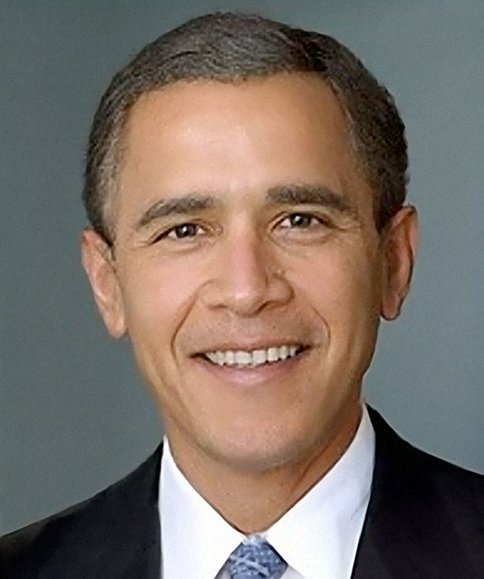
Texture Morphing
http://www.doobybrain.com/2009/01/24/george-w-bush-morphing-into-barack-h-obama/comment-page-1/

Slide 19
Non-Photorealistic Rendering
http://www.cse.ohio-state.edu/~crawfis/cse781/Slides/FISHKILL.MOV

Slide 20
Mesh Morphing
You can create several poses in FaceGen.
Write a shader that morphs between them.

Slide 21
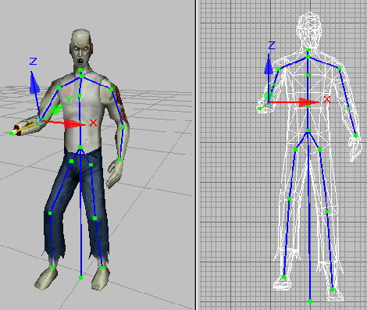
Character Animation
Read in a BVH file and develop a shader that does the proper animation and skinning.
http://www.beyondmotion.com.au/free_motion.html

Slide 22
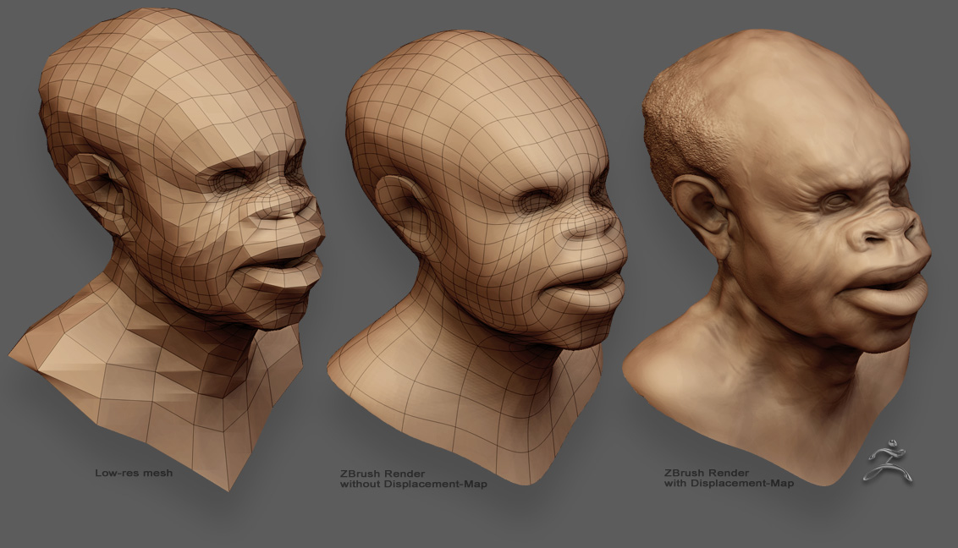
Displacement Mapping
http://www.zbrushcentral.com/zbc/index.php

Slide 23
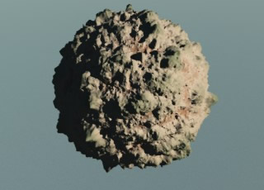
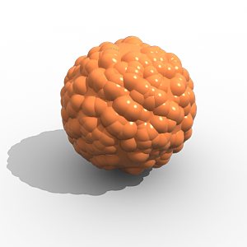
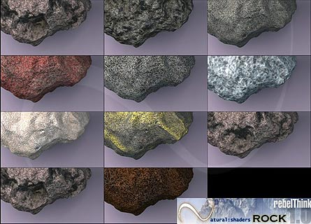
Displacement Mapping
Procedural Rocks

Slide 24
2D Text
Replace the normal Display List approach of text generation with a modern implement:
Use texture layers
Add the translate based on the VertexID?
Or pass in an array of character ID’s?
Use Unicode

Slide 25
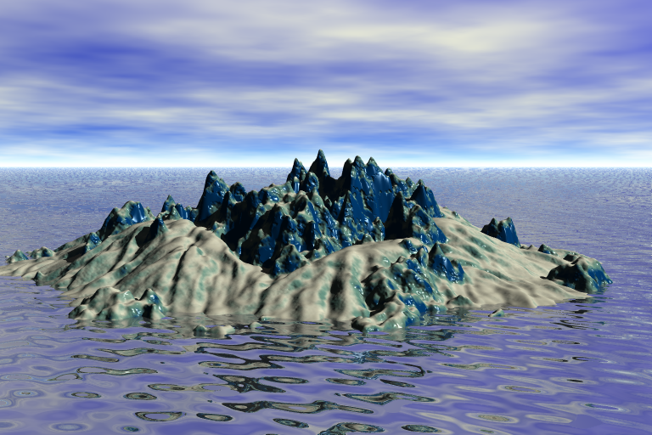
Terrain Synthesis

Slide 26
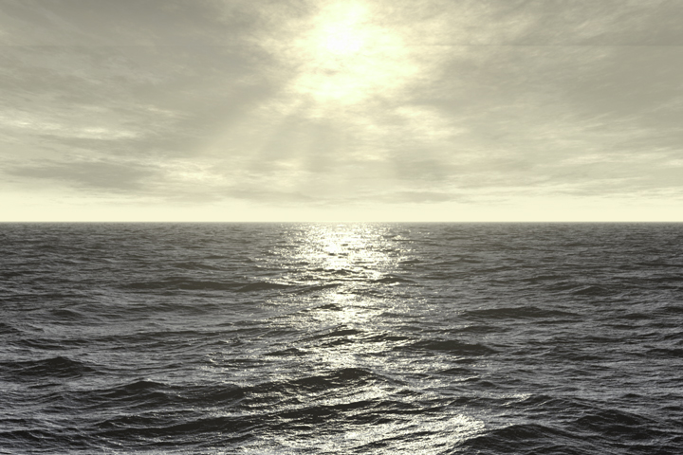
Water and/or Sky Shaders

Slide 27
3D Sculpting Program
Expand your paint program to include displacement mapping.
Add an Alpha Texture to cut out areas.
Include brushes that paint to several targets in a single pass (diffuse, gloss, alpha).

