Slide 1
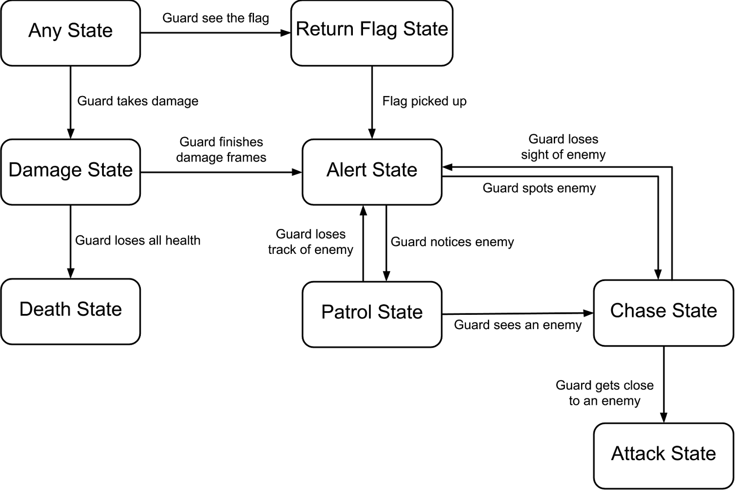
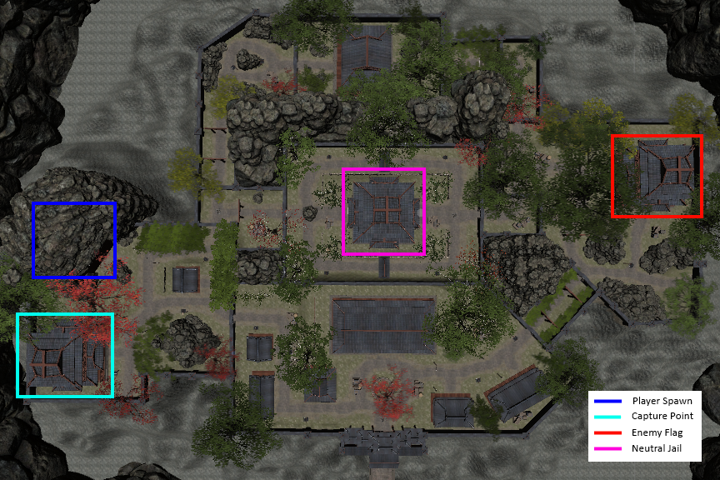
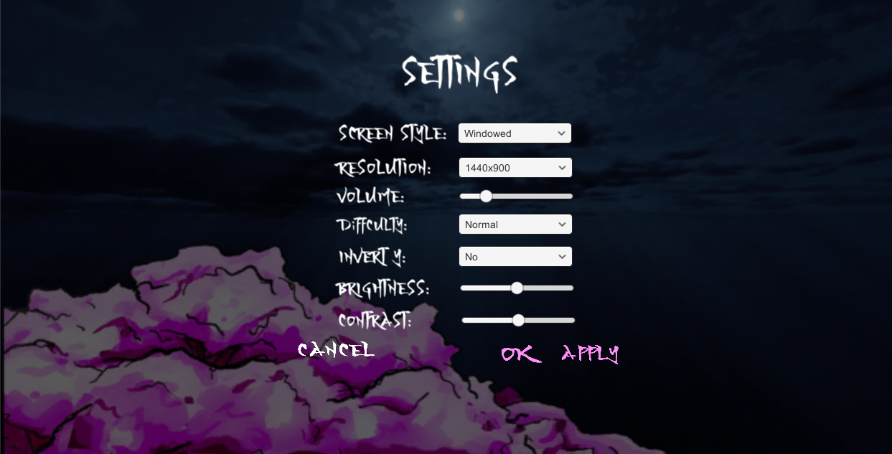
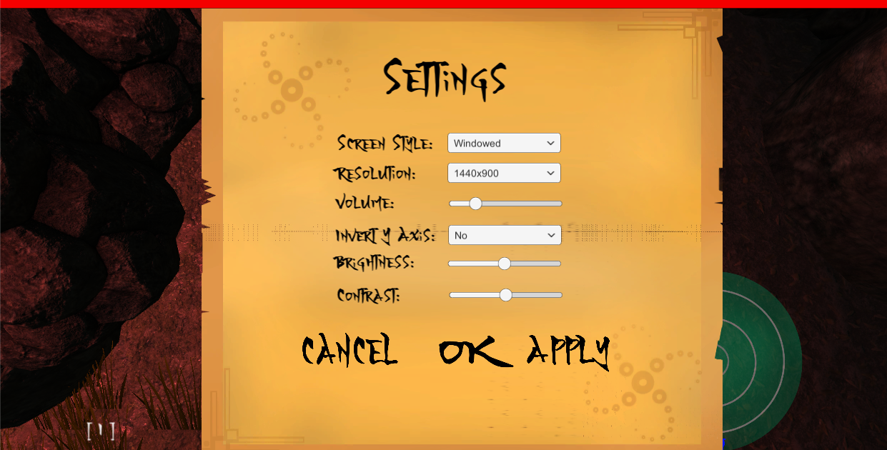
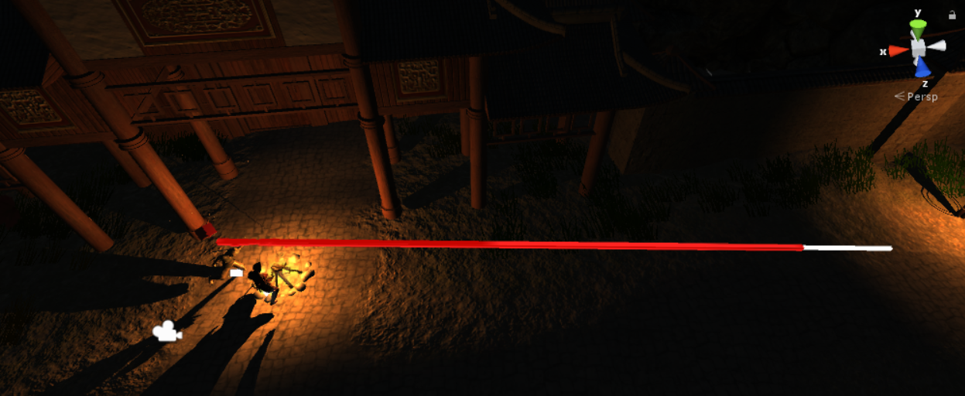
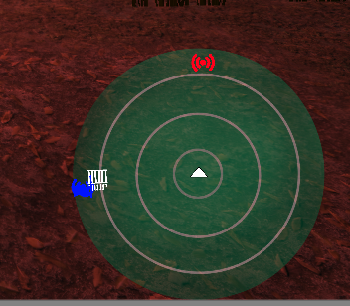
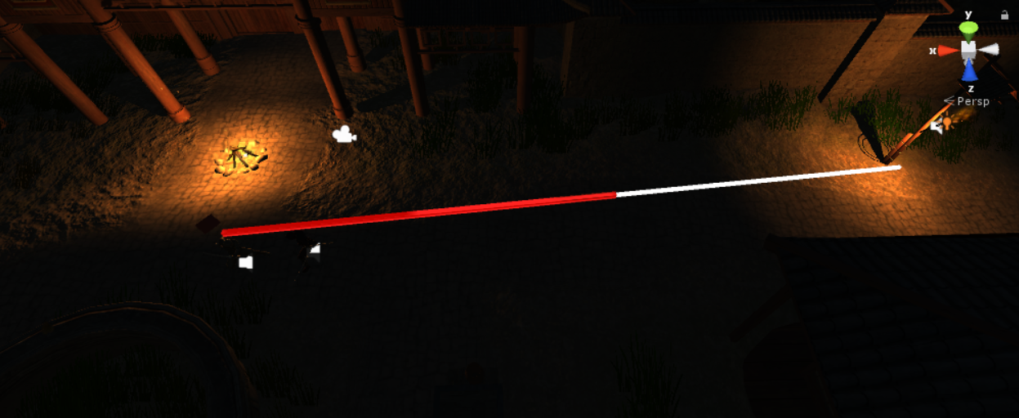
By
CSE 5912
Adam Kimble,
Chris Leight, Albert Maah, Nicolas Re, Kris Wenger
Technical Poster
Artificial Intelligence
Level Design
User Interface Design
Random Intelligent Pathing
Patrol path is randomly selected from a pool of 4 different paths at initialization
Waypoints are use to control the guards movement along the path
Waypoints from the current path are randomly assigned on path assignment and again in 3 minute intervals
State Design Pattern
Design goals
Multi-lane system for path diversity
Open focus areas for combat
Intelligently placed clutter and interactive light for cover and strategic diversity in approach to objective
Invisible triggers to maintain field of play within the desired bounds of the map
Main Menu
Settings Menu
Network Play Menu
Allows player to join a pre-existing lobby or create their own for players to join
Pause Menu
Allows player to go to the in-game settings menu, return to main menu, or exit the game entirely
In-game Settings Menu
Networking
Interactive Lighting
Uses User Datagram Protocol (UDP)
Data is transferred over the network through data streams and Remote Procedural Calls (RPC)
Data stream information usage
Player and enemy positions
Player and enemy states/animations
Interactive lighting
Flag position
Remote Procedural Call usage
Single time actions, such as dealing and taking damage, interacting with lights, and throwing the flag
Network Persistent AI
Created at level load time across the network
Public variables allow for modular creation of guards
Modular design makes passing guards easier for the network
Modular design allows for scalable difficulty
The more well lit an area of the map is the further away an enemy can see a player
Enemies vision depends on their own proximity to the light source not the players
Players can toggle lights on/off to given themselves a strategic advantage
Control Scheme Menu
Brings up the control layout for the game
In-game UI
Notifications
Health bar
Minimap
Score
The minimap provides the player with the
general direction and location of their home base (in red), the enemy base (in blue), the enemy flag (also blue), the jail (in white), and enemy and allied players (in their team colors)

