Slide 1
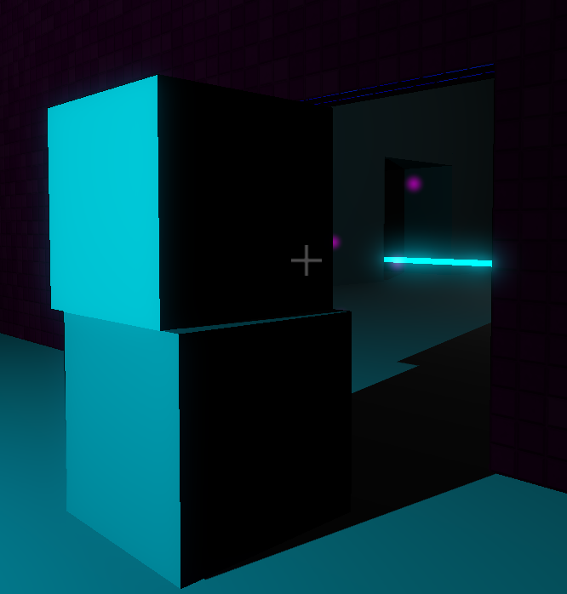
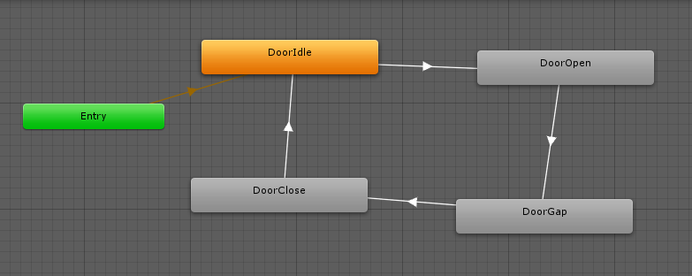
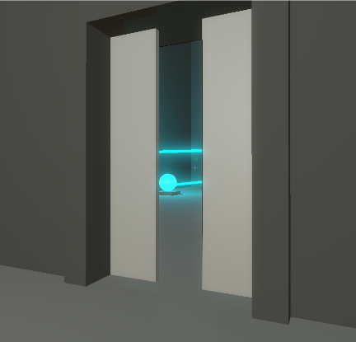
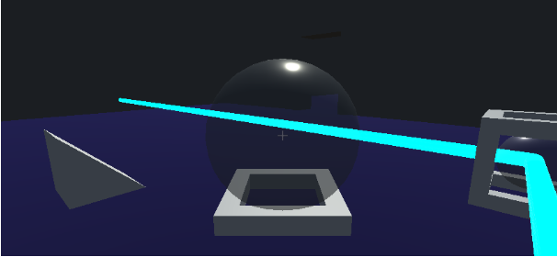
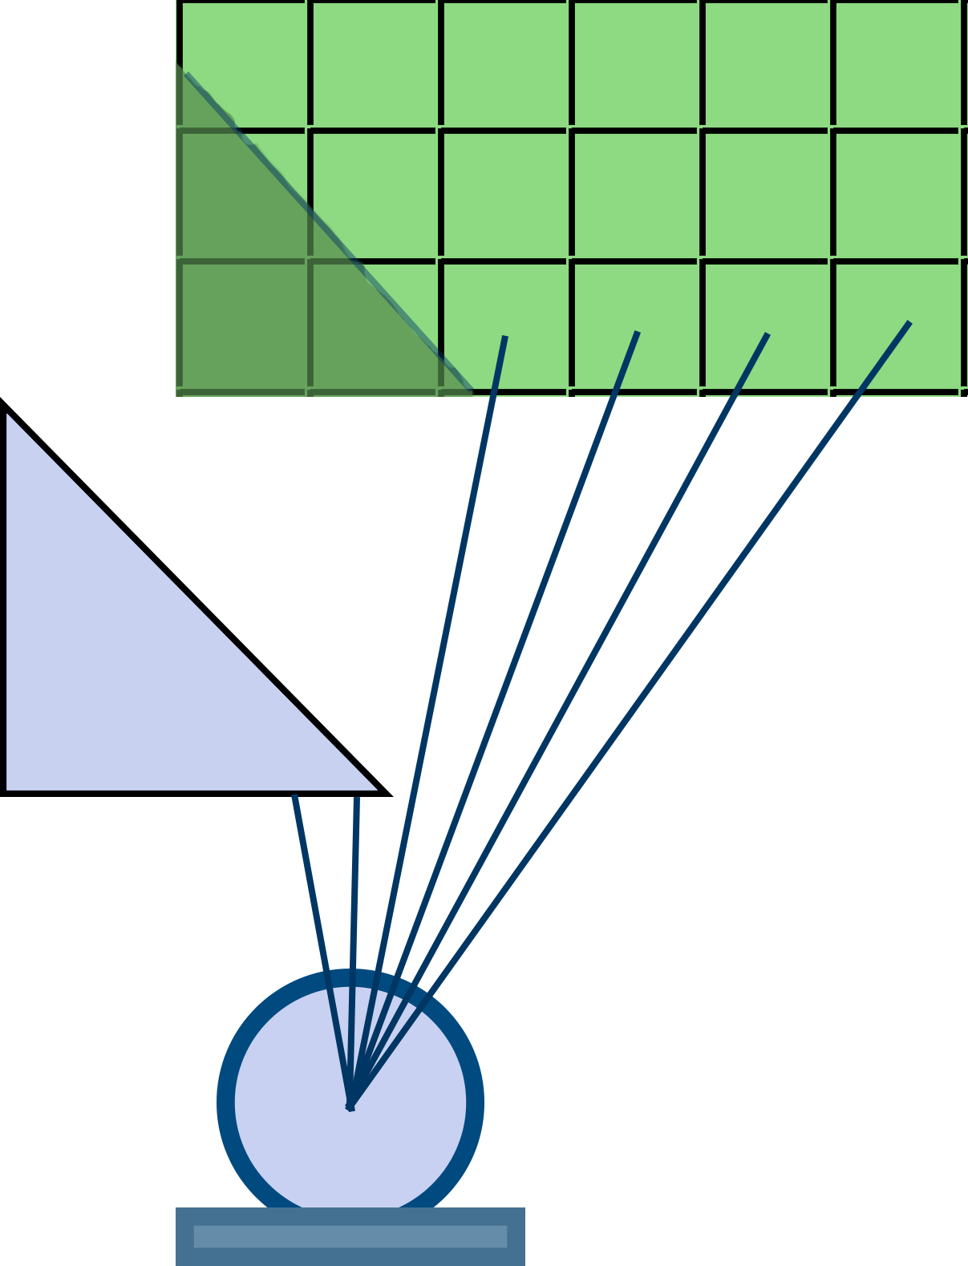
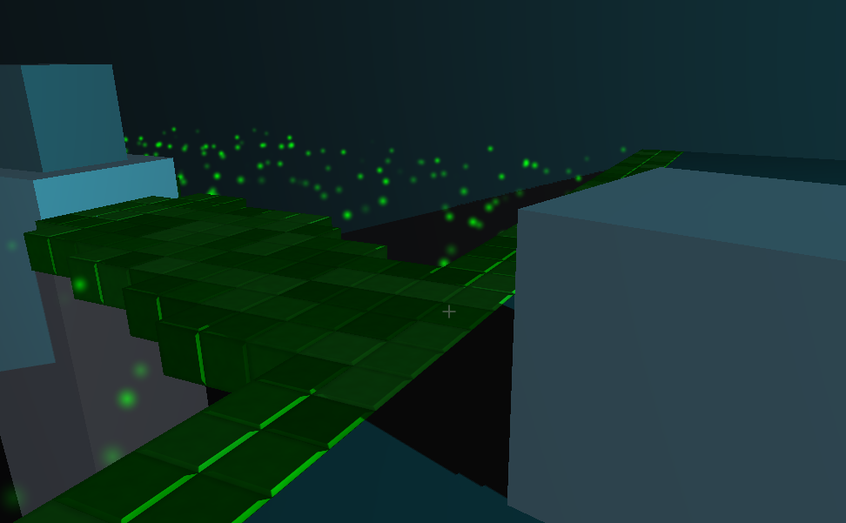
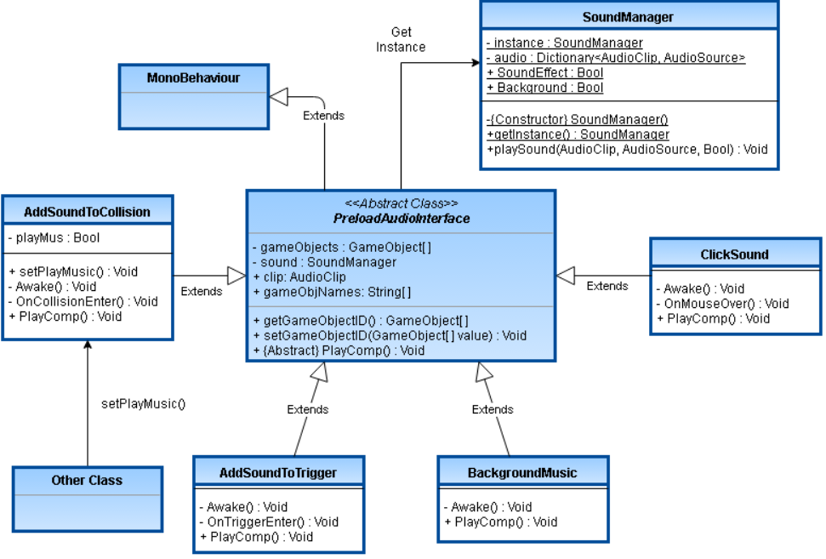
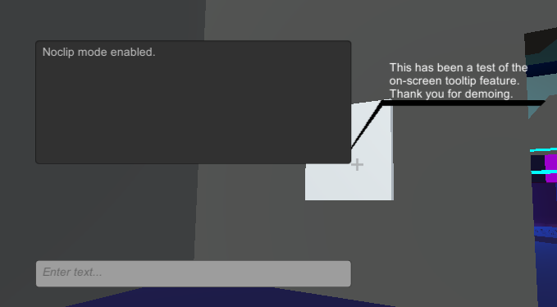
TECHNICAL POSTER
Department of Computer Science and Engineering
The Ohio State University
Ben Allen, Jin Cheah, Derrick Dent, Gwen Stevens, Logan Wilson
Laser reactant objects
Interactive Doors and Saving
All laser-reactive blocks contain behaviors which subscribe to a similar prototype, which are extracted and used by the active emitter behaviors on wall emitters and redirectors. Diffusers, when lit, add their spherical centers to a global registry which is then used for voxel block detection. Redirector cores have their own EmitterBehavior components which are controlled and activated by their laser-reactive counterpart, RedirectorBehavior. Emitters are responsible for informing reactive devices when they are removed from its path.
The doors run off of four Unity animations and an animation controller to transition between them. When they player enters the box collider trigger, the doors will go from a closed state to the opening state if it is unlocked. All but one door starts off as unlocked. The state of the doors being locked or not is held in a text file save. A save manager script reads the text file and makes an array to hold the values of the doors being locked or not. If the door is locked then the animations do not change.
Element Zeta, Dark Solid, and Light Solid
The core of Element Zeta's gameplay revolves around these light reactive blocks which are either solid or not solid (the player can see and pass through it, but it retains it's shape and is not quite a gas). A naive implementation of this is to check if the light source (the diffuser) is being blocked by anything. This can be done using a simple raycast from the diffuser to the block. If the raycast returns that something is in the way, then the block must be in shadow; otherwise, the block must be in light.
However, what this doesn't account for is the scenario where something is casting a shadow on the block, so part of the block is in shadow and part of the block is in light. To handle this, we split the blocks into many smaller blocks, each doing the same check of raycasting to the diffuser. This allowed for the shape of the shadows cast to be approximated in a blocky, stylized manner. The smaller the blocks, the better the approximation of the shadow.
However, each small block was a cube, so even if the cube was surrounded on all sides by other blocks, all six sides still had to be rendered, which was inefficient. This was also inefficient because rendering each block as a separate, small object meant that the parallel structure of the GPU (which is designed to render very large objects quickly) was not being utilized.
To fix this, we imported a
voxel renderer into our
project. A pixel is a point
in a 2-D grid, whereas a
voxel is a point in a 3-D
grid. By representing each
block as a voxel in a 3-D
grid, we were able to
preserve the same
we had before, but with
the advantage that a grid
of voxels can be rendered very efficiently.
The last hurdle for implementing the light reactive blocks was to optimize the raycasts. A 20x20x20 block would contain 8,000 voxels, which means that 8,000 raycasts would have to be performed to update the block. However, raycasts are not cheap operations, so this many would grind the game to a halt. The solution was to simply not do all of them at once. Each frame, a set number of voxels would be chosen to be updated, usually less than 1,000 at a time. Then the next frame, the next set of voxels would be updated, and so on. This means that the blocks have a small delay before they are fully up to date, but this delay is usually less than a second. The way the voxels update in chunks also adds to the stylized nature of the game, giving it an interesting, digital appearance, as if the game takes
place in some sort of simulation.
Custom Music System
Console and Dialogue
The music system is designed to allow ease of attaching music to any objects in the scene. There are two classes of great importance to facilitate this purpose. The first class is the SoundManager. It is a class containing methods to play, or stop sounds and a hidden library of music that’s currently playing.
The second class is an abstract class PreloadAudio, the main body that allows ease of attachment. It contains methods to find out which audio clip is being used, and load the clip.
These two classes form the backbone of the music system. On the other hand, the frontline of the system consists of 5 classes. Each of these classes inherits from the PreloadAudio class and implements incomplete methods. They also contain a SoundManager object, which they reference to play the music. The purpose of these classes is to play different types of sound.
The text in game utilizes a trigger-based system to present a storyline narrative. The dialog is handled by a text manager that outputs text it’s given by a game object. A game object will send the manager text in different ways: when the player or an object enters or leaves an area, usually handled a trigger collider; upon completion of a task or puzzle (e.g. pressing a button will often trigger some in-game change, but could also prompt text to appear on the screen acknowledging some change as
well); at a specific time or after an amount
of time has elapsed (e.g. if the player is
stuck at a certain point in a puzzle and
hasn’t progressed for a while the narrator
may point this out. This doesn’t necessarily mean
the narrator will provide a hint, of course).
A console is implemented for debugging and gameplay manipulation. It appears on the left side of the screen, and disappears after entering a command, with a brief delay to display the response the console gives. It takes input on the console line, and sends it to a parser that determines the command. These commands are handled on the back-end depending on the command entered. The console outputs a response, notifies a toggle to a change (e.g. noclip mode), or notifies the player if the command was invalid.

