Slide 1
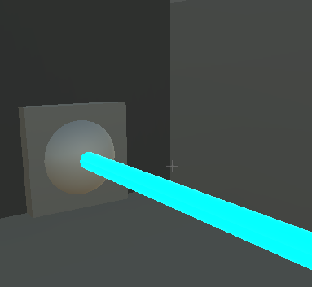
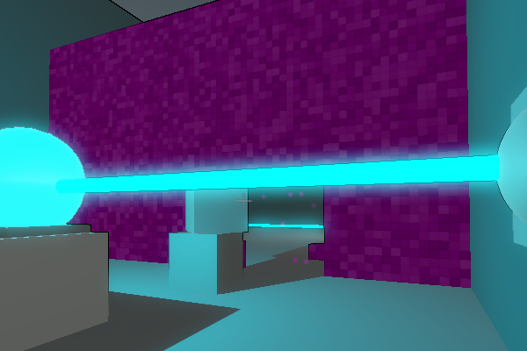
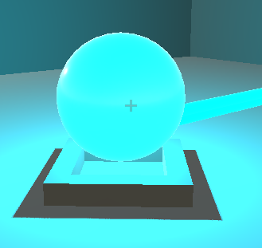
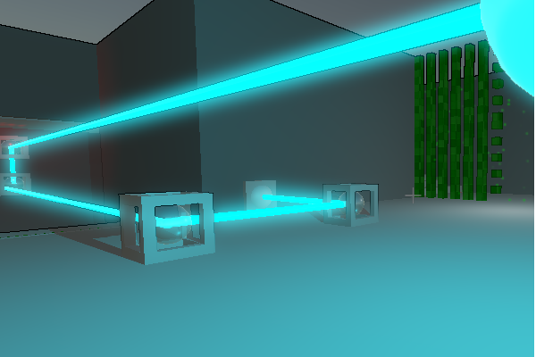
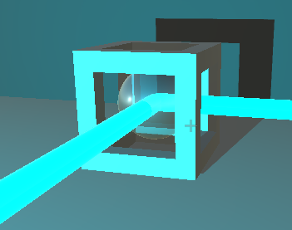
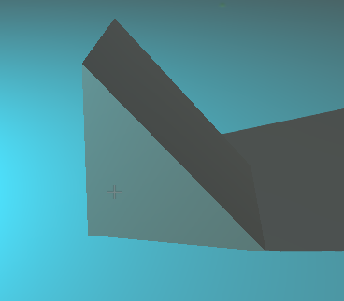
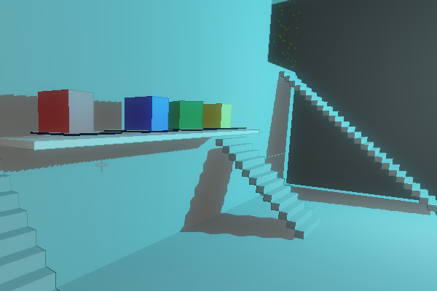
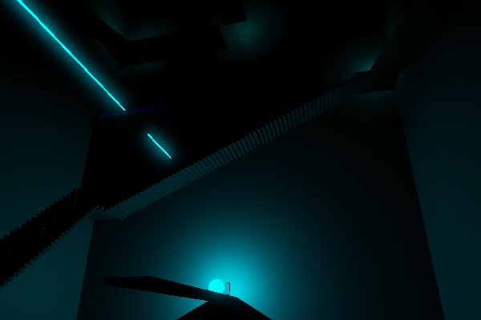
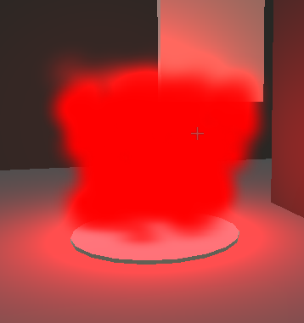
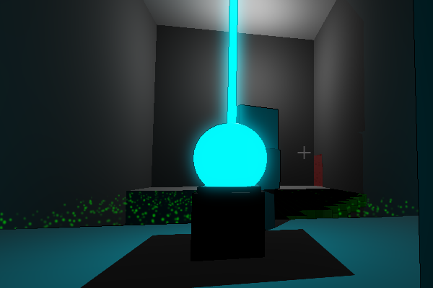
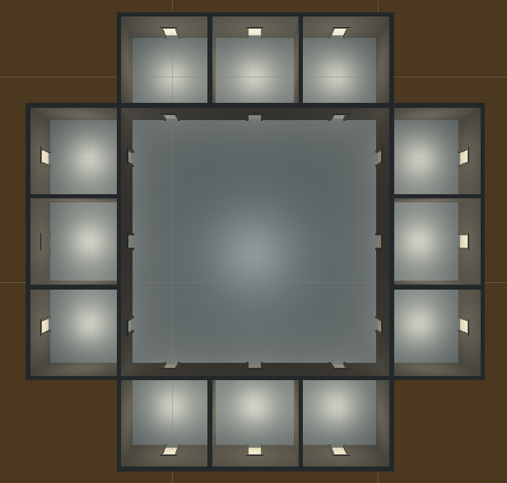
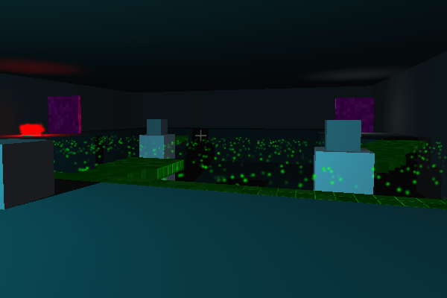
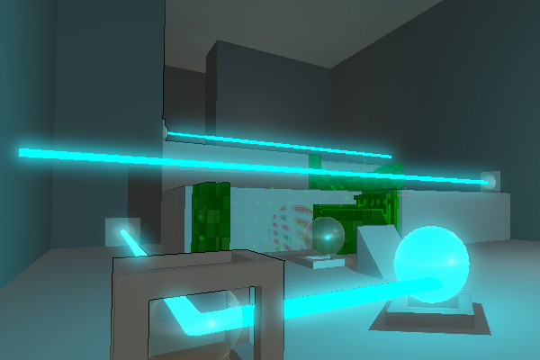
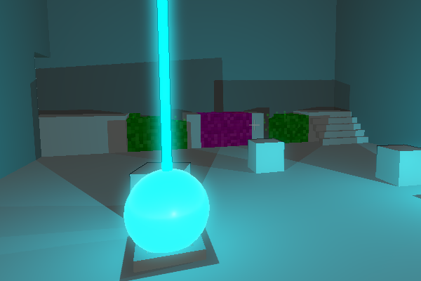
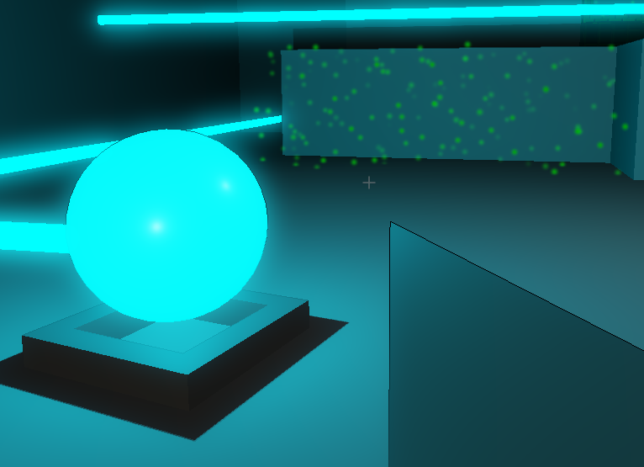
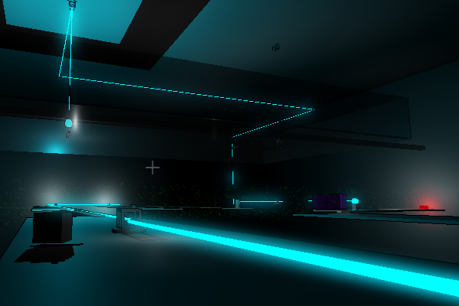
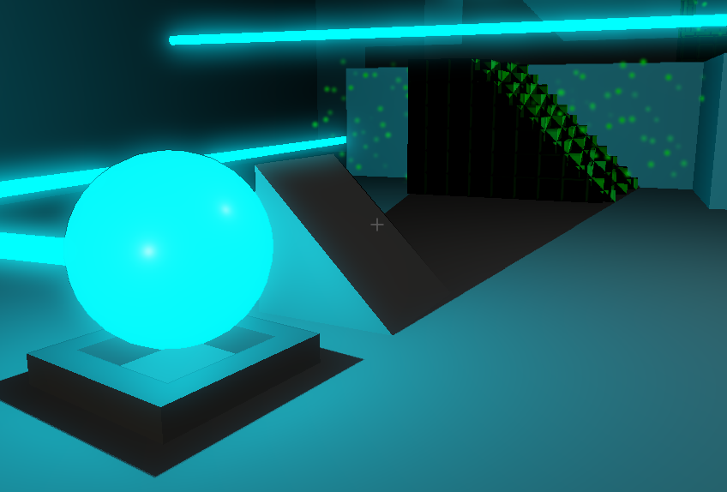
GAMEPLAY POSTER
Department of Computer Science and Engineering
The Ohio State University
Ben Allen, Jin Cheah, Derrick Dent, Gwen Stevens, Logan Wilson
Objects
Element Zeta laser
Baby Steps
A laser of the special element zeta
A general tutorial level to introduce the player to the game’s mechanics.
Diffuser
Pick up this object and place inside a laser to create Element Zeta light. This light reacts to dark solid and light solid materials
The Tower
Redirector
A vertical ascension-style level where the player has to navigate a tower to the top. It is the first level where the puzzles are more complex and require some thinking through.
Pick up this object to turn a laser by 90 degrees. Remember to use IJKL to rotate as needed
Moveable shapes
The Music Hall
Move around 3D shapes to create shadows from the Element Zeta light
A level with musical influence, where the level’s background music changes as you progress through the level.
Your Goal
The Dark Room
A level inspired by an Escher painting. The level is dark, with no light sources except for the puzzle itself.
Solve the puzzle to get to the end pedestal
Hub Room
The Training Room
A level that provides a heightened level of challenge. It showcases a number of initial puzzle designs we developed during production of the game.
Players start in an intro room. All but one puzzle starts locked. As each puzzle is completed, the next puzzle unlocks.
The First Trial
The first of three levels to test the player with the game's mechanics. It is a short puzzle and is simply to test the player without any guidance.
Controls
E - Pick up object
WASD - move
Left Mouse - direct camera IJKL - rotate held object ~ - open console P - Pause
The Second Trial
The second of three levels designed to further challenge the player. This puzzle is again without guidelines and requires more intuitive thinking.
Dark Solid and Light Solid
The Third Trial
The third and final level designed to push the player’s puzzle solving. This puzzle is short like the other two, but offers an extended logical challenge to the player.
Dark Solid is denoted in the light by green particles, and Light Solid is denoted by purple particles. Once Element Zeta is diffused into light, Light Solid will become a solid object the player can walk on. To the upper left, Dark Solid is shown in it’s not solid state. To the lower left Dark Solid is shown in it’s solid state. This is due to the shadow cast by the triangular prism from the diffused Element Zeta light. The player may walk on the green solid.
The Chasm
the final level of the game. It offers a player closure to the game’s story and presents one final challenge to the player.

