Slide 1
Designed by:
Notes:
david

Slide 2
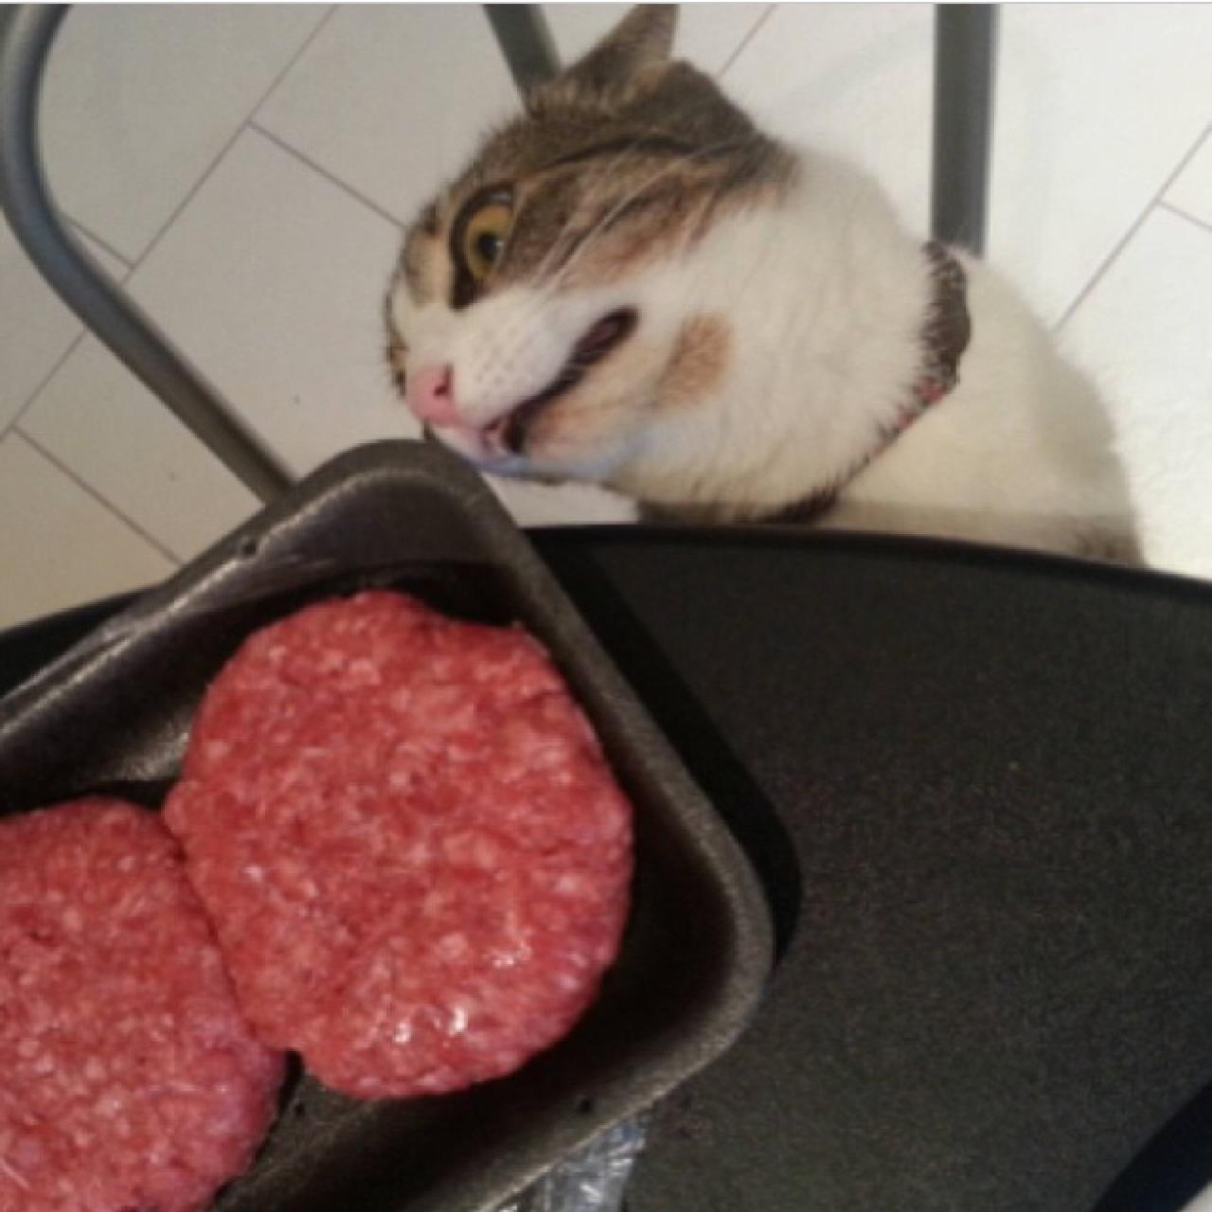
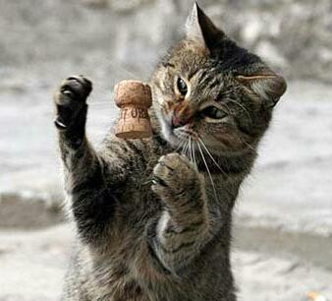
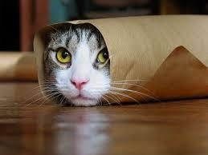
Members
Kim Boydstun
Scrum master, GUI, Single Player,
Level Creation
Michael Filliater
Sounds, Reliability, Interactive
Elements, Kinect
Ian Freshwater
GUI, Level Design (Main),
Level Creation
David Hazlett
Kinect, Single Player, A.I.,
Level Creation
Notes:
david

Slide 3
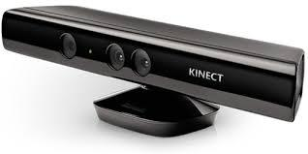
Timebox 5 Highlights:
Kinect Functionality
Movement
Looking
Menu Navigation System
Joystick capable
Issues
Kinect v2
Kinect for 360 sensitivity
Build Problems
OS calls/using UnityEditor
Notes:
kim

Slide 4
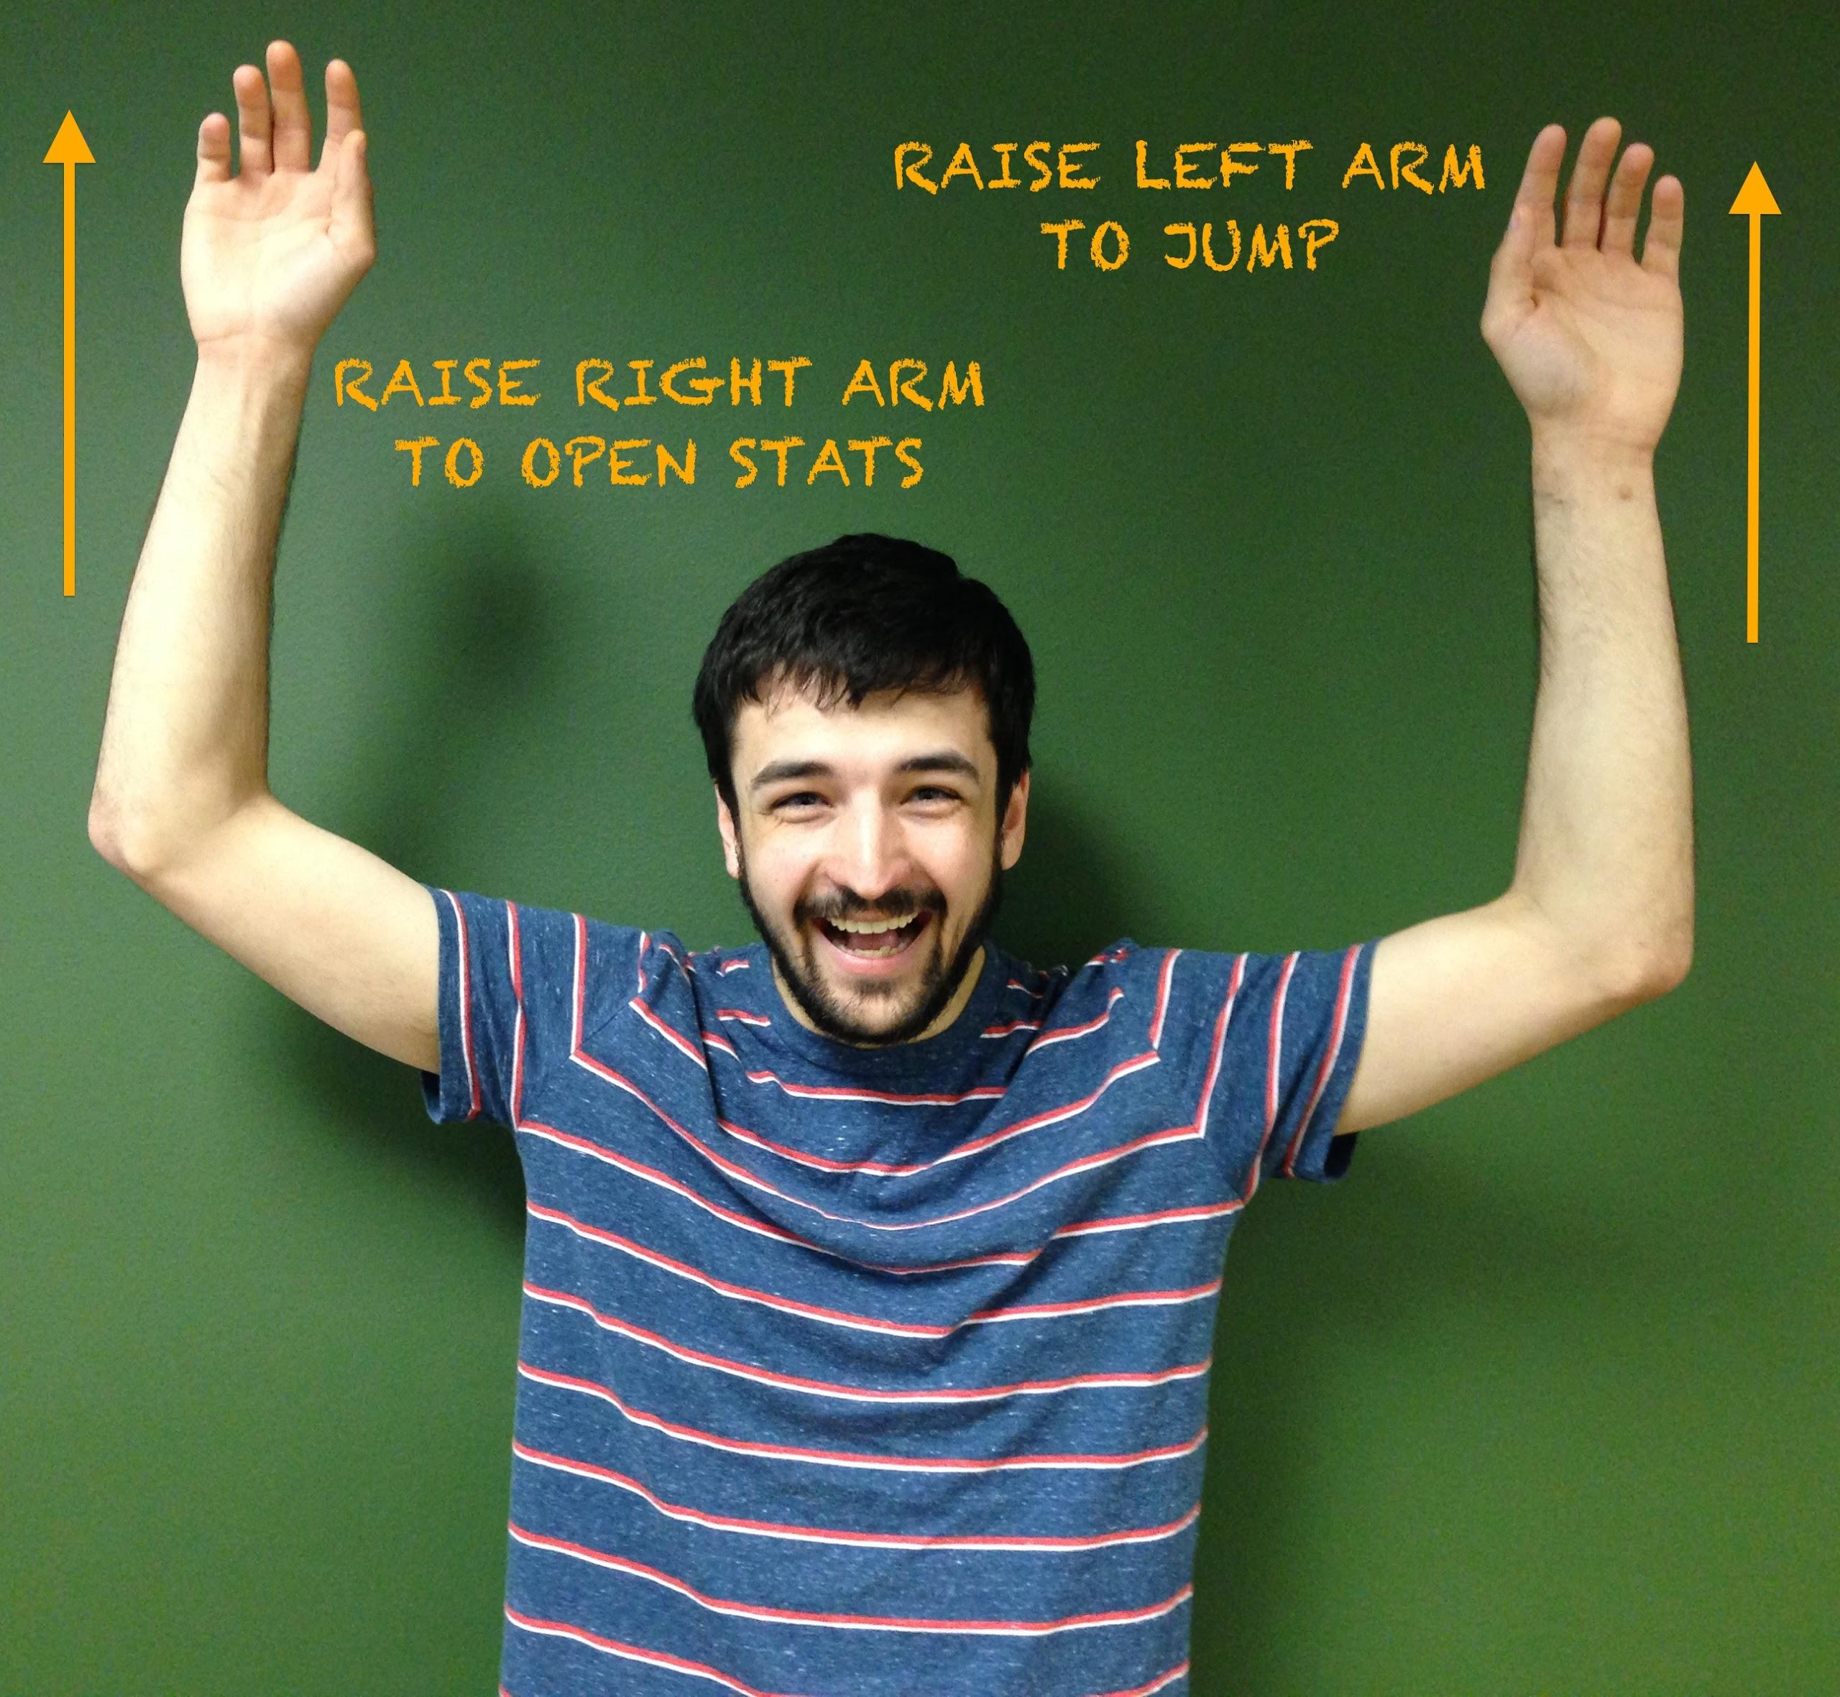
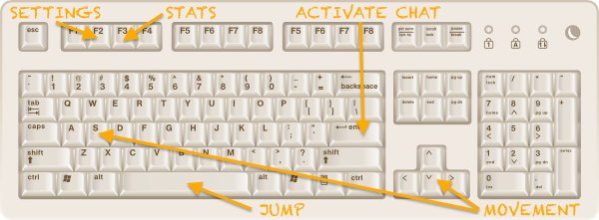
Timebox 5 Highlights:
Continuous Main Menu
Flows Between Pre-Game Elements
Updated “Directions” Section
New State Diagram
Notes:
kim

Slide 5
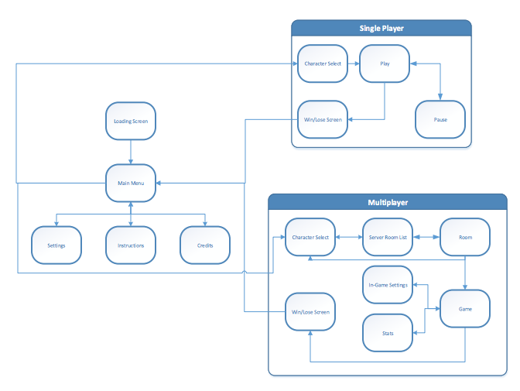
Notes:
kim

Slide 6
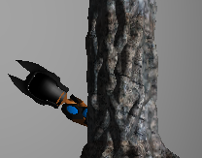
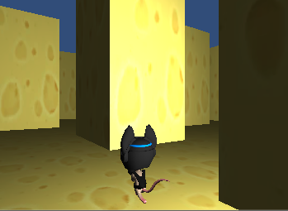
Timebox 5 Highlights:
Single Player Mode Added
Two Single Player Games
Storyline Created
Pokemon-esque Transitional Scenes
Notes:
kim

Slide 7
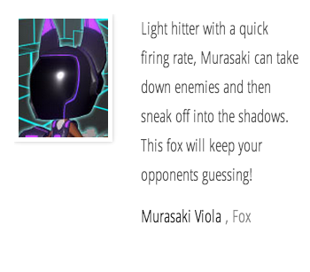
Timebox 5 Highlights:
New Website
Play Game
Read Character Descriptions
http://www.cse.ohio-state.edu/~freshwat/index.html
Notes:
david

Slide 8
Timebox 5 Highlights:
Added Sounds
Full Songs Created By Friends
Sound Effects for Items, Etc.
Notes:
kim

Slide 9
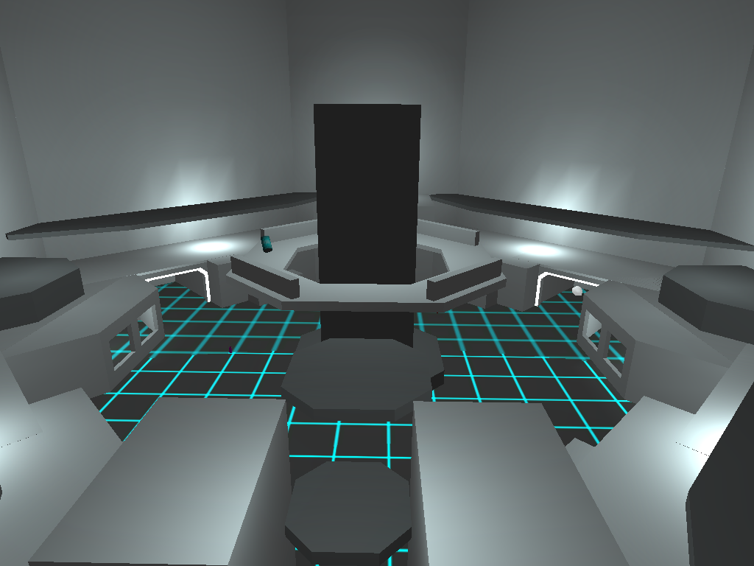
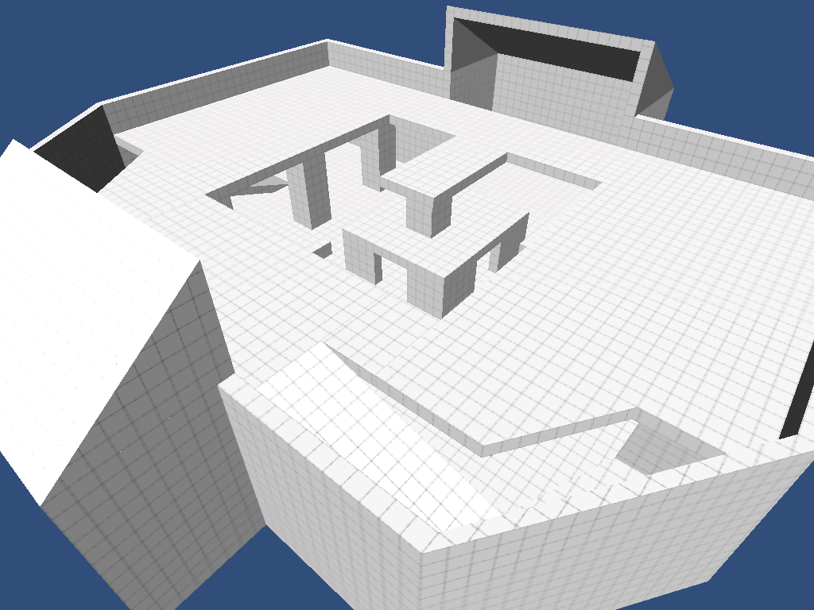
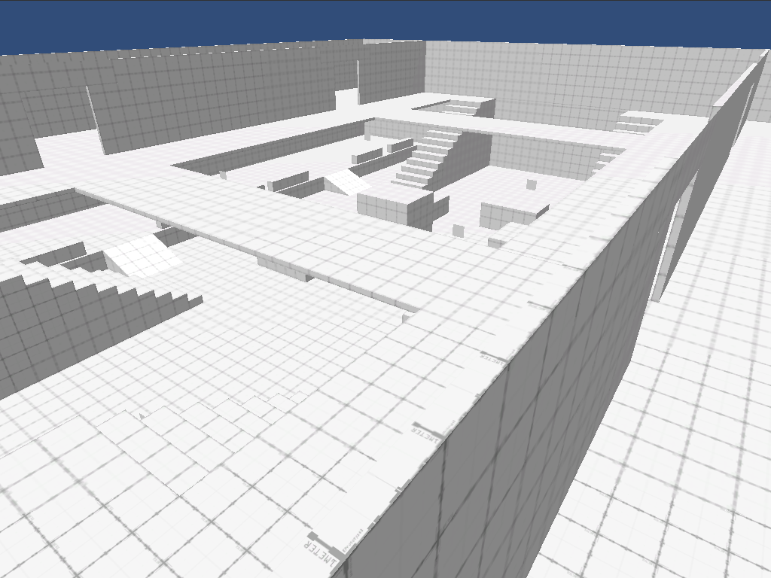
Timebox 5 Highlights:
New Levels
Training Grounds
Recycle Bin
Industrial Hazard
City Limits
Forgotten Temple
Notes:
david

Slide 10
Timebox 5 Highlights:
Interactive Elements
Button Activated Window
Notes:
kim

Slide 11
DEMO
Notes:
both

Slide 12
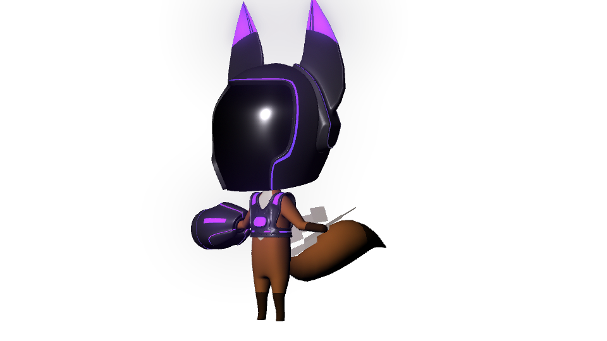
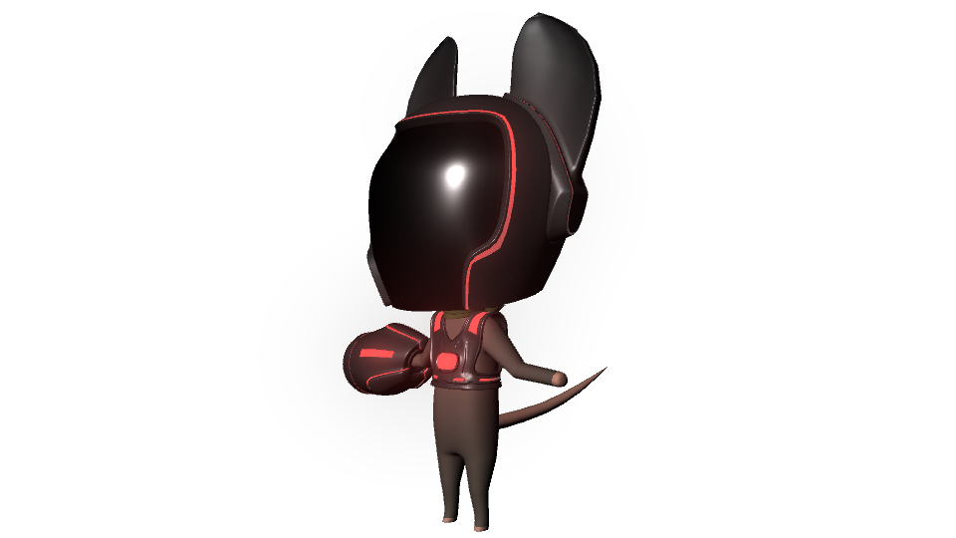
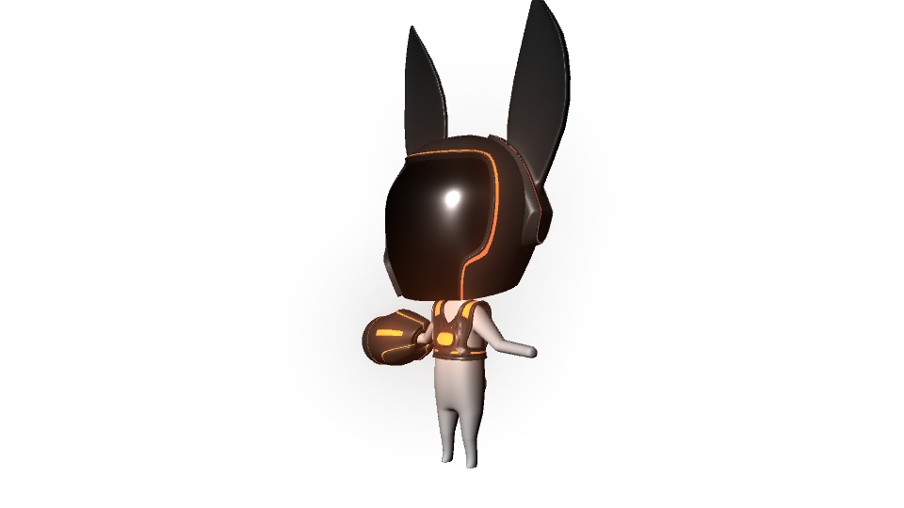
Final Goals:
Refine Levels
Add/Populate Interactive Features
Add New Character Models
Finish Single Player Levels
Refine Kinect Controls
Refine Storyline
Odds and Ends
Notes:
david

