Slide 1
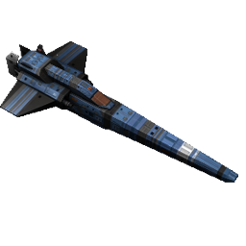
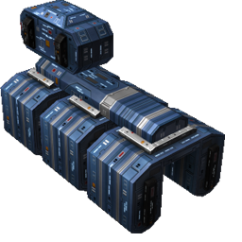
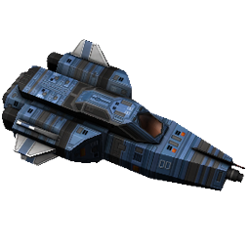
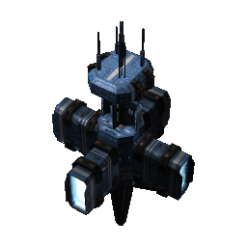
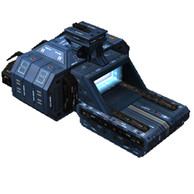
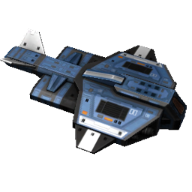
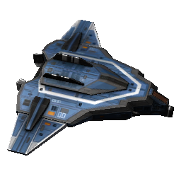
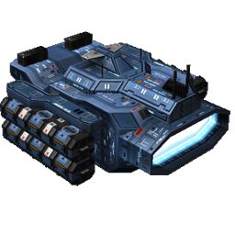
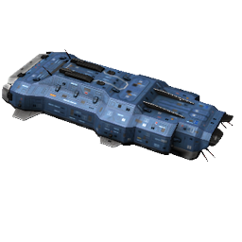
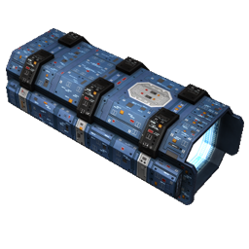
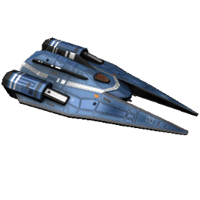
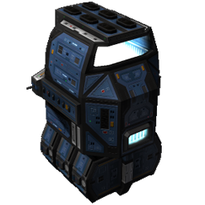
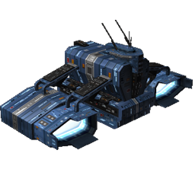
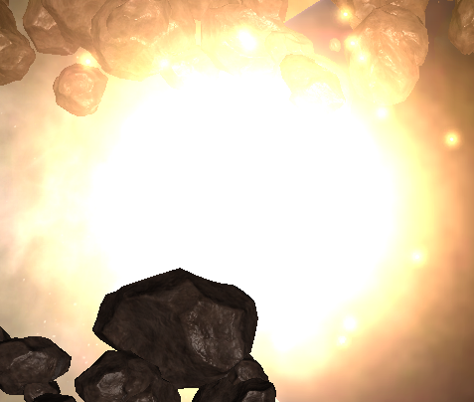
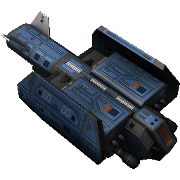
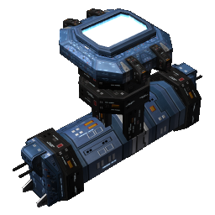
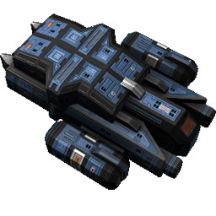
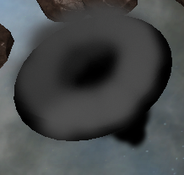
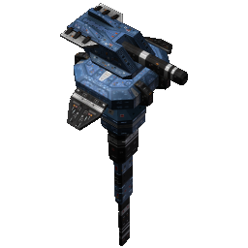
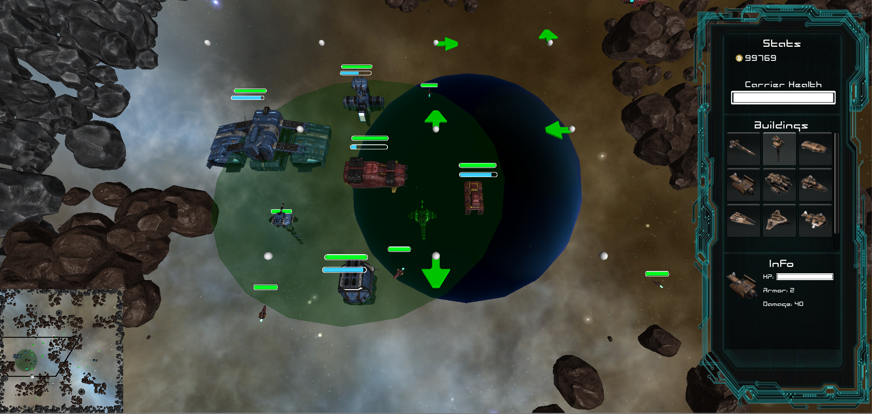
UNITS
BUILDINGS
MINE THE GAP
ASTEROID MAZE
Interceptor
Explore and solve a complex maze of asteroids by choosing a direction at each intersection.
Fighter
OBJECTIVES
Cruiser
MINE
BUILD
SOLVE
DESTROY
Avoid dangerous anomalies by placing markers.
Attack Cruiser
Find planets to capture and enemies to destroy.
Battleship
Resources
Factories & Units
Maze & Anomalies
Enemies
Destroyer
CONTROLS
ANOMALIES
Heavy Bomber
A top-down view allows you to easily click to select units and place buildings. Several hot keys have also been included such as ‘F’ to focus on the selected unit, ‘C’ to focus on your main carrier, and Backspace to destroy any buildings taking up unwanted space. Shift+click to choose directions at intersections and right click to add or remove anomaly markers.
Mines
Support
Black Holes
Missile Turret
BASE
OVERLAY
Build up a base within your “sphere of influence” around your main carrier or a captured planet.
Stats:
Resource Count
Carrier Health
Buildings:
Factory Selection
Unit Creation
Construct a variety of buildings to defend your main carrier, attack enemy units, and explore the map.
Info:
Health
Armor
Damage
Professor Roger Crawfis
Game Design & Development Capstone
Will Ruck
Mike McCarrick
Geoff McGinnis
Erik Schilling
Brett Mugglin
David Householder

