Slide 1
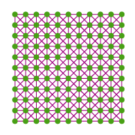
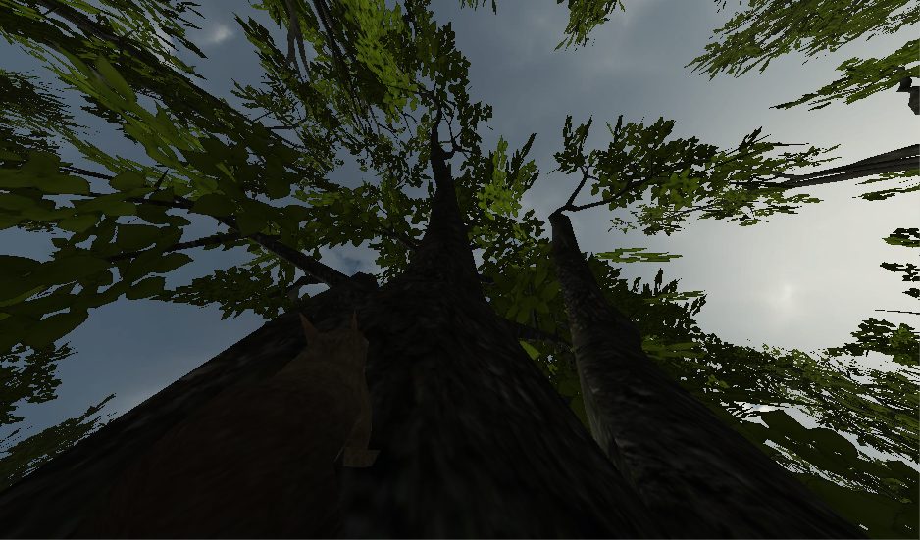
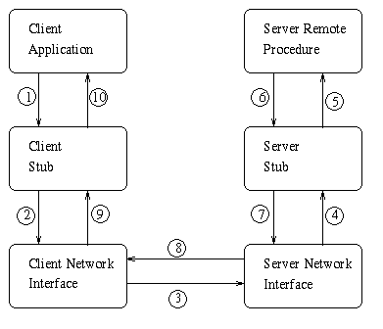
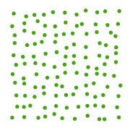
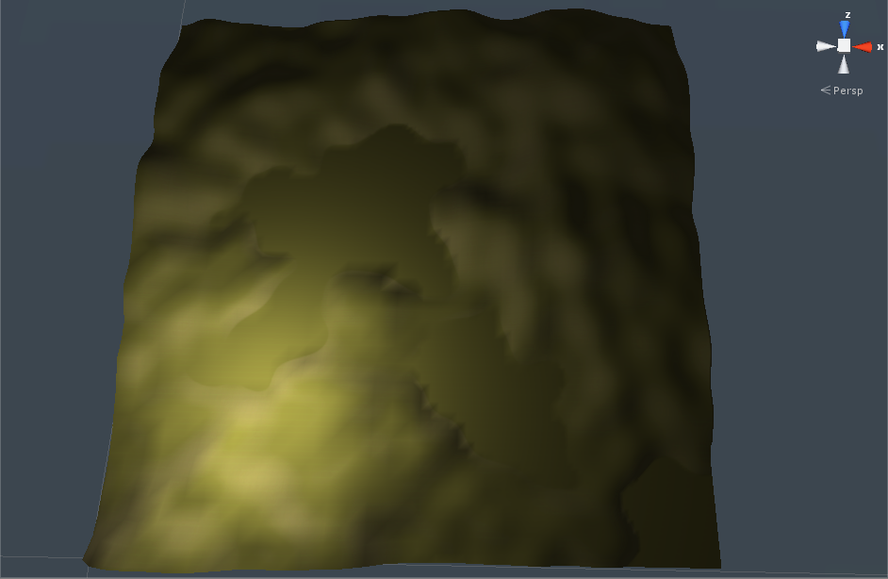
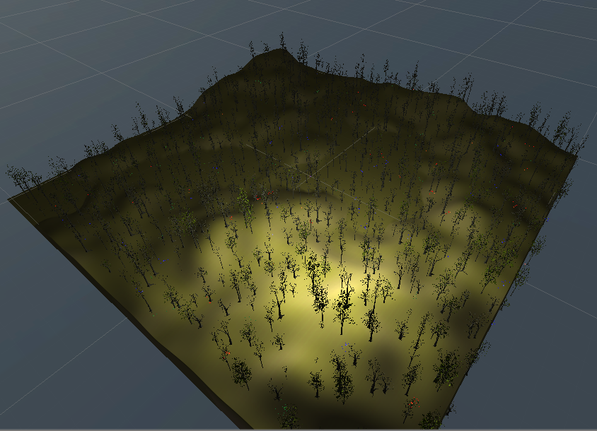
Squirvival
Technical Elements
Procedural Level
The world in Squirvival is created at runtime using a combination of noise generation and pseudo-random placement algorithms. First, Heights are created for the map using a fractal application of Simplex Noise (Figures 1 & 2). After the height maps have been calculated, Textures are applied based on the slope of the terrain: Steep slopes become rock faces and rolling hills and flat ground get textured with grass . Finally, a grid of trees are spawned into the world and then randomly perturbed so that the grid becomes an apparently random placement of trees (Figure 3). Once the trees are in place, Nuts, Power ups, and AI are spawned around trees. (Figure 4)
Multiplayer
The Unity master server hosts multiplayer skirmishes. Players join the game from a multiplayer screen using built-in Unity server Network functions. This allows for swift and simple networking between host and client machines. Upside is the simplicity for connectivity and downside is the lack of reliability of using Unity’s master server, as Unity’s taking it down frequently. Game data is shared between machines with the use of RPCs, as shown in Figure 6.
Climbing
The squirrel must traverse trees with ease. This is accomplished by detecting trees ahead of or below the squirrel and changing the direction of gravity to point towards the tree. Controls are exactly the same as on the ground. Gravity is restored when the squirrel jumps or the tree is no longer detected.
Figure 3 - Grid Perturbation (Above)
Figure 1 -
Noise Example
Figure 2 - Noise applied to Terrain
Figure 4 - Finished World (Right)
Figure 5 - Climbing in Action
Figure 1 - http://cogsandlevers.blogspot.com/2013/12/perlin-noise_31.html
Figure 3 - www.gamasutra.com/view/feature/1648/random_scattering_creating_.php?print=1
Figure 6 -Remote Procedure Call Diagram
Crawish Games - Daniel Frecka, Stephen Erickson, Tom Allenbaugh, Jared Hagans, Cameron Hopkins, Brandon Partridge

