Slide 1
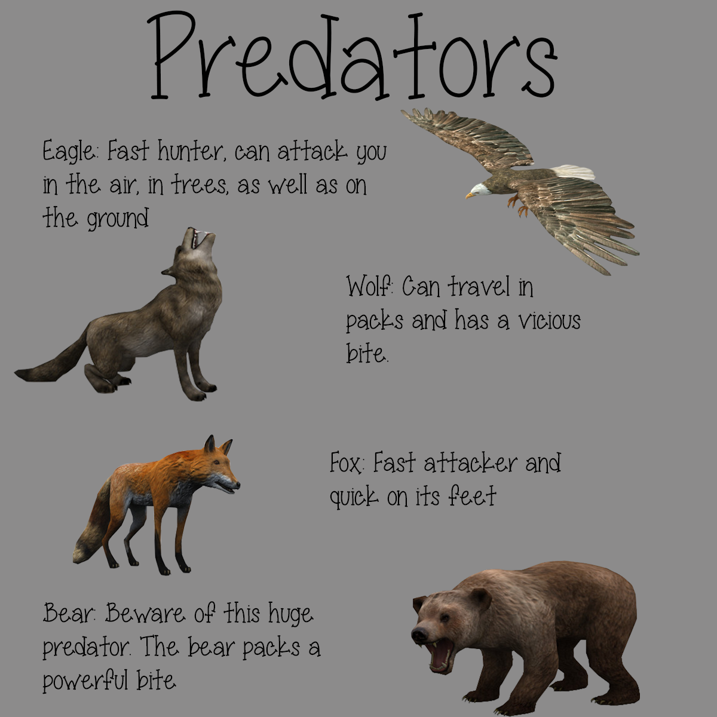
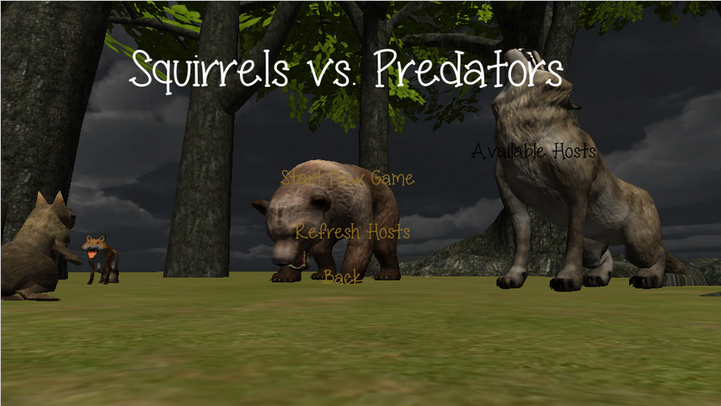
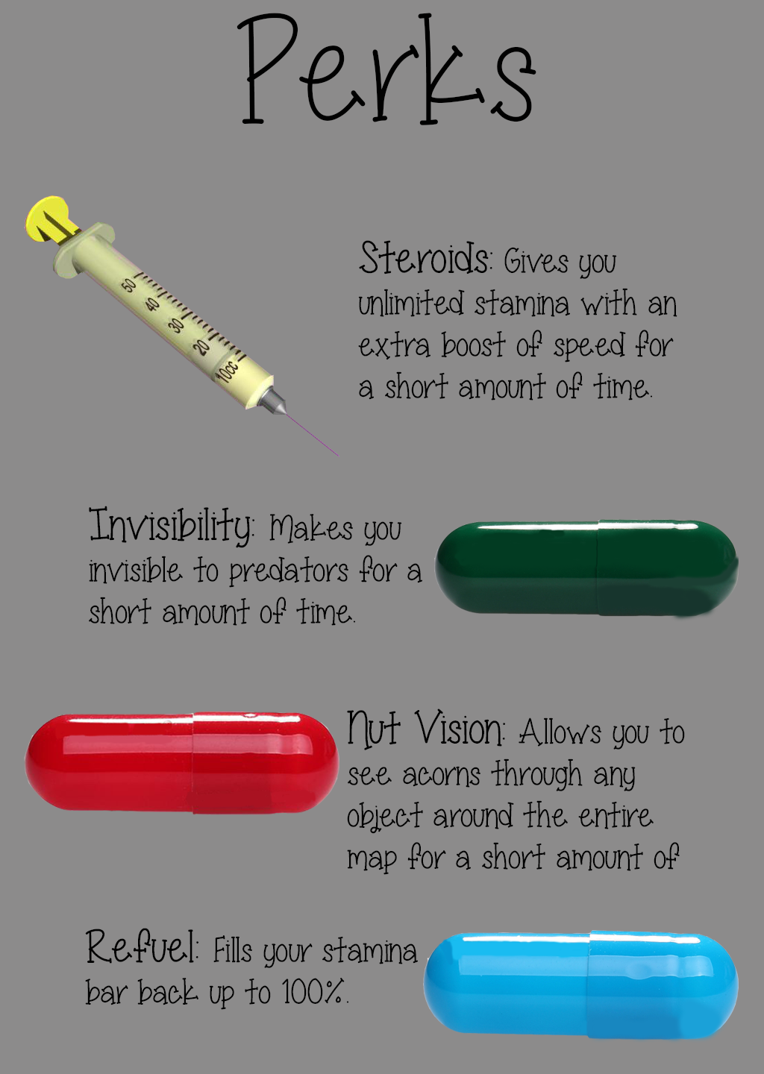
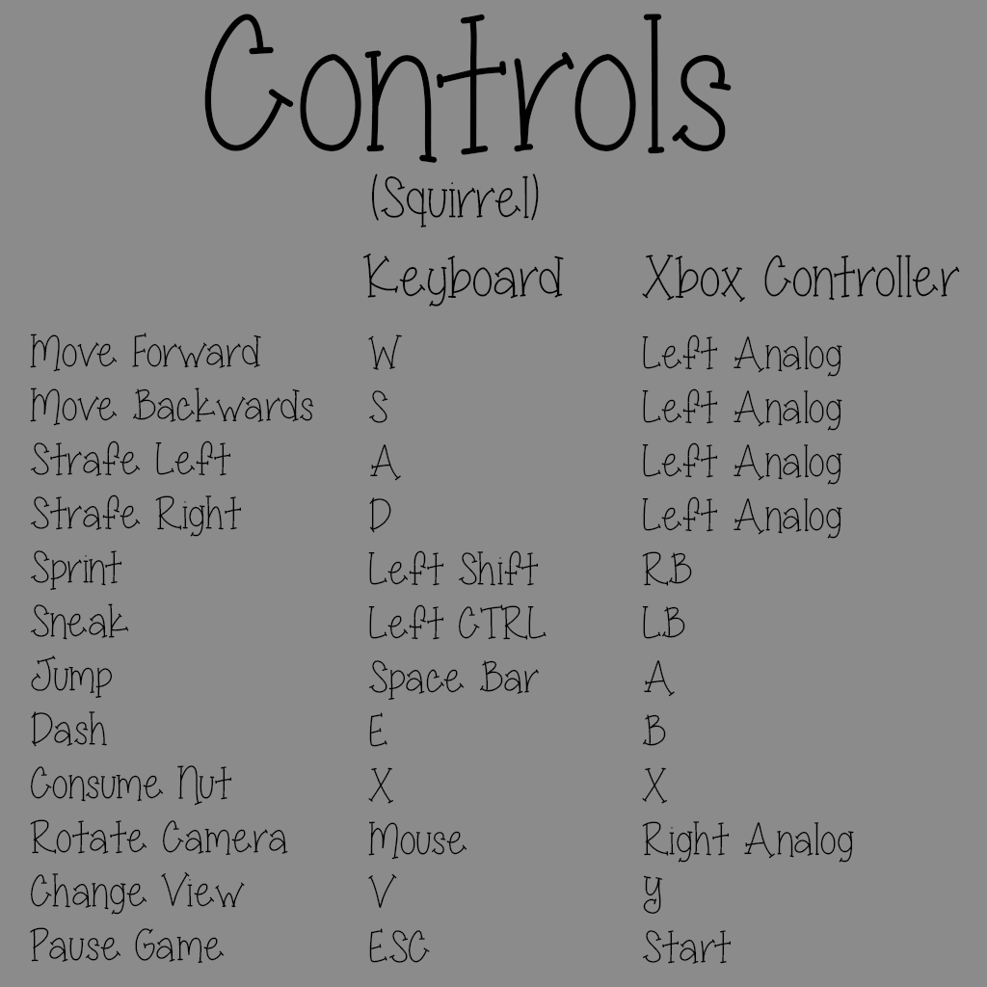
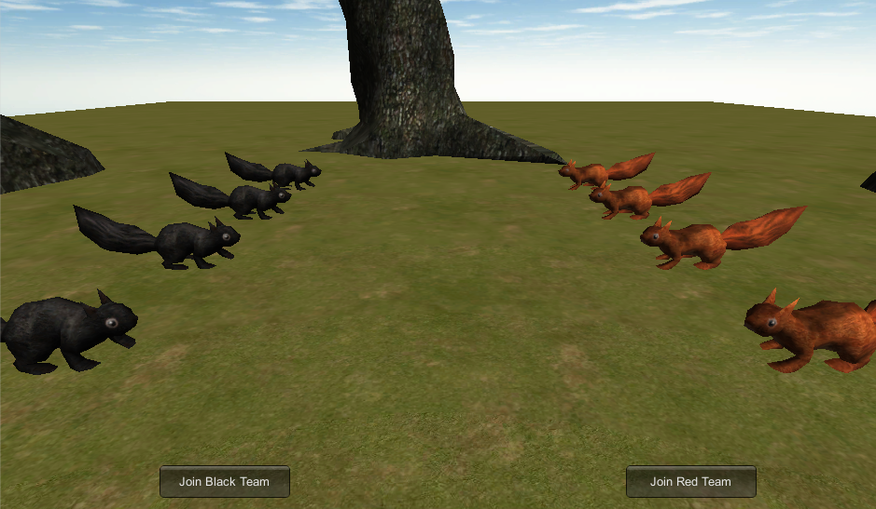
Squirvival
Gameplay Elements
Concept:
A zany squirrel “simulation”. Gather nuts, fend off rival squirrels, avoid being eaten by predators. Collect powerups to aid you. Experience the joy and freedom of a climbing, gliding super-squirrel.
Objectives:
In the Single Player the player takes on the role of a squirrel and must collect enough nuts to survive the winter before the timer runs out while avoiding AI Enemies.
Enemies:
These pesky predators are out for blood and want to stop you from collecting nuts! These four predators, the eagle, wolf, fox, and bear, will hunt you down and be a barrier to winning! The follow your scent, they guard nuts, and they travel in packs for a more vicious attack
Parkour Mode:
Parkour - Practice your climbing and gliding skills on a challenging set of obstacle courses where you must avoid touching the ground while retrieving a single nut from across the map.
Actions:
In order to collect these nuts, the player has some features they should use to survive. The player can climb trees, fl/glide for a short period, attack, go into stealth mode, sprint, or consume some nuts to regenerate health and stamina..
Multiplayer:
Squirrels vs. Predators - a game mode in which is team based where players can join together as a team of squirrels or a team of predators. The squirrels must advance around the map collecting nuts as a team and bringing all the nuts back before winter strikes. The predator team must try and stop the squirrels from reaching their selected amount of nuts!
Capture the Nuts - a game mode in which there are two teams, red squirrels and black squirrels. The teams must run through the map collecting nuts and bringing them back to their home base before time runs out. The team that brings the most nuts back home wins!
Perks:
There are random perks laying around the map to help you survive. Use these tools to give you that extra boost to stay away from enemies and to collect nuts!
Crawfish Games - Daniel Frecka, Stephen Erickson, Tom Allenbaugh, Jared Hagans, Cameron Hopkins, Brandon Partridge

