Slide 1
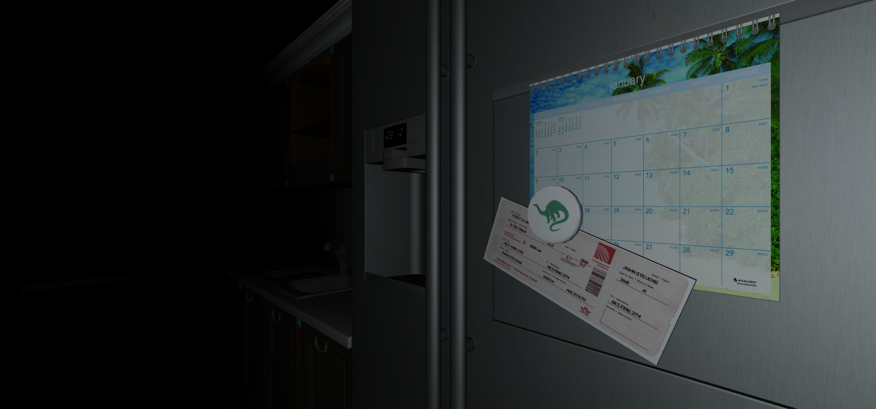
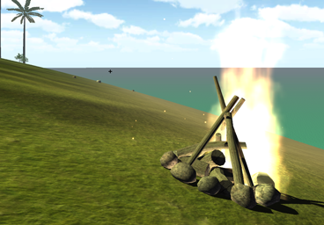
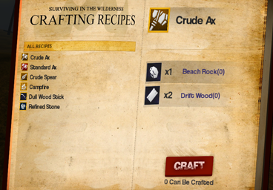
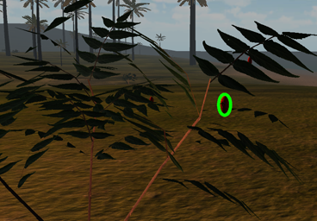
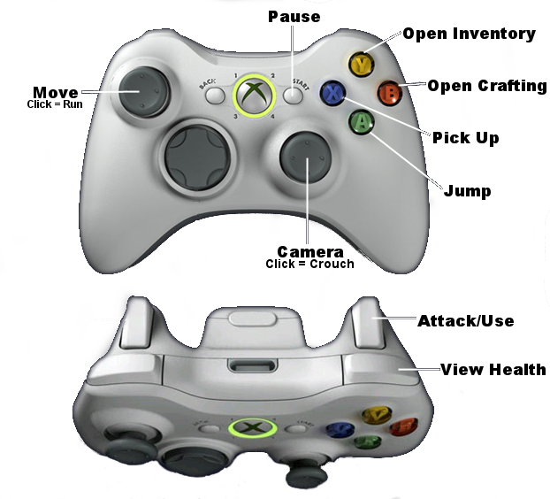
GAMEPLAY POSTER
Department of Computer Science and Engineering
The Ohio State University
Quentin Bloomfield, Keegan Donnelly, Jacob Grealy,
Zach Knickerbocker, Nate Niederkorn, Sean Peck
Player Status
It’s time for a vacation.
Health
The setting for the game is a survival scenario. You've awoken on an island following a plane crash, and find yourself stranded with little resources in a dinosaur inhabited paradise. Weather the harsh conditions, collect and craft the survival tools you need, and ultimately attempt escape from the island. As quick as you can muster – “Get Away”!
Depletes when injured
Hunger
Depletes faster when running
Thirst
Depletes faster during the day
Sanity
Survive The Night
Depletes during the night
Craft a campfire, place it on the island, and then click it to quickly sleep through the night. This is a great way to replenish sanity, and avoid dinosaurs that crawl the island in the cover of darkness.
Weapons & Tools
Ax
Chop trees to get logs and other resources.
Craft Weapons and More
Spear
Crafting new items from the resources you collect around the island will enable your survival. Craft an axe to chop down a tree. Craft a spear the take down a dinosaur. The possibilities are many.
Take down dinosaurs with a thrust of your spear.
Bow & Arrow
Collect Resources
Shoot at dinosaurs from afar.
Resources for both crafting or consumption can be collected from the island. Some items are commonly available everywhere, whereas others are rarer and restricted to particular climates like the jungle.
Torch
The night is dark, but a torch will light your way.
Your Goal
Controller Mapping
Build the raft to escape the island!

