Slide 1
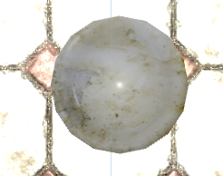
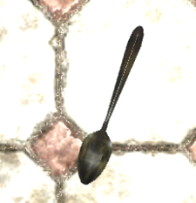
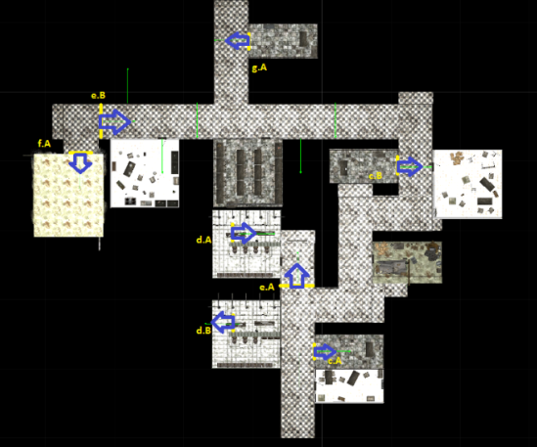
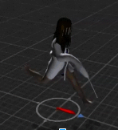
Forsaken
Portals
The portals allow us to manipulate the player’s location seamlessly. Throughout the asylum, hidden portals are used to confuse, trap, and disorient the player. The portals themselves act like a hole cut into the view, and the image from a corresponding portal camera is displayed in the empty space. Through tricky camera work and careful alignment, the portal camera orbits the portals exit point, displaying an uninterrupted view for the player.
Atalyah Wandering AI
Throughout the asylum are invisible waypoints. Atalyah will randomly choose a waypoint to walk to. Once she arrives, she scans the area for a few seconds then chooses a new waypoint to patrol to.
Throwable Objects
When props are thrown, the distance between the prop collision point and Atalyah is calculated. If that calculated distance is less than Atalyah’s hearing threshold, she hears the sound and moves towards the noise source
Atalyah Attacking AI
If you enter Atalyah’s field of vision as she patrols the asylum, she will begin chasing you. If you leaveher field of vision, either by running out of it or hiding behind an object, she will continue patrolling. If Atalyah gets close enough, she will kill you.
Animation
Created using Unity’s Mechanim animation system, using an envelope-weighted bone animation system. The key frames were made with blender. Her various actions are deceptively few – only a walking, idle, running, and searching animation are triggered.
Portal Architecture
An Architect was implemented to coordinate which portals to enable at any given time. This is decided by factors including player location and progression of the game state.
Serambiguous Games: Tony Xu, Robert Feeney, Steffan Pease, Ting-Chun Sun, Nicole Shaddock

