Slide 1
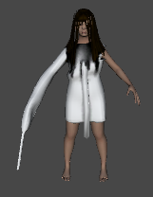
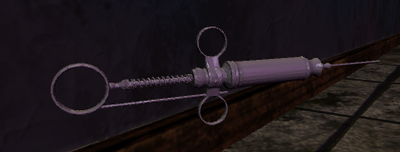
Forsaken
Atalyah – Patient
Advice to Survive:
Don’t be too loud
Don’t trust your sense of direction
Don’t trust your eyes
Escape
You wake up from a daze in a place you've never seen. The only sound that can be heard apart from your racing heart and heavy breathing are the echoes of a dripping pipe in the hall. This place is clearly abandoned and has been for quite some time. There is only one objective: escape. But this place seems almost alive, and it feels like it isn't quite done with you.
Controls
W Move Forward
A Strafe Left
S Shuffle Backwards
D Strafe Right
E Interact
Shift Run
Spacebar Jump
Ctrl Crouch/Crawl
Mouse Look
Mouse Left Throw Object
Esc Pause
Atalyah is a disturbed little demon girl who doesn’t want to be bothered. Don’t let her find you and try not to attract her attention. She is the only obstacle on your way to freedom.
Syringes – Help you see the world how it really is
Serambiguous Games: Tony Xu, Robert Feeney, Steffan Pease, Ting-Chun Sun, Nicole Shaddock

