Slide 1
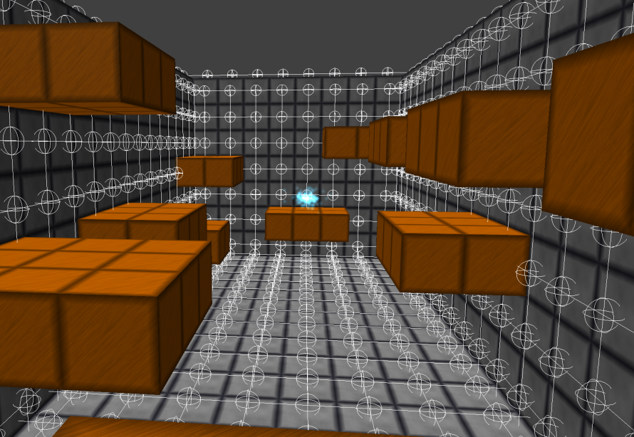
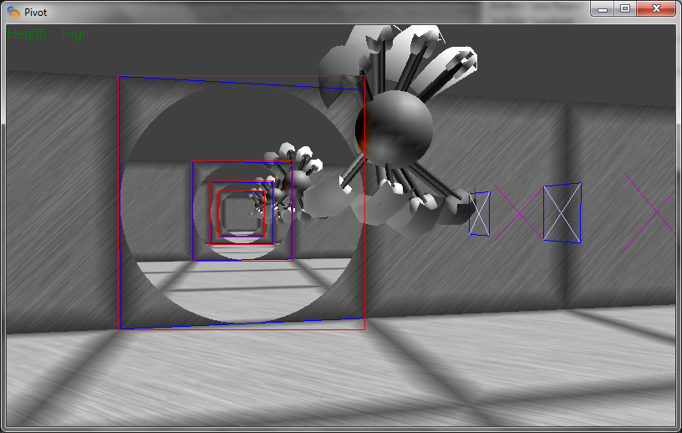
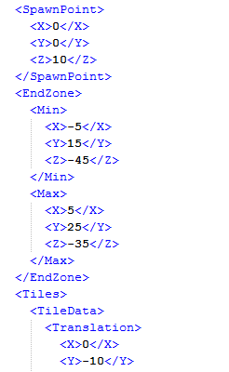
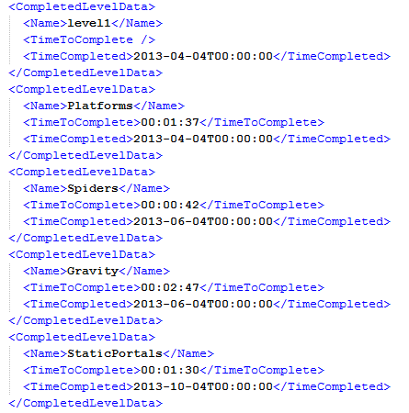

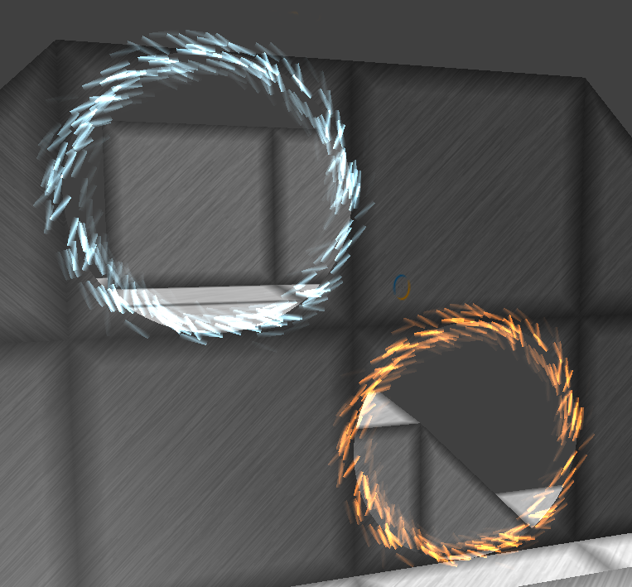
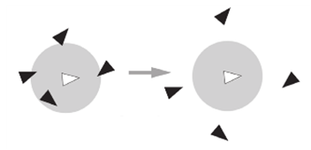
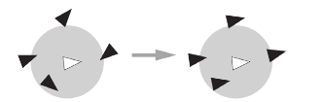

Pivot: Technical Details
Michael Griscom, David Klimek, Frans Kurniawan, Shitianyu Pan, Joshua Ventura
Department of Computer Science & Engineering, The Ohio State University, 2015 Neil Avenue, Columbus, OH 43210
SUMMARY
SOUND
CODE ARCHITECTURE
ARTIFICIAL INTELLIGENCE
Pivot is a single player puzzle game for the PC. It was created in the C# programming language using Microsoft’s XNA framework. The development took place over a span of 15 weeks.
The Model-View-Controller (MVC) design pattern was used to provide a flexible, loosely coupled system. This was backed by further encapsulation of the various game components (e.g., the physics, graphics, and AI engines).
The Cross-platform Audio Creation Tool (XACT) library was used in order to play in-game music and sound effects. The sound effects are generated in a virtual 3D space, meaning that sounds (e.g., that generated by the end-of-level marker) become louder or softer based on proximity, in addition to having differing left-right speaker strengths.
The foundational organization of the code base is designed using the Model-View-Controller (MVC) architecture, which provides a loose coupling between the game’s business logic and its visual manifestation. This design philosophy was leveraged across the codebase in order to create a flexible, maintainable application. Using the Visual Studio 2010 code metrics analysis, maintainability indices were calculated for the code. This index is a value between 0-100 designed to quantify the maintainability an application; Microsoft describes values greater than 20 as “good.” The results of this analysis are shown in the table below.
The enemies of Pivot follow a state-machine model, where an entity’s current state (e.g., “Idle”) can transition to another state (e.g., “Chase”) via a trigger (e.g., “Player Visible”). This allows for easy extension through the creation of additional, more complex states. Further, in the future alternate AI personalities could be added via the use of different state machines, such as those emphasizing exploratory or aggressive behavior.
GRAPHICS
All the in-game textures and models are created procedurally; that is, rather than utilizing modeling software the functions that describe the appearance of objects are represented mathematically within the code.
Table 1. VS2010 code metrics analysis results for the large projects in the game
Project | Maintainability Index | Executable Lines of Code
Framework | 83 | 714
GameCore | 91 | 1,335
GameState | 84 | 1,658
Graphics | 76 | 1,884
MapEditor | 90 | 554
Physics | 90 | 973
Weighted Avg. | 84.4
SAVING
Figure 4. Spider navigation graph for a level; note that the wooden cubes are excluded as spider locomotion is restricted to metallic surfaces
Figure 1. Portal nesting effect accomplished through the use of scissor rectangles
For the spiders, additional logic – in the form of path planning – is used to provide chasing mechanics. This is achieved through the creation of a navigation graph for the level. When they travel, spiders also are encoded with flocking tendencies to create more realistic and varied behavior.
Portals are rendered by creating a “stencil” which informs the graphics device which pixels to render, then re-drawing the world in that stencil. Fill rate is optimized through the use of scissor rectangles, which enable the consideration of only those pixels which might lie in the portal stencil. Portal nesting is accomplished recursively, and is optimized using back-face culling (indicating not to draw the scene), followed by frustum culling and occlusion testing.
The game progress (i.e., which levels have been beaten and the best time for each) is stored, along with the game settings, in the user’s AppData folder. Additionally, custom levels are serialized in an XML format within the same folder to allow for convenient saving, loading, and sharing.
CONTACT
Michael Griscom griscom@cse.ohio-state.edu
David Klimek klimek@cse.ohio-state.edu
Frans Kurniawan kurniawf@cse.ohio-state.edu
Shitianyu Pan pansh@cse.ohio-state.edu
Joshua Ventura venturaj@cse.ohio-state.edu
Figure 5. Left to right: separation, cohesion, and alignment forces that create flocking behavior in the spiders (Source: Programming Game AI by Example, Matt Buckland)
TECHNOLOGIES
Cross-Platform Audio Creation Tool (XACT)
The GNU Image Manipulation Program (GIMP)
Microsoft Visual Studio 2010
Microsoft XNA 4.0
QuickGraph, Graph Data Structures and Algorithms for .NET
Figure 2. Portal effects are created using an array of particles, each having a unique position and velocity and consisting of two graded triangles
Figure 3. Sample XML for custom level data (left) and game progress (right)

