Slide 1
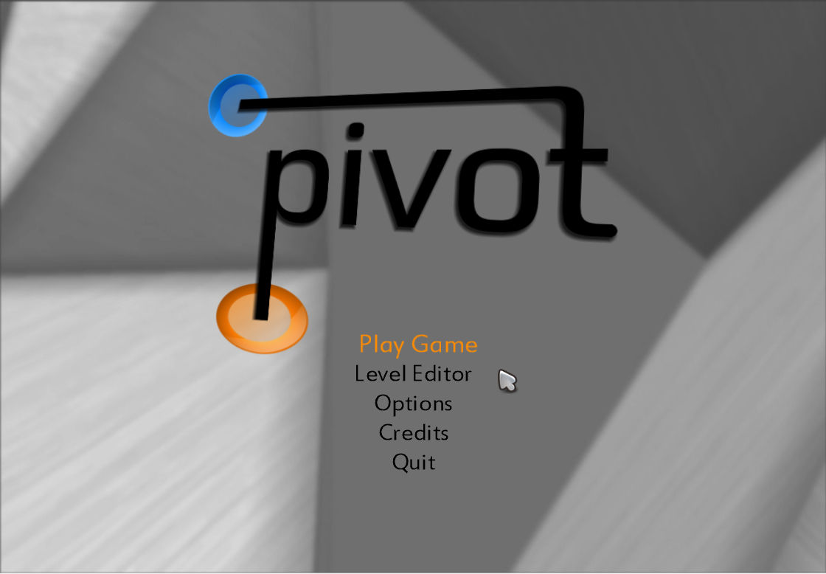
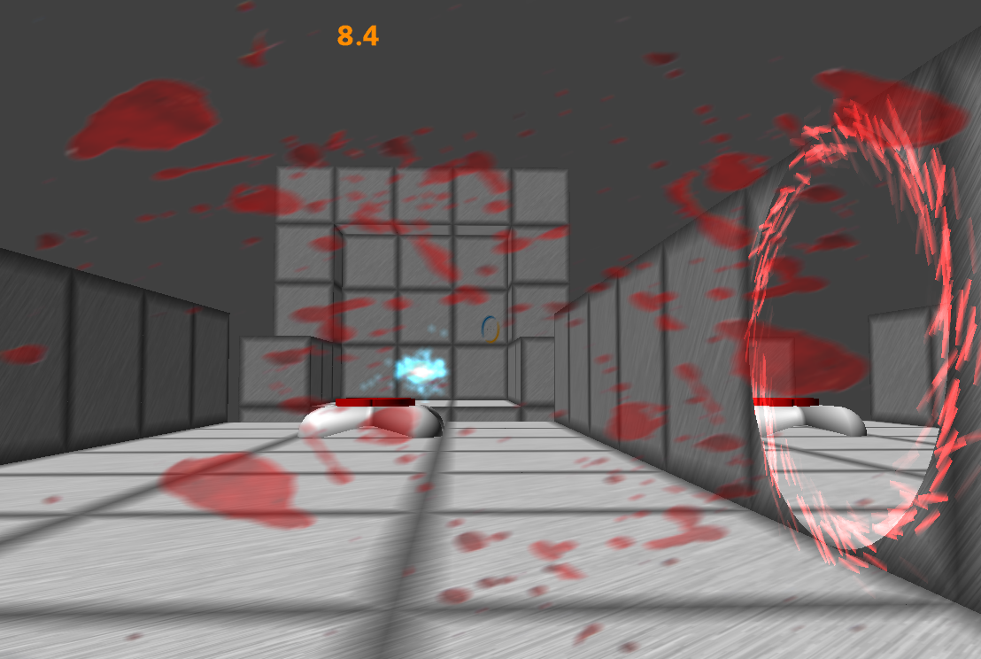
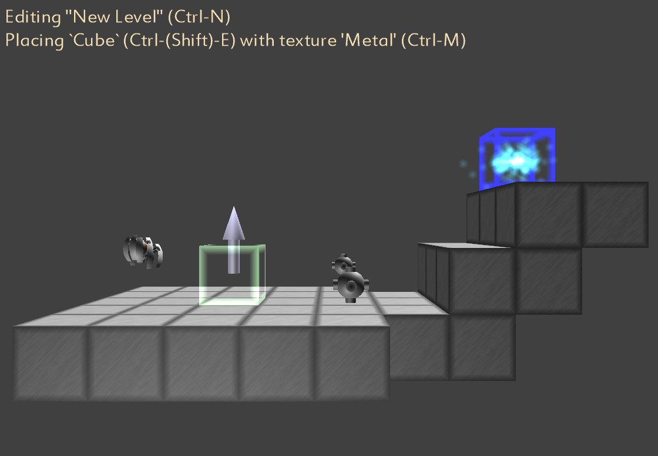
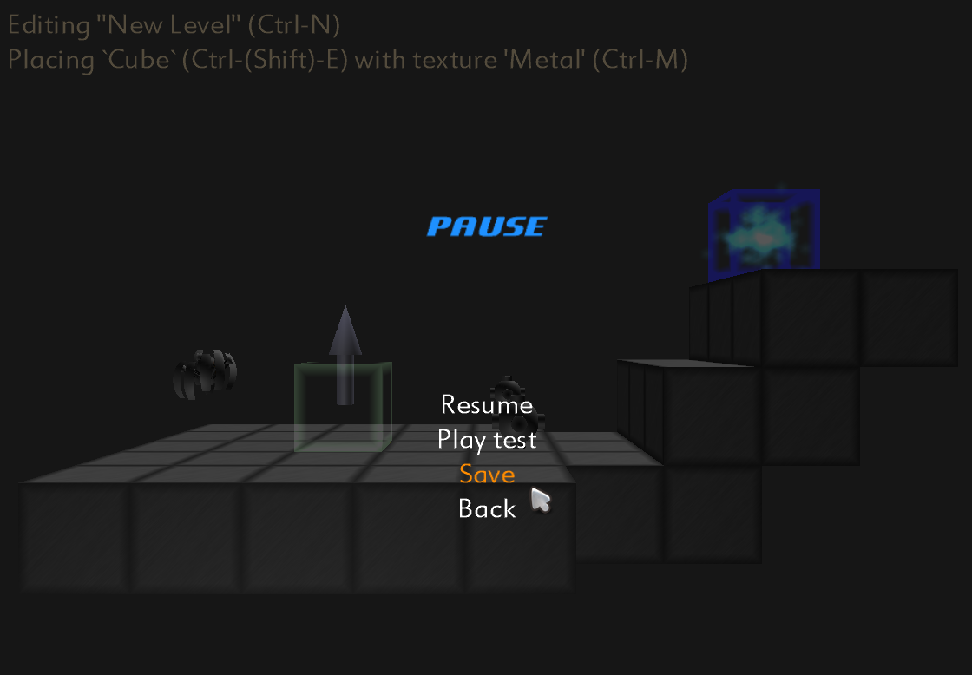

Pivot: The Game
Michael Griscom, David Klimek, Frans Kurniawan, Shitianyu Pan, Joshua Ventura
Department of Computer Science & Engineering, The Ohio State University, 2015 Neil Avenue, Columbus, OH 43210
SUMMARY
HOW TO PLAY
LEVEL EDITOR
Pivot is a single player puzzle-adventure game that is a twist on concepts popularized by Valve’s Portal. In Pivot, players have the ability to create portals, which act as wormholes allowing the player – and other objects – to transport across the level.
Pivot carries the physics-altering mechanics further by allowing players to manipulate gravity, adding to the depth of the puzzles. As the player progresses through the game the level difficulty increases, slowly introducing new game-play elements and forcing the player to avoid spiders, turrets, and other obstacles.
In addition to the built-in levels, players have the option of creating their own custom levels, which can then be shared with others. The diversity of in-game objects allows for many possible designs, enabling the creation of a wide variety of puzzles.
The goal of the game is to progress through every level. This is accomplished by reaching the “End Zone” through the use of tools at the player’s disposal, while avoiding obstacles. A timer adds an additional element of competition, allowing players to track their personal best times for each level. The levels become increasingly difficult, slowly introducing new puzzle elements as the player becomes accustomed to the game mechanics.
Players also have the option of creating custom levels through the use of a built-in level editor. The user-friendly interface and file format allow for the quick creation and sharing of levels. The level editor also provides a drop-in feature to allow immediate play testing during level creation.
Table 2. Level editor controls
Button | Function
Mouse/Arrow keys | Translate cursor
+/- | Move cursor forward/backward
U/I/O/J/K/L | Alter cursor orientation
W/A/S/D | Translate Camera
Q/E | Zoom camera out/in
Ctrl+[add or subtract key] | Rotate camera
Ctrl+Arrow Keys | Rotate level
Space/Left mouse button | Place object
Right mouse button | Remove object
Ctrl+(Shift)+E | Alter object type
Ctrl+M | Alter object sub-type
Esc | Pause Menu
Table 1. Game controls
Button | Function
W/A/S/D | Character Movement
Space | Jump
Mouse | Look
Left mouse button | Fire blue portal
Right Mouse button | Fire orange portal
Esc | Pause Menu
F2 | Audio Menu
Figure 2. Main menu screen
MAIN MENU
Upon starting the game, the player has several options. They can play the main game, unlocking new levels as they progress, or create their own levels using the level editor. There are also several audio, visual, and game play options that can be adjusted.
Spider
Climb walls
Stationary Turret
Fires out of all sides
Fires at predictable intervals
Lava Balls
Hurt player and spiders on contact
Only walk on metallic surfaces
Fall through portals
Figure 1. Level end is indicated by a blue marker, damage by a red screen overlay
Figure 4. Level editor and pause menu
CONTACT
Gravity Buttons
Alter universal gravity
Portals
Level portals alter player’s gravity
Activated when jumped on
Player can fire one pair of portals
Metal
Supports portals
Rubber
Bounces the player
Other
Do not support portals
Michael Griscom griscom@cse.ohio-state.edu
David Klimek klimek@cse.ohio-state.edu
Frans Kurniawan kurniawf@cse.ohio-state.edu
Shitianyu Pan pansh@cse.ohio-state.edu
Joshua Ventura venturaj@cse.ohio-state.edu
Figure 3. Gravity buttons can reorient the level in surprising ways

