Slide 1
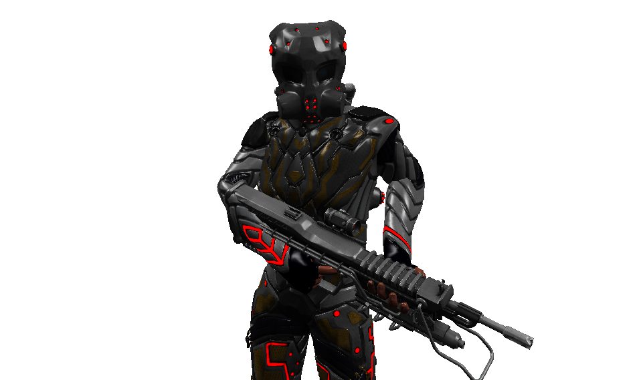
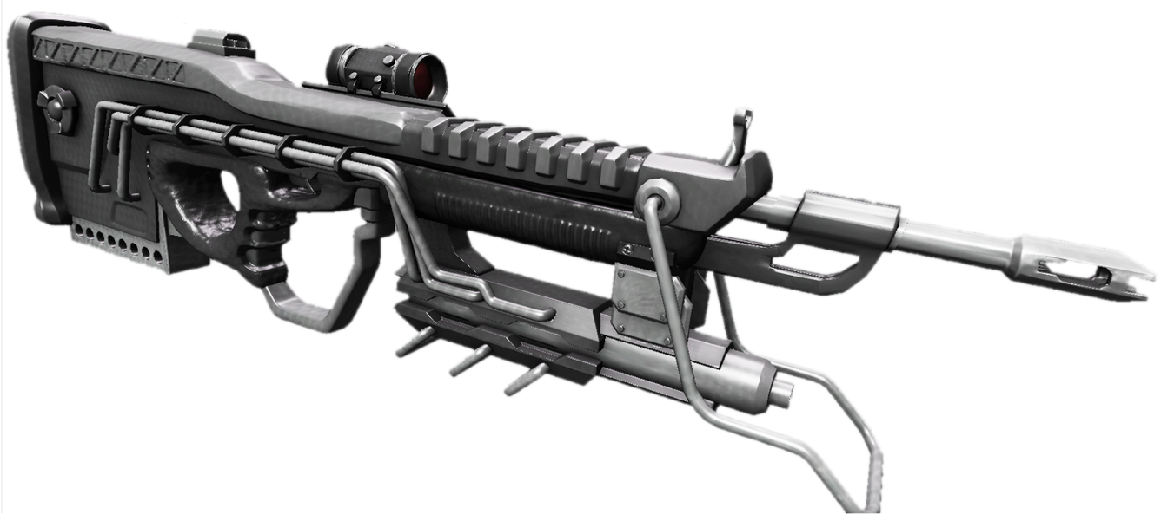
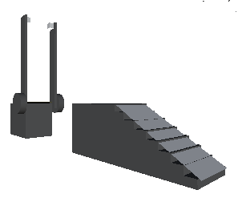
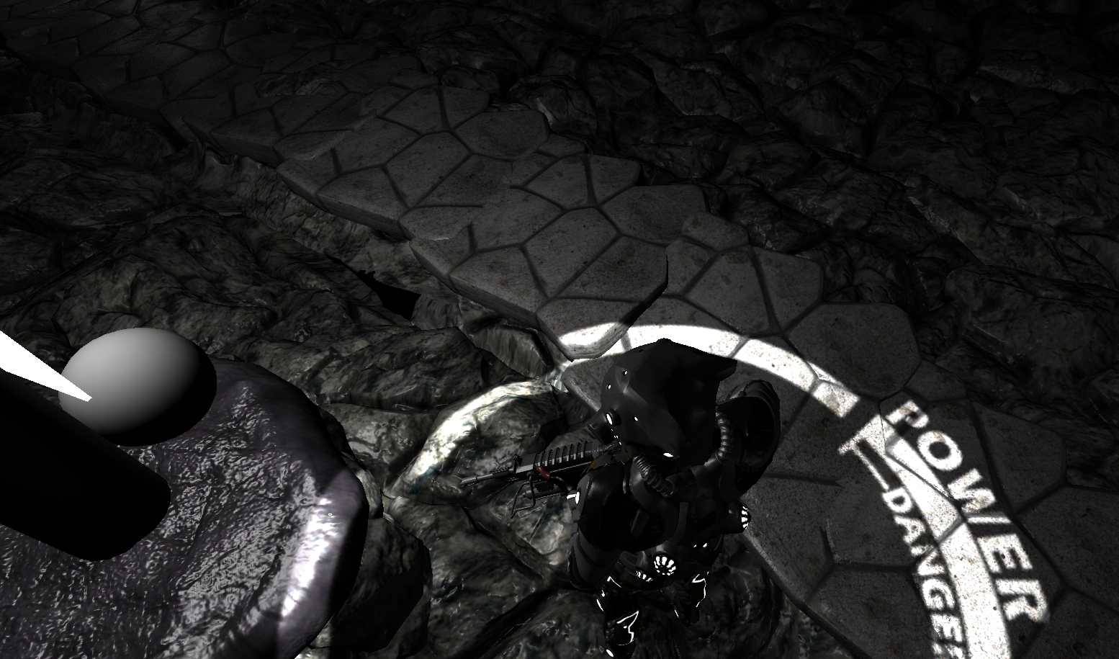
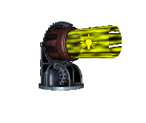
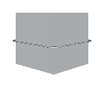
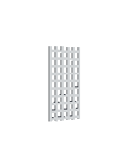
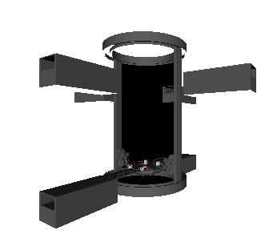
The Source: Can you survive the darkness?
Tim Carpenter, Lap Hou Chan, Mike Johnson, Chris Price, Stephen Smith, Chad Travis
Department of Computer Science and Engineering
The Ohio State University
Puzzle Components
Lux Lamp –
A permanent Light Source. Activated when the ball is shot with a flare. Helps tell the player where he has explored.
Story
Light has become valuable. The only source is the player plasma rifle. Use this to fight through enemies and complete puzzles. Can you survive the darkness?
Plasma Rifle –
Players lone weapon. Capable of shooting bullets and flares of different colors. Used for taking down enemies and operating different puzzles.
Controls
Keyboard
W – Forward
S – Backward/Cancel Climb
A – Strafe Left
D – Strafe Right
F – Focus in Gun
Spacebar – Put Away Gun
E – Climb Object
L – Lock/ Unlock the Mouse Cursor
Esc – Pause
Mouse
Move - Aim
Left Click – Shoot Bullet
Right Click – Shoot Flare
Scroll Wheel – Change color
Enemies
Bridge –
Activated by two Light Trails to help navigate the player over large gaps. Shoot the Light Trails switches and see if the color combination activates the bridge.
Numerous other adventures have gone down this dark path and failed. They are now tormented by the light, willing to attack any outsider wanting to use it.
Light Beam –
Sends out a constant source of light to keep switches activated. Combine these together to create a trail of light beam to activate otherwise impossible switches.
Map
The player must navigate through the map solving puzzles along the way. The puzzles all consist of different components. The map itself is a giant maze requiring the player to keep track of where he has been.
Push Box –
To block the player and create bridges. Push or pull these around to create a strategic advantage
Saving and Loading
Heads Up Display
Timed Gate –
A gate controlled by a switch that closes slowly over time. Shoot the switch with bullets to raise it.
The game features a saving and loading ability. It is done with an auto save that is initiated at the start of each level. The saving will save the position of push boxes, all turned on light lamps, and player location.
The player’s HUD is completely integrated within him. His power display is a circle going around his body when walking and ear while shooting. This is his health and energy for his plasma rifle. It drops when he is attacked and by shooting bullets and flares. Shooting flares takes much more power away than bullets. The power recharges over time. Once the player gets into the danger area his gun will no longer work and he must wait for it to recharge.
Death
Elevator –
An elevator operated by two light trails to move the player between levels. Different color combinations cause different effects: rise, lower, and rotate. Step on the center pad to see if you have the correct combination.
Another challenging aspect involved is player death. Enemies and venturing into some locations will bring damage to the player. The health of the player is signified by his energy bar underneath him. If it reaches zero the player must return to the last save.

Slide 2
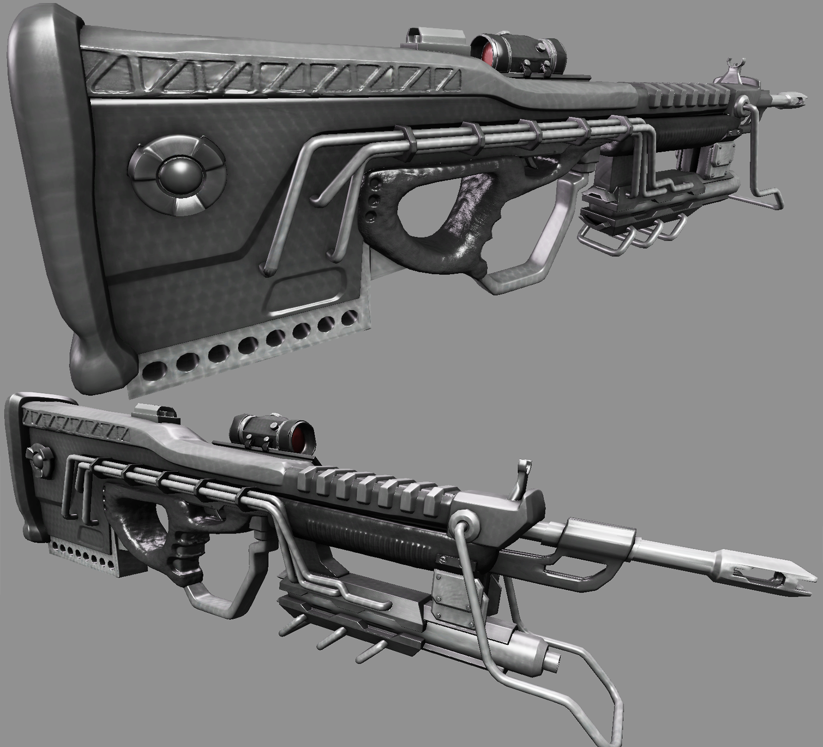
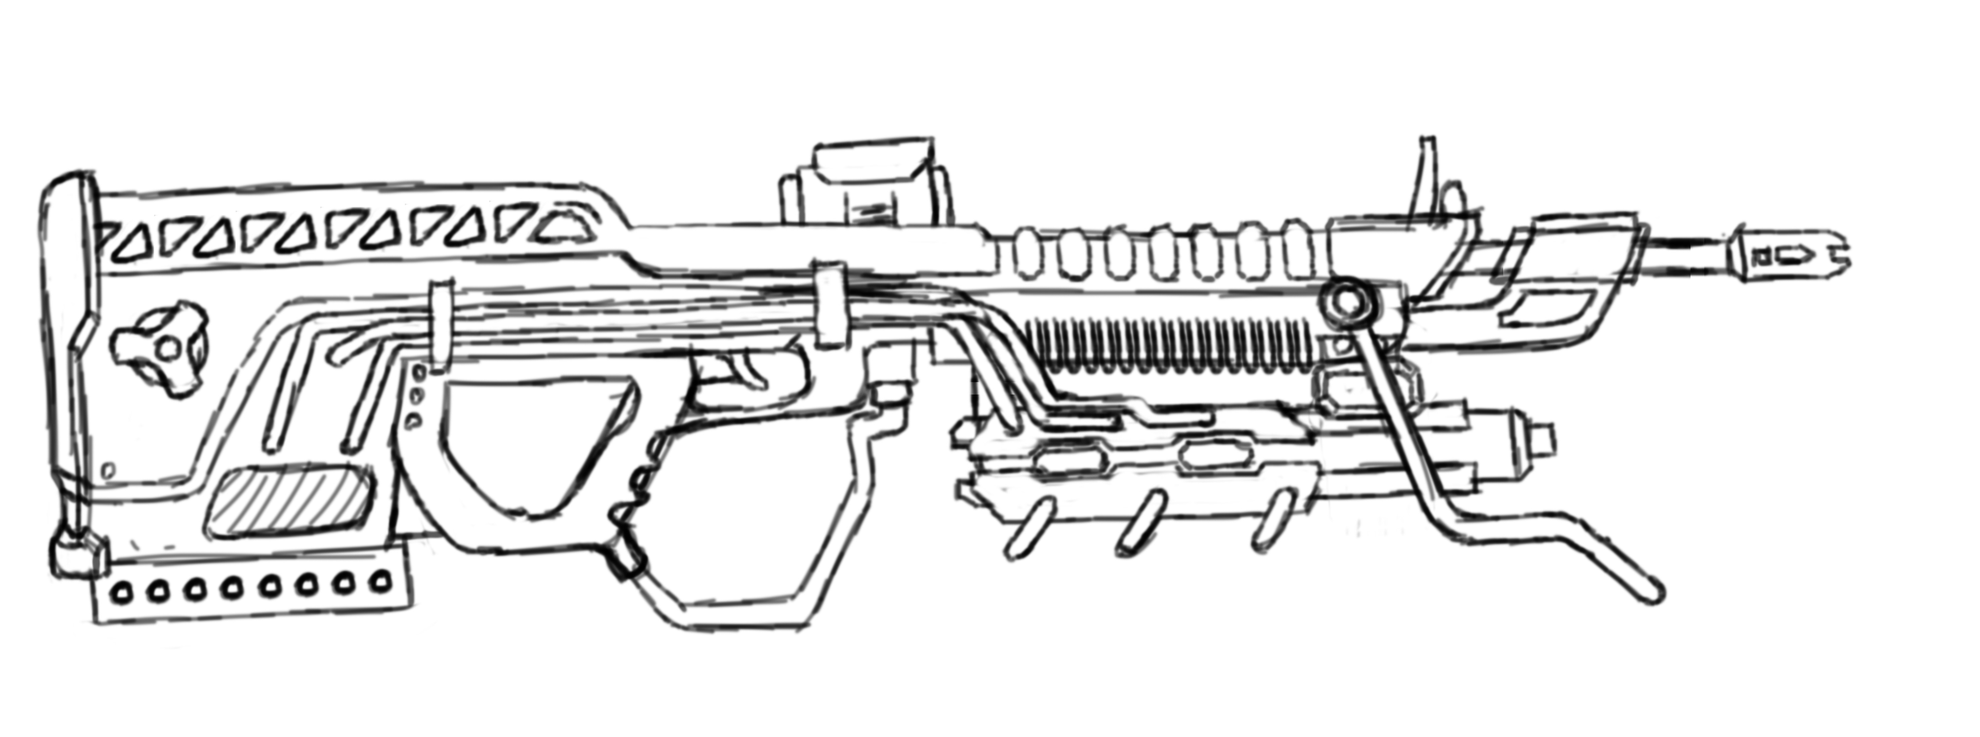
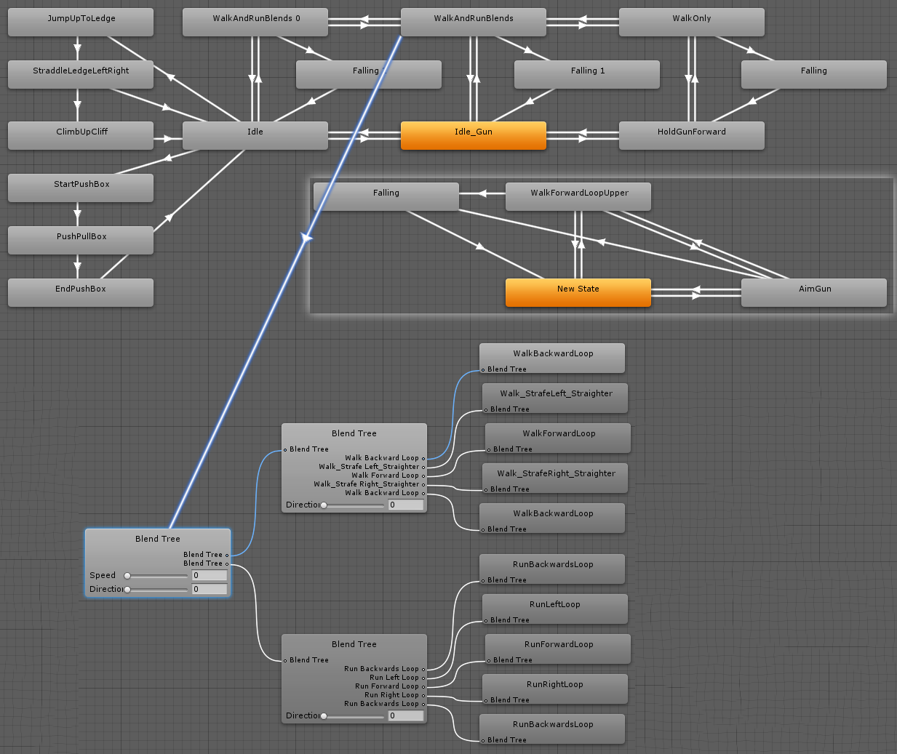
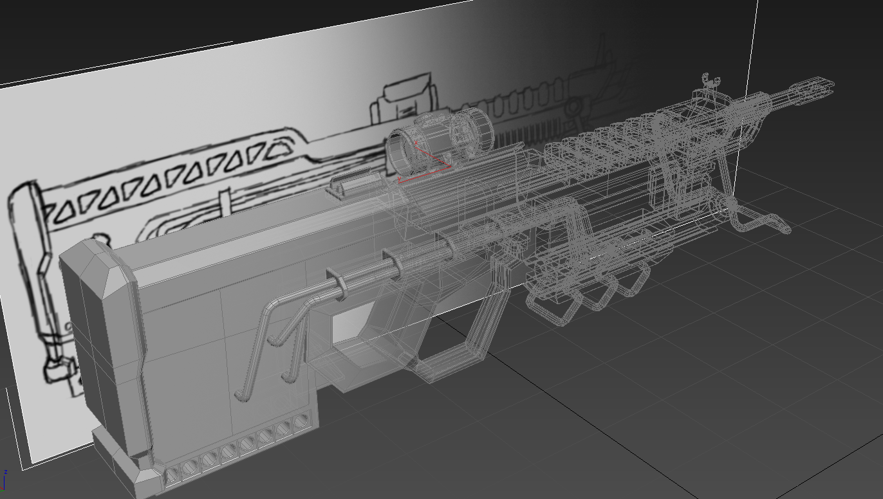
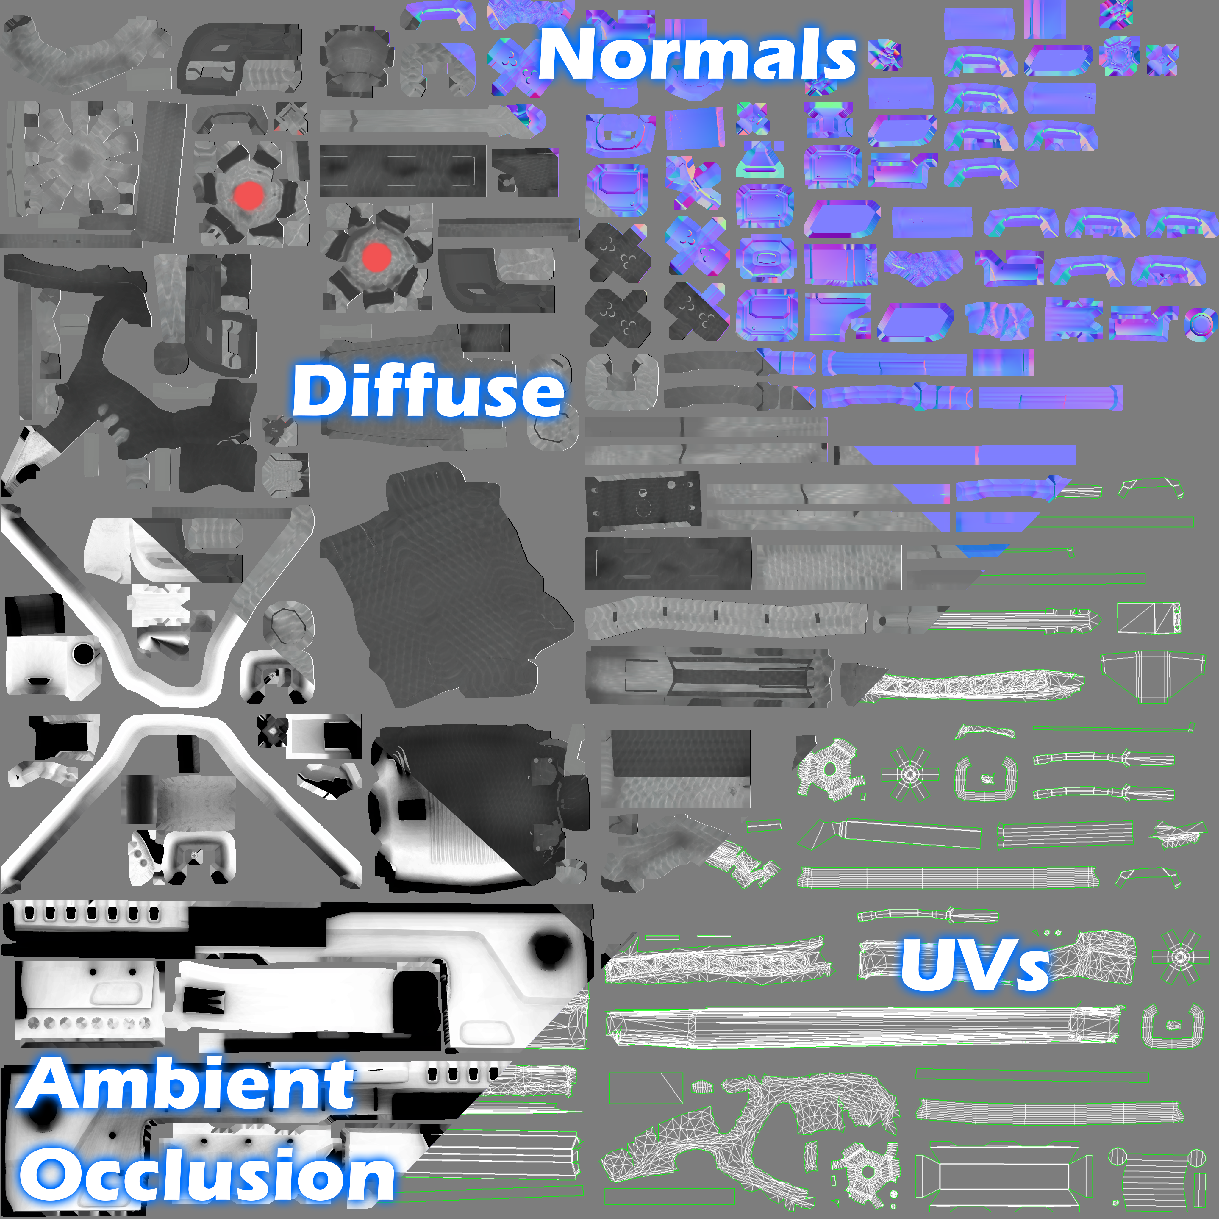
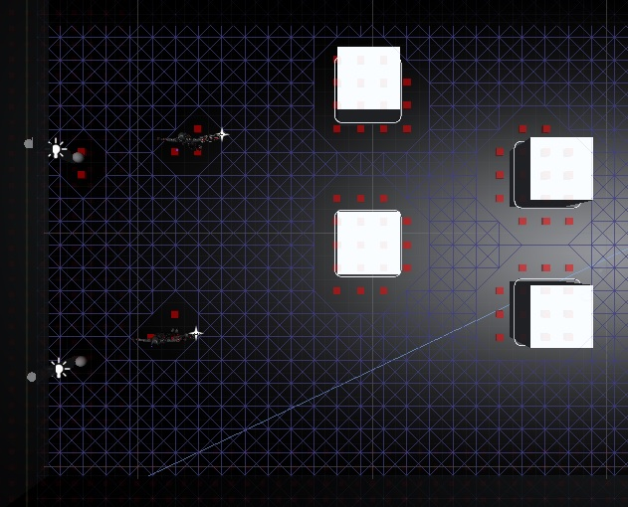
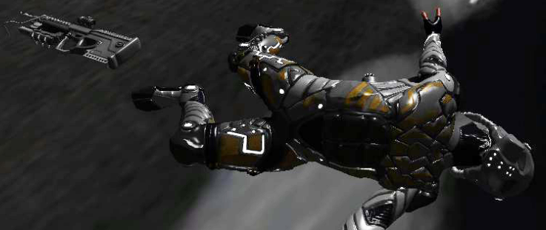
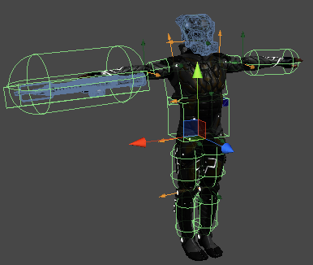
The Source: Can you survive the darkness?
Tim Carpenter, Lap Hou Chan, Mike Johnson, Chris Price, Stephen Smith, Chad Travis
Department of Computer Science and Engineering
The Ohio State University
Graphics
Animation
Introduction
When we set out to develop our game we had decided that we wanted to have next-gen graphics, such as you might see in the Halo series, Call of Duty, or Portal. In order to do that there is a very disciplined process we must go through to keep all the models consistent and comparable to that of a current generation game. The first step, like most other games, begins with concepting.
Concept Sketch
Rough idea of how the rifle could look like is sketched out on paper or in Photoshop, this then can directly be used to guide in the modeling process later.
Low Poly Model
Using the concept sketch as a guide rough shapes were blocked out, just enough so that they could be imported into Z-Brush for refinement.
Full Character Animation
Not only did we want the game to look good, but a game cannot have a truly authentic feel without a well rigged and animated character. To get the most realistic feel motion capture data was used alongside hand animation techniques. These were then blended together using Unity’s Mecanim system, across two layers consisting of an upper and a lower body blend tree/state machine.
Ragdoll
Using the physics joints in Unity, when the character loses all shields and is hit - ragdoll motion is then enabled signaling the players death.
Artificial Intelligence
Texture
Next, within Z-Brush, the model is detailed and painted, decimated, UVed, and the high poly details are transferred over to the low poly game model
In this game, enemy behavior is determined by a simple state-based AI. Based on the actions of the player, the AI will move through 4 states: Idle, Suspicious, Pursuing, and Attacking. Depending on the location of the player, location of bullets, location of light flares, and whether or not line of sight exists to any of those objects, the AI will investigate suspicious activities, or pursue and attack the player when detected.
Path finding is handled through a conventional A* implementation. The graph is generated when a level loads. To handle dynamic events in the game, for example the movement of boxes, the graph is updated periodically for a small area around the player. The graph is also used to promote more interesting behavior when multiple enemies are in a non-idle state, by increasing the path cost of nodes to encourage varied path for the active enemies.

