Slide 1



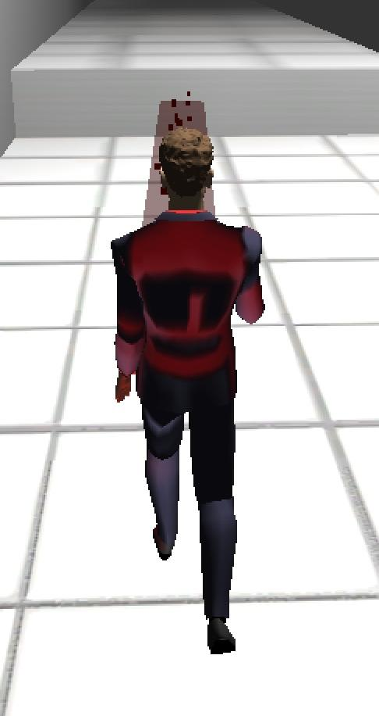
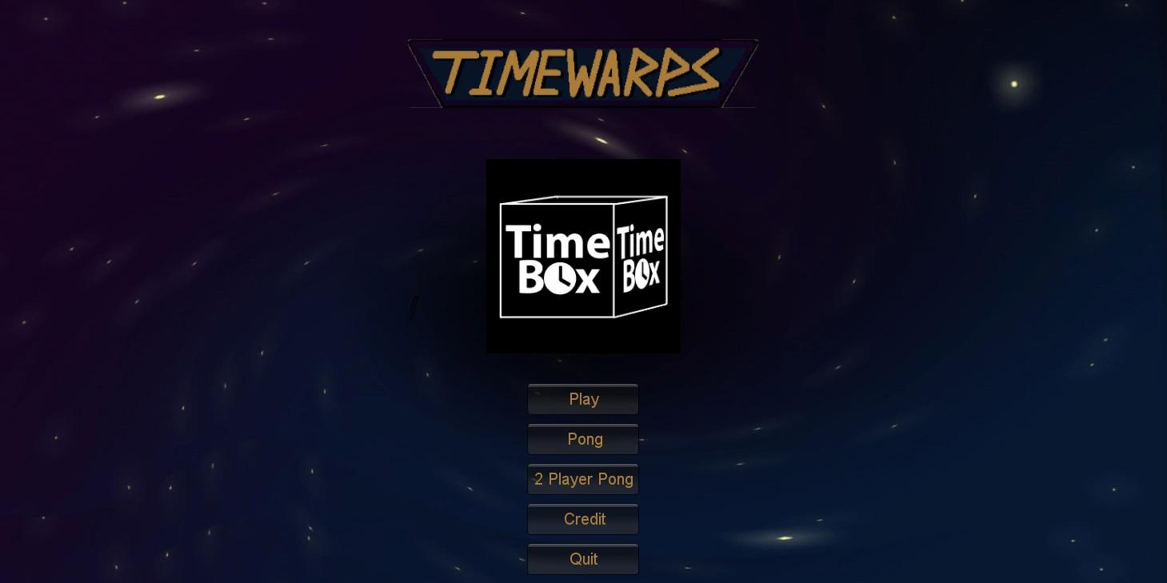
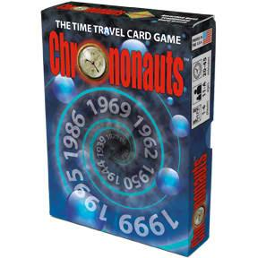
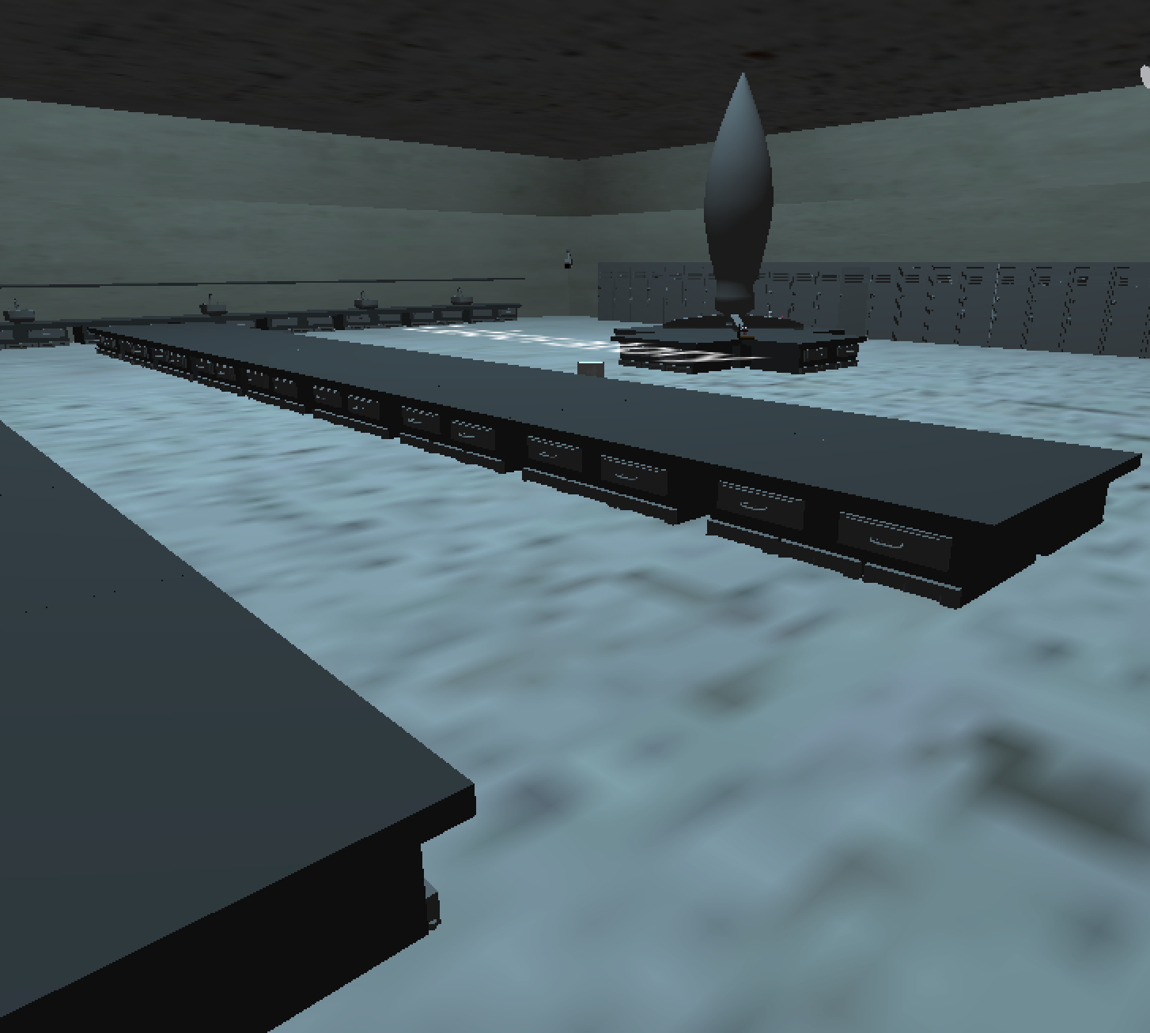
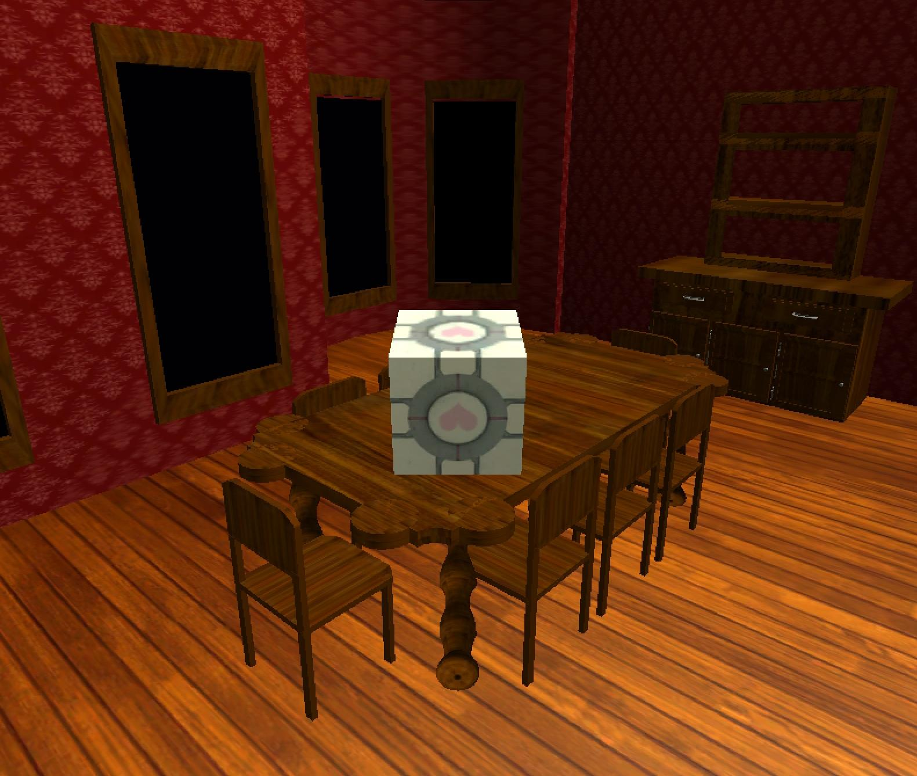
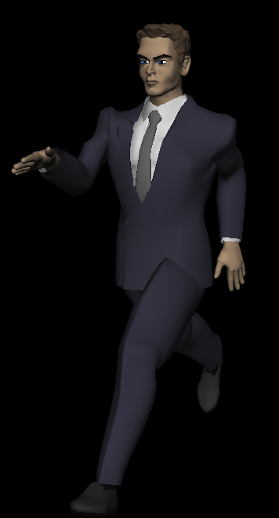
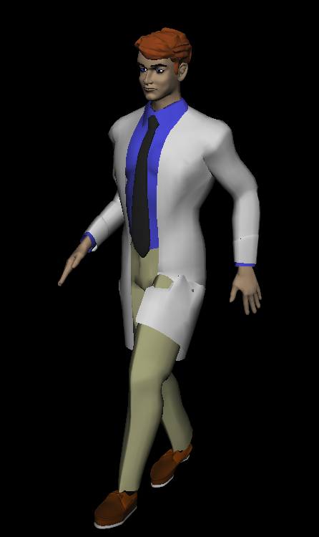
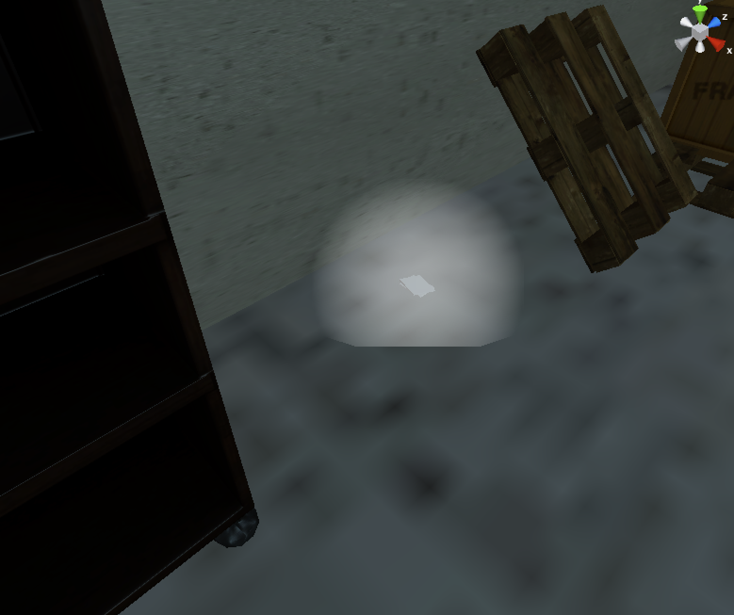
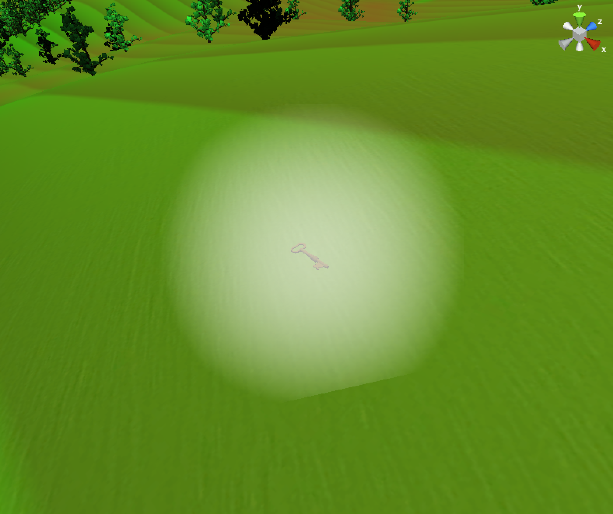
Timebox
DEPARTMENT OF
COMPUTER SCIENCE AND ENGINEERING
PRESENTS
Introduction
Equipment
TimeBox is a single-player stealth, platformer game. The game was inspired by the card game Chrononauts. It toys with the concept of traveling through time to alter the course of history. Still, one must be careful not to change history too much. This is where the stealth component comes in.
Andy starts out with a Ghostbusters-style backpack that either removes time from or gives time to people or inanimate objects. He might use this time vacuum to turn a guard into a baby or into an old man.
By: Tim McLean, Arthur Mo, Joshua Owusu-Dekyi, Breawn Schoun, Steven Wilson
Background
Setting
Andy Smith is a 22-year-old college graduate, living in the year 2012. He is not terribly different from most people. Just like most 22-year-olds, he is getting ready to start his first career. However, unlike most 22-year-olds, Andy has been trained to be a professional time traveler, and is getting ready to go on his first mission.
You might be thinking to yourself, "Time travel? That's not a real thing!" You would be right - time travel doesn't exist in our 2012 America. However, Andy doesn't come from our 2012 America. Yes, he lives in 2012, and yes, he lives in America, but the timeline leading up to his 2012 America is different from our own. The America he comes from is a more technologically-advanced, peaceful, and all-around better place.
The levels in Time Box are based loosely off of historical events and places. Andy's two main missions in the game are to sabotage the Manhattan Project and to turn Hitler into a baby. For this reason, the Manhattan stage is based off of images of 1940's research buildings, and Hitler's Mansion is based off of pictures and blueprints of Hitler's Berghof.
Chrononauts
Chrononauts is a card game that simulates ideas about how time travelers might alter history. There are "Timeline" cards that form the game board, ID and Mission cards that describe the goals of each player, and other cards that the player can collect and use to achieve those goals.
One way to win the game is for the players to alter the timeline to match the events on their ID card, therefore returning the player "home" to their own timeline. Timebox follows Andy Smith on his quest to return to his timeline.
Problem
On Andy's first mission, he makes a critical mistake, changing the course of history and landing him in our 2012 America. In order to make things right again, he must travel back in time to fix history and then return home.
Enemies
Collectibles
Changing the past is a dangerous undertaking. Altering even one small item in the past could have drastic repercussions from that point forward in time. The enemies detect your presence and see you as an intruder to their respective locations. They attack by charging at you and attempting to damage you. Some enemies damage you by continuing to charge until they collide with you while others damage you by taking shots at you with their weapon.
There are two levels with collectible objects. The first level is the Manhattan Project stage. In order to complete the level, the player must find all five parts of Dr. Oppenheimer's research. The research looks like glowing pieces of paper. Once all of the research is found, the Time Box will appear and the player can complete the level. The other level that has collectible objects is the outside of Hitler's mansion. In order to get into the mansion, the player must find five keys. Once all of the keys are found, the player can enter the mansion through the door near the garage.

Slide 2
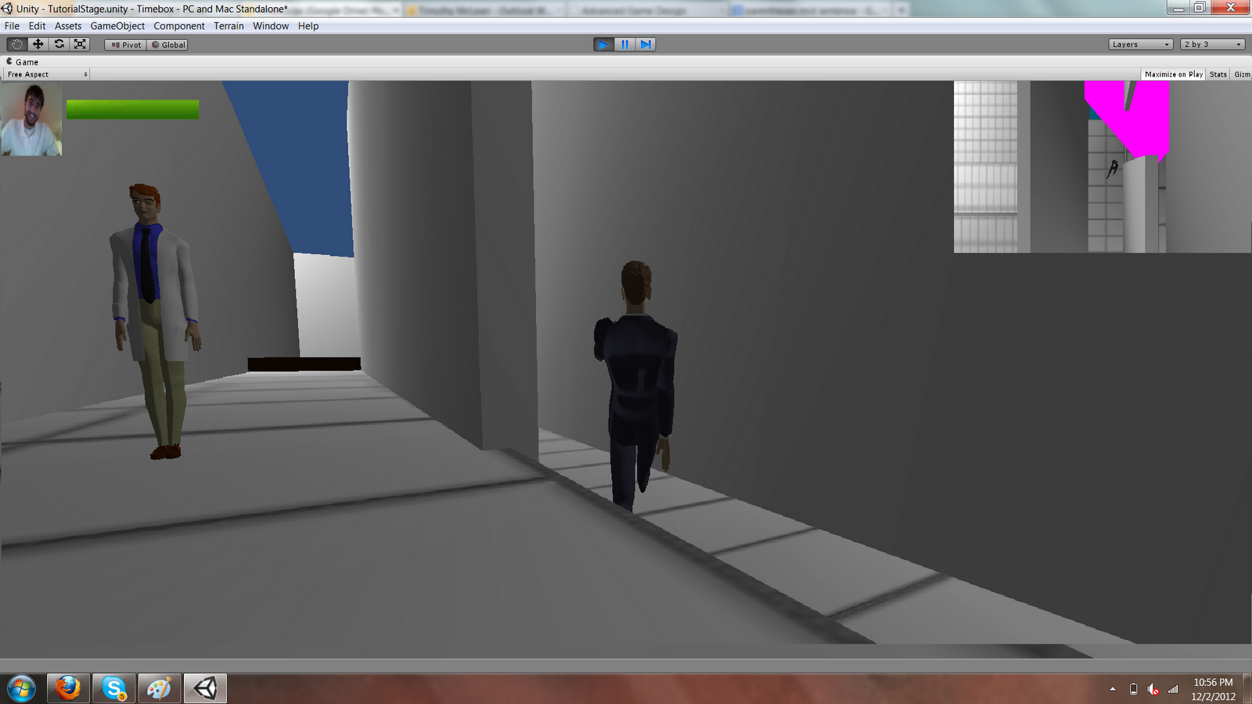
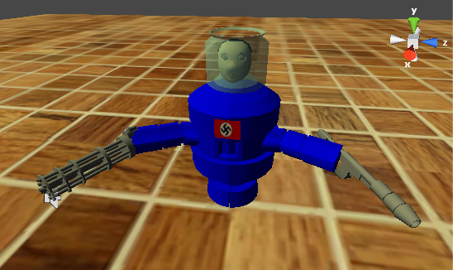
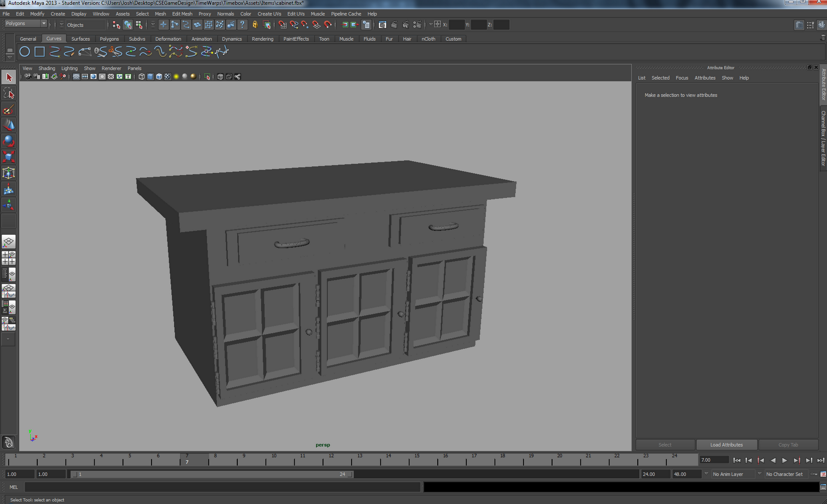
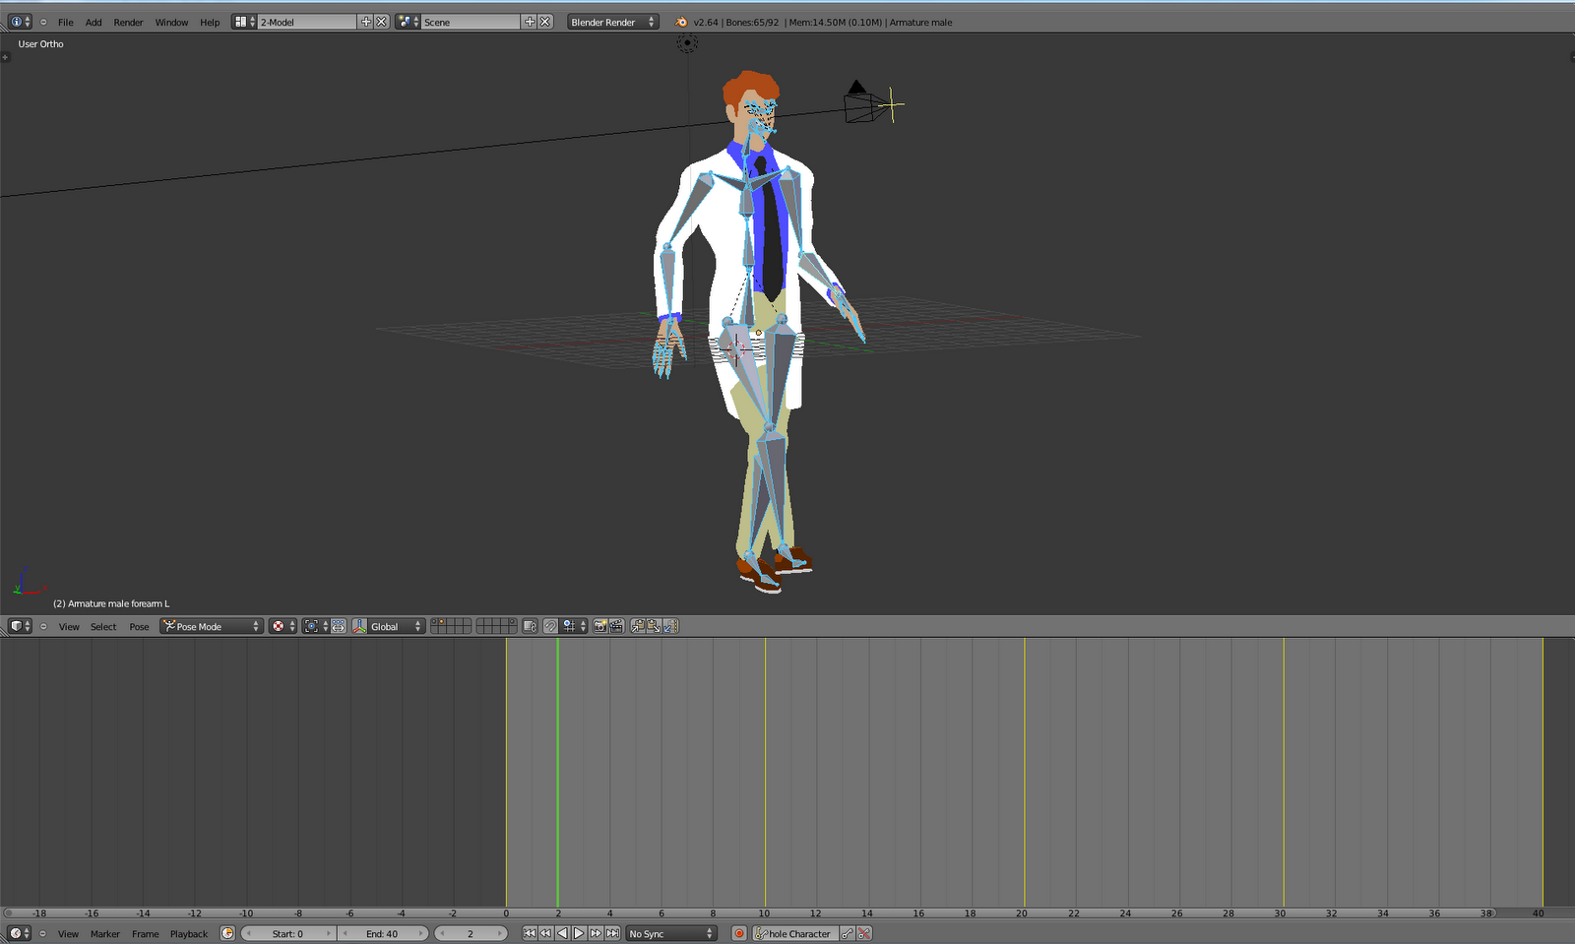
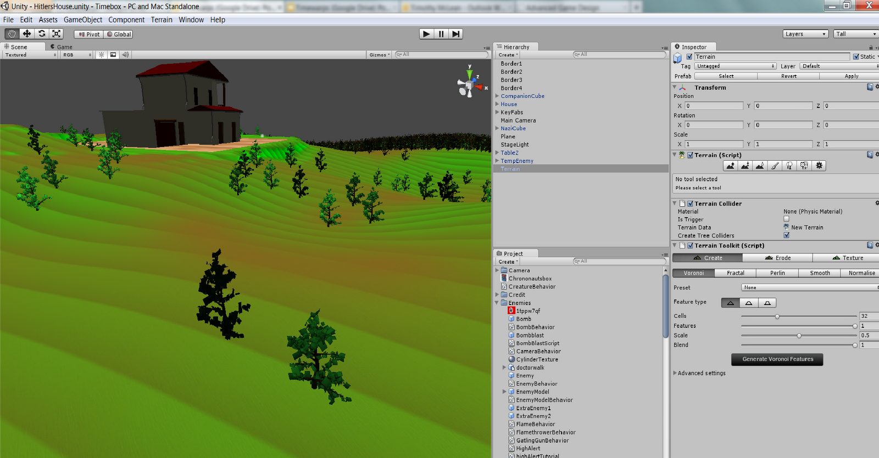
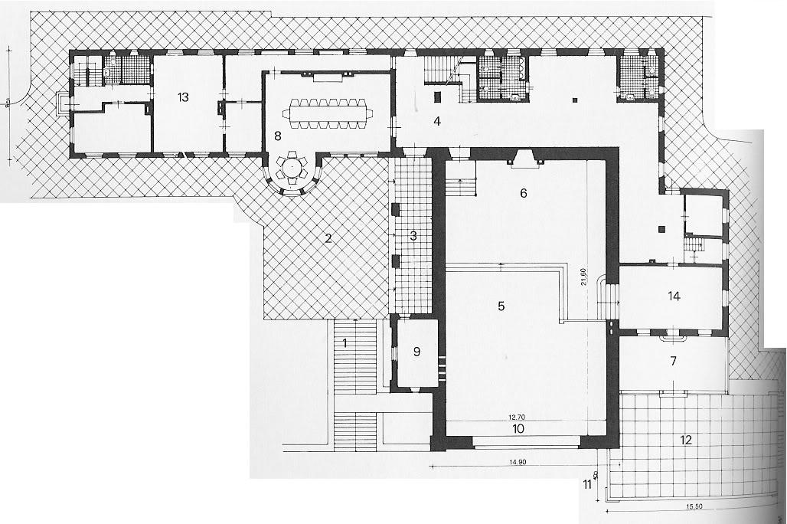
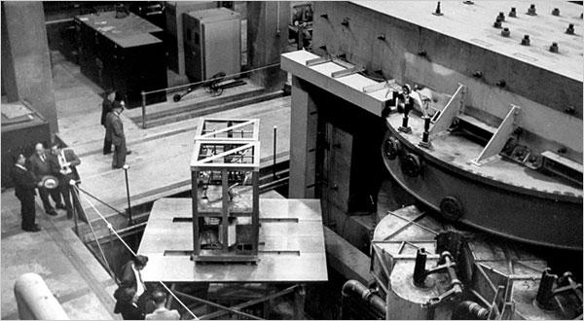
Introduction
Sound
TimeBox was created using the free version of the popular Unity Game Engine. The scripting for our game was done mostly in C#, with a few Javascript scripts thrown in for good measure. The rest of this poster will explain how we implemented some important components of our game, such as the enemy AI, the game models, and the stage design.
Music
Brett Seekely, roommate of two Timewarps members, wrote a piece of music to play during the training course of the game. He is majoring in Music at Ohio State and offered to help write a piece in his spare time. The music was then set to loop so that it continues to play throughout the duration of the tutorial level.
Dialogue
In order to introduce the player to the basic controls and how they are used in the context of the game, the first level is a tutorial level. The concept for the level is that it is a training course for the main character to go through in order to learn basic skills that an agent of the time-repair organization needs to know. In order to tell the player what to do, there is the voice of a drill sergeant type of character saying what to do. The audio for these commands were captured in a production studio and manipulated using the program Cool Edit Pro in order to give the desired end effect. The pieces of dialogue started by running into an invisible box collider that acts as a trigger for a script. This script not only plays the desired clip, but also destroys the object containing the box collider so that the particular clip can play only once.
Mini-Map
The mini-map for our game is just an additional top-down camera resized to fit in the top right hand corner of the screen with some extra tweaks. The mini-map is set to only render things important to the player, such as walls and enemies, in order to cut down on rendering costs. In addition, the mini-map also renders a few extra things, such as enemy vision cones, and room names in order to aid the player.
Artificial Intelligence
Enemy Behavior
The basic enemies in the game have a very basic AI. They patrol along a preset route until something interrupts this. This is known as the Oblivious enemy state. This can be interrupted by either the player triggering an alarm, causing the enemy to immediately enter the Alert state, or the player walking into the enemy's range of vision, which initially changes the state to Cautious, and then full-blown Alert if the enemy confirms the player's presence. If the player escapes, then the state is reset and the alerted enemies go back to their regular patrol.
When it comes to attacking, there are two different sorts of enemies: those that continue to pursue until they collide with the player and those that shoot at the player with a weapon. The latter starts shooting when it gets within a certain distance of the player and then continues to pursue the player until it gets within a certain distance. At this second defined distance, the enemy stops and focuses on shooting the player as a normal person generally would.
The enemy AI was also coded in such a way that different aspects of each enemy are contained by parameters that can easily be changed to make each enemy unique. Examples of such parameters include an enemy's speed, jump height, hearing radius, and shot accuracy.
Modeling/Animation
Modeling
The models that we created for our game were all modeled in Autodesk Maya. Some of the texturing was done in Autodesk Maya, however, due to importing issues with transparent textures, all transparent texturing was done in Unity.
Animation
The model for the main character and basic enemies came pre-rigged, but were all animated in 3D Blender. However, every 3D model has double sided normals, so the normals all needed to be reversed in Autodesk.
Procedural Content Generation
Procedural content generation is a way of generating a lot of game content really quickly. This content can be all sorts of things, from creating unique rocks, trees and terrain to even game sounds and artificial intelligence.
Our game uses Unity Terrain Toolkit to randomly generate the height map for our outdoor level. We then used the built-in Unity tree tool to procedurally generate a tree model and place massive amounts of trees on the map in order to spruce up the level a bit (no pun intended). In our case we used these tools one time to generate one level, but often times these tools can be used to create new levels each play through.
We also designed a very basic procedural music creation program, which is the music you'll hear inside the Hitler's Mansion stage. The music is generated at runtime from a C# script and will actually be a little different every time you play.
Although not technically procedural content, we do also have random preset spawn locations for things like security cameras and quest items.
Hitler Behavior
After getting through all other obstacles, the player has to face one last enemy to fully complete his quest. Hidden deep inside Hitler's mansion is Mecha-Hitler.
Mecha-Hitler's flamethrower emits particles with flame texture to simulate fire. The particles move forward from the mouth of the flamethrower and gather together with other fire particles to form a wall of fire to prevent the player from getting close. The player can be damaged by the fire through particle collision. The flamethrower rotates to spread fire through the stage.
Mecha-Hitler's gatling gun takes from the shooting element of the normal enemy behavior. Unlike the regular enemies, the gatling gun shoots at the ground in front of Hitler to prevent the player from getting close. Raycasting is used to determine if the player is hit.
The flamethrower and the gatling gun are meant to protect Hitler's front. If a player manages to get past both obstacles, Mecha-Hitler has one last weapon up his metal sleeves. Mecha-Hitler will drop a bomb behind him every few seconds. The blast radius of these bombs expands and damages the player, forcing him to retreat to a safer distance before continuing his attack.
The fight is split into two stages. After Mecha-Hitler loses more than half his health, he will begin moving around the arena. Mecha-Hitler will attempt to run the player over while continuing to fire his weapons.
Stage Design
The stages in our game are designed to look similar to actual historical buildings. Inspiration for the Manhattan Project stage came from pictures of the inside of one of the research facilities, and Hitler's Mansion is based off of pictures and blueprints of Hitler's home in the Berghof. The structure of the Manhattan Project building is somewhat simple, and was constructed entirely of cubes and planes in Unity. Hitler's mansion, however, was a little more complicated to create. Each individual room was created in Maya and then imported into Unity, which allowed for more interesting architecture.
Unity Terrain Toolkit GUI

