Slide 1
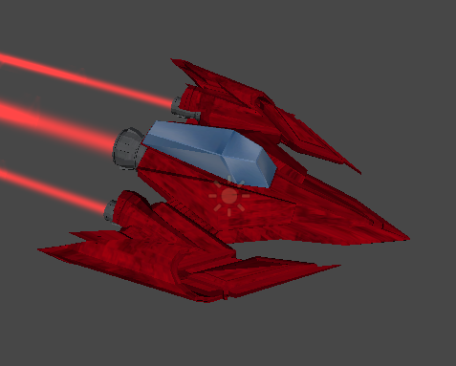
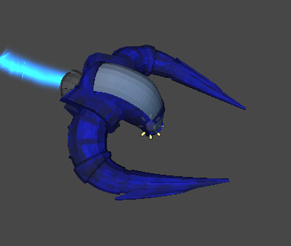
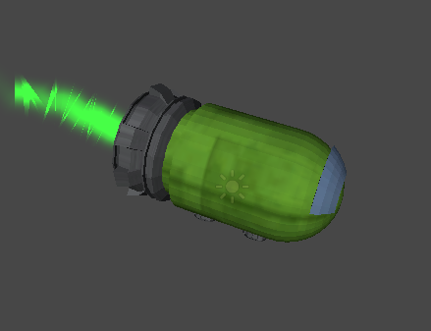
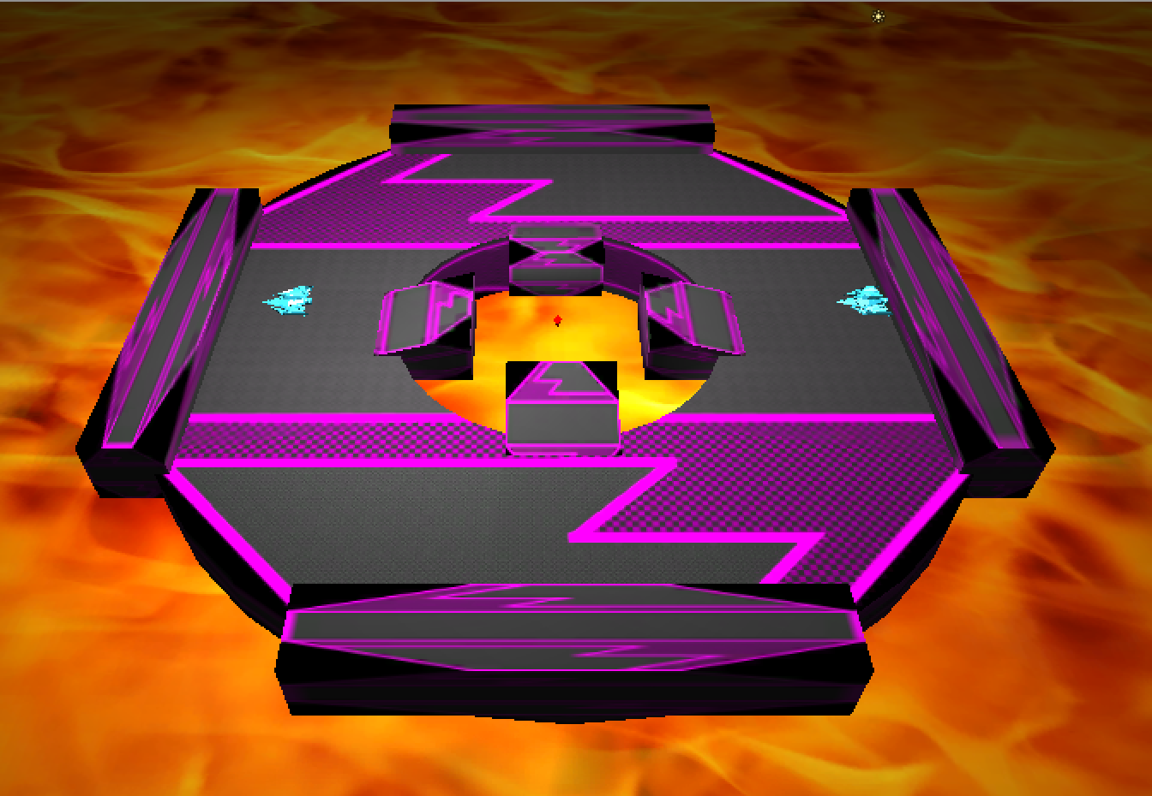
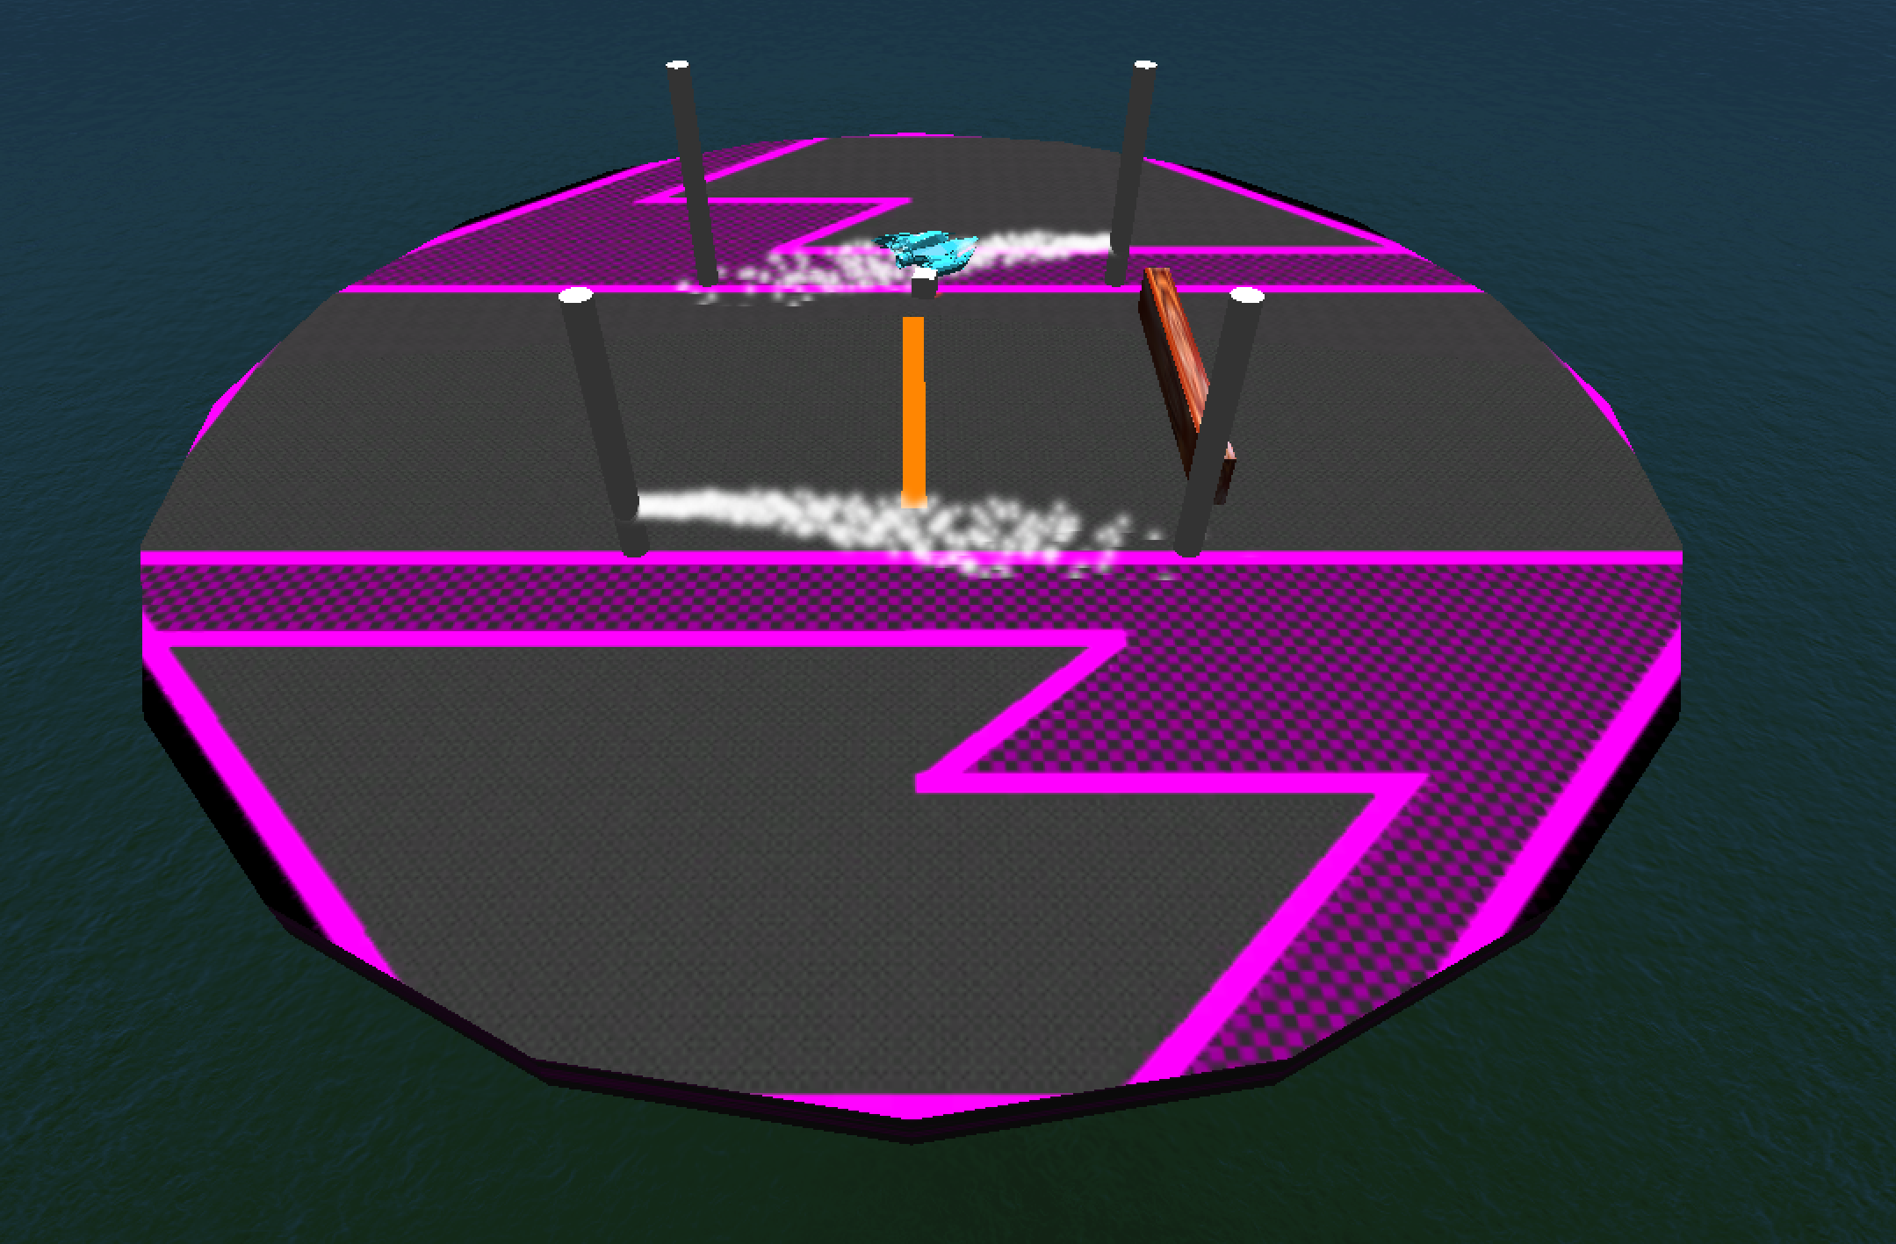
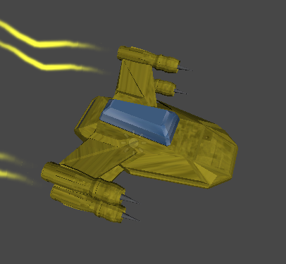
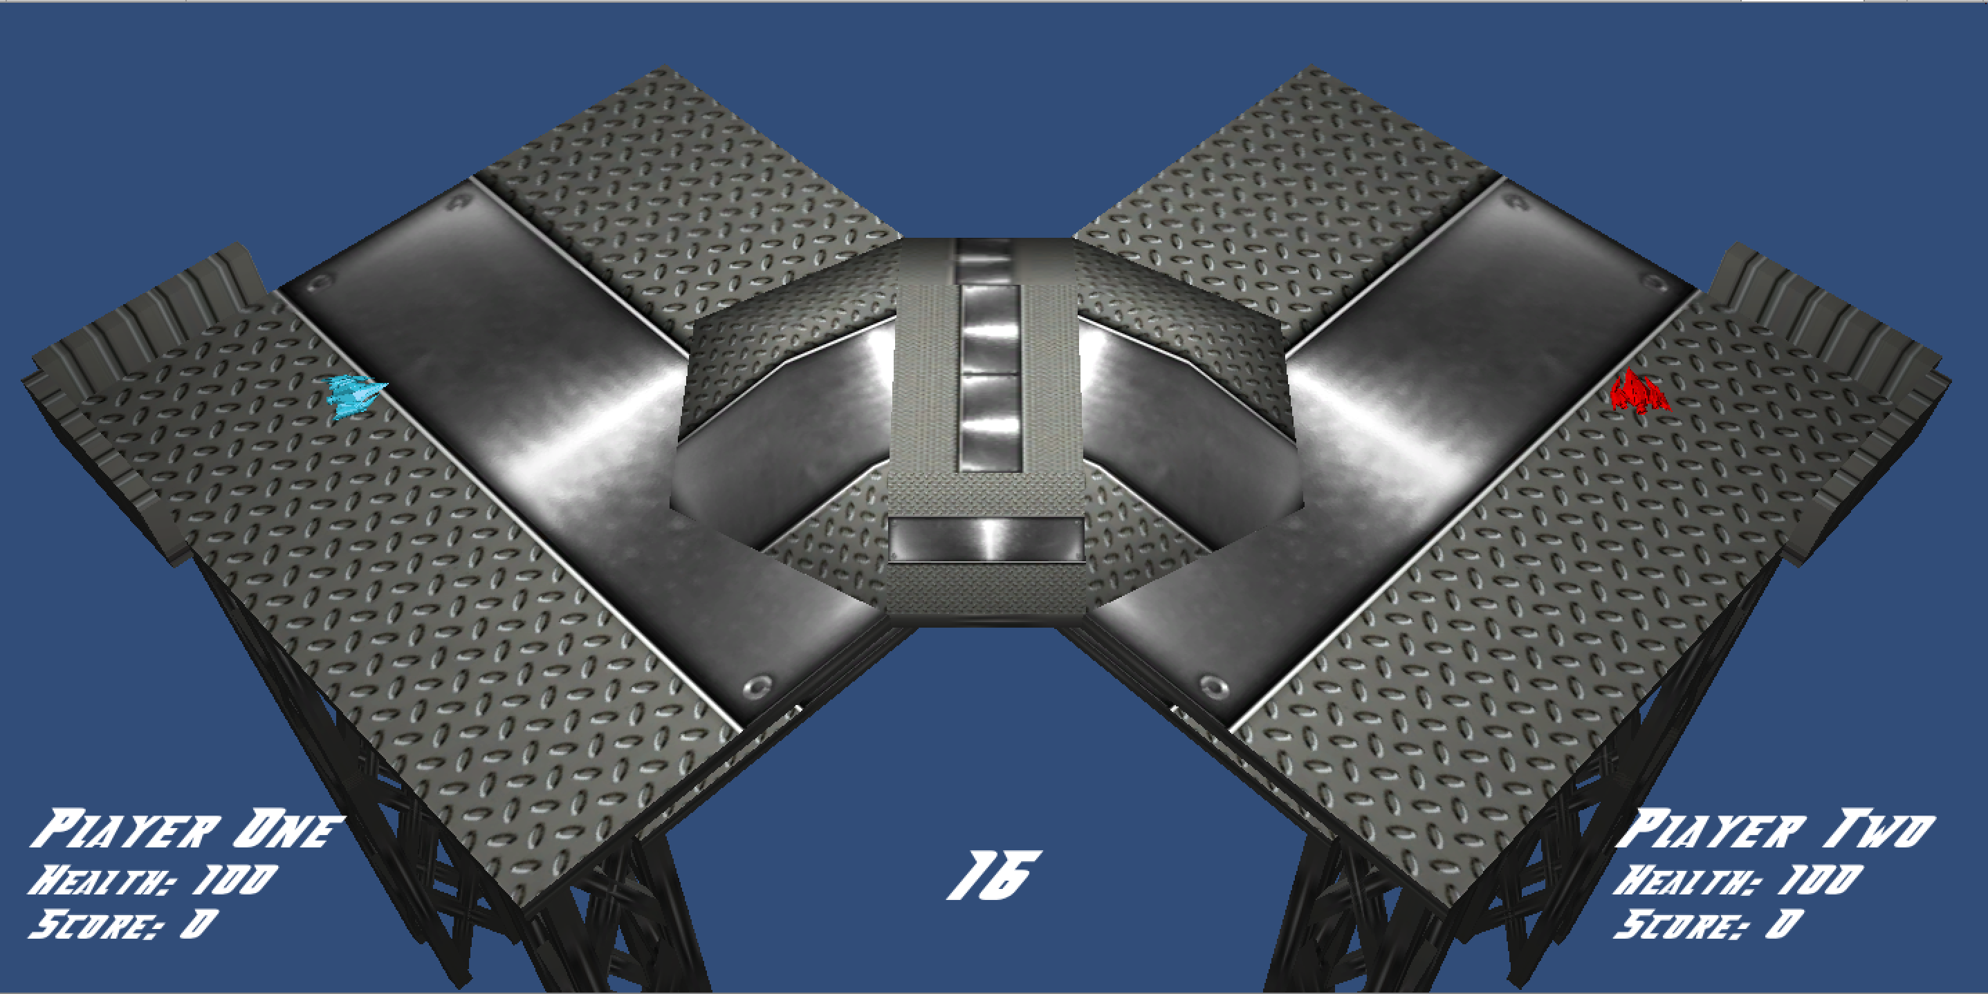
SmashBlasters
Chau Vo, David Huynh, Lowell Bateman, William Kentris
Department of Computer Science and Engineering
The Ohio State University
Introduction
Ships
Power Ups
SmashBlasters is a multiplayer party game that pits 2 to 4 players against each other in a free for all battle royale. Players earn points in the game by eliminating opposing ships either by smashing other ships off of the map or by blasting other ships to oblivion with their own arsenal of weaponry. Collect the most points at the end of the match and become the ultimate SmashBlasters champion!
The Ninja
This ship is the balanced ship in terms of speed, mass, and attack power. This ship is most useful for players who prefer a balance between smashing and blasting opponents.
Weapon: Laser
During the course of a match, random power up boxes will generate on the map for players to pick up and use. Players will be able to hold one power up.
Health Pick-Up
Recovers 20 health points to the player
Gameplay
Attack Power Increase
Increases the attack strength of the player by 10 attack points for 10 seconds
The goal of SmashBlasters is to eliminate your opponents by either knocking them off of the map or by lowering their health to zero and destroying their ships via your ships attacks. Each ship is equipped with its own unique attack that can be used to damage your opponents. Also, to help smash your opponents into oblivion, each ship has a boost capability that can be charged and unleashed on unsuspecting foes. Power-ups are randomly generated on the maps that can be used to increase your smashing and blasting efficiency.
Time Bomb
Allows the player to drop a bomb that explodes in 5 seconds, dealing 25 damage to any ship in the blast radius.
The Predator
Where this ship lacks in mass for smashing, it makes up for with its speed and quick attack rate. This ship is useful for those who want to be able to zip around the map in order to constantly chip away at their opponents health.
Weapon: Saw Blades
EMP
Temporarily disables all opposing ships for a short period of time.
Game Modes
Invincibility
Provides the player 15 seconds in which they take zero damage from opposing attacks.
Timed Match
This is the standard setting for SmashBlasters matches, in which the players select the duration of the match in the game select menu. The player with the most amount of points at the end of the match is deemed the winner.
Point Based Match
In this match setting, the players select the amount of points that the match will play to. No time limit is set on this match and the first player who reaches the set amount of points wins.
Survivor Match
In a survivor match, players compete until there is only one ship standing. This ship will be deemed the winner. The amount of lives each player gets is selected prior to the beginning of the match.
Maps
The Brute
This ship sacrifices movement speed for increased mass, allowing it to be extremely efficient in smashing other players from the map. This ship is for players who prefer the slow and steady style of game play.
Weapon: Mini-Gun
The game includes 3 different maps. Each map contains different elements in terms of design and feel in order to provide varying gameplay experiences for the players.
Controls
SmashBlasters supports two control configurations:
Keyboard & Mouse:
Left Click – Move ship in direction of the cursor
Right Click – Shoot weapon
Spacebar – Hold to charge boost (let go to unleash boost)
Left Ctrl – Use Power-Up
PS3 Controller
Left joystick – Aim ship direction
Square – Shoot
X – Move pointed direction
R1 – Hold to charge boost (let go to unleash boost)
L1 – Use Power-Up
The Hammer
This ship focuses on attack power while sacrificing speed and mass. The Hammer is the ship of choice for players who intend on shooting their opponents into submission from a distance.
Weapon: Rockets

