Slide 1
Team Gank
Chirantan Ekbote
Evan Liang
Ethan Klein
Henry Zhang
Wei-Cheng Tang

Slide 2
Requiem Of the Void
Presenting…

Slide 3
Game Basics
Horror based, 2-D mechanic fighting game
Objective: Defeat the enemy player… and don’t die!

Slide 4
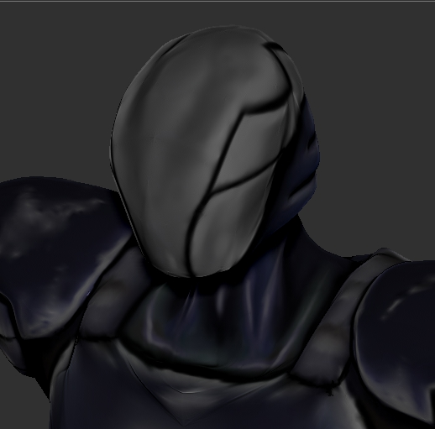
Main Characters — Oddjob / Void Beast
4-phase character, abilities change based on state

Slide 5
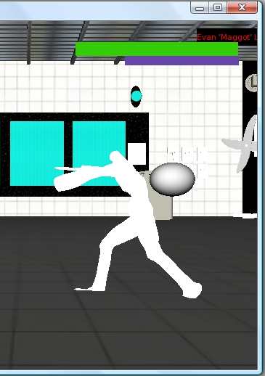
Main Characters — “Evan”
Long Distance Fighter
Shoots High and Low Fireballs

Slide 6
Main Operations
Fight! Throw kicks, punches, throws, and special combination moves against your opponent
Defend! Avoid your opponent’s attacks

Slide 7
AI
Scripting handles attacking/response
AI attacks if its target is in range, and defends against the player’s attacks
Needs a good balance
Adjustable difficulty determines attack script

Slide 8
DEMO

Slide 9
Controls
WASD keyboard input—up to 2 players
Attack keys:
(Player 1) F G T Y
(Player 2) K O P -- ↑→↓←
Combination attacks: down forward
Grabs: F T -- , O
2-player controls

Slide 10
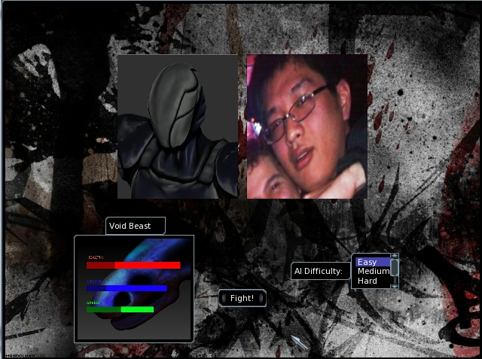
Top 3 Graphical Elements (1)
Character Selection Screen

Slide 11
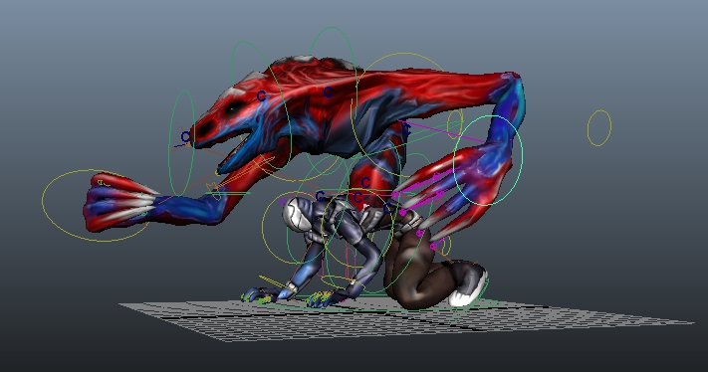
Top 3 Graphical Elements (2)
“Oddjob / Void Beast”

Slide 12
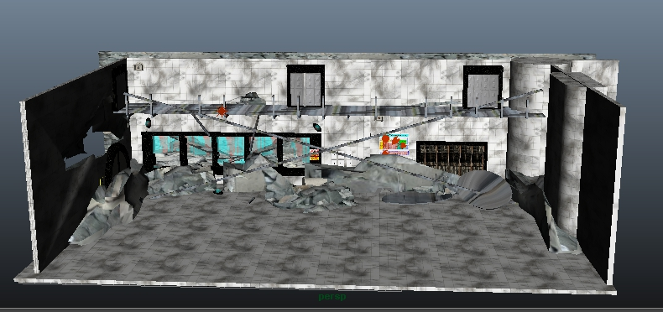
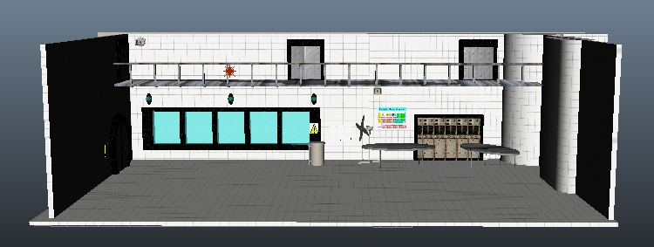
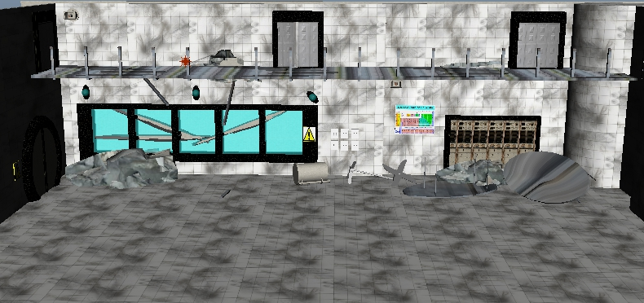
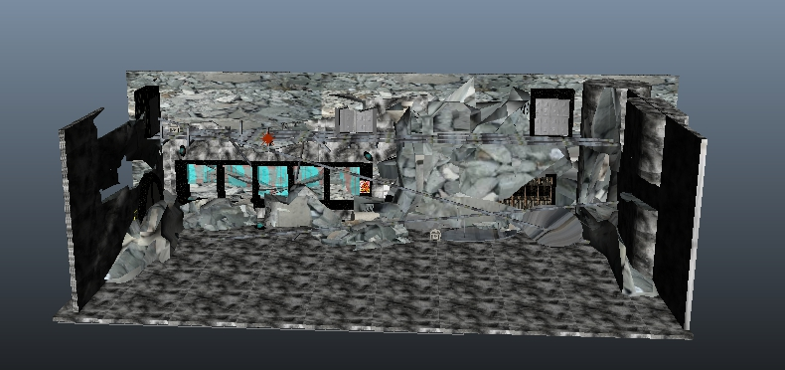
Top 3 Graphical Elements (3)
The environment

Slide 13
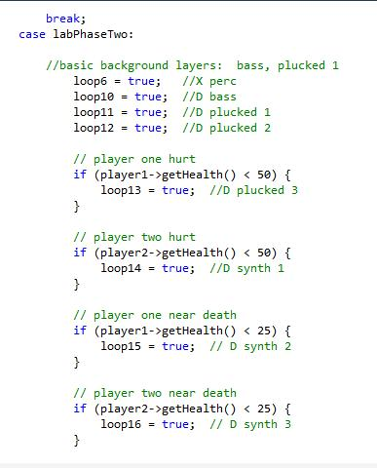
Sound Elements
Dynamic Music
Loops determined by stage, player health, and player stamina

Slide 14
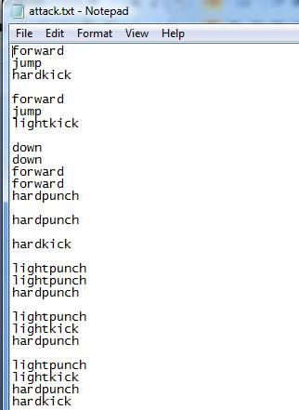
Scripting
AI determines attack sequences from input scripts
Interruptible if AI needs to defend
User-modifiable

Slide 15
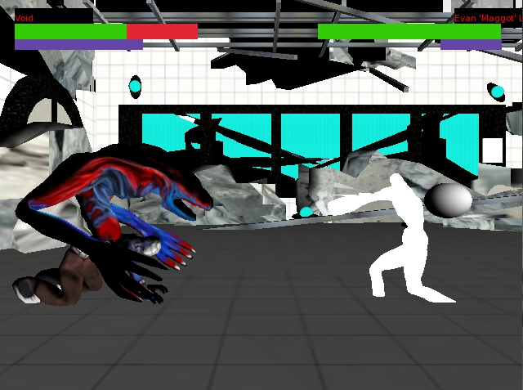
Physics Elements
Characters jump, fall, can be knocked to the ground

Slide 16
Demo

Slide 17
Questions?

