Slide 1
Null commandos
Final Presentation
Ronnie Hout, Dylan Miller, Michael Rojas, Geoff Smith, Ross Wang

Slide 2
What Is New Since Last Timebox?
Changed HUD
New Enemy models
Working Option Menu
New Sounds
New levels
Boss

Slide 3
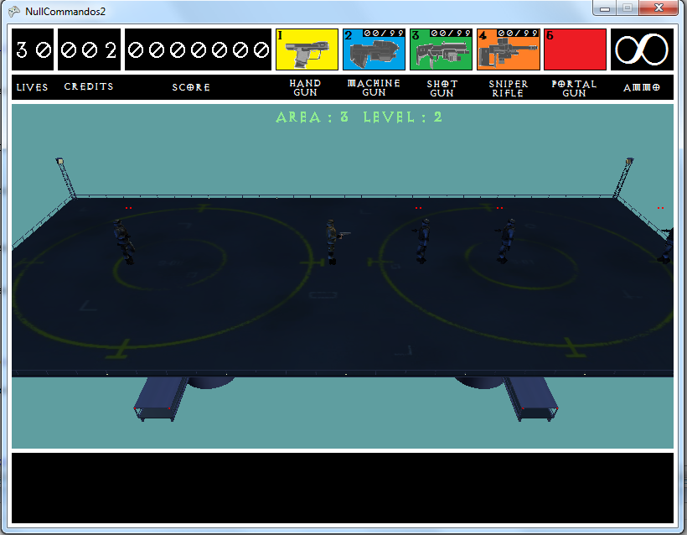
What Else Is New Since Last Timebox? (Cont.)
← New look and background
New and Improved Options→

Slide 4
Character Animations
Free model from turbosquid.com
Animations created using Autodesk 3ds Max
Extended content pipeline for XNA to handle keyframe animations

Slide 5
A Console That Does Something
Currently 3 new commands
SetGodMode()
RefillAmmo(int gunNumber)
SpawnEnemy(x,y,z)
More in development
Special Thanks to The Breakfast Club for helping out!

Slide 6
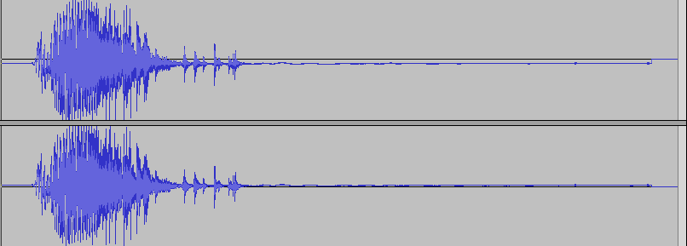
Sounds
Changed Music
Several New Sounds
Adjustable Sounds

Slide 7
Demo
Play Here

Slide 8
And That’s All
Questions? Comments? Concerns for the general good?

