Slide 1
4G(1G)² ^{lost marbles}
Christie Deiters
Conner Campassi
Razvan Lupusoru
Jason Stenftenagel
Tyler Wymer
Notes:
Introduce everyone

Slide 2
Quick Demo
Notes:
Keyboard Conner
LogoState (Everyone) – everyone talks about their lead
Settings (Tyler)– Data driven game. We save everything in a cfg file, blah (also turn down sound and save always)
Start Game –(Christie) Platformer, collect marbles
(Conner) movement and camera
(Jason) all powerups we have (what it is and point out timer)
(Tyler) rival : what he does, not how he does it
(Razvan) HUD – collected marbles, marbles left, powerup timer, health til reset

Slide 3
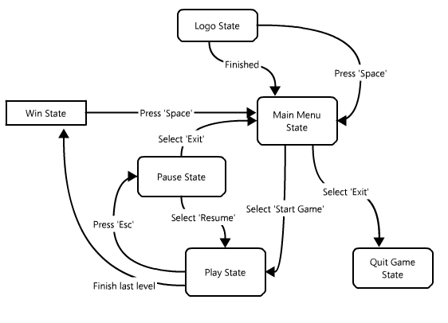
State Diagram
Notes:
(Jason, Architect Lead)
Game Manager and States

Slide 4
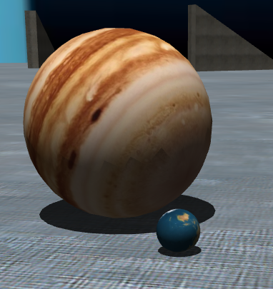
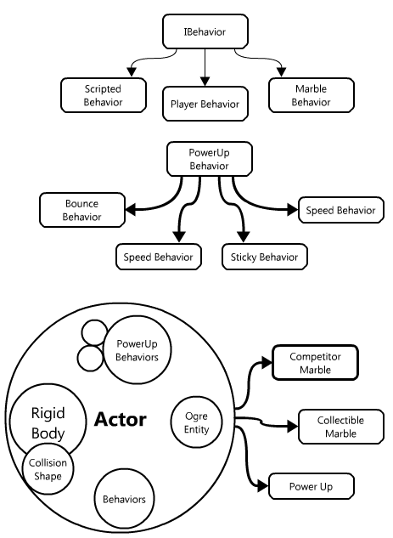
Actors
Visual (Ogre entity)
Physics properties (Bullet body)
Behaviors
Rival scripted behavior (Lua)
Player behavior
Active powerups
Notes:
(Jason)

Slide 5
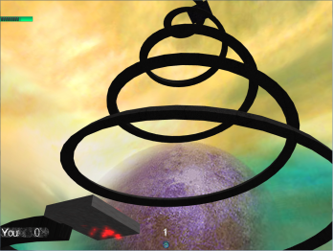
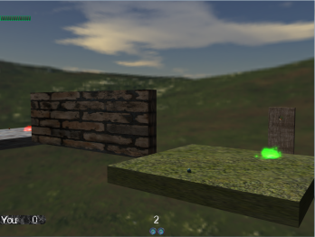
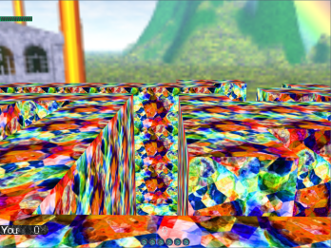
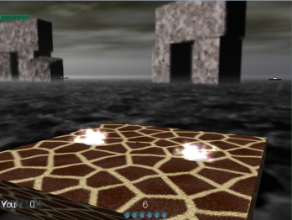
Level Design
Data driven
.level file
Ogitor generates most of a .level file
Physical layout
.actor file
ActorFileCreation generates .actor from .level file
Behaviors and physics properties
Notes:
(Razvan)

Slide 6
Notes:
(Christie)

Slide 7
Demo
Notes:
Supreme Key Commander Stenftenagel
Commentator Wymer
Creative Demo:
Open level, general theme, and fill the rest of time
Show off win state in last minute

Slide 8
Questions?

