Slide 1
Breakfast Battle
Kevin Brohaugh
Matt Griffin
Matt Kern
Nick Obee
Eric Witte

Slide 2
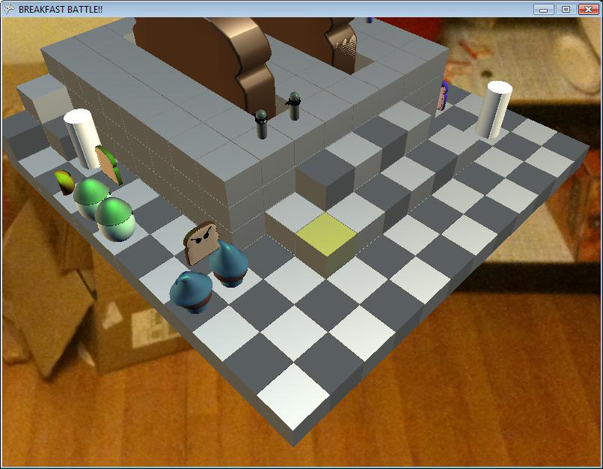
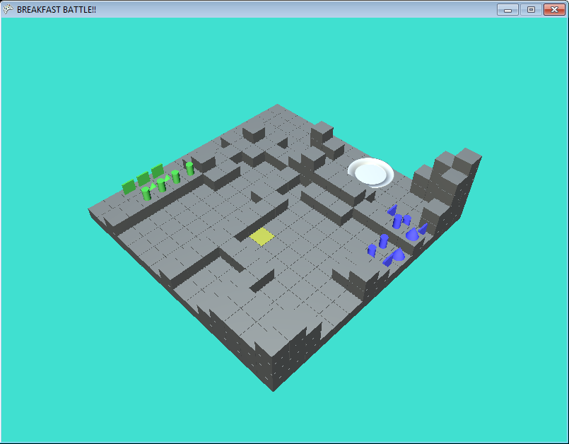
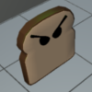
The Game
Breakfast Battle!
Programmed using XNA
3D Turn-based strategy
Player vs AI
Player vs Player
Now
Then

Slide 3
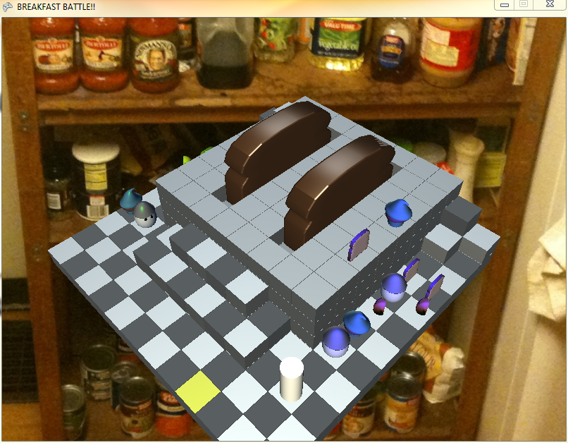
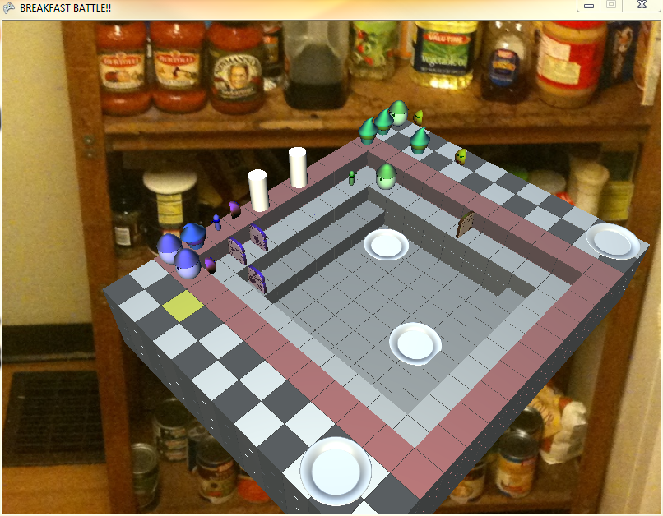
The Concept
The kitchen has been conquered by an enemy force
Your objective is to retake the kitchen
Multiple units allow for varied strategy
Every level has a kitchen theme
Toaster Level
Sink Level

Slide 4
DEMO!
Short Version

Slide 5
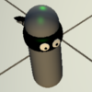
Our Models!
Basic Models
Sausage
Muffin
Toast
Orange Slice
Egg
Plate
Units Custom Made in Maya
Made by OSU students

Slide 6
The Units

Slide 7
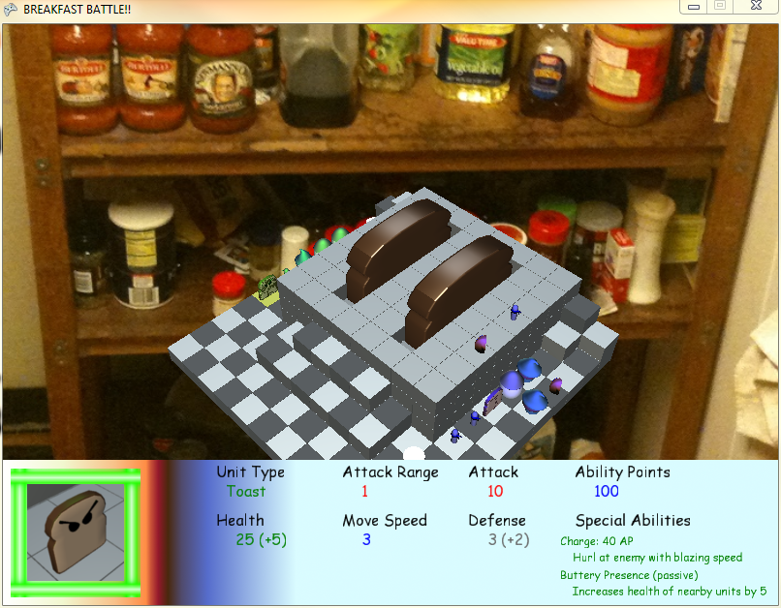
The HUD
Provides in-game information
Varies depending on phase of gameplay
Unit placement
Unit selection
Not always visible
Describes Unit
Stats
Describes Unit
Abilities

Slide 8
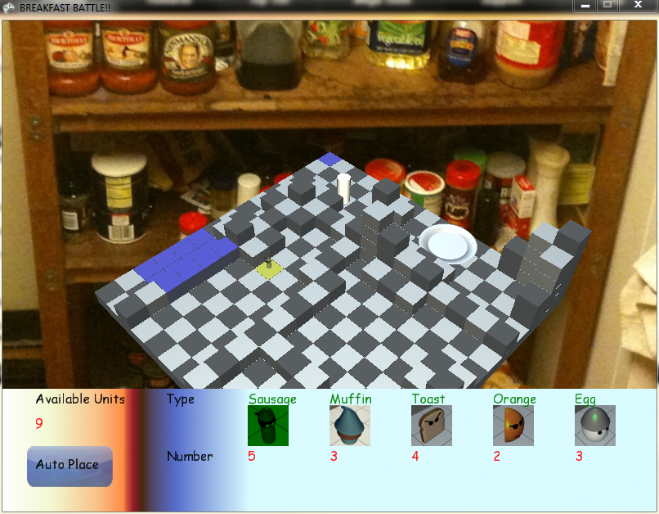
How To Play
Heads Up Display
Available unit count
Number of unit type
Unit Placements
Manual or Auto
Auto Placement for AI

Slide 9
We Have an in game Tutorial!
DEMONSTRATION!

Slide 10
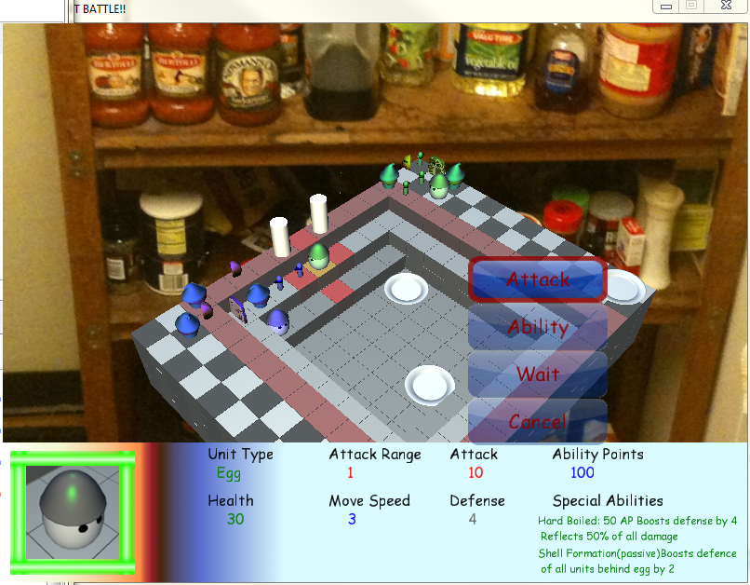
Unit Attack
Types of attack
Melee
Ranged
Height advantage
Ranged units only
+1 Attack range per 2 height
Height limited attacks
Can only attack 1 square up (all)
Can only attack 1 square down (melee only)

Slide 11
Special Abilities
Types of abilities
Active
Passive
Aggressive
Defensive
Healing
All active abilities require Ability Points
Each unit starts with 100
Regenerate 5 per turn

Slide 12
Sound
XACT sound manager
A custom class was made to add extra features
Music
Different music for each team
Various music intro, credits, etc.
Sound effects
Menu screen selection
Attacks
Death
Story Audio
Recorded and modified with Audacity
http://cpgs.school.hants.gov.uk/links/images/AudacityScreen.jpg
http://globalpatriot.com/wp-content/uploads/2009/09/Music-Note.jpg

Slide 13
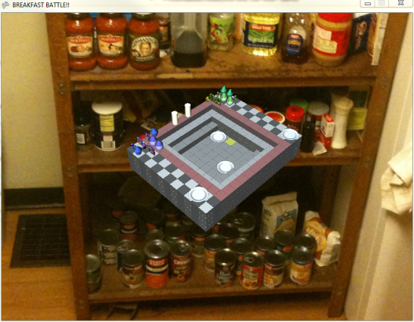
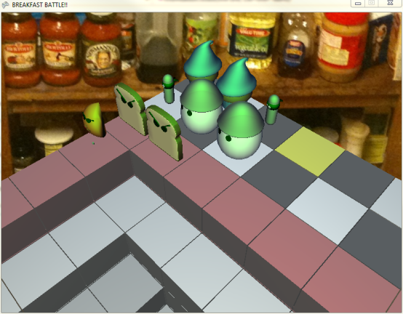
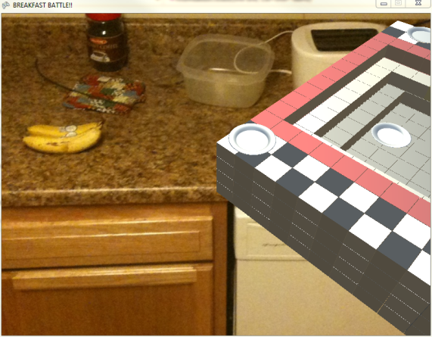
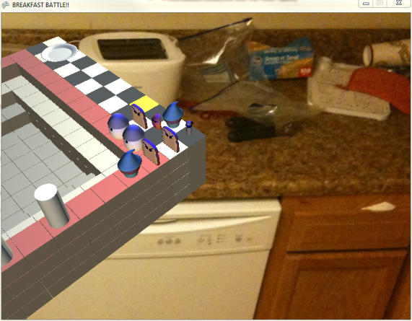
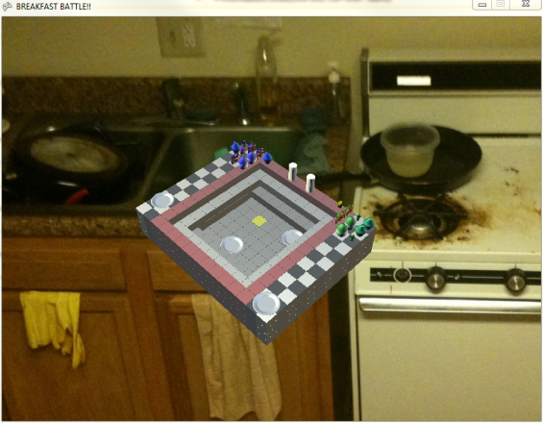
Background
4 images
Drawn as sprites
Pan with camera
Zoom in/out
Pictures are Eric and
Kevin’s kitchen

Slide 14
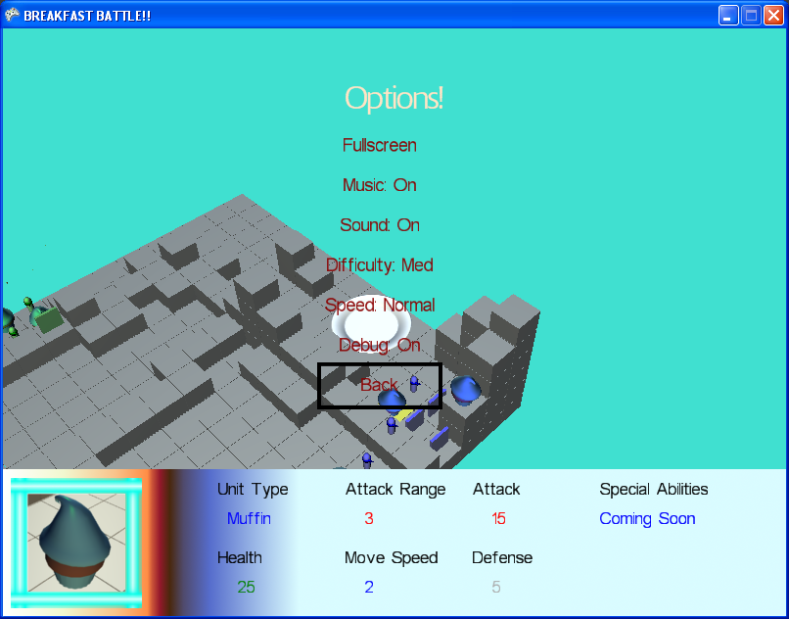
In-Game Options Menu
Based Off Main Menu Options
Provides Useful options without losing your game
Fullscreen
Speed up
Sound options
Debug

Slide 15
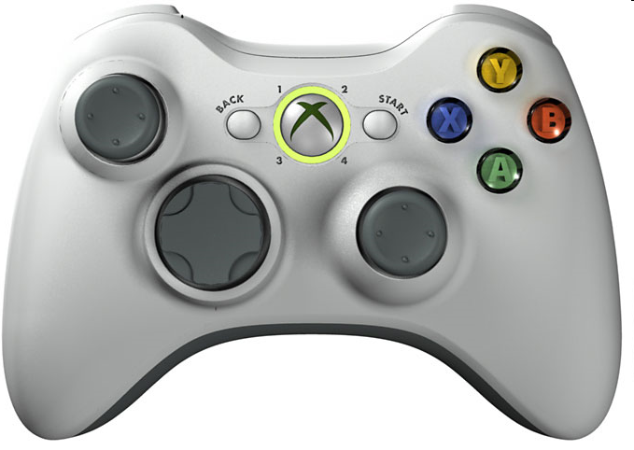
Input Manager!
Handles all input in one location
Simplifies input handling
Allows for coordination between multiple sources of input
Xbox
Keyboard
Mouse
Easily extended to add custom control schemes

Slide 16
Controls
Keyboard | Gamepad | Mouse | Effect
Escape | Start |  | Pause
Enter | A | Left Button | Continue
Backspace | B | Right Button | Cancel, previous
Tab | X |  | Toggle Placement Unit
V | Y |  | Toggle Health Bars
Z | L Trigger | Scroll Wheel Down | Zoom Out
X | R Trigger | Scroll Wheel Up | Zoom In
Q | L Bumper |  | Rotate Camera
E | R Bumper |  | Rotate Camera
Arrow Keys | DPad, Left Stick | Cursor | Navigate menu/game
W, A, S, D | Right Stick | Screen Edges | Pan Camera

Slide 17
AI
Three Difficulties
Easy
Medium
Hard
Can be changed in options menus
Handled in AIManager
Gives all units direction and strategy
Most Complex part of game
Could be developed forever

Slide 18
AI Strategies
Easy
Attack the closest
Medium
Uses some special abilities but not to the ideal efficiency
Hard
Eggs defend Muffins and Oranges
Ranged units seek high ground
Oranges heal weakened allies
Sausages try to use backstab
Toast acts as a back up attacker to the Sausage

Slide 19
Our Goals For Final Release Were
Goals (in no particular order)
Load unit data from file
Improve Analog Controls
Game play and Control Instructions
Flesh Out Medium and Hard AI
Shinier menu system
Multiple Abilities
Add in last two units
Playable on Xbox
Add/Improve Models
Fix Pathing Algorithm Jump Problem

Slide 20
FULL DEMO!

Slide 21
Questions?

