Slide 1
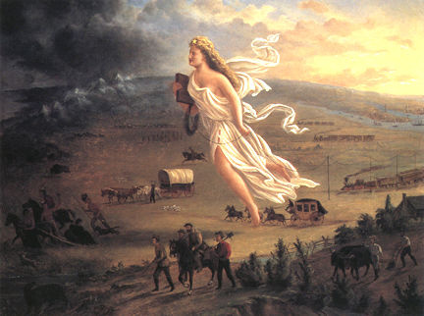
MANIFEST DESTINY
“The future of RTS games...”
560group3
Abe Kim
David Straily
Jarrod Freeman
Abdul Mod-Rokbi

Slide 2
Brief Overview
What is it?
RTS(Real-time strategy) based game
based on Parker Brother’s board game RISK
Micro-management of armies
Income based model
Strategic flanking maneuvers, unit allocation, combat stances, etc..
Considering Commando/King model as well…

Slide 3
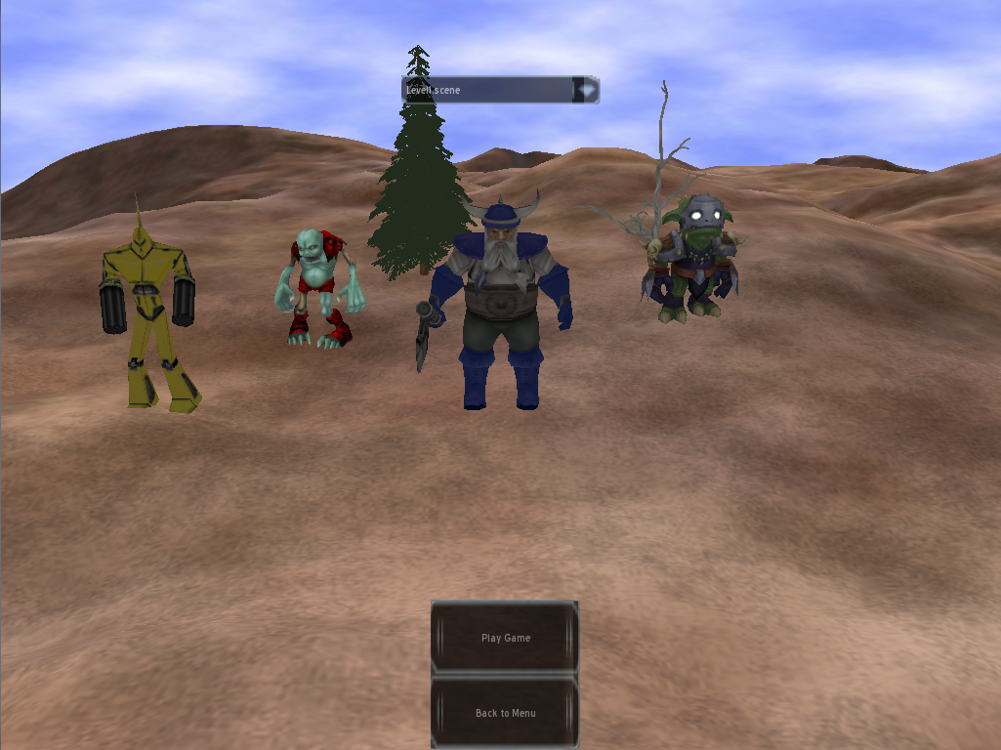
Brief Overview…(cont.)
Four races to choose from
Cyborg, Undead, Human & Orc
Playing against 3 other races(played by AI)
GOAL →Eliminate other races and conquer all barracks.

Slide 4
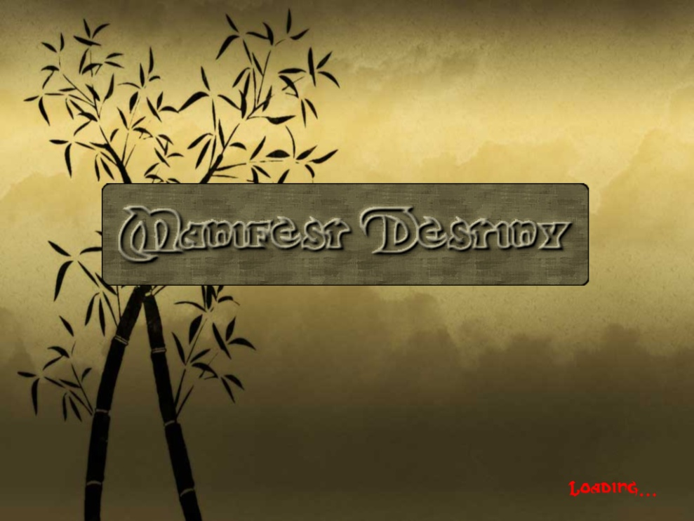
Features
Technical Aspects
Dynamic Loading for Map
Artificial Intelligence(AI)
HUD & Minimap
Control
Graphics & Sound
Installer
Many more…

Slide 5
Technical Aspects
Ogre3d – Open Source
Graphics Rendering Engine
FMOD – Open Source
Audio Library
CEGUI – Open Source
GUI Library

Slide 6
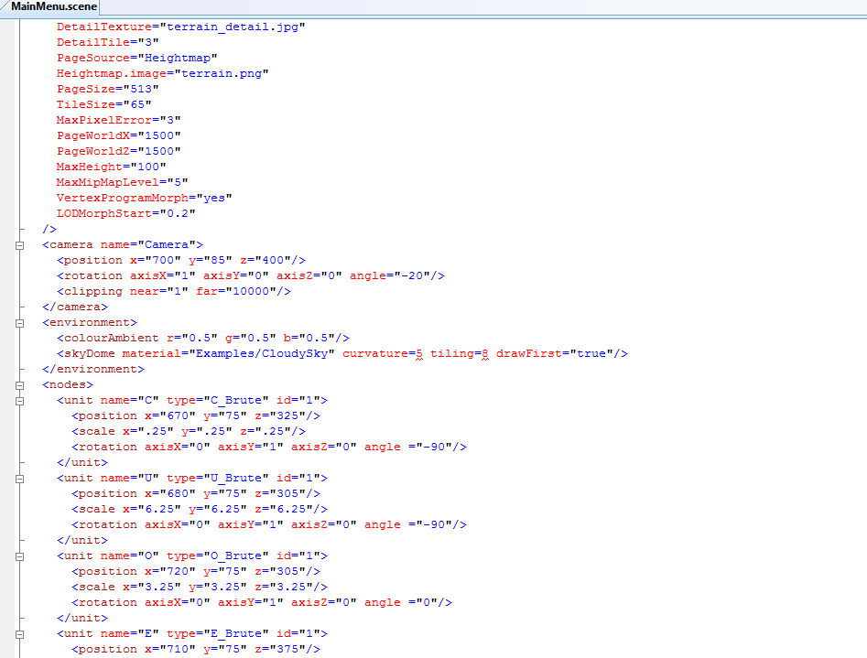
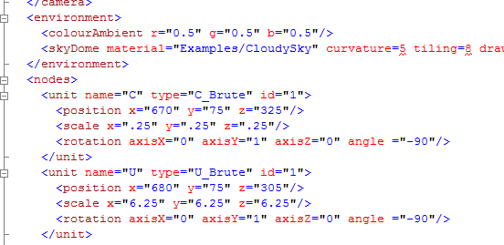
Dynamic Loading for Map
XML Scene Loading
Custom Scripting; includes barracks and unit insertion management
Modified version of the dotscene format

Slide 7
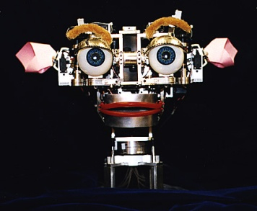
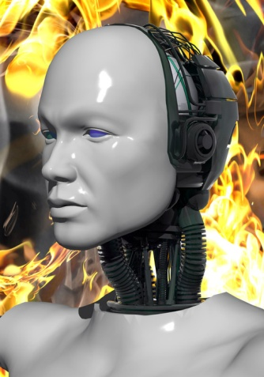
Artificial Intelligence(AI)
Units Flocking
Separation
Try not to draw units at one same point
Avoidance
Avoid running into other units
Cohesion
Keeps groups moving together
Enemy AI
Attacking algorithm – based on weight given and calculated

Slide 8
AI (cont.)
Flocking
based off Open-Steer code
Uses Proximity Databases to determine neighborhoods for regional unit detection.
Key to success is the balancing of numerous variables

Slide 9
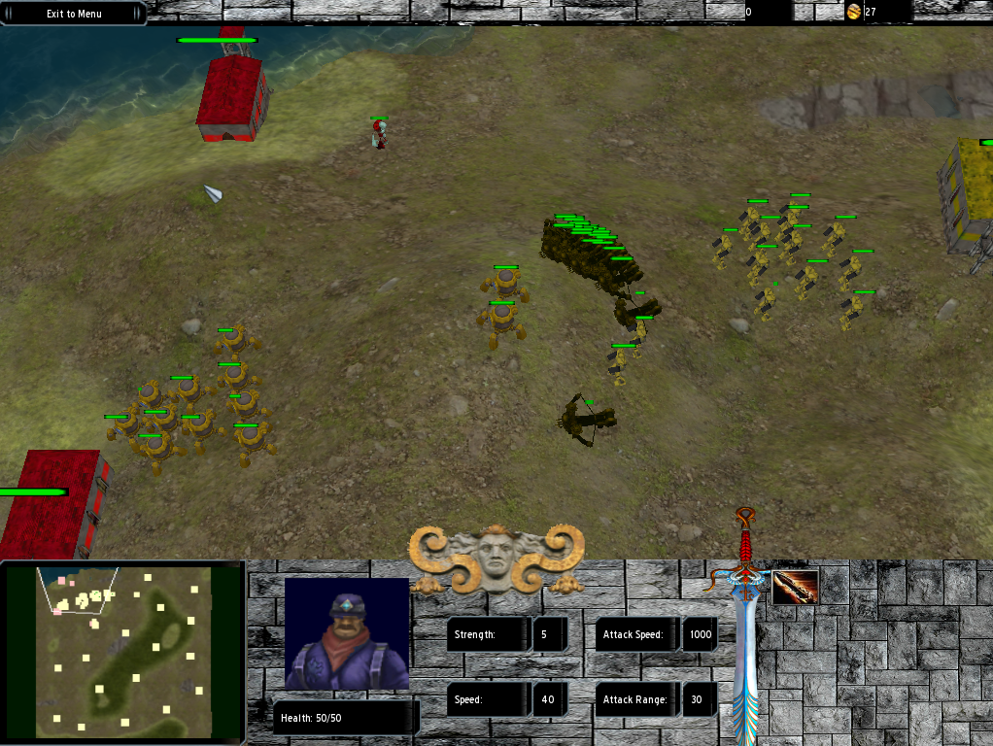
AI(cont.)
Enemy AI
3 Races controlled by AI
AI Works in One Group

Slide 10
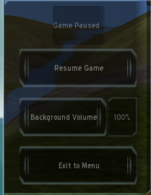
HUD & Minimap
HUD
User Interface for gameplay
Eg:
Create unit buttons
Pause Game
Gold Count
Unit Count
Unit & Barrack information

Slide 11
HUD & Minimap (cont.)
HUD Info display
loaded from modified .scheme, .lookNfeel , .imageset & .tga files from CEGUI library.
Then dynamically displayed in-game with statistics for each unit using same CEGUI interface.
Contains individualized pictures and information for each Unit or Barrack selected by user.

Slide 12
HUD & Minimap
Customized look/interface for each race
HUMAN’S
UNDEAD’S
CYBORG’S
ORC’S

Slide 13
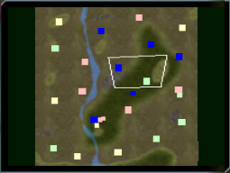
HUD & Minimap (cont.)
Minimap
Mini world view of the game world
Unit → small square
Barrack → big square

Slide 14
Control
Basic Controls
Mouse
Keyboard
Camera Control
Scroll wheel
Navigation
Keyboard arrow
Change Map – in Intro
Pause State – Pause Game, change background Volume Level, Exit to Menu

Slide 15
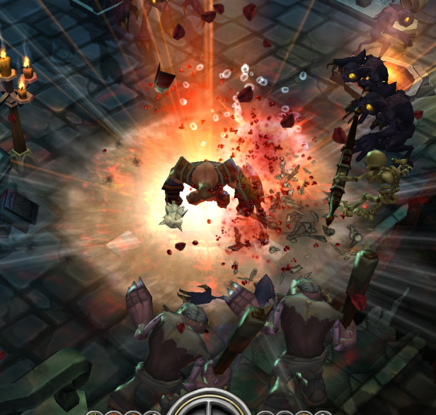
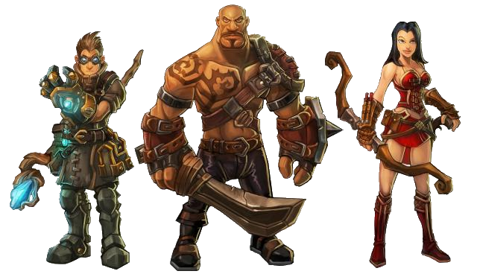
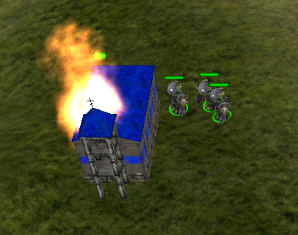
Graphics
Enrich game play experience
Animations
Skeleton based animations
are in separate skeleton files, must be loaded at runtime

Slide 16
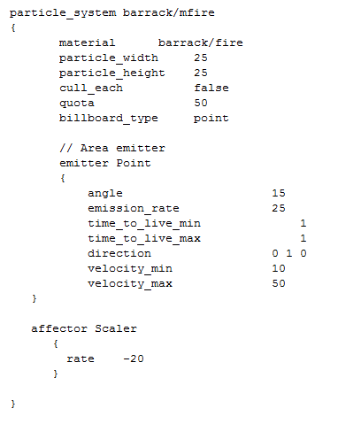
Graphics (cont.)
Particle effects
read from a material file
generated dynamically based off specific variables set.

Slide 17
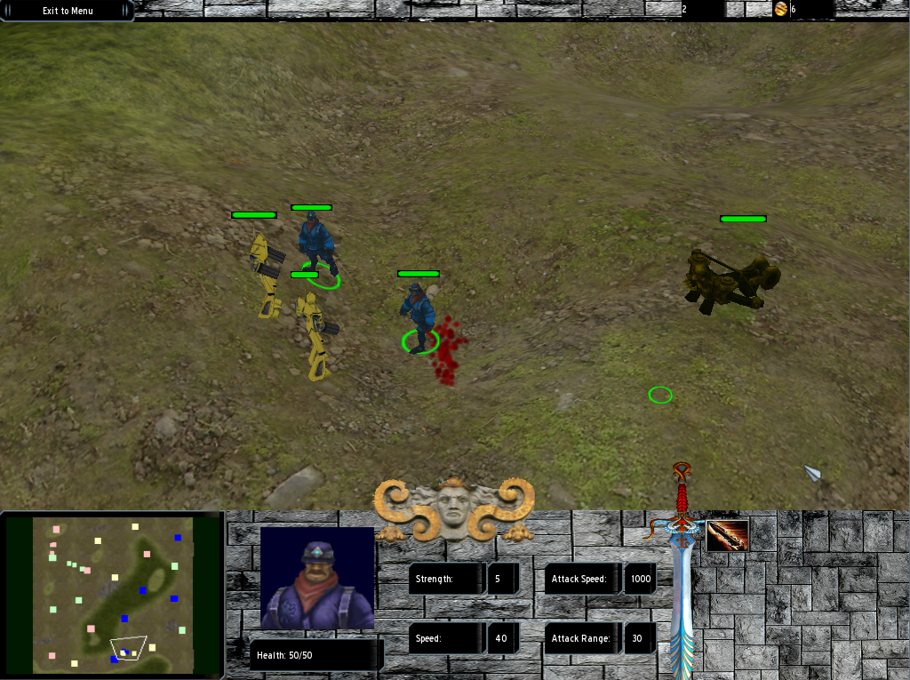
Graphics (cont.)
Special Units Have Particle Effects
Blood Effect Upon Death
Health Billboard
Show current health of a unit or a barrack

Slide 18
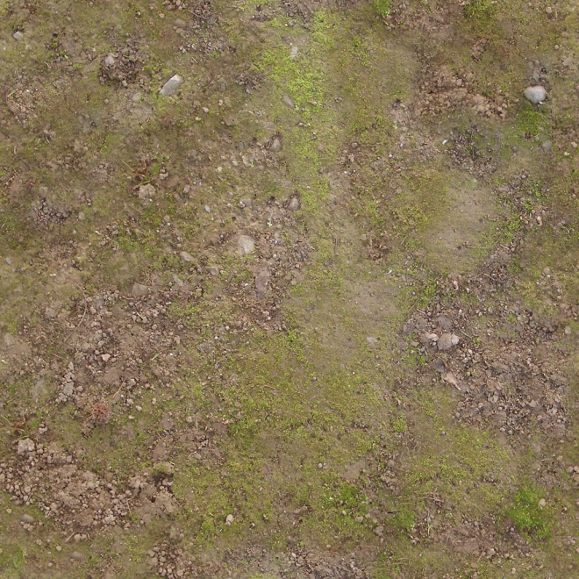
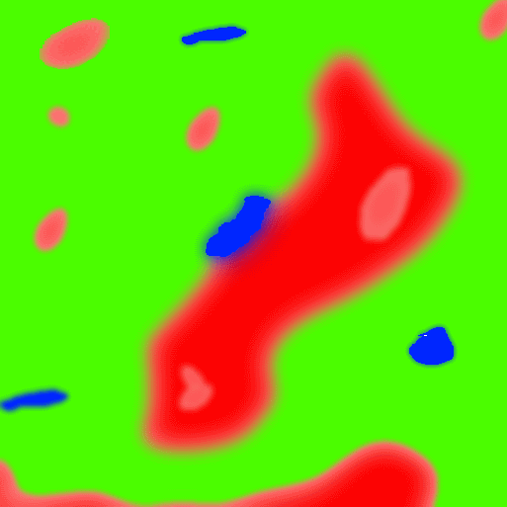
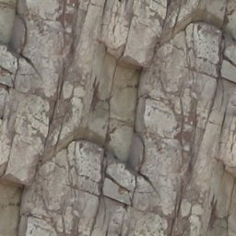
Graphics (cont.)
Terrain splatting
Can handle up to 10 different textures
Uses two alpha-maps
Blending between textures
Data-Driven

Slide 19
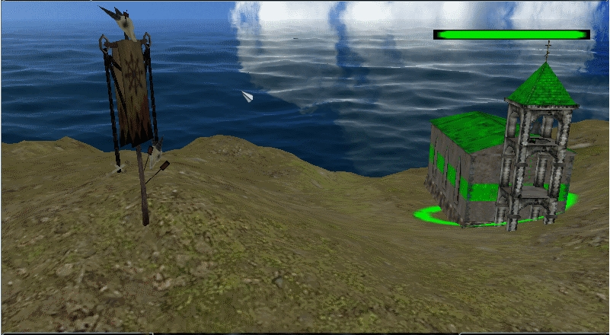
Graphics (cont.)
HYDRAX
generate a custom material file for the water.
D3D9 dependent though.

Slide 20
Sound
Enrich game play experience
Implemented using FMOD library
Sound effects unique to each race background.
Background sound to help player enjoy the game.

Slide 21
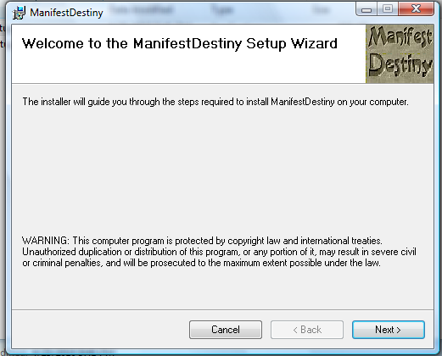
Installer
Easy distribution
MSI format (Windows Installer)
Visual Studio Setup Deployment Tools
Customized icon
Features
Create shortcut
Uninstaller
Repair program

Slide 22
Game Demonstration!

Slide 23
Questions or Comments?
Thank you for your time!

