Slide 1
Ogre Golf
Members:
Zach Howard
Clayton Snyder
Jeff Ridenbaugh
Dan Wagers

Slide 2
OgreGolf Overview
Golf Party Game
Mini-golf on a large scale course
Ninjas, Robots, Fire Hydrants, Castles, Warlocks, etc.
Powerups
Good – lose strokes
Bad - gain strokes
Particle System
Water hazards all around hole
Also small pond in the middle
Play against CPU or against friends
16 total possible players

Slide 3
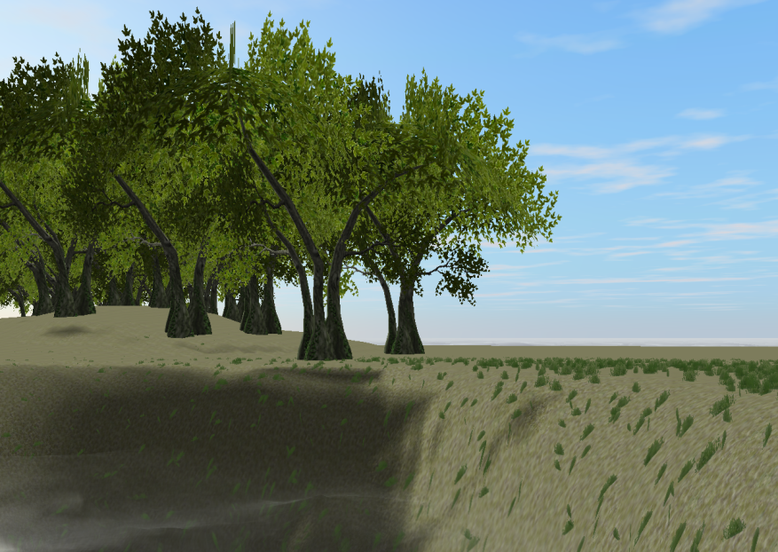
OgreGolf Technical Overview
Created with the Ogre Game Engine
Implemented using GameState Classes
MainMenuState, CreditsState, TurnState, etc.
Third Party Software
Hydrax
Caelum
Artifex Terra
ToolKits
Bullet physics Engine
FMOD Sound Toolkit

Slide 4
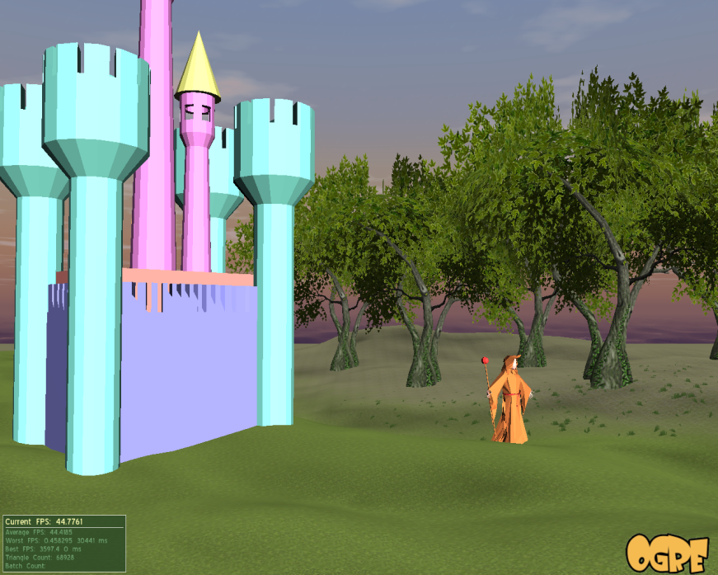
Environment
Third Party Software
Caelum, Hydrax, Artifex Terra
Features:
Trees, Sky, Water
Static Obstacles
Paged Geometry
Coverage Map for grass
Also acts as fairway/rough boundary

Slide 5
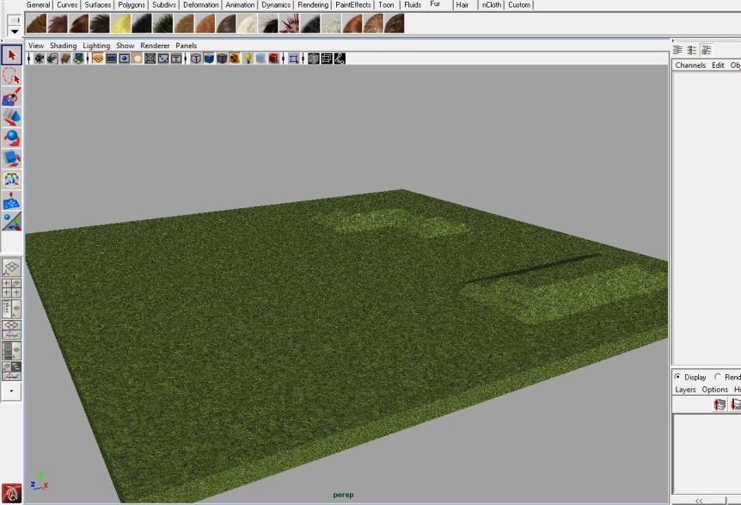
The Green
Artifex is bad since it isn’t precise enough for a hole
Modeled in Maya
Hole at the origin
Carved out terrain in Artifex
Lots of back and forth between game
Hole given particle effect to be visible

Slide 6
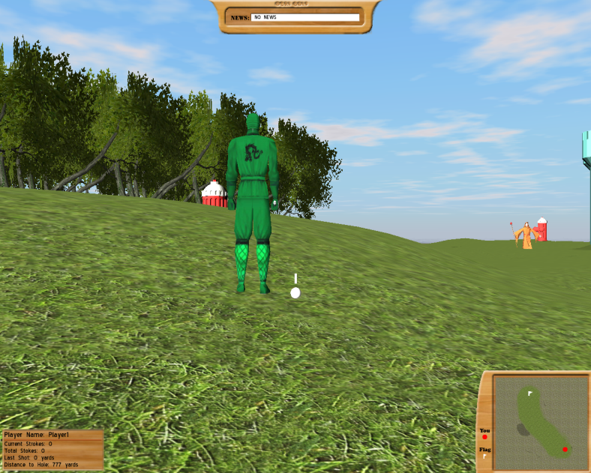
Ogre Heads Up Display
Created using Ogre Overlays
Scripted .overlay and .material files
Mini Map, Golfer Info, News Feed
Problems
Getting it all lined up
Scaling meters to pixels
Coordinate system
Texturing

Slide 7
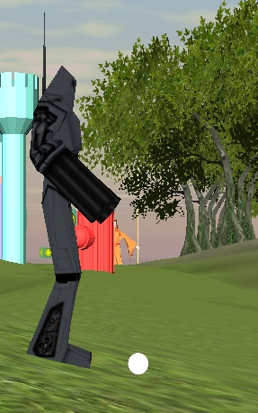
AI: If Then Else
Simple, but effective
Aims straight for hole
Probabilistic offset
Angle based on hole distance
Uses close to appropriate power level
Clamped based on terrain
Probabilistic variance
No obstacle detection

Slide 8
Physics
Bullet Physics Engine Overview
Simulates real-world physics with rigid bodies
Light btOgre Wrapper (MotionStates)
Links Ogre SceneNodes to Rigid Bodies
Tweak physical properties such as gravity, friction, restitution, etc

Slide 9
Physics in Ogre Golf
Ball, terrain, obstacles, etc, are all rigid bodies
Use ApplyImpulse() to simulate striking the ball with a club
Vary friction/restitution based on whether the ball is on the rough, fairway, or green, and whether the ball is bouncing or rolling

Slide 10
Obstacles
Obstacles are placed in the terrain editor provided by Artifex
Made into rigid bodies and Ogre entities when loaded

Slide 11
Player Control
Player turn divided into phases, hit spacebar to advance to next phase
Direction phase – use mouse/keyboard to select direction and arc of the shot
Power phase – the arrow contracts/expands
Curvature phase – the arrow swings back and forth to simulate curvature of the shot
Once all inputs are locked in, the ball is hit

Slide 12
Player Control
Control varies, based on location of the ball
Fairway
High maximum power, medium amount of control
Rough
Medium maximum power, low amount of control
Green
Low maximum power, high amount of control
Obstacles
Very high maximum power, medium amount of control

Slide 13
Sound
Sound levels adjusted in options menu, accessible from main menu or pause menu
Sound Effects
Sound on swing of club
Sound on ball’s impact (different based on object hit)
Volume dependent on force of impact
“Wah-Wah-wahhh” sound on hitting the ball in the water or into a bad power-up
Mario “1-up” sound on hitting the ball into a good power-up

Slide 14
Sound
Ambient sound
Water sound
Based on how close player is to water
Birds
Random bird sound played at random node above player
Crickets/Rooster
Crickets play at night, Rooster plays when the sun comes up
Background Music

Slide 15
Gameplay
Game ends when everyone has sunk their ball into the hole
Final strokes are recorded
Player standings are then displayed
Hit “done” to return to main menu

Slide 16
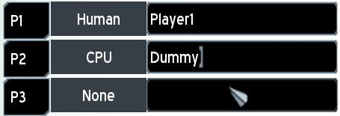
Game Modes
Original idea:
Single-player and Multi-player modes were separate, with only the single player mode including AI.
How it actually turned out:
Consolidation of the two modes and allowing up to 16 of both human and AI players

Slide 17
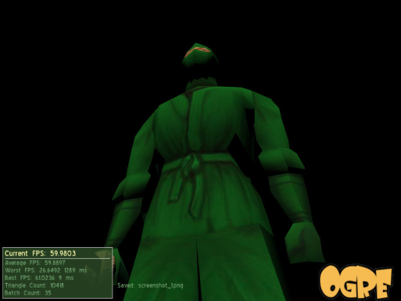
Player Avatars
Original idea:
Have a few different avatars for players to choose that allow them to distinguish each other
How it actually turned out:
Models with animations are expensive. Ninjas with psychic powers are cheap!

Slide 18
Mutators and Powerups
Original idea:
Lots of “power-ups” to mess with the other players, mutators to change the game mechanics
How it actually turned out:
We have a few power-ups. “Good” power-ups remove a stroke, “bad” power-ups add a stroke.
A robust mutator system probably would have taken too long to implement, and had too many variables to take into account.

Slide 19
Clubs
Original idea:
Simplified club inventory, with a driver, putter, and a variable-arc iron.
How it actually turned out:
We changed the system to instead use a single 3D arrow, which simplifies the system even further and gives the player a visual representation of his/her shot.

Slide 20
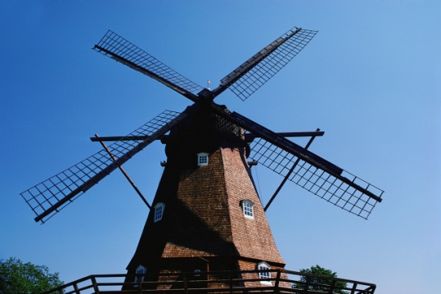
Obstacles
Original idea:
Interactive obstacles such as fire breathing clowns, trolls, windmills, etc.
How it actually turned out:
Getting the physics engine working with static objects was an animal in and of itself. Animated objects would have taken another few weeks.

Slide 21
Scripting
Original idea:
Do as much as we possibly can with scripting. Serialize everything, make an easy to use script binding framework.
How it actually turned out :
Scripting wasn’t fully implemented until Timebox 4, leaving us with an already-in-place game structure and little time to bind everything.

Slide 22
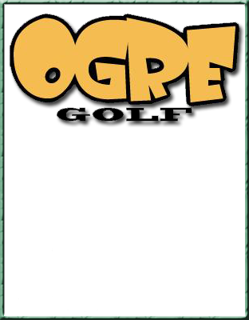
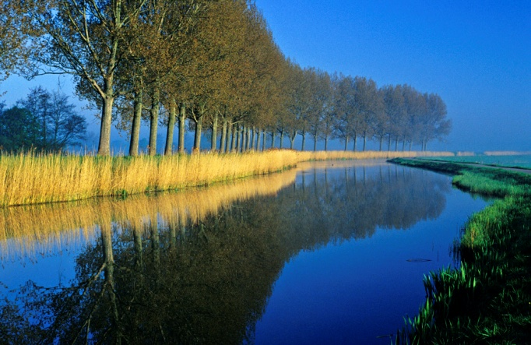
Managers
Original idea:
Implement “managers” to handle game state, game objects, game logic
How it actually turned out :
Pretty well! Our managers act as factory objects and overseers of the objects they create.

