Slide 1
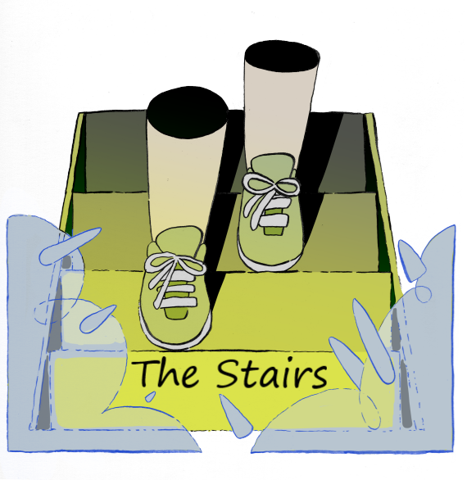

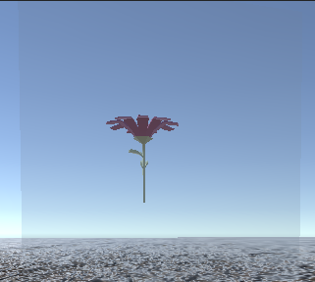
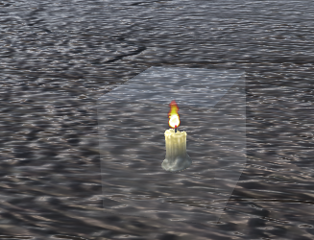
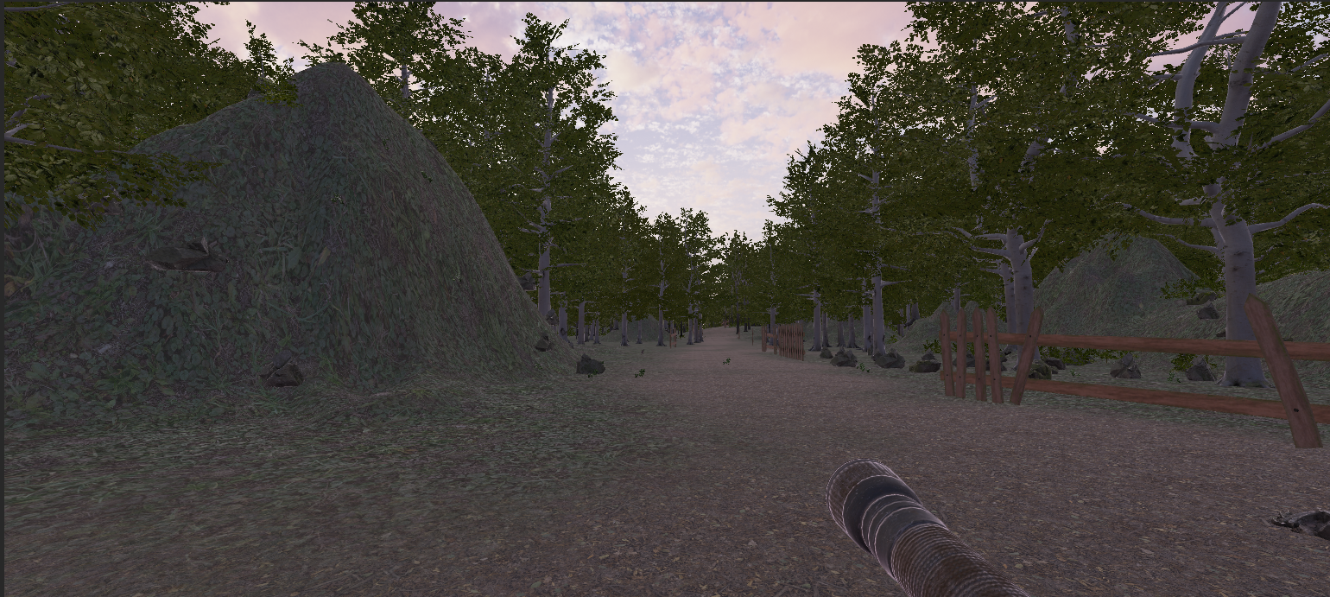
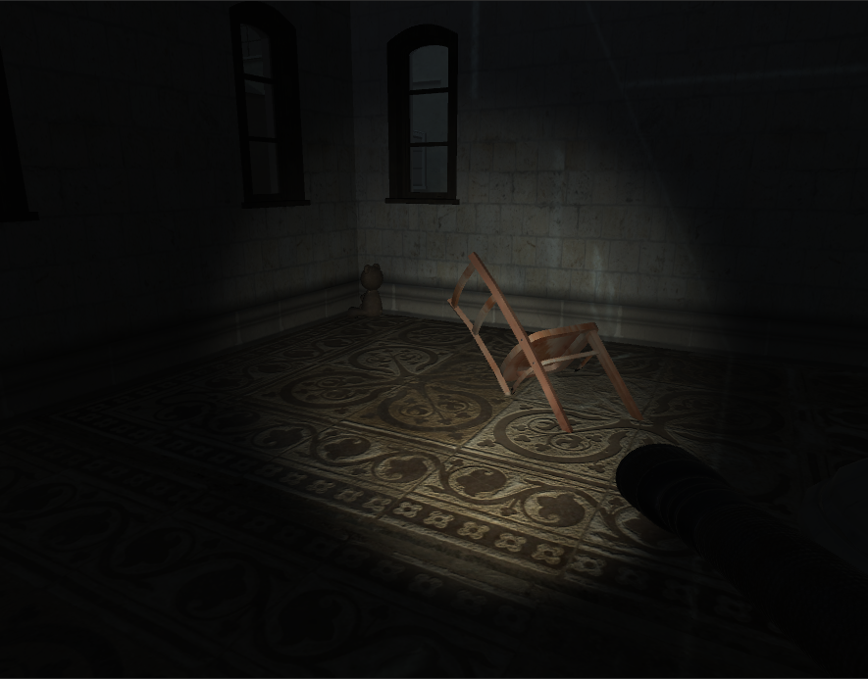
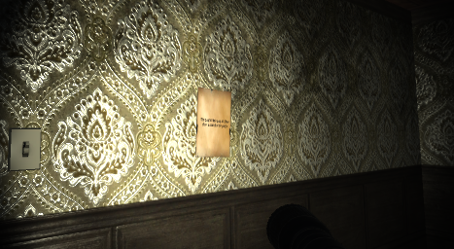
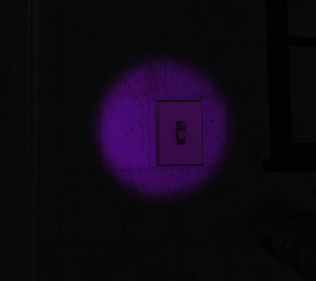
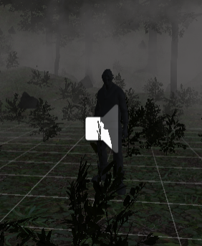
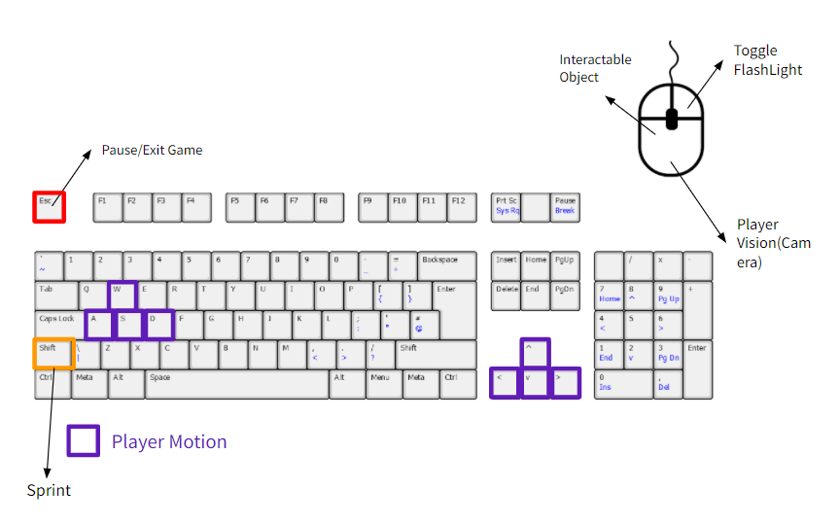
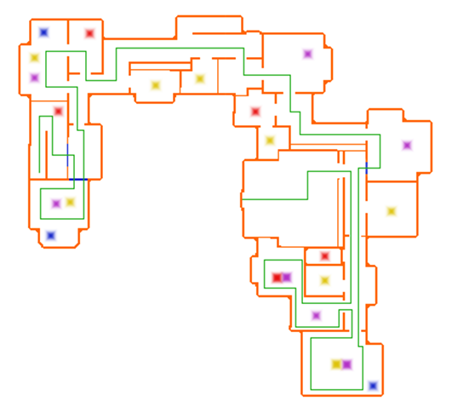
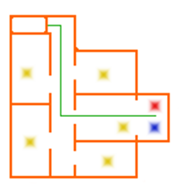
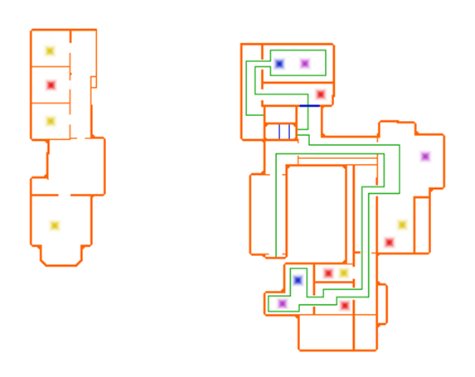
The Stairs
Team: Toddlers in a Trench coat
Connor Michetti, Katie Nichols, Andrew Reade, Evan Smith, Rui Zhou
Game Summary
The Stairs is a 3D horror game which takes the player along a journey to find a missing person. Throughout their journey, the player encounters many terrifying situations and is forced to partake in a series of puzzles.
The player is dropped into the middle of a forest where their campground is located. At nightfall, they hear a scream which leads the player to a strange staircase, seemingly leading to nowhere. Upon ascending the staircase, they are mysteriously transported to a dark mansion. Trapped with no way back, the player’s only option is to explore the horrors ahead. In the climatic finale, the player is free to make a choice that will decide everyone’s fate.
Artificial Intelligence
Different types of AI were used throughout the game. These ranged from simple AI, providing sound effects, to more complicated AI that would seek out the player.
Friendly Rabbit AI:
The Rabbit AI randomly wonder throughout the day terrain. They transition between three separate states (idle, turning, walking) which are chosen based off a random number generator.
Ghoul AI:
The Ghoul AI are randomly generated throughout the night terrain. They are black figures that start whispering as the player gets within a certain proximity. Once the player gets too close, they vanish from the map.
Hunter AI:
The Light Detecting AI reside within specific rooms of the mansion. They wonder aimlessly throughout the room until the player is in the room with their flashlight on the white light state. The AI can then detect the players position and tries to attack.
Chaser AI:
The Final AI is similar to the Light Detecting AI, except it can see the player no matter what state their flashlight is in. The goal of this AI is to capture the player before they are able to reach the last stage of the game.
Puzzles
There are multiple types of puzzles throughout the mansion, including reflection-based puzzles, changing the size of objects, and moving objects.
Each puzzle is unique, with each one requiring something different from the player. Luckily, those who came before left some clues to help you on your journey – if you can find them.
Notes:
Notes are placed throughout various rooms of the mansion. They are cryptic and function to provide background to the story and hints for the puzzles.
Terrain Map Development
Terrain was developed initially by hand for the clearing. This was because of the desire to have this part of the setting fine tuned. The rest of the terrain was developed via the terrain tool where the shape of the land, trees, foliage, and different ground textures were painted on by hand via the terrain tool’s brushes.
Day Scene:
Brighter Lighting
Rabbit AI
Rat Dance Party (easter egg)
Night Scene:
Darker Lighting
Fog
Fire in Firepit
Spooky AI (put actual defined name)
The Stairs
Flashlight
The flashlight is the player’s only tool to complete the game.
States:
White Light – Provides visibility for the player.
Purple Light – Used to interact with objects within puzzles.
No Light – Ability to turn off flashlight when not needed.
Mansion Map Development
Since the mansion was prebuilt, very limited control was given for progression. The main method was through locked doors and puzzles. Doors were locked at specific points in order to steer the player.
The tension curve was also closely monitored, with scares being the peaks of the curve and empty hallways and puzzles being the valleys
Keyboard Controls
Cheat codes:
Spacebar => Skip intro cutscene
Cutscenes
Cutscenes were used to help transition the player throughout the game and clue the player in on what they should do next. They were developed using Unity’s built in Timeline tool as well as Cinemachine. This allowed for anything with an Animator component to be used for a cutscene. This includes the camera, which Timeline/Cinemachine would take over in order to create different types of shots for the cutscenes. They then could be attached to a “trigger” object that would halt the player and play the cutscene.
Department of Computer Science and Engineering CSE 5912 – Fall 2021

