Slide 1
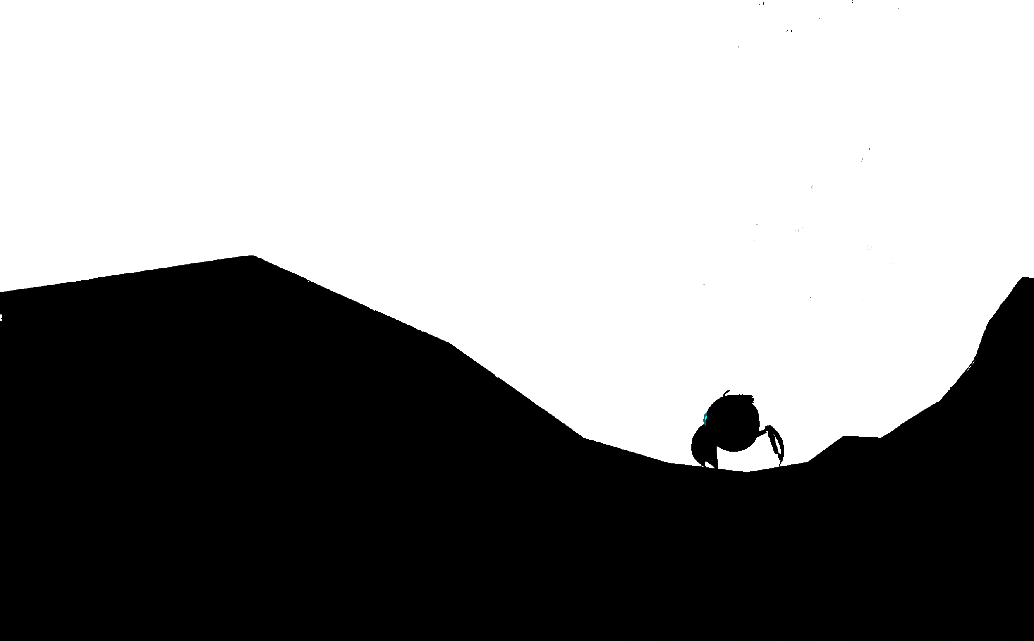
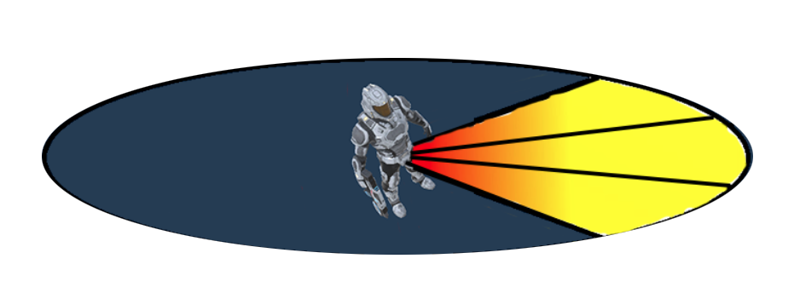
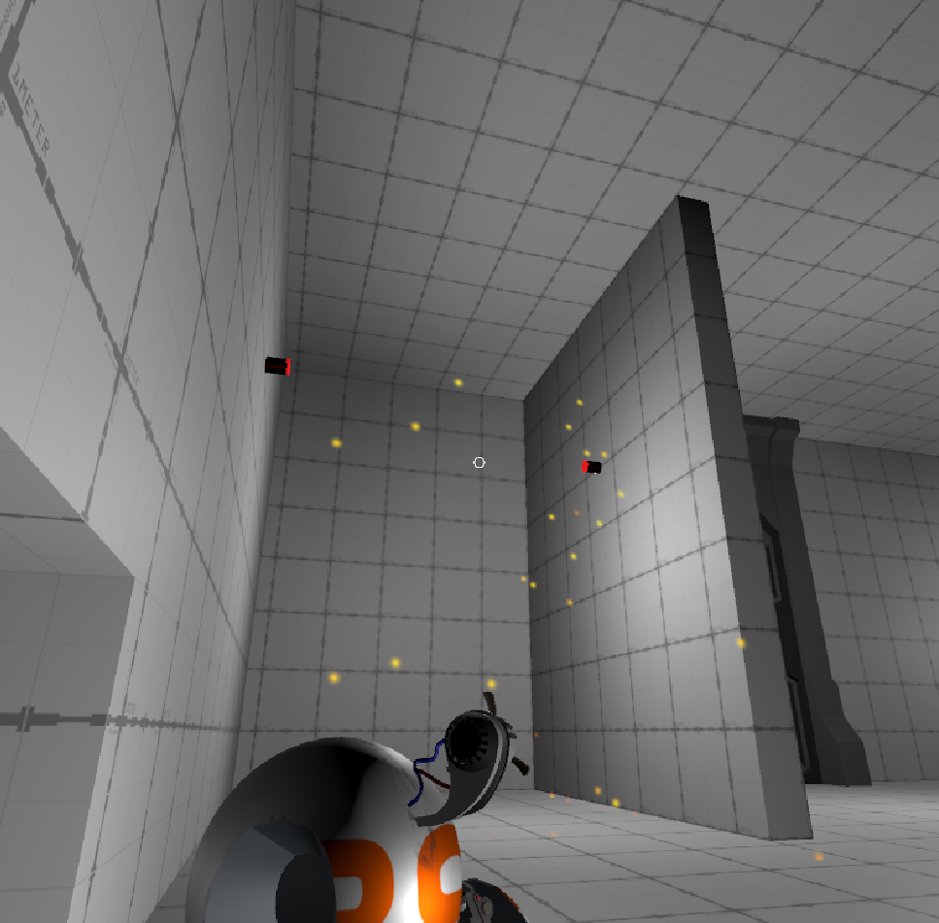
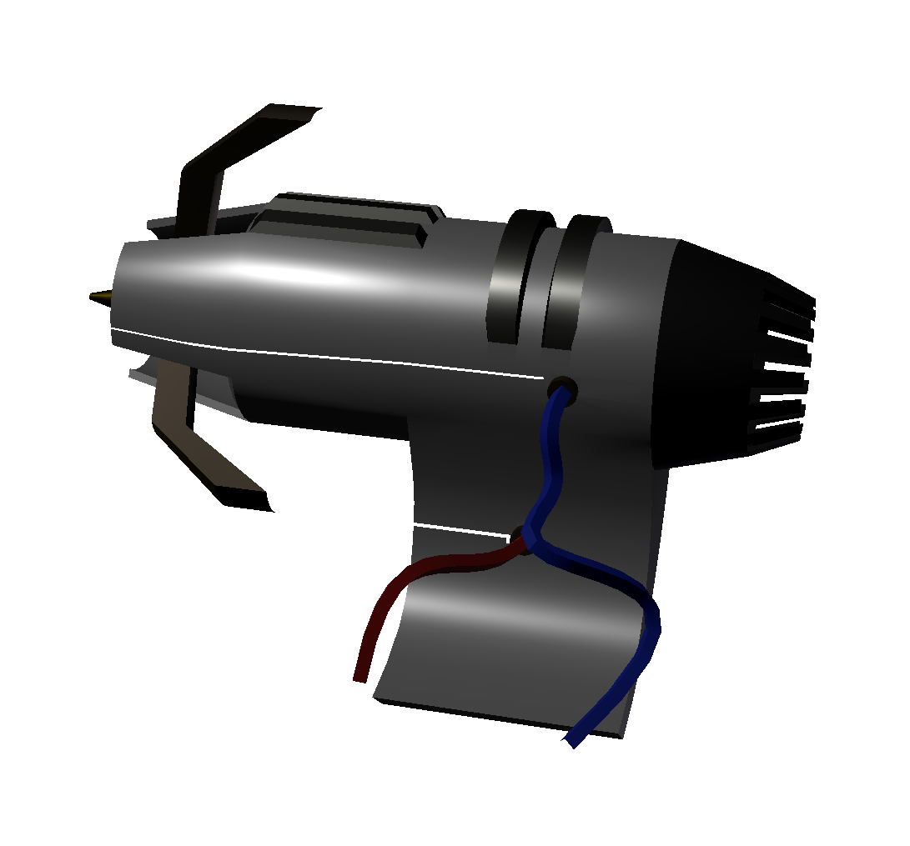
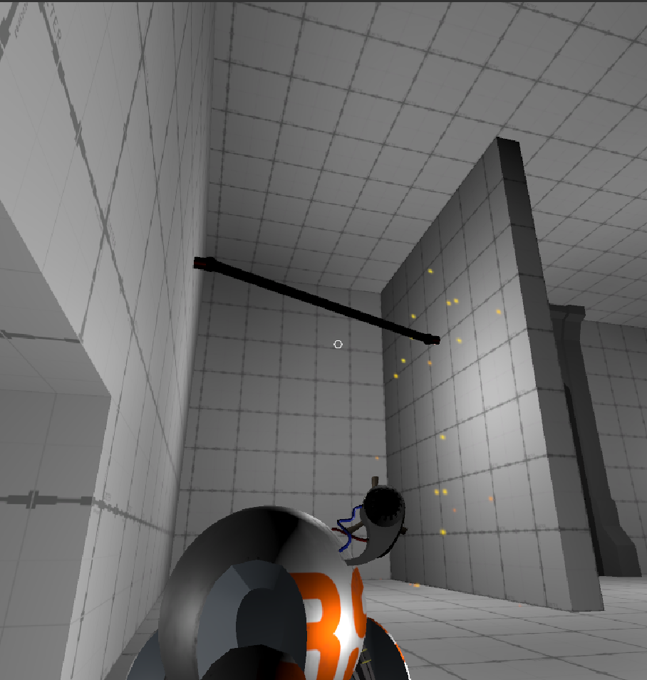
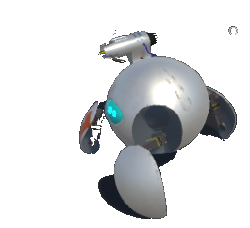
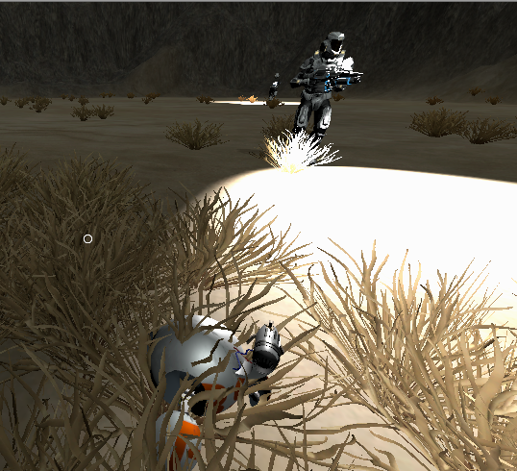
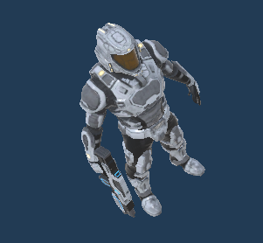
–
OHIO STATE UNIVERSITY / CSE / GAME DESIGN CAPSTONE
334 Commits
1167 File Changes
1,053,694 Total Lines Changed
129 Scripts Written
What is it?
Cannon ability attached to the player that fires ‘grapple-like’ projectiles.
What can it do?
Pull obstacles towards each other.
Complete/close open circuits.
Deliver/attach power items to enable doors, lights, or alarms.
Gameplay Implications
Adds layers of puzzle solving scenarios on top of the core stealth gameplay to add gameplay variety and higher scales of difficulty.
Player Movement
Transitions between three states: walking, rolling, and tether
Walking state allows for standard, third person movement
Rolling implements custom-made physics to move quicker in the spherical form
Tether allows for strafing with slower, more precise movements to aim and fire with higher precision
Camera Controlling
Camera moves along a rail behind the character
Character movement drives the camera
State machine for three different cameras
Tether camera
Rolling camera
Walking camera
Each camera optimized for ideal gameplay in that state
Goal Oriented Action Planning (G.O.A.P)
What is it?
GOAP uses A* to give AI agents access to smart decisions without a complex Finite State Machine (FSM)
How does it work?
Each agent has a set of goals which have a set of conditions to be valid, and a desired state
Each agent also has a set of actions which require some conditions and satisfy some conditions
When the agent reevaluates a plan, it pulls an unsatisfied goal from a priority queue and finds a sequence of actions that reach the desired state at the lowest cost (an arbitrary calculation)
Why use it?
Designing new behaviors
Planning decoupled from other game systems
Give agents diverse priorities, or specialized roles
Unity “GameObject”
Tracks world state
Handily serializes GOAP
Configurations
Reduces design footprint
Vision
How it works
Find every object we’re interested in.
Check if agent is able to observe player
Lock the target in sight
Factors Influencing Awareness:
Awareness = (player_visibility * (detection_radius - distance))/detection_radius * time
Closer to the target → high awareness
Noticed for longer → high awareness
Player hidden → no awareness
Dark environment → low awareness
Sound
Strategies to Avoid Detection:
Hide behind obstacles
Hide under the grass
Stay away from soldiers
Agent
Listens in a radius
Sound quality reduced by obstacles
Player
Walking makes less noise
Rolling makes more noise
Strategy
Walk past the soldier slowly
Move behind obstacles
Use the environment to distract soldiers
Contact
Bounding Box
Contact with a soldier would mean instant detection
Lock In Area
Detection Area
?
+
=
Sound Detected
Can’t Hear
Produced by: Jacob Grove, Garrett Kiefer, Jalen Soat, Jake Starrett and Weijie Xu

