Slide 1
Real-time Rendering
Shadow Maps
CSE 5542
Prof. Roger Crawfis

Slide 2
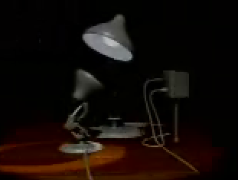
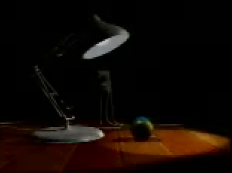
Shadow Maps
Casting curved shadows on curved surfaces
  Image-space algorithm
  Well suited for hardware implementation
Real-Time Luxo Jr. …uses three dynamic shadow maps (OpenGL, GeForce3)

Slide 3
Shadow Maps
Two-pass z-buffer algorithm:
First pass: Render scene from light
  Store z values in a shadow map
    Similar to a z-buffer. Stores the distance from
    the light to the nearest object.
Shadow Map
Distance

Slide 4
Shadow Maps
Second pass: Render scene from eye
  For each pixel to be drawn:
    Do normal z-buffer computation to see if the object is visible to the eye.
    If it is, compute distance from the corresponding
    world space point to light source.
    Compare this distance with the shadow map.
    If distance is greater, the point is in shadow.
Point Seen by
Light Source
Distance to
Light Source
Point
to Draw

Slide 5
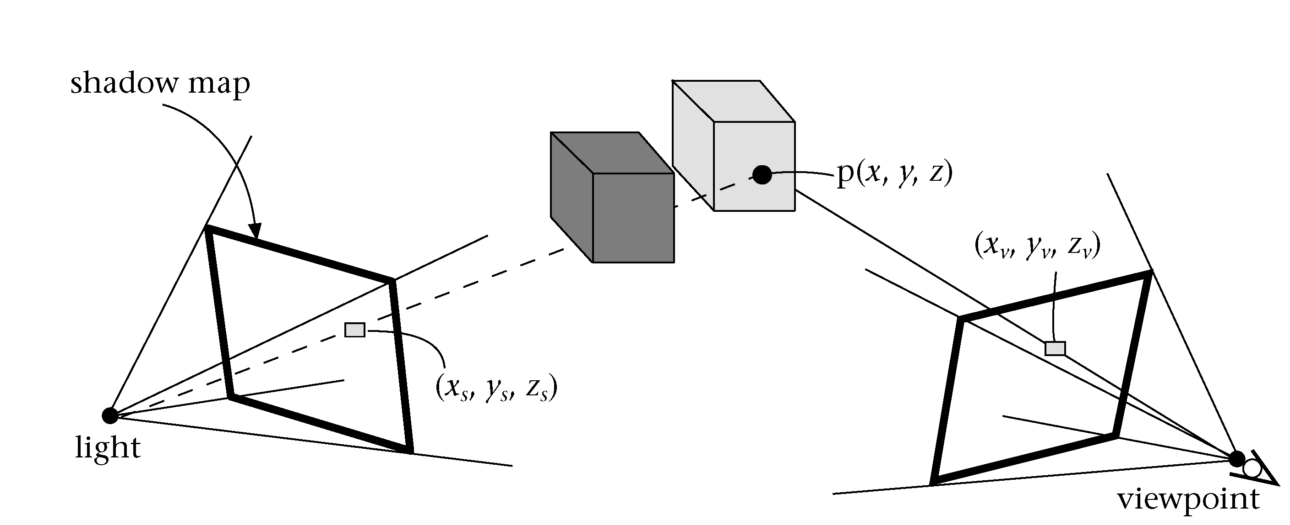
Shadow Maps
World-space ties the two passes together.

Slide 6
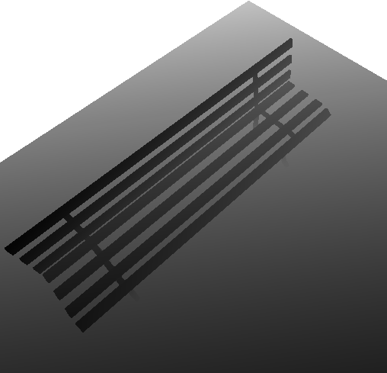
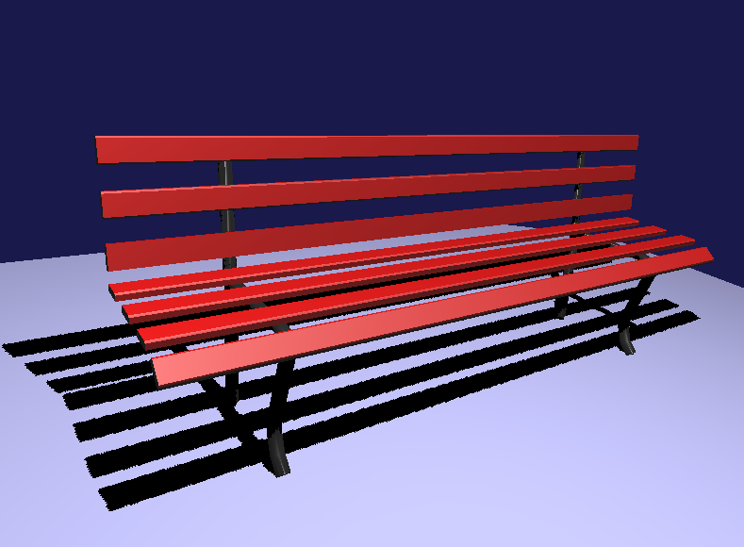
Shadow Maps
Final scene
Shadow map

Slide 7
Shadow Maps
Hardware implementation
  Render scene to z-buffer (light source view)
    Depthbuffer-to-texture copy
    RenderTexture with FBO
  Depth values of front most pixels
    These are the first occluders
  Issues:
    How do we sample / filter?
    How do we test?
    Transformations?

Slide 8
Shadow Maps
Two-pass z-buffer algorithm:
  Need to convert points from
  world-space to light-space:
World Space
L
Light Space
L V⁻¹
V⁻¹
V
Eye Space
V = viewing transformation
L = transformation to light space
p´ = L V⁻¹p

Slide 9
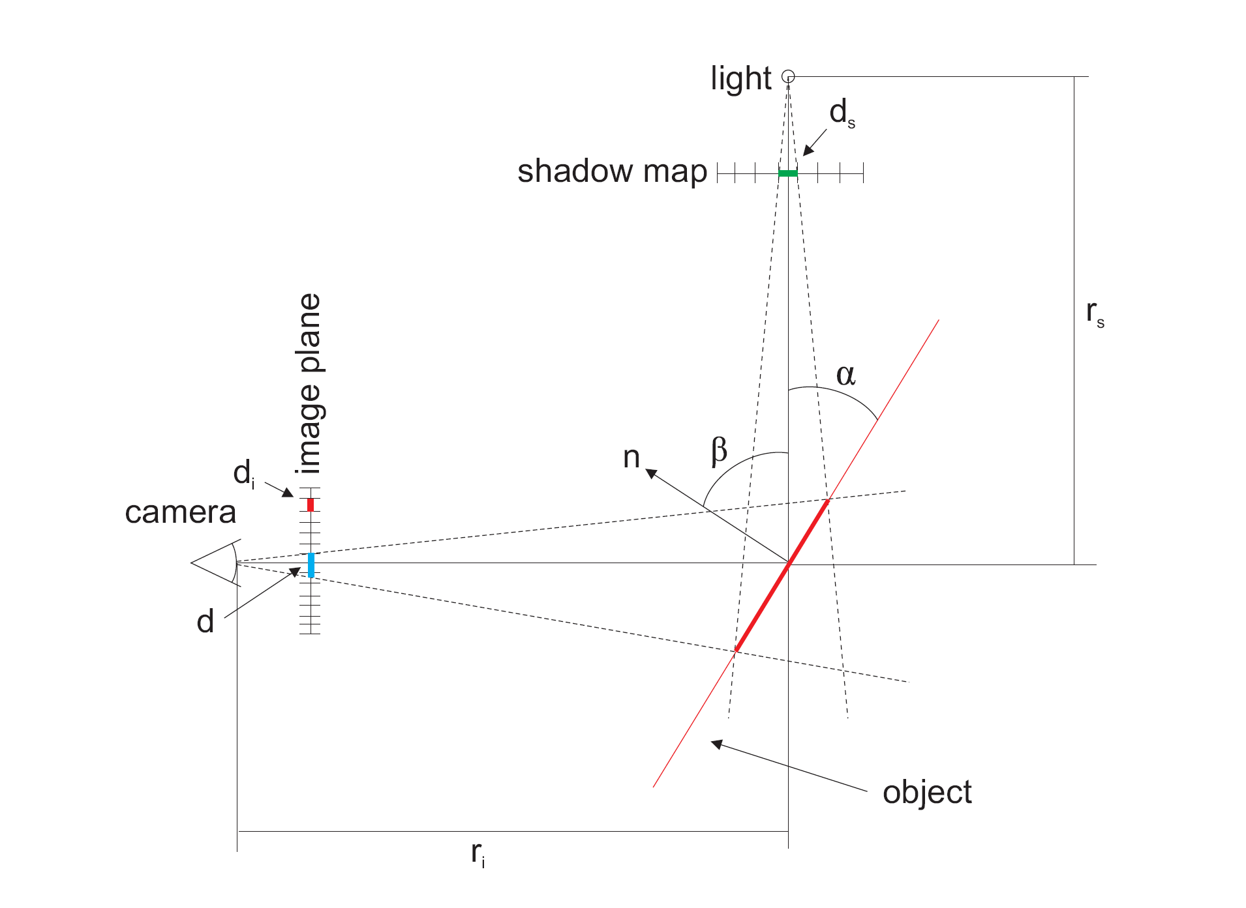
Aliasing in Shadow Maps
Sindholt, Joen. “A comparison of shadow algorithms” Examination thesis for MSE, TU Denmark. May 2005

Slide 10
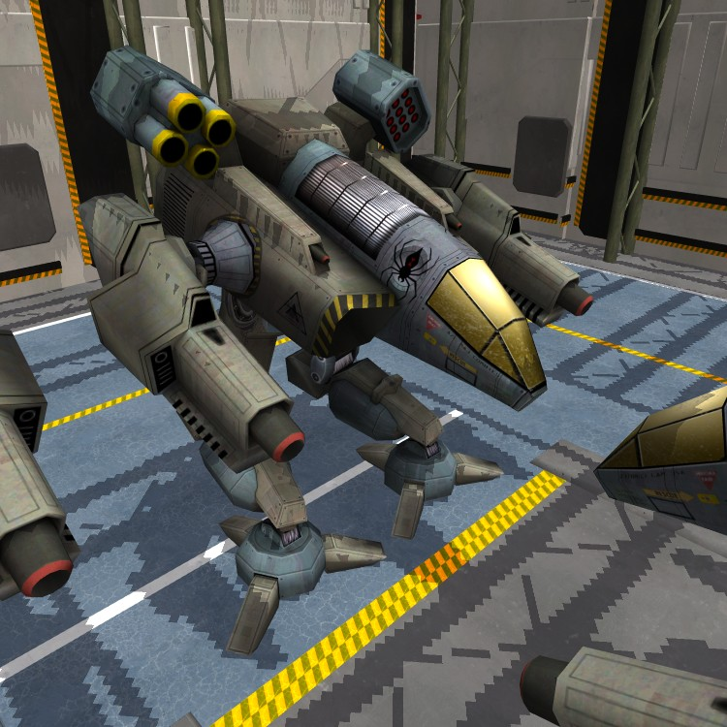

Aliasing error
Standard shadow map
Reference image
Notes:
10

Slide 11
Aliasing error
Standard shadow map
Reference image
Notes:
11

Slide 12
Aliasing error
objects
eye
Notes:
12

Slide 13
Aliasing error
far plane
view frustum
near plane
eye
Notes:
13

Slide 14
Aliasing error
standard
shadow map
texel
eye
Notes:
14

Slide 15
Aliasing error
more
samples
standard
shadow map
eye
fewer
samples
Notes:
15

Slide 16
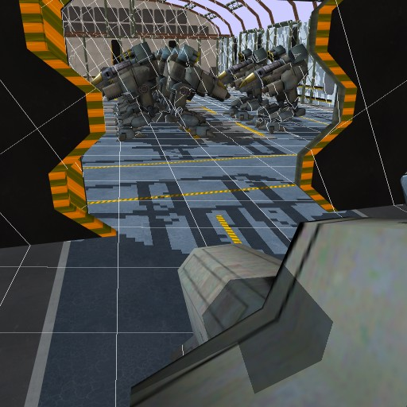
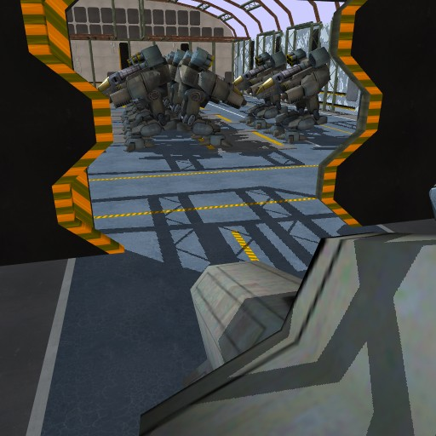
Aliasing error
projected
texel
Standard shadow map
Reference image
Notes:
16

Slide 17
Shadow Maps
The frustum and shadow map resolution affect the accuracy of the shadow z-buffer.

Slide 18
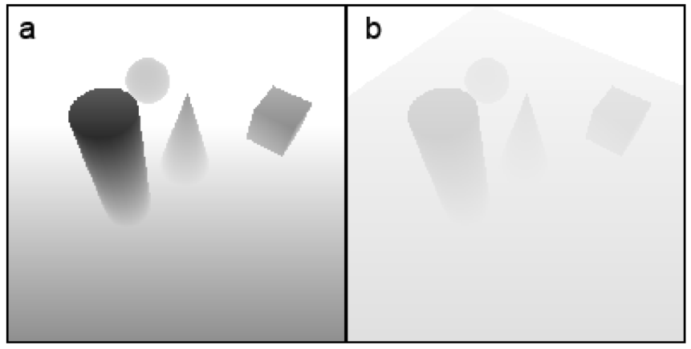
Shadow Maps
Near and Far Planes will affect the precision of the shadow z-buffer.
Sindholt, Joen. “A comparison of shadow algorithms” Examination thesis for MSE, TU Denmark. May 2005

Slide 19
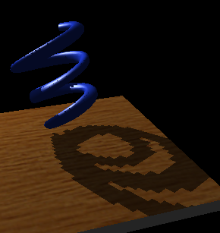
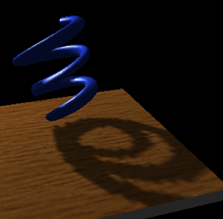
Shadow Maps
What texture filters to use?
GL_NEAREST
GL_LINEAR

Slide 20
Shadow Maps
Traditional filtering is inappropriate
What pixel covers in
shadow map texture
Pixel depth = 0.57
eye
position
Texel sample
depth = 0.25
Texel sample
depth = 0.63
0.25
0.25
Average(0.25, 0.25, 0.63, 0.63) = 0.44
0.57 > 0.44 so pixel is wrongly “in shadow”
Truth: nothing is at 0.44, just 0.25 and 0.57
0.63
0.63

Slide 21
Shadow Maps
Average comparison results, not depth values
What pixel covers in
shadow map texture
Pixel depth = 0.57
eye
position
Texel sample
depth = 0.25
Texel sample
depth = 0.63
Shadowed
Average(0.57>0.25, 0.57>0.25, 0.57<0.63, 0.57<0.63) = 50%
so pixel is reasonably 50% shadowed
(actually hardware does weighted average)
Unshadowed

Slide 22
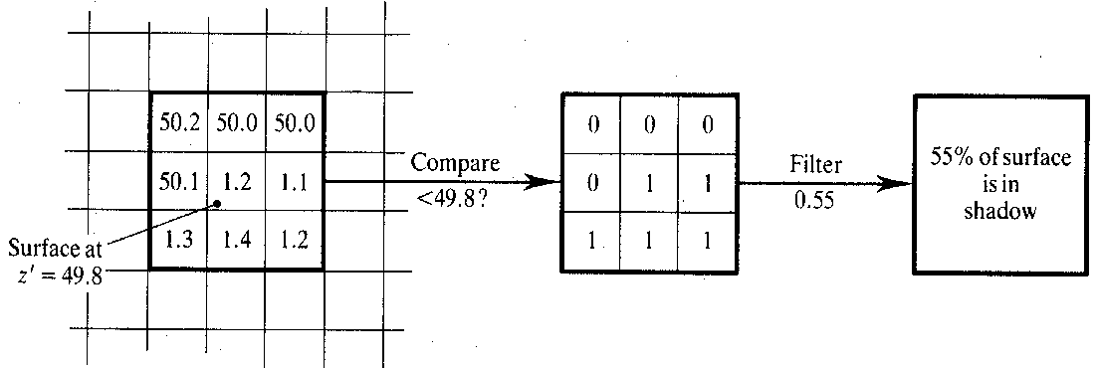
Shadow Maps
Percentage Closer filtering
  Normal texture filtering just averages color components, which does NOT work here.
  Implies all texels need to be evaluated.
Reeves, et al, SIGGRAPH 1987

Slide 23
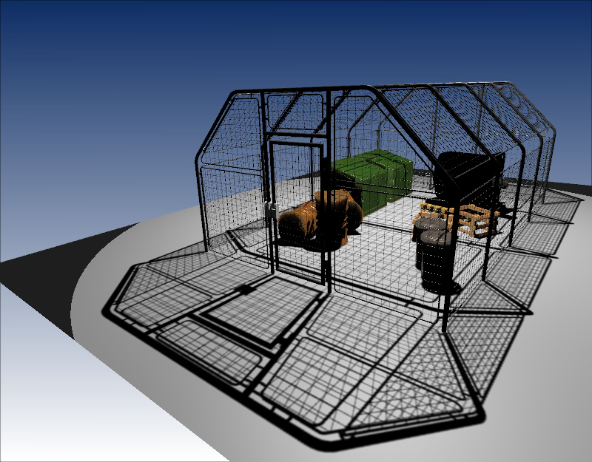
Shadow Maps and Alpha Testing
A key advantage of shadow maps over shadow volumes is the ability to handle alpha-masked objects and textures (e.g., billboard trees, picket fences, etc.).
from Thomas Annen et al, Exponential Shadow Maps, GI 2008

Slide 24
Shadow Maps
Advantages:
  No need for silhouette’s of the occluders
  All objects can be an occluder
  Fast (less than 2x).
  Hardware support for precision formats and filtering.
Disadvantages:
  Aliasing is a big problem
  Problems with bias’ing in the depth test.

