Slide 1
CSE 3541/5541
Behavioral (Path finding)– Part II

Slide 2
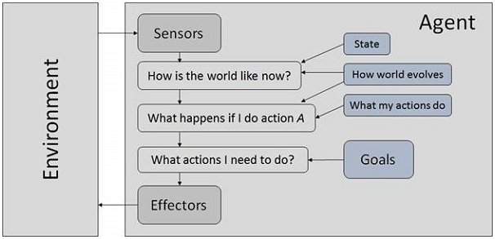
Goal-based Agent
Chooses actions to achieve goals
Models the state of the world and knowledge

Slide 3
Goal Orientated Action Planning (GOAP)
FSM’s are inflexible when defining behavior
Planning: A formalized process (plan formation) of searching for a sequence of actions to satisfy a goal
  Decouple actions from each other and goals
  Mix-and-match actions to make goals
  https://learn.unity.com/tutorial/an-introduction-to-goap?uv=2019.4&projectId=5e0bc1a5edbc2a035d136397
  https://www.youtube.com/watch?v=jUSrVF8mve4
  http://alumni.media.mit.edu/~jorkin/goap.html
Based on STRIPS (Stanford Research Institute Problem Solver) circa 1970

Slide 4
States and Actions
A state is a tuple of variables that represent the current “state” of the world
State description
  (Level, room, bullets, grenades, …)
  (“Map32 Hectic”, “main”, 20, 2, …)
An action is a transition from one state to another
  Throwing a grenade will reduce the number of grenades by one

Slide 5



Plans (GDC2006, Jeff Orkin)
A sequence of actions to achieve a goal
  Alma would like to order a pizza
Action
  Precondition
  Effect
Goal: Satisfy Alma’s hunger (Alma is not hungry)
“Phone call” action
  Preconditions: Alma is hungry, needs a phone, and needs phone number to Domino’s
  Effect: Make pizza order
“Delivery” action
  Preconditions: Pizza ready and delivery person available
  Effect: Pizza arrives at Alma’s house
“Eat pizza” action
  Preconditions: Pizza arrives at the door
  Effect: Alma is not hungry

Slide 6
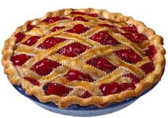

Plans
Alma’s hunger may be satisfied by pizza or pie
Two plans could achieve the goal
Alma needs a recipe to bake a pie

Slide 7

Plans
Goal: A state of the world where Alma is not hungry
State: (phone#, recipe, hungry?)
Goal: ( -- , -- , NO )
( , ,NO )
( , ,YES)
( , ,NO )

Slide 8

Plans
State: (phone#, recipe, hungry?)
Action: “Deliver pizza”
  Preconditions: ( , -- , YES )
  Effects: ( , -- , NO )

Slide 9
Plans
Construct plans by matching a previous action’s effect with the next action’s preconditions
An action my have a cost to help decide on a preferred or more optimal plan
Action: “Deliver pizza”
  Preconditions: ( , -- , YES )
  Effects: ( , -- , NO )

Slide 10
Actions (https://gamedevelopment.tutsplus.com/tutorials/goal-oriented-action-planning-for-a-smarter-ai--cms-20793)
class Action
{
// ( -- , -- , -- )
WORLD_STATE m_Preconditions;
WORLD_STATE m_Effects;
bool CheckPreconditions();
};

Slide 11
Actions
class Action
{
// ( -- , -- , -- )
WORLD_STATE m_Preconditions;
WORLD_STATE m_Effects;
bool CheckPreconditions();
void ActivateAction();
};

Slide 12
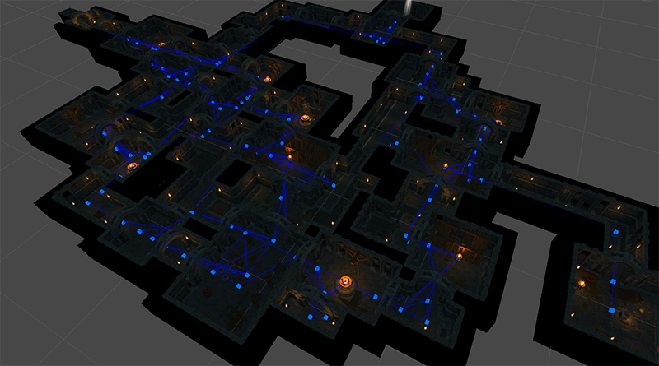
Pathfinding

Slide 13
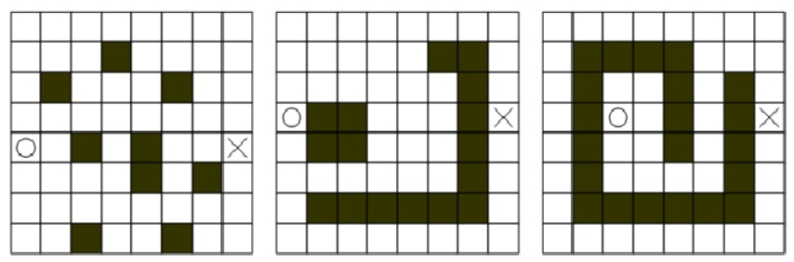
Pathfinding
Find the shortest best route between two points vertices or states
  How do we represent the environment
  Lots of algorithms
  May not be computationally efficient
Search space

Slide 14
Pathfinding
Agent needs to know where they can move
Search space should represent either:
  Clear routes that can be traversed
  The entire walkable surface
Search space typically doesn’t represent:
  Small obstacles or moving objects
Common search space representations
  Grids
  Waypoint graphs
  Navigation meshes

Slide 15
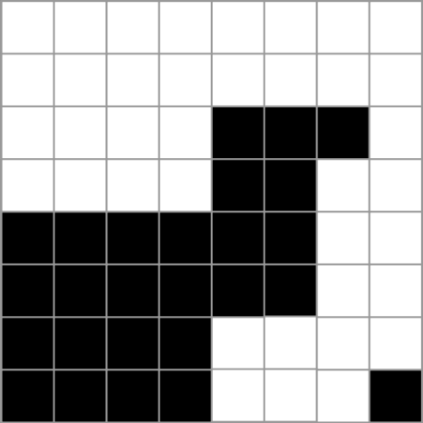
Grids
2D grids
  Intuitive representation of a 3D game world
  Each cell is flagged
    Passable or impassable
    Each object can occupy one or more cells

Slide 16
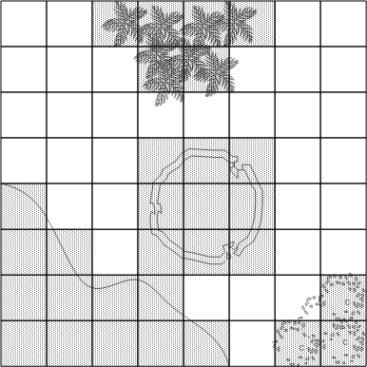
Grids
Fast look-up
Easy access to neighboring cells

Slide 17
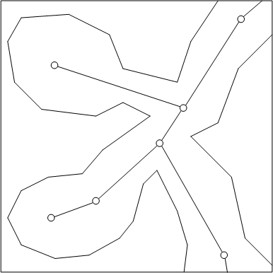
Waypoint Graph
Specifies lines/routes that are “safe:” for traversing
Each line(link) connects exactly two waypoints
More arbitrary than grids

Slide 18
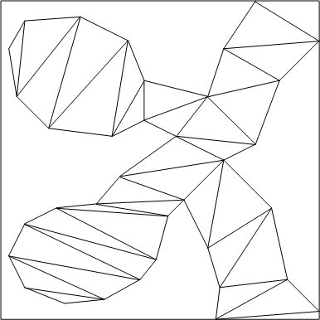
Navigation Mesh
Combines grids and waypoint graphs
Every node is a convex polygon (or area)
  A waypoint node is a single position
A walkable surface

Slide 19
Pathfinding
Path: List of cells, points, or nodes that an agent must traverse
Pathfinding algorithm
  Find a path from a start position to a goal position
start
end

Slide 20
Random Walk
Simple algorithm
  Agent takes a random step
  If goal reached, then done
Add Intelligence
  Only take the step where distance to the goal is smaller
  Prone to getting stuck (local minimum)
    Allow a step where distance to goal is greater with certain probability
  If obstacle
    Trace around the obstacle clockwise or counter-clockwise (pick randomly) until free path towards goal
    Called Random Trace

Slide 21
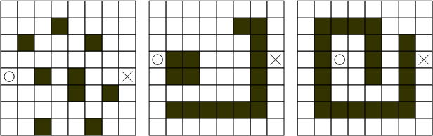
Random Trace
How will it do on the following maps?

Slide 22
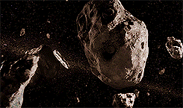
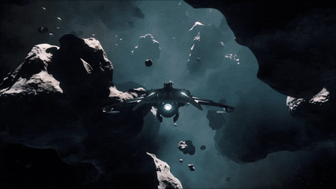
3D Asteroid Belt
3D volume of moving objects -> Use wandering. A* unfit.

Slide 23
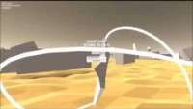
Dynamic objects (2D)
https://www.youtube.com/watch?v=6T2AEWHKovs

Slide 24
Random Trace
No guarantee to reach target
Found path is not optimal (usually)
Consumes very little memory
Works well with small moving objects and sparse fields
Notes:
Complete algorithm: Algorithm always finds a solution

Slide 25
Search Algorithms
Breadth-First
Best-First
Dijkstra’s
A*
  Combination of Best-first and Dijkstra

Slide 26
Search Algorithms
Algorithms use two lists: open and closed
Open list: Unexplored nodes
Examine a node on the open list:
  Check if it is the goal
  If not, check its neighbors (edges) and add more nodes to the open list
    An added node has a reference to the node that explored it
  Place the explored node onto the closed list (mark as visited)
Closed list: Explored nodes and not the goal

Slide 27
Search Algorithms
Create starting node and push onto the open list
While open list not empty
  Get node from the open list (currentNode)
  If currentNode is the goal, break from step 2
  Create new nodes (successors) for neighboring cells and push onto the open list
  Put currentNode onto the closed list

Slide 28
Breadth-First Search
Complete algorithm
  Not necessarily the shortest path
Start node A and goal node H
Initialize open list to A and closed list to empty
Closed List: Ø
Open List:
A (Path A)
A
B
C
D
E
F
G
H

Slide 29
Breadth-First Search
A
Closed List (Those visited)
A (Path A);
Open List (To be visited)
B (Path A->B)
C (Path A->C)
B
C
D
E
F
G
H

Slide 30
Breadth-First Search
Closed List (Those visited)
A (Path A);
B (Path A->B);
Open List (To be visited)
C (Path A->C);
E (Path A->B->E);
D (Path A->B->D);
A
B
C
D
E
F
G
H

Slide 31
Breadth-First Search
Closed List (Those visited)
A (Path A);
B (Path A->B);
C (Path A->C);
Open List (To be visited)
E (Path A->B->E);
D (Path A->B->D);
D (Path A->C->D);
A
B
C
D
E
F
G
H

Slide 32
Breadth-First Search
Closed List (Those visited)
A (Path A);
B (Path A->B);
C (Path A->C);
E (Path A->B->E);
Open List (To be visited)
D (Path A->B->D);
D (Path A->C->D);
D (Path A->B->E->D);
A
B
C
D
E
F
G
H

Slide 33
Breadth-First Search
Closed List (Those visited)
A (Path A);
B (Path A->B);
C (Path A->C);
E (Path A->B->E);
D (Path A->B->D);
Open List (To be visited)
D (Path A->C->D);
D (Path A->B->E->D);
G (Path A->B->D->G)
F (Path A->B->D->F)
A
B
C
D
E
F
G
H

Slide 34
Breadth-First Search
Closed List (Those visited)
A (Path A);
B (Path A->B);
C (Path A->C);
E (Path A->B->E);
D (Path A->B->D);
Open List (To be visited)
G (Path A->B->D->G)
F (Path A->B->D->F)
A
B
C
D
E
F
G
H

Slide 35
Breadth-First Search
Closed List (Those visited)
A (Path A);
B (Path A->B);
C (Path A->C);
E (Path A->B->E);
D (Path A->B->D);
G (Path A->B->D->G)
Open List (To be visited)
F (Path A->B->D->F)
H (Path A->B->D->G->H)
A
B
C
D
E
F
G
H

Slide 36
Breadth-First Search
Closed List (Those visited)
A (Path A);
B (Path A->B);
C (Path A->C);
E (Path A->B->E);
D (Path A->B->D);
G (Path A->B->D->G)
F (Path A->B->D->F)
Open List (To be visited)
H (Path A->B->D->G->H)
A
B
C
D
E
F
G
H

Slide 37
Breadth-First Search
Closed List (Those visited)
A (Path A);
B (Path A->B);
C (Path A->C);
E (Path A->B->E);
D (Path A->B->D);
G (Path A->B->D->G)
F (Path A->B->D->F)
H (Path A->B->D->G->H) … Found!
Open List (To be visited)
A
B
C
D
E
F
G
H

Slide 38
Keeping Track of the Path
Once we find the target, how do we know the path?
In this case, each node was visited from exactly one other node.
Keep track of the parent in this chain.

Slide 39
Best-First Search
Heuristic Search
  Use problem specific knowledge to speed up search process
  Assume cost is distance along path to the goal
  Head straight for the goal by computing distance from every node to the goal
  Next node removed from the open list is the one with the shortest distance to the goal
Not a complete algorithm
Tends to find good paths
Not guaranteed to find optimal paths

Slide 40
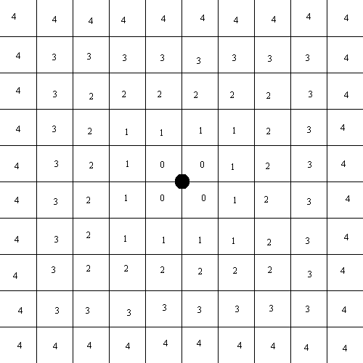
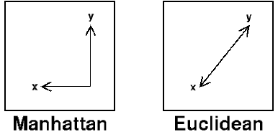
Best-First Search
Heuristic: Estimate cost to the goal from any node
Imagine a distance field (to a goal) defined for each location

Slide 41
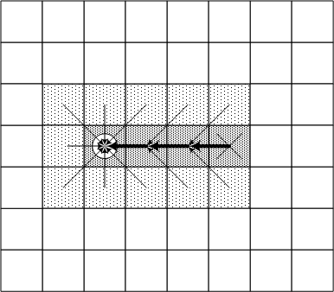
Best-First Search
Choose node on the open list with the smallest distance to the goal

Slide 42
Best-First Search
Start at the red and try to reach goal at green.
Numbers are the Manhattan distances
8
7
6
5
4
3
2
3
4
5
6
7
5
4
3
5
6
3
2
1
0
1
2
4
7
6
5
8
7
6
5
4
3
2
3
4
5
6

Slide 43
Best-First Search
Sub-optimal path
8
7
6
5
4
3
2
3
4
5
6
7
5
4
3
5
6
3
2
1
0
0
1
2
4
7
7
6
5
8
7
6
5
4
3
2
3
4
5
6

Slide 44
Best-First Search
Local-minimum problem

Slide 45
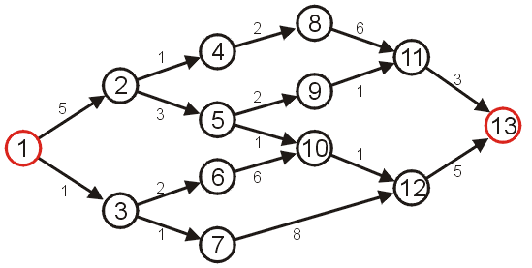
Example
Find the shortest path from start vertex 1 to end vertex 13

Slide 46
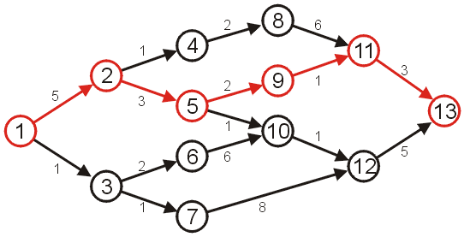
Shortest Path Example
The shortest path has length 14

Slide 47
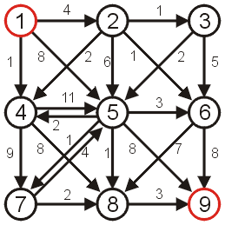
Dijkstra’s Algorithm
Greedy Algorithm
  Build paths from the starting node
  Keep track of all paths
  Determine next shortest path to any node (accumulated path cost from start to a node)
How?

Slide 48
Dijkstra’s Algorithm
Consider the following graph with positive weights
  Start vertex 1
  End vertex is 9

Slide 49
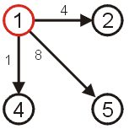
Dijkstra’s Algorithm
3 Paths from start vertex 1
  (1, 2) length 4
  (1, 4) length 1
  (1, 5) length 8
The shortest path so far is (1, 4) which is of length 1

Slide 50
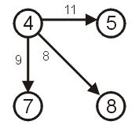
Dijkstra’s Algorithm
Greedy choice: Choose vertex 4
Paths
  (1, 4, 5) length 12
  (1, 4, 7) length 10
  (1, 4, 8) length 9
Remember that the length of the path from vertex 1 for vertex 4 is length 1
How do we know there is no other shorter path?

Slide 51
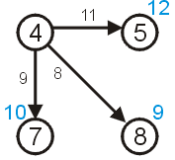
Dijkstra’s Algorithm
Greedy choice: Choose vertex 4
Paths
  5 of length 12
  7 of length 10
  8 of length 9
We are storing the length of a path that goes through vertex 4

Slide 52
A* Search
Combine Best-First and Dijkstra’s
  Heuristic – Use estimated cost to the goal
  Given cost – Use cost from the start to the current node
  https://www.youtube.com/watch?v=-L-WgKMFuhE
Choose a node with the best combined cost:
  Known cost from start to node + heuristic cost from the node to the goal
  The goal node has heuristic cost = 0 and so the combined cost is just the cost from the start to the goal node
  Note, if the heuristic is 0 for all nodes then this is just Dijkstra’s algorithm
Complete algorithm
Optimal algorithm … with the right heuristic
  Heuristic never overestimates the true cost
  Called an admissible heuristic

Slide 53
A* Search
Optimal search with an admissible heuristic
8+3
8+3
7+4
7+4
6+5
6+3
5+6
5+6
4+7
4+7
3+8
3+8
2+9
8
7
6
5
4
3
2+9
3+10
2
3
4
5
6
7+2
7+2
5+6
4+7
3+8
7
5
4
3+8
3
5
6+1
6+1
2+9
2+9
1+10
1+10
0+11
6
3
2
1
0+11
0
1
2
4
7+0
7+0
6+1
7
6+1
6
5
8+1
8+1
7+2
7+2
6+3
6+3
5+4
5+4
4+5
4+5
3+6
3+6
2+7
8
7
6
5
4
3
2+7
3+8
2
3
4
5
6

Slide 54
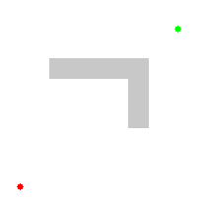
Comparison: A* and Dijkstra

Slide 55
Pathfinding Algorithm Summary
Breadth-First processes the node that has been waiting the longest
  Uses a FIFO queue
Best-First processes the one that is closest to the goal
  Uses a priority queue –node value is distance to goal
Dijkstra’s processes the one that is the cheapest to reach from the start cell
  Uses a priority queue – node value is lowest cost from the start
A* chooses a node that is cheap and close to the goal
  Uses a priority queue – node value is a combination of Best-First and Dijkstra’s

Slide 56
More Reading on Pathfinding
Amit’s A* Pages http://theory.stanford.edu/~amitp/GameProgramming/
Beginner’s guide to pathfinding http://ai-depot.com/Tutorial/PathFinding.html
Waypoint graphs vs. navigation meshes http://www.ai-blog.net/archives/000152.html

