Slide 1
CSE 3541/5541 Behavioral – Part I

Slide 2
Behavioral Animation
An intelligent agent:
Perceives its environment
Takes actions autonomously
Achieves goals
May use knowledge
May improve its performance with learning
https://unity.com/products/machine-learning-agents

Slide 3
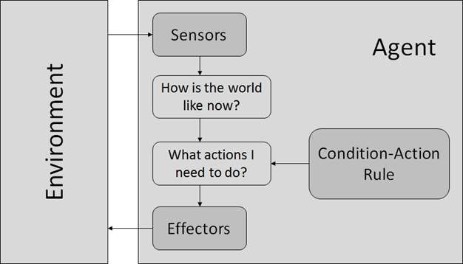
Reflex Agent
All possible decisions are encoded with condition-action rules
Always results in predictable behavior

Slide 4
Example: Simple Trap
Player gets close
Attack
If Statement!!!

Slide 5
Finite State Machine (FSM)
https://www.youtube.com/watch?v=JyF0oyarz4U
State
A behavior that a character or other system should execute
States: Idle, Attack, Move to a target location, Jump
Inputs (hit the space bar for jump) cause a transition from one state to another
IDLE
JUMP
MOVE

Slide 6
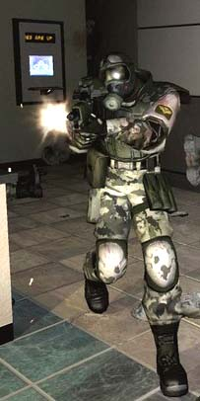
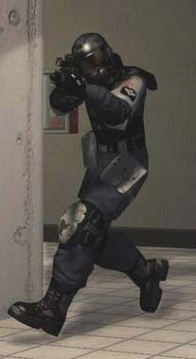
Finite State Machine (FSM)
Provides simple sequential logic
The standard for AI logic in the 1990’s and 2000’s
Unity programming
Use of the enum type to list all states
The “State pattern”
https://www.youtube.com/watch?v=nnrOhb5UdRc
Create a Unity class for each state in a class hierarchy
https://www.youtube.com/playlist?list=PL8lV_joQZ5sczN_xHOEXEmfSIt3gYr1Rh
https://www.youtube.com/watch?v=db0KWYaWfeM
https://www.youtube.com/watch?v=V75hgcsCGOM
Attack Search

Slide 7
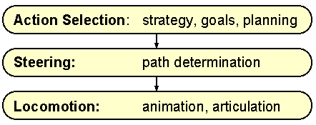
Motion Behaviors
Action Selection
Reflex agent
State logic
Planning
Steering
Position and orientation changing logic
Locomotion
Figure animation
http://www.red3d.com/cwr/steer/gdc99/

Slide 8
Actor Properties (Position Only)
Goal (x_{g}, y_{g})
V = Goal - Position
Next Position = Position + V * dt
Position (x, y)

Slide 9
Actor Properties (Position And Orientation)
Orientation (ox, oy) = transform.forward
Determine which rotation (±θ) orients the actor closer to the goal using dot product
Rotate(θ)
Rotate(-θ)
Goal (x_{g}, y_{g})
V_{target} = Goal - Position
Position (x, y)
In Unity, you can use RotateTowards()

Slide 10
Sample Code
class OrientedAgent2D {
// Data
Vector3 position;
GameObject model; // Use this for geometry and orientation
// Methods
Update(float deltaTime);
TurnLeft();
TurnRight();
MoveForward();
MoveBackward();
};

Slide 11
Knowing the Environment
Vision and other senses
Information available now
Memory
Information stored from the past

Slide 12
Vision
General vision
What can the actor see?
Targeted vision
Can the actor see object X?
Computation vs accuracy
How much of an object needs to be seen to be identified?
Need to model visual perception?

Slide 13
Omniscience
Everything in the scene is known

Slide 14
Distance Limited Omniscience

Slide 15
Field of View

Slide 16
Field of View
Orientation Vector (O)
Vector from agent to vertex (V)
Angle of cone = θ
Inside the cone when the angle between O and V is less then or equal to θ/2

Slide 17
Field of View
Vector3 agentPosition, orientation, objectPosition;
float cosVisionLimit;
Vector3 agentToVertex = objectPosition – agentPosition;
agentToVertex.Normalize();
if(Vector3.Dot(agentToVertex, orientation) > cosVisionLimit)
// agent can see object

Slide 18
Occluded Vision
Ray casting with collision detection – sample the environment

Slide 19
Target-testing Vision (per object)
Can the actor see X?
Cast a ray
How well can the actor see X?
Use multiple rays

Slide 20
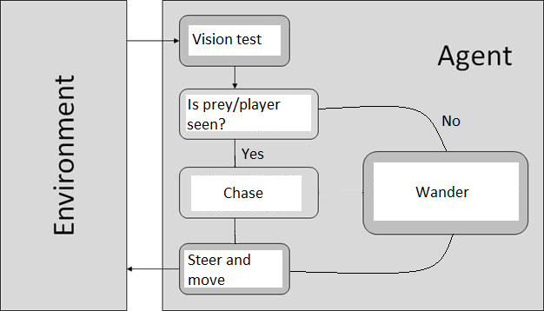
Predator/Prey Agent
Autonomously moving
https://learn.unity.com/project/autonomously-moving-agents?uv=2019.4
Decision trees
https://www.youtube.com/watch?v=CdSzlp0OSzk

Slide 21
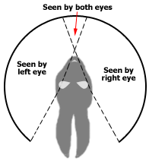
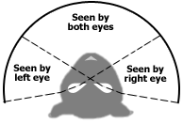
Predator Prey Vision Anatomy

Slide 22
Prey-Predator (Vision)

Slide 23
Motion – Force Based
Force = c * pos_{prey} - pos_{pred}
Apply a force on the predator towards the prey when in view

Slide 24
Motion – Kinematic Based
v_{new}
v_{old}
Determine the closest prey in view
then turn towards it and increase forward velocity

