Slide 1
CSE 3541/5541
Rendering & Animation Loops (Part III)
Lecture 12

Slide 2
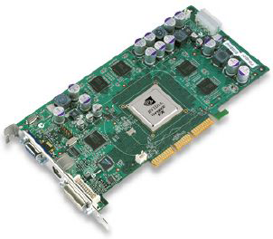
Popular Rendering Pipeline
Backward Projection
Ubiquitous in the industry
Graphics hardware support
Z-buffer algorithm
Polygon-based
Special effects not easy to come by
Z-Buffer
For each triangle
  For each projected pixel
  Project scene to the pixels

Slide 3
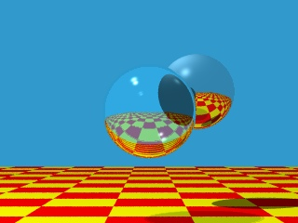

Ray Tracing
Forward Projection
Photorealism
Slow, slow, slow
  No special hardware support
  Though, attempts are being made to implement it
Easy to handle different kinds of object representations
Easy to handle special effects
Ray Casting
For each pixel
  For each object
Send pixels to the scene

Slide 4
Ray Casting In Action
For every pixel
construct a ray from the eye
  For every object in the scene
    Find intersection with the ray
    Keep if closest

Slide 5
Ray Casting In Action
For every pixel
construct a ray from the eye
  For every object in the scene
    Find intersection with the ray
    Keep if closest

Slide 6
Ray Tracing In Action
Shade (interaction of light and material)
Secondary rays (shadows, reflection, refraction)

Slide 7
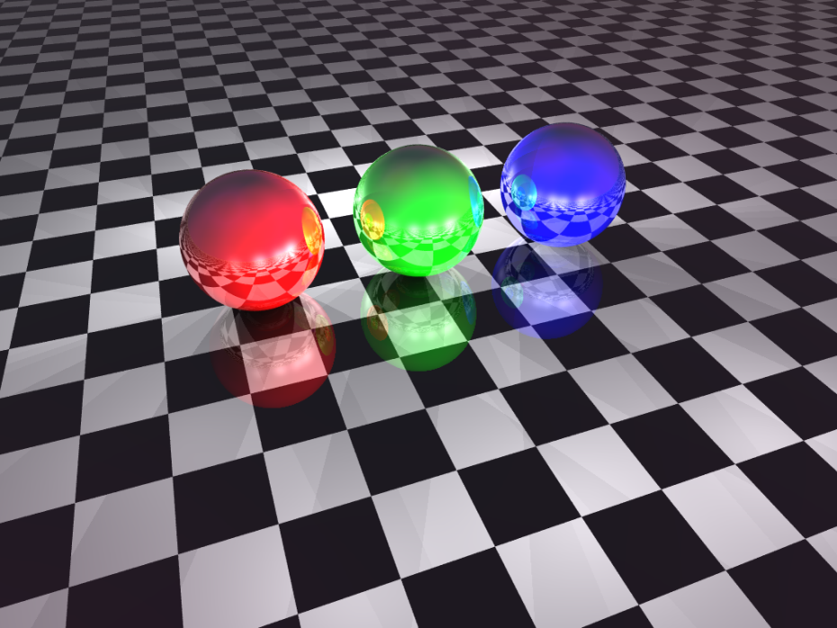
Ray Tracing Through the Years
Turner Whitted, circa 1979
Today

Slide 8
Basic Ray Tracing Algorithm
Spawn a primary ray through each pixel center

Slide 9
Basic Ray Tracing Algorithm
Continue in scanline order

Slide 10
Ray Representation
Parametric line equation:
  L(t) = origin + t * direction
  direction = pixel center – eye
L(t)
pixel center
direction
eye

Slide 11
Ray-Sphere Intersection
Problem: Intersect a line with a sphere
  Assume the sphere is centered at the origin and has radius r
  Ray equation: L_{(x, y)}(t) = R + tD
  Sphere equation: x² + y² = r²
  Solve for t

Slide 12
Ray-Sphere Intersection

Slide 13
Calculate Normal
N = P(t) – C … and remember N/|N|
C
t
D
R
N
normal

Slide 14
Closest Sphere
Minimum search problem
For each pixel {
  form ray from eye through the pixel center
  t_{min} = ∞
  For each object {
    if (t = intersect(ray, object)) {
      if (t < t_{min}) {
        closestObject = object
        t_{min} = t
      }
    }
  }
}

Slide 15
Final Pixel Color
if (t_{min} == ∞)
pixelColor = background color
else
pixelColor = color of object at d along ray (shade)
d
eye
ray
object

Slide 16
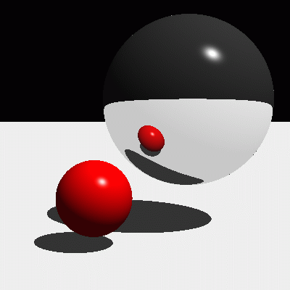
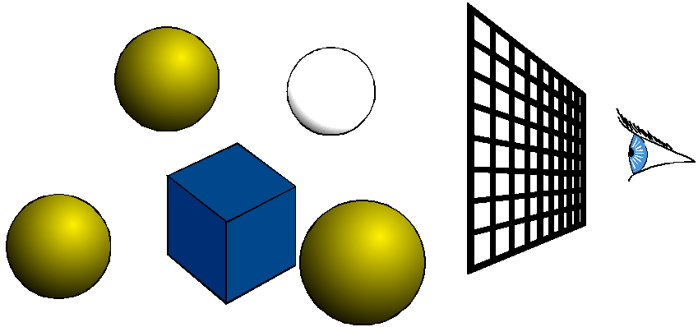
Mirror Reflection
Shiny Objects
  Perfect mirror in the extreme case
  Assume this for now – mathematics easy for this nice case
Spawn a secondary ray from ray-object intersection
Reflect the view vector about the normal and cast a reflection ray

Slide 17
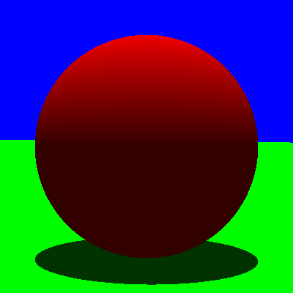
Shadows
A ray-object intersection point is in shadow if an object occludes it from a light source
Well … shoot a ray from the point
to each light source and detect
occluders
  Yeah, you saw that coming

Slide 18
Shading a Point In Shadow
Assume Phong illumination …
Ambient?
  Unaffected by a shadow
Diffuse?
  Turn off
Specular?
  Turn off

Slide 19
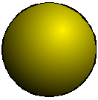
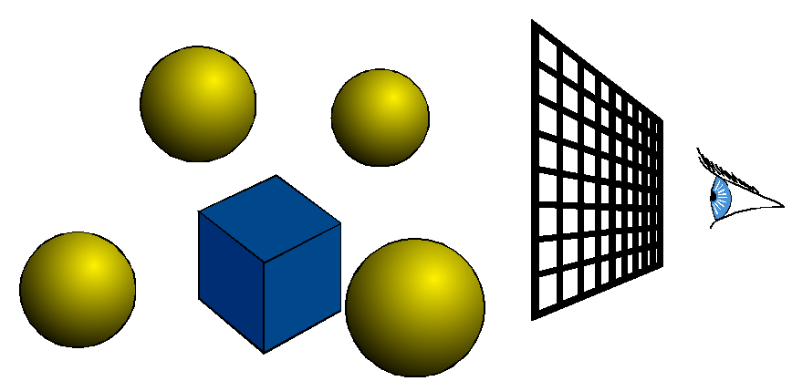
Pseudocode
for each light source
  if behind the light source (“backface”)
    inShadow = TRUE;
  else
    inShadow = FALSE;
    ray = intersection point p to light source;
    for each object
    inShadow = intersect ( ray );
    if inShadow is TRUE
    break out of loop;
return inShadow;
Optimization:
Stop at very first object intersection
Don’t need closest intersection!!!

Slide 20
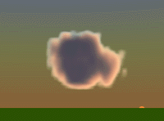
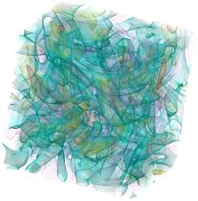
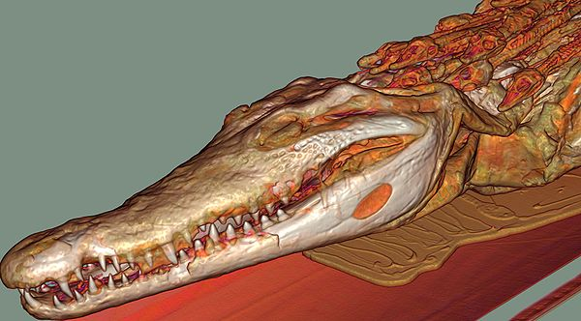
Raycasting vs. Raytracing
We often use the term raycast for the first primary ray.
Used in Volume Rendering to
march through a 3D volume
(often a 3D texture)
  Sometimes called Ray Marching
Max, Crawfis, 1992
Crawfis, 1998

Slide 21
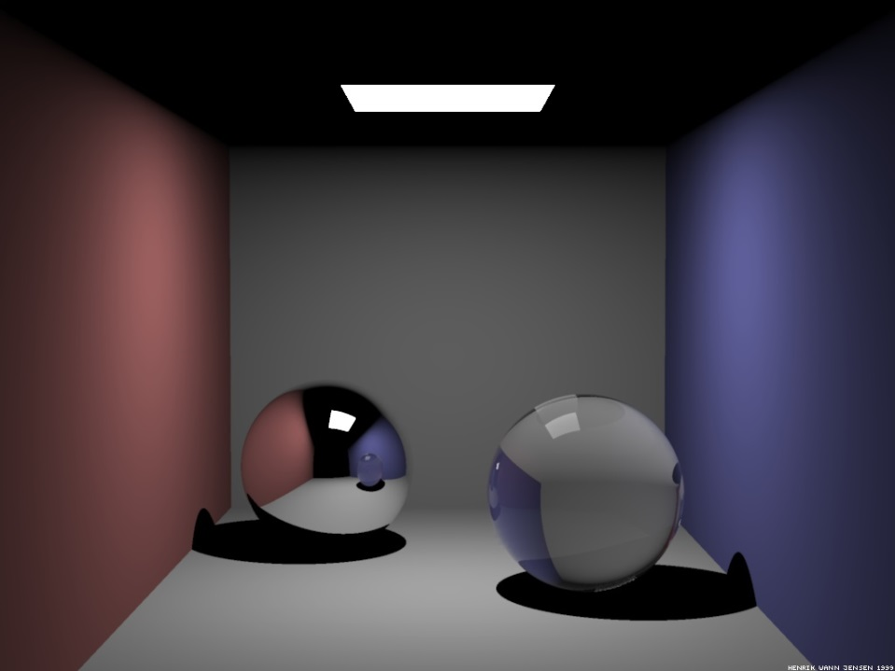
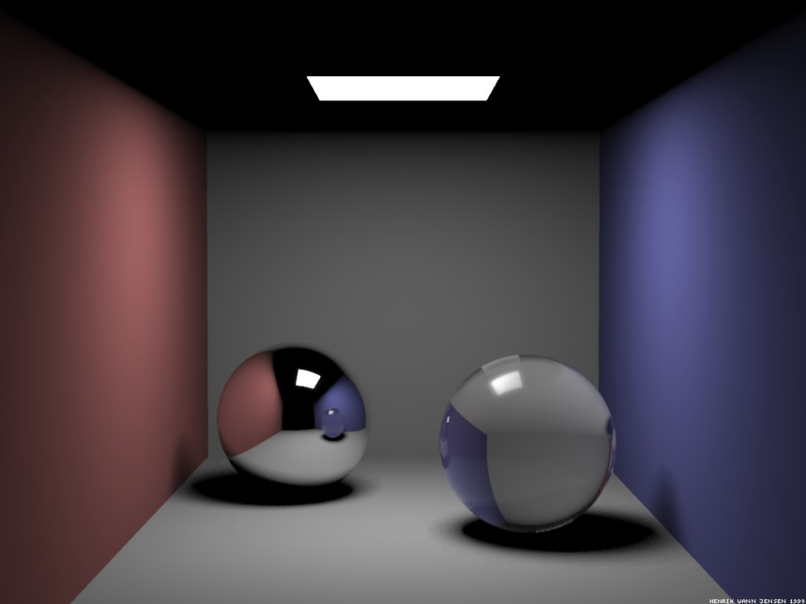
Soft Shadows
Hard shadows (left) vs soft shadows (right)

Slide 22
Soft Shadows
Hard shadows
  Assume an infinitely small (point) light source
Soft shadows
  Umbra (invisible) and Penumbra (fuzzy looking drop off)
  Assumes an area light source
  Treat the light as many point lights
    Expensive!!!

Slide 23
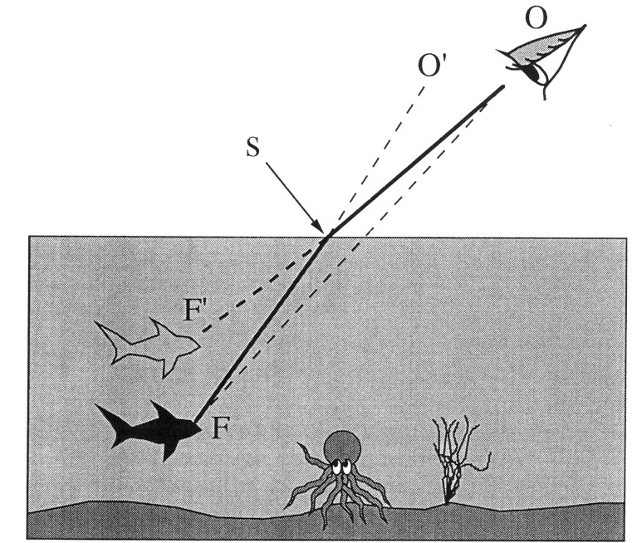
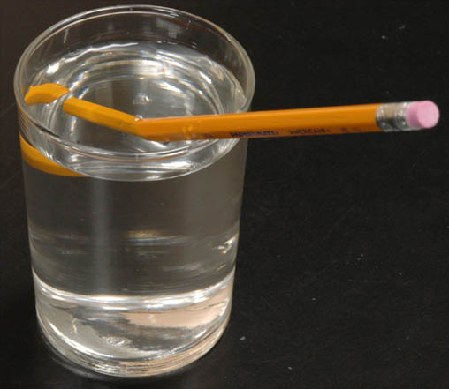
Refraction
Transparency depends upon the refractive properties of the material
  Light bends through some materials

Slide 24
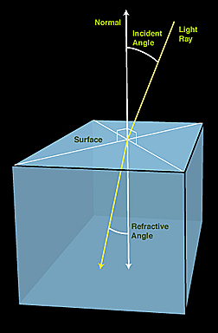
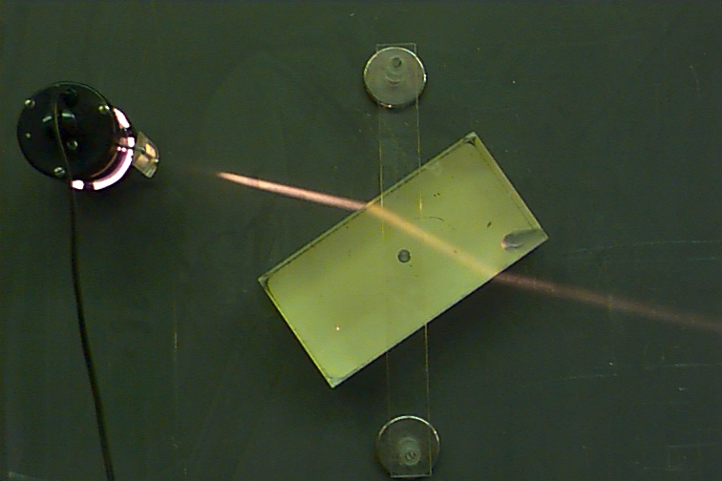
Snell’s Law
Willebrord Snell (Dutch Physicist) determined how light refracts through a medium in 1621

Slide 25
Refraction (Ray Tracing)
Since we are following rays from the eye to the light, we “refract” using the view vector
  Cast a secondary ray (refractive ray)
  Incorporate the color from this ray into our shading

Slide 26
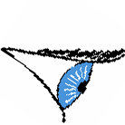
Refraction
How do we compute the refraction vector T?

Slide 27
Raytracing Pseudocode
Shadows, Reflection, and Refraction
Color shade( ray, recursionDepth )
{
c = background color;
intersectFlag = FALSE;
for each object
intersectFlag = intersect ( ray, p );
if intersectFlag is TRUE
c = ambient;
for each light source
shadowFlag = intersectShadowRay ( p );
if shadowFlag is FALSE
compute reflective ray R (or H);
c += diffuse;
c += specular components;
if ( recursionDepth < MAXRECURSION)
if (object is shiny)
compute reflection of the ray, R1;
c += shininess * shade( R1, recursionDepth + 1 );
if (object is transparent)
compute transmittance ray T;
c += refraction * shade( R1, recursionDepth + 1 );
return c;
}
Keep track of the depth
of the ray tree
First illuminate the point
Don’t spawn reflection ray
past the pre-chosen tree depth
Recursively return a color
Get the reflected color
Get the transmitted color

Slide 28
Recursive Ray Tracing
Image plane
Eye

Slide 29
Sampling and Aliasing
Problem: Representing pixel by a single ray.
Notes:
Using higher resolution won’t solve problem.
No matter how small pixels are, objects can be smaller.

Slide 30
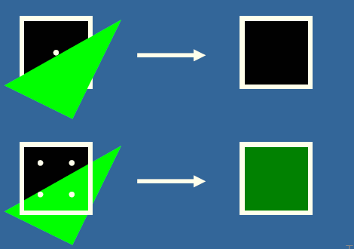
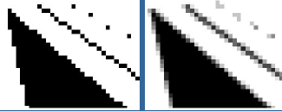
Aliasing
One ray per pixel leads to aliasing effects
Undersampling a function
Idea
Example

Slide 31
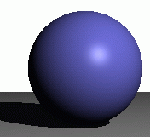

Anti-aliasing: Supersampling
Jaggies
Anti-aliasing
One sample/pixel
Multiple samples/pixel

Slide 32
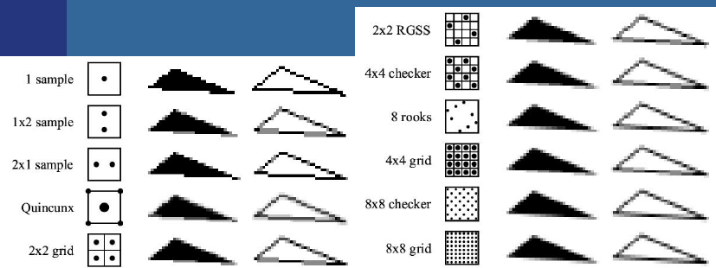
Supersampling Schemes
There are many ways to subdivide a pixel

