Slide 1
Games and Animation Unity Editor Scripting
CSE 3541
Prof. Roger Crawfis

Slide 2
Property Attributes
Heavily use of Attribute-based programming
Can often just place an attribute within your code
MonoBehaviour
ScriptableObject
Any Serialized object
[RequireComponent(type)] // class definition
E.g.: [RequireComponent(typeof(Rigidbody))]
[SerializeField]
[Range(min, max)] // serialized int or float
[Tooltip("Health value between 0 and 100.")]
[Space(10, order = 0)]
[Header("Header with space around it", order = 1)]
[Space(40, order = 2)]
See https://champview.wordpress.com/2014/12/12/a-summary-of-unity-attributes/ for a complete list

Slide 3
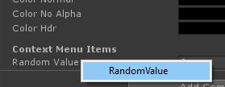
Context Menus
Easy to add Context Menus
ContextMenuItem – for a specific field
ContextMenu – for the entire component (image on right)
https://unity3d.college/2017/05/22/unity-attributes/

Slide 4
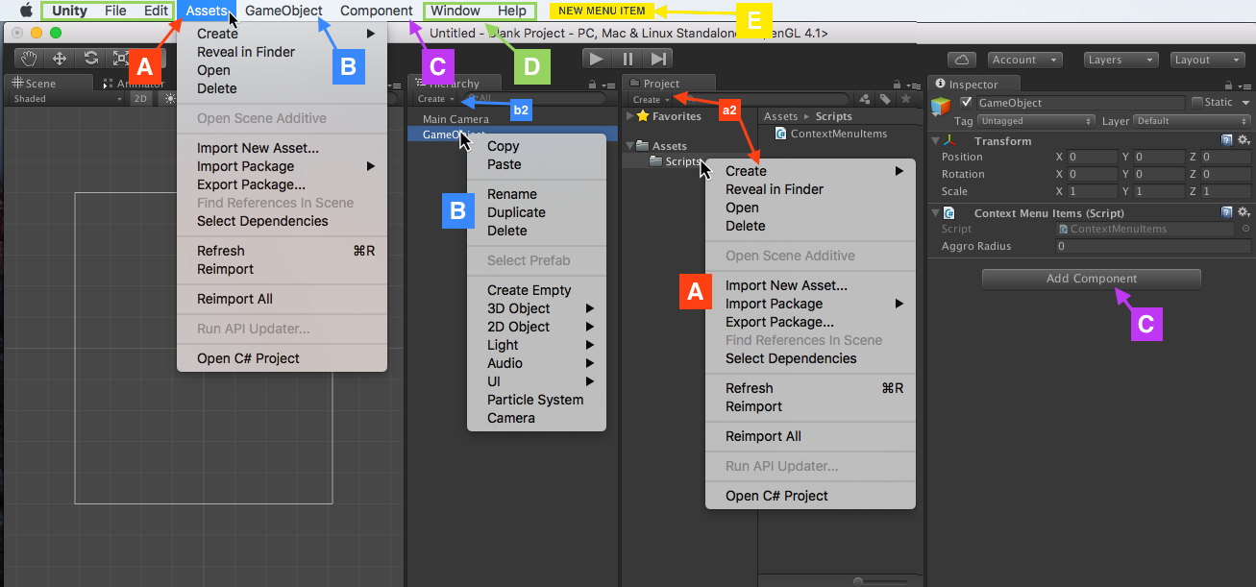
Custom Menus

Slide 5
Menu Example
Snap all of the selected objects to the ground.
public class SnapToGround : MonoBehaviour
{
[MenuItem("Custom/Snap To Ground %g")]
public static void Ground()
{
foreach(var transform in Selection.transforms)
{ …
https://unity3d.college/2017/09/26/using-unity-editor-extensions-to-snap-to-ground-when-placing-gameobjects/

Slide 6
Example
https://unity3d.college/2017/05/22/unity-attributes/

Slide 7
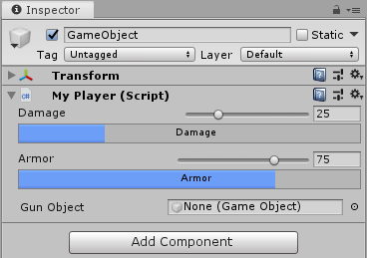
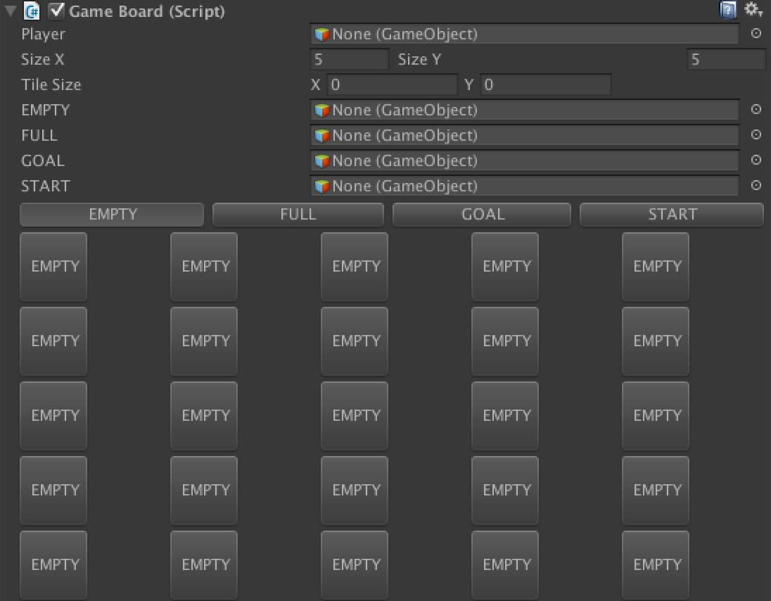
Custom Appearances
You can write new windows, add GUI components to an existing component, etc. in Unity
http://www.ryan-meier.com/blog/?p=87
https://docs.unity3d.com/ScriptReference/Editor.html

Slide 8
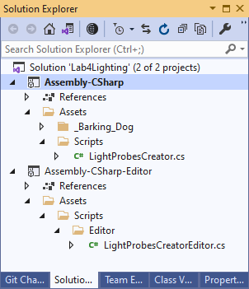
Editor Folder(s)
Any scripts placed in a folder with the name “Editor” will be put in a separate project and loaded into the Unity Editor, not the game or project.
Can have several “Editor” folders.
Used to modify / extend the Unity editor menu’s (context and main), as well as the appearance of Components.

Slide 9
Example: Adding a Button
Make sure to include the UnityEditor namespace
Add a button to the display of a MonoBehaviour component (aka script)
Script name of LightProbesCreator
Class name: arbitrary
Derives from Editor
Binding uses Attribute-based programming.
Button text is Generate
Clicking the button calls: Create in the script
using UnityEditor;
using UnityEngine;
namespace CrawfisSoftware
{
[CustomEditor(typeof(LightProbesCreator))]
public class LightProbesCreatorEditor
: Editor
{
public override void OnInspectorGUI()
{
DrawDefaultInspector();
LightProbesCreator lightProbes = (LightProbesCreator)target;
if (GUILayout.Button("Generate"))
lightProbes.Create();
}
}
}
Any logic you want to program

Slide 10
GUILayout class
Example used GUILayout
if (GUILayout.Button("Generate")
Many static methods in this class
https://docs.unity3d.com/ScriptReference/GUILayout.html

Slide 11
Adding Gizmos
Can also draw gizmos in the Scene Editor
Field-of-View Gizmo
Distance with circle
View with white lines (360 here)
Detected targets with red lines
Game mode only?
Useful for visually seeing a component value’s effect.
See UnityEditor.Handles
https://www.youtube.com/watch?v=73Dc5JTCmKI

