Slide 1
Games and Animation Shortest Paths
CSE 3541
Prof. Roger Crawfis

Slide 2
Shortest Path
Given a weighted directed graph, one common problem is finding the shortest path between two given vertices
Recall that in a weighted graph, the length of a path is the sum of the weights of each of the edges in that path

Slide 3
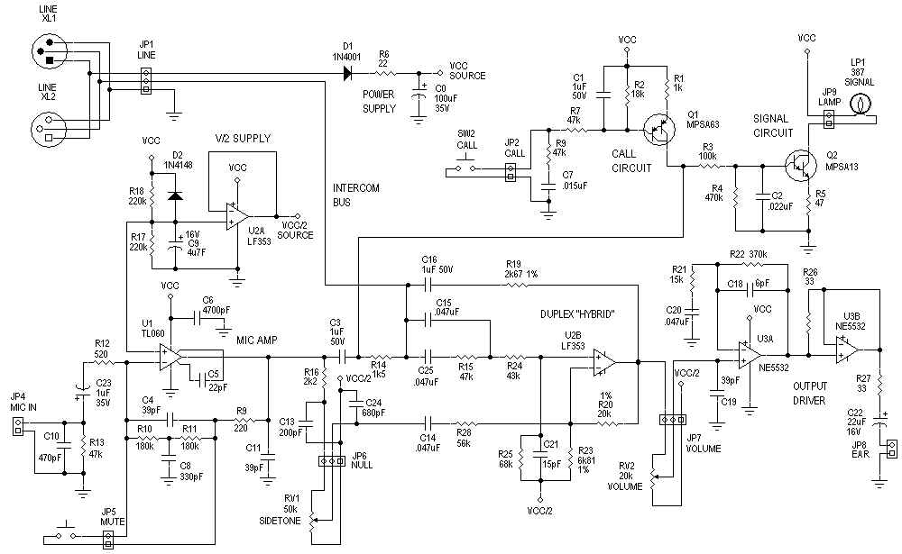
Applications
One application is circuit design: the time it takes for a change in input to affect an output depends on the shortest path
http://www.hp.com/

Slide 4
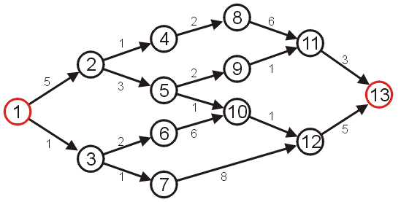
Shortest Path
Given the graph below, suppose we wish to find the shortest path from vertex 1 to vertex 13

Slide 5
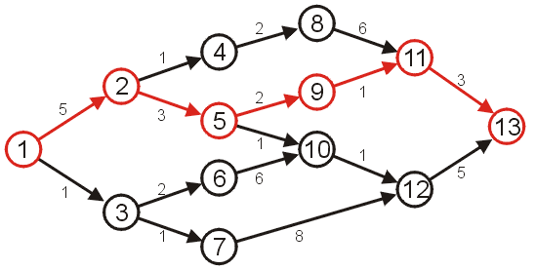
Shortest Path
After some consideration, we may determine that the shortest path is as follows, with length 14
Other paths exists, but they are longer

Slide 6
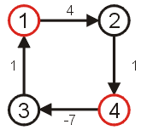
Negative Cycles
Clearly, if we have negative vertices, it may be possible to end up in a cycle whereby each pass through the cycle decreases the total length
Thus, a shortest length would be undefined for such a graph
Consider the shortest path from vertex 1 to 4...
We will only consider non- negative weights.

Slide 7
Shortest Path Example
Given:
Weighted Directed graph G = (V, E).
Source s, destination t.
Find shortest directed path from s to t.
2
23
3
9
Cost of path s-2-3-5-t = 9 + 23 + 2 + 16 = 48.
s
18
14
2
6
6
30
4
19
15
5
11
5
6
20
16
7
t
44

Slide 8
Discussion Items
How many possible paths are there from s to t?
Can we safely ignore cycles? If so, how?
Any suggestions on how to reduce the set of possibilities?
Can we determine a lower bound on the complexity like we did for comparison sorting?
2
23
3
9
s
18
14
2
6
6
30
4
19
15
5
11
5
6
20
16
7
t
44

Slide 9
Key Observation
A key observation is that if the shortest path contains the node v, then:
It will only contain v once, as any cycles will only add to the length.
The path from s to v must be the shortest path to v from s.
The path from v to t must be the shortest path to t from v.
Thus, if we can determine the shortest path to all other vertices that are incident to the target vertex we can easily compute the shortest path.
Implies a set of sub-problems on the graph with the target vertex removed.

Slide 10
Dijkstra’s Algorithm
Works when all of the weights are positive.
Provides the shortest paths from a source to all other vertices in the graph.
Can be terminated early once the shortest path to t is found if desired.

Slide 11
Tree of paths
Treat the start node as the root of a tree.
Each node in the resulting tree has a parent leading up to the root.
Red is the resulting tree
Blue possible edges but higher costs (currently)
https://en.wikipedia.org/wiki/Dijkstra's_algorithm

Slide 12
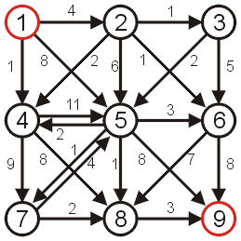
Shortest Path
Consider the following graph with positive weights and cycles.

Slide 13
Dijkstra’s Algorithm
A first attempt at solving this problem might require an array of Boolean values, all initially false, that indicate whether we have found a path from the source.
1 | F
2 | F
3 | F
4 | F
5 | F
6 | F
7 | F
8 | F
9 | F

Slide 14
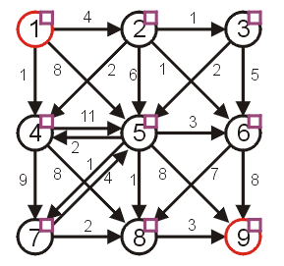
Dijkstra’s Algorithm
Graphically, we will denote this with check boxes next to each of the vertices (initially unchecked)

Slide 15
Dijkstra’s Algorithm
We will work bottom up.
Note that if the starting vertex has any adjacent edges, then there will be one vertex that is the shortest distance from the starting vertex. This is the shortest reachable vertex of the graph.
We will then try to extend any existing paths to new vertices.
Initially, we will start with the path of length 0
this is the trivial path from vertex 1 to itself

Slide 16
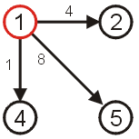
Dijkstra’s Algorithm
If we now extend this path, we should consider the paths
(1, 2) length 4
(1, 4) length 1
(1, 5) length 8
The shortest path so far is (1, 4) which is of length 1.

Slide 17
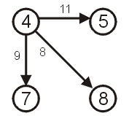
Dijkstra’s Algorithm
Thus, if we now examine vertex 4, we may deduce that there exist the following paths:
(1, 4, 5) length 12
(1, 4, 7) length 10
(1, 4, 8) length 9

Slide 18
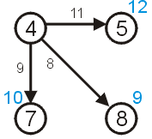
Dijkstra’s Algorithm
We need to remember that the length of that path from node 1 to node 4 is 1
Thus, we need to store the length of a path that goes through node 4:
5 of length 12
7 of length 10
8 of length 9

Slide 19
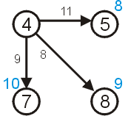
Dijkstra’s Algorithm
We have already discovered that there is a path of length 8 to vertex 5 with the path (1, 5).
Thus, we can safely ignore this longer path.

Slide 20
Dijkstra’s Algorithm
We now know that:
There exist paths from vertex 1 to vertices {2,4,5,7,8}.
We know that the shortest path from vertex 1 to vertex 4 is of length 1.
We know that the shortest path to the other vertices {2,5,7,8} is at most the length listed in the table to the right.
Vertex | Length
1 | 0
2 | 4
4 | 1
5 | 8
7 | 10
8 | 9

Slide 21
Dijkstra’s Algorithm
There cannot exist a shorter path to either of the vertices 1 or 4, since the distances can only increase at each iteration.
We consider these vertices to be visited
Vertex | Length
1 | 0
2 | 4
4 | 1
5 | 8
7 | 10
8 | 9
If you only knew this information and nothing else about the graph, what is the possible lengths from vertex 1 to vertex 2? What about to vertex 7?

Slide 22
Relaxation
Maintaining this shortest discovered distance d[v] is called relaxation:
Relax(u,v,w) {
if (d[v] > d[u]+w) then
d[v]=d[u]+w;
}
5
2
9
5
2
6
u
Relax
v
u
Relax
v
5
2
7
5
2
6

Slide 23
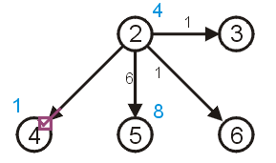
Dijkstra’s Algorithm
In Dijkstra’s algorithm, we always take the next unvisited vertex which has the current shortest path from the starting vertex in the table.
This is vertex 2

Slide 24
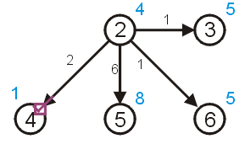
Dijkstra’s Algorithm
We can try to update the shortest paths to vertices 3 and 6 (both of length 5) however:
there already exists a path of length 8 < 10 to vertex 5 (10 = 4 + 6)
we already know the shortest path to 4 is 1

Slide 25
Dijkstra’s Algorithm
To keep track of those vertices to which no path has reached, we can assign those vertices an initial distance of either
infinity (∞ ),
a number larger than any possible path, or
a negative number
For demonstration purposes, we will use ∞

Slide 26
Dijkstra’s Algorithm
As well as finding the length of the shortest path, we’d like to find the corresponding shortest path
Each time we update the shortest distance to a particular vertex, we will keep track of the predecessor used to reach this vertex on the shortest path.

Slide 27
Dijkstra’s Algorithm
We will store a table of pointers, each initially 0
This table will be updated each time a distance is updated
1 | 0
2 | 0
3 | 0
4 | 0
5 | 0
6 | 0
7 | 0
8 | 0
9 | 0

Slide 28
Dijkstra’s Algorithm
Graphically, we will display the reference to the preceding vertex by a red arrow
if the distance to a vertex is ∞, there will be no preceding vertex
otherwise, there will be exactly one preceding vertex

Slide 29
Dijkstra’s Algorithm
Thus, for our initialization:
we set the current distance to the initial vertex as 0
for all other vertices, we set the current distance to ∞
all vertices are initially marked as unvisited
set the previous pointer for all vertices to null

Slide 30
Dijkstra’s Algorithm
Thus, we iterate:
find an unvisited vertex which has the shortest distance to it
mark it as visited
for each unvisited vertex which is adjacent to the current vertex:
add the distance to the current vertex to the weight of the connecting edge
if this is less than the current distance to that vertex, update the distance and set the parent vertex of the adjacent vertex to be the current vertex

Slide 31
Dijkstra’s Algorithm
Halting condition:
we successfully halt when the vertex we are visiting is the target vertex
if at some point, all remaining unvisited vertices have distance ∞, then no path from the starting vertex to the end vertex exits
Note: We do not halt just because we have updated the distance to the end vertex, we have to visit the target vertex.

Slide 32
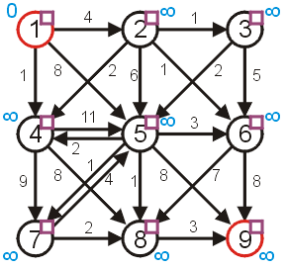
Example
Consider the graph:
the distances are appropriately initialized
all vertices are marked as being unvisited

Slide 33
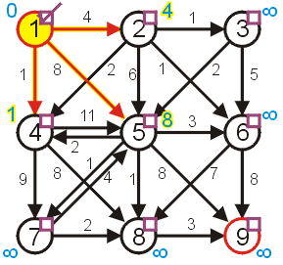
Example
Visit vertex 1 and update its neighbours, marking it as visited
the shortest paths to 2, 4, and 5 are updated

Slide 34
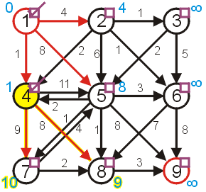
Example
The next vertex we visit is vertex 4
vertex 5 1 + 11 ≥ 8 don’t update
vertex 7 1 + 9 < ∞ update
vertex 8 1 + 8 < ∞ update

Slide 35
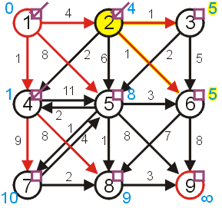
Example
Next, visit vertex 2
vertex 3 4 + 1 < ∞ update
vertex 4 already visited
vertex 5 4 + 6 ≥ 8 don’t update
vertex 6 4 + 1 < ∞ update

Slide 36
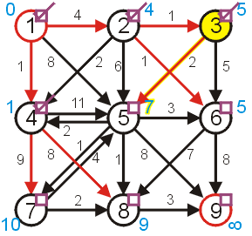
Example
Next, we have a choice of either 3 or 6
We will choose to visit 3
vertex 5 5 + 2 < 8 update
vertex 6 5 + 5 ≥ 5 don’t update

Slide 37
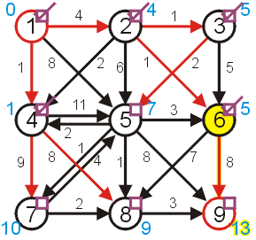
Example
We then visit 6
vertex 8 5 + 7 ≥ 9 don’t update
vertex 9 5 + 8 < ∞ update

Slide 38
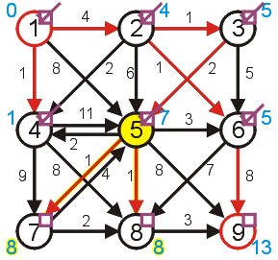
Example
Next, we finally visit vertex 5:
vertices 4 and 6 have already been visited
vertex 7 7 + 1 < 10 update
vertex 8 7 + 1 < 9 update
vertex 9 7 + 8 ≥ 13 don’t update

Slide 39
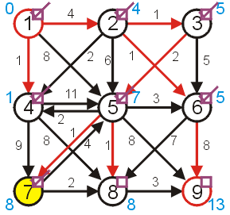
Example
Given a choice between vertices 7 and 8, we choose vertex 7
vertices 5 has already been visited
vertex 8 8 + 2 ≥ 8 don’t update

Slide 40
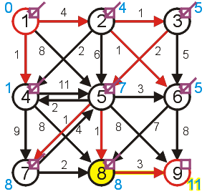
Example
Next, we visit vertex 8:
vertex 9 8 + 3 < 13 update

Slide 41
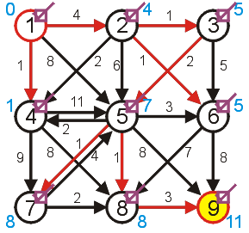
Example
Finally, we visit the end vertex
Therefore, the shortest path from 1 to 9 has length 11

Slide 42
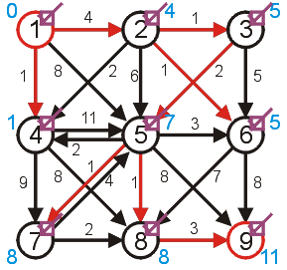
Example
We can find the shortest path by working back from the final vertex:
9, 8, 5, 3, 2, 1
Thus, the shortest path is (1, 2, 3, 5, 8, 9)

Slide 43
Example
In the example, we visited all vertices in the graph before we finished
This is not always the case, consider the next example

Slide 44
Example
Find the shortest path from 1 to 4:
the shortest path is found after only three vertices are visited
we terminated the algorithm as soon as we reached vertex 4
we only have useful information about 1, 3, 4
we don’t have the shortest path to vertex 2

Slide 45
Dijkstra’s algorithm
d[s] ← 0
for each v ∈ V – {s}
do d[v] ← ∞
S ← ∅
Q ← V ⊳ Q is a priority queue maintaining V – S
while Q ≠ ∅
do u ← EXTRACT-MIN(Q)
S ← S ∪ {u}
for each v ∈ Adj[u]
do if d[v] > d[u] + w(u, v)
then d[v] ← d[u] + w(u, v)
p[v] ← u

Slide 46
Dijkstra’s algorithm
d[s] ← 0
for each v ∈ V – {s}
do d[v] ← ∞
S ← ∅
Q ← V ⊳ Q is a priority queue maintaining V – S
while Q ≠ ∅
do u ← EXTRACT-MIN(Q)
S ← S ∪ {u}
for each v ∈ Adj[u]
do if d[v] > d[u] + w(u, v)
then d[v] ← d[u] + w(u, v)
p[v] ← u
relaxation step
Implicit DECREASE-KEY

Slide 47
Example of Dijkstra’s algorithm
2
Graph with nonnegative edge weights:
B
D
10
A
8
1
4
7
9
3
C
E
2

Slide 48
Example of Dijkstra’s algorithm
∞
∞
Initialize:
2
B
D
10
A
8
0
1
4
7
9
3
Q:
A
B
C
D
E
C
E
2
0
∞
∞
∞
∞
∞
∞
S: {}

Slide 49
Example of Dijkstra’s algorithm
∞
∞
“A” ← EXTRACT-MIN(Q):
2
B
D
10
A
8
0
1
4
7
9
3
Q:
A
B
C
D
E
C
E
2
0
∞
∞
∞
∞
∞
∞
S: { A }

Slide 50
Example of Dijkstra’s algorithm
10
∞
Relax all edges leaving A:
2
B
D
10
A
8
0
1
4
7
9
3
Q:
A
B
C
D
E
C
E
2
0
∞
∞
∞
∞
3
∞
10
3
∞
∞
S: { A }

Slide 51
Example of Dijkstra’s algorithm
10
∞
“C” ← EXTRACT-MIN(Q):
2
B
D
10
A
8
0
1
4
7
9
3
Q:
A
B
C
D
E
C
E
2
0
∞
∞
∞
∞
3
∞
10
3
∞
∞
S: { A, C }

Slide 52
Example of Dijkstra’s algorithm
7
11
Relax all edges leaving C:
2
B
D
10
A
8
0
1
4
7
9
3
Q:
A
B
C
D
E
C
E
2
0
∞
∞
∞
∞
3
5
10
3
∞
∞
7
11
5
S: { A, C }

Slide 53
Example of Dijkstra’s algorithm
7
11
“E” ← EXTRACT-MIN(Q):
2
B
D
10
A
8
0
1
4
7
9
3
Q:
A
B
C
D
E
C
E
2
0
∞
∞
∞
∞
3
5
10
3
∞
∞
7
11
5
S: { A, C, E }

Slide 54
Example of Dijkstra’s algorithm
7
11
Relax all edges leaving E:
2
B
D
10
A
8
0
1
4
7
9
3
Q:
A
B
C
D
E
C
E
2
0
∞
∞
∞
∞
3
5
10
3
∞
∞
7
11
5
S: { A, C, E }
7
11

Slide 55
Example of Dijkstra’s algorithm
7
11
“B” ← EXTRACT-MIN(Q):
2
B
D
10
A
8
0
1
4
7
9
3
Q:
A
B
C
D
E
C
E
2
0
∞
∞
∞
∞
3
5
10
3
∞
∞
7
11
5
S: { A, C, E, B }
7
11

Slide 56
Example of Dijkstra’s algorithm
7
9
Relax all edges leaving B:
2
B
D
10
A
8
0
1
4
7
9
3
Q:
A
B
C
D
E
C
E
2
0
∞
∞
∞
∞
3
5
10
3
∞
∞
7
11
5
S: { A, C, E, B }
7
11
9

Slide 57
Example of Dijkstra’s algorithm
7
9
“D” ← EXTRACT-MIN(Q):
2
B
D
10
A
8
0
1
4
7
9
3
Q:
A
B
C
D
E
C
E
2
0
∞
∞
∞
∞
3
5
10
3
∞
∞
7
11
5
S: { A, C, E, B, D }
7
11
9

Slide 58
Summary
Given a weighted directed graph, we can find the shortest distance between two vertices by:
starting with a trivial path containing the initial vertex
growing this path by always going to the next vertex which has the shortest current path

Slide 59
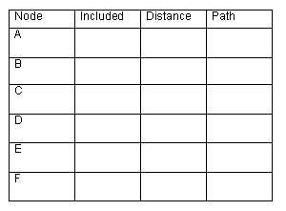
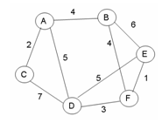
Practice
-
-
t
f
t
4
A
f
t
2
A
f
t
5
A
∞
-
B
F
f
t
10
9
f
t
∞
8
-
B
Give the shortest path tree for node A for this graph using Dijkstra’s shortest path algorithm. Show your work with the 3 arrays given and draw the resultant shortest path tree with edge weights included.

Slide 60
Games and Animation Shortest Paths – A*
CSE 3541
Prof. Roger Crawfis

Slide 61
History
Originally developed in 1968
One of our students and our own Prof. Jim Davis tracked down its meaning:
Communications of the ACM, January 2020

Slide 62
A* Search
Combine Best-First and Dijkstra’s
Heuristic – Use estimated cost to the goal
Given cost – Use cost from the start to the current node
Choose a node with the best combined cost:
Known cost from start to node + heuristic cost from the node to the goal
The goal node has heuristic cost = 0 and so the combined cost is just the cost from the start to the goal node
Note, if the heuristic is 0 for all nodes then this is just Dijkstra’s algorithm
Complete algorithm
Optimal algorithm … with the right heuristic
Heuristic never overestimates the true cost
Called an admissible heuristic

Slide 63
A* Search
Optimal search with an admissible heuristic
8+3
8+3
7+4
7+4
6+5
6+3
5+6
5+6
4+7
4+7
3+8
3+8
2+9
8
7
6
5
4
3
2+9
3+10
2
3
4
5
6
7+2
7+2
5+6
4+7
3+8
7
5
4
3+8
3
5
6+1
6+1
2+9
2+9
1+10
1+10
0+11
6
3
2
1
0+11
0
1
2
4
7+0
7+0
6+1
7
6+1
6
5
8+1
8+1
7+2
7+2
6+3
6+3
5+4
5+4
4+5
4+5
3+6
3+6
2+7
8
7
6
5
4
3
2+7
3+8
2
3
4
5
6

Slide 64
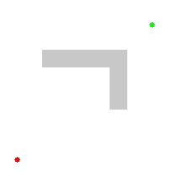
Comparison: A* and Dijkstra

Slide 65
Video Explanation

Slide 66
Pathfinding Algorithm Summary
Breadth-First processes the node that has been waiting the longest
Uses a FIFO queue
Best-First processes the one that is closest to the goal
Uses a priority queue –node value is distance to goal
Dijkstra’s processes the one that is the cheapest to reach from the start cell
Uses a priority queue – node value is lowest cost from the start
A* chooses a node that is cheap and close to the goal
Uses a priority queue – node value is a combination of Best-First and Dijkstra’s

Slide 67
More Reading on Pathfinding
Amit’s A* Pages http://theory.stanford.edu/~amitp/GameProgramming/

Slide 68
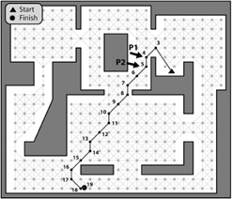
Path Finding in Finely Grained Graph
Depending on the grid resolution can be fairly smooth.
The coarser, the more zig-zags
Still, looks unnatural

Slide 69
Simple Smoothing
Node Collapse
Check for occluder between adjacent edges
Cast a ray between A and C
If no occluded, then waypoint B is not needed

Slide 70
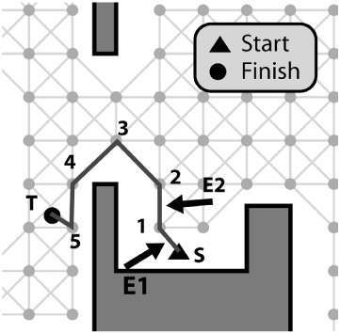
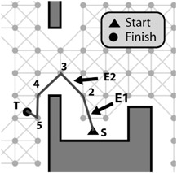
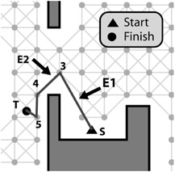
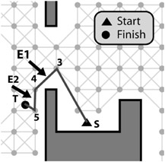
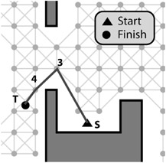
Path Smoothing Example
E1

Slide 71
Games and Animation Navigation Mesh
CSE 3541
Prof. Roger Crawfis

Slide 72
Navigation meshes
Convex polygons as navigable space
Nodes are polygons
Edges show which polygons share a side

Slide 73
Advantages of navigation meshes
More efficient and compact representation
Equivalent waypoint graph would have many more nodes and would take longer to traverse
Models entire navigable space
Can plan path from anywhere inside nav mesh
Paths can be planned around dynamic obstacles
Zig-zagging can be avoided
Naturally handles entities of different radii
Don't go through edges less than 2 * radius long
Leave at least a distance of radius when moving around nav mesh vertices

Slide 74
Navigation meshes
Different from collision mesh
Only contains walkable faces
Stairs become a single, rectangular polygon
Polygons are usually smaller to account for player radius

Slide 75
Navigation meshes
Annotate special regions
Can have regions for jumping across, falling down, crouching behind, climbing up, ...
Regions are usually computed automatically

Slide 76
Games and Animation Finding a Smooth Path
CSE 3541
Prof. Roger Crawfis

Slide 77
Navigation loop
Process for robust path navigation on a navigation mesh:
Find sequence of polygons (corridor) using graph algorithm
Determine how to move through polygons
Steer using smoothing
Actually move/collide entity
Find Corridor

Slide 78
Tile-Based Navigation Graphs
Squares or hexagons
Node center of cell; edges to adjacent cells
Straight line or each tile has a set of predefined paths
Each cell labeled with material (mud, river, etc.)
Can have different costs for different materials
http://opinionatedgamers.com/2011/12/07/review-of-kingdom-builder/

Slide 79
Tile-Based Navigation Graphs
Heavy CPU and memory loads
Small100x100 hex cell map has 10,000 nodes and 78,000 edges!
May have multiple AI’s needing a path.
May have many possible targets (ammo, health, enemies).
How can we search faster / better?
http://forum.cocos2d-objc.org/t/tilemapkit-complete-tiled-tmx-tilemap-support-including-hex-staggered-iso/17313

Slide 80
Finely Grained Graphs
Easy to generate
Masked grid
Flood-fill
This provides reasonable paths if fine enough

Slide 81
Path generation: problem statement
Given a list of polygons (output of a graph search)
The light polygons
Construct the shortest path for the agent
Where a path is a sequence of connected segments
The path must lie entirely in the list of polygons

Slide 82
Path generation: first attempt
Can we just connect polygon centers?
No: the path might not even be within the polygons
Polygons’ convexity only tells us that any 2 points in a single polygon can be connected with a segment

Slide 83
Path generation: second attempt
Can we just connect centers of polygon sides?
This always produces a valid path (within the polygons)
But not always the optimal path (zig-zagging)
This is just a waypoint graph!

Slide 84
Path generation: third attempt
The Funnel algorithm finds the optimal path
Hugs corners
Is like “pulling a string” that connects A and B until it is taut

Slide 85
Funnel algorithm
Traverses through a list of polygons connected by shared edges (portals)
Keeps track of the leftmost and rightmost sides of the "funnel" along the way
Alternates updating the left and right sides, making the funnel narrower and narrower
Add a new point to the path when they cross
Funnel

Slide 86
Funnel Algorithm

Slide 87
Funnel Algorithm
Start
Apex point = start of path
Left and right points = left and right vertices of first portal
Step
Advance to the next portal
Try to move left point to left vertex of next portal
If inside the funnel, narrow the funnel (C-D in previous slide)
If past the right side of the funnel, turn a corner (E-G in previous slide)
Add right point to path
Set apex point to right point
Restart at portal where right point came from
Try to move right point to right vertex of next portal
Similar to left point

Slide 88
Edge cases
Zero-length funnel side (portals that share a vertex)
Always use left*0.99+right*0.01 for the left and left*0.01+right*0.99 for the right (shrinks portal slightly)
End iteration of the funnel algorithm
End point is portal of size 0, need to check for potential restart like other portals

Slide 89
Funnel algorithm example
Don't restart search from any of these points
Restart search from here (apex)

Slide 90
Games and Animation Pathfinding Optimization
CSE 3541
Prof. Roger Crawfis

Slide 91
Possible Pathfinding Load Spikes
Many AI agents, all moving to different destinations
Many choices and need to decide best.
All of these take a fair amount of processing (CPU) time
→ Game loop can’t keep up!
Reduce CPU load by:
Faster pathfinding
Pre-compute paths
Hierarchical pathfinding
Grouping
Time slice

Slide 92
Faster Pathfinding
A* tree branches exponentially
Do two searches
Start to target
Target to start
Periodically check for an intersection (one node visited by both)
Several other enhancements to A* over the years

Slide 93
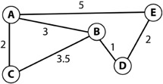
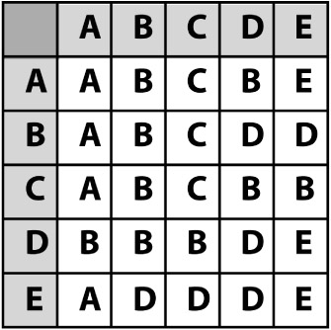
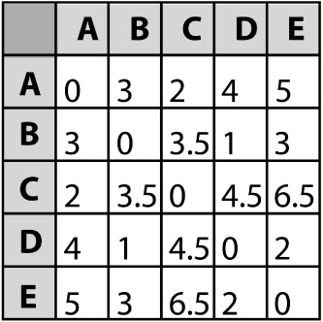
Precompute Table
If static paths, pre-generate paths and costs
(e.g., using Djikstra’s)
Time/space tradeoff
e.g., path A to D?
Shortest path table (next node)
Path cost table

Slide 94
Precompute Table
Even if dynamic. Once a path is computed can memorize it. Remains valid until something moves by some tolerance.
Shortest path table (next node)
Path cost table

Slide 95
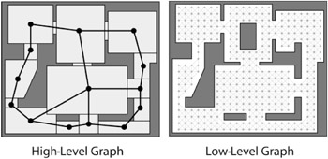
Hierarchical Waypoints / NavMeshes
Typically, two levels, but can be more
First plan in high-level, then refine in low-level
E.g., Navigate (by car) Atlanta to Richmond
States Georgia and Virginia
State navigation: Georgia → South Carolina → North Carolina → Virginia
Fine grained pathfinding within state

Slide 96
Agent Grouping
In many cases, individuals do not need to independently plan path
E.g., military has leader
So, only have leader plan path
Other units then follow leader
Using steering behaviors

Slide 97
Time Slicing
Evenly divide fixed CPU pathfinding budget between all current callers
Must be able to divide up searches over multiple steps
Considerable work required!
But can be worth it since makes pathfinding load constant

