Slide 1
Games and Animation
Shadows
CSE 3541
Prof. Roger Crawfis

Slide 2
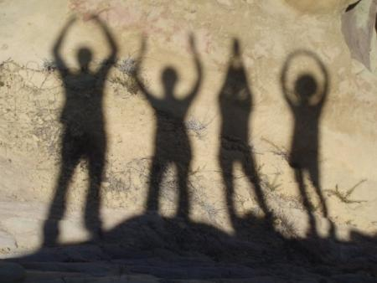
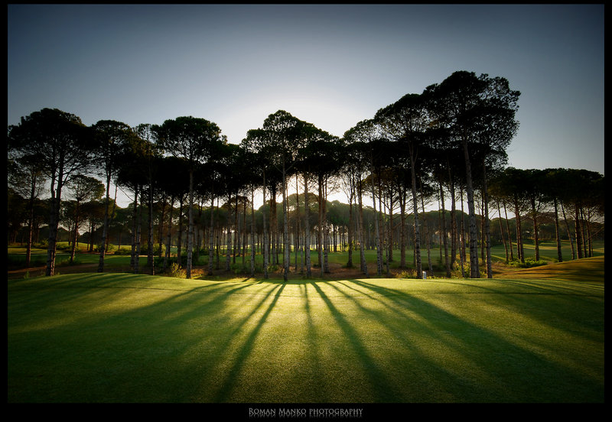
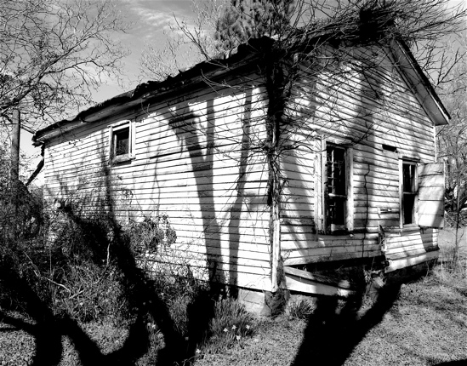
Shadows can be Wonderful!

Slide 3
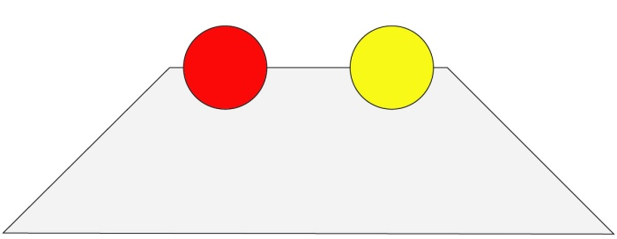
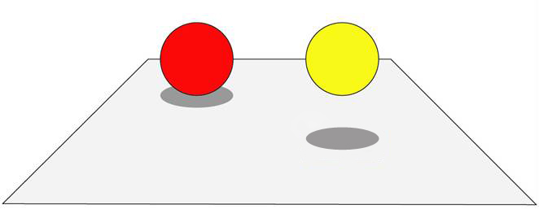
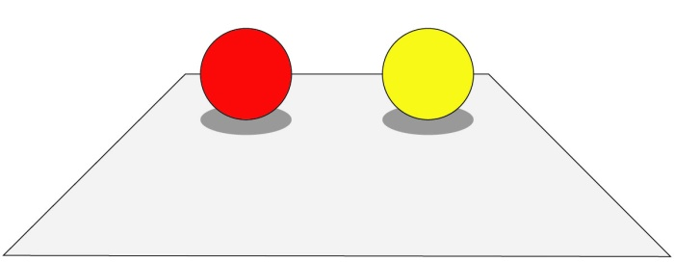
Importance of Shadows
Trapezoid?

Slide 4
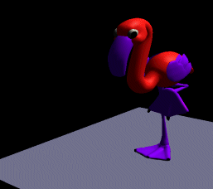
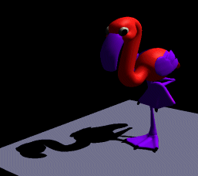
Importance of Shadows
Cue to object-object relationship.
Provides additional depth cue.

Slide 5
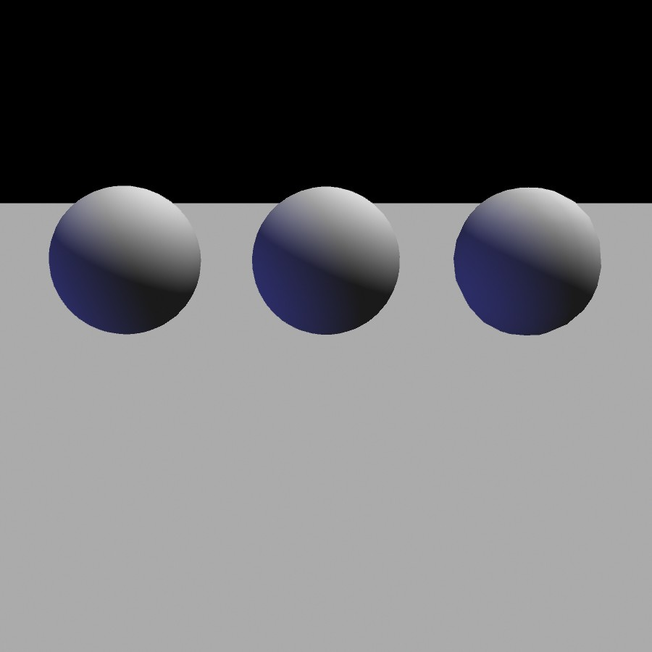
Importance of Shadows
Notes:
5

Slide 6
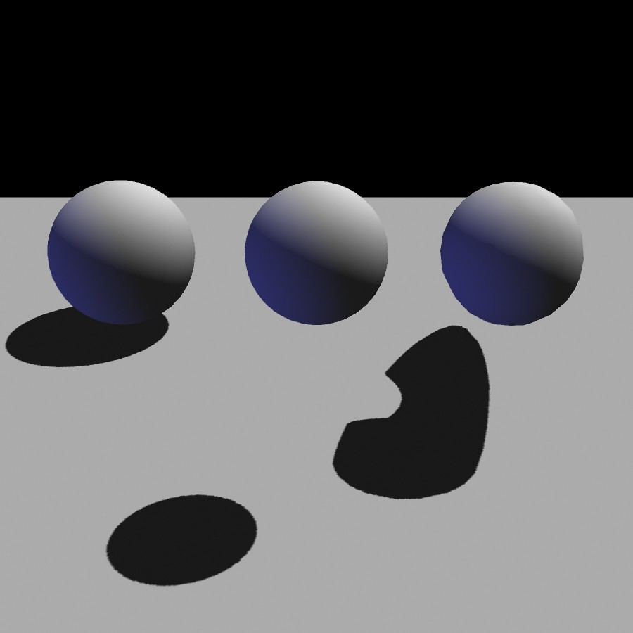
Importance of Shadows
Notes:
6

Slide 7
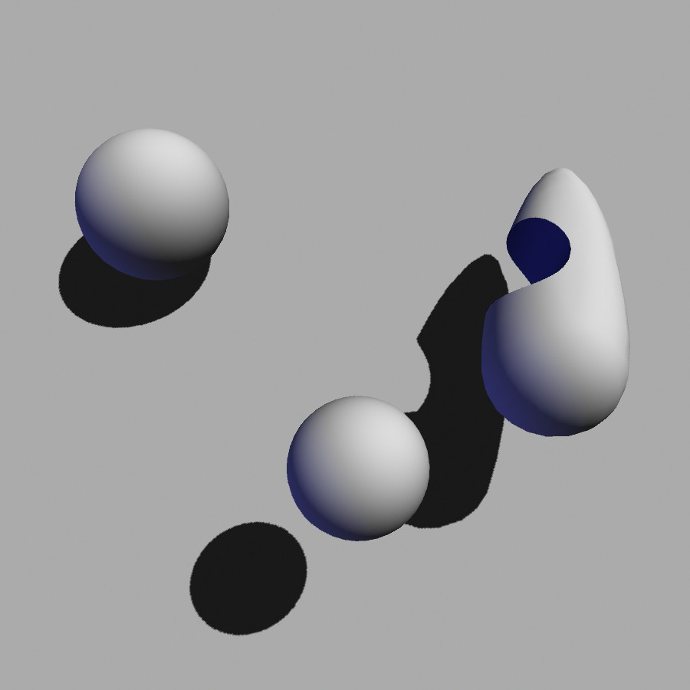
Importance of Shadows
Notes:
7

Slide 8
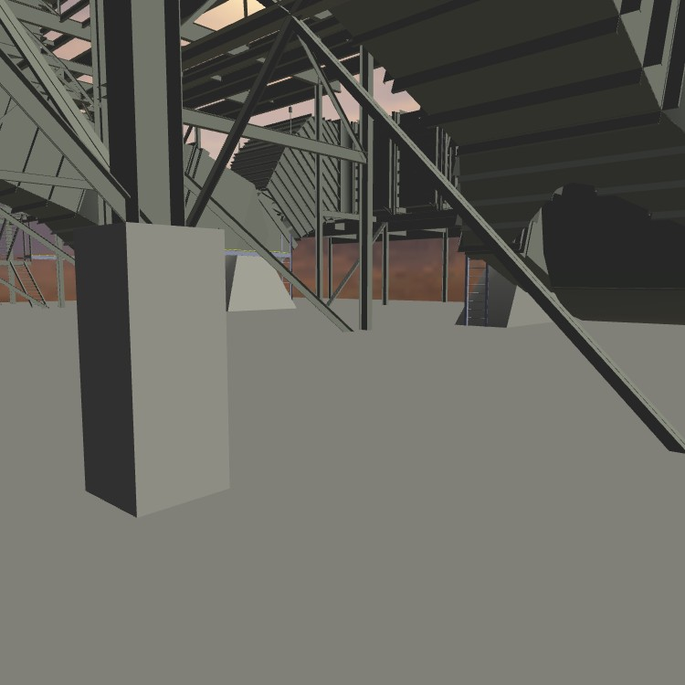
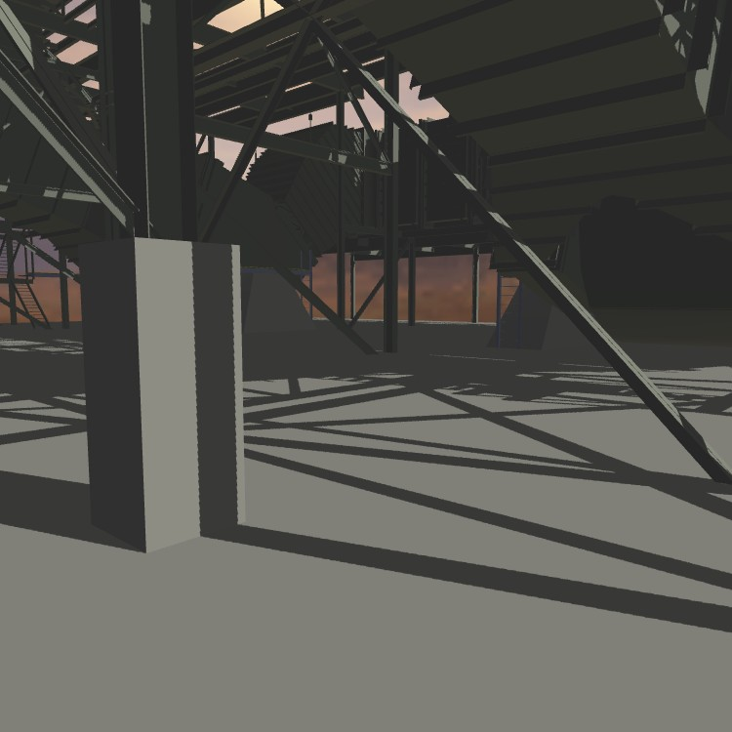
Importance of Shadows
Without shadows
With shadows
Notes:
8

Slide 9
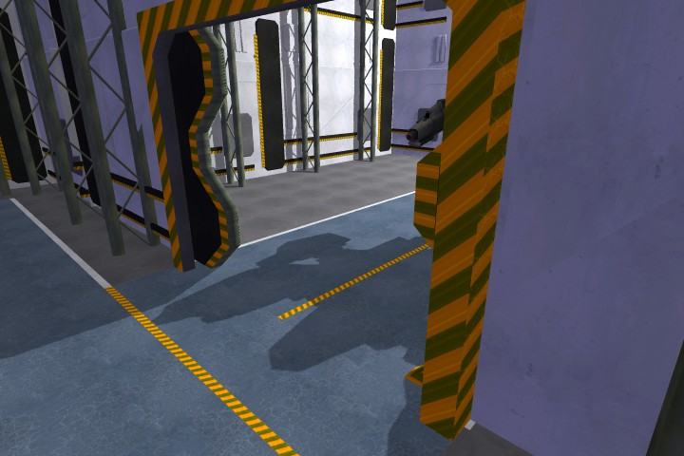
Importance of Shadows
Notes:
9

Slide 10
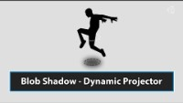
Can be Lost w/o Shadows
Blob Shadow using Projection https://www.youtube.com/watch?v=1T1zorxNEZk - Start at 11:40 and end at 12:40

Slide 11
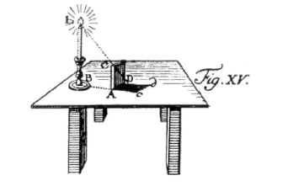
Definition
Shadow: Darkness caused when part or all of the illumination from a light source is blocked by an occluder.
light
occluder
shadow
Notes:
11

Slide 12
Terminology
(area) light source
occluder
penumbra
umbra
receiver
shadow
umbra – fully shadowed region
penumbra – partially shadowed region

Slide 13
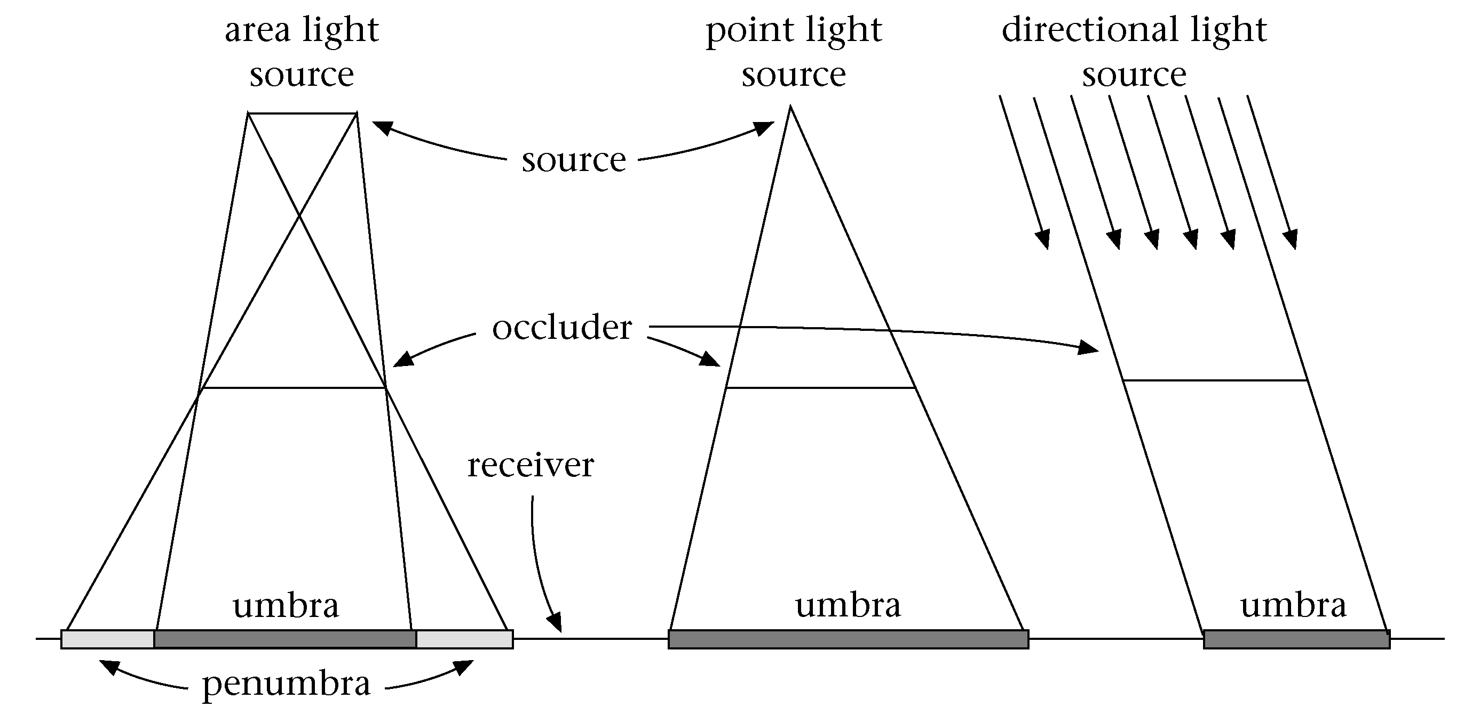
Terminology

Slide 14
Definition: Shadow Volume
Volume formed by extruding the occluder from the light source.
Open and infinite
Space inside the volume is in shadow.
Space outside the volume is not.

Slide 15
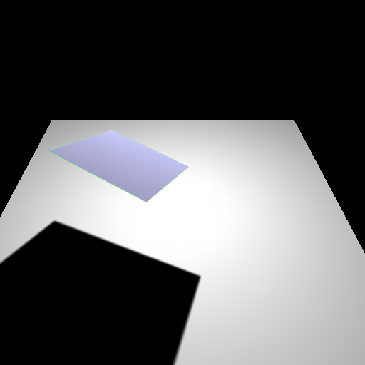
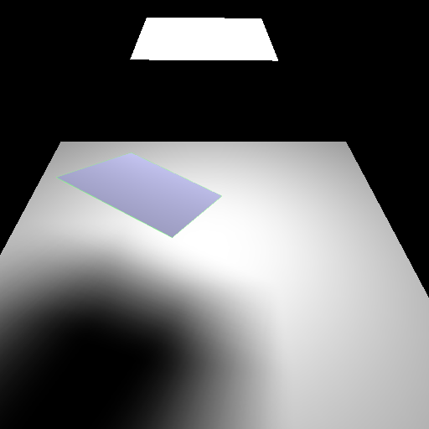
Hard and soft shadows
point
light
extended
light
penumbra
umbra
umbra
Hard shadow
Soft shadow
Notes:
15

Slide 16
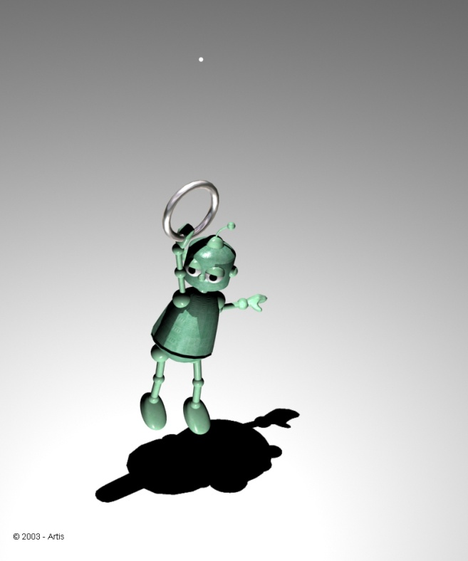
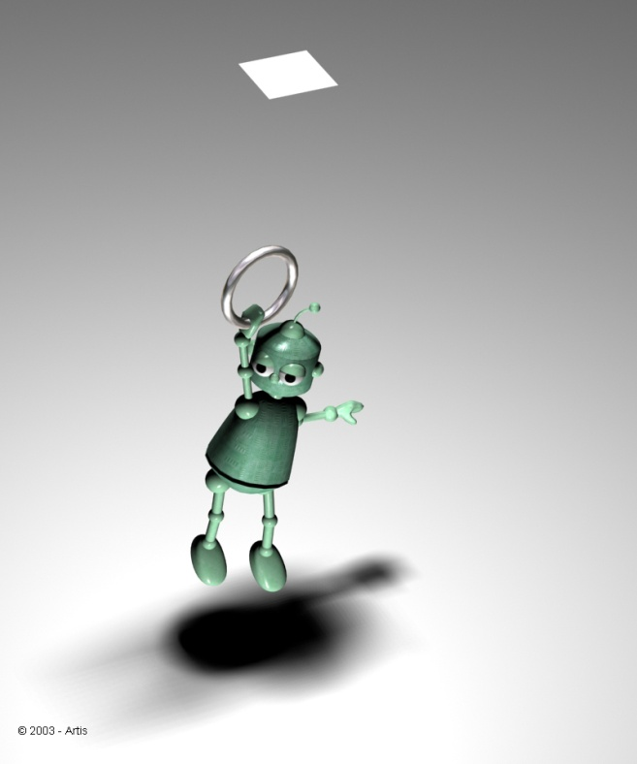
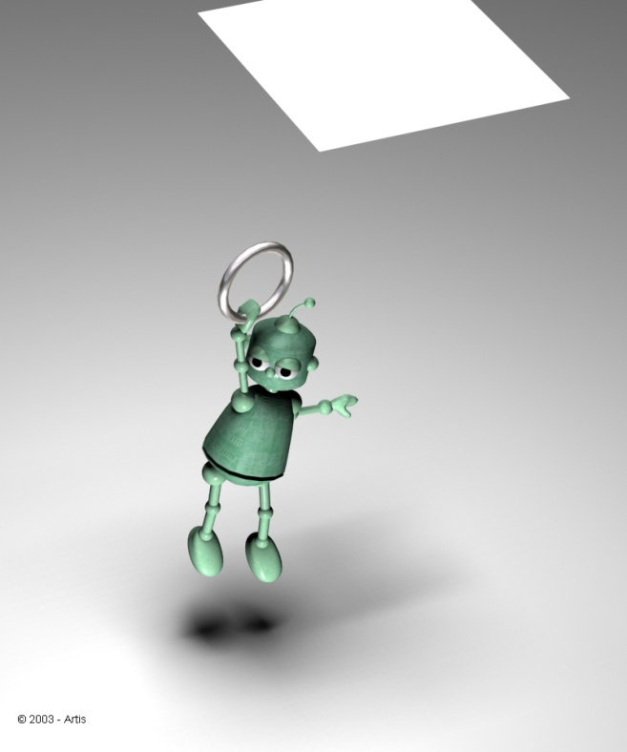
Soft Shadows
Shadow is a function of the area of the light source and the distance.

Slide 17
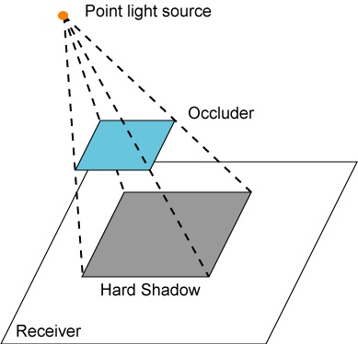

Hard shadow creation
For every pixel, light source is either visible or occluded.

Slide 18
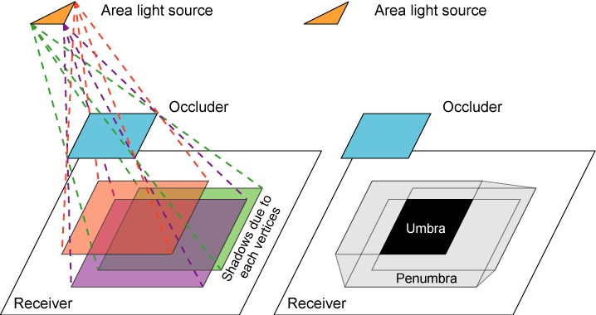
Soft shadow creation

Slide 19
Issues Affecting Shadows
Scene Complexity
  Number of light sources
  Types of light sources
  Number of occluders
  Number of receivers
  Position, size and strength of lights
Static vs. dynamic
  Occluders, Receivers, Lights, Light properties (on/off, intensity, …)
Self-shadowing
Opaque vs. transparent objects
Precision or realism of shadows

Slide 20
Current Shadow Methods
There exist a very large number of methods
We are interested in methods suitable for interactive walkthroughs, speed is crucial
We will classify them on complexity:
no shadows
Sharp shadows
Soft shadows
Special effects

Slide 21
Sharp Shadows
Point or directional light sources
Fake
Hardware Assisted
Pre-computed
Ray tracing
Fast but often
inadequate
Billboard
Projected object
Use of specialized
hardware to generate
shadows
• Shadow texture
• Shadow volumes
Shadows are
pre-computed
and stored for
repeated use
• Detail polygons
Rather slow
for large scenes

Slide 22
Soft Shadows
Area light sources
Hardware Assisted
Pre-computed
Radiosity
Ray-based
Mainly treat the
light source as a
collection of points
• Accumulation
buffer
• Shadow volumes
• Shadow textures
Mainly analytical
computation on
the geometry of
the source
• Light maps
• Discontinuity
Meshing
This is also
pre-computed
• Hemi-cube
• Ray casting
• Distributed
ray tracing
• Cone Tracing

Slide 23
Approaches
Ad-hoc / Custom
  Artist directed shadows
  Very simple and constrained conditions.
Analytical
  Find all boundaries within the umbra / penumbra. Precise.
Sampling
  Probabilistic sampling of whether a particular fragment is within the umbra / penumbra. With enough samples can be made precise.

Slide 24
Shadows and Illumination
Given a point is in shadow, how do we change the illumination?
Light Source
Viewer
Occluder
Point is in shadow
Point is lit

Slide 25
Shadows and Illumination
Illumination model with included visibility term:
Visibility term determines if a light can “see” the point
If point is in shadow, only ambient term applies
For all lights
Visibility Term: 0 or 1 for point/directional lights

Slide 26
Shadows and Rendering Pipeline
The geometry for a model goes through a pipeline.
The Visibility function, V, is not a constant in our illumination model.
  Per vertex information?
  Per fragment using a texture map?
  Some per-pixel masking function?
Recall that we need a V for each light.

Slide 27
Shadows and Illumination
Note, we can re-write our illumination equation:
Negative light.
c_{i}

Slide 28
Masking and Shadows
Graphics hardware provides several ways of masking pixels
  Stencil buffer with stencil test
  Alpha test with fragment’s alpha values
  Blending with fragment’s and framebuffer’s alpha values.
  Texture sampling and shaders.

Slide 29
Negative Light
Algorithm (single light)
  Render receivers with full illumination
  For each occluder
    Project occluder from the light to the receivers
    Darken (set to black or ambient) the illumination.

Slide 30
Negative Light
With multiple light sources this technique does not work. If the algorithm simply sets the pixels to black (or ambient), then it will erases the contributions from all light sources.

Slide 31
Positive Light w/ Forward Rendering
Algorithm (single-pass)
  For each light, calculate a shadow mask
  For each fragment:
    Add ambient illumination
    For each light source
      Calculate illumination from this light only
      Scale illumination by associated shadow mask
      Add contribution to fragment
Algorithm (multi-pass)
  Render scene with ambient illumination only
  For each light source
    Create a shadow mask
    Render scene with illumination from this light only
    Scale illumination by shadow mask
    Add contribution to frame buffer

Slide 32
Real-Time Rendering
Ad-hoc Shadows
CSE 3541
Prof. Roger Crawfis

Slide 33
Ad-Hoc and Custom Shadows
Fake proxy geometry – Blob shadows.
Projection of model to a plane.
Projection of a texture to a plane.
Fake
Hardware Assisted
Pre-computed
Ray tracing
Fast but often
inadequate
Billboard
Projected object
Use of specialized
hardware to generate
shadows
• Shadow texture
• Shadow volumes
Shadows are
pre-computed
and stored for
repeated use
• Detail polygons
Rather slow
for large scenes

Slide 34
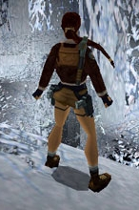
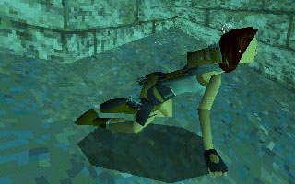
Fake Proxy Shadow
Shadows are simple hand-drawn polygons or textures.
Images from TombRaider. ©Eidos Interactive.

Slide 35
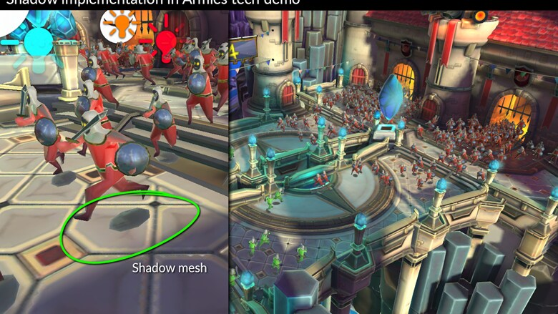
Blob Shadows
Great for small details.
https://blog.unity.com/technology/lighting-tips-for-mobile-game-development

Slide 36
Fake Proxy Shadow
Neither static lighting or dynamic lighting – it is faked.
Do not care whether it is a static or dynamic occluder.
Typically, a single object (occluder) to a single, and simple, object (receiver).
Hard and soft (fake) shadows are easily supported.
For certain cases works great!

Slide 37
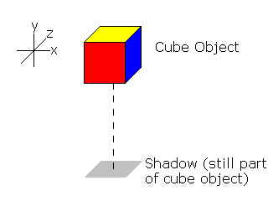
Fake Proxy Shadow
Approximation of shadow position and shape based on object’s typical use.
Typically assumes overhead lighting.
Typically assumes a single flat ground plane as a receiver.
E.g., draw the bottom of the bounding box.

Slide 38
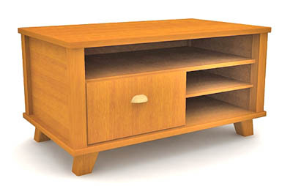
Fake Proxy Shadow
Consider this model
of a desk with a fake
shadow using an
ellipse:
Know where the shadow is going to be.
Will change some depending on the light placement in the room, but good enough!
The ellipse is part of the model.

Slide 39
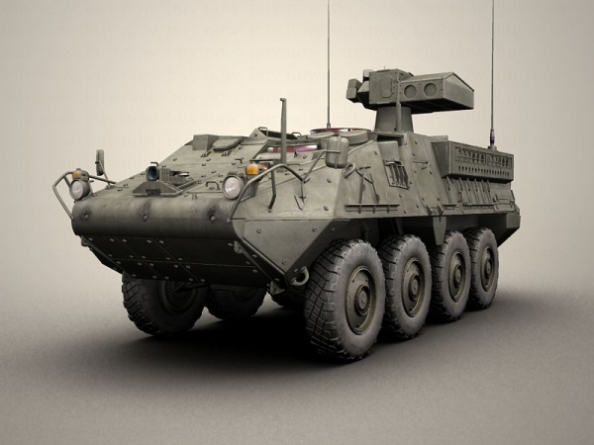
Fake Proxy Shadow

Slide 40
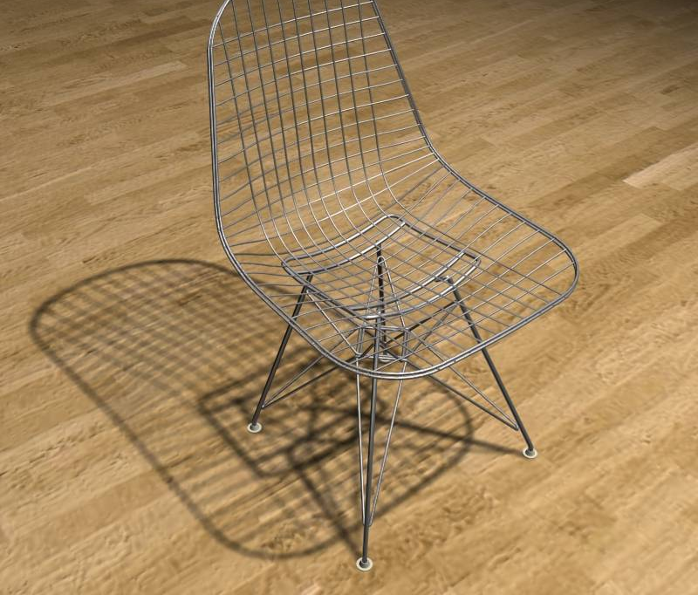
Fake Proxy Shadow
Quite complex model.
Know it will sit on a flat floor.
Will fail if we place another object behind or underneath it.

Slide 41
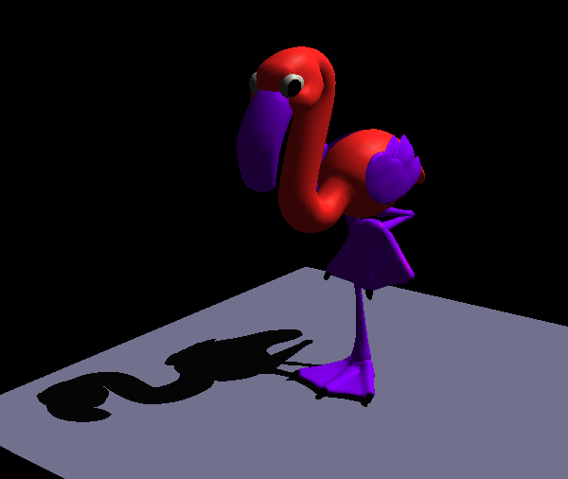
Projected Occluder
Shadows for large planar receivers
  Ground plane
  Walls
Use mathematics to flatten (splat) the object to the plane.

Slide 42
Projected Occluder
Works for:
  Static or dynamic occluders.
  Only planar receivers.
    A wall and a floor can be shadowed separately.
  Static or dynamic light sources.
  Mainly hard shadows.
  Usually a single light source.

Slide 43
Projected Occluder
Projection of a vertex, v, to a plane with normal, n, and coefficient d.
Could be done in shader, but also leads to a 4x4 matrix.

Slide 44
Projected Occluder
Example: xz plane at y=0
l=(l_{x},l_{y},l_{z})
y
v
p
y=0

Slide 45
Projected Occluder
Transformation as a 4 by 4 matrix

Slide 46
Projected Occluder
Basic algorithm
  Render scene (full lighting)
  For each receiver plane
    Compute projection matrix M
    Multiply with actual transformation (modelview)
      Note, even though this is a projection.
      Need to flatten it in world space.
    Render selected (occluder) geometry
      Darken/Black

Slide 47
Projected Occluder
Summary
  Only practical for very few, large receivers
  Easy to implement
  Use stencil buffer (z fighting, overlap, receiver)
  Requires occluder geometry to be redrawn for each light source.
    Can use a simplified model (proxy occluder geometry).

Slide 48
Projected Shadow Texture
Sky layers
Cast shadows

Slide 49
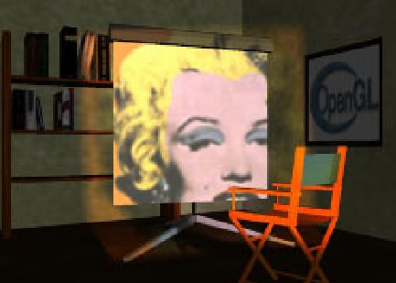
Projective Textures
Textures can be projected like a slide projector.
Before we talk about projective textures let’s look at texture interpolation.
Source: Wolfgang Heidrich [99]

Slide 50
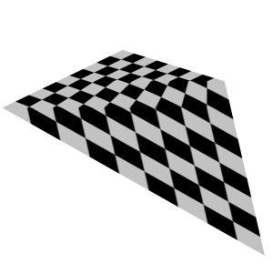
Perspective-Correct Texturing
While we think of 2D texture mapping using only the (s, t) coordinates, doing this will lead to errors.
The texture will swim.
A fix for this is needed
for regular 2D texture
mapping.

Slide 51
Perspective-Correct Texturing
Interpolation in screen space is not the same as interpolation in 3-space
  Problem is perspective
  Need to interpolate in the plane of the triangle.
Interpolation in screen space
Interpolation in plane

Slide 52
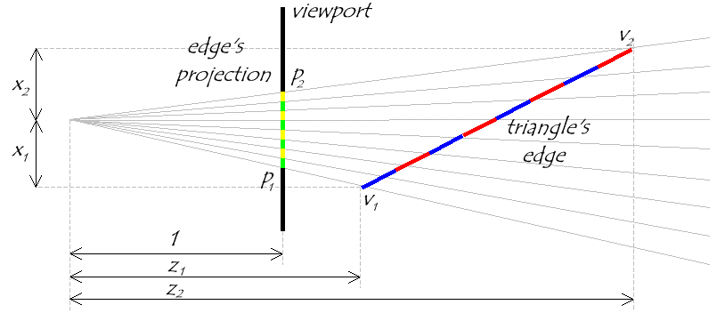
Visualizing the Problem
Notice that uniform steps on the image plane do
not correspond to uniform steps along the edge.

Slide 53
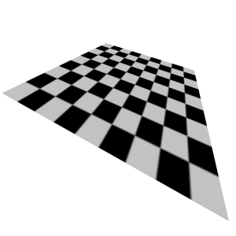
Perspective-Correct Texturing
2D perspective-correct texture mapping
  (s, t) should be interpolated linearly in eye-space.
  Compute per-vertex s/w, t/w, and 1/w
  Linearly interpolate these three
  parameters over the polygon.
  Per-fragment compute:
    s’ = (s/w) / (1/w)
    t’ = (t/w) / (1/w)

Slide 54
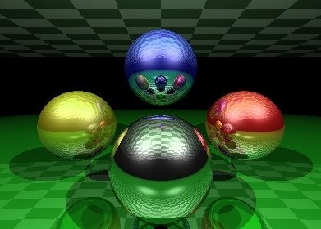

Projective Textures
Similar to projecting objects to the screen.
Now project the scene to the light source.
Use this projection from the receivers as their texture coordinates (a texture parameterization).
Receiver geometry
image plane
camera
Slide projector

Slide 55
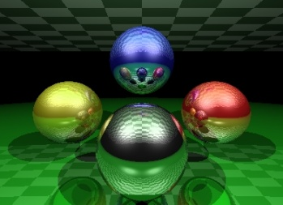
Projective Textures
Texture Coordinates – Project the objects to the “image plane” of the projector and use the projector’s NDC to calculate the texture coordinates
objects
objects
Texture
Projection
projector
projector

Slide 56
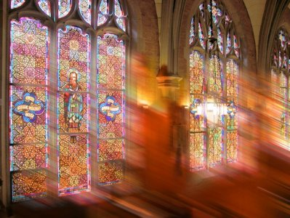
Projective Textures
The receiver’s need to know about the projected texture, the light (or decal) does not automatically apply to objects.
4D texture coordinates handle the projection.

Slide 57

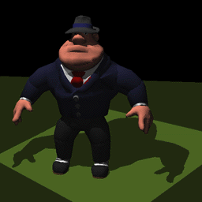
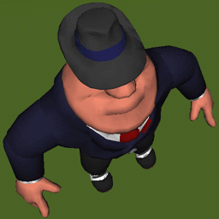
Projective Texture Shadows
Light’s point-of-view
Shadow projective texture (modulation image or light-map)
Eye’s point-of-view, projective texture applied to ground-plane

Slide 58
Projective Texture Shadows
Two-pass approach
For each light source:
  Create a light camera that encloses shadowed area (bounding box of the occluder).
  Render shadow casting objects into light’s view.
    Use a simple shader (set fragment color to black).
  Create projective texture from light’s view
Render Scene using the projective textures.
  Render fully-lit shadow receiving objects.
    Modulate light contribution with the projective-texture for that light.
  Render fully-lit shadow casting objects

Slide 59

Projective Texture Shadows
Texture can easily be projected onto multiple receivers.
Receivers do not need to be planar.
Static scenes only or you need to regenerate textures.
  A sky layer can however
  move its shadow image
  with the clouds.
No self shadowing.
No area light sources (you can blur
the texture though for a fake effect).

Slide 60
Ad-Hoc Shadow Summary
A common theme of these methods is that the occluders and/or receivers were predetermined.
For Fake shadows, the occluder was part of the model. Any receiver rendered before it would be darkened.
For the projection-based techniques, either the occluder had a priori knowledge of the receiver (projected occluders) or the receiver had a priori knowledge of the occluder(s) (projected shadow textures).
The occluder must also be different than the receiver (no self-shadowing).

Slide 61
Games and Animation
Self-Shadowing
CSE 3541
Prof. Roger Crawfis

Slide 62
Self-Shadow Algorithms
Many of the shadow techniques can have receivers and occluders from the same set.
Self-shadowing implies that the occluder is equal to the receiver.
In this section, we will only be interested in the case where a single occluder is equal to a single receiver.

Slide 63
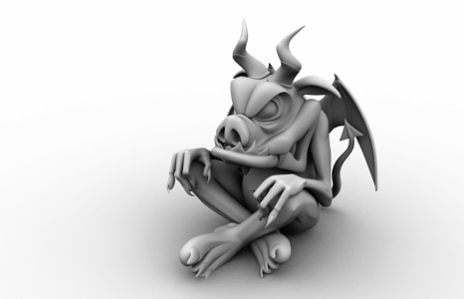
Self-Shadowing
Note, our definition of a model can be a scene graph, so we can have self-occlusion on an object level.
http://plugins.angstraum.at/vrayao/gargoyle.jpg

Slide 64
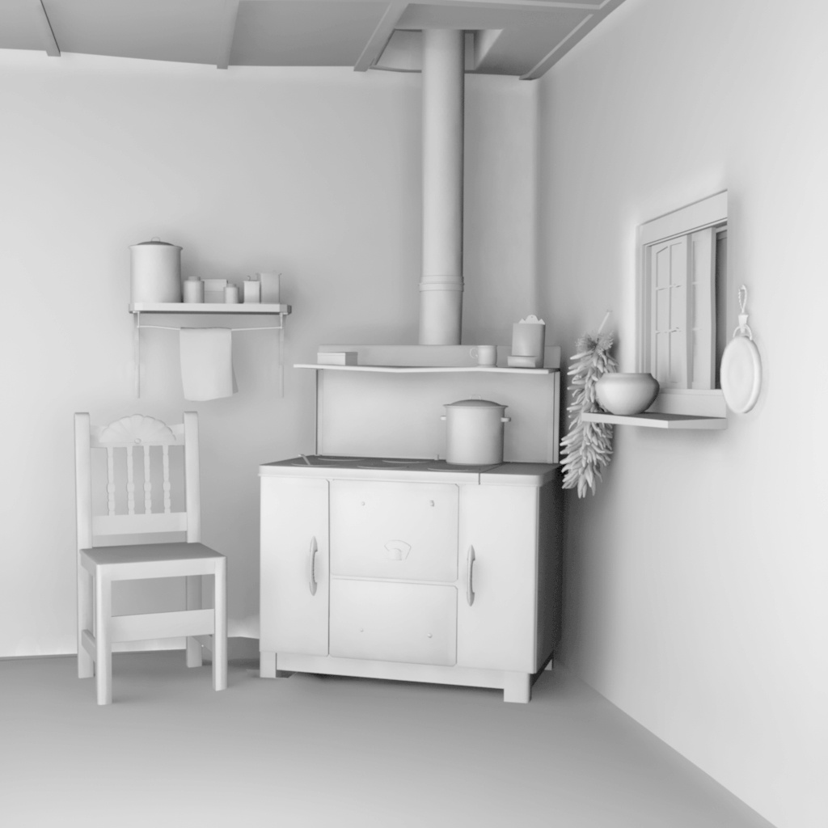
Self-Shadowing
Or we can have self-shadowing on a static scene level.
http://www.bjaramillo.com/renders/kitchen_fg_ambientOcclusion.JPG

Slide 65
Self-Shadowing
Light-maps
Ambient Occlusion
Hardware Assisted
Pre-computed
Radiosity
Ray-based
Mainly treat the
light source as a
collection of points
• Accumulation
buffer
• Shadow volumes
• Shadow textures
Mainly analytical
computation on
the geometry of
the source
• Light maps
• Discontinuity
Meshing
• Distributed
ray tracing
• Cone Tracing
This is also
pre-computed
• Hemi-cube
• Ray casting

Slide 66
Pre-computed Illumination
For static scenes and lighting, the illumination can be pre-computed.
Store the illumination at each vertex or as a texture map (light-map) across the model.
Usually this is done for the majority of the scene using photon-tracing, radiosity or other advanced light transport models.

Slide 67
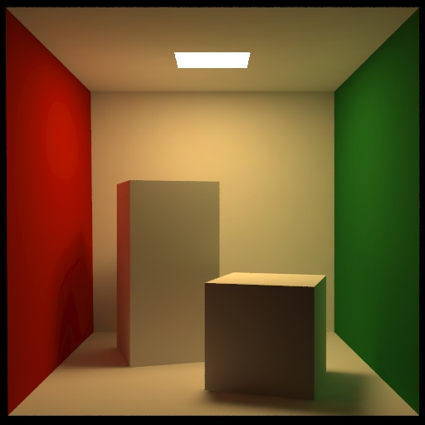
Radiosity
Radiosity precomputes the light interaction between multiple diffuse surfaces.
Not covered in this
class.
The Cornell Box test

Slide 68
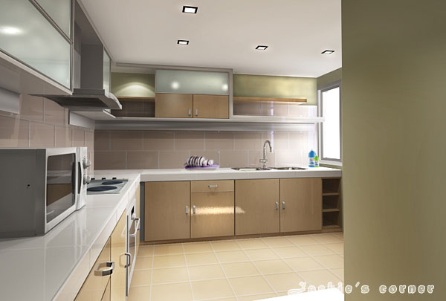
Radiosity
http://forums.3dtotal.com/attachment.php?attachmentid=115312&stc=1&d=1210750917

Slide 69
Pre-computed Illumination
With pre-computed illumination, you have the additional benefit of very simple and fast shaders. No lighting calculations need to be performed at the vertex or fragment level.
You can add illumination from dynamic light sources.
You can also cheat and darken areas with fake shadows.

Slide 70
Ambient Occlusion
Pre-compute the visibility rather than the illumination.
Use this visibility to control the ambient illumination.
For a single static model we can pre-compute the visibility.
Initially just used as the ambient term.
Extended to have some control on the rest of the illumination as well as for dynamic models.

Slide 71
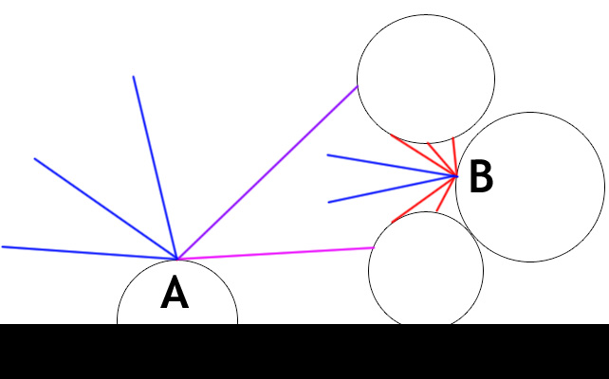
Ambient Occlusion
Point A is not occluded
Point B is darkened

Slide 72
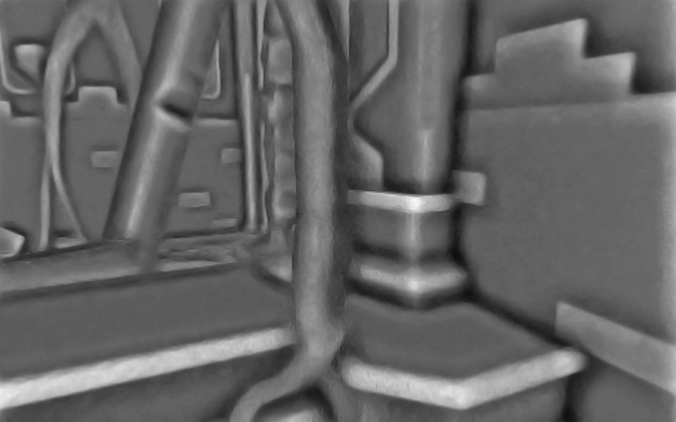
General Idea

Slide 73
2-Hemisphere Lighting
Sky Color
θ
Ground Color

Slide 74
Area Light Shadows
Self occlusion not well represented
Representation is a scalar
  At each point we want the area of the hemi-sphere that is visible (not occluded by self).
Use ray-casting to generate this information as a pre-process.

Slide 75
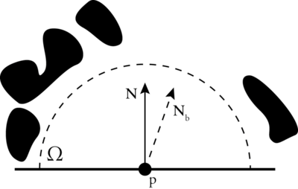

Ambient Occlusion
Integral of blocker function over the hemisphere

Slide 76
Occlusion Representations
Can store result in various ways
Compute ratio of hits / misses
  Occlusion Factor
  A single scalar parameter
  Should weight with cosine
Use to blend in shadow color
Sufficient for hemisphere lighting

Slide 77
2-Hemisphere Lighting
Sky Color
Ground Color
Sphere Model
Object Color
Occlusion Factor
Final Color

Slide 78
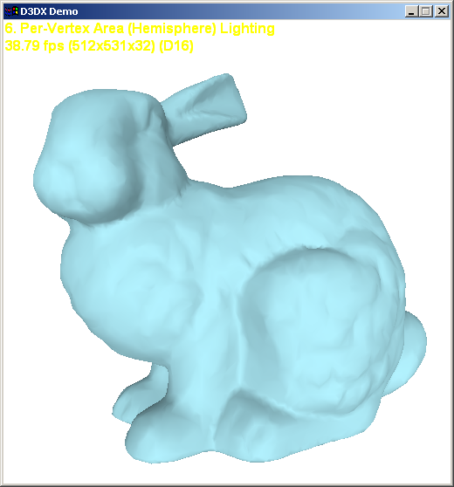
Occlusion Factor Absent

Slide 79
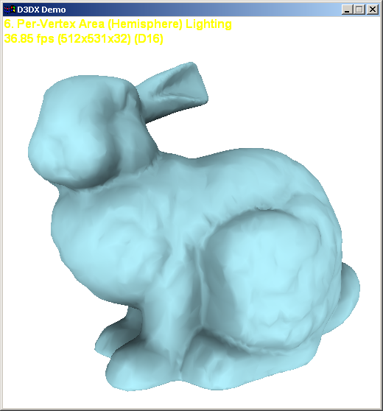
Occlusion Factor Present

Slide 80

Occlusion Factor Absent

Slide 81

Occlusion Factor Present

Slide 82

Occlusion Factor Absent

Slide 83

Occlusion Factor Present

Slide 84
Occlusion Extensions
Ambient Occlusion only stores the percentage of the hemi-sphere visible.
Consider the example
What if the light is
overhead, or slightly
to the left of the
scene?
  Point B should be in shadow.

Slide 85


Occlusion Extensions
For many models, the portion of the hemisphere visible is contiguous.
A common trick is to bend the normal towards the center of the visible region.

Slide 86
Surface Response
With Spherical Harmonic representation we can include:
  Self-shadowing
  Inter-reflection: glows, caustics
  Subsurface scattering

Slide 87

No Shadow

Slide 88

Shadow

Slide 89

Shadow + Inter-Reflection

Slide 90


Ambient Occlusion Example
Local lighting
Ambient Occlusion
Notes:
Why do we need Ambient Occlusion?
Ambient occlusion is…. but….

Slide 91


Ambient Occlusion Example
Local lighting
Ambient Occlusion
Notes:
can see hi level structures like alpha helixes!

Slide 92
Self-Occlusion Summary
These pre-computed strategies provide some of the most pleasant imagery.
Assumes static scenes but can generally work well with dynamic scenes.
Should almost always be used in modern illumination settings.

Slide 93
Games and Animation
Shadow Maps
CSE 3541
Prof. Roger Crawfis

Slide 94


Shadow Maps
Casting curved shadows on curved surfaces
  Image-space algorithm
  Well suited for hardware implementation
Real-Time Luxo Jr. …uses three dynamic shadow maps (OpenGL, GeForce3)

Slide 95
Shadow Maps
Two-pass z-buffer algorithm:
First pass: Render scene from light
  Store z values in a shadow map
    Similar to a z-buffer. Stores the distance from
    the light to the nearest object.
Shadow Map
Distance

Slide 96
Shadow Maps
Second pass: Render scene from eye
  For each pixel to be drawn:
    Do normal z-buffer computation to see if the object is visible to the eye.
    If it is, compute distance from the corresponding
    world space point to light source.
    Compare this distance with the shadow map.
    If distance is greater, the point is in shadow.
Point Seen by
Light Source
Distance to
Light Source
Point
to Draw

Slide 97

Shadow Maps
World-space ties the two passes together.

Slide 98


Shadow Maps
Final scene
Shadow map

Slide 99
Shadow Maps
Hardware implementation
  Render scene to z-buffer (light source view)
    Depthbuffer-to-texture copy
    RenderTexture with FBO
  Depth values of front most pixels
    These are the first occluders
  Issues:
    How do we sample / filter?
    How do we test?
    Transformations?

Slide 100
Shadow Maps
Two-pass z-buffer algorithm:
  Need to convert points from
  world-space to light-space:
World Space
L
Light Space
L V⁻¹
V⁻¹
V
Eye Space
V = viewing transformation
L = transformation to light space
p´ = L V⁻¹p

Slide 101

Aliasing in Shadow Maps
Sindholt, Joen. “A comparison of shadow algorithms” Examination thesis for MSE, TU Denmark. May 2005

Slide 102


Aliasing error
Standard shadow map
Reference image
Notes:
102

Slide 103
Aliasing error
Standard shadow map
Reference image
Notes:
103

Slide 104
Aliasing error
objects
eye
Notes:
104

Slide 105
Aliasing error
far plane
view frustum
near plane
eye
Notes:
105

Slide 106
Aliasing error
standard
shadow map
texel
eye
Notes:
106

Slide 107
Aliasing error
more
samples
standard
shadow map
eye
fewer
samples
Notes:
107

Slide 108


Aliasing error
projected
texel
Standard shadow map
Reference image
Notes:
108

Slide 109
Shadow Maps
The frustum and shadow map resolution affect the accuracy of the shadow z-buffer.

Slide 110

Shadow Maps
Near and Far Planes will affect the precision of the shadow z-buffer.
Sindholt, Joen. “A comparison of shadow algorithms” Examination thesis for MSE, TU Denmark. May 2005

Slide 111


Shadow Maps
What texture filters to use?
GL_NEAREST
GL_LINEAR

Slide 112
Shadow Maps
Traditional filtering is inappropriate
What pixel covers in
shadow map texture
Pixel depth = 0.57
eye
position
Texel sample
depth = 0.25
Texel sample
depth = 0.63
0.25
0.25
Average(0.25, 0.25, 0.63, 0.63) = 0.44
0.57 > 0.44 so pixel is wrongly “in shadow”
Truth: nothing is at 0.44, just 0.25 and 0.57
0.63
0.63

Slide 113
Shadow Maps
Average comparison results, not depth values
What pixel covers in
shadow map texture
Pixel depth = 0.57
eye
position
Texel sample
depth = 0.25
Texel sample
depth = 0.63
Shadowed
Average(0.57>0.25, 0.57>0.25, 0.57<0.63, 0.57<0.63) = 50%
so pixel is reasonably 50% shadowed
(actually hardware does weighted average)
Unshadowed

Slide 114

Shadow Maps
Percentage Closer filtering
  Normal texture filtering just averages color components, which does NOT work here.
  Implies all texels need to be evaluated.
Reeves, et al, SIGGRAPH 1987

Slide 115

Shadow Maps and Alpha Testing
A key advantage of shadow-maps over shadow-volumes is the ability to handle alpha-masked objects and textures (e.g., billboard trees, picket fences, etc.).
from Thomas Annen et al, Exponential Shadow Maps, GI 2008

Slide 116
Shadow Maps
Advantages:
  All objects can be an occluder
  Fast (less than 2x).
  Hardware support for precision formats and filtering.
Disadvantages:
  Aliasing is a big problem
  Problems with bias’ing in the depth test.

Slide 117

Cascaded Shadow Maps

Slide 118

Cascaded Shadow Maps
Similar to Parallel-Split Shadow Maps, but light aligned.
Hence, they overlap.
See: https://docs.microsoft.com/en-us/windows/win32/dxtecharts/cascaded-shadow-maps

