Slide 1
Games and Animation Shader Graphs
CSE 3541
Prof. Roger Crawfis

Slide 2
More Complex Lighting
Diffuse and Specular shading can get quite complex.
Phong and Gouraud shading models are more ad-hoc.
Other models take into account microfacets and sub-surface scattering.
Cook-Torrance
Torrance-Sparrow
Oren-Nayer
Ward anisotropic
Light fields
Still being worked on Heitz 2016, Kulla & Conty 2017
Photogrammetry measures the radiance across a real surface
Physically-Based Rendering (PBR) is not a model, but an idea.

Slide 3
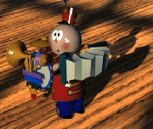
Shaders
Local illumination quite complex
Reflectance models
Procedural texture
Solid texture
Bump maps
Displacement maps
Environment maps
Need ability to specify each shading description, which we call a shader
Shaders also describe
lights, e.g. spotlights
atmosphere, e.g. fog

Slide 4
Shading v. Modeling
Shaders generate more than color
Displacement maps can move geometry
Opacity maps can create holes in geometry
Frequency of features
Low frequency ⬄ modeling operations
High frequency ⬄ shading operations

Slide 5
Shade Trees
Cook, SIGGRAPH 84
Hierarchical organization of shading
Breaks a shading expression into simple components
Visual programming
Modular
Drag-n-drop shading components
*
+
copper color
*
*
ka
Ca
ks
specular
normal
viewer
roughness

Slide 6
Texture v. Bump Mapping
Texture mapping simulates detail with a color that varies across a surface
Bump mapping simulates detail with a surface normal that varies across a surface
+
+
*
*
*
*
kd
tex(s,t)
⋅
⋅
ks
kd
tex(s,t)
⋅
⋅
ks
L
bump()
H
L
N
H
N
B
Color Texture
Bump Mapping

Slide 7
Problems with Shade Trees
Shaders can get very complex
Sometimes need higher-level constructs than simple expression trees
Variables
Iteration
Need to compile a program instead of evaluate an expression

Slide 8
Renderman Shading Language
Hanrahan & Lawson, SIGGRAPH ‘90
FYI: Crawfis & Allison, Visualization ‘91 for scientific visualization
High level little language
Special purpose variables useful for shading
P – surface position
N – surface normal
Special purpose functions useful for shading
smoothstep(x₀,x₁,a) – smoothly interpolates from x₀ to x₁ as a varies from 0 to 1
specular(N,V,m) – computes specular reflection given normal N, view direction V and roughness m.

Slide 9
Renderman Example
Surface dent(float Ks=.4, Kd=.5, Ka=.1, roughness=.25, dent=.4) {
float turbulence;
point Nf, V;
float I, freq;
/* Transform to solid texture coordinate system */
V = transform(“shader”,P);
/* Sum 6 octaves of noise to form turbulence */
turbulence = 0; freq = 1.0;
for (i = 0; i < 6; i += 1) {
turbulence += 1/freq + abs(0.5*noise(4*freq*V));
freq *= 2;
}
/* sharpen turbulence */
turbulence *= turbulence * turbulence;
turbulence *= dent;
/* Displace surface and compute normal */
P -= turbulence * normalize(N);
Nf = faceforward(normalize(calculatenormal(P)),I);
V = normalize(-I);
/* Perform shading calculations */
Oi = 1 – smoothstep(0.03,0.05,turbulence);
Ci = Oi*Cs*(Ka*ambient() + Ks*specular(Nf,V,roughness));
}

Slide 10
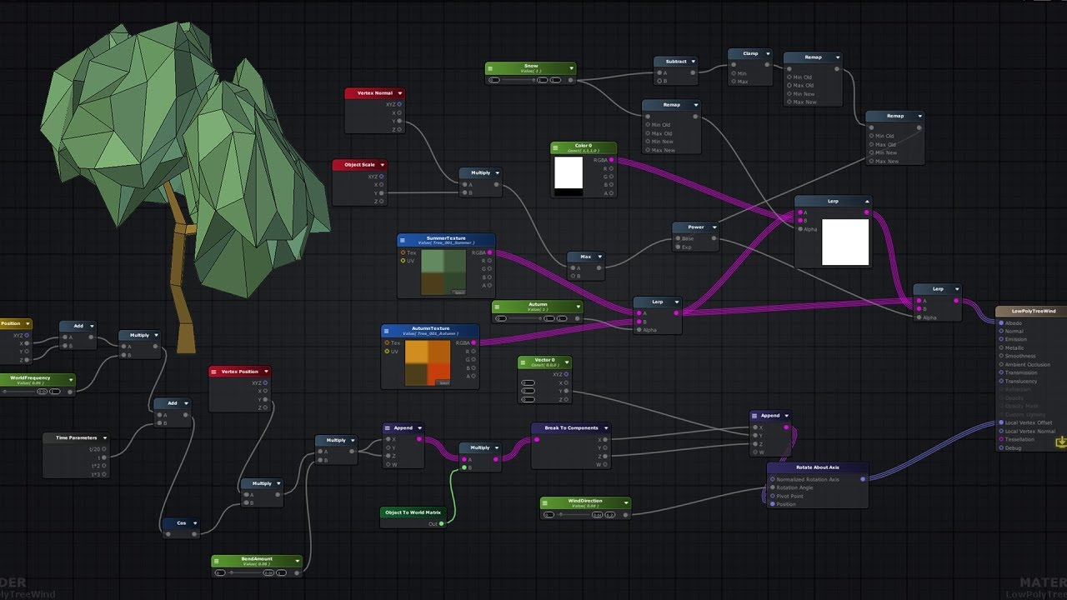
Unity’s Shader Graph
Visual Programming for Shaders:
https://unity.com/shader-graph
https://i.ytimg.com/vi/o0ZlwiXP48I/maxresdefault.jpg, from https://www.youtube.com/watch?v=o0ZlwiXP48I

Slide 11
Programmable Shaders
CSE 5542 - Real-Time Rendering
Typically, OpenGL (WebGL)
Unity Shader language: ShaderLab, also HLSL,OpenGL
Microsoft’s shading language: HLSL
Apple’s shading language: Metal
Other’s: Houdini VEX, Gelato’s, Vulkan, DirectX Raytracing
Requires deep knowledge of hardware to make efficient. Shader variants typically exist for different hardware.

Slide 12
Shader Architectures
Forward Rendering
Rasterize each primitive into fragments and run the shader associated with the fragment to set the pixel color (if visible).
Deferred Rendering (simplified)
Rasterize each primitive into fragments and perform the z-test only. Store a shader ID with each fragment.
Once all primitives have been rasterized, go over the image and run the shader associated with each pixel / sample.
Choice may be at the hardware level (ARM vs. nVidia)

