Slide 1
Games and Animation Pathfinding Weights
CSE 3541
Prof. Roger Crawfis

Slide 2
Optimal Pathfinding Requires Weights
Possible Edge Weights:
Manhattan Distance (x+y)
Diagonal is as expensive as 2 steps – need to walk around buildings
Euclidean distance squared (x²+y²)
Integer: Sqrt(2) = 1.4…, so multiply by 10. x, y step =>10, diagonal =>14
Terrain type: grass, forest, swamp, …
Transportation type: path, gravel road, dirt road, paved road, freeway
Explored versus unknown
Penalize lack of knowledge: unknown more expensive
Promote exploration: unknown less expensive
Promote going into cities
Promote avoiding enemies

Slide 3
NPC specific
Some objects may be wider / larger and not able to fit thru narrow passageways
Tank vs soldier, cat versus human
Likewise, some abilities may be possible or impossible
Jump up, glide down, tunnel, etc.
Limits on vehicles, riding a horse, …
Edge wight can be set to infinity or edge could be deleted.

Slide 4
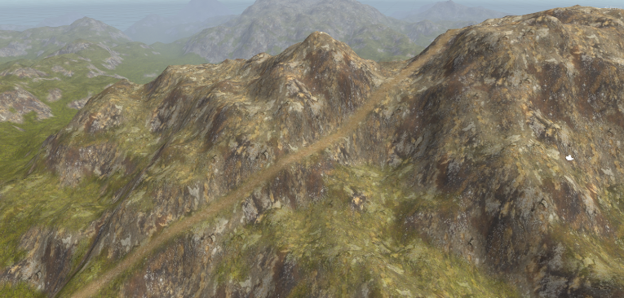
Creating paths in terrain
Cost = (a*slope)^{n}
Uniform cost
http://blog.runevision.com/2016/03/note-on-creating-natural-paths-in.html

Slide 5
A* Heuristics
For A*, need heuristic to be conservative
H(x,y) = 0 is conservative!!!
Goal: Lower bound to reach the goal for each node.
Usually achievable with some creativity.
Consider railroad (Civilization these we free) that goes from A->B.
H(x₁) = min(|x₁-x₂|, |x₁-A|+|x₂-B|, …), where x₂ is target
Same with portals

Slide 6
Memorization and A*
Can compute and store a minimum.
For each start/target pair?
Landmarks
Cost is the difference between paths to landmark
h_{L}(n) = |d(L,n) - d(L,T)|
Can have multiple landmarks?
Assume portals are static (can be on and off though)

Slide 7
Multiple Heuristics
All heuristics are conservative.
What should we do?
Min?
Sum?
No, take the maximum!!!

Slide 8
A* on State Graphs
Yinxuan (Chloe) Shi’s dissertation work at OSU.

Slide 9
Problem Formulation

Slide 10
Level Design: Cover me

Slide 11
Problem Formulation

Slide 12
Problem Formulation

Slide 13
Problem Formulation

Slide 14
Problem Formulation

Slide 15
Damage Function

Slide 16
Damage Function

Slide 17
Damage Function

Slide 18
Damage Function

Slide 19
Damage Function

Slide 20
Damage Function

Slide 22
A

Slide 23
B
A

Slide 24
B
A

Slide 25
B
A

Slide 26
B
A

Slide 27
B
A

Slide 28
B
A

Slide 29
B
A

Slide 30
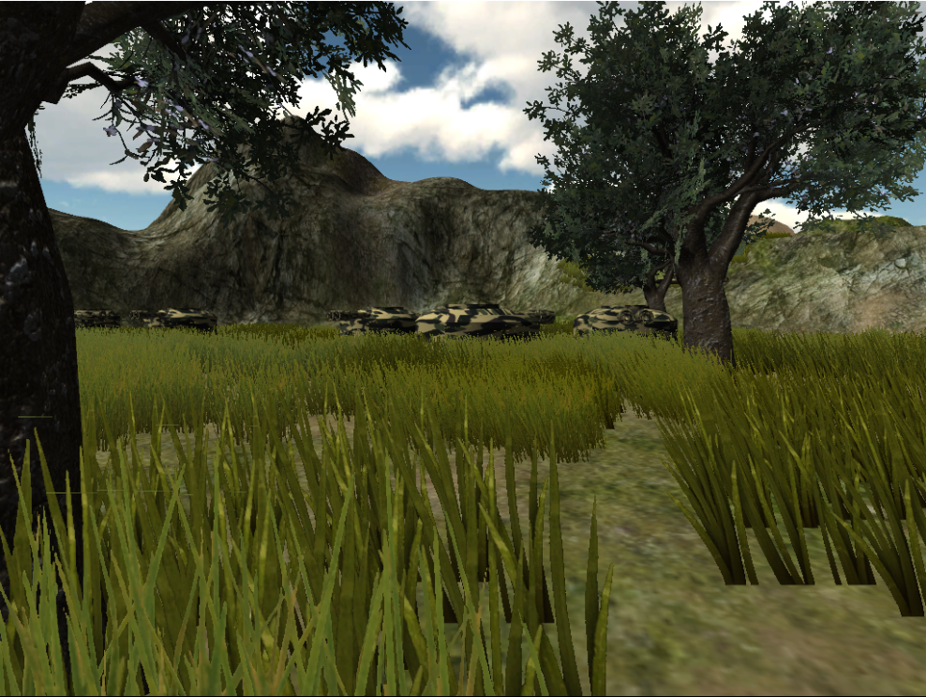
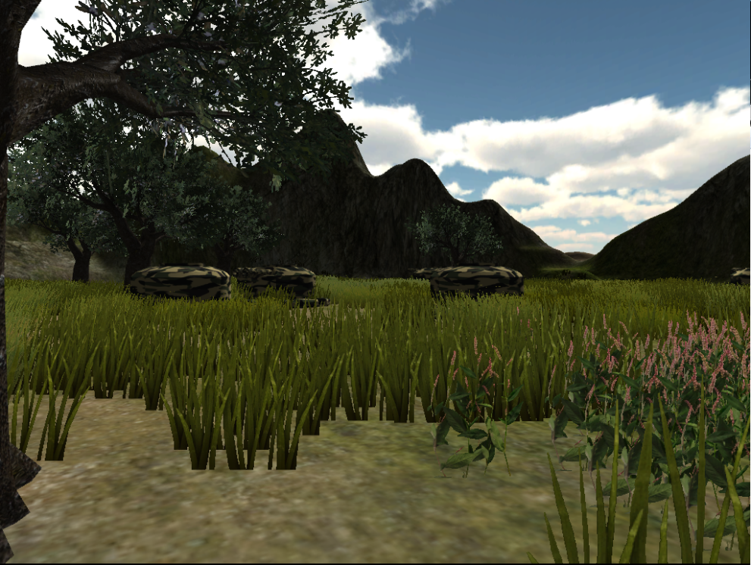
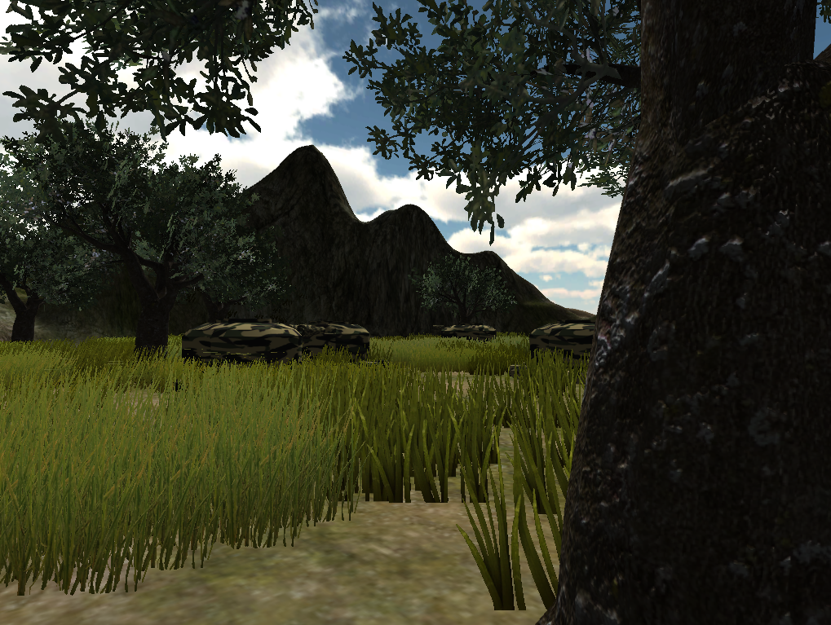
Turrets as enemies
Rocks and trees as cover

Slide 31
Damage Function
The damage function is dependent on:
Enemy locations
Cover locations
Optimal path has least resistance (minimal damage) going from A to B
B
A

Slide 32
Optimal Path
B
A

Slide 33
Improving the Level

Slide 34
Improving the Level
B
A

Slide 35
Improving the Level
B
B
A
A

Slide 36
Improving the Level
B
B
B
A
A
A

Slide 37
Improving the Level
B
A

Slide 38
PCG Search for a Level
B
A

Slide 39
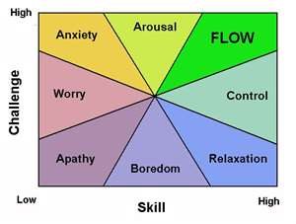
Other Metrics

Slide 40
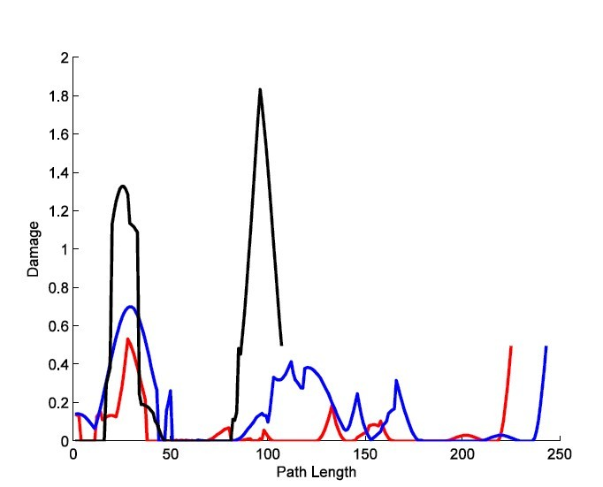
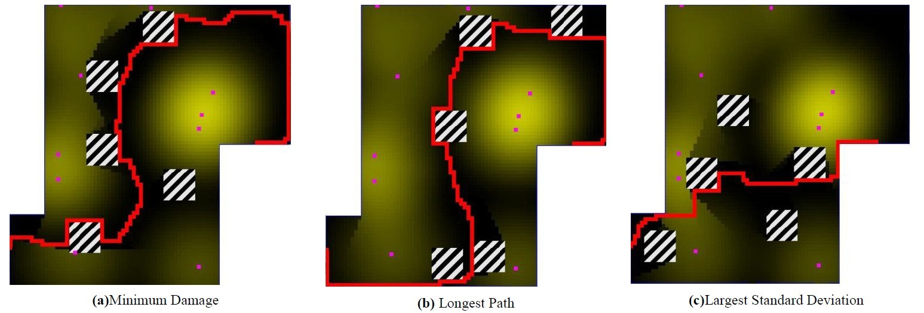
Stealthy Game : Analysis
Minimum Damage (red)
Create an easy level
Longest Path Length(blue)
Touch more map, strategy
Largest Standard Deviation(black)
drama

Slide 41
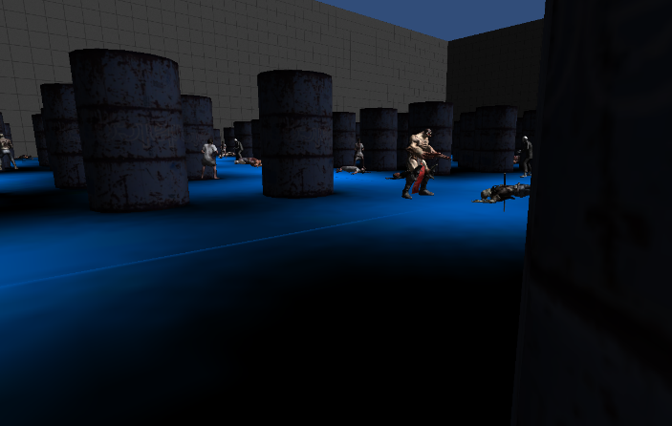
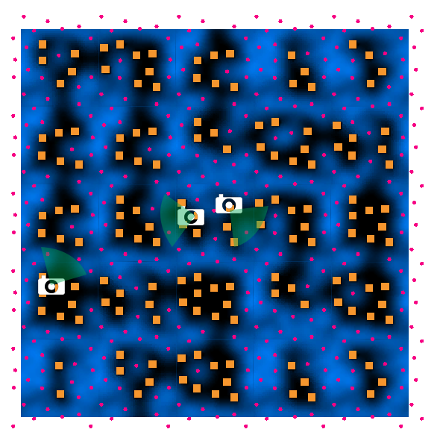
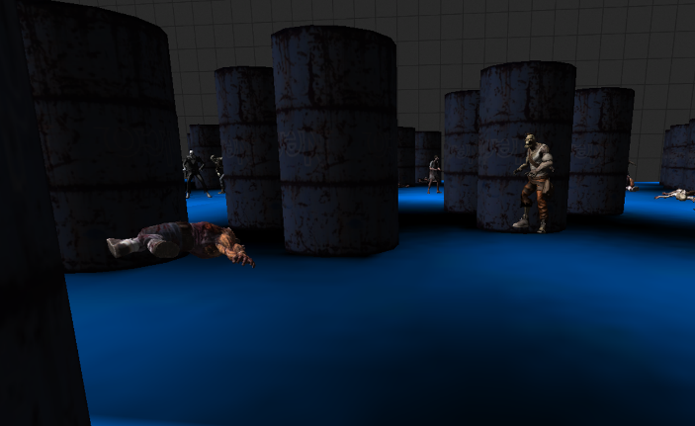
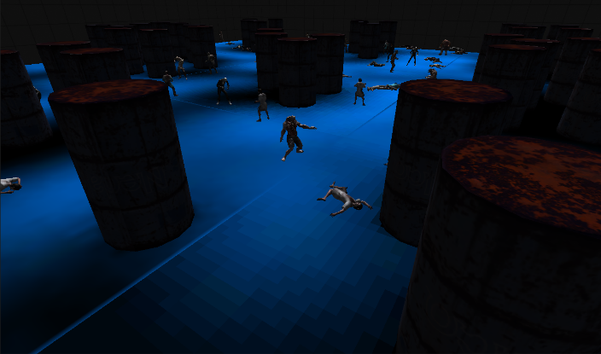
Tile-based

Slide 42
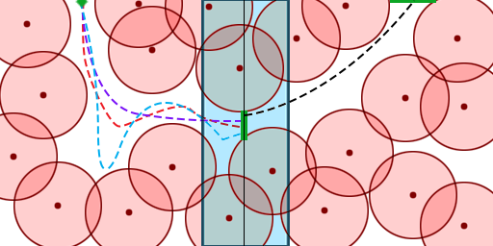

Slide 43
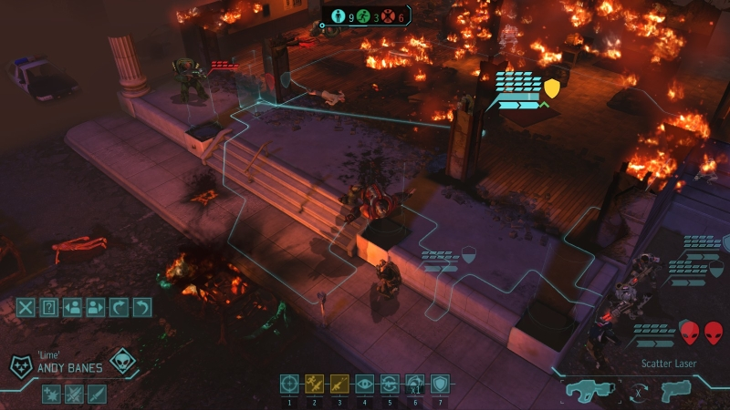
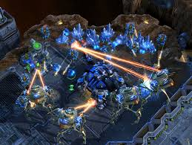
Use Case: Strategy Game
Strategy Game
Squad Behavior: taking cover and suppress enemies
Squad tactics
Two types of squad behavior in strategy game:
Centralized squad system by planned squad tactics.
Decentralized squad AI based on emergent behavior.

Slide 44
Strategy Game : Process
Create Bipartite Graph for Suppression Fire
Create Cover State Graph $G_{1}$
Generate Cover Locations
Create Cover Graph $G$
Compute Heuristic on $G$
Find Shortest Path in $G_{1}$

Slide 45
Strategy Game : Setup
Closed Area $S$ with cover set
Entrance A
Exit B
Enemy locations $\left(q_{1}, q_{2} … q_{l}\right)$
Squad locations $(p_{1}, p_{2} … p_{n})$
Initialize at entrance A

Slide 46
Strategy Game : Setup
How to evaluate cover location?
Location Safety
$damage\left(\vec{x}\right)< σ$
Ability to provide suppression fire for team.
$$∪Suppression\left(neighbour\left(\vec{x}\right)\right)> τ$$

Slide 47
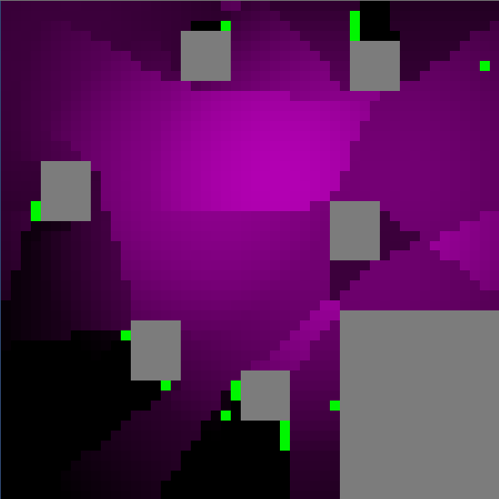
Strategy Game : Cover Location
Generate damage map
Damage dictates brightness
Grey area is inaccessible
Select cover locations
Green dot means cover locations
Include start and end

Slide 48
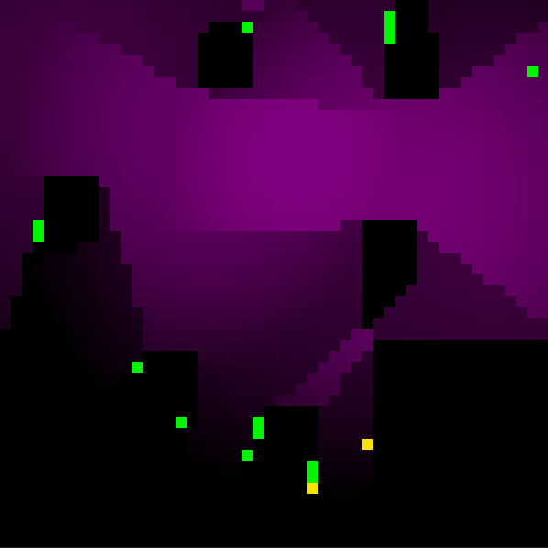
Strategy Game : Suppression Fire
Assume squad $p_{i}$ provides cover for $p_{k}$
If $p_{i}$ is able to see $q_{j}$from neighboring locations and decide to pin down $q_{j}$
$suppress\left(q_{j},p_{k},C,\vec{x_{1}},\vec{x_{2}}\right)= \left\{\begin{aligned}1 provide cover \\ 0 otherwise\end{aligned}\right.$
Damage for moving squad
$damage\left(\vec{x_{1}},\vec{x_{2}}\right)=\sum_{j=1}^{l}{\sum_{k=1,k≠i}^{n}{w_{j}}}$
$$∗\sum_{\overset{⃑}{x}= \overset{⃑}{x_{1}}}^{\overset{⃑}{x_{2}}}{visible\left(q_{j},path\left(\vec{x}\right)\right)}∗suppress(q_{j},p_{k},C,\vec{x_{1}},\vec{x_{2}})$$

Slide 49
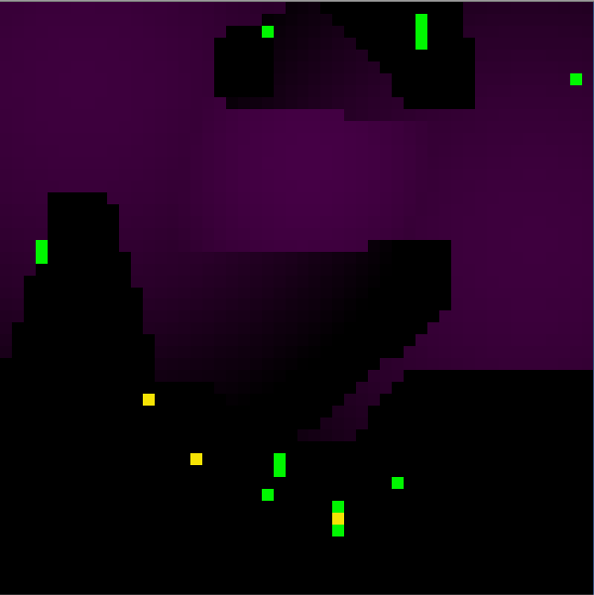
Strategy Game : Suppression Fire
How to choose which enemy to suppress?
Each pair of $p_{u}$ and $q_{v}$ can form an edge of a bipartite graph
Edge weight $w(p_{u}, q_{v})={\sum_{\overset{⃑}{x}= \overset{⃑}{x_{1}}}^{\overset{⃑}{x_{2}}}{visible\left(q_{v},path\left(\vec{x}\right)\right)∗}w_{v}}_{}$
Find maximum weight matching in this bipartite graph

Slide 50
Strategy Game : Cover Graph $G$
If we allow player to travel to any cover to cover locations
Complete graph
However
A squad member can only travel a limited distance in a certain time.
Edge weight is related to squad location
Works for instantaneous state, but not globally

Slide 51
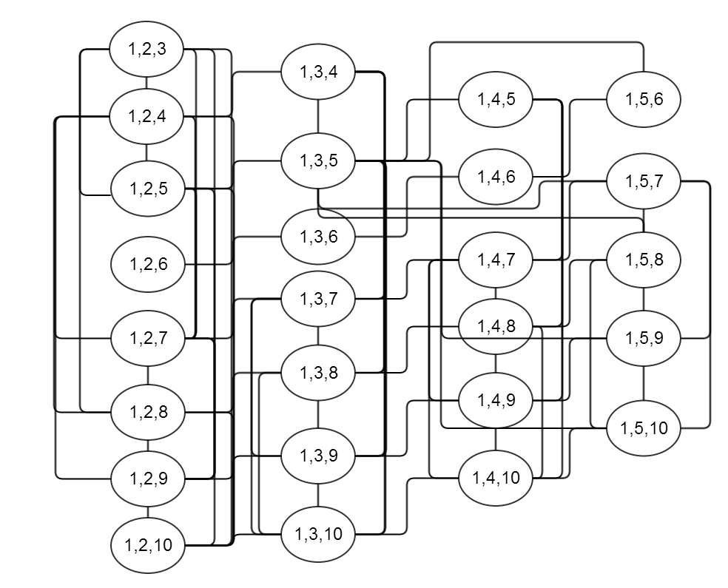
Strategy Game : Cover State Graph $G_{1}$
Assume all squad members are the same
$$S = \left\{c_{i_{1}},c_{i_{2}}… c_{i_{n}}\right\},(c_{i_{1}}, c_{i_{2}}… c_{i_{n}}∈C)$$
Takes $\frac{m!}{\left(m−n\right)!n!}$ states
Total states 592
Partial cover state graph

Slide 52
Strategy Game : Optimal Squad Movement
Optimal strategy: Find shortest path on cover state graph
$\text{Use} Dijkstra to find shortest path (0,0,0) →(15,15,15)$
Can we do it faster?
To guarantee global optimal
Need to find admissive heuristic for A*
Use distance metric as heuristic estimate on Cover State Graph?
Edge weight on $G_{1}$ maybe 0
Need to consider cover graph

Slide 53
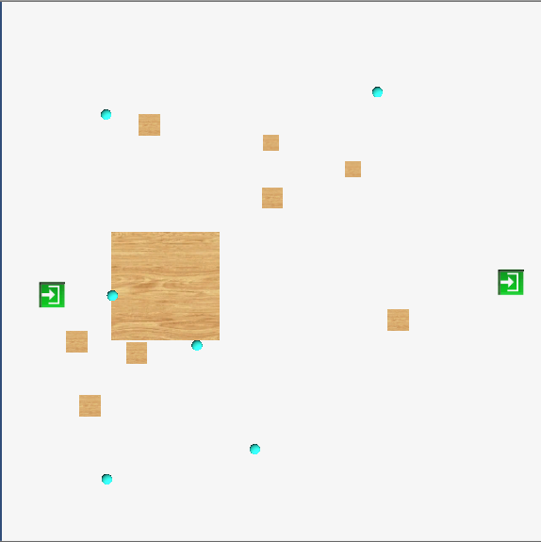
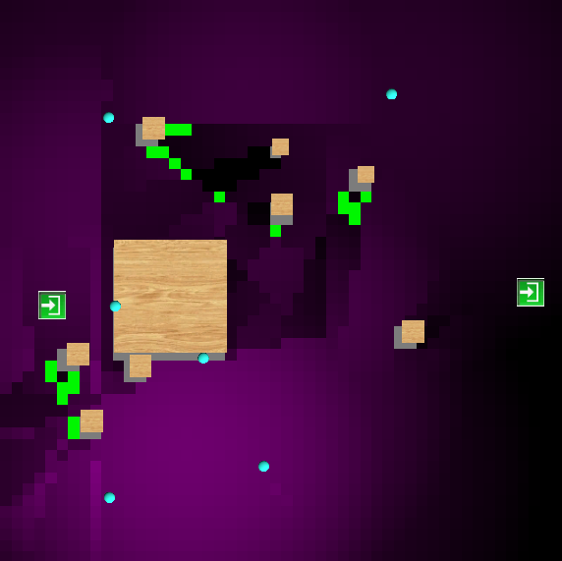
Strategy Game : Result
Sample setup
Cyan dots as enemies
Cubes as obstacles
Doors as entrance & exit
Damage Map and Cover Locations

Slide 54
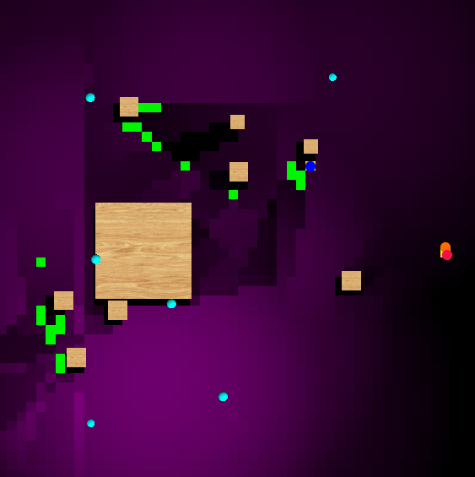
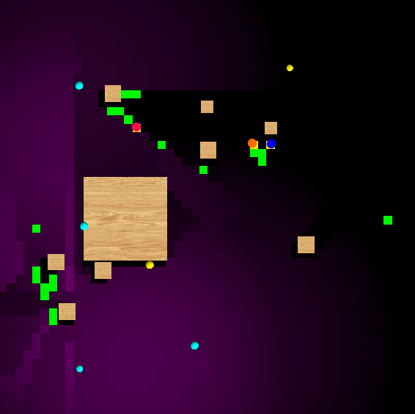
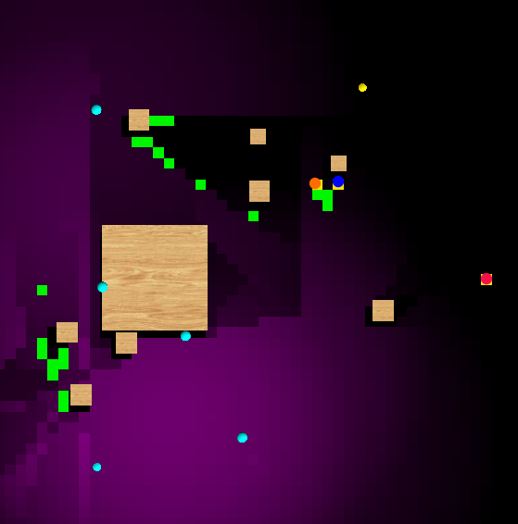
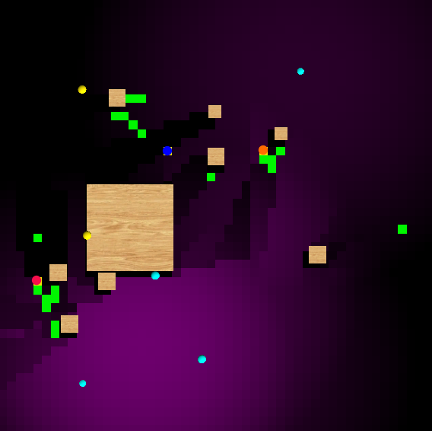
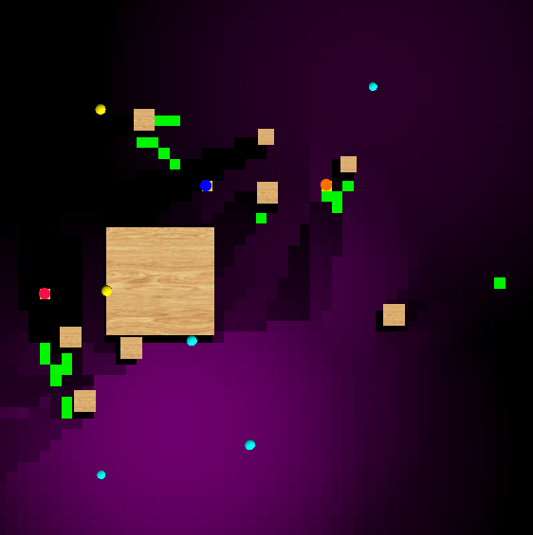
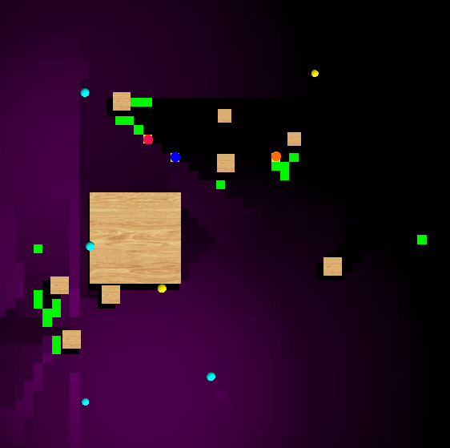
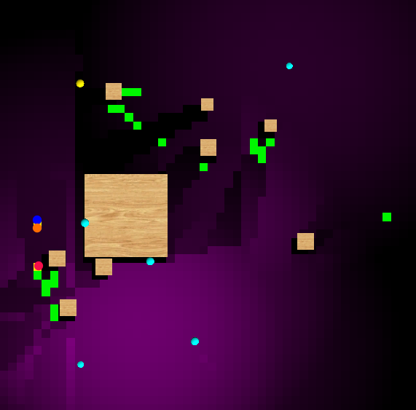
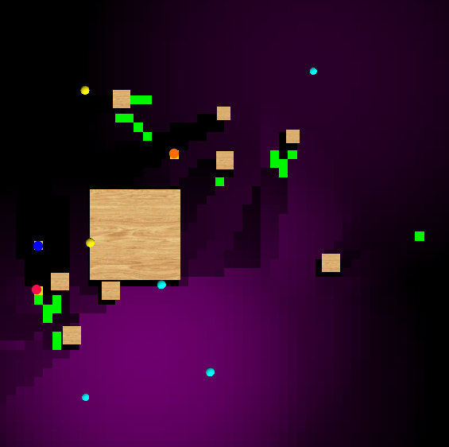
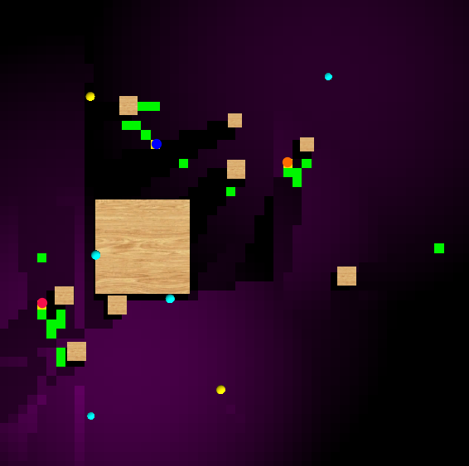
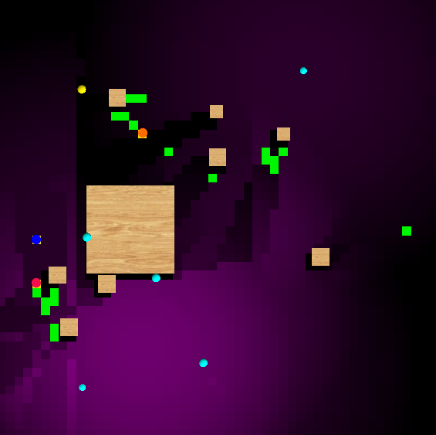
Strategy Game : Result
Enemies pinned down marked as yellow dots.
Players marked as different color dots.
Damage Map changes as enemies pinned down.
Takes 13 steps
Total damage: 91.18386

Slide 55
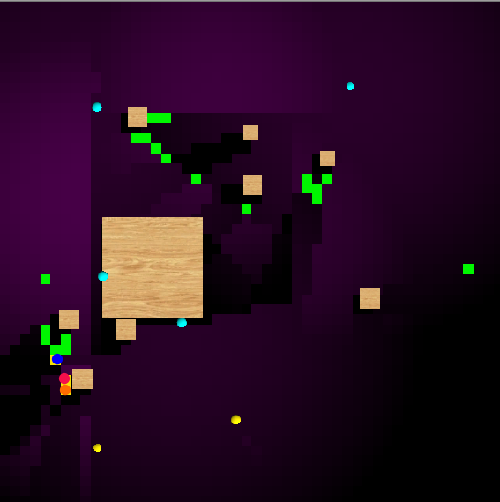
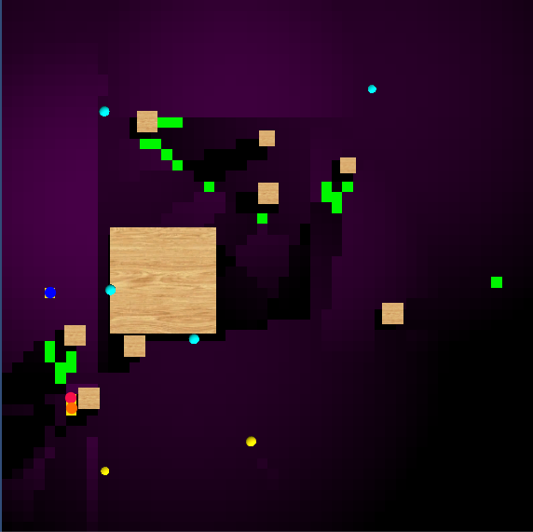
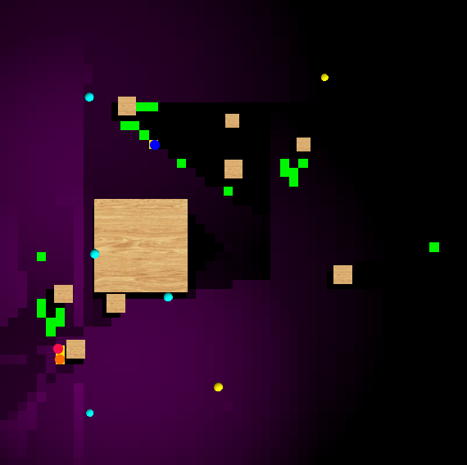
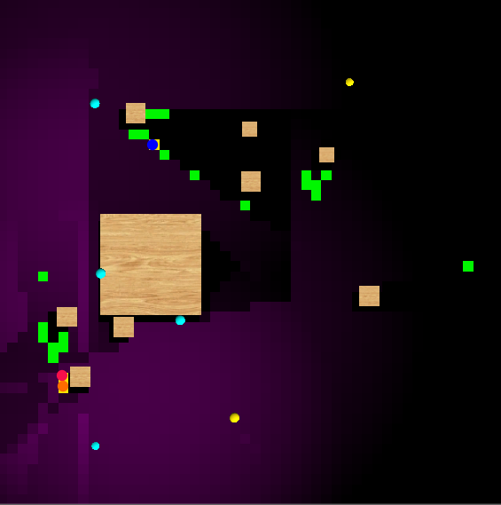
Strategy Game : Evaluation
Greedy method
Always go to next best location
May lead to dead situation
Blue squad member
Takes too many steps
Step 73 – 76 on show
Takes more than 1000 steps

Slide 56
Strategy Game : Conclusion
Conclusion
Model Squad behavior of taking covers and suppressing enemies
Use cover graph and cover state graph to formulate the problem
Deterministic algorithm guarantees the global optimal

Slide 57
Strategy Game : Optimal Squad Movement
Heuristic Function
$h\left(S_{i}\right)=\sum_{k=1}^{n}{MinimalCostToExit\left(c_{i_{k}}, G\right)}$ $(∀i, 1≤k≤n, c_{i_{k}}∈S_{i})$
Estimate the cost of each member move to exit.

Slide 58
Strategy Game : Estimate Heuristic
Form a new graph $G^{∗}$ the same as cover graph $G$
Assume the rest squad always suppress the strongest enemies
Replace edge weight with maximum suppression fire.
$MinimalCostToExit\left(c_{i_{k}}, G\right)$
Find shortest path $c_{i_{k}}→exit$
Guarantee to be admissive
Cost $edge(6,14)≤$ any edge in $G_{1}$ involves transit from 6 to 14

