Slide 1
Games and Animation
Occlusion Culling
CSE 3541
Prof. Roger Crawfis

Slide 2
Culling Problem
Hardware will clip against view frustum
Hardware will optionally perform backface culling.
Hardware will do z-Buffer test for each fragment
500,000+ triangles to test
  Need to be transformed to the camera space first.
10+ million fragments to test
  Hardware has a hyper-Z technology

Slide 3
Higher-level Culling
Makes no sense to even send to the hardware the interior of a building with no windows if the player is outside. Many other use cases.
Higher-level culling is typically use case specific.
  Game Engine pre-processing
  Game Engine runtime
  Application (aka you the programmer) specific

Slide 4
Culling examples
view frustum
detail
backface
portal
occlusion

Slide 5
Culling Techniques
“To cull” means “to select from group”
In graphics context: do not process data that will not contribute to the final image
The “group” is the entire scene, and the selection is a subset of the scene that we do not consider to contribute to the final image.
Notes:
If you look up the word CULL in a DICTIONARY...
What’s it all about: do NOT send geometry through the pipeline if it does not contribute to the final image
Reason: Z-buffer is NOT very smart -- every pixel can be unnecessarily overdrawn several times

Slide 6
View-Frustum Culling
Remove objects that are outside the viewing frustum
Construct bounding
volumes (BVs)
Create hierarchy
BV/V-F intersection
tests
Mostly done in “Application Stage”

Slide 7
View-Frustum Culling
Culling against bounding volumes to save time
Bounding volumes – AABB, OBB, Spheres, etc. – easy to compute, as tight as possible
AABB
Sphere
OBB

Slide 8
View-Frustum Culling
Often done hierarchically to save time
In-order, top-down
traversal and test

Slide 9
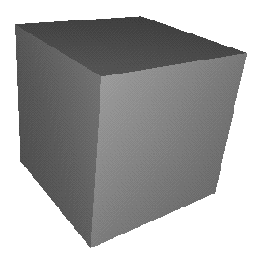
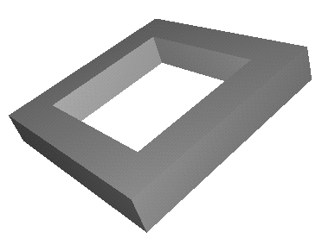
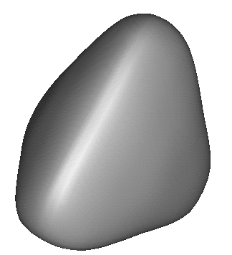
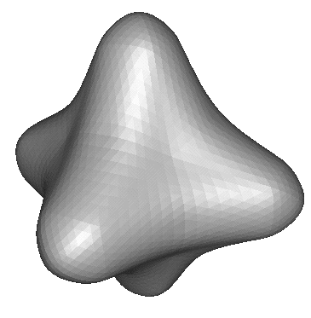
Hierarchical View Frustum Culling
root
camera
Notes:
Assuming that testing a sphere against the view frustum is cheaper than rendering the object

Slide 10
View-Frustum Culling
Hierarchical spatial subdivision – BSP Tree and Octree
Axis-Aligned BSP
Polygon-Aligned BSP
Intersecting?

Slide 11
View-Frustum Culling
Octree
A parent has 8 children
Subdivide the space until the
number of primitives within
each leaf node is less than a
threshold
In-order, top-down traversal

Slide 12
Cells and Portals
  [Airey90, Teller91, Luebke95]

Slide 13
Cells and Portals
For each cell, create a list (set) of potentially visible objects (or PVS) from any viewpoint in the cell.
During run-time:
  Determine cell of the current eye-point and gets its PVS.
  Cull down this list by clipping to the viewing frustum.
  Render this set.

Slide 14
Determining the PVS
Two options:
  Static (preprocessing stage)
    Cell-to-cell visibility
    Cell-to-region visibility
    Cell-to-object visibility
    Leads to very large and complicated data structures.
  Dynamic (dependent on the viewing frustum)
    Eye-to-cell
    Eye-to-region
    Eye-object

Slide 15
Cells and Portals
Decompose space into convex cells
For each cell, identify its boundary edges into two sets: opaque or portal
Pre-compute visibility among cells
During viewing (e.g., walkthrough phase), use the pre-computed potentially visible polygon set (PVS) of each cell to speed-up rendering

Slide 16
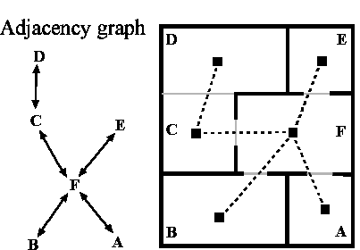
Determining Adjacent Information

Slide 17
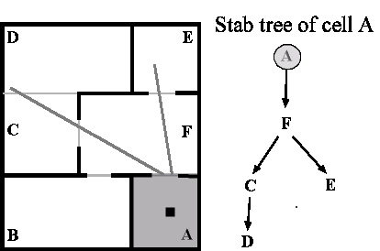
Cell-to-Cell Visibility
For Each Cell Find Stabbing Tree

Slide 18
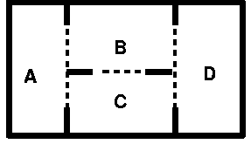
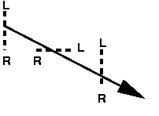
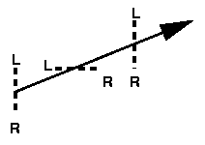
Determine Visible Cells
S•L ≥ 0, ∀ L ∈ L
S•R ≤ 0, ∀ R ∈ R
Linear programming problem:
Find_Visible_Cells(cell C, portal sequence P, visible cell set V)
V=V ∪ C
for each neighbor N of C
for each portal p connecting C and N
orient p from C to N
P’ = P concatenate p
if Stabbing_Line(P’) exists then
Find_Visible_Cells (N, P’, V)

Slide 19
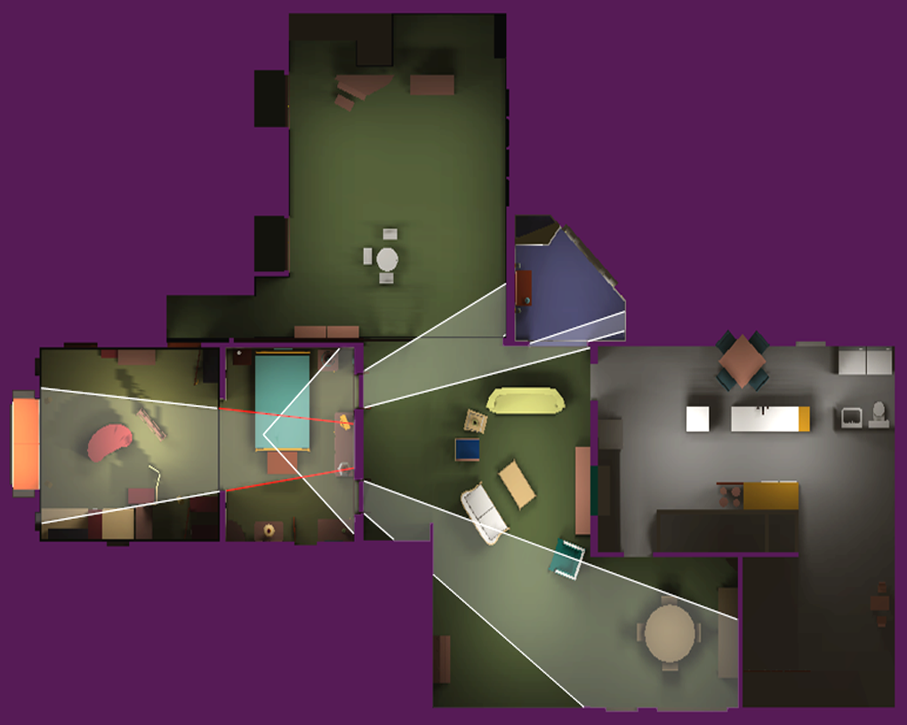
Top View Showing the Recursive Clipping of the View Volume

Slide 20
Replacing Geometry with Images
Algorithm
  Select subset of model
  Create image of the subset
  Cull subset and replace with image
Why?
  Image displayed in (approx.) constant time
  Image reused for several frames

Slide 21
Portal Images
  [Aliaga97]

Slide 22
Creating Portal Images
Ideal portal image would be one sampled from the current eye position
portal
eye

Slide 23
Creating Portal Images
Reference COPs
Display one of a large number of pre-computed images (~120)
portal

Slide 24
Creating Portal Images
Reference COPs
or…
Warp one of a much smaller number of reference images
portal

Slide 25
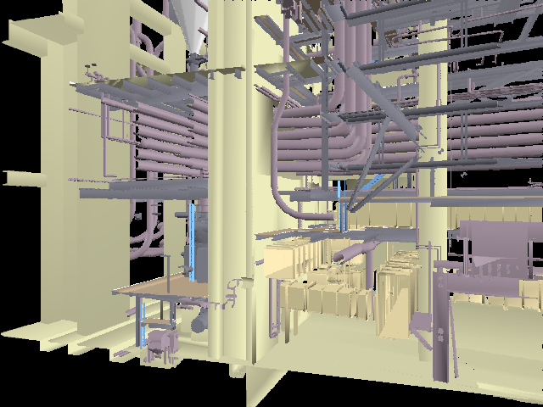
Example Rendering
Geometry
+ =
Final Scene
Image

Slide 26
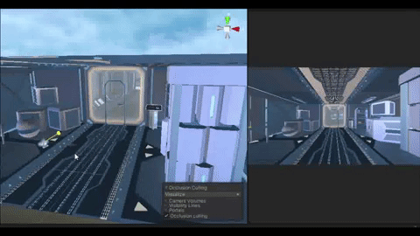
Unity Occlusion Culling
Unity can bake occlusion culling in your static scene.
Seems to use an Octree
https://taiebchaabini.medium.com/how-ive-optimized-my-first-vr-game-prototype-on-unity-4be50aa6146c

Slide 27

Unity Cell and Portal

