Slide 1
Procedural Content Noise
CSE 5559
Prof. Roger Crawfis

Slide 2
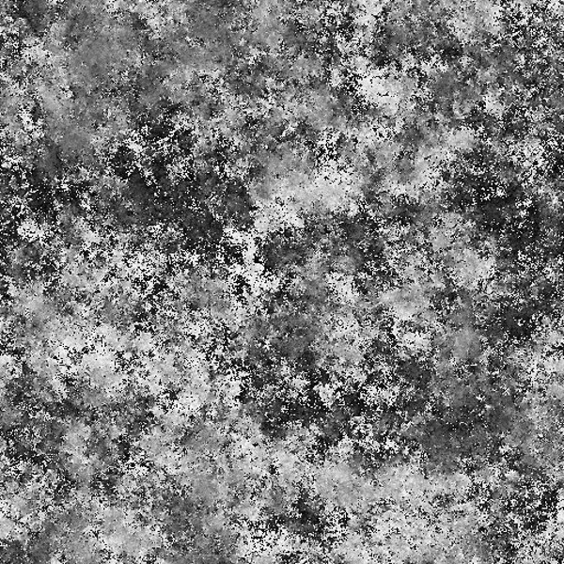
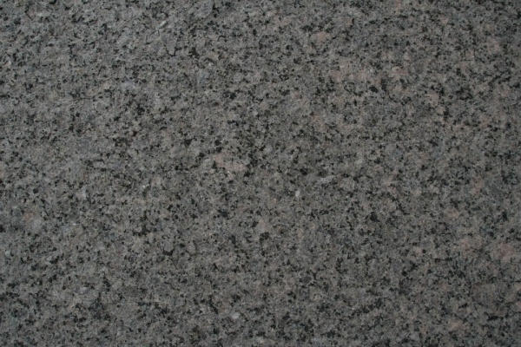
What is Noise?
https://www.freecreatives.com/textures/noise-texture.html

Slide 3
Colors of Noise
Color is defined by a frequency or wavelength.
Almost all colors are a spectrum of frequencies.

Slide 4
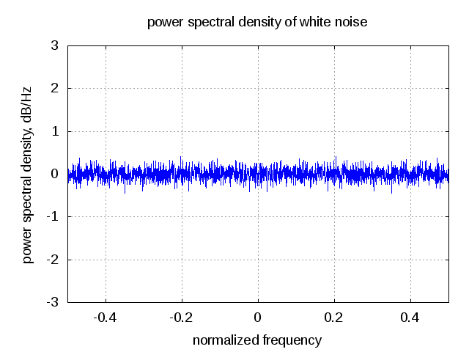
White Noise
All possible frequencies (of spacing)
Pure random

Slide 5
White Noise
White noise threshold > 0.3
Fourier Transform
Blurred
Some images from http://momentsingraphics.de/BlueNoise.html

Slide 6
Problems with White Noise
Tiled White Noise
Repeating due to low frequencies
In many cases, we do not want all frequencies.
Only lower frequencies, no high frequencies
Only specific frequencies, no high and no low.
Aliasing
(randomness)

Slide 7
Pink Noise
Used in audio
Pink Noise

Slide 8
Blue Noise
Band Limited
Fourier Transform

Slide 9
Blue Noise
Tiled
Threshold > 0.3
Blurred

Slide 10
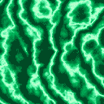
Perlin Noise
Named for its creator, this guy, Ken Perlin.
It’s a great way to make smooth, natural
noise which can be used to create terrain,
cloud patterns, wood grain, and more!
Many variants and tweaks over the years: Value Noise, Simplified Perlin Noise
Based on: http://graphics.cs.cmu.edu/nsp/course/15-462/Fall07/462/lectures/nov20a.ppt

Slide 11
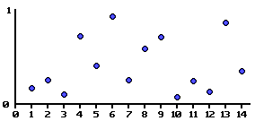
What is noise?
Randomness
e.g. From 0 to 14 take a random number between 0 and 1
By itself, it is jagged and not useful

Slide 12
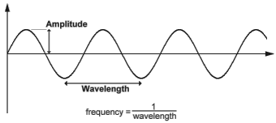
Wave Functions

Slide 13
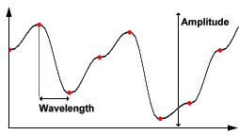
Wave Functions

Slide 14
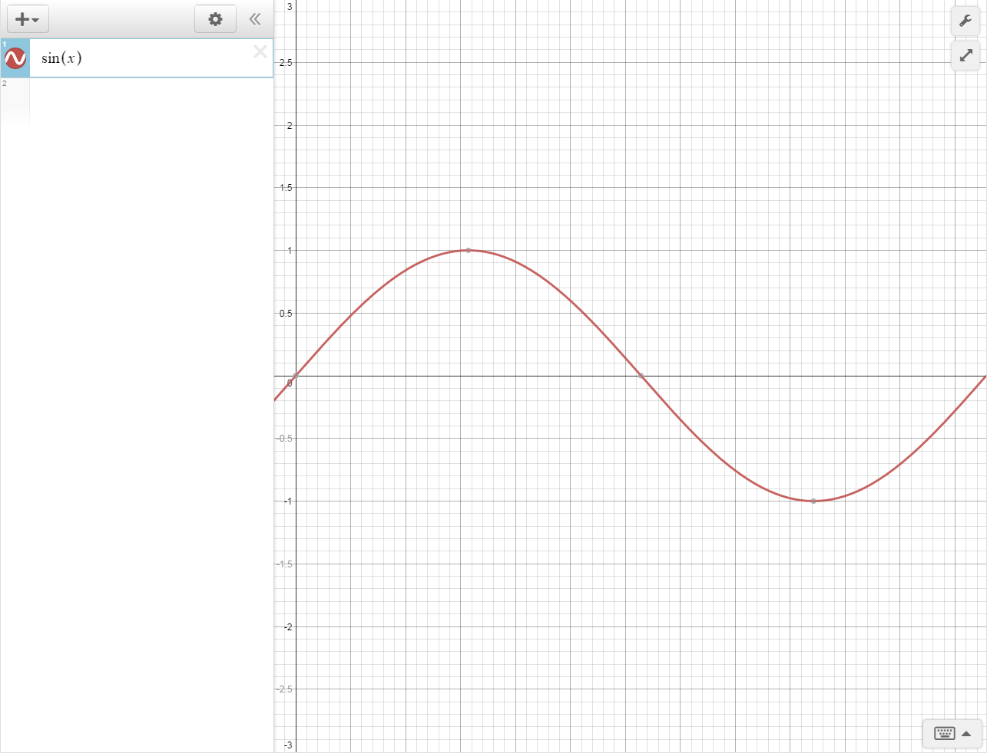
Wave Functions

Slide 15
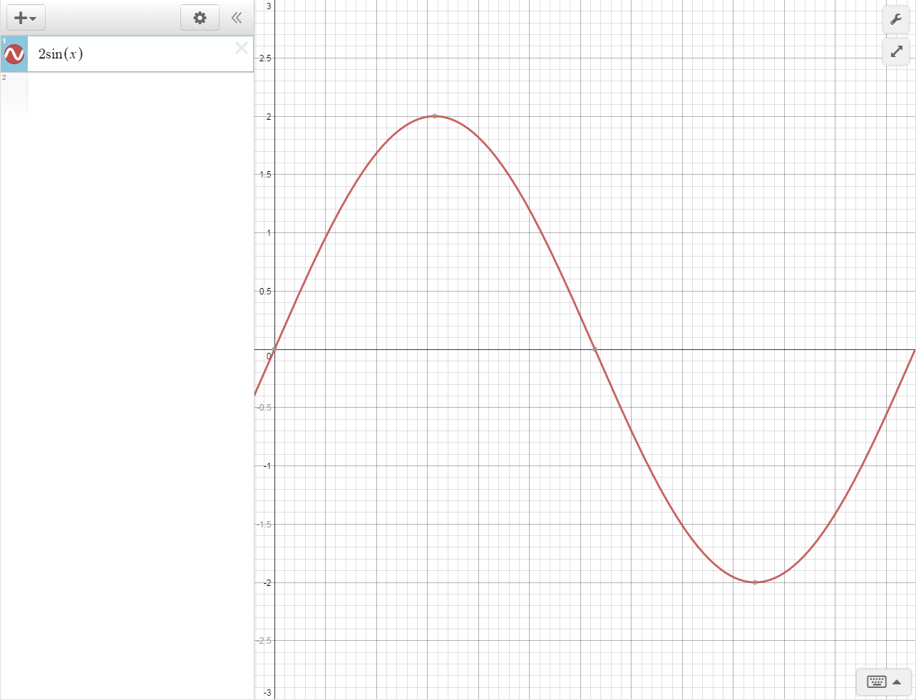
Wave Functions

Slide 16
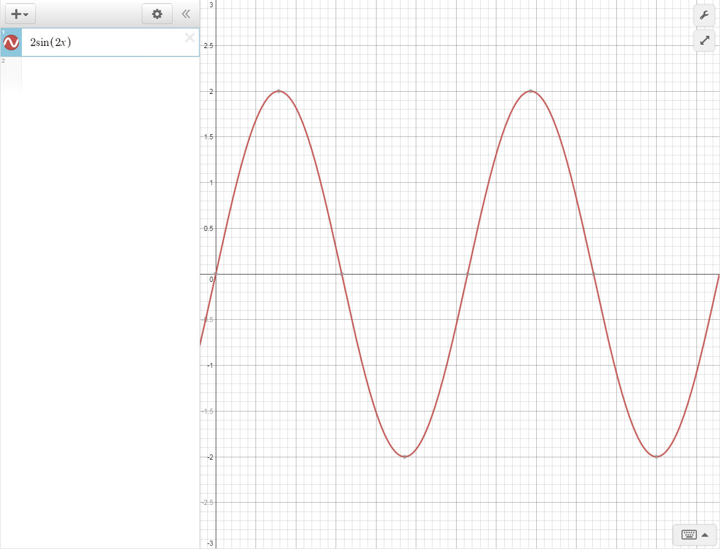
Wave Functions

Slide 17
Wave Functions
For sin(x) we can change the amplitude and frequency using:
amplitude * sin( frequency * x)

Slide 18
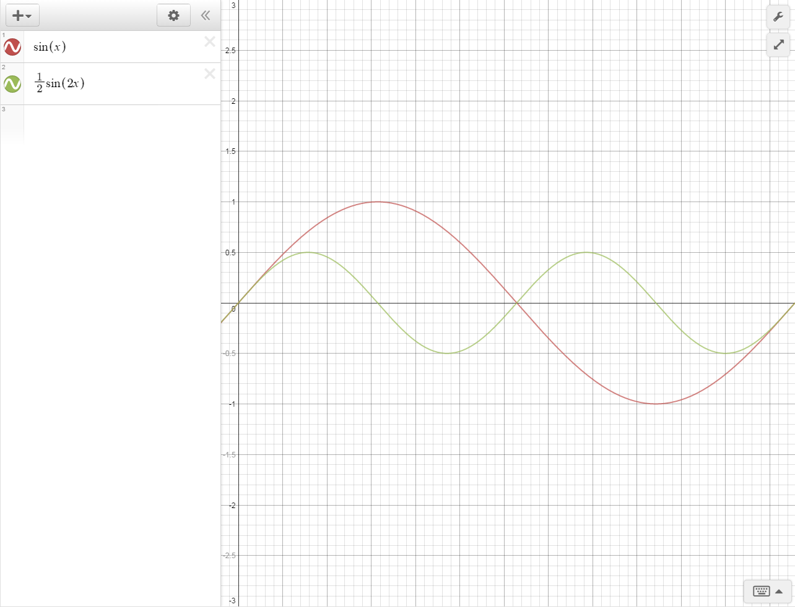
Adding Wave Functions

Slide 19
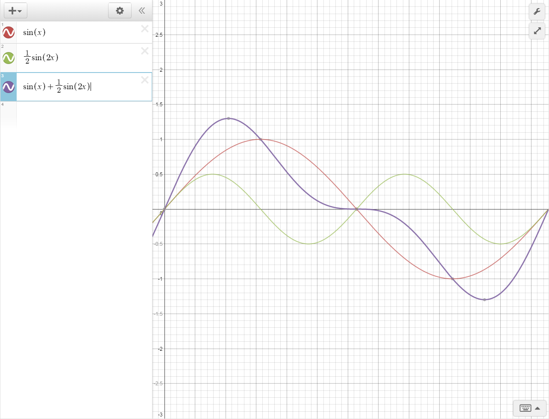
Adding Wave Functions

Slide 20
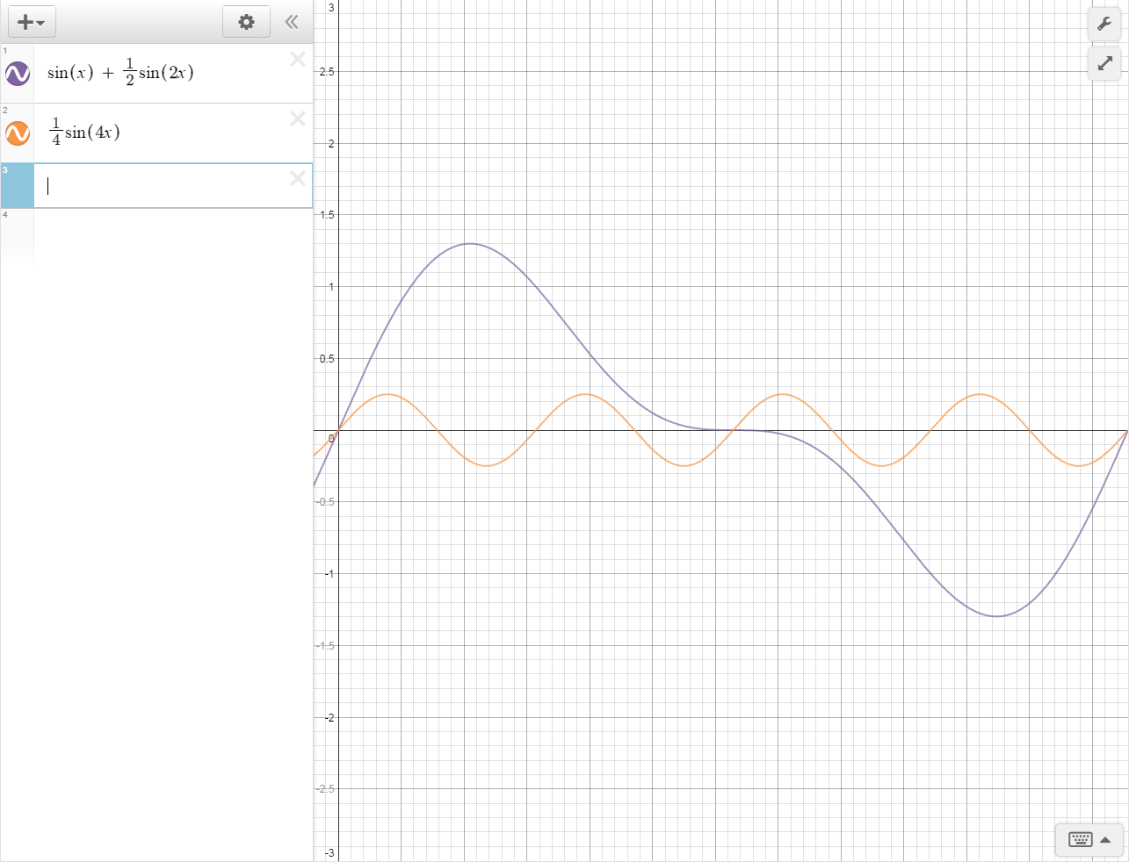
Adding Wave Functions

Slide 21
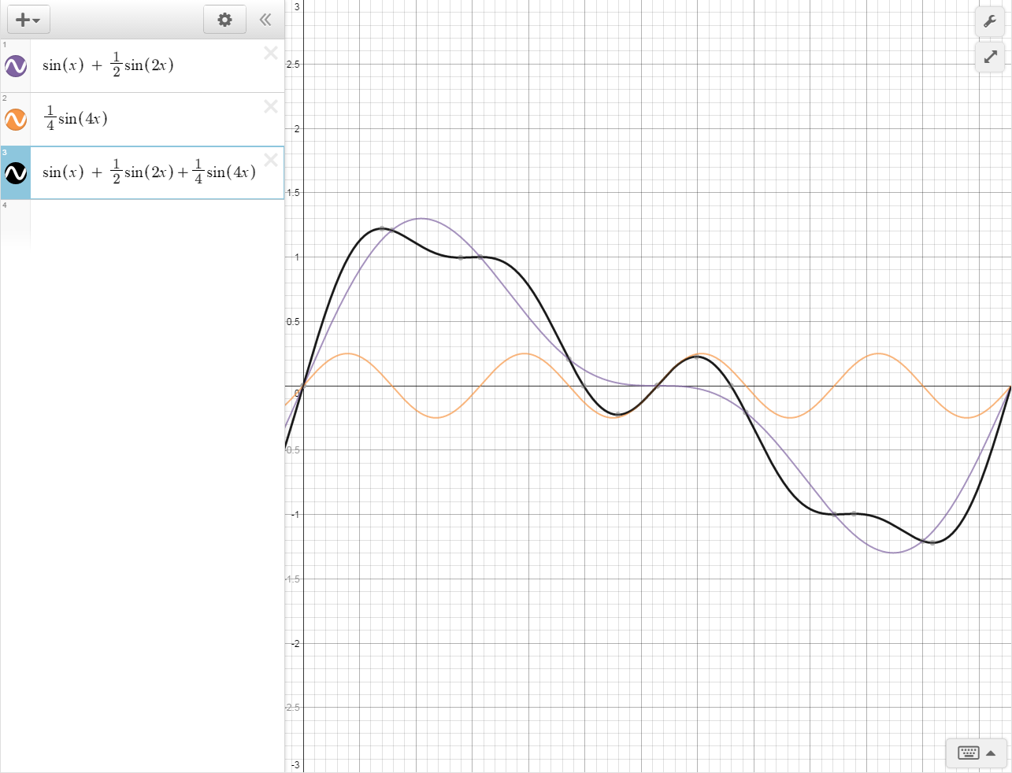
Adding Wave Functions

Slide 22
Adding Noise Functions
Freq. | 1 |  | 2 |  | 4 |  | 8
Amp. | 1 |  | ¹/₂ |  | ¹/₄ |  | ¹/₈ |  | result
Noise |  | + |  | + |  | + |  | =
A frequency of 1 means that there is a spike at every single tile, so don’t use much smaller freq’s in your algorithm!

Slide 23
Value Noise
Great, so we can add noise functions
Now we need a smooth noise function that will always return the same value given the same seed and same (x,y) pair.
Let’s focus on the smooth part first, and the randomness given a seed/(x,y) part second
Coherent noise, more useful…
Non-coherent noise, less useful…

Slide 24
Smooth Noise
Most interpolation functions take three arguments.
$a$ and $b$, the value to interpolate between.
$x$, a value between 0 and 1.
When $x$ is 0, function returns $a$
When $x$ is 1, function returns $b$

Slide 25
Smooth Noise
Option 1: linearly interpolate between points
For any $a$, $b$, and $x$ on this graph:
$$v=a∗\left(1−x\right)+(b∗x)$$
This doesn’t look so great

Slide 26
Smooth Noise
Better option: cosine interpolation
$$f=\left(1−\cos\left(x∗π\right)\right)∗.5$$
$$v=a∗\left(1−f\right)+\left(b∗f\right)$$
Looks much better
Slightly slower, but worth it for the results

Slide 27
Perlin Noise
Gradient Noise
Unity Project (FastNoise)
Demos https://academo.org/demos/perlin-noise/ http://kitfox.com/projects/perlinNoiseMaker/ https://www.redblobgames.com/maps/terrain-from-noise/

Slide 28
Procedural Textures Using Tilings With Perlin Noise
Maung, David, Shi, Yinxuan, and Crawfis, Roger
Department of Computer Science
The Ohio State University
Ohio, USA
Slides from the talk: Maung, D.; Shi, Y.; Crawfis, R.; Procedural Textures Using Tilings With Perlin Noise, Computer Games (CGAMES), 2012 17th International Conference on , 30 July-2 Aug 2012.

Slide 29
Background – Seamless Tiles
G(x, y) = (
F(x, y) * (w - x) * (h - y) +
F(x - w, y) * (x) * (h - y) +
F(x - w, y - h) * (x) * (y) +
F(x, y - h) * (w - x) * (y)
) / (w*h)
w
y
h
x

Slide 30
Example Texture Using a Seamless Tile
A repetitive pattern can be seen even though the tile is seamless.
The noise is blurred due to the averaging effect of equation 1.

Slide 31
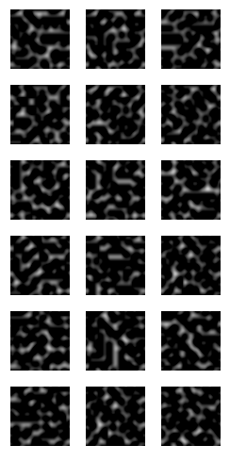
Use a Set of Tiles Instead of One Tile
A set of 18 Wang Tiles consisting of 3 possible edge colors.
For each combination of top color and left color, there are two tiles.
This allows us to construct a non-periodic tiling.

Slide 32
Constructing a Tiling
An example of tiling a plane from top-left to bottom-right
Each time we add a new tile, we can make a random choice

Slide 33
Constructing Tiles With Perlin Noise
Perlin Noise is generated using a set of random gradient values specified on an integer lattice.
For any given point$\left(x, y\right)$in$ℝ^{2}$, Perlin Noise is a bi-quintic interpolation between the gradients at the four surrounding integer lattice points.

Slide 34
Local Influence of Integer Lattice Gradients
Each gradient affects the noise in a region ±1 unit in the x and y directions.
x
y

Slide 35
Seamlessly Tiling Perlin Noise
Two tiles with their underlying integer lattice.
If the single gradients along an edge match, the tiles will tile seamlessly
Matching Edge Colors

Slide 36
Constructing the Tile Set
The integer lattice for one tile. Each gradient is represented by a single byte value.
The four corners are the same.
The set of numbers along each edge represent an edge color.

Slide 37
Turbulence
Use a modified turbulence equation
$$Turbulence\left(point\right)= \sum_{i−1}^{n}{\frac{{Noise}_{λ_{i}}(point)}{2^{i}}}$$
$λ_{i}$ represents a new set of gradients for each band of noise.
Use mipmaps to store the gradients for turbulence.
$$λ_{0}$$
x
y
$$λ_{1}$$
x
y
$$λ_{2}$$
x
y

Slide 38
Varying Frequencies
Mipmap levels represent a doubling in frequency.
Linear interpolate between noise generated at two mipmap levels.
Use Log₂(frequency)
Noise(x,y,f)
$$2^{2}$$
x
y
$$2^{3}$$
x
y
$$2^{4}$$
x
Frequency

Slide 39
A Perlin Noise Tiling
(movie of continuous tiling)
(fade in outline of tiles in gold)
(fade out outline of tiles)

Slide 40
A Turbulence Tiling
(movie of continuous turbulence tiling)
(fade in tile outline in gold)
(fade out tile outline)

Slide 41
Varying Frequency Tiling
(movie of maze with varying frequency noise on floor. Marble walls, wood roof)

Slide 42
Other Noises
Wavelet
Fourier?
Simplicial

Slide 43
Poisson Point Sampling

