Slide 1
Procedural Content Mazes to Tilings
Prof. Roger Crawfis
Crawfis Software
The Ohio State University

Slide 2
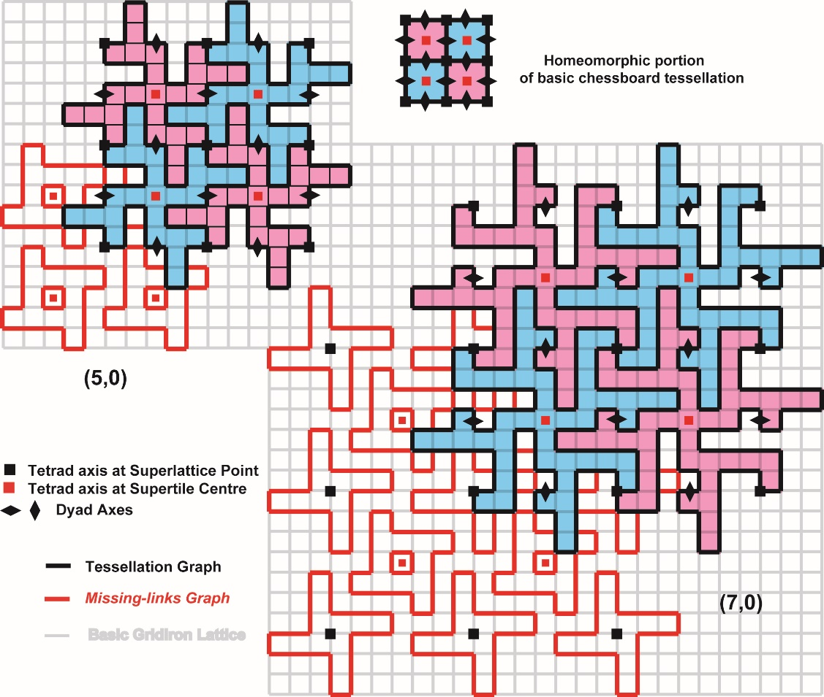
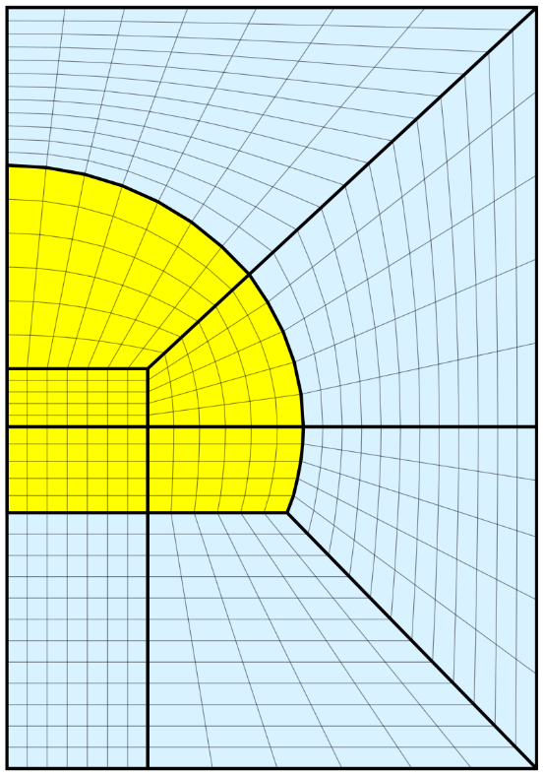
Think Abstractly
A maze is still a mathematically abstract concept.
A graph
No spatial layout
Even if defined on a regular grid.
https://latticelabyrinths.wordpress.com/category/japanese-labyrinths/
https://en.wikipedia.org/wiki/Regular_grid

Slide 3
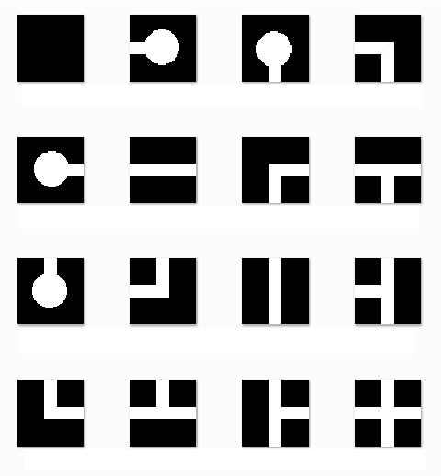
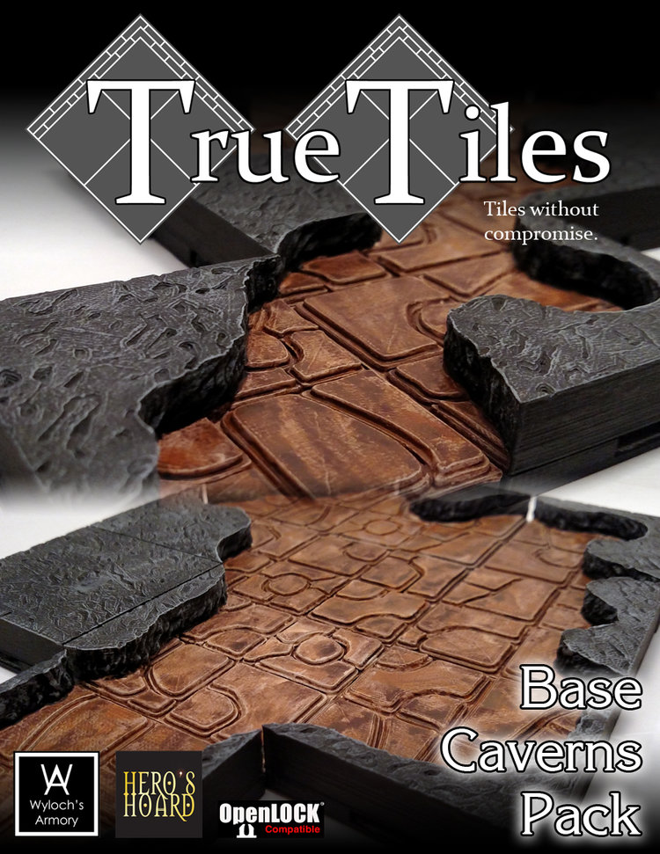
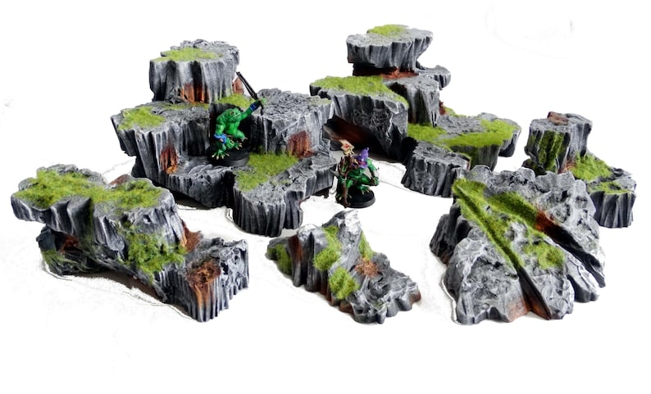
Regular Tiling
Easiest graph embedding is a regular tiling.
16 abstract tiles – 4 edges w/2 choices
No weaves
N concrete tiles
N_{i} per abstract tile

Slide 4
Regular Tiling
Do not need all 16. Since neighbor is consist, only need say the left and top edges. Four abstract tiles.
Avoids some double walls.
Need to close the bottom and right edges.
Open
Open
Closed
Closed
Closed
Open
Open
Closed

Slide 5
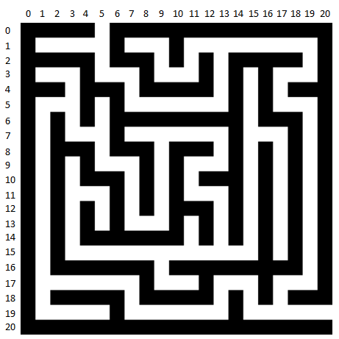
Occupancy Grid
Can simplify further by embedding the maze into a larger occupancy grid
Path => white (true)
Wall / Blocked => black (false)
Geometry for both, only walls or only the path

Slide 6
Path Tiles
Only Path tiles
“Walls” are the abys

Slide 7
Wall Tiles
Floor is continuous underneath the overall maze.

Slide 8
Occupancy Grid
Given a Maze expand it to an occupancy graph.
Grid<Direction> goes to Grid<bool> of a larger size.
Grid<T> is a generic wrapper for a 2D array T[,]
4 by 5 occupancy grid

Slide 9
Occupancy Grid
Example: Direction = West | North
3x3 construction – option1
Set all 9 spaces to false – default, so can be a no-op
If direction <> blank than set middle to true;
For each direction, if true set corresponding opening location to true;
Direction = West | North

Slide 10
Occupancy Grid
Example: Direction = West | North
3x3 construction – option2
Set all 9 spaces to true
If direction == blank than set middle to false;
For each direction, if false set entire edge to false;
Direction = West | North

Slide 11
Occupancy Grid – 2x2
Only top and left edges – 3 (4) templates / tiles
Some choices
No difference between these top 2?
More Open
or
Always black
2 by 2 occupancy grid

Slide 12
Occupancy Grid – 2x2
4 tiles hallway style
Direction.Blank
Direction.West
Direction.North
Direction.West | Direction.North

Slide 13
Occupancy Grid – 2x2
4 tiles hallway style
Direction.Blank
Direction.West
Direction.North
Direction.West | Direction.North

Slide 14
Software Design
Rather than directly going from a Maze cell to a 3x3, 2x2, or NxM set of cells in an occupancy grid
Create a tile generator that produces 16 (or more) occupancy grid masks or stamps (aka small Grid<bool>’s)
Create a master convertor that stamps in these masks for each maze cell.
Input: Maze NxM
Input: Dictionary<Direction,Grid<bool>> of stamps
Output: Grid<bool> of size S_{i}N x S_{j}M, where S_{i}, S_{j} stamp size.
Could do int’s if you need more control: corner, clutter, spawn location, …

Slide 15
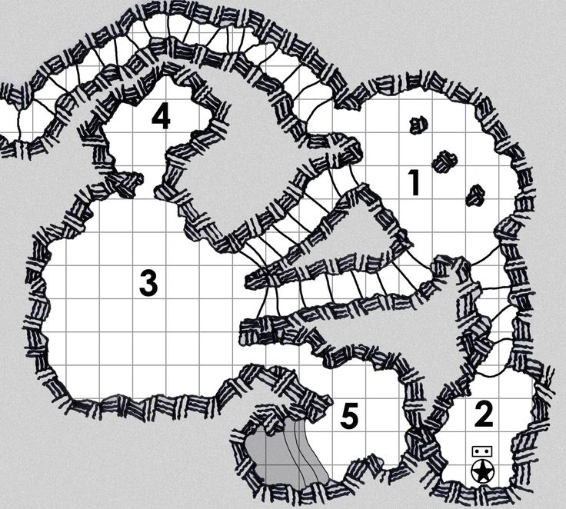
Maze Cell, Grid Cell
A maze cell may be a maze!
Image on the right shows a Dead-end cell
A grid cell may be grid.
Grid<bool> => Grid<bool>

Slide 16
Algorithm – Abstract part
Create a Maze which contains a Grid<Direction>
Create a set of tiles which are represented as Grid<Direction>
at least one for each Direction value.
Must all be the same size
Create a Grid<bool> that represents the occupancy graph.

Slide 17
Algorithm – Level Generation
Create a prefab or prefabs for the true values (path)
Create a prefab or prefabs for the false values (or allow nulls below)
Determine size of these prefabs (they should be consistent)
Determine positions for each grid cell
Create models (prefabs) for each position based on the Grid<bool> values.

Slide 18
Data Flow Diagram
Maze Width and Height
Create Prefabs
Create Maze
Create Occupancy Grid
Determine prefab positions
Create Tileset
Stamp size, other params
Create Prefabs

Slide 19
Questions?

