Slide 1
Maze Generation Algorithms
The Ohio State University
Roger Crawfis

Slide 2
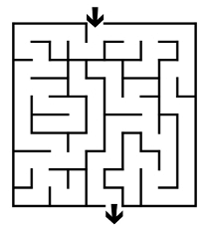
What is Maze?
Puzzle
Simple Goal
Find a path from an entrance to a goal
Maze is also used as a tool in various fields

Slide 3
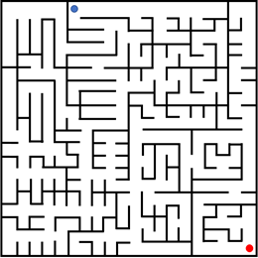
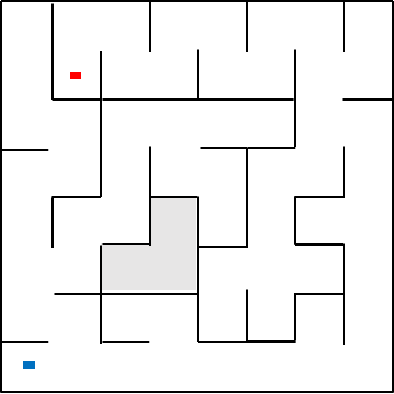
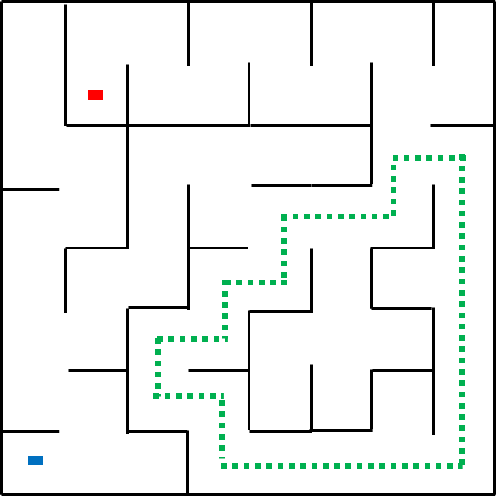
Perfect Maze Definition
Example: Rectangular Perfect Maze
No Loops
No Inaccessible Areas

Slide 4
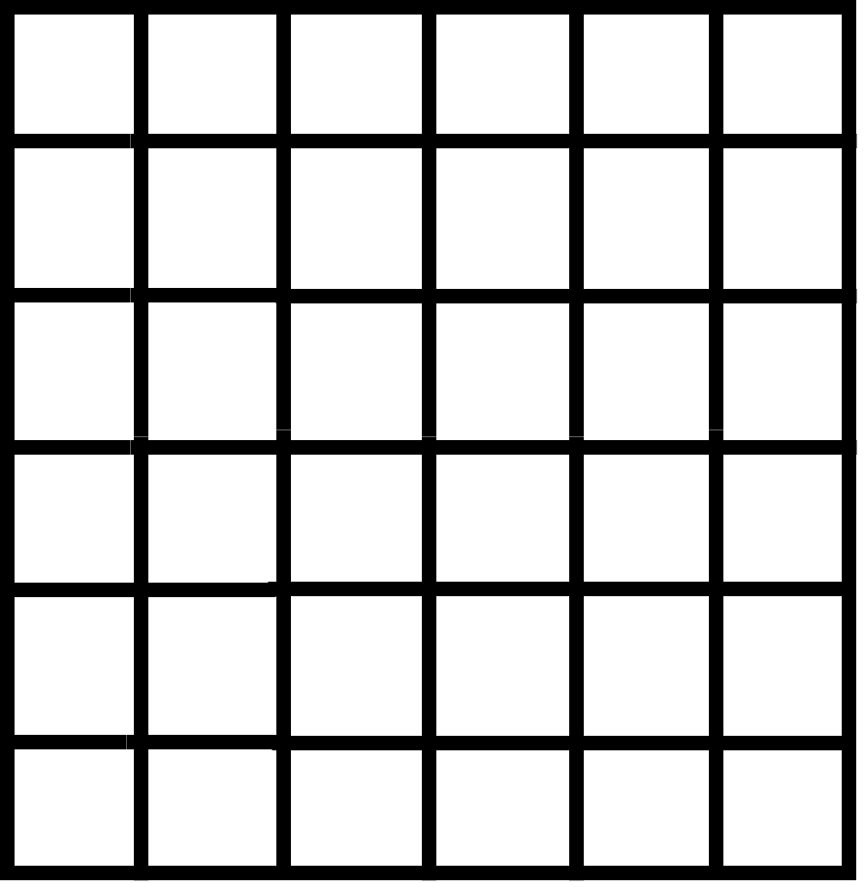
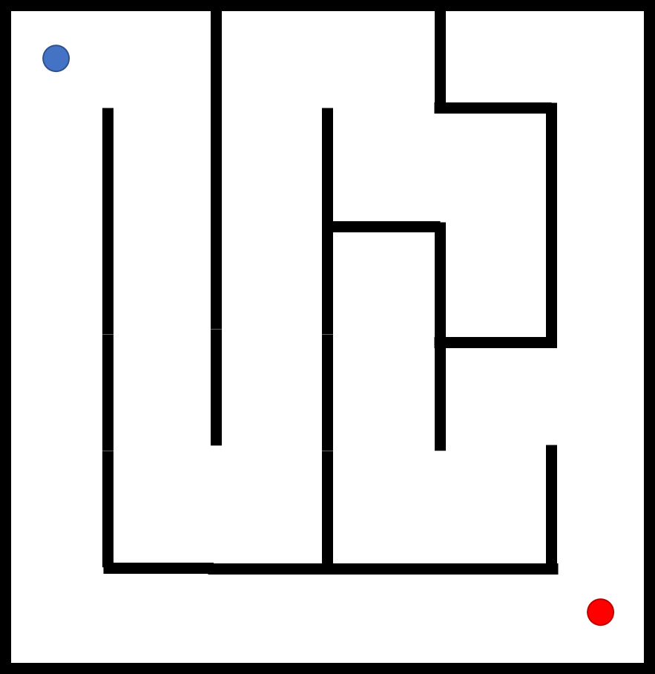
Perfect Maze Definition
Rectangular Perfect Maze
Build on Rectangle Cells of Regular Grid
Cells’ Boundaries → Walls
Only Vertical and Horizontal Walls
6x6 Grid

Slide 5
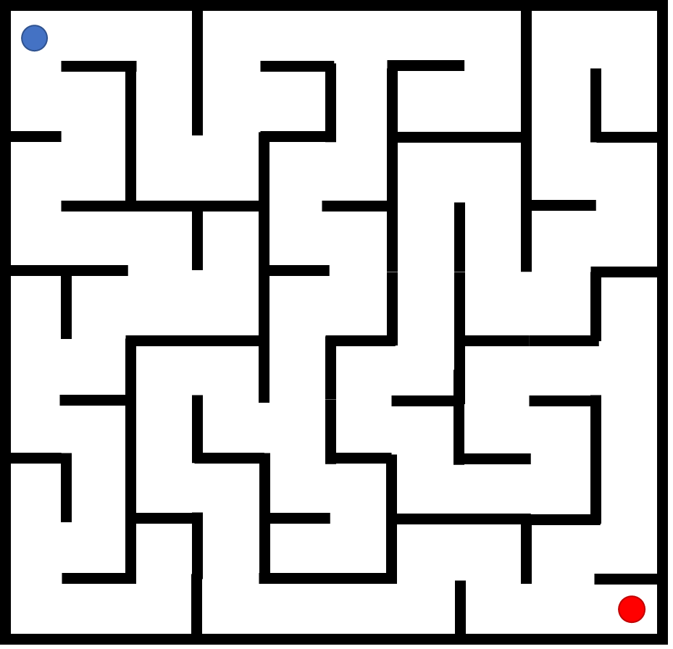
Perfect Maze Definition
Start Point & End Point

Slide 6
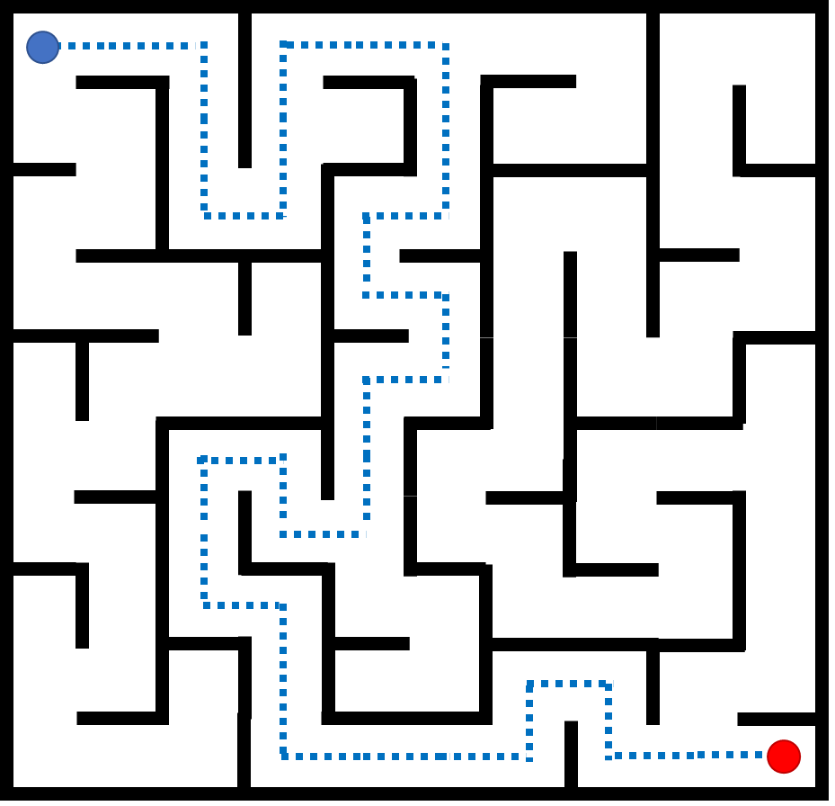
Perfect Maze Definitions
Solution Path
Notes:
Let’s look at the perfect maze more

Slide 7
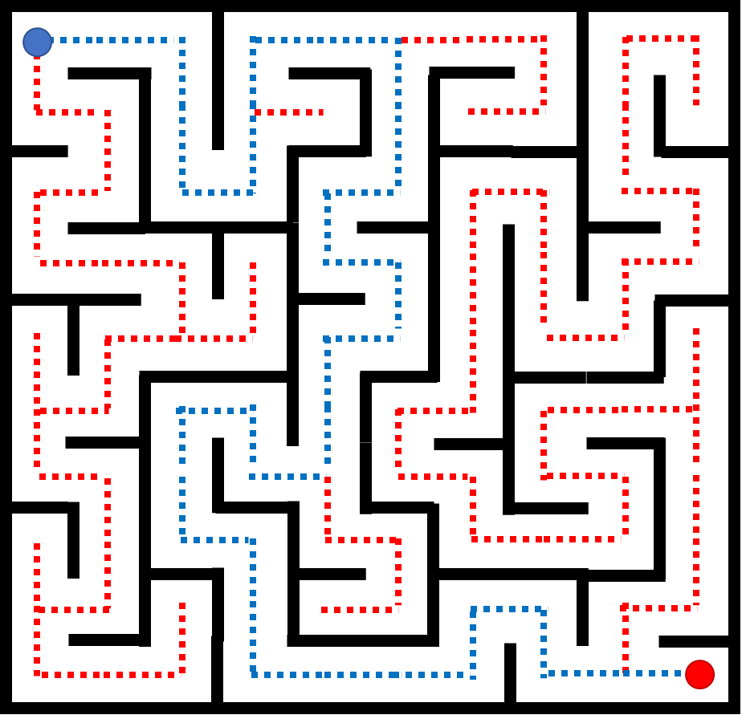
Perfect Maze Definition
Dead-End Trees

Slide 8
Perfect Maze Definition
Maze Cell of Perfect Maze
North 0b0x00
West 0bx000
Cell
East 0b00x0
South 0b000x
Or Left, Top, Right, Bottom

Slide 9
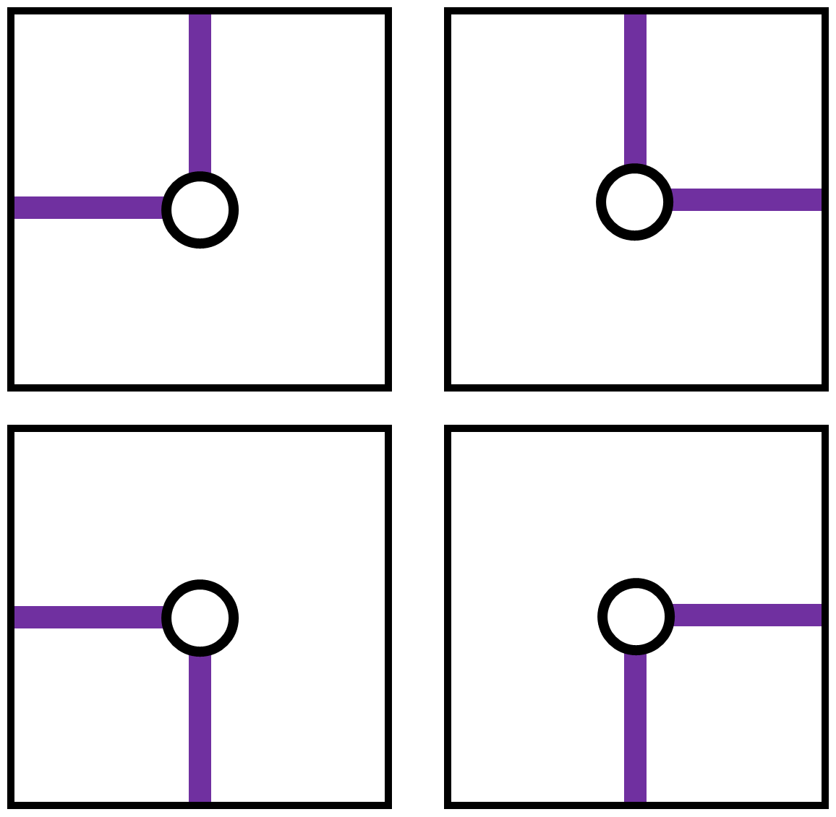
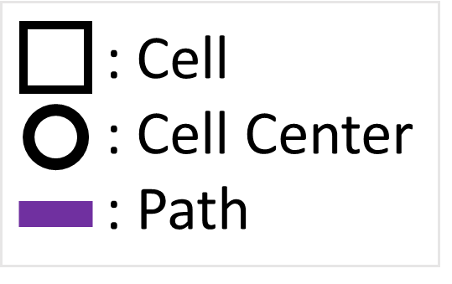
Perfect Maze Definition
Maze Cell of Perfect Maze
Turns
1100 0110
1001 0011

Slide 10
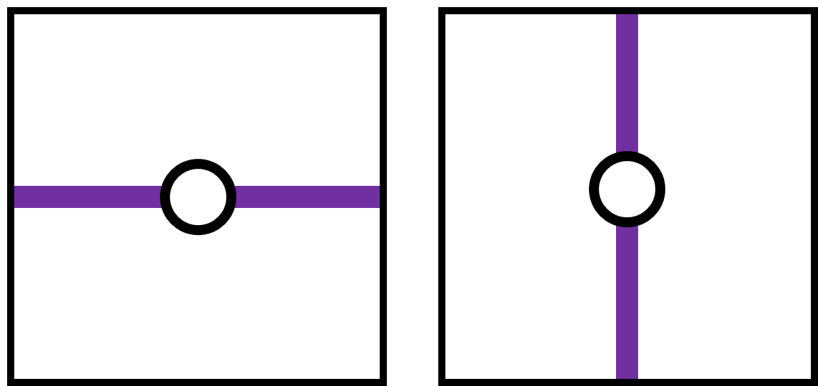
Perfect Maze Definition
Maze Cell of Perfect Maze
Turn
Straight
Horizontal (1010)
Vertical (0101)

Slide 11
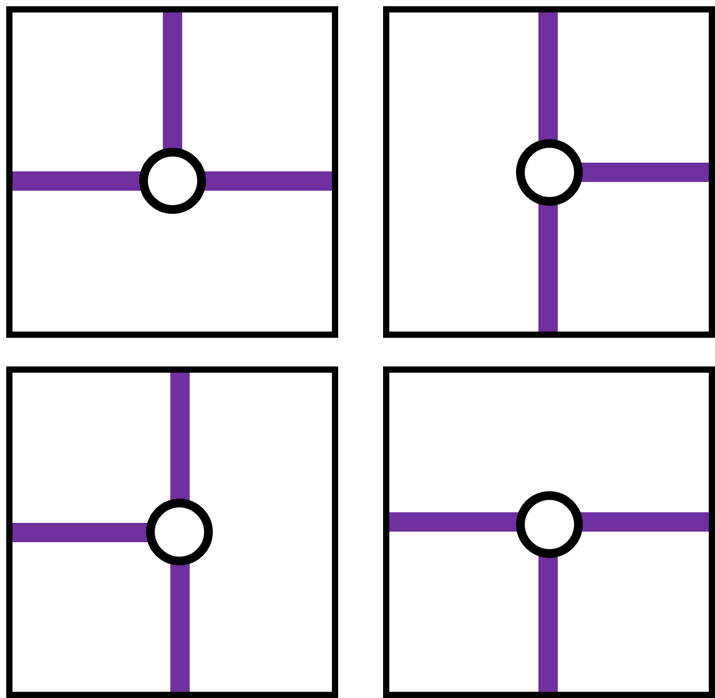
Perfect Maze Definition
Maze Cell of Perfect Maze
Turn
Straight
T-Junction
1110 0111
1101 1011

Slide 12
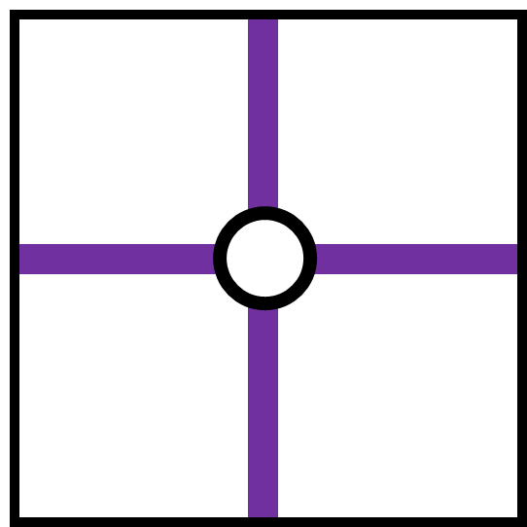
Perfect Maze Definition
Maze Cell of Perfect Maze
Turn
Straight
T-Junction
Cross-Junction
1111

Slide 13
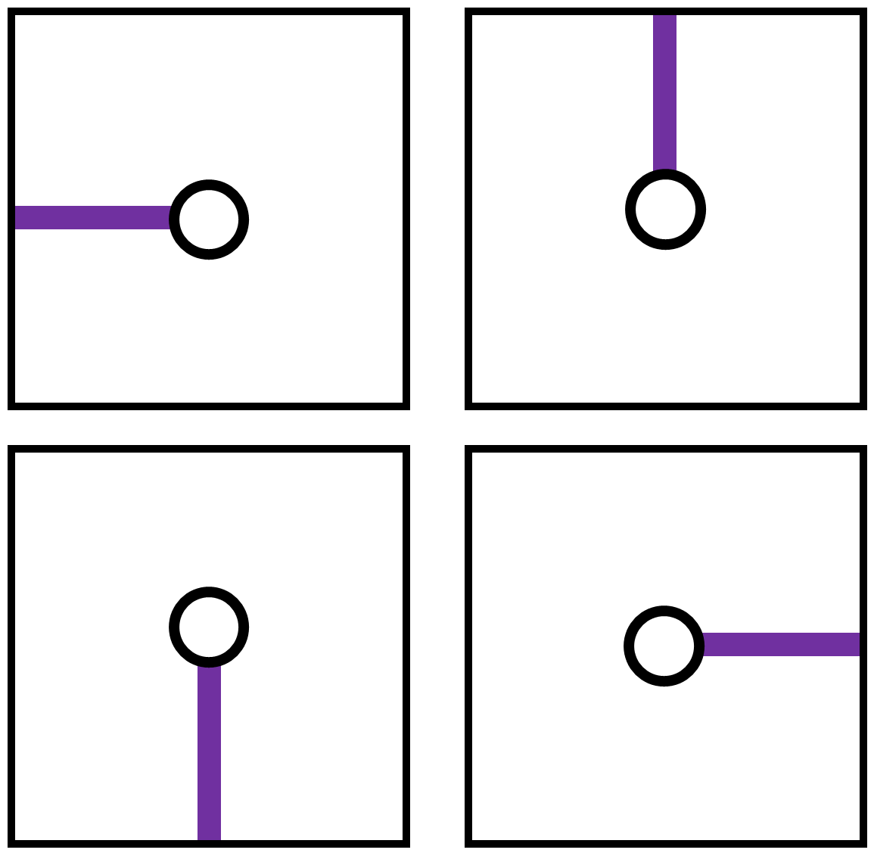
Perfect Maze Definition
Maze Cell of Perfect Maze
Turn
Straight
T-Junction
Cross-Junction
Dead-End
1000 0100
0001 0010

Slide 14
Perfect Maze Properties
All perfect mazes are minimum spanning trees (MST)
All MST’s on a grid can be thought of as a perfect maze
Add a start and end location

Slide 15
Properties of MST
On a grid (or any connected graph of N nodes)
Unique path from any node to any node.
Any node can be a start or an end and solution will exist.
There are N-1 edges in a MST
MST is a tree graph (unrooted)
Grid => at most 4 neighbors.

Slide 16
Perfect Maze Algorithms
Kruskal’s
Eller’s
Aldous-Broder
True Prim’s
Modified Prim’s
Recursive backtracking
Hunt and kill
Growing tree
Growing forest
Recursive division
Binary tree
Sidewinder
OSU Research

Slide 17
Quiz Time
First quiz in the MazeQuiz.pptx file.
Answer with Zoom poll.
Second quiz in the MazeQuiz.pptx file.
Answer with Zoom poll.
Third quiz in the MazeQuiz.pptx file.
Answer with Zoom poll.

Slide 18
Resources
All algorithms are implemented in Ruby
Comparison and other features
https://www.amazon.com/Mazes-Programmers-Twisty-Little-Passages/dp/1680500554/
Also
http://weblog.jamisbuck.org/
http://www.mazelog.com/
https://www.astrolog.org/labyrnth/algrithm.htm

Slide 19
Basic generation operations
Carve a passage
Start with all cells being walled off and add a door or passage
Most popular
Add a wall
Start with all cells being open and block a passage.

Slide 20
Binary Tree Maze Generation
Perhaps the simplest algorithm
Cell independence
Foreach cell in grid
Carve out a North or an East passage
Could be South / East or South / West or North / West instead
Can we mix directions as we go?
https://codereview.stackexchange.com/questions/227660/maze-generator-animator-in-python

Slide 21
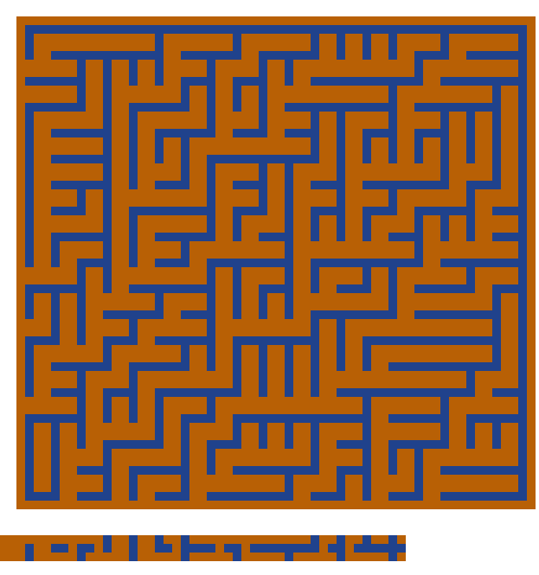
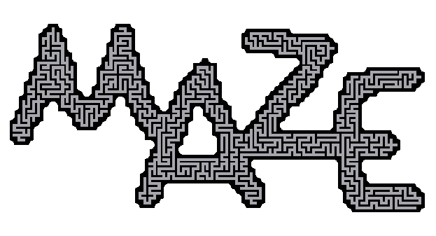
Binary Tree Maze Generation
Strong diagonal texture
Two sides are straight (top and right in image)
Difficult to mask

Slide 22
Binary Tree in C#
private void BinaryTreeMaze(bool preserveExistingCells) {
// Initial state is that all directions are zero.
const int maxRandomValue = 1000;
int threshold = (PercentHorizontal * maxRandomValue) / 100; // Favor horizontal runs
int row, column;
IndexedGraphEnumerator<N, E> graphWalker = new IndexedGraphEnumerator<N, E>(grid);
foreach (var node in graphWalker.TraverseNodes()) {
if (grid.TryGetGridLocation(node, out column, out row))
{
bool moveEast = RandomGenerator.Next(maxRandomValue) < threshold;
bool eastBorder = false;
if (column >= Width - 1) eastBorder = true;
moveEast &= !eastBorder;
bool carved = false;
if (moveEast) {
carved = CarveDirectionally(column, row, Direction.E, preserveExistingCells);
}
if (!carved && (row < (Height - 1))) {
carved = CarveDirectionally(column, row, Direction.N, preserveExistingCells);
}
if (!carved && (row == (Height - 1)) && !eastBorder) {
carved = CarveDirectionally(column, row, Direction.E, preserveExistingCells);
}
}
}
}

Slide 23
Binary Tree Correctness
Each cell is visited once
All cells except the top-right create one edge.
Top-right (North-East) has no choice. It cannot go North and cannot go East.
Hence, N*M-1 edges are added.
Every cell is either connected by its neighbor from the South or West.
Every cell connects to another either North or East.
Hence every cell has (at most) two neighbors – Binary tree.
Think more as 2 possible parents (W or S) and 1 child (N or E).

Slide 24
Path Generation w/ Binary Tree
What if we just wanted a path (as in your homework)?
Go East until you pick North.
Stop that row, go to the next row
Start the Binary Tree algorithm on the column where you picked North.
Or just randomly walk East or North.

Slide 25
Sidewinder Maze Generation
Similar to Binary Tree
Consider each row and split the row into spans
Randomly pick a cell in each span and go North
Foreach row in grid
Divide into random spans
Connect all cells within a span
Foreach span
Randomly pick a cell and carve a passage North
https://codereview.stackexchange.com/questions/227660/maze-generator-animator-in-python

Slide 26
Sidewinder Maze Generation
Strong vertical texture
Not really, can be controlled
Top row is all connected
Difficult to mask
No continuous path may exist with a mask.

Slide 27
Sidewinder Correctness
Each cell belongs to a span.
All but the last cell in the span carve a new edge.
One cell in each span carve a passage North.
Hence each row has N new edges
Top row has N-1 new edges (All East)
Hence NM-1 edges

Slide 28
Path Generation - Sidewinder
Key idea is to pick cell to go North.
Binary Tree picked the right-most of the span.
Path algorithm:
Foreach row
Pick a column
Carve to that column
Carve up
Can limit the span length to a range.
+---+---+---+---+---+
| |
+ +---+---+---+---+
| | | | |
+---+ +---+---+---+
| | | | |
+ +---+---+---+---+
| | |
+---+---+---+ +---+
| | |
+ +---+---+---+---+
| | |
+---+---+---+ +---+
| | |
+---+---+---+---+---+

Slide 29
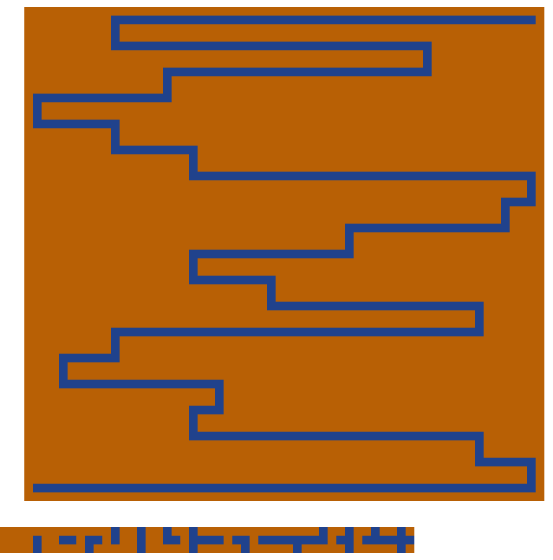
Sidewinder Path
+---+---+---+---+---+
| | | |
+---+---+ +---+---+
| | | | | |
+---+---+ +---+---+
| | | |
+ +---+---+---+---+
| | | |
+---+---+ +---+---+
| | | | |
+---+---+---+ +---+
| | | |
+---+ +---+---+---+
| | | | |
+---+---+---+---+---+
Looks like a snake !

Slide 30
Sidewinder Path
public class PathGeneratorSideWinder : MazeBuilderAbstract<int, int> {
public PathGeneratorSideWinder(int width, int height, GetGridLabel<int> nodeAccessor, GetEdgeLabel<int> edgeAccessor) : base(width, height, nodeAccessor, edgeAccessor)
{ }
public override void CreateMaze(bool preserveExistingCells = false)
{
int lastColumn = 0;
for(int row = 0; row < (Height-1); row++) {
int column = RandomGenerator.Next(Width);
CarveDirectionally(column, row, Direction.N, preserveExistingCells);
lastColumn = CarveSpan(row, lastColumn, column, preserveExistingCells);
}
CarveSpan(Height - 1, lastColumn, Width - 1, preserveExistingCells);
}

Slide 31
Sidewinder Path
private int CarveSpan(int row, int lastColumn, int column, bool preserveExistingCells) {
int start = column;
int end = lastColumn;
lastColumn = column;
if (start > end) {
start = end;
end = column;
}
for (int i = start; i < end; i++) {
CarveDirectionally(i, row, Direction.E,
preserveExistingCells);
}
return lastColumn;
}

Slide 32
Break on mazes
Slides 1 and 2 of the Class3Extras.pptx slides.

Slide 33
Row-based Methods
Summary so-far
Binary Tree – cell-based carving
Sidewinder – row-based (or span-based) carving.
Eller’s algorithm
Row-based sweeping (carve-based).

Slide 34
Eller’s Maze Generation
Slight, but significant twist on Sidewinder
Treat each span as a set and keep track of sets as we go row to row.
Allow multiple passages from a set to the next row.
For each row, any unvisited cells are put in their own set.
A span would be a merge between two sets on a row.
Merge only if in different sets.

Slide 35
Eller’s Maze Generation
Interactive App
http://jpsierens.me/maze-generation/
Step 1 – put unvisited cells in a set
Current row
1
2
3
4
5

Slide 36
Eller’s Maze Generation
Step 2
Randomly merge sets
Current row
1
1
3
3
5

Slide 37
Eller’s Maze Generation
Step 3
Foreach set pick at least one cell to carve south
Add those cells to the set.
Current row
1
1
3
3
5
1
3
5

Slide 38
Eller’s Maze Generation
Step 4
Repeat for each row
Unvisited cells added to new sets
1
1
3
3
5
1
3
5
Current row
6
7

Slide 39
Eller’s Maze Generation
Step 4
Repeat for each row
Randomly merge sets
Don’t really care about this row or its sets now
1
1
3
3
5
1
1
7
Current row
6
7

Slide 40
Eller’s Maze Generation
Step 4
Repeat for each row
Pick cells to carve south and join the party
1
1
3
3
5
1
1
7
Current row
6
7
6
1
7
7

Slide 41
Eller’s Maze Generation
Continue
Okay, we care some. Might be easier to use lowest set number.
1
1
3
3
5
6
1
1
7
7
6
6
8
8
Current row
8

Slide 42
Eller’s Maze Generation
Continue
Two cells chosen.
1
1
3
3
5
6
1
1
7
7
6
6
8
8
8
6
8
8
Current row
9
10

Slide 43
Eller’s Maze Generation
Continue
Two cells chosen.
1
1
3
3
5
6
1
1
7
7
6
6
8
8
8
6
6
6
Current row
9
10

Slide 44
Eller’s Maze Generation
Continue
1
1
3
3
5
6
1
1
7
7
6
6
8
8
8
9
6
6
10
6
9
6
10
6
Current row
11

Slide 45
Eller’s Maze Generation
Last row: Merge all sets (only once)
1
1
3
3
5
Can’t merge this with the rest.
6
1
1
7
7
6
6
8
8
8
9
6
6
10
6
9
9
9
9
Current row
9

Slide 46
Eller’s Maze Generation
Final maze

Slide 47
Eller’s Maze Generation
Final row needs to merge all distinct sets so it may have a longer run.
Difficult to mask.
Infinite mazes are possible as the rows sweep.

Slide 48
Eller’s Correctness
Each cell belongs to a single set.
Each set must grow (hence no single isolation)
Only one set at the end => connected.
Like Kruskal’s MST, not allowing a passage between members of the same set prevents loops.

Slide 49
Graph-based Generation
Recall that a grid is a graph
Graph algorithms
DFS
BFS
Prim’s MST
Kruskal’s MST
DFS
Recursive Backtracking
Prim’s
True Prim’s
Simplified Prim’s
Growing Tree

Slide 50
Graph Basics
DFS and BFS are node enumerators (not really searches)
DFS => Stack (LIFO)
BFS => Queue (FIFO)
A* => Heap (Priority Queue)
Prim’s MST
Greedy Algorithm
Start w/vertex and add minimum edge
Repeat avoiding loops
Kruskal’s MST
Greedy Algorithm
Start w/ forest of single node trees
Merge forests

Slide 51
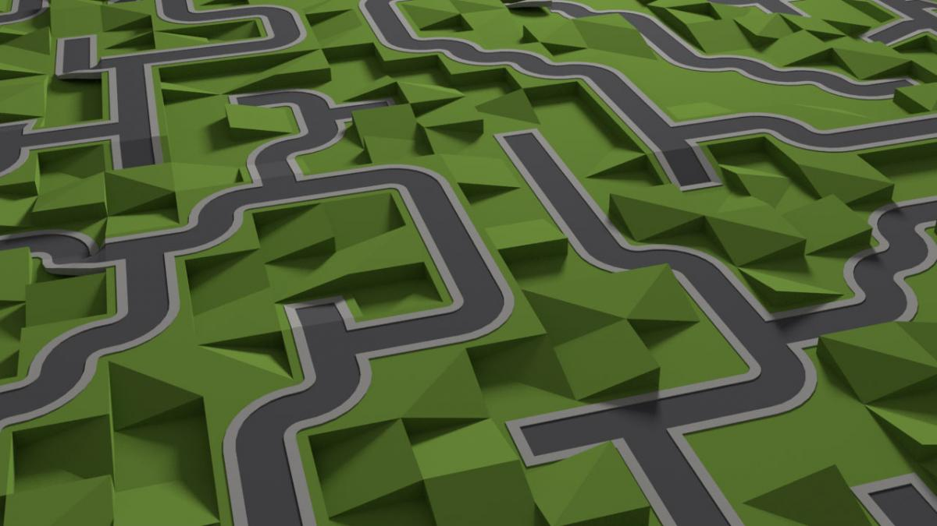
Recursive Backtracking
Really just DFS with a random decision on which child to visit first, second, etc.
Random Walk
Passage is carved if the neighbor is unvisited.
Backtrack and try a new random walk when stuck.

Slide 52
Recursive Backtracking in C#
Initialization (Could have used the Graph DFS)
private void RecursiveBackTracker(int startingNode, bool preserveExistingCells = true)
{
bool[,] visited = new bool[directions.GetLength(0), directions.GetLength(1)];
Stack<int> currentPath = new Stack<int>();
currentPath.Push(startingNode);
List<int> neighbors = new List<int>(4);

Slide 53
Recursive Backtracking in C#
while (currentPath.Count > 0)
{
int currentNode = currentPath.Peek();
neighbors.Clear();
// Select neighbors who have not been visited
foreach (int neighbor in grid.Neighbors(currentNode))
{
int row = neighbor / Width;
int column = neighbor % Width;
if (!visited[column,row])
{
neighbors.Add(neighbor);
}
} …
Get a list of available neighbors to visit

Slide 54
Recursive Backtracking in C#
bool pathCarved = false;
int nextNode = -1;
while (!pathCarved && neighbors.Count > 0)
{
int randomNeighbor = RandomGenerator.Next(neighbors.Count);
nextNode = neighbors[randomNeighbor];
pathCarved = CarvePassage(currentNode, nextNode, preserveExistingCells);
visited[nextNode % Width, nextNode / Width] = true;
neighbors.RemoveAt(randomNeighbor);
}
…
Go through all neighbors until there are no more or a passage was carved.

Slide 55
Recursive Backtracking in C#
if (pathCarved)
{
currentPath.Push(nextNode);
}
else
{
currentPath.Pop();
}
}
}
Move to neighbor
Backtrack

Slide 56
Recursive Backtracking
http://kidscancode.org/blog/2018/09/godot3_procgen2/

Slide 57
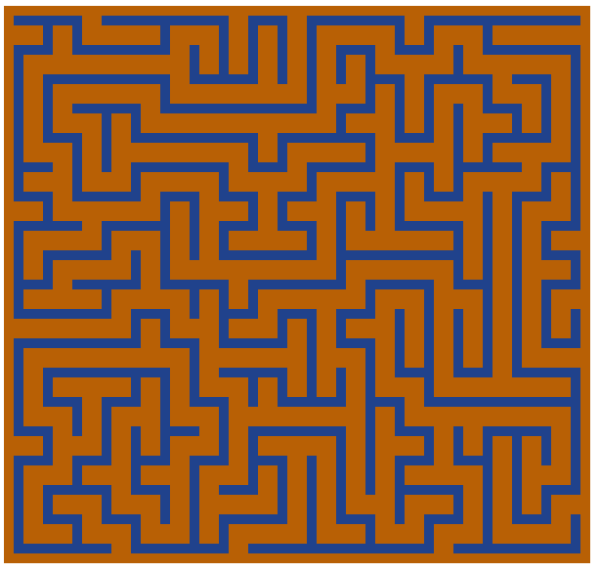
Recursive Backtracking
Long twisty passages
This is known as the river (high river)
Needs memory to keep track of visited cells.
Few dead-ends

Slide 58
Recursive Backtracking Correctness
Same properties of DFS
Every reachable node will be visited
Can use restarts for disconnected masks
Each cell is marked as visited only once
When a passage is carved into it.

Slide 59
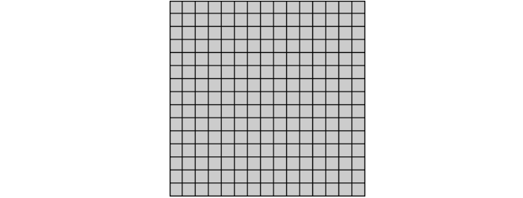
Hunt and Kill
Similar to Recursive Backtracker
Random Walk
Find another random starting cell the neighbors the path.
Carve into path and start a new random walk.
Done when no more unvisited cells.

Slide 60
Hunt and Kill
Long twisty passages (high river)
Few dead ends
Slower than Recursive Backtracking

Slide 61
Prim’s
Book has Simplified and True but they are the same. Difference is whether you explicitly use edge (or node) weights
True:
Assign every cell a random weight. (think of all incoming edges as having this weight).
Initial set with the cell with the minimum weight. Add neighbor with the lowest weight to the cell and carve.

Slide 62
Prim’s Simplified
Start with a random cell as the initial set
Add neighbors and select one at random.
Remove from set if no unvisited neighbors.

Slide 63
Prim’s Algorithm
Many dead ends
Short continuous runs
Radial from initial cell or jigsaw texture
Theoretically unbiased

Slide 64
Prim’s Correctness
It is a Minimum Spanning Tree algorithm so the proof in that is sufficient

Slide 65
Growing Tree
Variation of the sets with Prim’s. Choose a cell from the set
Then choose an unvisited neighbor and link these
Add neighbor to the set
Repeat
Selecting randomly from the set is exactly Simplified Prim’s

Slide 66
Growing Tree
Controlling the set selection
Random -> Prim’s
LIFO -> Recursive Backtracking
Texture and properties depend on the cell selection algorithm from the set.

Slide 67
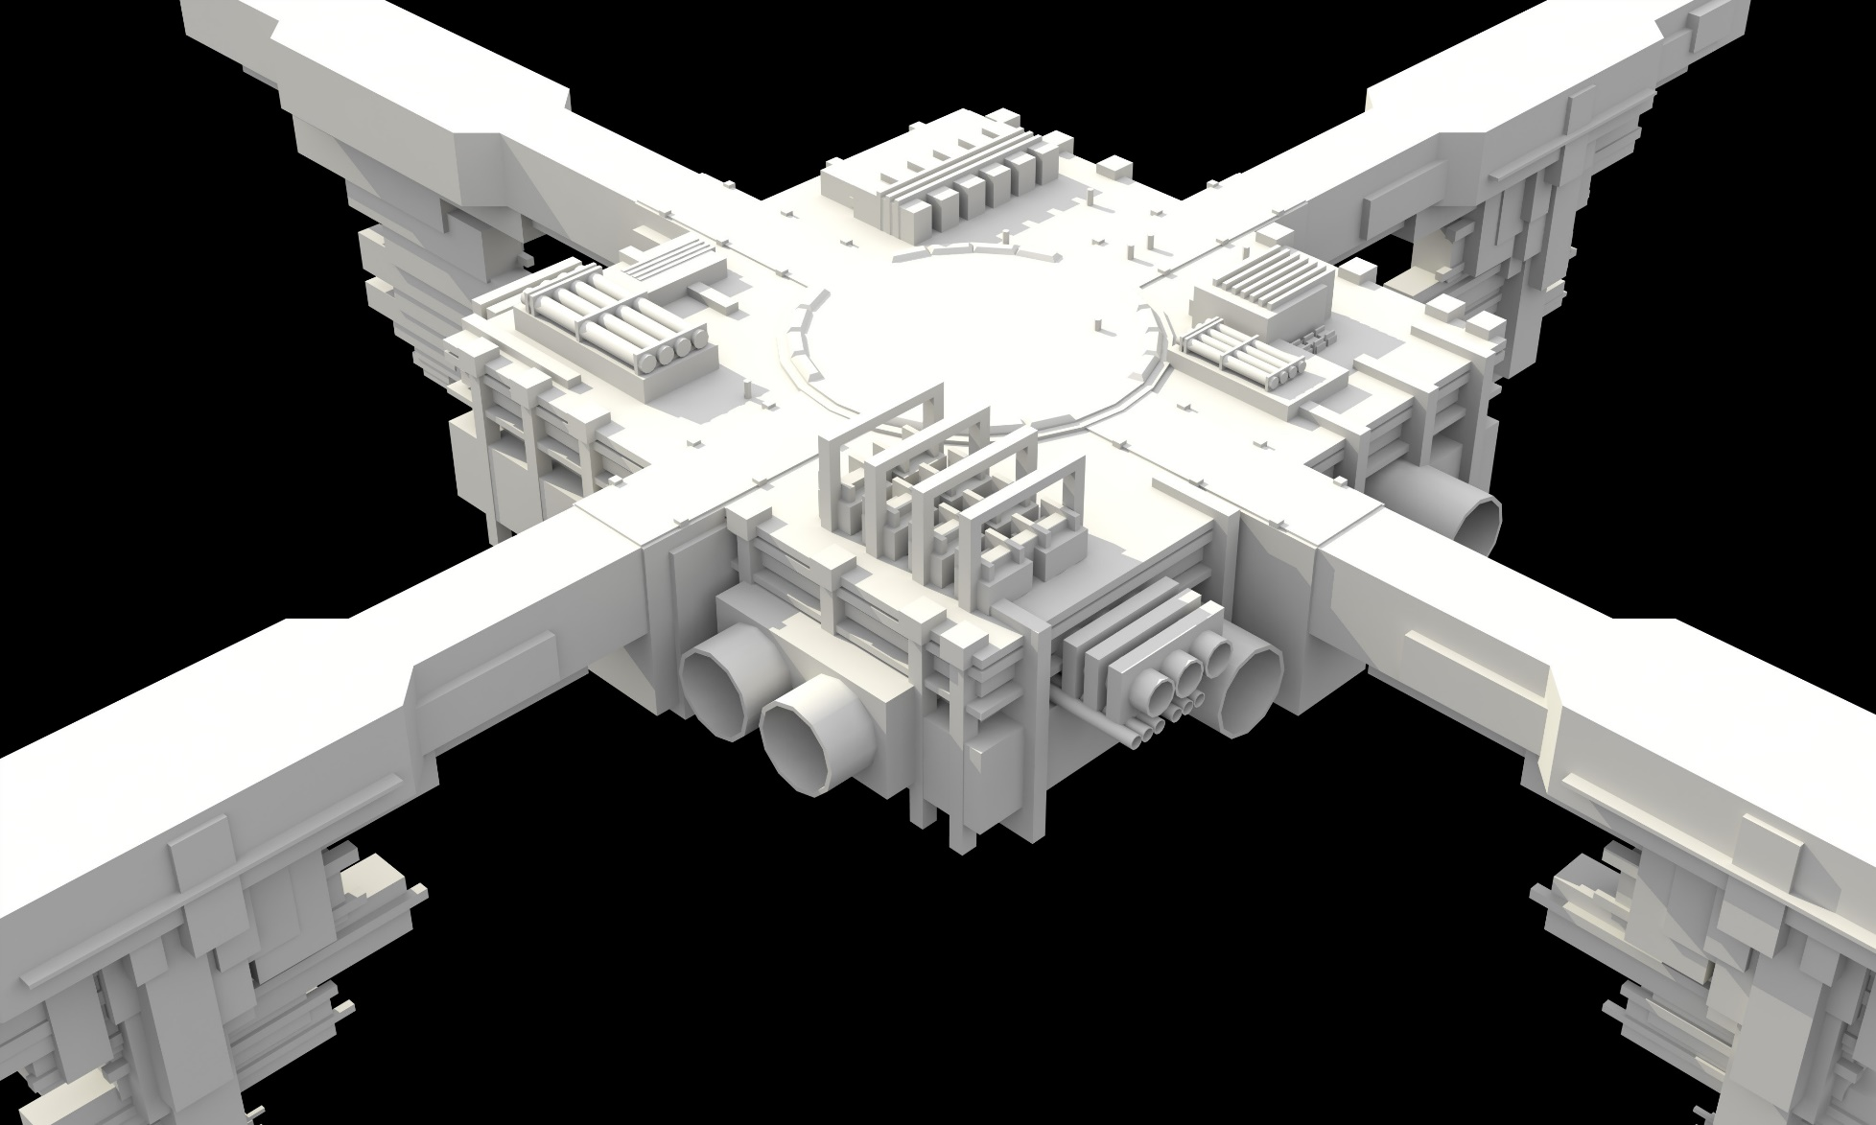
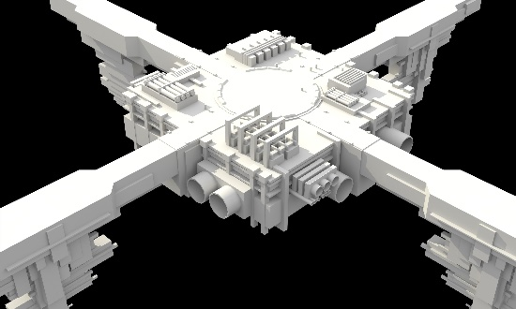
Growing Tree
Cool cross-section tile
https://nylira.com/maze-generation-in-unreal-engine-4/

Slide 68
Kruskal’s Algorithm
Assign each cell to a set
Randomly link two adjacent cells that belong to different sets
Merge the sets
Repeat until all cells are in the same set
Sounds more complicated than Prim’s but actually easier to implement.

Slide 69
Kruskal’s Algorithm
Fairly unbiased
Regular or uniform looking mazes
Easy to start with a partial maze put into sets (templates).

Slide 70
Kruskal’s Correctness
It is a Minimum Spanning Tree algorithm so the proof in that is sufficient

Slide 71
Random Walk Maze Gen
Aldous Broder
Pure random walk
Wilson’s
Loop erased random walk
These are unbiased
These can take a long time to finish (relatively speaking)

Slide 72
Aldous-Broder Algorithm
Start at a random cell and move randomly
If moving to a unvisited cell, then carve a passage.
Else just keep on moving
End when there are no more unvisited cells.

Slide 73
Aldous-Broder Algorithm
int randomCell = RandomGenerator.Next(grid.NumberOfNodes); visited[randomCell] = true; while (unvisited > 0) { List<int> neighbors = grid.Neighbors(randomCell).ToList<int>(); //if(neighbors.Count > 0) // Actually all grid cells have at least 1 neighbor
{ int randomNeighbor = RandomGenerator.Next(neighbors.Count); int selectedNeighbor = neighbors[randomNeighbor]; if (!visited[selectedNeighbor]) { visited[selectedNeighbor] = true; CarvePassage(randomCell, selectedNeighbor, preserveExistingCells); unvisited--; } randomCell = selectedNeighbor; } }

Slide 74
Aldous Broder
An unbiased algorithm
This may be a bad thing
There are trillions of spanning trees on a simple 6x6 grid
Unbiased then produces the “norm” far more often than the “irregular” mazes.
Same with Wilson’s Algorithm

Slide 75
Wilson’s Algorithm
Start at a random cell and “add” it to the maze
Pick another random cell not in the maze.
Perform a random walk until you collide with the existing maze
Add this path to the maze
Repeat

Slide 76
Recursive Division
Binary-Space Partitioning Trees (BSP) or k-D Trees approach
Start with an open grid
Add walls to divide the grid into two grids with a single passage
Repeat on each sub-grid
Can be used to create a hierarchical maze.
https://en.wikipedia.org/wiki/Maze_generation_algorithm

Slide 77
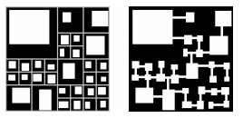
Recursive Subdivision
The dividers do not need to be the same on each child.
The dividers do not need to be linear (but makes it more difficult).
Used for dungeons as well. How?
http://amazeaday.blogspot.com/2009_03_01_archive.html

Slide 78
Labyrinth or Unicursal Maze
A maze with no T-junctions or cross-sections
Space filling curve
Solution path is the entire maze

Slide 79
Unicursal Maze

Slide 80
Unicursal Maze Generation
Take a perfect maze
Replace each cell with cells having double edges, placing a wall in the middle

Slide 81
Unicursal Maze
Also need to remove the exit to prevent two paths.
Implies start and exit are the same cell.
Can do the same with the start to create a loop.
Given a loop, can you “cut” it to create a maze?

Slide 82
Maze Templates
You can also think of different algorithms or complete smaller mazes as templates

Slide 83
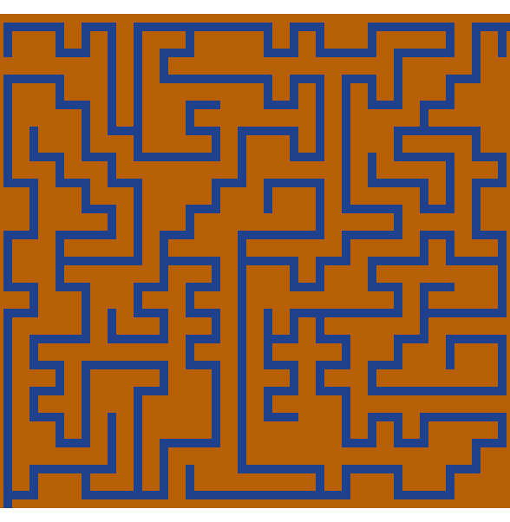
Maze Enhancements
Remove Dead-ends
Add walls
Thins out maze
Eventually to the solution path

Slide 84
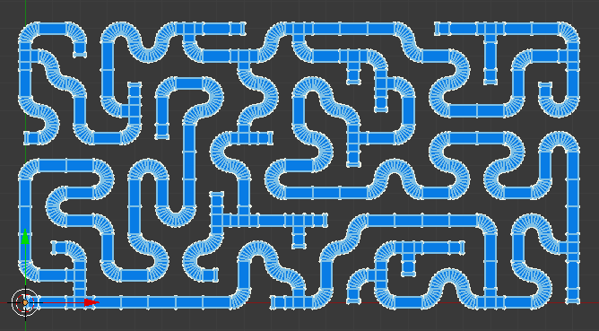
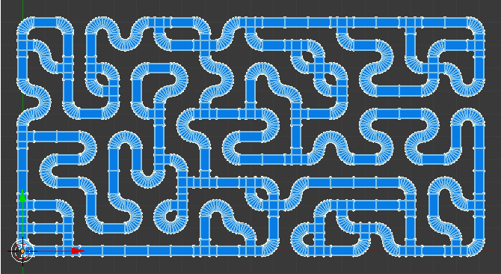
Braided Mazes
Remove all Dead-ends
Carve a Passage
https://elfnor.com/blender-2d-maze-generator.html

Slide 85
Weaves
Add the concept of an under and over cell
Interactive App
https://weblog.jamisbuck.org/2011/3/4/maze-generation-weave-mazes.html

Slide 86
Selected Weaves
Longleat Hedge Maze
Wiltshire, UK

Slide 87
Weaves - Implementation
Buck’s book provides a set of “construction” rules.
Two simpler methods (IMHO)
Randomly place weaves avoiding overlap as templates to initialize RBT, Prim’s or Kruskal’s. Easiest with Kruskal’s.
Generate Maze with cross-sections. Convert cross-sections to weaves. Add edges to connect components.

Slide 88
Weaves - Implementation
Templates
Need a new label for the tunnel.
Visited Cell
0
0
1
0
1
2
0
0
2
1
0
1
0
0
0

Slide 89
Caterpillar Graph
Solution path with a maximum number of alcoves (small dead-ends).
One giant hallway!

Slide 90
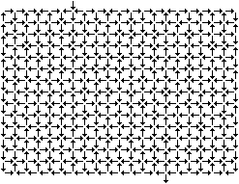
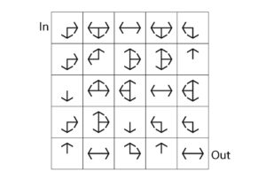
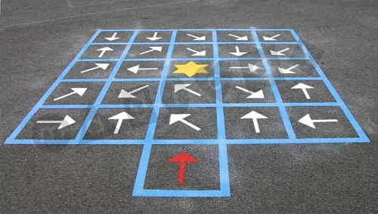
Directional Mazes
Grid Town Maze
Crazy City streets
Can you solve this?
http://www.mazelog.com/
Harder than you think!

Slide 91
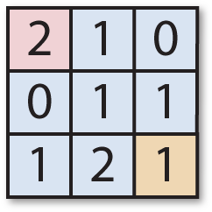
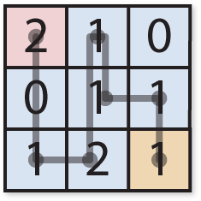
Jump Mazes
You can jump the specified number of squares horizontally or vertically.
http://www.mazelog.com/

Slide 92
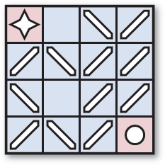
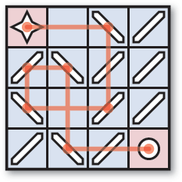
Mirror Maze
Similar to Directional. Light can go through or reflect 90 degrees. It thus depends on which way you enter the cell.
http://www.mazelog.com/

Slide 93
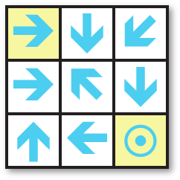
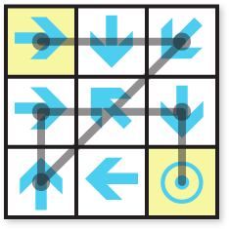
Jump or Slide Mazes
Cell goes one way for n spaces
Can go only in one direction for 1-N spaces
Can go in any direction, but must go until blocked (Battle Pigs?)
http://www.mazelog.com/

Slide 94
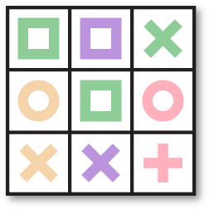
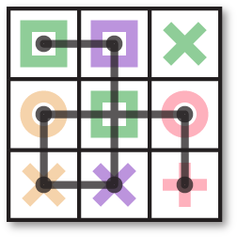
Matching or Link Mazes
Can match shape or Color (like Uno)
http://www.mazelog.com/

Slide 95
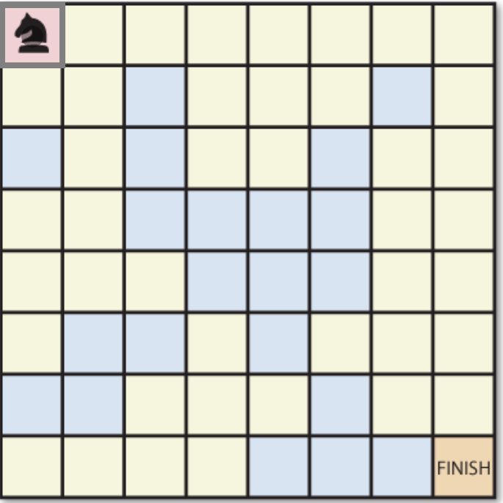
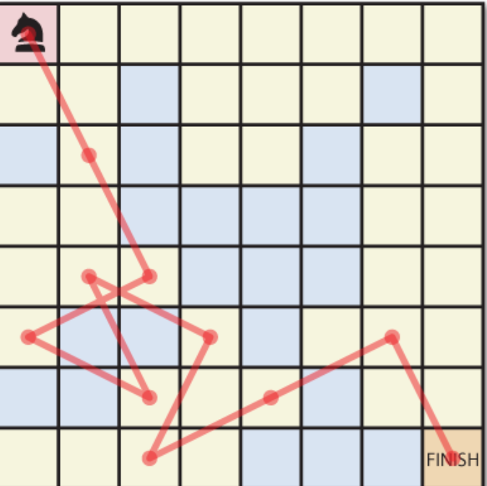
Chess Mazes
Move like a chess piece.
In this example the Knight must stay on the yellow squares
http://www.mazelog.com/

Slide 96
Chess Mazes
These change the game mechanics!
Only Knight can jump
Pawn is a no-op (you stay the same character)
http://www.mazelog.com/

Slide 97
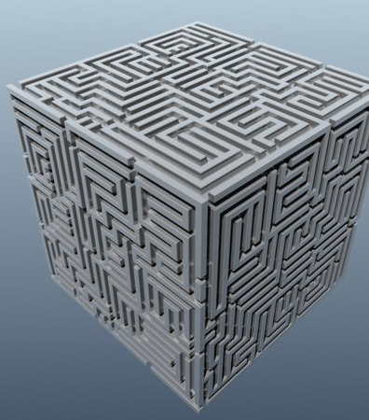
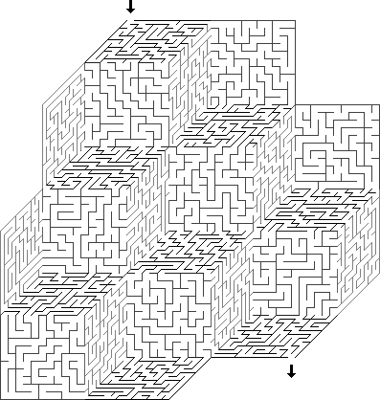
3D Mazes
Surface-based

Slide 98
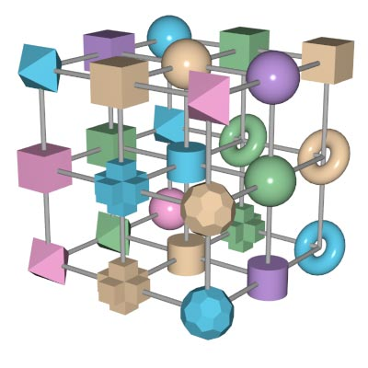
3D Mazes
True 3D
http://www.mazelog.com/

Slide 99
Dual or Intertwined Mazes
Two mazes that overlap and share the same space
Roads, rivers, bridges, …
Do they connect?

Slide 100
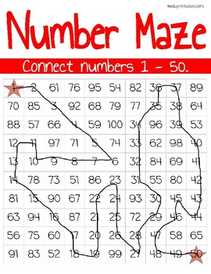
Number Mazes
We could also alternate the solution between two colors say black and white
Rules: Move one step at a time using this pattern.
a < b < c

Slide 101
Portal Mazes
Door 1 leads to ?
Door 5 leads to ?
Blue Portal 1 leads to ?
Need an image

Slide 102
Circuits
Fractal Maze from https://www.astrolog.org/labyrnth.htm

Slide 103
Chromatic Mazes
Solution path has valid colors that appear next to each other on the color wheel. All other off paths are an invalid color.

Slide 104
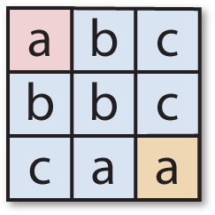
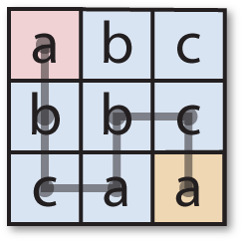
Sequence Maze
This may be similar to Chromatic maze
Given a pattern, you have to follow the pattern to reach the end (Boogle?)
http://www.mazelog.com/

Slide 105
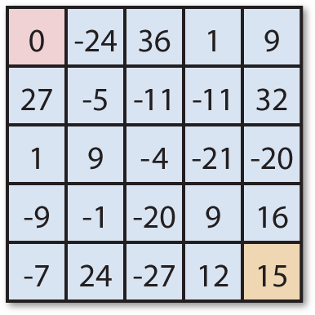
Calculation Mazes
Each jump step in this one must make the sum of the total path a perfect square.
Could remove jumps

Slide 106
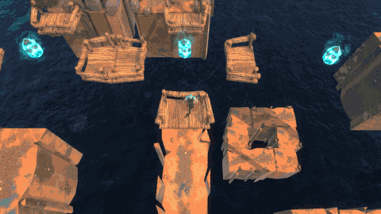
Time Varying Mazes
https://metraplayers.blogspot.com/

Slide 107
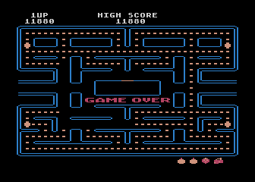
Others
Pacman like
Gravity based
Aka Roll a Ball
Minesweep paths

Slide 108
Spatial Layout
Triangular
https://www.astrolog.org/labyrnth/algrithm.htm

Slide 109
Spatial Layout
Hexagonal
https://www.astrolog.org/labyrnth/algrithm.htm

Slide 110
Spatial Layout
Polar
https://www.astrolog.org/labyrnth/algrithm.htm

Slide 111
Spatial Layout
Octagon and Square tiling
https://www.astrolog.org/labyrnth/algrithm.htm

Slide 112
Spatial Layout
Allowing Diagonals
https://www.astrolog.org/labyrnth/algrithm.htm

Slide 113
Spatial Layout
Amorphous
https://www.astrolog.org/labyrnth/algrithm.htm

Slide 114
Design Considerations
What can we control?
Which algorithm would I tend to use for FPS games versus a stealth games?
How can I mask out parts?
How can I prespecify parts?

Slide 115
Maze Metrics
Desired Properties of Perfect Maze
Set up desired values for maze metrics
Examples of Maze Metrics
# Turns (Twistiness)
# Straights (Directness)
Solution Path Length
# Cross-Junctions on Dead-End Tree
# Turns on Dead-End Tree
Distance from Solution Path
$$⋮$$

Slide 116
Metric Space
Each algorithm has different characteristics
Very hard to get some maze configurations.
Caterpillar Graphs
Labyrinths
# Perfect Mazes

Slide 117
Percent Dead-Ends
Desired Amount of Dead-Ends (10% or 50%)
Recursive Backtracker
Prim’s

Slide 118
Percent Turns
Desired Amount of Turns (10% or 65%)
Note: Turns may be a little misleading as it does not include T-junctions
Prim’s
Recursive Backtracker

Slide 119
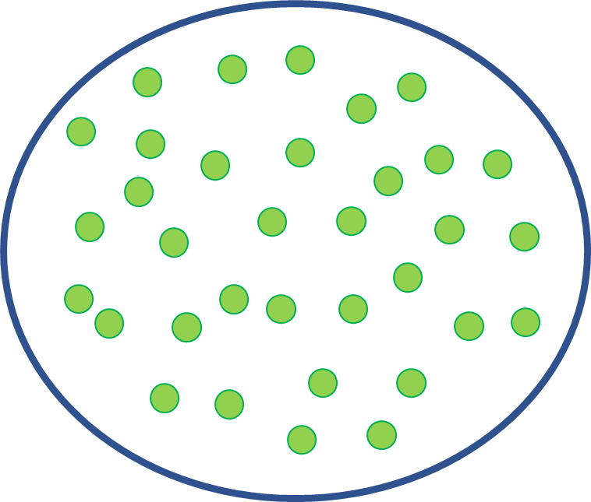
Expressive Range
We will cover this later, but you can think of the entire space of mazes versus what your algorithm generates.
While unbiased algorithms can theoretically generate the entire space, it is unlikely.
Kruskal’s
Prim’s

Slide 120
Maze Research
Kim and Crawfis have looked at the entire space of spanning trees / mazes for small N, as well as the expressive range of each algorithm.
They have also developed an AI-assisted algorithm for better control over maze design.
Evolutionary and Constraint-based approaches.

