Slide 1
Games and Animation LOD – Level of Detail
CSE 3541
Prof. Roger Crawfis

Slide 2
Continuous LOD
Progressive LOD
Popular in terrains
Subject of research (older research)
Decimation, edge split
Rank-order set of refinements
Refinements can be animated in or out
Terrain
SOAR
ROAM
Geometry Clipmaps

Slide 3
Discrete LOD
N distinct models
Perhaps a billboard
Main technique used in game engines.
Hardware selects LOD at runtime.
Typically associated with a distance from the camera
Fading or dissolving can be used to hide the popping
Can bias towards a lower LOD for better performance

Slide 4
Appropriate Quality – Distance-based
What the models look like
What you see
http://glasnost.itcarlow.ie/~powerk/3DGraphics2/Theory/Levelofdetail.htm
https://developer.arm.com/documentation/102496/0100/Level-of-Detail---LOD

Slide 5
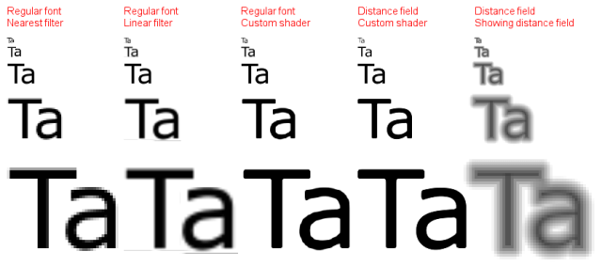
Signed Distance Fields
An alternative representation to 3D models
Used for text

Slide 6
Signed Distance Functions
Alternative 3D model representation
https://nv-tlabs.github.io/nglod/

Slide 7
Image-based Rendering
Amplify’s Imposters: https://assetstore.unity.com/packages/tools/utilities/amplify-impostors-119877

Slide 8
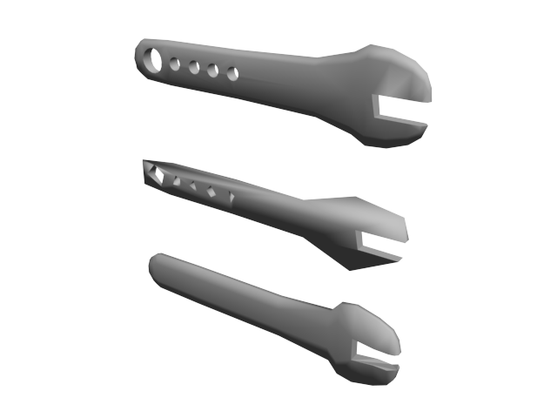
Issues
Budget – Desired reduction to N triangles (what is optimal?)
Geometry – simplify flat areas
Texture – preserve discontinuity in the texture mapping
Holes – preserve or remove
Change of topology

Slide 9
LOD and Aliasing
LOD’s are also needed to avoid aliasing artifacts as the triangle size becomes sub-pixel in size the further the model is away.
Example: Mountain peaks may sporadically pop in and out or jump abruptly.

Slide 10
LOD and Aliasing
You will hear statements like the LOD is not bad, or good enough.
In reality, the high-res is wrong! The LOD is needed, much like Mipmaps are needed in textures.

