Slide 1
Procedural Content Dungeons
CSE 5559
Prof. Roger Crawfis
Created September 12, 2020. Last Modified September 16, 2020

Slide 2
Dungeon Generators
Many different algorithmic approaches:
Maze generation with rooms (cell-based)
Random Walk
Tunneling
Space Partitioning (BSP or kD trees)
Cellular Automata
Physics

Slide 3
Resources / References
https://devforum.roblox.com/t/dungeon-generation-a-procedural-generation-guide/342413
https://slsdo.github.io/procedural-dungeon/
https://www.gamasutra.com/blogs/AAdonaac/20150903/252889/Procedural_Dungeon_Generation_Algorithm.php
http://pcg.wikidot.com/pcg-algorithm:dungeon-generation
http://cs.brown.edu/courses/cs1971/lectures/lecture03.pptx

Slide 4
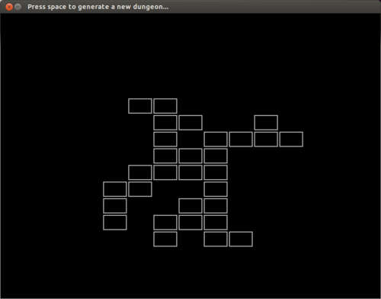
Maze of Rooms
Prune the maze
Each cell is a room
Can merge some rooms to form a larger room

Slide 5
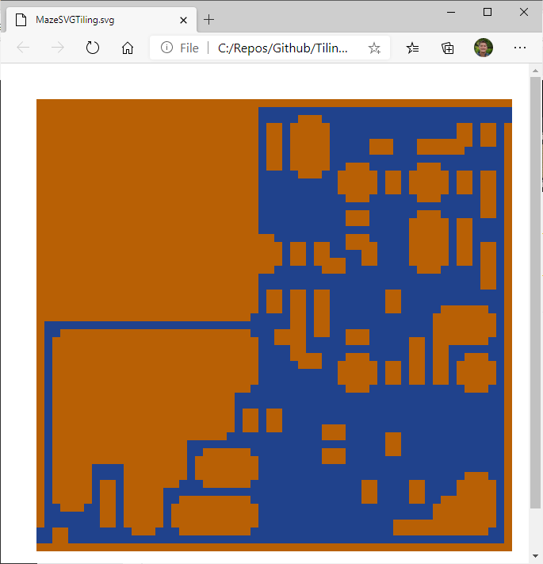
Random Walk
This just works
Can favor a walker to move towards the center of a room
Hard to control
8 walkers, favor forward
Path from start to end
Removed all dead-ends

Slide 6
Random Rooms (Tunneling)
Basic algorithm:
Randomly create a room
It cannot overlap any existing room
Create a tunnel from the center of this room to the previous room
Go horizontal and then vertical on a grid
Or vice versa
Repeat
Show examples

Slide 7
Implementation
private List<Room> roomList = new List<Room>();
public override void CreateMaze(bool preserveExistingCells) { MakeRooms(); MakePassages(); }
private void MakeRooms()
{
CreateRandomRooms();
foreach (Room room in roomList)
{
int lowerLeftIndex = room.minX + Width * room.minY;
int upperRightIndex = lowerLeftIndex + (room.height - 1) * Width + (room.width - 1);
CarveRoom(lowerLeftIndex, upperRightIndex);
}
}

Slide 8
Implementation
private void CreateRandomRooms() { int deltaWidth = MaxRoomSize - MinRoomSize + 1; // Random create rooms int roomTrys = 0; while (roomList.Count < this.NumberOfRooms && roomTrys < maxNumberOfTrys) { int roomWidth = MinRoomSize + RandomGenerator.Next(deltaWidth); int roomHeight = MinRoomSize + RandomGenerator.Next(deltaWidth); int minimumXCoord = Width - roomWidth; int minumumYCoord = Height - roomHeight; int minX = RandomGenerator.Next(minimumXCoord); int minY = RandomGenerator.Next(minumumYCoord); Room room = new Room(minX, minY, roomWidth, roomHeight); roomTrys++; bool canPlace = CheckForOverlap(room);
if (canPlace) { roomList.Add(room); } } }
foreach (Room placedRoom in roomList) { int distance = RoomDistance(placedRoom, room); // Ensure they are RoomMoatSize apart. if (distance < RoomMoatSize) { canPlace = false; break; } }

Slide 9
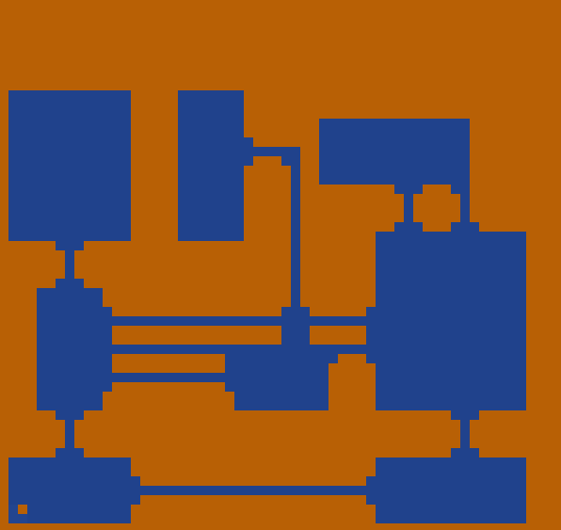
Implementation
var dungeonBuilder = new DungeonMazeBuilder<int, int>(width, height);
dungeonBuilder.MaxRoomSize = 7; dungeonBuilder.MinRoomSize = 3; dungeonBuilder.NumberOfRooms = 8; dungeonBuilder.RoomMoatSize = 1; dungeonBuilder.CreateMaze(false);

Slide 10
Enhancements
Randomly create a room
Avoid too small. Avoid square. Avoid thin.
It cannot overlap any existing room
Small overlap? N cells away.
Create a tunnel from the center of this room to the previous room
Pick door. Other paths
Room templates

Slide 11
Random Room Analysis
Cost
If overlap is stringent and rooms are confined to a small space may not be able to place a room.
Grow the range
Terminate early (after say 10 million attempts)
Tunnels are rather straight
Rooms are rectangular by default

Slide 12
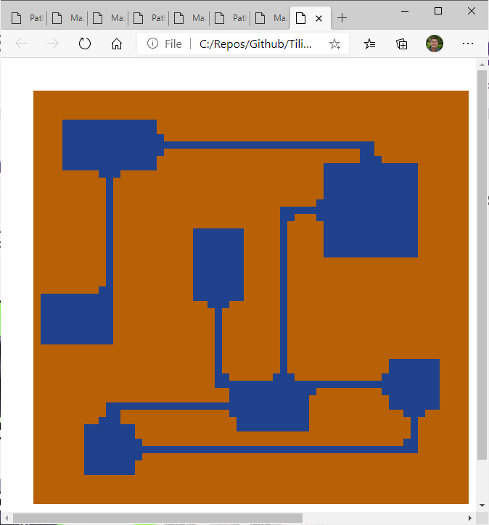
Cost
Asked for 20 rooms in 100 million trys (~25 seconds).
Padding was 3 cells
Was only able to get 7 rooms!
Exhaustive search may have been faster.

Slide 13
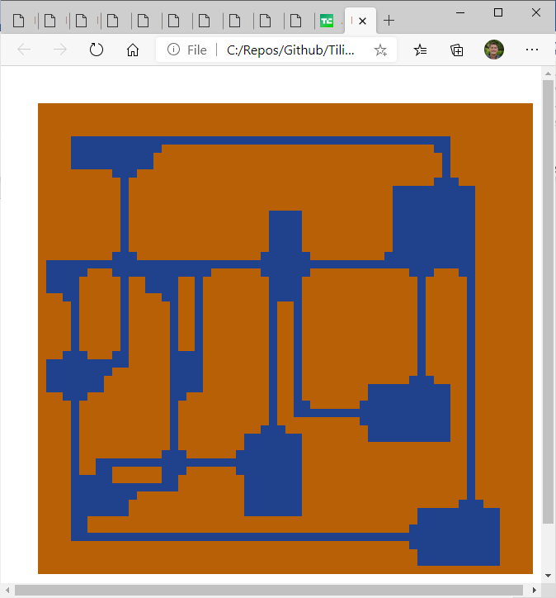
Cost
Smaller rooms.
Less padding
12 rooms

Slide 14
Moat size < 0
70 rooms of size 3 to 9, moat size = -5, without passages added

Slide 15
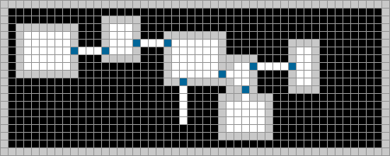
Variant
Dig out a single room in the center of the map
Pick a wall of any room
Decide upon a new feature to build
See if there is room to add the new feature through the chosen wall
If yes, continue. If no, go back to step 3
Add the feature through the chosen wall
Go back to step 3, until the dungeon is complete

Slide 16
Space Partitioning
Grid
Quad-tree
Kd-Tree
Binary Space Partitioning (BSP)
Others (ad hoc)
Used in many fields and many ways in games – physics, raycasting, scene management, …

Slide 17
Quad-trees
Start with a rectangular space
Split in the middle along both the x and y axes to form 4 quadrants.
For each quadrant repeat as needed
Forms a quad-tree (4 children)
https://robotics.stackexchange.com/questions/2373/using-vision-for-monte-carlo-localization

Slide 18
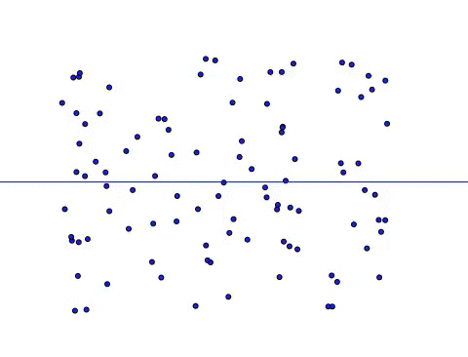
Kd-Trees
Generalization of quad-tree.
Alternate between the k dimensions and split the space in this dimension (e.g., x split, then y split on each half, then x, …)
Binary tree – 2 children
Level determines dimension.
Does not need to be in the center.
(extension) Can select arbitrary dimension each level (x, x, y, x, y, x, y, y, …

Slide 19
BSP Trees
BSP splits the space by an arbitrary plane in N space (hyper-plane)
Recurse over each sub-space
Forms a binary tree
Most general
All Kd-trees are BSP-trees.
https://robotics.stackexchange.com/questions/2373/using-vision-for-monte-carlo-localization

Slide 20
Kd-Tree Dungeon Generation
Variant of Recursive Division used in maze generation.
Don’t carve passages (yet)
Stop early – when cell size is bigger than rooms
Create rooms within each cell
Connect rooms
Basic idea – keep splitting the map up into smaller subsections to create rooms

Slide 21
Kd-Tree Dungeon Generation
Start with an empty rectangular grid.
Slides from: http://cs.brown.edu/courses/csci1971/

Slide 22
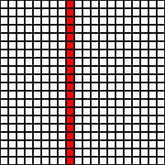
Kd-Tree Dungeon Generation
Pick a random index on which to divide the space along the x axis.

Slide 23
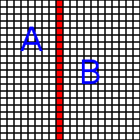
Kd-Tree Dungeon Generation
Dungeon
A
B

Slide 24
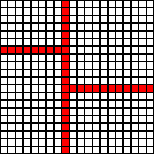
Kd-Tree Dungeon Generation
Pick another index on which to divide, this time dividing along the other axis (in this case y).
Use a different index for each split

Slide 25
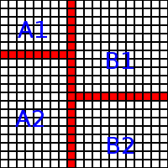
Kd-Tree Dungeon Generation
Dungeon
A
B
A1
A2
B1
B2

Slide 26
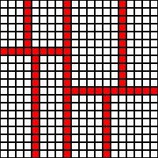
Kd-Tree Dungeon Generation
Keep dividing, switching between x and y until you hit some depth (3 here).

Slide 27
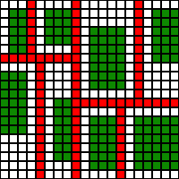
Kd-Tree Dungeon Generation
Fill spaces with random sized boxes.
Make sure boxes fill up more than half of the width or height of the space they occupy.

Slide 28
Connecting Rooms
We now have
Rooms separated
A tree data structure that describes this space
Connect rooms
Parent to children?
How?
Parent is conceptual only

Slide 29
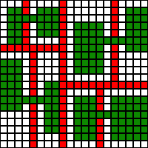
Kd-Tree Dungeon Generation
Connect sister leaf nodes of the tree.
Rooms must either take up more than half their space’s width and height or will have z-shaped hallways.

Slide 30
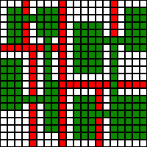
Kd-Tree Dungeon Generation
Connect cousins?
Any random line?
Paths?

Slide 31
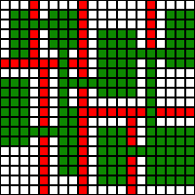
Kd-Tree Dungeon Generation
Keep on connecting up the tree.

Slide 32
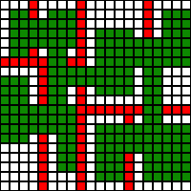
Kd-Tree Dungeon Generation
If the halls are too narrow, Increase width of hallways to create more open space.

Slide 33
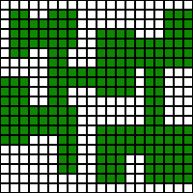
Kd-Tree Dungeon Generation
Result

Slide 34
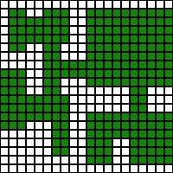
Kd-Tree Dungeon Generation
Instead of naively checking depth, have some branches of the tree stop early so you end up with more variation in room size.

Slide 35
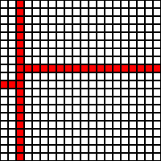
Kd-Tree Dungeon Generation
To prevent rooms from being too small and weirdly shaped, keep your dividing index with a certain range.

Slide 36
Kd-Tree Dungeon Generation
Teams!
When you do your first split, assign one side of the tree to Team A and the other to Team B.

Slide 37
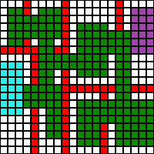
Kd-Tree Dungeon Generation
At the bottom of the tree, assigning one room to each team as a base will ensure that the bases are on different halves of the map and no one is locked in.
Structure is a tree

Slide 38
Analysis
Cost
Linear in rooms (no checking)
Paths are constant or perhaps picking which cousins to merge (at most 4 per sub-space)
Design
Rooms look rather randomly spaced
Size variation from different sized cells

Slide 39
Room Subdivision Dungeons
Some bloggers, describe this as a BSP algorithm. That is technically incorrect as it is not binary and really no hierarchy.
Only the top room spans the entire space.

Slide 40
Room Subdivision Algorithm
Start with a single rectangle covering the entire map.
Add to Rectangle List
Sub-divide it into 4
Add these 4 to Rectangle List
Repeat:
Obtain a random rectangle from the rectangles list.
Generate a random sub-rectangle inside this rectangle.
If room “fits”:
Apply the room to the map (build it).
Add it to the rooms list.
Sub-divide the new rectangle into quadrants and add those to Rectangle List.

Slide 41
Generalization
Basic steps
Determine room location or lot / bounding box
Carve out room
Determine doors or connector locations
Determine which rooms are connected
Find paths between connected rooms
Carve out paths
Steps 2 and 3 can be switched.
Can step 3 come first?
Graph embedding

Slide 42
Generalization
Many approaches to spacing out rooms
Many approaches to determining connections (graph)
Rooms can be rectangles, buildings, caves, stamps, …
Do rooms have predefined doors and doorways? If so, how does this affect our path algorithms.
Paths can be straight, curved, avoid rooms, possibly go through rooms, portals?…
Can paths intersect?
Build re-usable components!!!

Slide 43
Maze-based Dungeon Paths
http://journal.stuffwithstuff.com/2014/12/21/rooms-and-mazes/

Slide 44
Physics-based Dungeons
Use rigid bodies and place room “proxies” randomly.
Let physics run to push rooms apart.
Option:
Select a few of the rooms (or all)
https://github.com/Widdin/Procedural-Dungeon-Generator

Slide 45
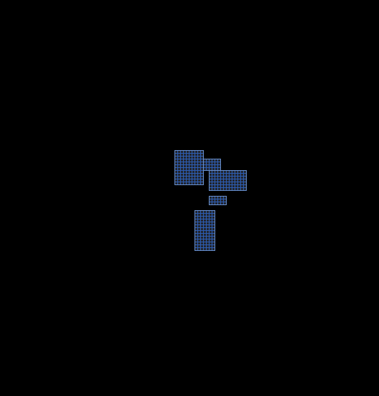
Physics-based Dungeons
Build a complete graph from room centers
Use distance between rooms for edge weights
Run a Minimum Spanning Tree algorithm to determine rooms that should be connected
Add extra edges for richness
Find path and carve
They used a Delaunay Triangulation here.
https://www.gamasutra.com/blogs/AAdonaac/20150903/252889/Procedural_Dungeon_Generation_Algorithm.php

Slide 46
Spring-Mass Dungeons
Can start with a desired connectivity
Model as spring mass system
Planar graph layouts
Many algorithms

Slide 47
Reworking the Software
What are the key properties of our Maze and MazeBuilders?
Grid
Do dungeons fit this model?
No!
What is a dungeon?
Set of “rooms”
Layout of rooms
Graph of room connectivity
Set of “paths”

Slide 48
IDungeonBuilder interface
These might indicate separate builders
Design questions
What do we need to instantiate a dungeon?
How much control do we offer?
What does this build?
Important / not important
Room size
Room orientation
Door placement
Room spacing
Length of passages
Spatial layout
Connections
Special Rooms

Slide 49
IRoom interface
What is a room?
Rectangle
Collection of rectangles
Office building
Is a room a dungeon?

Slide 50
Possible Design Spaces
Less is better!!!
I want rooms with these specific sizes, but I do not care how they are connected or the spatial layout.
I want rooms connected according to this graph, with this specific room in the center and 4 rooms like this at each corner.
As above, but my connections are a minimum requirement.
I want some room like so and then some caves and then some more open areas, …
Multiple room builders, multiple path builders

Slide 51
Tiling a Dungeon
For the maze / tiling framework we can “rasterize” the dungeon like we did in the previous slides.
Room tiles could contain the doors and paths to the tile edges

Slide 52
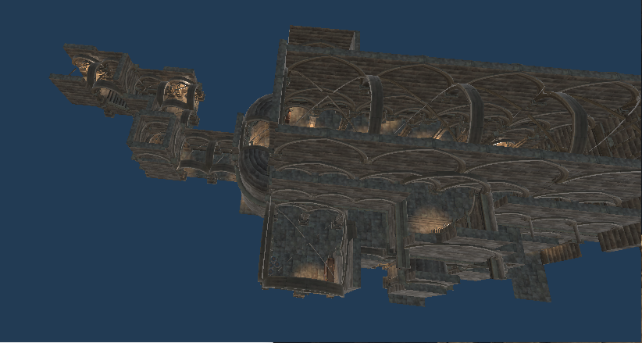
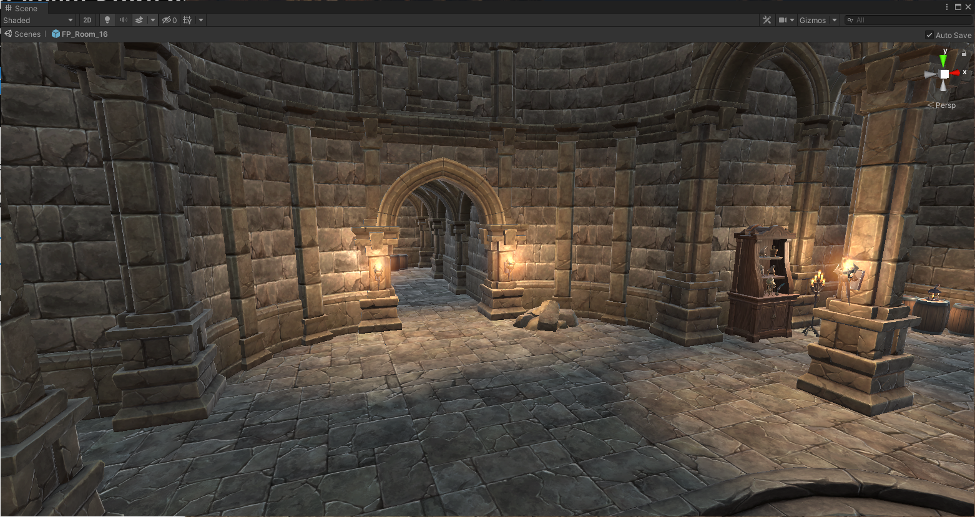
Connectors
Many assets use connectors and endcaps with their dungeons to piece things together.
Exact positioning may need to be changed
Need to be careful to avoid overlap.
Can use these to build tilesets as well.

Slide 53
Dungeon Metrics
Start / End
Shortest path
Unimportant areas – place keys, treasure
Distance to shortest path
Room variance
…
Breakout Rooms – What is important to you? Under what use case or circumstances?

Slide 54
Important vs. Exploration
There may be one or more paths from the start to the end of a level.
These paths are important.
Also possibly some side paths (keys, etc.)
Rest is interesting, useful, ???
https://www.worldofleveldesign.com/categories/level_design_tutorials/how-to-plan-level-designs-game-environments-workflow.php

Slide 55
PCG Search
Level too big for effective search?
Perhaps rework to possible experiences.
Player may go from room 1 to room 5 to …
Compute a Hamiltonian path?
Graph Theory – NP problems
Route Inspection Problem

Slide 56
PCG Search - Subproblems
Given rooms and doors in space, compute paths.
Determine choke-points (or strongly connected components) that separate the level into subgraphs.
Analyze each sub-graph
Analyze the meta-graph

