Slide 1
Games and Animation Character Animation
CSE 3541
Prof. Roger Crawfis

Slide 2
Todo
These slides are a merge of Dr. Boggus, Dr. Shareef and Dr. Huamin Wang’s slides. Formatting and organization need improvement.
Add Overview / Outline
3D Model animation
Rigidbody animation
Concept of a keyframe
Keyframe of only matrices for a whole rigid body
Flip-chart of models => 1000’s of models
Interpolating between two meshes (topologically equivalent)
Introduction to Blendshapes
Problem with model-based keyframes => 10’s of models
Character animation w/ keyframes of the model (i.e. no bones) – Cylinder bending
Concepts of joints, linkages and constraints
Robotic arms examples
Keyframe of local matrices for each rigid body linkage
Skinned Meshes, Bones and bone weights at each vertex

Slide 3
Rigid body Animation
Transform for every frame
60 fps => 60 matrices per second.
Transform every Nth frame
60/N matrices per second
Keyframes
Transform at time, t_{i}, since animation start.
Interpolate between keyframes

Slide 4
Rigid Body Demo

Slide 5
Geometry Flipbook

Slide 6
Flipbooks
https://www.prbmotion.com/blog/2017/4/27/the-beginning

Slide 7
Geometry Flipbook
New model every frame and just cycle through the models.
60 fps => 60 models per second.
Can we interpolate like we did with rigid bodies?
Matrices vs. meshes, textures, …
http://clvrlwn.blogspot.com/2014/01/gaming-topology.html

Slide 8
Example

Slide 9
Image Morphing
Image Blending
Image Warping
https://tenor.com/view/its-black-its-white-michael-jackson-video-gif-8810963 from Michael Jackson’s Black or White video

Slide 10
Point Correspondence
https://azmariewang.medium.com/face-morphing-a-step-by-step-tutorial-with-code-75a663cdc666

Slide 11
Mesh Correspondence
Consistent mesh topology
https://azmariewang.medium.com/face-morphing-a-step-by-step-tutorial-with-code-75a663cdc666

Slide 12
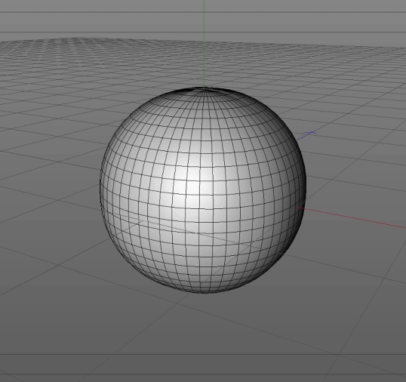
Mesh Animation and Morphing
Keep the topology the same (aka the triangulation in this case) and move the position (vertices).
https://forum.sketchfab.com/t/cinema-4d-morphing/5957/3

Slide 13
Adding Texture
Recap:
Topology stays the same
Could change it, but more difficult
Positions change
Implicit is that the positions carry information. In this case, texture coordinates.
Warp both textures / images
Cross fade (blend) between the two results.
https://azmariewang.medium.com/face-morphing-a-step-by-step-tutorial-with-code-75a663cdc666

Slide 14
More Fun
http://vision.gel.ulaval.ca/~jflalonde/cours/4105/h16/tps/results/tp3/JIZHA16/index.html
https://champagnemanagement.com/post/89781141691

Slide 15
Physically Based Characters: Linked rigid bodies
Head (mass, inertia, …)
Chest
Joint
(The place where two body parts meet)
No matter how body moves, the parts stay connected at the joint. (Articulated body)

Slide 16
Joints
Rotation allowed at the joints
Model rotation angles at the joints
Differ in freedoms to rotate
Joint angle has limits
Muscles apply forces to move the links between the joints
How do we control the muscles in the animation?
Determine muscle/joint forces

Slide 17
Degrees of Freedom
The minimum number of coordinates required to specify completely the motion of an object
yaw
roll
pitch
6 DOF: x, y, z, raw, pitch, yaw

Slide 18
Terms
Joint – allowed relative motion & parameters
Joint Limits – limit on valid joint angle values
Link – object involved in relative motion
Linkage – entire joint-link hierarchy
End effector – most distant link in linkage
Articulation variable – parameter of motion associated with joint
Pose – configuration of linkage using given set of joint angles
Pose vector – complete set of joint angles for linkage

Slide 19
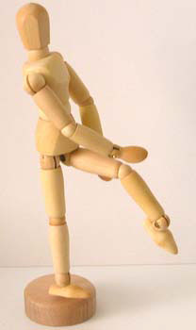
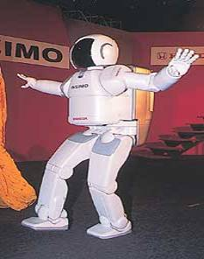
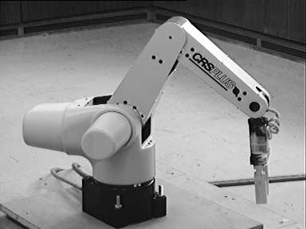
Kinematics
The branch of mechanics concerned with the motions of objects

Slide 20
Forward and Inverse Kinematics
Forward kinematics
mapping from joint space to cartesian space
Inverse kinematics
mapping from cartesian space to joint space

Slide 21
Forward and Inverse Kinematics
Forward kinematics
Mapping from joint space to cartesian space
Inverse kinematics
Mapping from cartesian space to joint space
Forward Kinematics
Inverse Kinematics

Slide 22
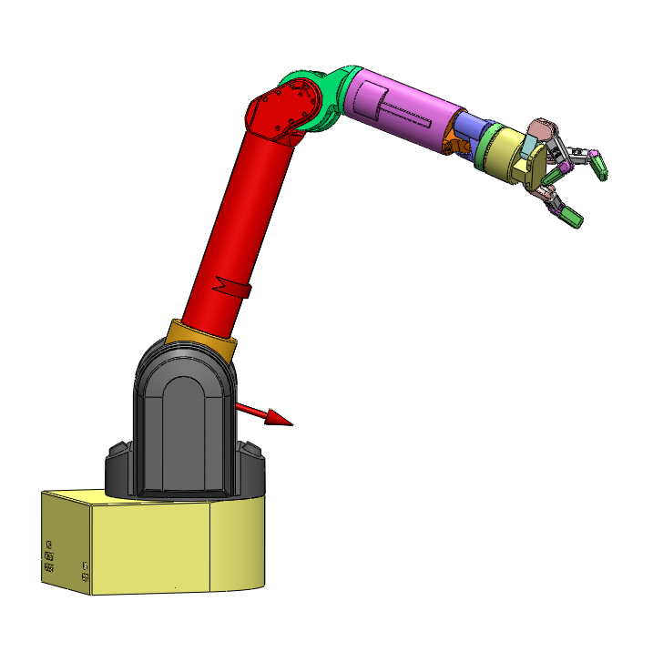
End Effector Goal
Desired goal:

Slide 23
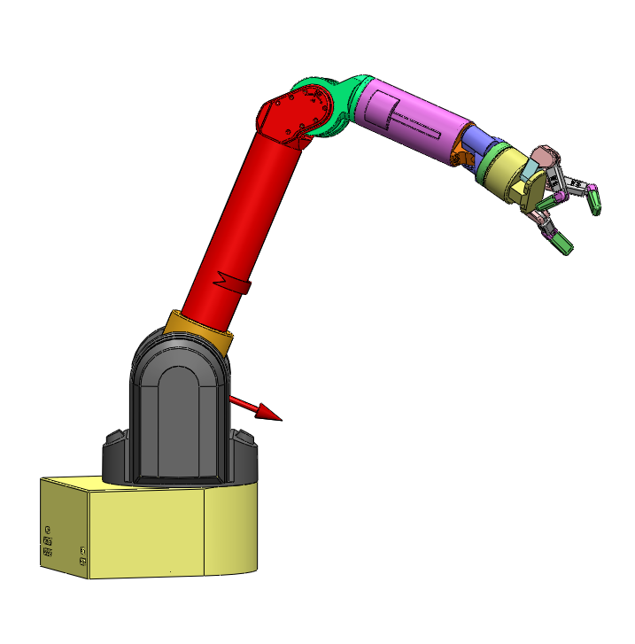
End Effector Goal
Move the robot to each subgoal in sequence

Slide 24
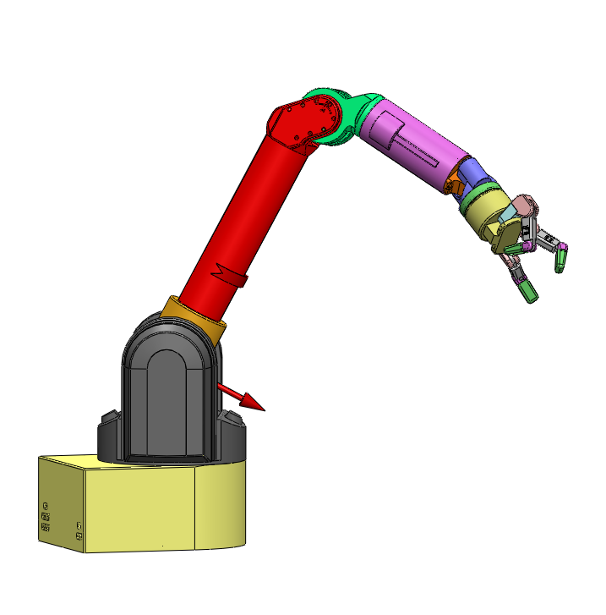
End Effector Goal
Move the robot to each subgoal in sequence

Slide 25
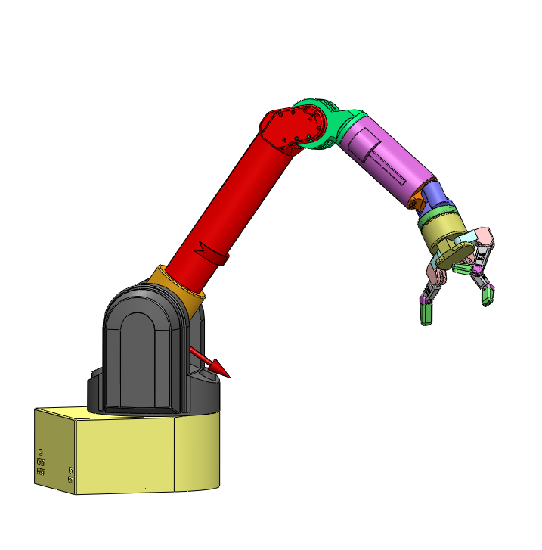
End Effector Goal
Move the robot to each subgoal in sequence

Slide 26
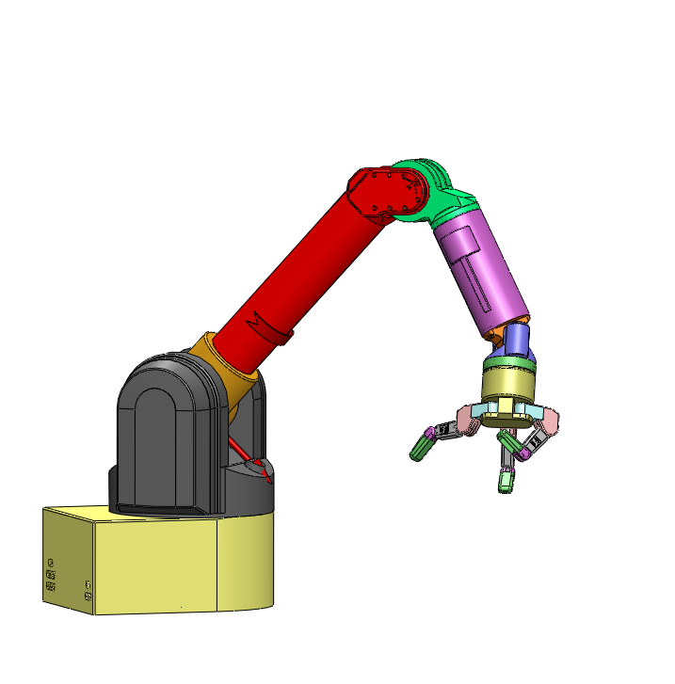
End Effector Goal
Hard to specify with forward Kinematics, but doable.
Think of tweaking 5-14 different knobs
Iterate until arrive at final goal

Slide 27
End Effector Goal
Line with sub goals
Goal

Slide 28
Forward vs Inverse Kinematics
Forward Kinematics
Input: Joint angles
Output: Link positions and orientations
End-effector position
Inverse Kinematics
Input: End-effector
Output: Joint angles

Slide 29
Forward Kinematics
Animator specifies values of articulation variables
Compute global transform for each linkage
Define joint angles in relation to the end-effector

Slide 30
Forward Kinematics
A chain of transformations from local to global coordinates given joint angles

Slide 31
2-Arm Forward Kinematics
https://www.youtube.com/watch?v=b89WHj6eITg – first 3:10 minutes

Slide 32
Controlling Forward Kinematics
QWOP
http://www.foddy.net/Athletics.html
Your brain models this easily to control forces using muscles
Though, your brain was developed over a long period of time

Slide 33
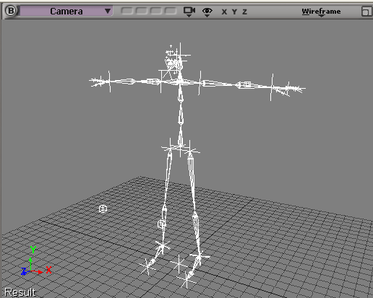
Inverse Kinematics
Mathematically determine the position and angle of joints (articulation variables) in a series of flexible, jointed objects after determining the position and orientation of the end effector

Slide 34
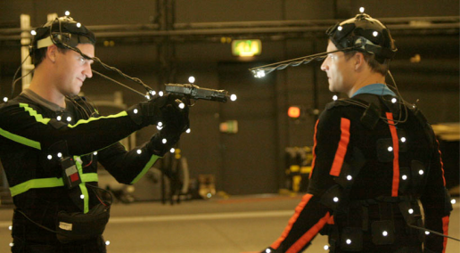
Inverse Kinematics
Animator specifies final desired global transform for end-effector (and possibly other linkages)
Compute articulation variables
Goal driven: “Grab the cell phone on the table”
Our brain optimizes our muscles and joints gradually until we reach goal
Need to model this
Easier to specify goal and compute position and orientation
Easier to determine goal with motion capture
Posing
Requires math

Slide 35
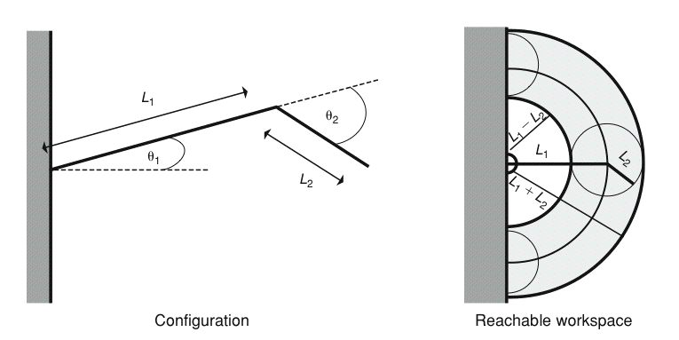
Inverse Kinematics
Spaces: Configuration, Reachable, and Dextrous spaces

Slide 36
Inverse Kinematics (Analytic Solution)
θ₂
L2
L1
Goal
θ₁
(X,Y)

Slide 37
Inverse Kinematics (Analytic Solution)
L2
180- θ₂
L1
(X,Y)
θ₁
θ_{T}
Y
X

Slide 38
Cosine Law
C
A
α
B

Slide 39
Inverse Kinematics – Analytical Solution

Slide 40
Inverse Kinematics (Analytic Solution)
Note: Assumes (X,Y) is a valid configuration
L2
L1
180- θ₂
(X,Y)
θ₁
θ_{T}
Y
X

Slide 41
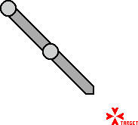
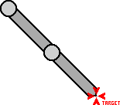
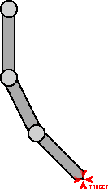
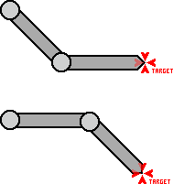
Inverse Kinematics
Unique solutions may not exist
http://freespace.virgin.net/hugo.elias/models/m_ik.htm
Zero One
Two Many

Slide 42
Inverse Kinematics
Requires a Numerical Solver:
Inverse Jacobian
CCD – Cyclic-Coordinate Descent
Fabrik - Forward And Backward Reaching Inverse Kinematics

Slide 43
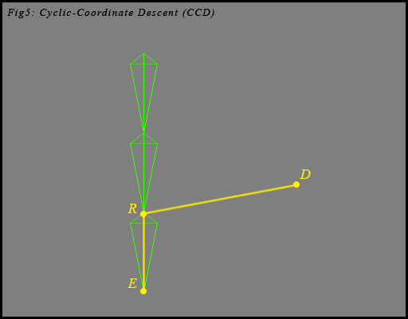
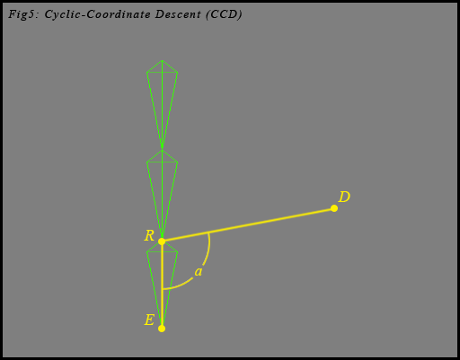
Cyclic Coordinate Descent
E is the endpoint (end effector)
D is the goal end effector

Slide 44
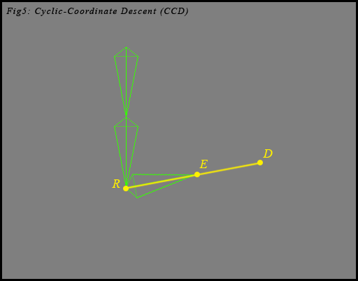
Cyclic Coordinate Descent
Draw a vector from R to D
Use the inverse cosine of the dot product to compute the angle

Slide 45
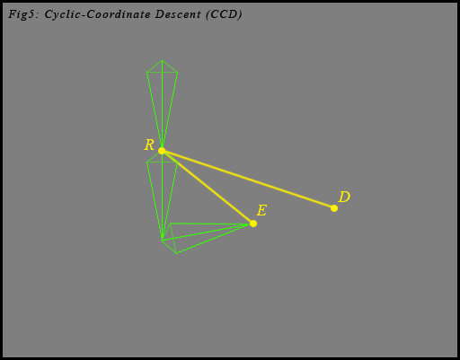
Cyclic Coordinate Descent

Slide 46
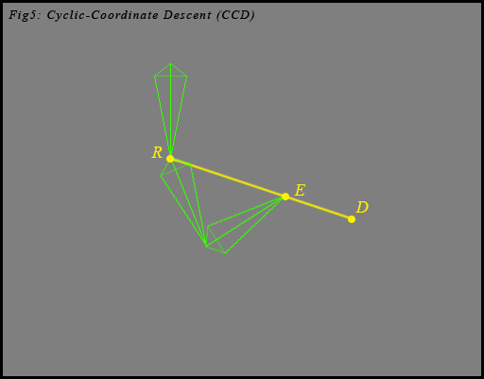
Cyclic Coordinate Descent

Slide 47
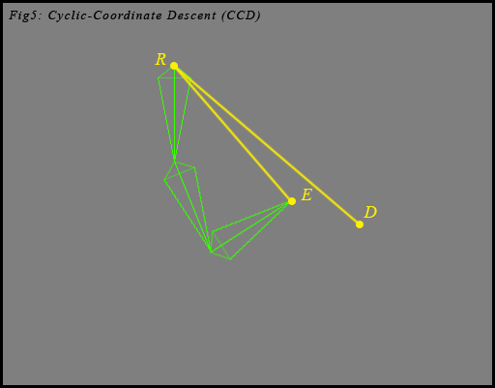
Cyclic Coordinate Descent

Slide 48
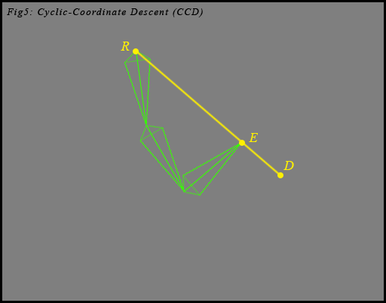
Cyclic Coordinate Descent

Slide 49
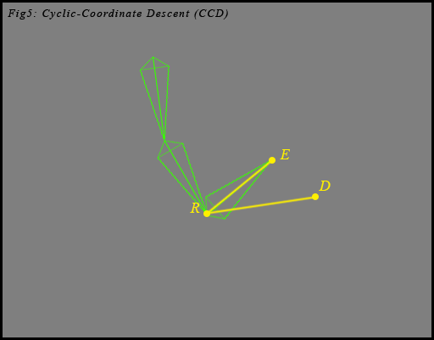
Cyclic Coordinate Descent

Slide 50
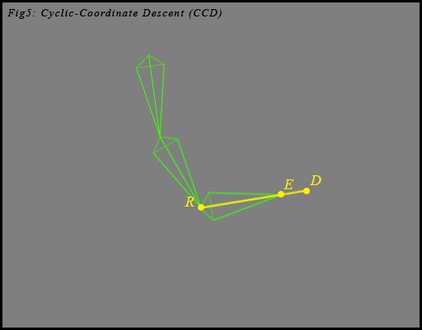
Cyclic Coordinate Descent

Slide 51
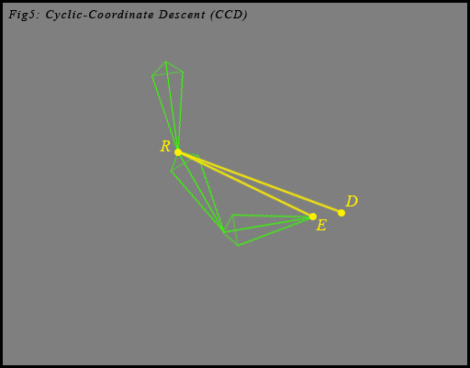
Cyclic Coordinate Descent

Slide 52
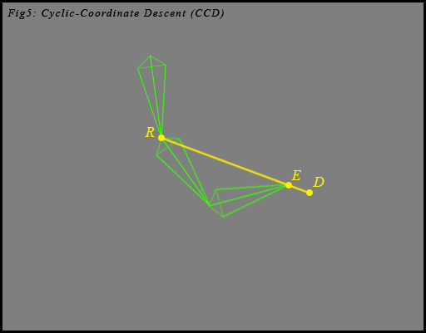
Cyclic Coordinate Descent

Slide 53
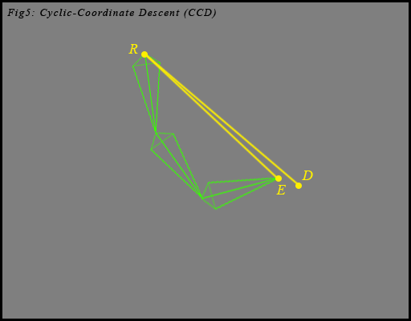
Cyclic Coordinate Descent

Slide 54
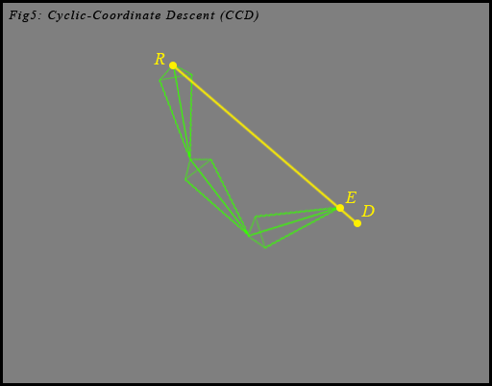
Cyclic Coordinate Descent

Slide 55
Unity
You can design characters and their motions using Maya or Blender
Then import into Unity
Unity controls the animation
You can find free characters from the Unity asset store
Miximo
Poser demo

Slide 56
Hierarchical Articulated Model
Represent an articulated figure as a series of links connected by joints
Enforce limb connectivity in a tree-like structure
root

Slide 57
Hierarchical Modeling (Remember)
Relative motion
Parent-child relationship
Simplifies motion specification
Constrains motion
Reduces dimensionality

Slide 58
Modeling & Animating Hierarchies
Three aspects:
Linkages & Joints
The relationships
Data structure
How to represent such a hierarchy
Converting local coordinate frames into global space

Slide 59
Hierarchical Structure

Slide 60
Tree Structure

Slide 61
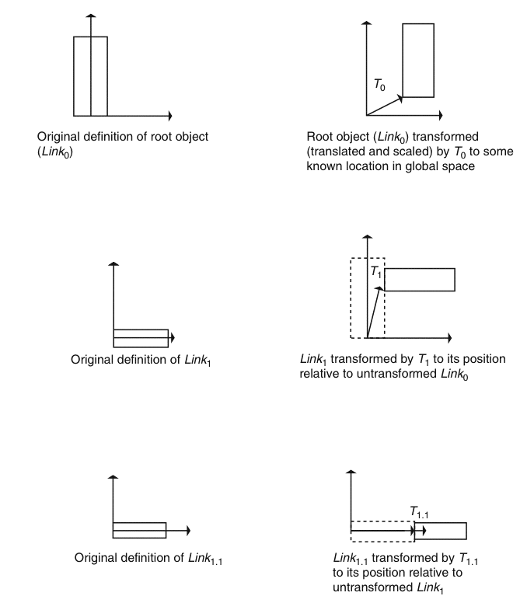
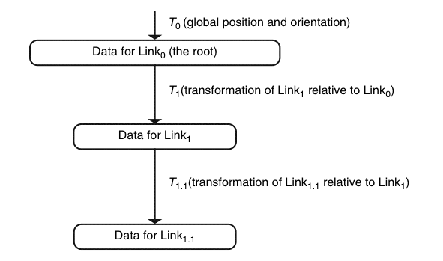

Slide 62
Relative Movement

Slide 63
Tree Structure

Slide 64
Arbitrary number of children
Array of pointers to children
Node points to first child
Each child points to next sibling

Slide 65
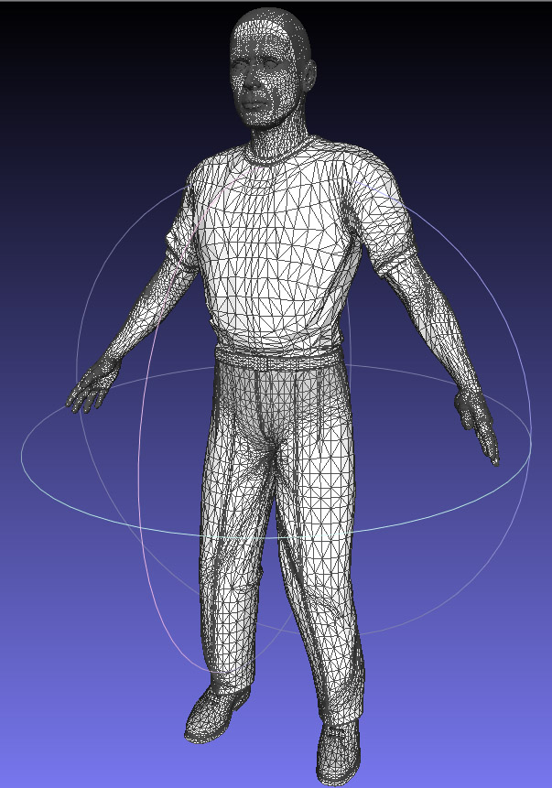
Skinned Human Body
Skinning
Skeleton representation
Polygonal representation

Slide 66
Review: Skeleton Model
Joint A
Joint A
Bone 1
R₁X+b₁
Bone 1
Joint B
Joint B
Bone 2
R₂X+b₂
Bone 2
Joint C
Joint C
Each bone is doing rigid transformation.

Slide 67
Skinning/Rigging
Let x be a skin vertex in the original space
We can transform x as the combination of the transformations caused by two bones:
w₀(R₀x+b₀) + w₁(R₁x+b₁)
W₀ and w₁ are constant weights.
When there are more bones, there are also more weights…
Demo

Slide 68
Skinned Meshes
Bones within model
Think of as thin rigid body cylinders with joints
Only need keyframes of transformations
Or procedural movement of the rigid body bones.

Slide 69
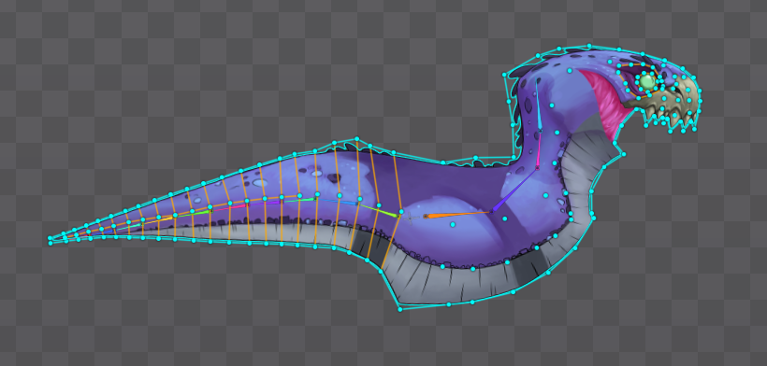
Skinned Meshes
Need a relationship between the mesh vertices and the bones.
http://esotericsoftware.com/spine-weights

Slide 70
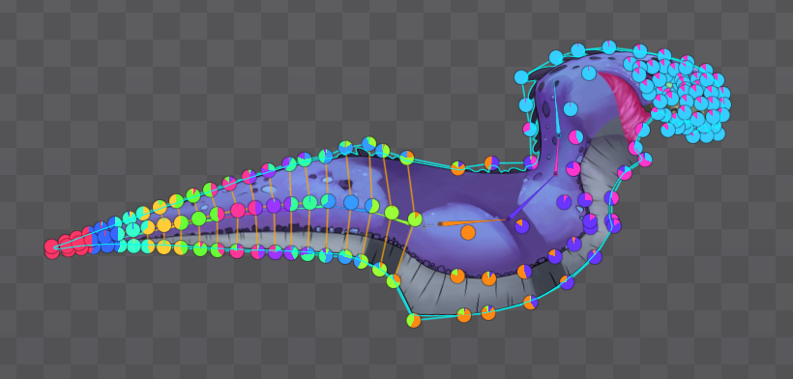
Skinned Meshes
A vertex can be affected by several bones.
2
3
4?
http://esotericsoftware.com/spine-weights

Slide 71
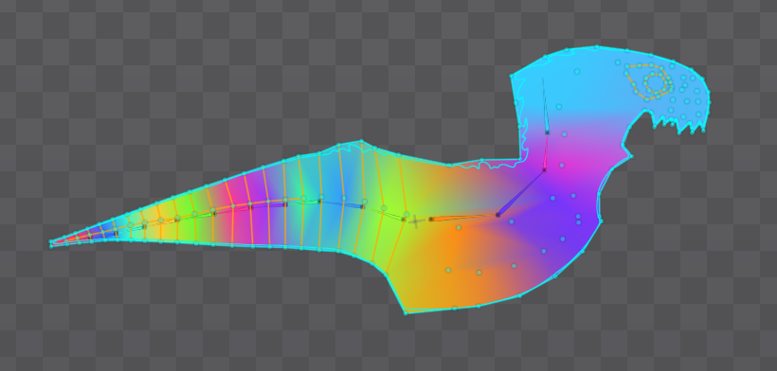
Skinned Meshes
A vertex can be affected by several bones.
http://esotericsoftware.com/spine-weights

Slide 72
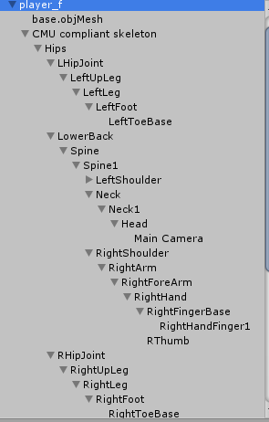
Skinned Human Body
Humanoid pose and skeletal tree. Root at the hip
15-40+ bones
Mixamo
(Note, skull shows the bones)

Slide 73
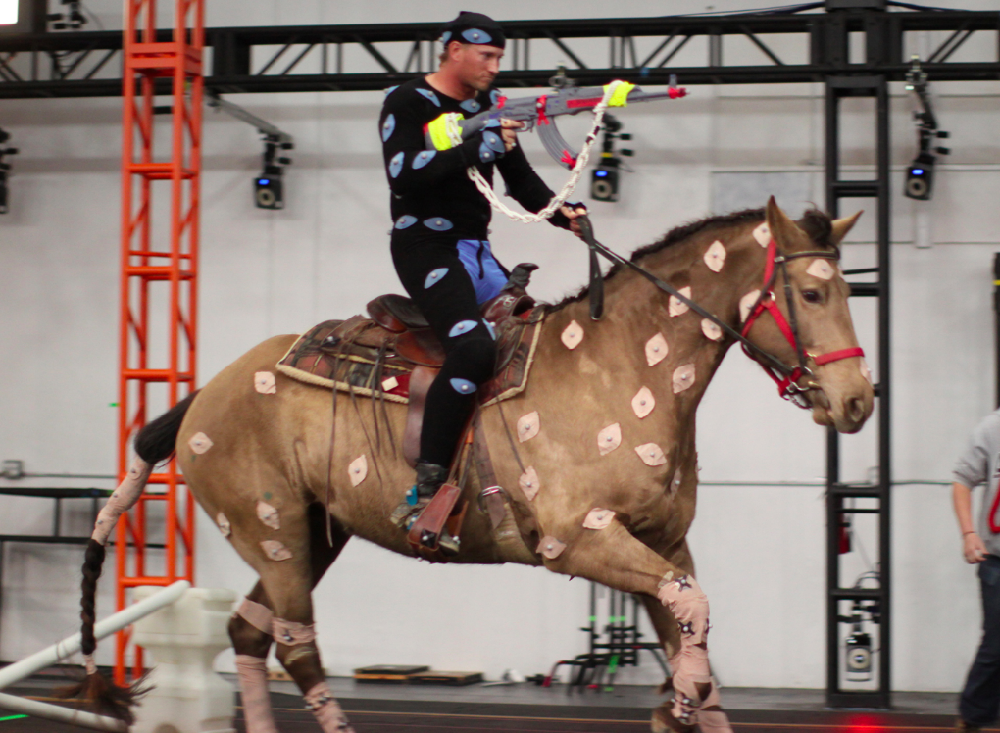
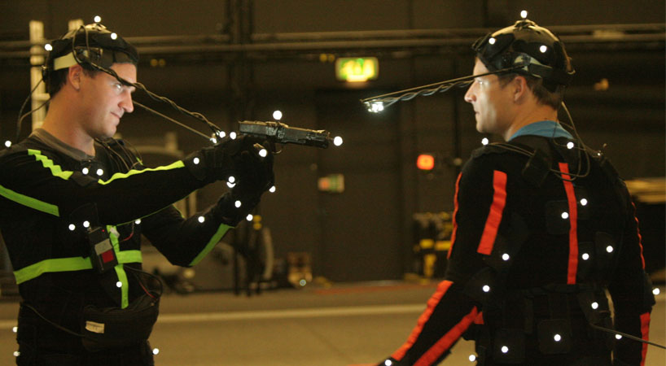
Motion Capture
Record motions to re-use on models
Use sense-able markers to retrieve positional and possibly rotational states

Slide 74
Mo Cap Technologies
Optical – Video capture
Passive – Markers reflect light
Active – Markers emit light
Magnetic
Active sensors sense their position and orientation in a magnetic field
Electro-mechanical
Rotors connected to limb-aligned rods record their status

Slide 75
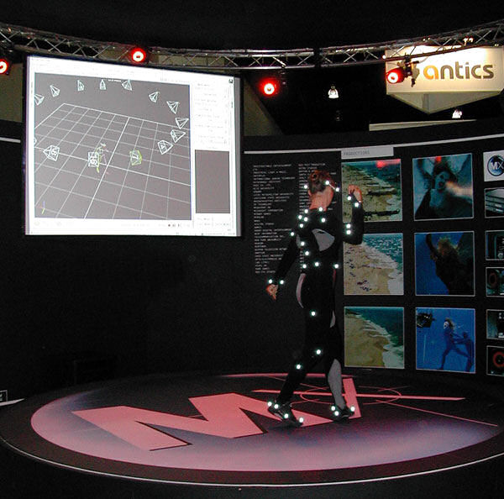
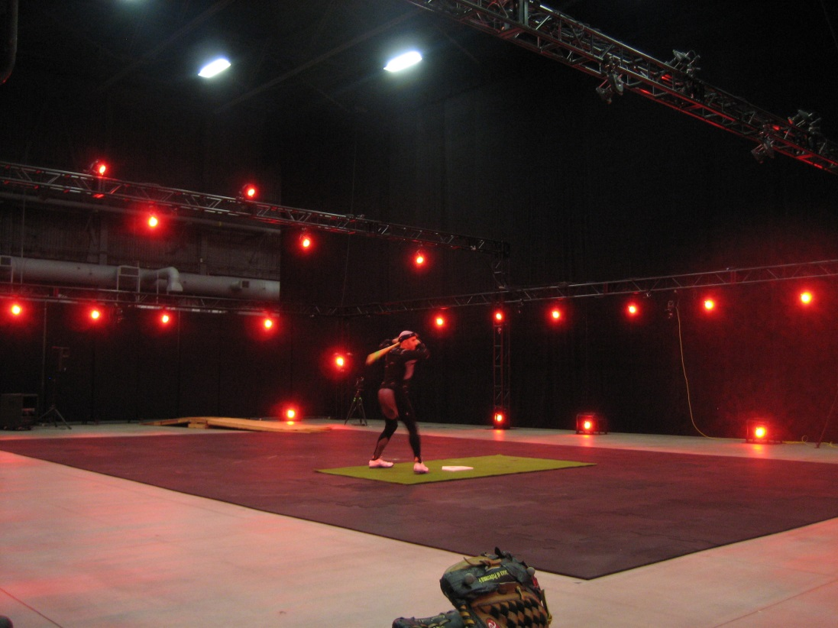
Optical - Passive
Markers reflect light

Slide 76
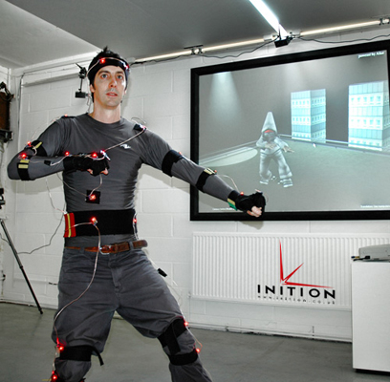
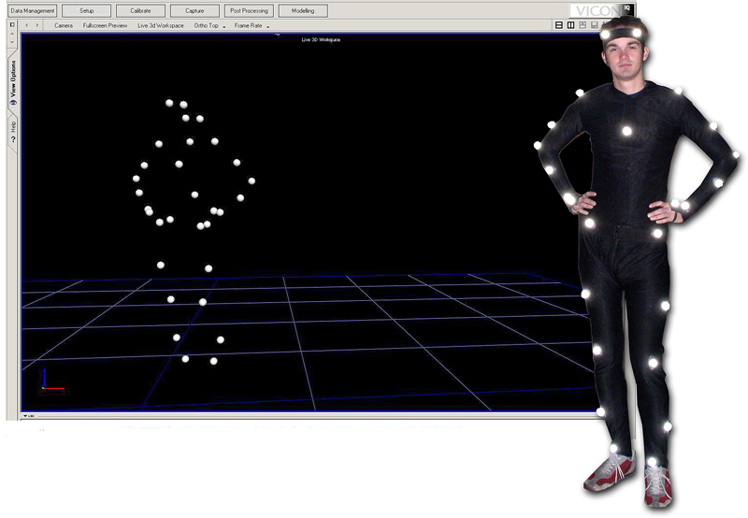
Optical - Active
Markers emit light

Slide 77
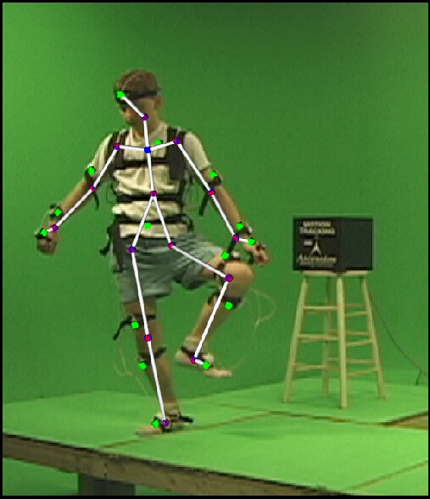
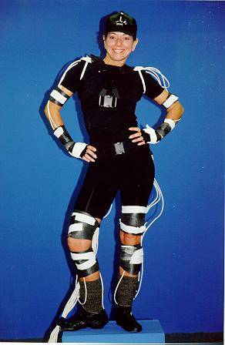
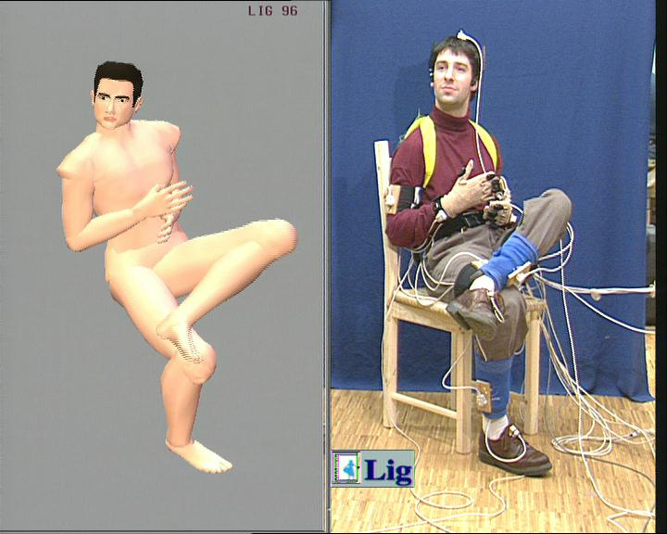
Magnetic
Example: Ascension technology http://www.ascension-tech.com/

Slide 78
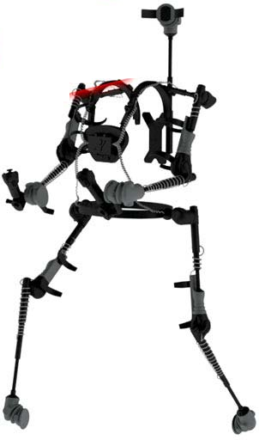
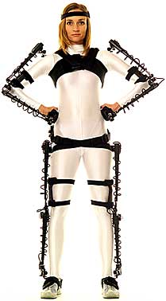
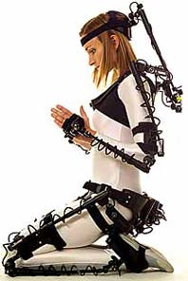
Electro-mechanical
Example: Metamotion http://www.metamotion.com

Slide 79
Newer Mo Cap Technologies
Inertial systems (similar to Wii technology)
Make-up (fluorescent powder)
Semi-passive imperceptible markers
Emit light and observe changes
Kinect uses infrared
Markerless systems
Video tracking
Notes:
Inertial motion capture^{[20]} technology is based on miniature inertial sensors, biomechanical models and sensor fusion algorithms. The motion data of the inertial sensors (inertial guidance system) is often transmitted wirelessly to a computer, where the motion is recorded or viewed

Slide 80
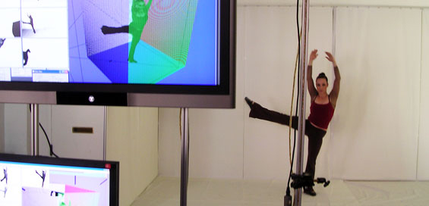
Markerless
Examples: www.organicmotion.com/ www.image-metrics.com/ (facial)

Slide 81
References
Using the Kinect in Unity
http://channel9.msdn.com/coding4fun/kinect/Unity-and-the-Kinect-SDK
Sample files
http://accad.osu.edu/research/mocap/mocap_data.htm
http://mocap.cs.cmu.edu/
https://sites.google.com/a/cgspeed.com/cgspeed/motion-capture
http://www.turbosquid.com/
http://www.motioncapturedata.com/
Tools
MotionBuilder
Maya
3DSMax

Slide 82
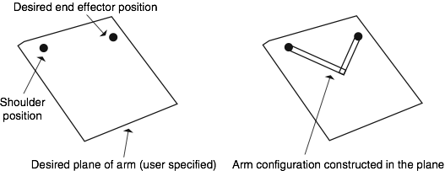
Modeling Motion
Reaching (model the arm)

Slide 83
Modeling Motion
Grasping (model the hand)

Slide 84
Modeling Motion

Slide 85
Modeling Locomotion
Walking

Slide 86
Modeling Locomotion
Running

Slide 87
Modeling Locomotion
Ankle to toe bend

Slide 88
Modeling Locomotion
Examples
Swimming
Falling and Accidents
Matching human movements to non-humans

Slide 89
Facial Animation
Motion capture (Many people don’t like this)
Real-time face capture (Siggraph)

Slide 90
Facial Animation
Parameterized facial attributes
Example: http://www.facegen.com/

Slide 91
Facial Animation
Blend shapes
Example:
https://www.youtube.com/watch?v=1nAWqQSH7fk
Interpolate between 3D models

Slide 92
Facial Animation
Muscle models (surface vs deep muscles)

Slide 93
Facial Animation
Surface muscle model
Example: Geometry-based Muscle Modeling for Facial Animation
Kolja K¨ahler J¨org Haber Hans-Peter Seidel

Slide 94
Real-Time Face Capture

Slide 95
Hair and fur

Slide 96
Hair Animation
Complexity
On the order of 100,000 strands
Collisions
Shadowing
Reflections
Hair type
Populate head with hair
Design hairstyle
Animate hair
Example:Strands and hair modeling, animation, and rendering, Siggraph 2007 Course notes

Slide 97
Poor Hair Animation
Rigid mesh

Slide 98
Hair Animation
Physically based
Model each strand (linkages and springs)

Slide 99
Hair Animation
Physically based
Groups (Hierarchical modeling)

Slide 100
Hair Animation
Particle System

Slide 101
Hair Animation
Physically based modeling
Computationally expensive (collisions)
Simulate a small number of hairs and then interpolate hair strands
Movie Brave example
Data-driven
Hair capture and modeling from videos
Manipulating the hair in videos directly!

Slide 102
Facial Hair and Fur
Facial Hair: Disney Research
Fur: Real-time Fur over Arbitrary surfaces paper
Notes:
At runtime, the patches of volume textures are rendered as a series of concentric shells of semi-transparent medium. To improve the visual quality of the fur near silhouettes, we place “fins” normal to the surface and render these using conventional 2D texture maps sampled from the volume texture in the direction of hair growth.

Slide 103
Fur Animation

Slide 104
Cloth Animation
Reference: “Techniques for Animating Cloth”, by M. Yalcin, C. Yildiz

Slide 105
Cloth Modeling
Total energy = repel + stretch + shear + bend + gravity

Slide 106
Cloth Interaction

Slide 107
Cloth Animation

Slide 108
Cloth Animation

