Slide 1
Game Design and Development Physics
CSE 5912
Prof. Roger Crawfis

Slide 2
Physics Types
Kinematics / Newtonian
Fluid flow
Facial animation
Free-form deformations
Soft-body
Cloth
Fracture
Carving
Fluid-object interaction
Atmospheric
Tire tracks / footprints, bullet holes
Will focus on Collisions and Kinematics

Slide 3
Collisions
Two aspects of collisions:
Collision Detection – How do we detect two objects collided?
Collision Response – What should happen as a result of the collision?

Slide 4
Collision Detection
Whole books (and libraries) are written on this.
Many complex geometric algorithms.
Optimized to avoid the N^2 complexity (check every object against every object).
Actually, avoid checking every triangle against every triangle!!!!!
More expensive algorithms to handle:
Does it matter what Time 1 is?
Object B
Object B
Object A
Object A
Fast moving object
Time 1
Time 0
Very thin object

Slide 5
Collision Response
Many books are also written on this. Even more complex!
Pseudo-real physics: deformations, fluids, precise contacts
Cheap physics
RigidBody with detailed mesh
Cheaper physics
RigidBody with simplified mesh
Do nothing
Perform the Macarena
Die, play animation
Who cares? Off-screen, no real impact on game play, …
Your world is Virtual!!!
Act (write code) like it!

Slide 6
Unity Collision Detection
Collision detection will happen when a GameObject (not a mesh or model!) has a collider component:
Sphere Collider - fastest
Box Collider
Capsule Collider
Terrain Collider
Mesh Collider
Why? What mesh? – avoid, but has its uses (cloth, etc.)
Hierarchy of Colliders

Slide 7
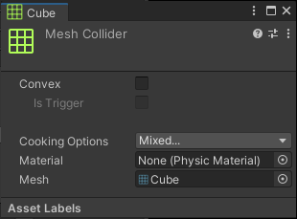
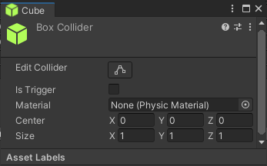
Unity Colliders
Basic colliders require a size and origin. Again, can be disjoint from the model (smaller or larger).
IsTrigger flag indicates whether this is a “wall” or an object that just wants to be notified if anything enters its collider.
Physic material controls friction, bounciness, etc. (Part of RigidBody in 2D).
Mesh Colliders are assumed static unless marked as Convex!

Slide 8
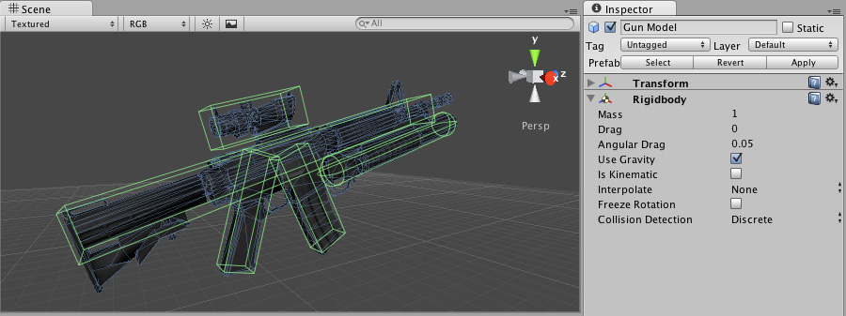
Compound Colliders
Single RigidBody
Child objects have the colliders.
Can get multiple OnCollision callbacks.
RigidBody will apply physics to move the parent (and hence all child colliders).

Slide 9
Unity Collision Detection
Example: Games That Move You has two box colliders attached to their kinematic player. Player movement is disabled if collision is detected:
Box 1 to detect a (possible) future collision with the head (player should squat).
Box 2 to detect a (possible) future collision with the feet (player should shift left or right).
Notes:
Collider has nothing to do with model.
No collider is on or associated with the actual (animated) model.
Response is handled via triggers.
Colliders

Slide 10
Collision / Trigger Table
See: Unity - Manual: Colliders (unity3d.com)
Basically:
If one of the entities is non-static AND both have a Rigidbody ANE one is not Kinematic (i.e., a Trigger).
OnCollisionEnter, OnCollisionStay and OnCollisionExit are called.
If one of the entities is non-static AND only one is a Trigger
OnTriggerEnter, OnTriggerStay and OnTriggerExit are called.
If both are static or both marked isKinematic.
No check or callbacks.

Slide 11
Unity – Rigidbody vs Trigger
Careful!!
This Object is Kinematic, meaning it does not move based on Physics. But it does exert forces on other objects.
Turns on the Physics Engine
Moving object?
Responds to forces?
Yes
Add Rigid Body
Yes
No
No
No
IsKinematic disables the “default” response.
Only Decorative?
Make Static
Make Kinematic
Yes
How does it know to exert force?
Great for doors, bullets or empty GameObjects
Exerts forces (blocks)?
No
Make it a Trigger
(w/o RigidBody)
Remove Collider

Slide 12
Static
Helps the physics engine (Assumed on objects w/o rigid bodies).
Reduces the number of collision detection pairs to:
Dynamic vs. dynamic objects
Dynamic vs. static objects
Does not mean there is no response. Often this is the behavior, but you control the behavior, not the physics engine.
Fracture models
Switches
Visual responses (particle affects, force fields, etc.)
Death
If you move a static object, then optimizations are invalid and must be re-computed.

Slide 13
Unity RigidBody Collision Response
Unity’s rigid body response only affects the Transform (hence, rigid). The shape, material, color of the object stays the same.
You can program your own changes.
IsKinematic disables this.
OnCollision methods used for additional responses

Slide 14
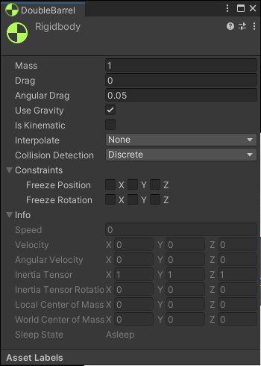
Unity Rigidbody Settings
A heavy mass doesn’t freefall any faster than a low mass.
Think of Drag and Angular Drag as the effect of wind on the object.
Zero drag => no effect (heavy)
High drag => chaff in the wind
Can constrain the y position to stay on a plane (nothing gets “launched”)
Constraining rotations is useful.
Turn off gravity for static rigid bodies.

Slide 15
Demo
Unity 2020.2 Demo – RigidBodiesVersusTriggers project.

Slide 16
Bullets, Arrows, Projectiles
IMHO IMAO: Never, ever, ever use physics for bullets!!!
No colliders, no models, no rigid bodies, …
Your (default) physics engine will break => no collisions
Almost never want a response to what the bullet collided with.
If you want a barrel or something to move when shot, then apply your own force.
Alternative: Use ray-casting (in the same frame) with layers.
Arrows – ditto!
Projectiles – Only if very slow like Angry Birds.

Slide 17
Issues
Only have one RigidBody component in a hierarchy of objects.
2020.2 added IsKinematic RigidBodies with Articulated joints.
Non-kinematic rigidbodies will affect the simulation as well as be affected by the simulation themselves (they will push stuff and get pushed by stuff).
Kinematic rigidbodies will affect the simulation, but not be affected by it themselves. So they will push stuff, but do not respond to something pushing them.
Colliders on GameObjects without rigidbodies in their transform hierarchy are considered static. The physics simulation will bake them into a model of the static collision world.
If you move a static collider, the physics simulation will have to re-bake the static world.

Slide 18
Runtime State Change
A Rigidbody component can be switched between normal and kinematic behavior at any time using the IsKinematic property.
A common example of this is the “ragdoll” effect where a character normally moves under animation but is thrown physically by an explosion or a heavy collision. The character’s limbs can each be given their own Rigidbody component with IsKinematic enabled by default. The limbs will move normallly by animation until IsKinematic is switched off for all of them and they immediately behave as physics objects. At this point, a collision or explosion force will send the character flying with its limbs thrown in a convincing way.

Slide 19
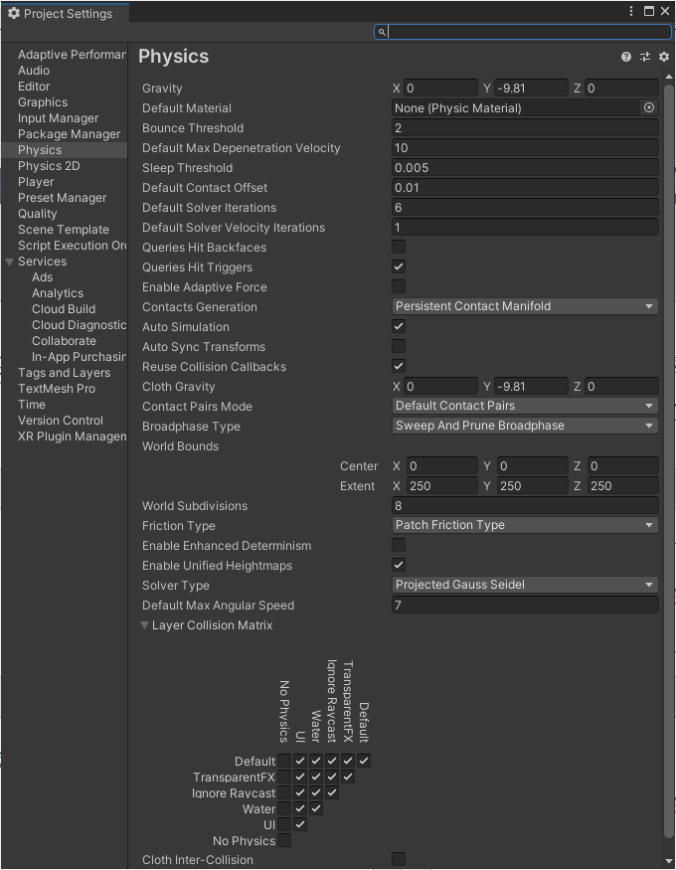
Unity Physics
Get a PhD in Physics!
Trade quality for performance and vice versa.
Remove physics by placing objects in user-defined layers.

Slide 20
Physics and NavMesh
Should a NavMeshAgent have a RigidBody component?
No?
How do NavMeshAgents work with other rigid bodies?
NavMeshPlayground scene

Slide 21
DOTS Physics
Colliders -> Physics Shapes
RigidBodies -> Physics Bodies

Slide 22
Thank-You
Questions?
Exercise: A sliding door that:
Blocks the player if not completely open.
Automatically, but slowly opens the door when approached.
Case 1: Player is kinematic (position)
Case 2: Player is not (Force, NavMesh)
If player has a key?

