Slide 1
Computer Games and Animation Math Review
CSE 3541
Prof. Roger Crawfis
Slides prepared by Dr. Matt Boggus, Dr. Naeem Shareef and Dr. Roger Crawfis, The Ohio State University

Slide 2
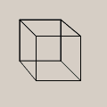
Thinking Ahead
Fact or Fiction?
Any sequence of rotations r₁,r₂, … is equivalent to a single rotation r_{ϕ} , where:
r_{i} == some angle θ, and axis $\vec{v}$.
Fact

Slide 3
Outline
Primitives and operations on them
Scalars
Vectors
Points
Coordinate Spaces

Slide 4
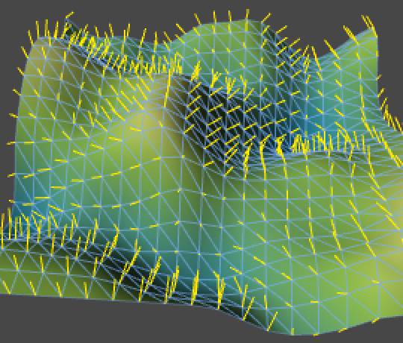
Usage
Why learn this?
All geometry is defined by points.
Transformations, like movement and placement, are defined within a (set of) coordinate system(s) using vectors.
https://catlikecoding.com/unity/tutorials/noise-derivatives/

Slide 5
Scalars
Scalar value – a number (integer or real) ; one unit of data
Ex: the scale, weight, or magnitude of something
Examples elsewhere in CS&E
(Software I) 2 scalars -> low and high for random number range
(Systems I) Representing fractional values using binary numbers
Notes:
Au’16 deleted slides on qualities and properties of scalar addition and multiplication

Slide 6
Operations on scalars and their effects
Add another scalar
y += 2
Multiply by another scalar
y *= 2
Add a product of scalars
y += 2 * rate
Assign to another scalar
y = 2
y = cos(x)
Divide by another scalar
y /= 3.1415
Comparison
y < 5, y == 3.14
Absolute value
|y| >= 0

Slide 7
Scalar Representation
Machine / language specific, but in C# / .NET
Integer
System.Int16 == short
System.Int32 == int
System.Int64 == long
System.Byte == byte
Note: unsigned int8 with values from 0 to 255.
Newer versions of .Net added UInt32, etc.

Slide 8
Scalar Representation
Machine / language specific, but in C# / .NET
Real Numbers
System.Single == float
System.Double == double
System.Decimal == a cross between Fixed floating point and double-double.
Fixed floating point
Uses an integer with a fixed scale factor to divide by.

Slide 9
Properties of Scalars
Rules for scalar operations (yes, basic but important when we get to spaces that these do not hold)
Set
Commutative
Associative
Distributive

Slide 10
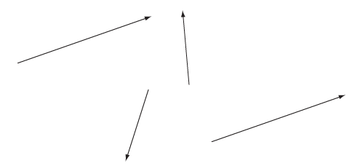
Vectors
Vector – often used to represent a direction or change in another quantity (ex: velocity)
Mathematically described as n-tuples of scalars
Examples: (0,0,0) (x,y) (r,g,b,a)

Slide 11
Vector operations
Vector-vector addition: add pairwise components
u + v = (u₀ + v₀, u₁ + v₁, …, u_{n-1}, v_{n-1})
Scalar-vector multiplication: multiple all components by the scalar
α v = (α v₀, α v₁, …, α v_{n-1})
Special Vector: Zero Vector
$\vec{u}+ \vec{0}=$ $\vec{u}$
$\vec{u}$+ $\left(−\vec{u}\right)=\vec{0}$

Slide 12
Vector operations – intuitively
Vector-Vector Addition
Visualize using head-to-tail axiom
Scalar-vector multiplication
Resize (scale) the
directed line segment
α > 1 length increases
0 > α > 1 length decreases
α < 0 reverse direction
Head-to-tail axiom
Scalar-vector multiply

Slide 13
Vector decomposition
Represent or operate on components of the vector individually
v = (1,2,3) for a point in 3D Cartesian coordinates
$\overset{→}{x}=1$, $\overset{→}{y}=2$, $\overset{→}{z}=$3
Generalization: In an N-dimensional space, given N independent vectors, we can represent any vector as a composition of the independent vectors with weights.

Slide 14
Vector Spaces
Vectors = n-tuples
$v=\left(v_{1},v_{2},…,v_{n}\right)$
What does this mean?
Defined with respect to some vector space.
Vector space: $R^{n}$
n basis vectors that span the space.

Slide 15
Vector Space
Linear Independence
Linear combination: $\vec{v}=v_{1}{\vec{u}}_{1}+v_{2}{\vec{u}}_{2}+⋯+v_{n}{\vec{u}}_{n}$
Vectors are linear independent if the only set of scalars
is

Slide 16
Vector Space and Basis Vectors
Generalization: In an N-dimensional space, given N independent vectors, we can represent any vector as a composition of the independent vectors with weights.
Called basis vectors:
Usually, unit length
Usually, orthogonal
=> Orthonormal basis vectors
$\vec{v}$ can be represented using e₁ and e₂ or f₁ and f₂.

Slide 17
Vector Space
Dimension
The greatest number of linearly independent vectors
Basis
n linearly independent vectors (n: dimension)
Representation: {v_{i}}
Unique expression in terms of the basis vectors
$$\vec{v}=v_{1}{\vec{u}}_{1}+v_{2}{\vec{u}}_{2}+⋯+v_{n}{\vec{u}}_{n}$$

Slide 18
Vector Norms
Measure the magnitude of a vector
Is the error in x small or large?
General class of p-norms:
1-norm:
2-norm:
∞-norm:
Manhattan distance

Slide 19
Properties of Vector Norms
For any vector norm:
These properties define a vector norm

Slide 20
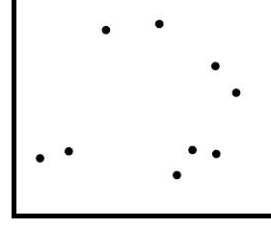
Points
Point – a location or position
Visualized as a dot relative to an origin
Mathematically described as n-tuples of scalars
Examples: (0,0,0) (x,y) (r,g,b,a)

Slide 21
Thinking ahead
Can we think of any vector (or point) as lying in a space of higher-dimension? Or this vector lies in a hyper-plane of a higher-dimensional space.
(x,y) = (x,y,0)? Or (x,y,1) Or (x,y,w), where w is a constant
(x,y,z) = (x,y,z,1)?
…

Slide 22
Coordinate system
Board work examples: 1D, 2D, 3D coordinate systems
Notes:
Instances of primitives are defined within the context of a coordinate system, so refresh with examples of these first.

Slide 23
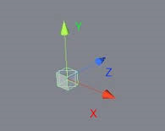
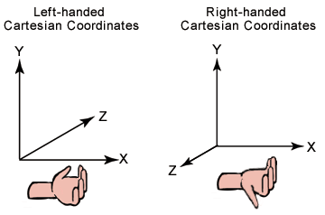
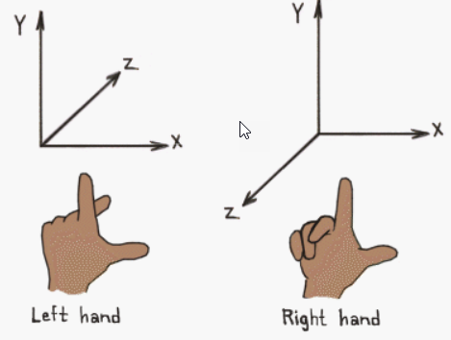
Coordinate system in Unity
3D, right- or left-handed coordinate systems
x-y-z
y-z-x
z-x-y
Which one?

Slide 24
Coordinate system or Frame
Origin – a point
Indicates the “center” of the coordinate system
Other points are defined relative to the origin
Basis vectors
A set of linearly independent vectors
Basis
vectors
located
at the
origin
Vectors are only directions. Placement doesn’t matter

Slide 25
Vectors and points in a system
Coordinate frame defined by point P₀ and set of vectors v_{0,} v₁, …, v_{n-1}
A vector v = α₀v_{0,} α₁v₁, …, α_{n-1}v_{n-1}
A point P = P₀ + β₀v_{0,} β₁v₁, …, β_{n-1}v_{n-1}
where α and β indicate scalar values

Slide 26
Point-Vector operations
P and Q are points, $\vec{v}$ is a vector
Point-point subtraction operation
$$\vec{v}=P−Q$$
Vector-point addition operation
$$P=\vec{v}+Q$$
$\vec{\left(P−Q\right)}+\vec{\left(Q−R\right)}$= $\vec{\left(P−R\right)}$
$P=\vec{0}+P$
P

Slide 27
Point-Vector operations
What about point plus point?
No!
What about vector addition and subtraction?
Fine – (v + (-1*u))
What about a scalar times a point?
No! Maybe? We will see.
Equivalence between points and vectors?
No! Well, perhaps, .. No!
Division?
No! Not even sure what that means.
Is this just a mathematical purism?

Slide 28
Working toward a distance metric
The previous operations do not include a way to determine a length or estimate the distance between points
Create a new operation: Inner (dot) Product
Input: two vectors
Output: scalar
Properties we want:
For orthogonal vectors

Slide 29
Dot product logic
The dot product thus provides:
Magnitude (length) of a vector
Distance between two points
Notes:
Note: some reference materials use || instead of |

Slide 30
Dot product computation
Dot product of two vectors, u and v
Ex: (5,4,2) ∙ (1,0,1) = 5 * 1 + 4 * 0 + 2 * 1 = 7
With some algebra we find that the dot product is equivalent to where θ is the angle between the two vectors
cosθ = 0 ➔ orthogonal
cosθ = ±1 ➔ parallel

Slide 31
Angles
Degrees, Radians, Gradians
90° = π / 2 radians
180° = π radians
270° = 3π / 4 radians
360° = 2π radians ≠ 0°
Unity Inspector will show Degrees.
UnityEngine.Mathf.Cos() takes Radians
System.Math.Cos() and System.MathF.Cos() take Radians
Use Mathf.PI or MathF.PI if needed

Slide 32
Projecting a vector to another vector
We can determine if two points are “close” to each other, what about vectors?
How much of w is in the same direction as v?
Given vectors v and w, decompose w into two parts, one parallel to v and one orthogonal to v
Projection of one
vector onto another
Notes:
Step 1: decompose w into two parts, one with some unknown amount (alpha) in the same direction as v (hence the scaling of v by alpha) plus some vector u whose direction we define as orthogonal to v but has an unknown magnitude.
Step 2: Dot product w and v, but substitute the decomposition of w and distribute.
Step 3 (same line as step 2): by definition u dot v is zero and drops out
Step 4: solve for alpha
Step 5: solve for u

Slide 33
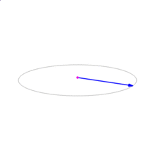
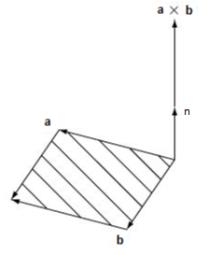
Cross product
Input: two vectors
Output: vector, orthogonal to input vectors
General formula
$$a⨂b=\left|a\right|\left|b\right|\sin{θ}∙\vec{n}$$
Two 3D vectors
$$=\left(aybz −azby, azbx −axbz, axby−aybx\right)T$$
http://en.wikipedia.org/wiki/Cross_product
Modified Figure 1.1.6 from Essential Mathematics for Games and Interactive Applications
Notes:
Note: sin and cos (also sin⁻¹ and cos⁻¹)can be expensive to compute – involves computing a series until sufficient precision is reached
See After computers: power series on page http://www2.clarku.edu/~djoyce/trig/compute.html

Slide 34
Thinking ahead
Can we think of any vector (or point) as lying in a space of higher-dimension? Or this vector lies in a hyper-plane of a higher-dimensional space.
(x,y) = (x,y,0)? Or (x,y,1) Or (x,y,w), where w is a constant
(x,y,z) = (x,y,z,1)?
…
Sure, but why?

Slide 35
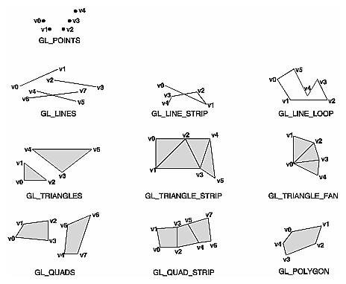
Summary
Primitives and operations on them
Scalars
Vectors
Points
Coordinate Spaces
Basis vectors

Slide 36
Thinking ahead
Can we think of any vector (or point) as lying in a space of higher-dimension? Or this vector lies in a hyper-plane of a higher-dimensional space.
2D Point (x,y)^{T} -> (x,y,1)^{T} in 3D
2D Vector (x,y)^{T} -> (x,y,0)^{T} in 3D
Important when we talk about transformation matrices, M, later (and their transpose, M^{T}).
Point ≠ Vector

