Slide 1
Games and Animation History
CSE 3541
Prof. Roger Crawfis

Slide 2
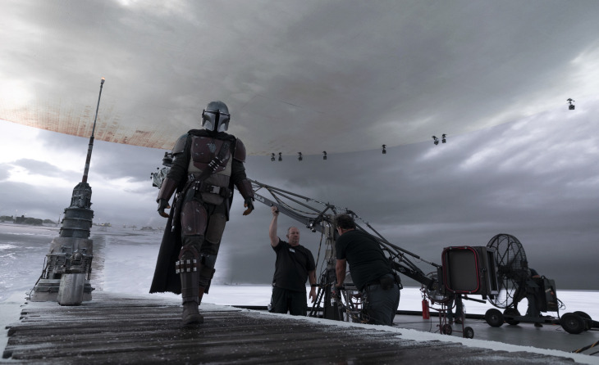
Objectives
Won’t spend much time on this.
Things are changing (always)
Virtual sets and cinematography
Rapid Prototyping (VR sets) versus pencil sketches and mock-ups
https://www.youtube.com/watch?v=trUexo_Tvkg

Slide 3
Computer Graphics application areas
Film/TV/Ads
Computer-aided design
Visual arts, Concerts
Scientific visualization
Computer games
Esports, speed-running, physical training and rehabilitation, VR
Fashion

Slide 4
Exemplar of current tools – Maya
Notes:
Image source, with label documentation
https://knowledge.autodesk.com/support/maya/getting-started/caas/CloudHelp/cloudhelp/2017/ENU/Maya/files/GUID-F4FCE554-1FA5-447A-8835-63EB43D2690B-htm.html?v=2018

Slide 5
Exemplar of current tools – Unity

Slide 6
12 Principles of Animation
Squash and stretch
Arcs
Secondary action
Slow in & slow out
Anticipation
Exaggeration
Solid drawing
Appeal
In-between v. straight ahead
Follow-through
Staging
Timing
To summarize:
Simulate physics
Make it appealing
Effective presentation
https://www.youtube.com/watch?v=uDqjIdI4bF4
Notes:
Both videos for reference ; watch outside of class
Additional notes on time/cost of drawing from scratch vs. tracing ; http://thevirtualinstructor.com/blog/is-it-ok-to-trace-in-art

Slide 7
Computer game history eras
First games, consoles
Video game crash
8 and 16 bit eras
32 and 64 bit eras
Current era
For more on the history of games, check out
The Video Game Revolution | PBS
Notes:
Video linked to watch outside of class

Slide 8
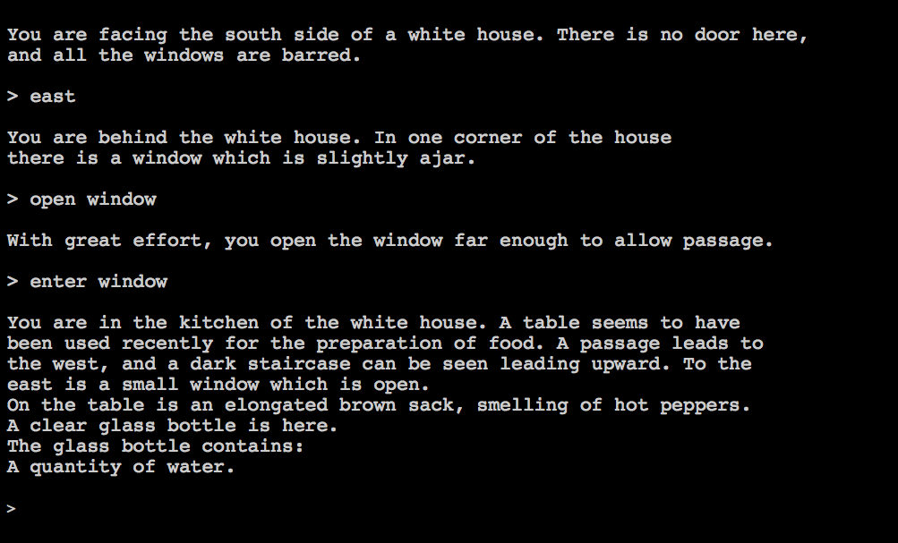
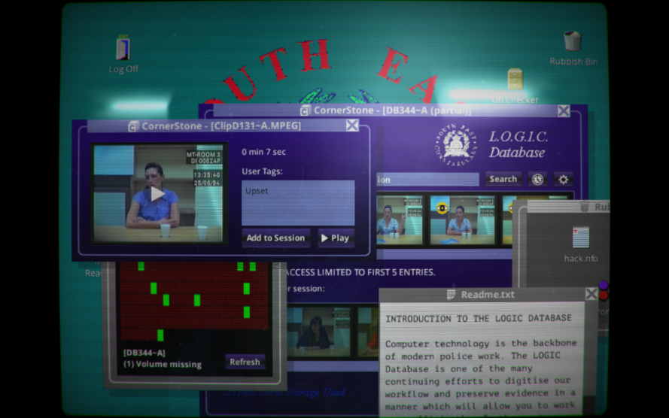
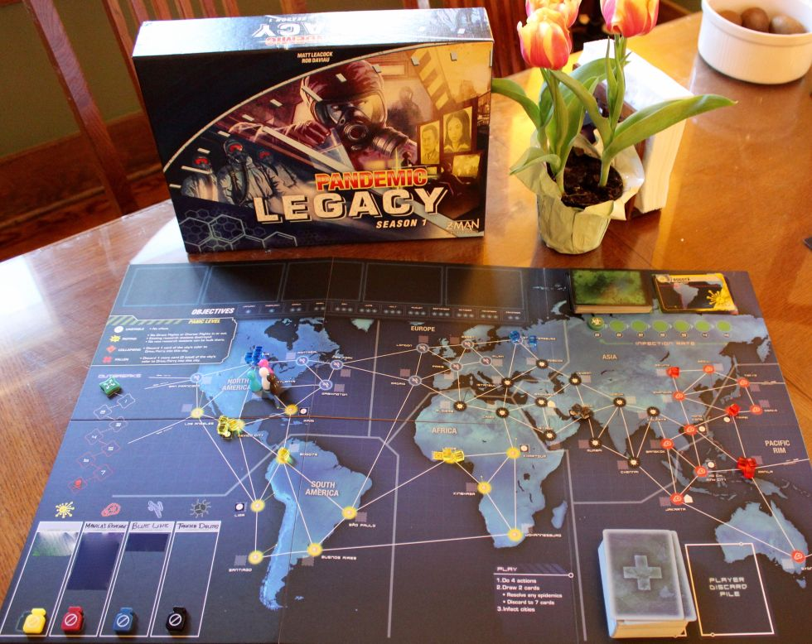
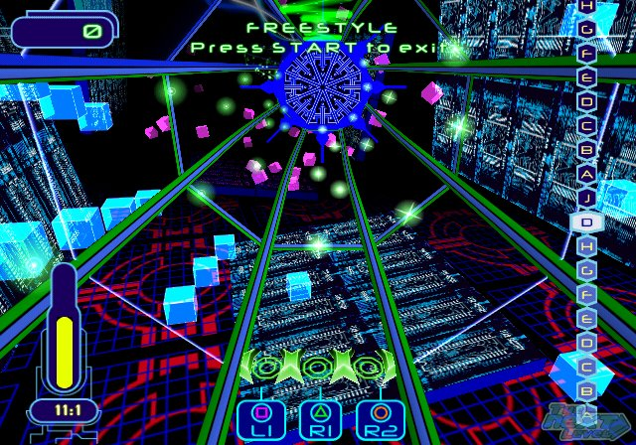
Not enough time to discuss all game types
Notes:
Image sources:
https://nonlinearnarratives.files.wordpress.com/2011/02/zork.png
https://upload.wikimedia.org/wikipedia/commons/thumb/8/83/Her_Story_screenshot_01.png/1200px-Her_Story_screenshot_01.png
https://cdn.arstechnica.net/wp-content/uploads/2016/03/IMG_9737-1-980x778.jpg
https://gamersthumb.files.wordpress.com/2010/07/frequency1.jpg

Slide 9
Game development process
Concept
Design document
Prototype
Production
Design, Levels
Programming
Art, Audio
Testing
Deployment
Maintenance
Note: I am including this in history ☺
Notes:
Similar to animation production pipeline ; again note that rough work is made first

Slide 10
Types of game programming
Game engine
Graphics
Animation
Artificial Intelligence
Sound
Game logic / scripts
User Interfaces
Networking
Databases
Development tools
Systems/Parallel programming / Optimization
Testing
User Experience
Mobile support
Notes:
Note the specialization areas

Slide 11
Film and Games are Big Business
Video game revenue was $180 billion in 2020. That is larger than:
Film ($100 billion)
Sports ($75 billion)
Music ($12 billion)
https://www.businessinsider.com/video-game-industry-revenues-exceed-sports-and-film-combined-idc-2020-12

Slide 12
Employment
Video Games
261,906 in 2021
4.8% annualized growth since 2016
Film and animation
84,000 in film

Slide 13
http://www.newgamernation.com/wp-content/uploads/2011/05/vgdevcost.jpg
Read more at:
http://vgsales.wikia.com/wiki/Video_game_costs
http://www.forbes.com/2006/12/19/ps3-xbox360-costs-tech-cx_rr_game06_1219expensivegames.html
Notes:
Motivates research area of procedural content
(As of Au’16 haven’t come across updated study or data, but $50-60M for biggest titles is accurate)

Slide 14
http://www.newgamernation.com/wp-content/uploads/2011/05/game-cost.jpg
(Data from Forbes 2006 study)
Notes:
Note the three biggest cost areas and practices to reduce those costs

Slide 15
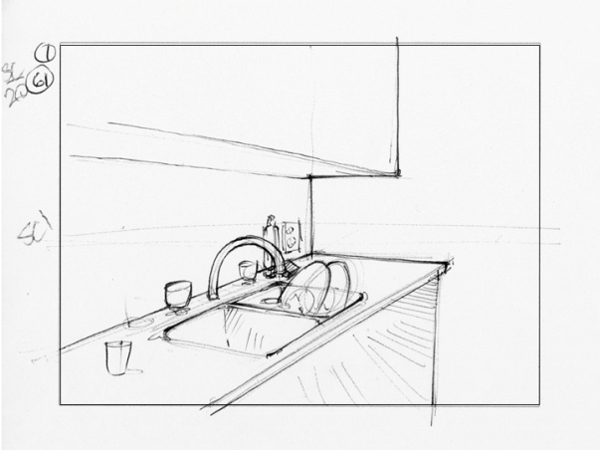
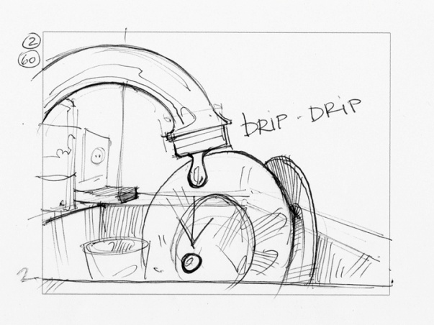
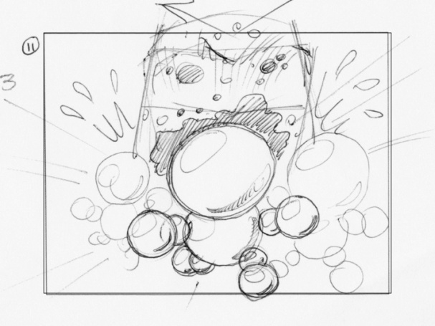
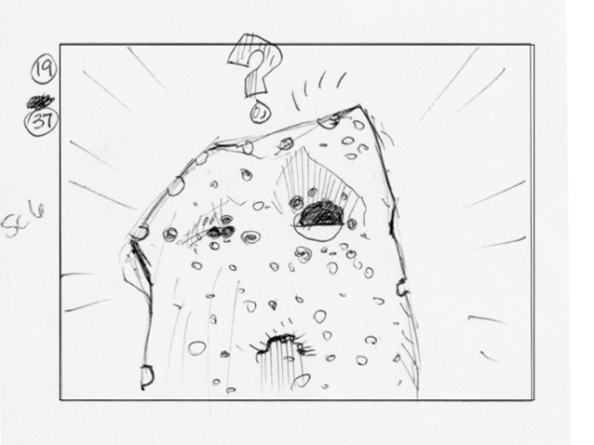
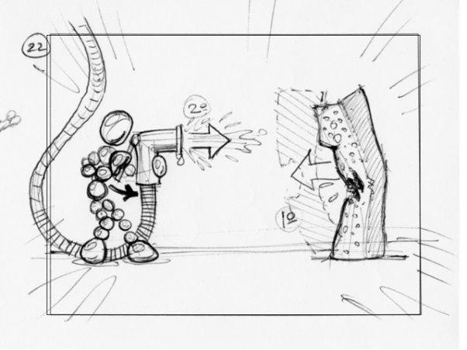
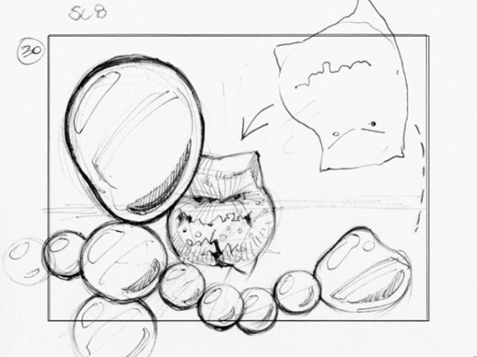
Storyboards for animation
Notes:
Example of student work from CSE 682

Slide 16
Storyboards for video game
https://www.cs.cornell.edu/courses/cs3152/2019sp/labs/design1/

Slide 17
Game Storyboard – Different Levels
https://www.dummies.com/programming/programming-games/designing-video-games/

Slide 18
Storyboard for games

