Slide 1
Games and Animation Course Expectations
CSE 3541
Prof. Roger Crawfis

Slide 2
CSE 3541/5541: Computer Game and Animation Techniques
Instructor: Prof. Roger Crawfis (crawfis.3@osu.edu)
Webpage:
Meeting: TR: 2:20-3:40
Office hours: T: 1:00-2:00, R: 5:15-6:00pm in DL 683
Credits: 3 -> 9 hours of outside course work / week
Prerequisite: CSE 3901, 3902 or 3903 (project design)
Familiar with C#, own computer

Slide 3
What will you learn from this course?
A basic understanding of the game/animation production pipeline
Learn how to implement basic animation effects using the Unity game engine
Learn basic game development programming
Some advanced game and animation algorithms and concepts

Slide 4
Specific Topics: Math
Vector and linear algebra
Transformations and matrices
Coordinate systems and frames
Interpolation
Numerical differentiation and integration
Differential equations and solvers (advanced)

Slide 5
Specific Topics: Physics
Newton’s three laws of motion
Forward and inverse kinematics
Contact: collision and friction
Deformation: elasticity, plasticity, fracture
Fluid dynamics

Slide 6
Specific Topics: Graphics
Some basic graphics knowledge
Geometry
Materials and textures
Lights and lighting
Rendering and shaders
Scene creation, hierarchical modeling
These are touched upon in more detail in CSE 5542 – Realtime Rendering.

Slide 7
Specific Topics: Animation
Key framing
Motion capture
Rigid-body collisions
Rigid-body response
Particle systems (Unity Vfx)
Physically based simulation
Springs, cloth, deformable bodies, fluids, …
And my favorite – Cheating!

Slide 8
Specific Topics: Gameplay
Game loop
Events and event-based programming
Input controls
Character control
Path finding
NPC agents (triggers, AI, etc.)

Slide 9
Specific Topic: Programming
C# async and await keywords
Unity coroutines and IEnumerator
Component-based software architecture
Event-based programming
Attribute-based programming (usage)

Slide 10
Where do I do my labs?
Your own machine … or
Graphics PC Lab
A good graphics card
Platforms: PC, Mac OS (or Linux?)

Slide 11
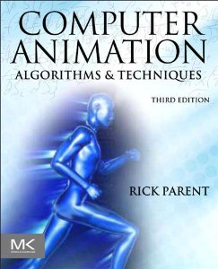
Textbooks
Computer Animation: Algorithms and Techniques
3rd Edition by Rick Parent
Available for OSU students on O’Reilly learn: https://www.oreilly.com/library/view/temporary-access/
Select top entry: Not listed? Click here.
https://learning.oreilly.com/library/view/computer-animation-3rd/9780124158429/

Slide 12
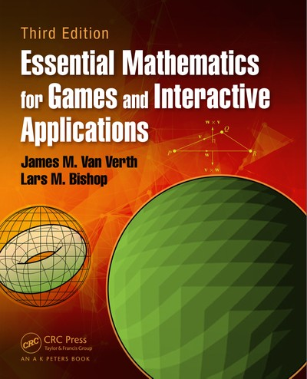
Textbooks
Essential Mathematics for Games and Interactive Applications
By James M. Van Verth, Lars M. Bishop
3rd Edition
Available for OSU students on O’Reilly learn: https://www.oreilly.com/library/view/temporary-access/
Select top entry: Not listed? Click here.
https://learning.oreilly.com/library/view/essential-mathematics-for/9781482250954/

Slide 13
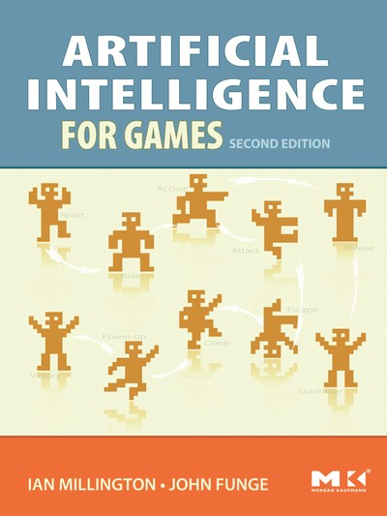
Textbooks
Artificial Intelligence for Games
By Ian Millington, John Funge
2nd Edition
Available for OSU students on O’Reilly learn: https://www.oreilly.com/library/view/temporary-access/
Select top entry: Not listed? Click here.
https://learning.oreilly.com/library/view/artificial-intelligence-for/9780123747310/

Slide 14
Other Reference Material
There are many good videos that:
Grind through doing something in Unity
Explain a theoretical concept.
Tutorials to get you started
Shared on the MS Teams or website or email.
Also, many good (and many poorer) packages (Unity Assets) that do many useful tasks.

Slide 15
Unity3D Game Engine
http://www.unity3d.com
Download the Unity Hub to install the actual app
Real-time game engine
Can be used for animations (film / commercial) as well.
https://unity.com/solutions/film-animation-cinematics
Recently added Sequences support: https://extra-ordinary.tv/2021/06/25/the-new-unity-sequences-support-for-cinemachine/
https://learn.unity.com/project/cutscenes-and-trailers-with-timeline-and-cinemachine

Slide 16
Grading
Six Labs: 45%
Final Lab: 15%
Exams / Quizzes: 25-35%
Three homeworks (TBD): 5-15%
Deadlines are deadlines!
15% penalty each day. (No points after 3 days.) May award +10% for being early
Grader:
Office Hours:
Grader Office:

