Slide 1
Procedural Content Generation
Prof. Roger Crawfis
Computer Science and Engineering
The Ohio State University
http://4.kicksonfire.net
Notes:
This is an excellent name. It is now our name.

Slide 2
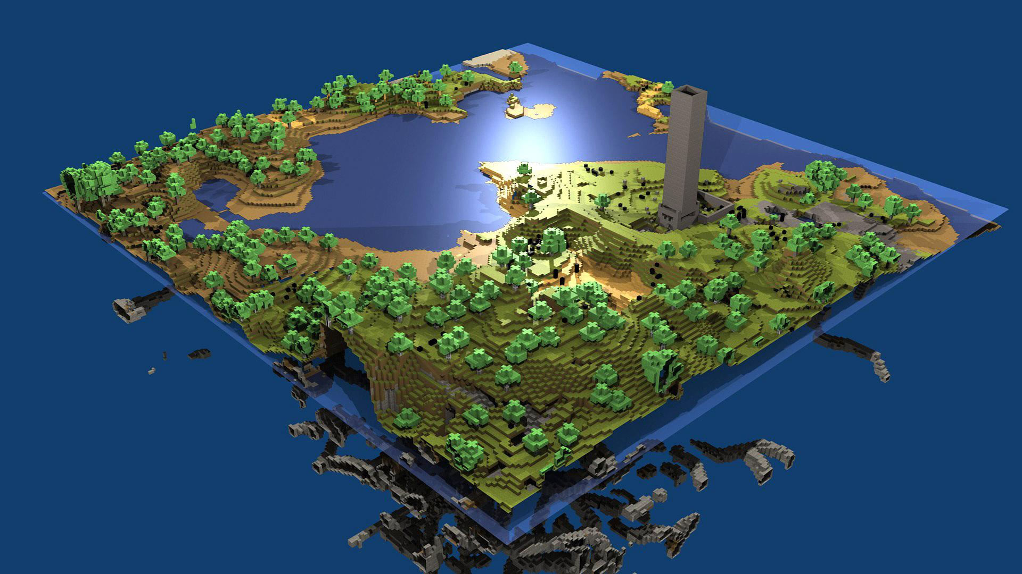
What is Procedural Content Generation?
Content generated algorithmically rather than manually
http://files.tested.com/photos/2012/11/27/41660-minecraft.jpg
Notes:
what pg?

Slide 3
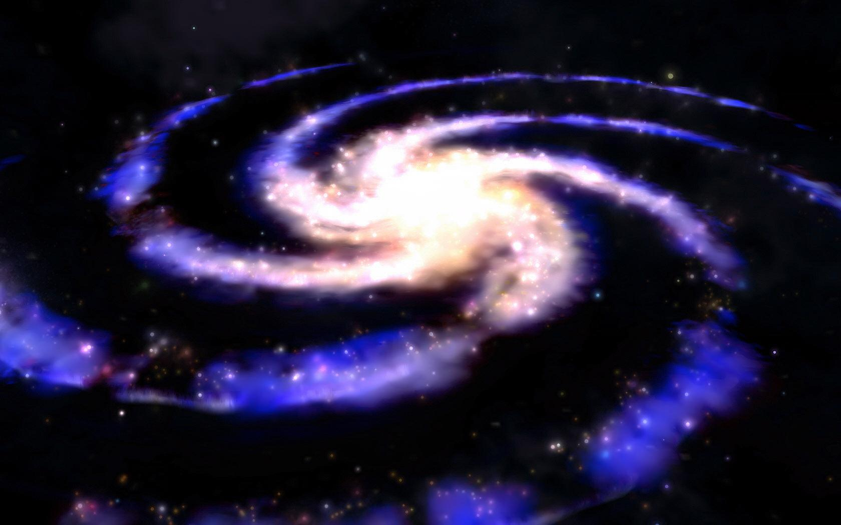
What is Procedural Content Generation?
Procedural refers to the process that computes a particular function
From a few parameters, a large number of possible types of content can be generated
Can be applied to most art assets and even AI behavior
http://img2.wikia.nocookie.net/__cb20110706190126/spore/images/6/61/Haloian_Galaxy.jpg
Notes:
what pg?

Slide 4
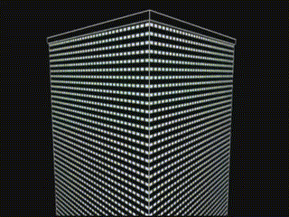
Why Procedurally Generate?
Save time
Notes:
The earliest computer games were severely limited by memory constraints. This forced content, such as maps, to be generated algorithmically on the fly: there simply wasn't enough space to store a large amount of pre-made levels and artwork.
Why PG?

Slide 5
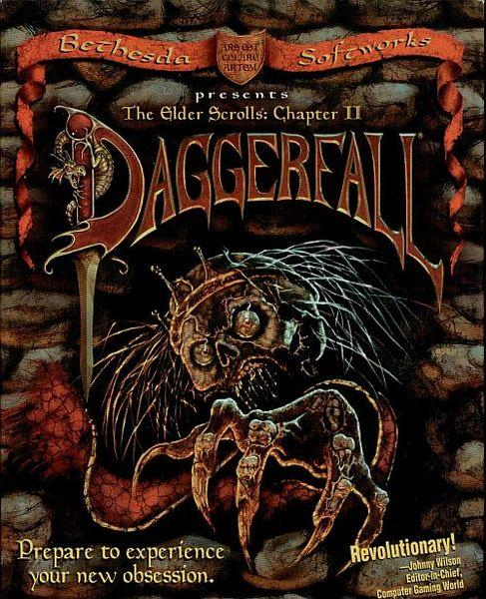
Why Procedurally Generate?
Save space
The Elder Scrolls II: Daggerfall
Over 88,000 square miles
Over 15,000 cities, villages, and dungeons
750,000 NPCs
http://static.giantbomb.com/uploads/original/0/5150/1257508-daggerfall_box1.jpg
Notes:
The earliest computer games were severely limited by memory constraints. This forced content, such as maps, to be generated algorithmically on the fly: there simply wasn't enough space to store a large amount of pre-made levels and artwork.
Why PG?

Slide 6
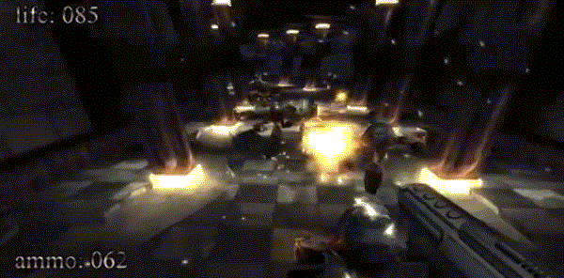
Why Procedurally Generate
.kkrieger
Fairly complex game in 94 kb
http://static.giantbomb.com/uploads/original/0/4511/1095099-fractalus_cockpit.jpg
Notes:
Levels, maps, terrain, building placement, graphics, texture, modeling, animation, items, ai, quest, skyrim, npcs, features, trees, clutter

Slide 7
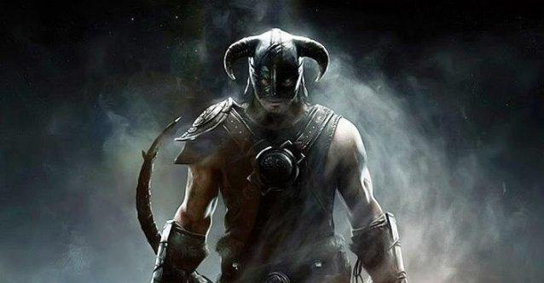
Why Procedurally Generate?
Allows content to react differently for different players
Skyrim
Radiant Story System
Change story based on user actions
http://www.gameranx.com/img/11-Nov/skyrim-1.jpg
Notes:
The earliest computer games were severely limited by memory constraints. This forced content, such as maps, to be generated algorithmically on the fly: there simply wasn't enough space to store a large amount of pre-made levels and artwork.
Why PG?

Slide 8
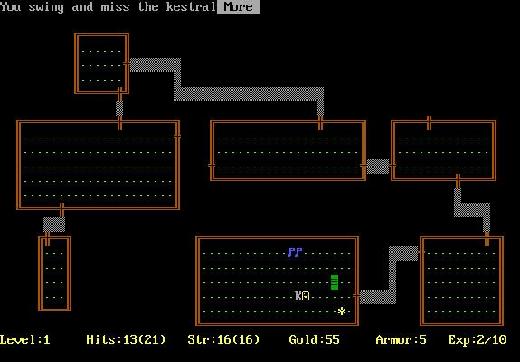
Know Your History
Originally, used for reducing size
Rogue
Possibly first use of PCG in games
Created random levels on the fly
http://2.bp.blogspot.com/-oo1P7eCZER0/T48OX07suuI/AAAAAAAAAM0/xIpr2xD6-m4/s640/rogue-2.jpg
Notes:
Levels, maps, terrain, building placement, graphics, texture, modeling, animation, items, ai, quest, skyrim, npcs, features, trees, clutter

Slide 9
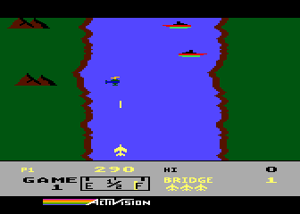
Know Your History
Level creation
River Raid
Random, dynamic level
Banned in West Germany from 1982 until 2002
http://www.atarimania.com/8bit/screens/river_raid_2.gif
Notes:
Levels, maps, terrain, building placement, graphics, texture, modeling, animation, items, ai, quest, skyrim, npcs, features, trees, clutter

Slide 10
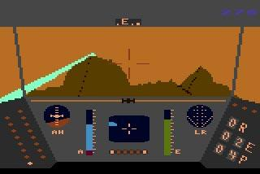
Know Your History
Generate Art Assets
Rescue on Fractalus!
Generate mountains using fractals
First use of fractal terrain
http://static.giantbomb.com/uploads/original/0/4511/1095099-fractalus_cockpit.jpg
Notes:
Levels, maps, terrain, building placement, graphics, texture, modeling, animation, items, ai, quest, skyrim, npcs, features, trees, clutter

Slide 11
Dwarf Fortress
Part roguelike, part city building game released in 2006.
Uses mid-point displacement algorithm to create base elevation information.
Erodes the terrain with simulation of weather, volcanic activity, temperature models, and other effects.
Uses trade simulation to create roads and villages.

Slide 12
Dwarf Fortress

Slide 13
Diablo (series)
The earlier entries had more procedurally generated towns and dungeons.
Diablo III has a hand-crafted hub, and uses larger tiles leading to less variety between runs.

Slide 14
Elder Scrolls
The Elder Scrolls II Daggerfell
World is procedurally generated at installation.
Wilderness, dungeons, quests, and NPCs are as well.
Towns and cities are handcrafted for better navigation.
Landmass is twice the size of the British Isles.
Easy to get lost and difficult to navigate.

Slide 15
Elder Scrolls
The Elder Scrolls V: Skyrim
Much more of the game is handcrafted including dungeons.
Randomly generated quests are used to pad out the handcrafted ones.
Quests are easier to complete as the locations are easier to find.
Map is much smaller than Daggerfall's.
~41 sq. km vs ~400,000 sq. km

Slide 16
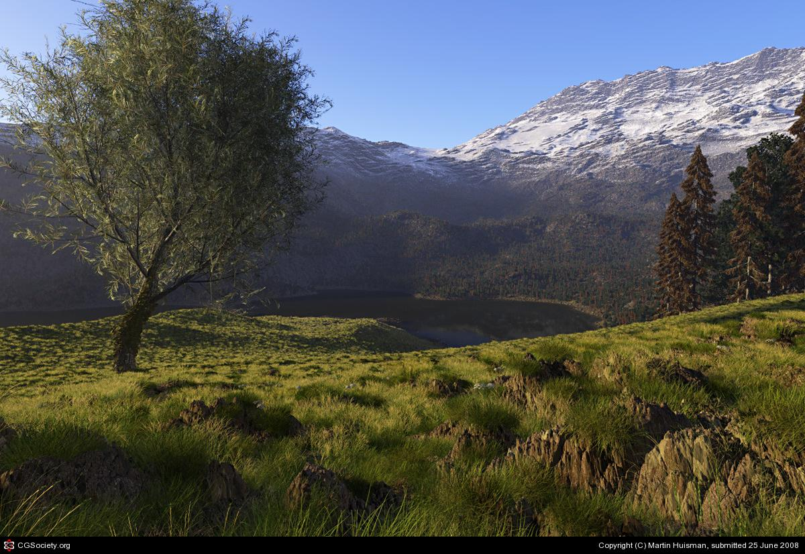
Know Your History
Computing power increases
Focus shifts to decreasing artist workload
http://features.cgsociety.org/newgallerycrits/g87/147987/147987_1214418561_large.jpg
Notes:
Levels, maps, terrain, building placement, graphics, texture, modeling, animation, items, ai, quest, skyrim, npcs, features, trees, clutter

Slide 17
Development costs
Gran Turismo 5 budget: $60 Million [source]
Average AAA game development cost: $28 Million [source]
For comparison:
Movie budgets
Kick-Ass (2012) : budget of $28 Million
Television
Game of Thrones : budget approx. $60 Million [source]

Slide 18
Applications of PCG
landscape
terrain
history
mazes
textures
music
compression
items
dungeons
noise
characters
AI

Slide 19
Procedural content in games

Slide 20
Procedural content in games

Slide 21
Examples in commercial games

Slide 22
Game Bits
Basic Functions

Slide 23
Trig
Sine, Cosine, arctan
Amplitude
Frequency
Summation and cancellation

Slide 24
Windowing
Windowed Cosine
Gaussian

Slide 25
Other Functions
Change of coordinates:
Bias
Gain
Smoothstep
Splines

Slide 26
Other Stuff
Table look-up
Modulus

