Slide 1
Virtual Reality
Jacob Edelen
Tyler Wolf Leonhardt
Matt Tatoczenko

Slide 2
Terminology
VR is virtual reality
HMD is head-mounted display
FoV is field of view

Slide 3
Contents
History
Modern Technology
Game Integration

Slide 4
What is VR?
A computer-generated 3-D environment that can simulate physical presence in real world or imagined worlds
Sometimes referred to as immersive multimedia
Can create sensory experiences
Most familiar with HMD of today

Slide 5
VR History
Jacob Edelen

Slide 6
Origins
Idea has been around for a long time
Originated from French Playwright Antonin Artaud in 1938 book “The Theatre and it’s Double”
Described the theatre as “la realite virtuelle ” a reality both illusory and fictitious
“Artificial Reality” coined by Myron Krueger during research in the 70’s
Became popular through Science Fiction movies and other media

Slide 7
Through the years
Oldest known source from the 1860’s where 360 degree art through panoramic murals
Sala delle prospettive is one such example. Very immersive

Slide 8
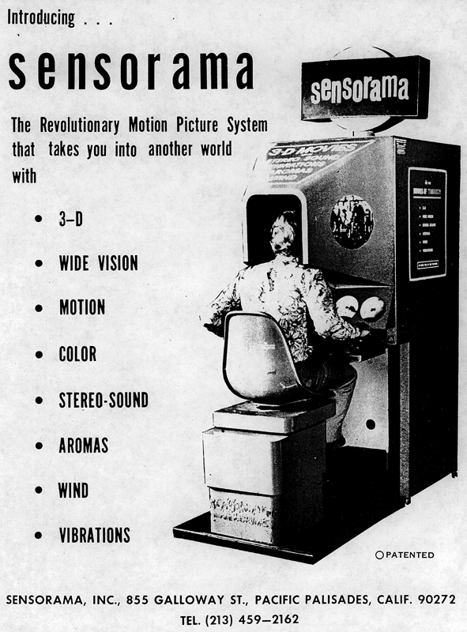
Sensorama (1962)
Idea and prototype created by Morton Heilig
Machine displayed 5 short films while engaging the 5 senses
Able to display stereoscopic 3D images in wide angle view
Motorcycle ride
Purely mechanical, uses computer screens as input and output
Unable to get financial backing
Still works to this day

Slide 9
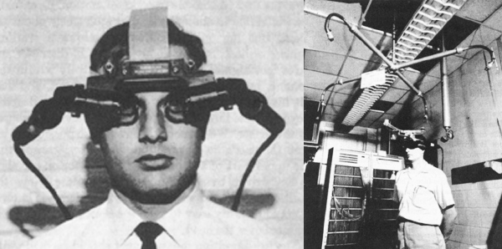
Sword of Damocles (1968)
First ever HMD created by Ivan Sutherland and Bob Sproull
Widely considered to be the first VR and AR Head Mounted Display System
Much larger and heavier than HMD’s of today
Needed to be suspended from the ceiling to use
Very primitive
Supported Head tracking
Displayed simple wire frame rooms

Slide 10
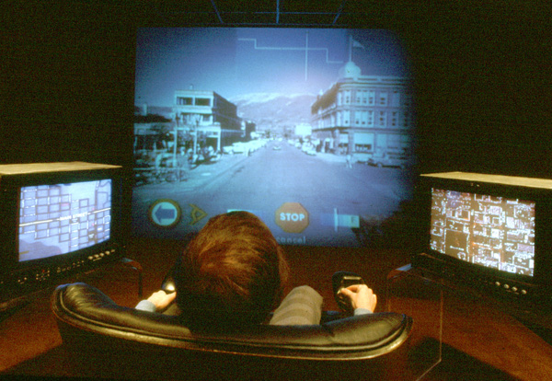
Aspen Movie Map (1977)
Developed by MIT
Was a virtual simulation of Aspen, Colorado
take the user through city streets in summer, winter, or polygons
First two based showed photographs of all steps through the streets
Last was actual 3-D model of city

Slide 11
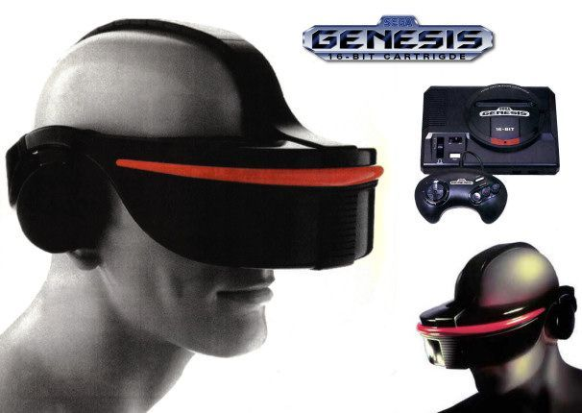
Sega VR (1991)
HMD with LCD screens in visor and headphones
Supported advanced headtracking
Never made it past prototype stages due to development difficulties
Cost
headaches
Technology later changed and used in arcades
Negative response

Slide 12
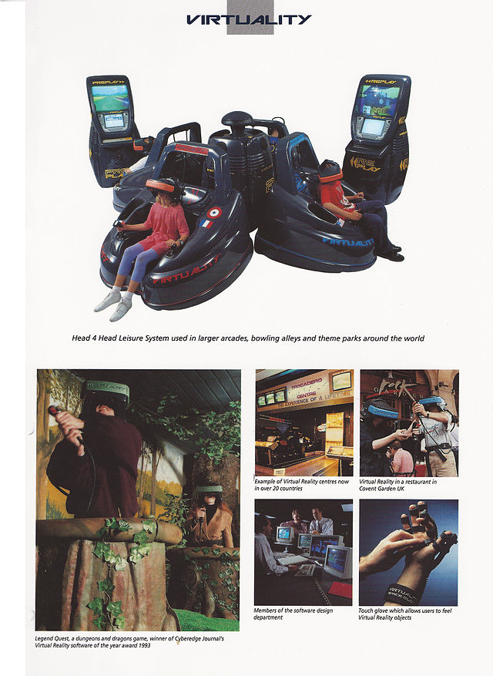
Virtuality (1991)
Creates first VR based multiplayer entertainment system
Used gloves and headset for a very immersive experience
276x372 resolution
$73,000
Affordable VR predicted by 1994
“Computer Gaming World”

Slide 13
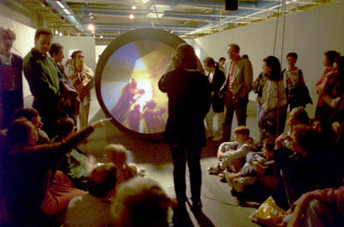
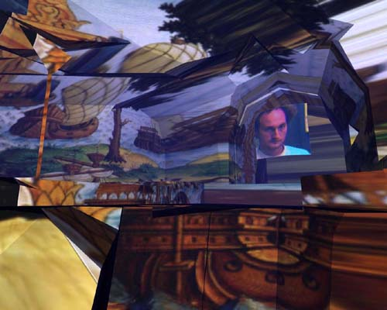
First VR artwork (1995)
Created by Maurice Benayoun Connected between Pompidou Center in France with the museum of contemporary art in montreal
Included 3D modeling, video chat, spatialized sound, and AI content management
Considered the first metaphysical video game
Was an exploration of the limitations of communication

Slide 14
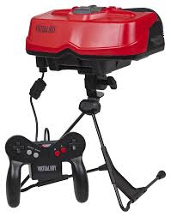
Virtual Boy (1995)
Introduced by Nintendo
Huge marketing failure
Mounted VR headset player became level with and controlled
Displayed polygons in a 3 dimensional environment
Red LED
Off shelves within 4 months in America

Slide 15
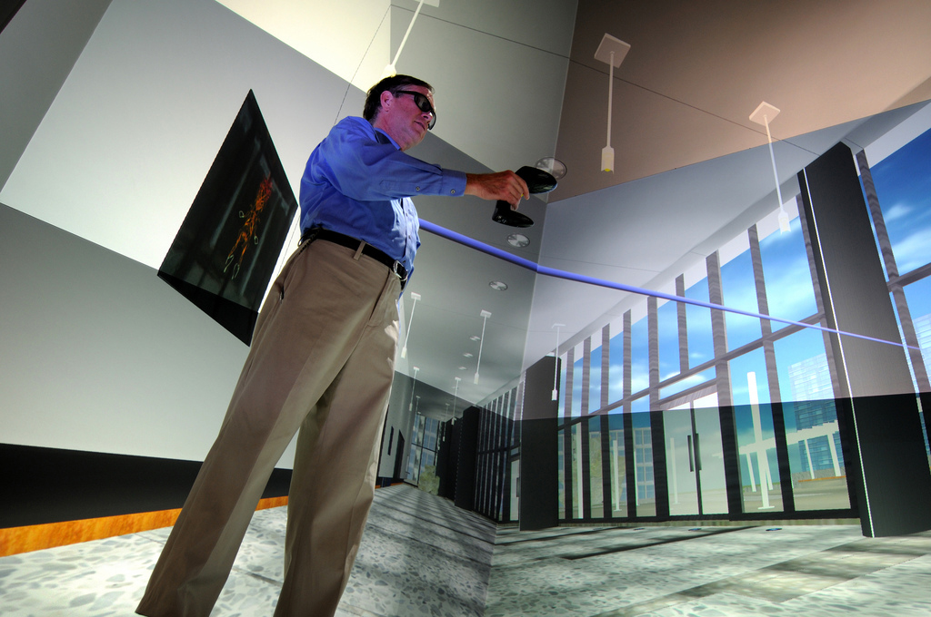
SAS3 (2001)
First PC based cubic room
Installed in Laval, France
Glasses with controller in cubic room
Dispenses need for weighty HMD
Software gave birth to Virtools VR pack
Enables Developers to make richer experiences
Uses industry standard virtual reality
Open Source

Slide 16
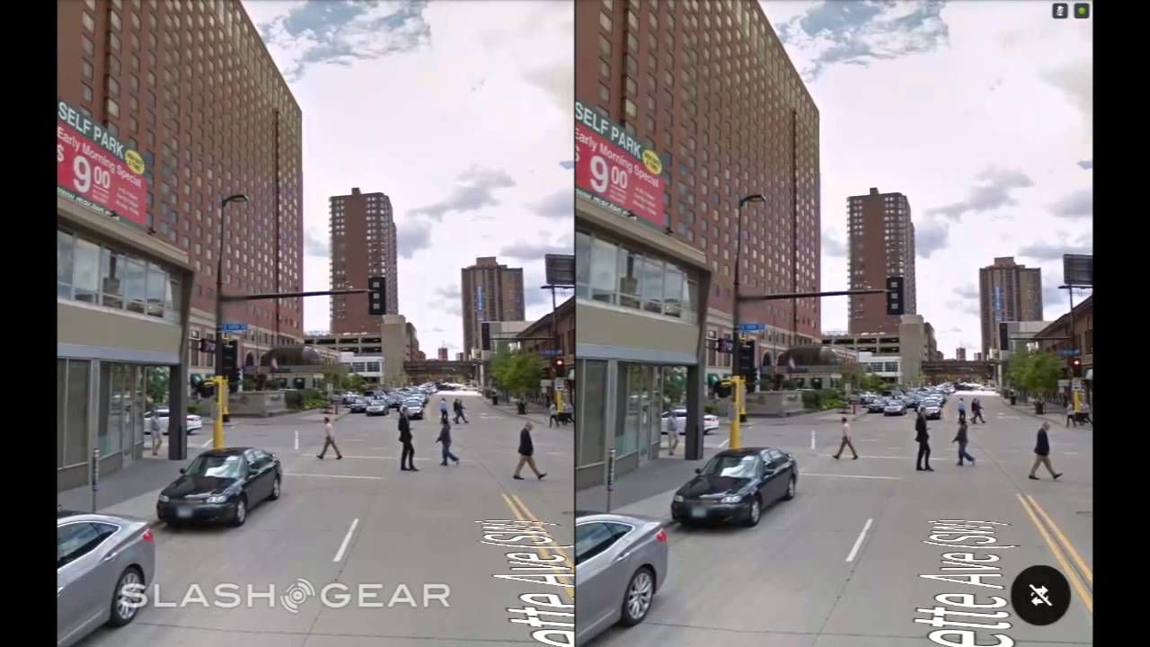
Google
Introduces Street View in 2007
Shows panoramic views of streets, roads, indoor buildings, and rural areas
Stereoscopic 3D introduced in 2010
Can be used by VR HMDs of today for immersive experience
Uses vehicle data and pictures collected from Google maps cars
Also utilizes street cameras

Slide 17
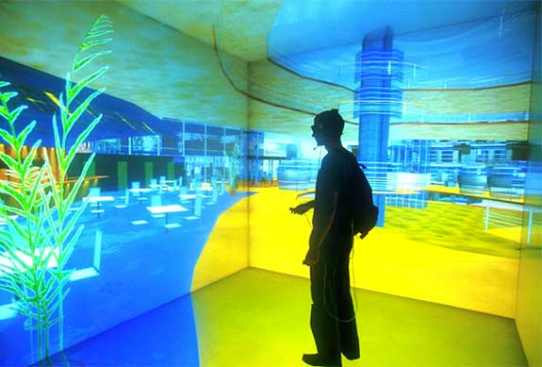
Future and Present
Plenty of money from major companies investing
Google and Facebook large contributors
A couple gaming companies creating VR for their consoles
Sony
Valve
Nintendo filed a patent for #3D effect on a 2D television
Future looks bright but long

Slide 18
Current VR Technology
Matt Tatoczenko

Slide 19
Google Cardboard
Notes:
Nothing to really talk about with it. It’s really that simple. I’ll have it on my phone and hopefully have a demo for the class

Slide 20
Samsung Gear VR

Slide 21
Samsung Gear VR
Display
It’s a Samsung Galaxy Note 4!
1280x1440p per eye by splitting the display virtually in half
Low latency screen makes images smooth
96 degree FoV achieved with the lenses in the headset
Tracking Sensors
Accelerometer, gyrometer, etc.; Regular head motion sensors
No head tracking as it’s meant for mobile
Using the Phone
Includes a touch pad, back button, and volume keys to interact with phone
Optional Android controller is helpful for game playing
Notes:
Latency is smaller because the display and cables are all in the headset, whereas other VR headsets connect to the PC/console through a long cable

Slide 22
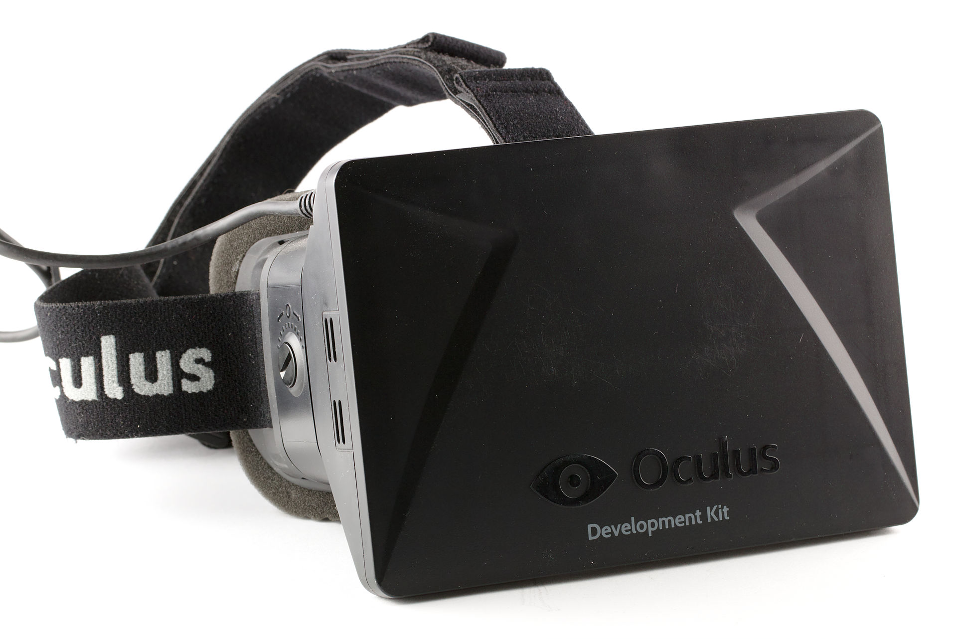
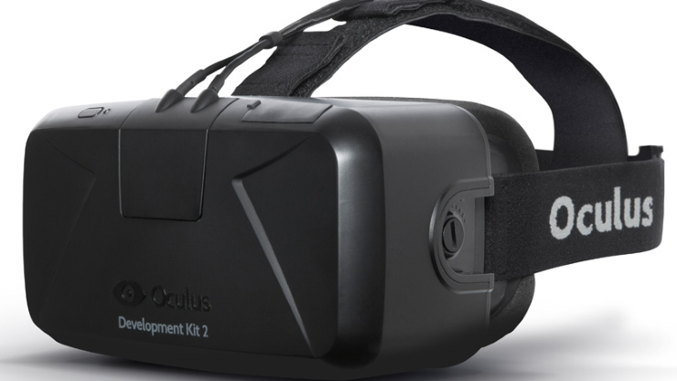
Oculus Rift

Slide 23
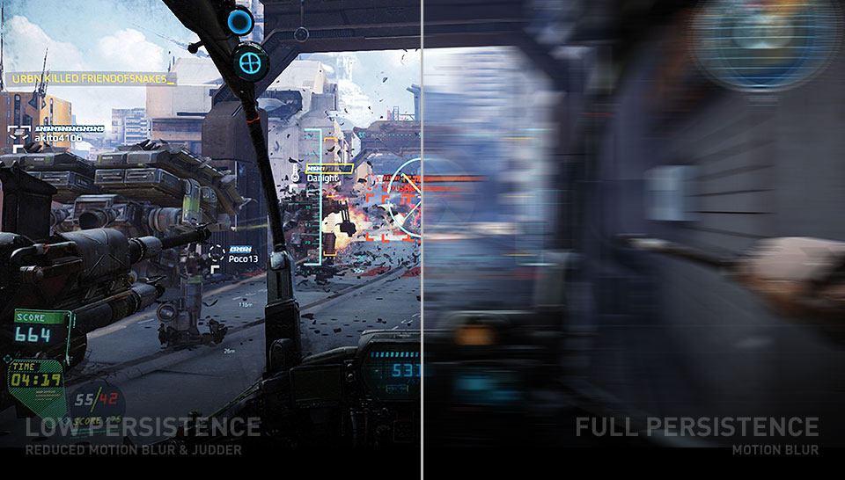
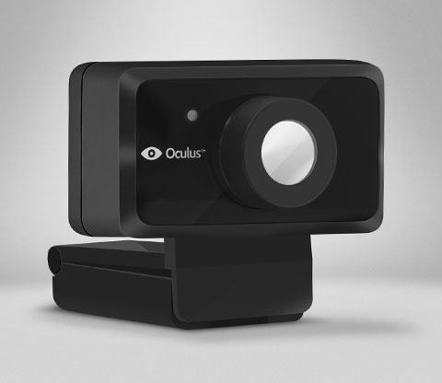
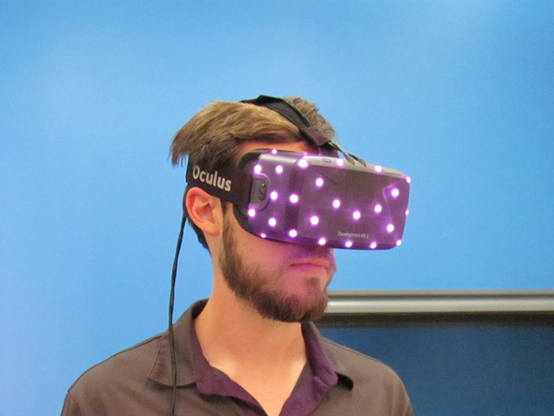
Oculus Rift (DK2) Specs
Display
960x1080 per eye (Full HD)
Galaxy Note 3 display!
75Hz (best), 72Hz, and 60Hz refresh rates
Low Persistence OLED to reduce motion blur
Low persistence: screen is only on for a small amount of time; 2ms and 3ms supported
100 degree field of view for more immersion
Tracking Sensors
Gyroscope, Accelerometer, Magnetometer update at 1000 Hz
Near Infrared CMOS (positional tracker) updates at 60 Hz
Notes:
The display on the DK2 is a Galaxy Note 3 display, which has a pixel rating of 1920x1080. The DK2 virtually splits this to give 960x1080 to each eye.
The higher the refresh rate, the smoother the images move and feel, so 75 Hz is the top the DK2 offers. This means the display was overclocked to achieve that
“Low persistence makes the scene appear visually stable, increasing the potential for presence.”
Humans have about a 180 degree FoV, so getting as close to that as possible is better for immersion.
Have to have sensors to track head movement for real first-person immersion. Bottom left is the positional tracker and bottom right are the infrared lights on the headset to track position
Unfortunately, no specs yet on the Crescent Bay kit. It looked like it had headphones attached to it, but that may just have been the demo kit they setup

Slide 24
Sony Project Morpheus

Slide 25
Project Morpheus Specs
Display
960x1080p per eye
100 degree FoV
120Hz refresh rate for exceptionally smooth visuals
“Early games won't natively run at 120 FPS - instead the PlayStation4's reprojection software will add an extra ‘tween’ every frame to make it feel like they are, but the overall experience should be silky-smooth.” -Wareable.com
Tracking Sensors
9 Tracking LEDs
Playstation Camera tracks the user/headset - tracks headset 1000 times per second
Games can be controlled with Dualshock4 controller and Move paddles
Notes:
Not a lot of concrete data. Nothing specific from Sony yet. Info is from GDC 2015 prototype
Will connect to PS4 instead of PC, possibly limiting it to a system peripheral instead of a full use VR headset

Slide 26
SteamVR and HTC Vive

Slide 27
SteamVR and HTC Vive Specs
Display
1200x1080p per eye
90 Hz refresh rate for smooth pictures, eliminating jitter
110 defree FOV
Tracking Sensors
Gyroscope, accelerometer, and laser position sensor in headset track head movement
SteamVR Base Stations
Place 2 in a room (15’ x 15’ max) in opposite corners
Tracks headset and the two SteamVR controllers used to play games

Slide 28
Virtual Reality Game Engine Integration
Tyler Wolf Leonhardt

Slide 29
Assumptions
All VR is assumed to run on the PC
All VR is assumed to have head tracking capabilities
All VR is assumed to render at 90 FPS
Notes:
We are going to make a few assumptions
We will not be focusing on VR which runs on mobile or console environments in this talk because they are currently less accessible

Slide 30
Contents
The Challenges of Virtual Reality
Integrating with Design
Integrating with Technology
Questions

Slide 31
Contents
The Challenges of Virtual Reality
Integrating with Design
Integrating with Technology
Questions

Slide 32
Simulation Sickness
Exposure to virtual environments may cause sickness
Low framerates and high latency amplify simulation sickness
Severity and susceptibility to sickness depends on the person
Notes:
Simulation sickness is the primary problem with virtual reality

Slide 33
Users are Free to Examine Anything
Head tracking allows the player to control cameras via head motion
This lets players examine objects in more detail than ever before
Players may also be able to move their heads through walls
Notes:
This has ramifications for head collisions as well as normal maps

Slide 34
Two Render Targets: One for Each Eye
To create stereoscopic 3D, each eye needs its own render target
Each has a different position and viewport
This requires every vertex in the scene to be rendered twice
Notes:
The main cost here is performance

Slide 35
VR Challenges Overview
Simulation sickness may occur
Users are free to examine anything
Two render targets must be updated
Notes:
While other challenges exist these are the major ones
We will focus on solutions to these challenges in this talk

Slide 36
Contents
The Challenges of Virtual Reality
Integrating with Design
Integrating with Technology
Questions

Slide 37
I’ll make this fast
We will cover design requirements first and them move on to suggestions

Slide 38
Design Requirements
Fix collision bounds to prevent players from viewing through walls
Notes:
This causes the camera to stop moving which is disorienting
We will discuss a solution to this problem

Slide 39
Design Requirements
Project HUDs into world space so they aren’t fixed to the screen
Notes:
Standard text moves down when the player moves their heads down
When your reading a book text moves up as you move your head down

Slide 40
Design Requirements
Increase the player’s Field of View so it matches your HMD
Notes:
This is rarely an issue
This is like wearing blinders.

Slide 41
Design Suggestions
Add a button to allow camera centering
Notes:
The player looks forward and the camera has drifted from the expected location
Press a button to center the camera

Slide 42
Design Suggestions
Add a fadeout post-process if the player leaves the tracking volume
Notes:
This fixes problems when the players head hits a wall
This also fixes problems when the player moves their head outside of a tracking volume

Slide 43
Design Suggestions
Display a countdown when returning to desktop
Notes:
Transitions from VR to desktop are disorienting

Slide 44
Tips for Reducing Simulation Sickness
Remove pixels around the nose to simulate human features
Recently presented research
Apply noise in a rendering post-process to eliminate smooth coloring
Valve
Eliminate parabolic camera movement wherever possible
Oculus VR
Notes:
These tips may not actually help
They are based more on speculation than anything

Slide 45
Contents
The Challenges of Virtual Reality
Integrating with Design
Integrating with Technology
Questions

Slide 46
Basic Integration: From Scratch
Initialization
Initialize VR library and HMD
Create application window for HMD and bind
Create render context (DirectX, OpenGL, etc.) for window and bind
Create render target textures for eyes and bind
Configure tracking
Simulation
Wrap simulation code in VR library begin/end routines
Fuse input from tracking sensors with camera movement
Notes:
I have code available if anyone is interested in an OpenGL implementation

Slide 47
Basic Integration: From Scratch
Notes:
I will discuss rendering a few slides from now

Slide 48
Basic Integration: From Scratch
Initialization
Initialize VR library and HMD
Create application window for HMD and bind
Create render context (DirectX, OpenGL, etc.) for window and bind
Create render target textures for eyes and bind
Configure tracking
Simulation
Wrap simulation code in VR library begin/end routines
Fuse input from tracking sensors with camera movement

Slide 49
Basic Integration: With an Engine
Initialization
Initialize VR library and HMD
Create application window for HMD and bind
Create render context (DirectX, OpenGL, etc.) for window and bind
Create render target textures for eyes and bind
Configure tracking
Simulation
Wrap simulation code in VR library begin/end routines
Fuse input from tracking sensors with camera movement

Slide 50
Goals for a Good Product
Reduce simulation sickness
Require lower GPU specs so that VR is more affordable
Retain high graphics quality
Notes:
If people get sick playing your game they wont buy it
If people can’t afford your game they wont buy it
If your game is ugly they wont buy it

Slide 51
Most of these goals are at ends Current engines are not good enough

Slide 52
Modern Game Engine Comparison
Notes:
Modern game engines do not provide you with the tools to make appropriate technical changes
Unreal less-so because you have the source code

Slide 53
Goals for a Good Product
Reduce simulation sickness
Require lower GPU specs so that VR is more affordable
Retain high graphics quality
Notes:
Reducing simulation sickness involves increasing framerate
Lowering GPU specs involves lowering framerate
Raising graphics quality involves lowering framerate

Slide 54
We need optimization!

Slide 55
Optimization Contents
Fast Stereo Rendering (Timothy Wilson) (FPS ++)
Prediction (Oculus VR) (Latency --)
Time Warp (Oculus VR) (Latency --)
Running Start Algorithm (Valve) (FPS ++)
Lens Distortion Mesh Stencil (Valve) (FPS ++)
Statistically Encoded Mipmaps (Valve) (Quality ++)
Geometric Specular Antialiasing (Valve) (Quality ++)
Finite Environment Maps (Valve) (Quality ++)
VR Direct (Nvidia) (FPS ++)
Notes:
These are the topics that I think are the best

Slide 56
Optimization Contents
Fast Stereo Rendering (Timothy Wilson) (FPS ++)
Prediction (Oculus VR) (Latency --)
Time Warp (Oculus VR) (Latency --)
Running Start Algorithm (Valve) (FPS ++)
Lens Distortion Mesh Stencil (Valve) (FPS ++)
Statistically Encoded Mipmaps (Valve) (Quality ++)
Geometric Specular Antialiasing (Valve) (Quality ++)
Finite Environment Maps (Valve) (Quality ++)
VR Direct (Nvidia) (FPS ++)

Slide 57
Optimization Contents
Fast Stereo Rendering (Timothy Wilson) (FPS ++)
Prediction (Oculus VR) (Latency --)
Time Warp (Oculus VR) (Latency --)
Running Start Algorithm (Valve) (FPS ++)
Lens Distortion Mesh Stencil (Valve) (FPS ++)
Statistically Encoded Mipmaps (Valve) (Quality ++)
Geometric Specular Antialiasing (Valve) (Quality ++)
Finite Environment Maps (Valve) (Quality ++)
VR Direct (Nvidia) (FPS ++)

Slide 58
Traditional Stereo Rendering: Overview
APIs abstract the screen to make VR easy to implement
This splits the screen into two render targets: one per eye
This requires the entire scene to be submitted for each eye
Unity and Unreal Engine use this form of rendering (2014)

Slide 59
Traditional Stereo Rendering: Problems
Traditional Stereo Rendering: Problems
Everything has to be drawn twice
Everything has to be drawn twice

Slide 60
Traditional Stereo Rendering

Slide 61
Fast Stereo Rendering: Overview
Draw to the entire framebuffer instead of the standard VR half-framebuffer
Use instanced drawing to render objects twice per draw call
Change vertex shaders to handle each eye
This does make regular instancing a little bit more complicated

Slide 62
Fast Stereo Rendering: Implementation
Tag vertex with an eye identifier
Transform vertex from world space to eye-clip space
Set up clipping/culling to prevent overflow between eyes
Scale the x coordinate of vertex by 0.5
Offset vertex by (+-0.5) * w depending on the eye

Slide 63
Fast Stereo Rendering: Implementation
Tag vertex with an eye identifier
Transform vertex from world space to eye-clip space
Set up clipping/culling to prevent overflow between eyes
Scale the x coordinate of vertex by 0.5
Offset vertex by (+-0.5) * w depending on the eye

Slide 64
Fast Stereo Rendering: Implementation
Tag vertex with an eye identifier
Transform vertex from world space to eye-clip space
Set up clipping/culling to prevent overflow between eyes
Scale the x coordinate of vertex by 0.5
Offset vertex by (+-0.5) * w depending on the eye
Notes:
This is suspect to me because I don’t understand why it wouldn’t distort the image.

Slide 65
Fast Stereo Rendering: Implementation
Tag vertex with an eye identifier
Transform vertex from world space to eye-clip space
Set up clipping/culling to prevent overflow between eyes
Scale the x coordinate of vertex by 0.5
Offset vertex by (+-0.5) * w depending on the eye

Slide 66
Fast Stereo Rendering

Slide 67
Traditional Stereo Rendering

Slide 68
Optimization Contents
Fast Stereo Rendering (Timothy Wilson) (FPS ++)
Prediction (Oculus VR) (Latency --)
Time Warp (Oculus VR) (Latency --)
Running Start Algorithm (Valve) (FPS ++)
Lens Distortion Mesh Stencil (Valve) (FPS ++)
Statistically Encoded Mipmaps (Valve) (Quality ++)
Geometric Specular Antialiasing (Valve) (Quality ++)
Finite Environment Maps (Valve) (Quality ++)
VR Direct (Nvidia) (FPS ++)

Slide 69
Head Tracking: Problems
Sensor readings for renders are only fresh when they are first taken
These values are then used for rendering 11ms later
Another 11ms passes between rendering and vsync
After vsync it takes 11ms to produce photons
This gives us a total of 33ms of latency
Notes:
This problem is based off of the best case scenario where we synchronize our engine with VSync.
If we are not synchronized with VSync our prediction intervals are difficult to guess and become much longer.

Slide 70
Head Tracking: Problems
During the 33ms second of latency, the user may move their head
A leisurely head nod clocks in at 100 degrees per second
This puts pixels 3.3 degrees out of place in good cases

Slide 71
Pipeline without Sensors

Slide 72
Prediction: Overview
By polling the headset at a constant rate we can calculate derivatives
With small and consistent derivatives we can predict positions
VR software does this automatically
Notes:
This problem is based off of the best case scenario where we synchronize our engine with VSync.
If we are not synchronized with VSync our prediction intervals are difficult to guess and become much longer.

Slide 73
Pipeline with Sensors

Slide 74
This creates additional problems

Slide 75
Prediction: Problems
33ms is still a very long interval to predict
If the user makes an unexpected movement the prediction will be off
Synchronizing with VSync is difficult
The synchronization can cost a lot of render time
Notes:
We will discuss solutions to these problems

Slide 76
Optimization Contents
Fast Stereo Rendering (Timothy Wilson) (FPS ++)
Prediction (Oculus VR) (Latency --)
Time Warp (Oculus VR) (Latency --)
Running Start Algorithm (Valve) (FPS ++)
Lens Distortion Mesh Stencil (Valve) (FPS ++)
Statistically Encoded Mipmaps (Valve) (Quality ++)
Geometric Specular Antialiasing (Valve) (Quality ++)
Finite Environment Maps (Valve) (Quality ++)
VR Direct (Nvidia) (FPS ++)

Slide 77
Prediction: Problems
33ms is still a very long interval to predict
If the user makes an unexpected movement the prediction will be off
Synchronizing with VSync is difficult
The synchronization can cost a lot of render time

Slide 78
Time Warp: Overview
If we have knowledge of a pixels (x, y, z) position we can rotate it
We can run a fixed-time post process safely before vsync
We can update our tracking values safely before vsync
These points combined let us reproject a scene before vsync

Slide 79
Time Warp: Implementation
Predict the position of the HMD .33ms in the future
Use the values for simulation
Predict the position of the HMD .22ms in the future
Use the values for rendering
Predict the position of the HMD .11ms in the future + dt
Use the values to reproject the scene, this should take dt

Slide 80
1. Predict the position of the HMD .33ms in the future

Slide 81
2. Use the values for simulation

Slide 82
3. Predict the position of the HMD .22ms in the future

Slide 83
4. Use the values for rendering

Slide 84
5. Predict the position of the HMD .11ms in the future + dt

Slide 85
6. Use the values to reproject the scene, this should take dt

Slide 86
Optimization Contents
Fast Stereo Rendering (Timothy Wilson) (FPS ++)
Prediction (Oculus VR) (Latency --)
Time Warp (Oculus VR) (Latency --)
Running Start Algorithm (Valve) (FPS ++)
Lens Distortion Mesh Stencil (Valve) (FPS ++)
Statistically Encoded Mipmaps (Valve) (Quality ++)
Geometric Specular Antialiasing (Valve) (Quality ++)
Finite Environment Maps (Valve) (Quality ++)
VR Direct (Nvidia) (FPS ++)

Slide 87
Prediction: Problems
33ms is still a very long interval to predict
If the user makes an unexpected movement the prediction will be off
Synchronizing with VSync is difficult
The synchronization can cost a lot of render time

Slide 88
Running Start: Overview
Synchronizing with VSync can cause the CPU or GPU to idle
Running start allows synchronization with VSync without GPU bubbles
It works by predicting when VSync will occur
This requires support form hardware/operating system or hacks

Slide 89
Basic Time Warp Pipeline

Slide 90
Expanded Time Warp Pipeline

Slide 91
Expanded Time Warp Pipeline

Slide 92
Expanded Time Warp Pipeline

Slide 93
Expanded Time Warp Pipeline: Problems

Slide 94
Running Start: Implementation
(Simulate Thread) Collect fresh sensor data
(Simulate Thread) Simulate
(Render Thread) Present previous frame
(Render Thread) Inject an event query
(Render Thread) Sleep
(Render Thread) Wake 2ms before next Vsync
(Render Thread) Submit render commands
(Render Thread) Spin on event query

Slide 95
Expanded Time Warp Pipeline

Slide 96
Running Start Pipeline

Slide 97
Running Start Pipeline

Slide 98
1. (Simulate Thread) Collect fresh sensor data

Slide 99
2. (Simulate Thread) Simulate

Slide 100
3. (Render Thread) Present previous frame

Slide 101
4. (Render Thread) Inject an event query or try to read a pixel

Slide 102
5. (Render Thread) Sleep

Slide 103
6. (Render Thread) Wake 2ms before next VSync

Slide 104
7. (Render Thread) Submit render commands

Slide 105
8. (Render Thread) Spin on event query

Slide 106
Running Start Pipeline

Slide 107
Contents
The Challenges of Virtual Reality
Integrating with Design
Integrating with Technology
Questions

Slide 108
Questions

Slide 109
References
http://www.samsung.com/global/microsite/gearvr/gearvr_specs.html
http://www.techradar.com/us/reviews/gaming/gaming-accessories/samsung-gear-vr-1263308/review
https://www.ifixit.com/Teardown/Oculus+Rift+Development+Kit+2+Teardown/27613
https://www.oculus.com/dk2/
http://en.wikipedia.org/wiki/Head-mounted_display (for general info use on DK2 slide)
http://www.wareable.com/project-morpheus/sony-project-morpheus-release-date-price-games
http://www.htcvr.com/
http://store.steampowered.com/universe/vr
http://www.vrs.org.uk/
http://archive.ncsa.illinois.edu/Cyberia/VETopLevels/VR.History.html
http://science.howstuffworks.com/innovation/big-thinkers/term-virtual-reality.htm

Slide 110
References
Simulation Sickness Overview:
http://www.gamasutra.com/blogs/BenLewisEvans/20140404/214732/Simulation_Sickness_and_VR__What_is_it_and_what_can_developers_and_players_do_to_reduce_it.php
Oculus Rift SDK Documentation:
http://static.oculus.com/sdk-downloads/documents/Oculus_Developer_Guide_0.4.4.pdf
John Carmack’s Time Warp Paper:
https://web.archive.org/web/20140719085135/http://www.altdev.co/2013/02/22/latency-mitigation-strategies/

Slide 111
References
Valve VR Optimization:
http://alex.vlachos.com/graphics/Alex_Vlachos_Advanced_VR_Rendering_GDC2015.pdf
Fast Stereo Rendering:
https://docs.google.com/presentation/d/19x9XDjUvkW_9gsfsMQzt3hZbRNziVsoCEHOn4AercAc/edit#slide=id.p
VR Direct:
http://blogs.nvidia.com/blog/2014/09/18/maxwell-virtual-reality/

