Slide 1
Illumination
Austin Grosel & Aaron Ebbinghaus

Slide 2
Outline
Standard Realtime Lighting
Types of Lights
Lighting effects
Starting a new lighting scene
New In Unity 5
Baked Lighting
Light Probes
Reflection Probes
Sky Boxes
Demo

Slide 3
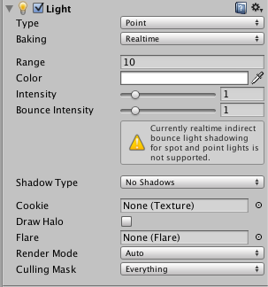
Standard Realtime Lighting

Slide 4
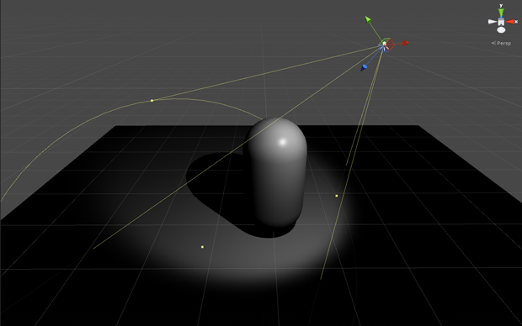
Standard Realtime Lighting
Dynamic lights updated every frame
No bounced light! Unrealistic
Standard Lighting
Point Lights
Directional Lights
Spot Lights
Area Lights
Standard Lighting effects
Ambient Lighting

Slide 5
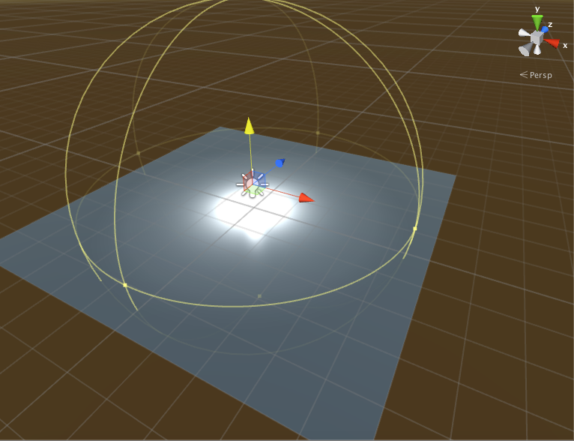
Point Lights
Bare light bulb
Rotation has no effect
Light is equal in all directions
Properties
Range
Color
Intensity

Slide 6
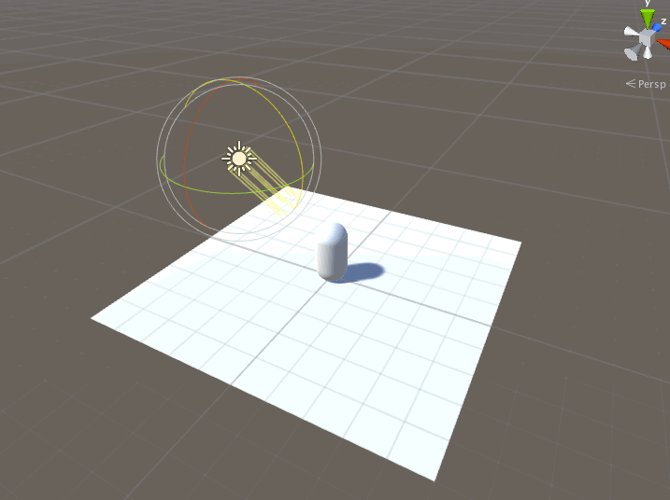
Directional Lights
Behaves like the sun
Position is irrelevant
Properties
Color
Intensity

Slide 7
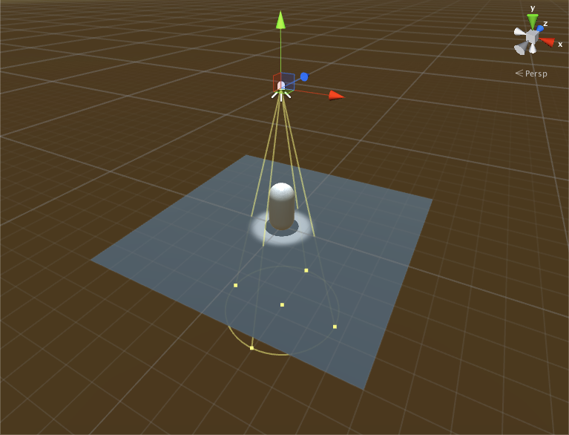
Spot Lights
Behaves like a flash light or lights on a car
Rotation and position are both relevant
Properties
Range
Color
Intensity
Spot Angle

Slide 8
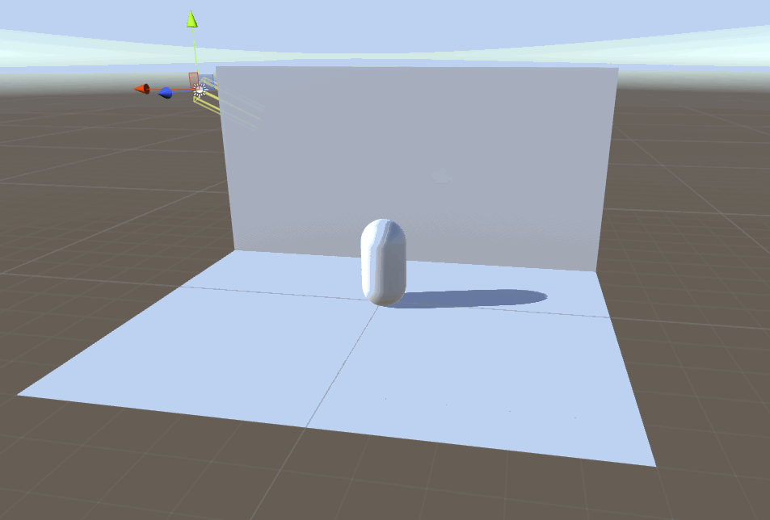
Effects: Shadows
Types
Hard - efficient
Soft - more convincing, expensive
Strength
Bias
How far the shadow is away from the object

Slide 9
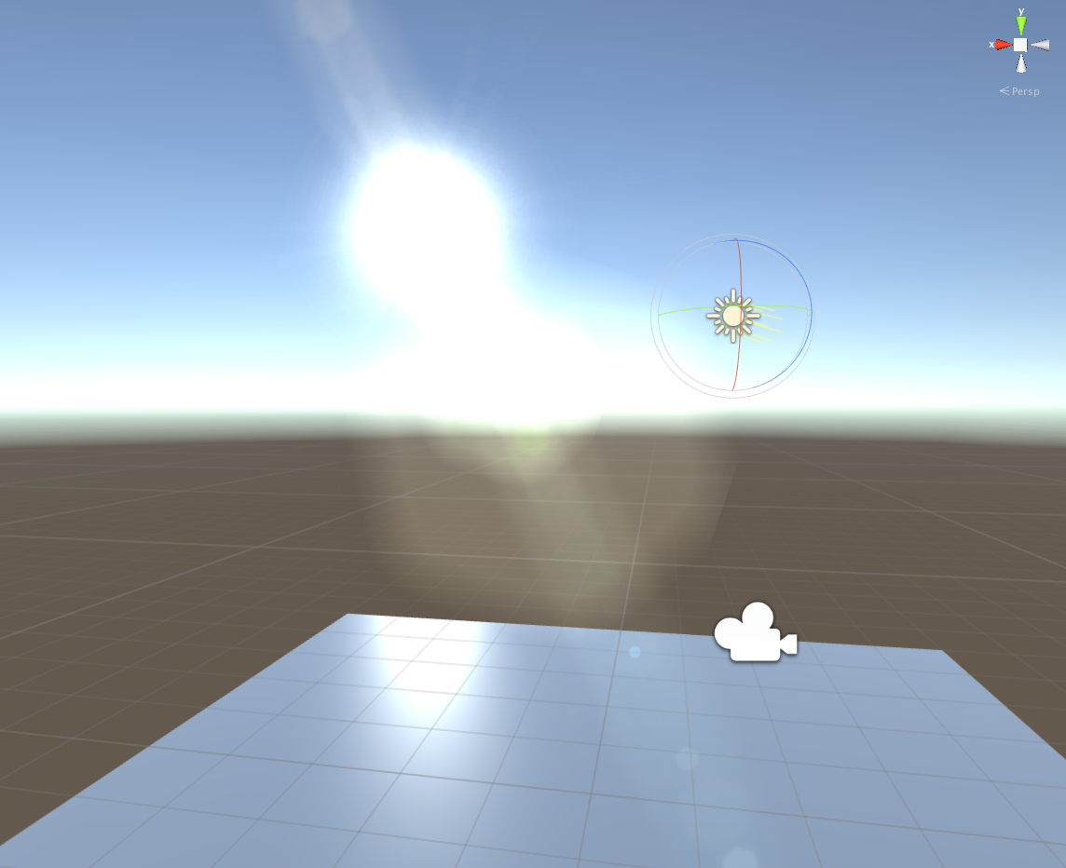
Effects: Lens Flares
The effect when looking at a bright light like the sun
Used often on directional lights

Slide 10
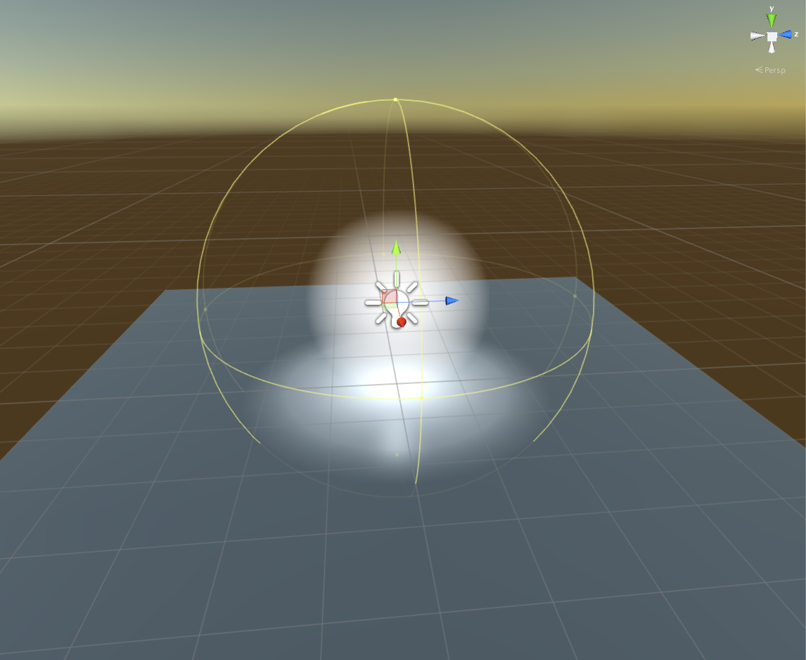
Effects: Halos
Light areas around light sources
Think of looking directly at a street lamp’s light at night
Could apply a texture to the halo to give it a unique shape

Slide 11
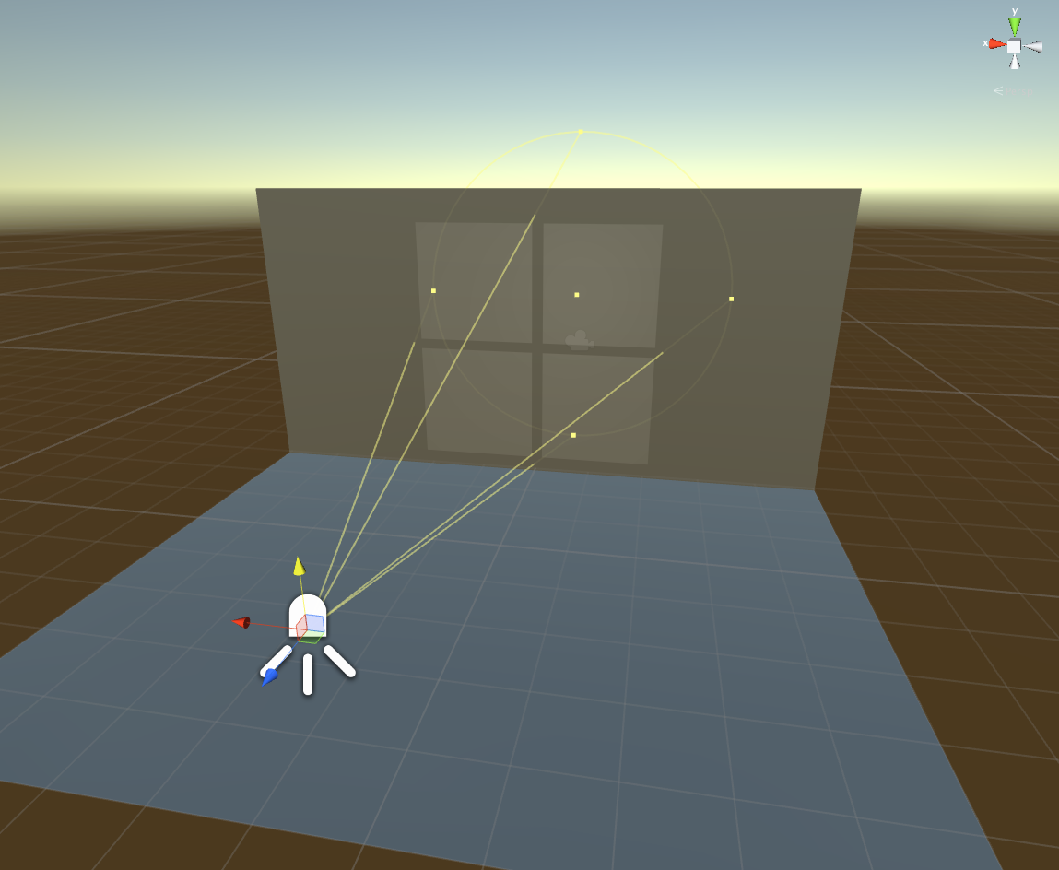
Effects: Cookies
A mask added to the light to give a patterned shadow
Masks can be custom created
For directional and spot lights, masks must be textures.
For point lights, the masks must be a cube map.

Slide 12
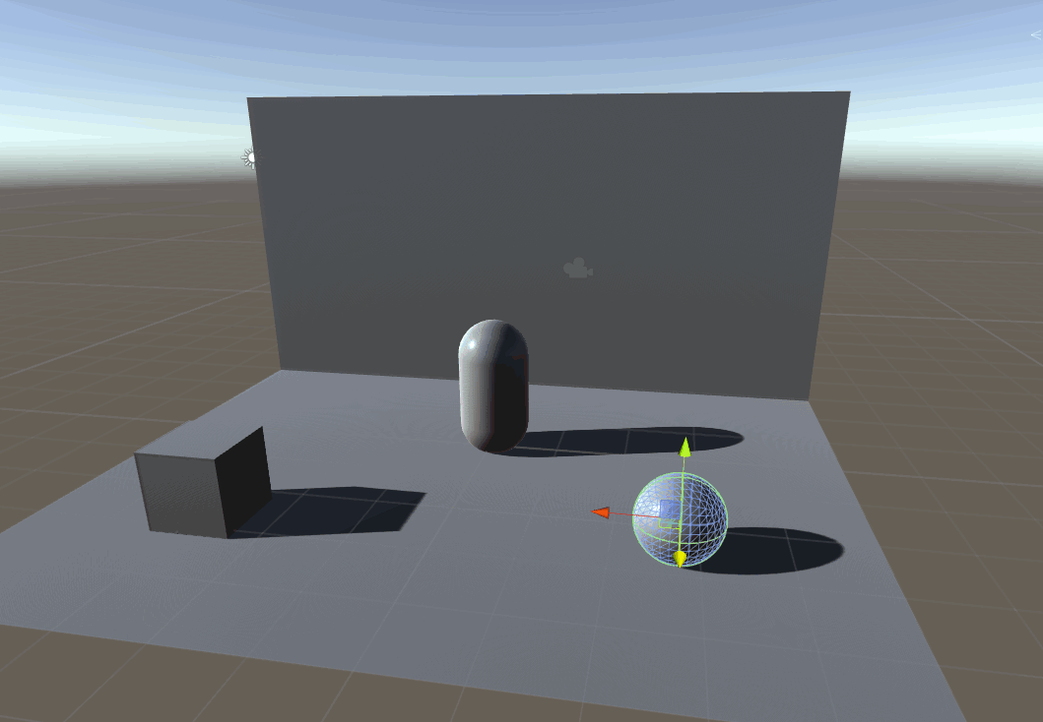
Ambient Light
Light is present throughout the scene equally without coming from a specific light source
Cheap to render, good for mobile applications
Default source is the skybox
Can switch to a color or a gradient

Slide 13
Starting a New Lighting Scene

Slide 14
Rendering Paths
Forward Rendering
Unity default
Each object is rendered in a “pass” for each light that affects it
Advantage: fast, not much hardware needed
Disadvantage: cost is equated on a per-light basis
Deferred Rendering
Light information stored in a buffer after “first pass” of light
Advantage: cost is proportional to the pixels each light illuminates rather than the light itself
Disadvantage: generally requires more powerful hardware

Slide 15
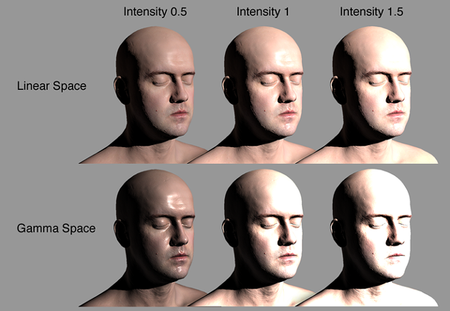
Color Space
Determines the calculations of mixing colors on illuminated textures
Linear
Realistic
Colors will brighten linearly as light intensity increases
Gamma
Some machines and mobile devices can’t handle linear color space
Colors will turn more white as light intensity increases

Slide 16
GI Cache
In both Baked and Precomputed Realtime GI, Unity caches data in the GI Cache and will try to reuse this data whenever possible to save precompute time
Can be cleared (Preference->GI Cache->Clear Cache)
Will cost more time precomputing, but disk space will be freed up

Slide 17
New For Unity 5

Slide 18
New for Unity 5
Global Illumination solutions
Enlighten
Precomputed Realtime Global Illumination
Emissive material effects
Lighting Window
Lighting Workflow
Scene will precompute in the background without any user intervention

Slide 19
What is Global Illumination?
Global Illumination (or GI) is a fancy word to describe the techniques and mathematical models which simulate the complex behavior of light in a scene.
Challenging can be expensive
This is the GI equation. Yes, it’s horrible to look at.

Slide 20
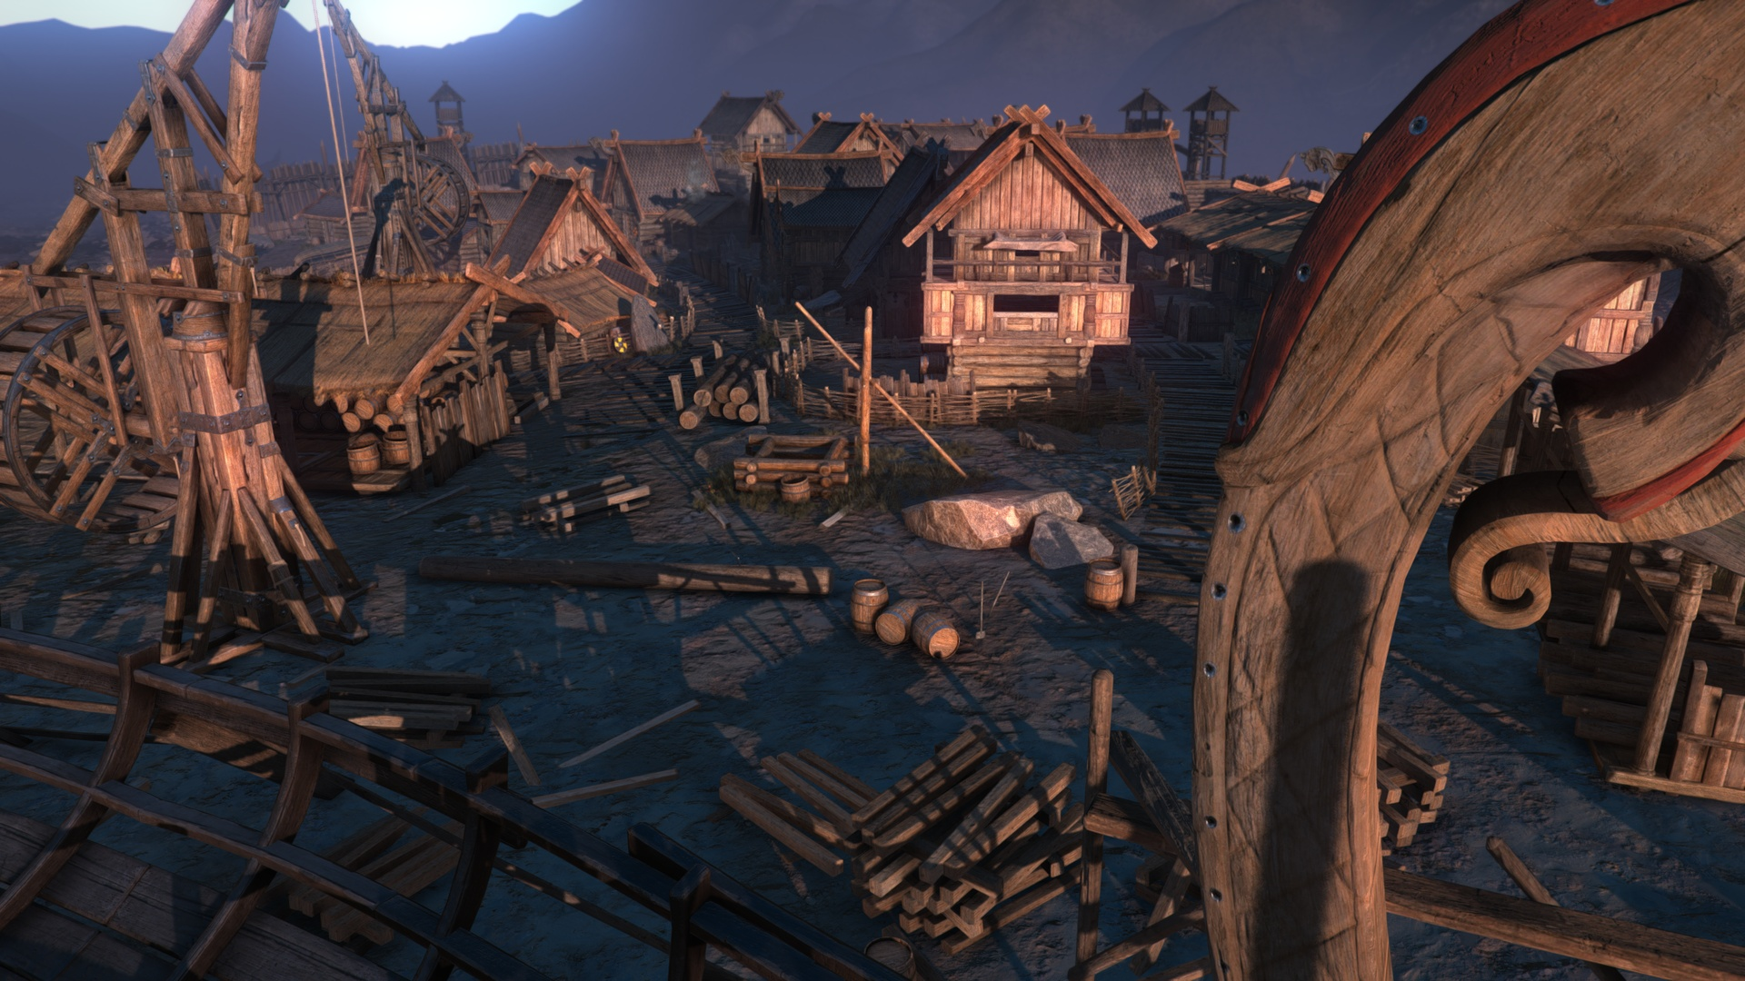
Enlighten
Created by Geomerics
Helps solve (part of) the problem of GI
The gaming industry’s only product to deliver realtime GI across all platforms

Slide 21
Enlighten
A start in the right direction
Geometry to be affected has to be static
Could get around this using light probes
Enlighten is limited to computing GI for diffuse transport
This is because diffuse transport is typically low frequency, so lightmaps can be low resolution and updatable

Slide 22
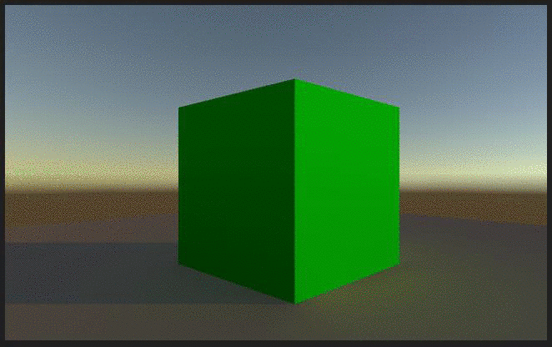
Precomputed Realtime Gl
With static lightmaps or baked GI unable to react to frame by frame lighting changes, precomputed realtime GI allows this to happen
Most common instance: changing the time of day
Light is also able to bounce, unlike in standard realtime lighting

Slide 23
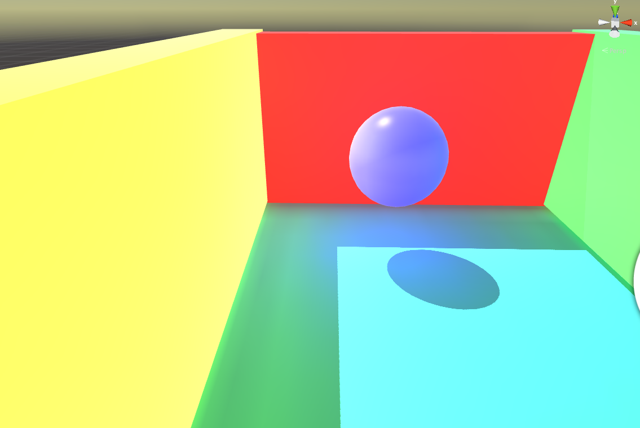
Emissive Lighting
Allows objects to have emissive materials to give a glowing effect from the inside
This affects other objects near the glowing object
Demo later

Slide 24
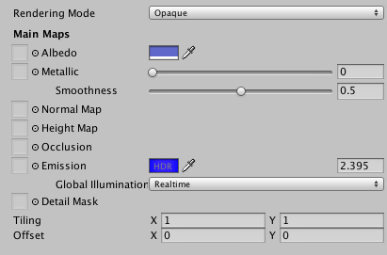
Emissive Lighting
Global Illumination Options
None
Object is emissive, but nearby objects aren’t affected
Realtime
Calculations done frame by frame in the scene, so even moving objects will be affected
Baked
Nearby static objects will be affected, dynamic ones will not

Slide 25
Baked Lighting

Slide 26
Baked Lighting
Creation of light maps
Use of indirect lighting and bounce lighting
Light probes
Area lights
Reflection Probes

Slide 27
Realtime vs Baked Lighting
Realtime Lighting
Lighting updated every frame within the scene
Realtime lights do not bounce when they are used by themselves
Lower quality, more expensive
Baked Lighting
Effects of light on static objects in the scene are calculated beforehand and written to the objects textures.
The textures do not change during gameplay even with the presence of new lights in the scene.
Potential increase in performance

Slide 28
Combining different lighting techniques
Precomputed Realtime GI + Baked GI
Not a good idea
Very expensive, can be detrimental for performance
Standard Realtime Lighting + Baked GI
Better
Can be useful when you are using lightmaps in your static environment, but still want character to use these lights to cast realtime shadows.

Slide 29
Area Lights
Rectangles from which light is emitted in all directions from the objects +z direction.
Only available in Baked GI
Illuminated uniformly across their surface area.
No manual control for the range of this type of light
Intensity will diminish at inverse square of the distance it travels away from the source.
Good use for soft lighting effects
Performance not affected

Slide 30
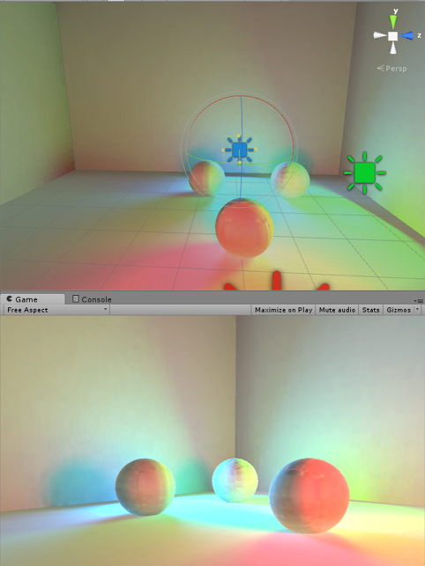
Area Lights Example

Slide 31
LightMaps
Textures made when using Baked Global Illumination Technique
Effects of light on static objects in the scene are calculated beforehand and written to the objects textures.
Includes both direct light that strikes object’s surface and indirect light that bounces from other objects in the scene, unlike RT GI.
Lights maps do not change during game time so we call them static.

Slide 32
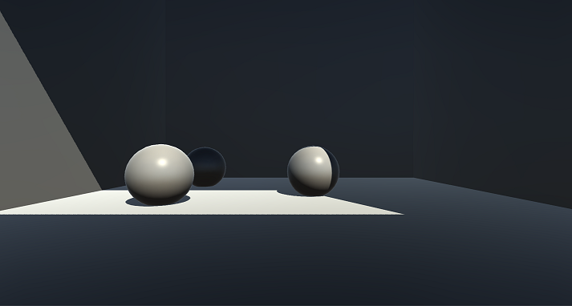
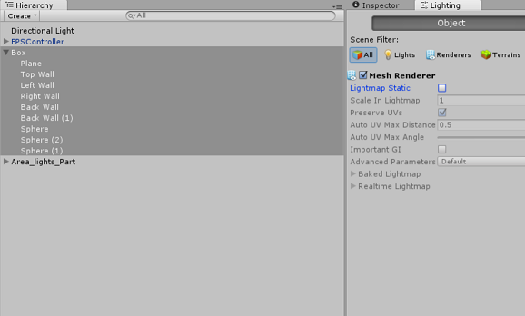
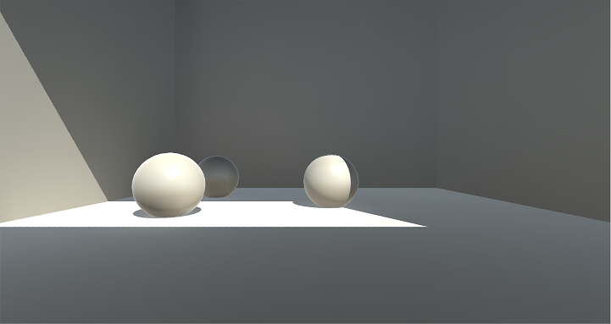
Making Light Maps

Slide 33
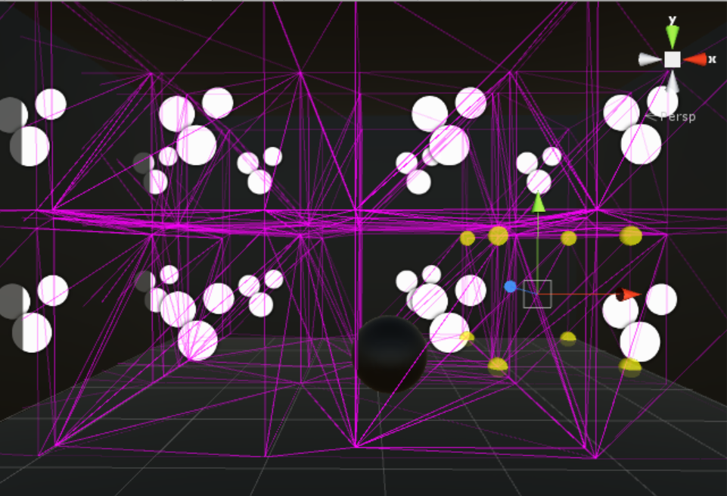
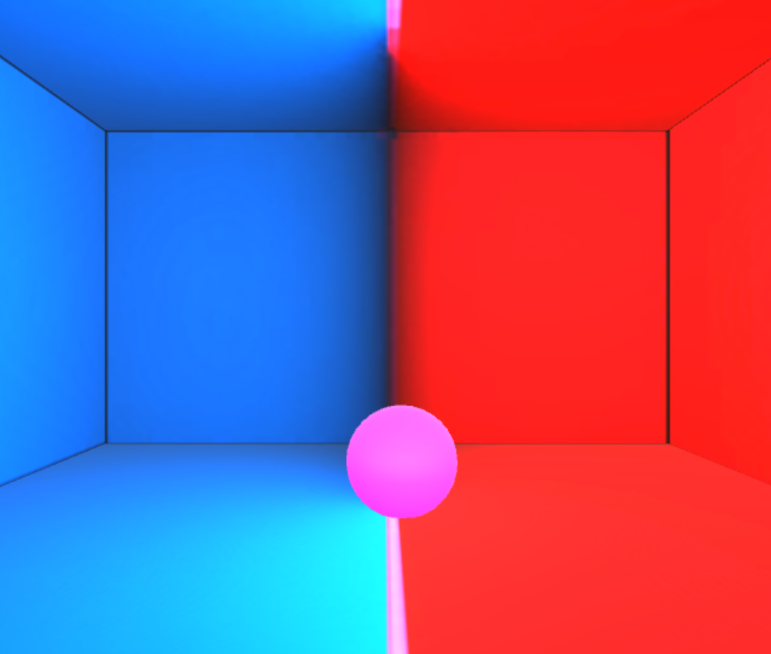
Life Probes
Enables dynamic objects to receive bounced lighting
Capture lights from all directions
Encoded into coefficients for use in game
Blend light colors around them

Slide 34
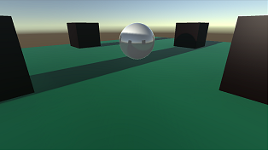
Reflection Probes
Creates accurate reflections
Used for objects that occluded from the skybox
These are not meant for precise accurate results but for the “impression” of reflection.
Generally best to use as few as possible for performance
Baked > Realtime reflection probes
Objects are only seen if checked as ‘Reflection Probe Static’

Slide 35
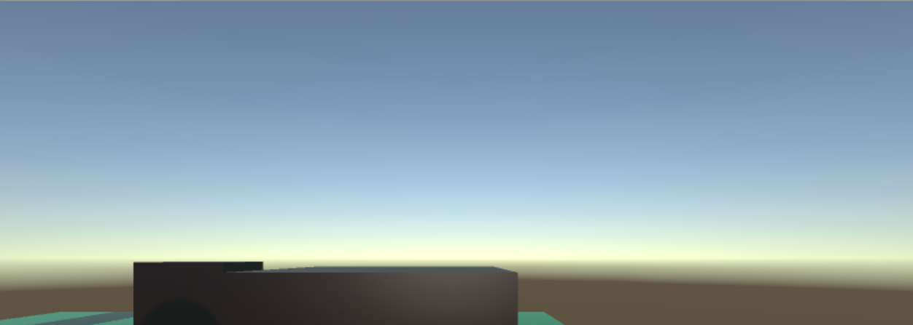
Skybox
Panoramic view split into six textures representing six directions(up,down,left,right,forward,backward).
Textures fit to create ‘neverending’ sky from all directions
Rendered behind all game objects and rotates to match orientation of the camera not the position

Slide 36
Resources
Unity Lighting and Rendering
http://unity3d.com/learn/tutorials/modules/beginner/graphics/lighting-and-rendering?playlist=17102
Unity 5 Lighting Cookbook
http://www.edy.es/dev/docs/unity-5-lighting-cookbook/
Global Illumination in Unity 5
http://blogs.unity3d.com/2014/09/18/global-illumination-in-unity-5/
Geomerics Enlighten
http://www.geomerics.com/enlighten/

Slide 37
Demo

